Slide 1
JJ fab/test update
20191203

Slide 2
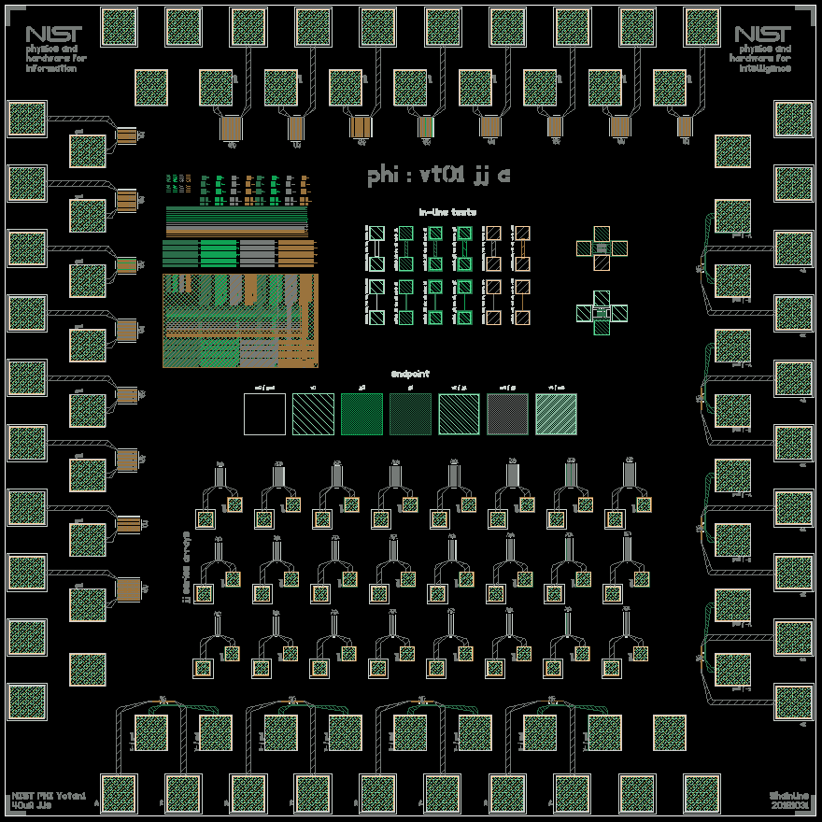
This is the basic chip layout
There are two jj chips: jja and jjb
jja has junctions targeting 40uA Ic
jjb has junctions targeting 100uA Ic
The jj diameter sweeps were intended to achieve these Ic values for a range of Jcs from 0.5 kA/cm^2 to 2 kA/cm^2
The junctions around the perimeter are shunted for low-temp Ic measurements
The jjs in the block of series arrays in the middle are unshunted for room-temperature Rn measurements

Slide 3
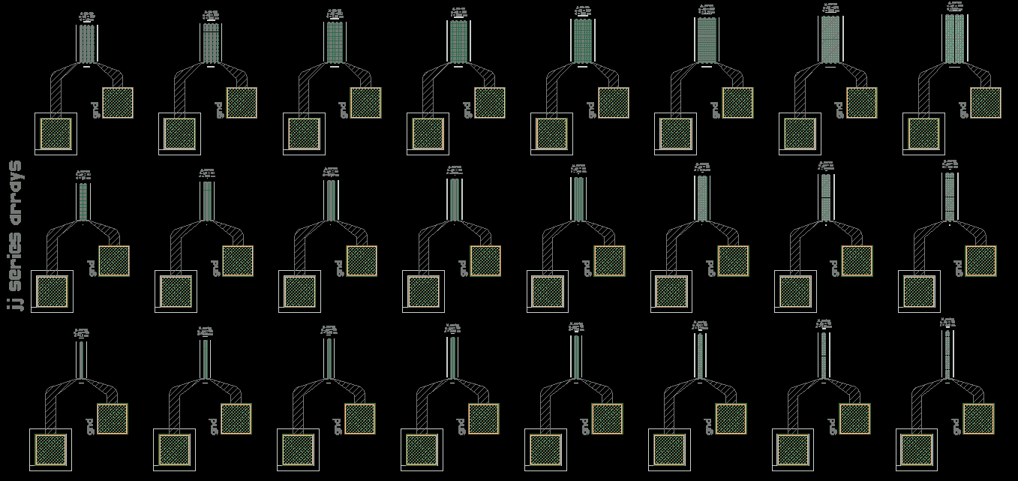
160 jjs
Here is the block of unshunted JJ series arrays
80 jjs
40 jjs
jjs in this column would have Ic = 40uA (100uA) on jja (jjb) chips if Jc = 2 kA/cm^2
jjs in this column would have Ic = 40uA (100uA) on jja (jjb) chips if Jc = 0.5 kA/cm^2

Slide 4
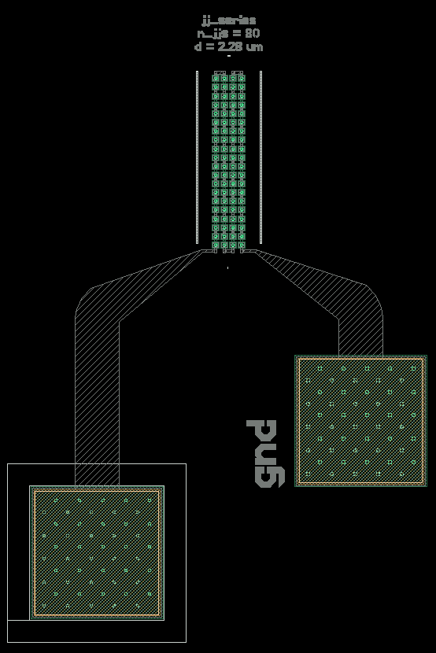
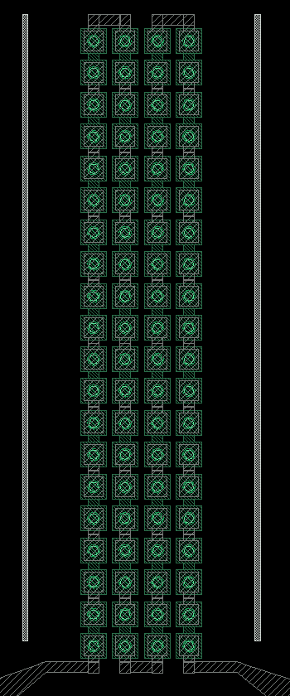
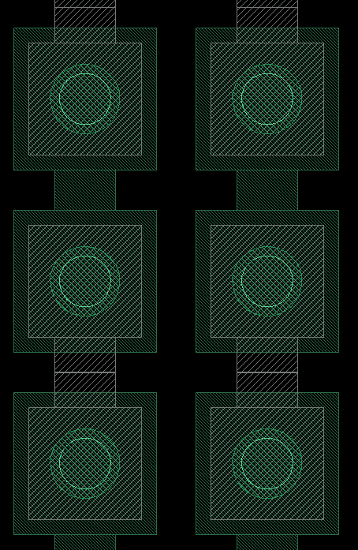
Here is the layout in more detail

Slide 5
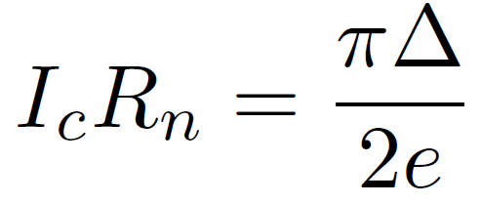
Recall that we can relate the junction critical current to the normal-state resistance provided we know the superconducting gap:
This expression is valid for SIS junctions. I am using 1.278e-22 J for the energy gap of niobium.

Slide 6
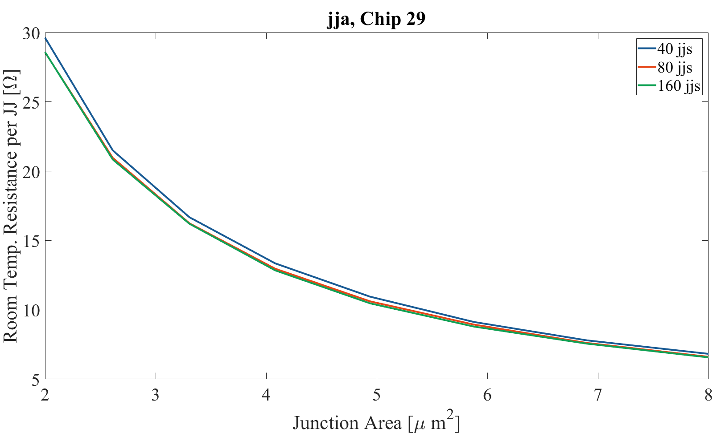
Here is the measured resistance minus the series contributions (contact and Nb wiring) divided by the number of JJs in the array.
I took this type of data for five 40uA and five 100uA chips from across the wafer.
Junctions targeting 40uA Ic
The fact that these curves align so closely indicates the parasitic series resistances have been subtracted appropriately.

Slide 7
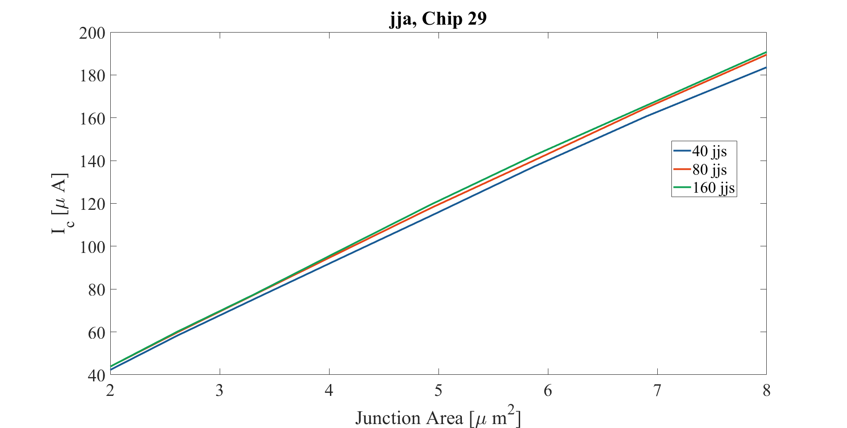
Here I use the expression to convert from Rn to Ic

Slide 8
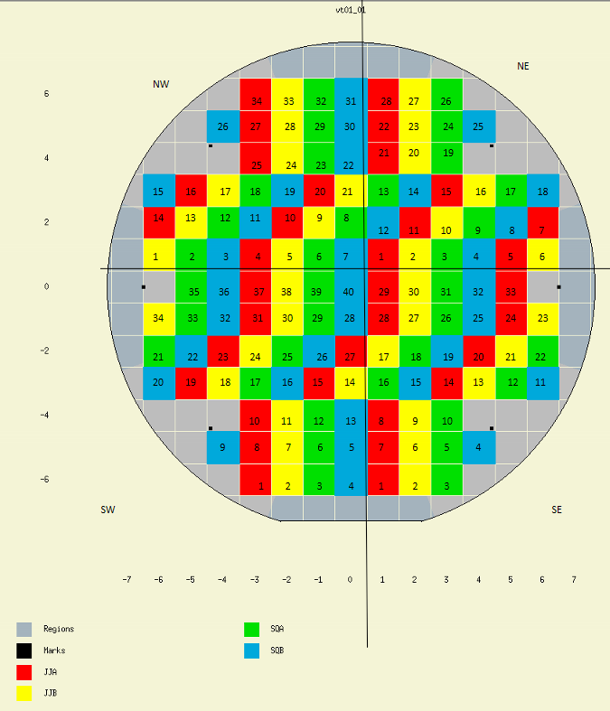
Investigating cross-wafer variation
These are the chips with 40uA junctions investigated here
These are the chips with 100uA junctions investigated here

Slide 9
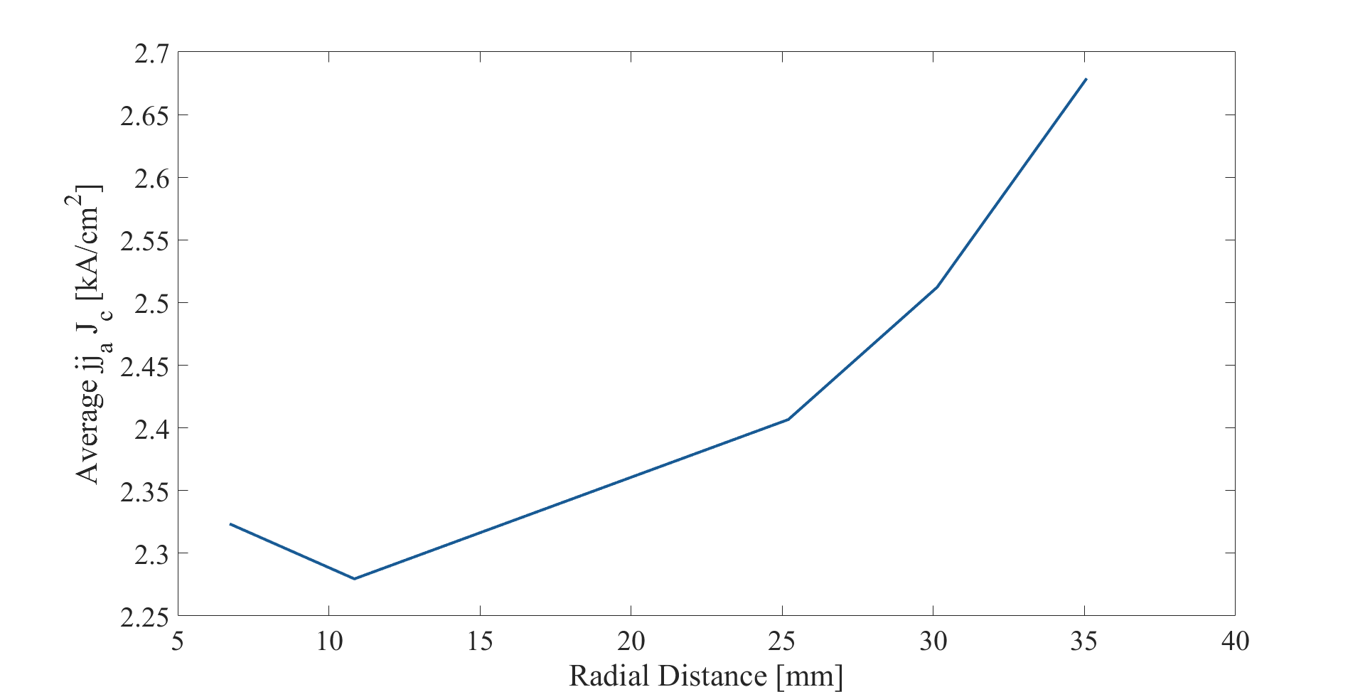
Here is the spatial variation of Jc as measured on five die intended to have 40uA Ic junctions.

Slide 10
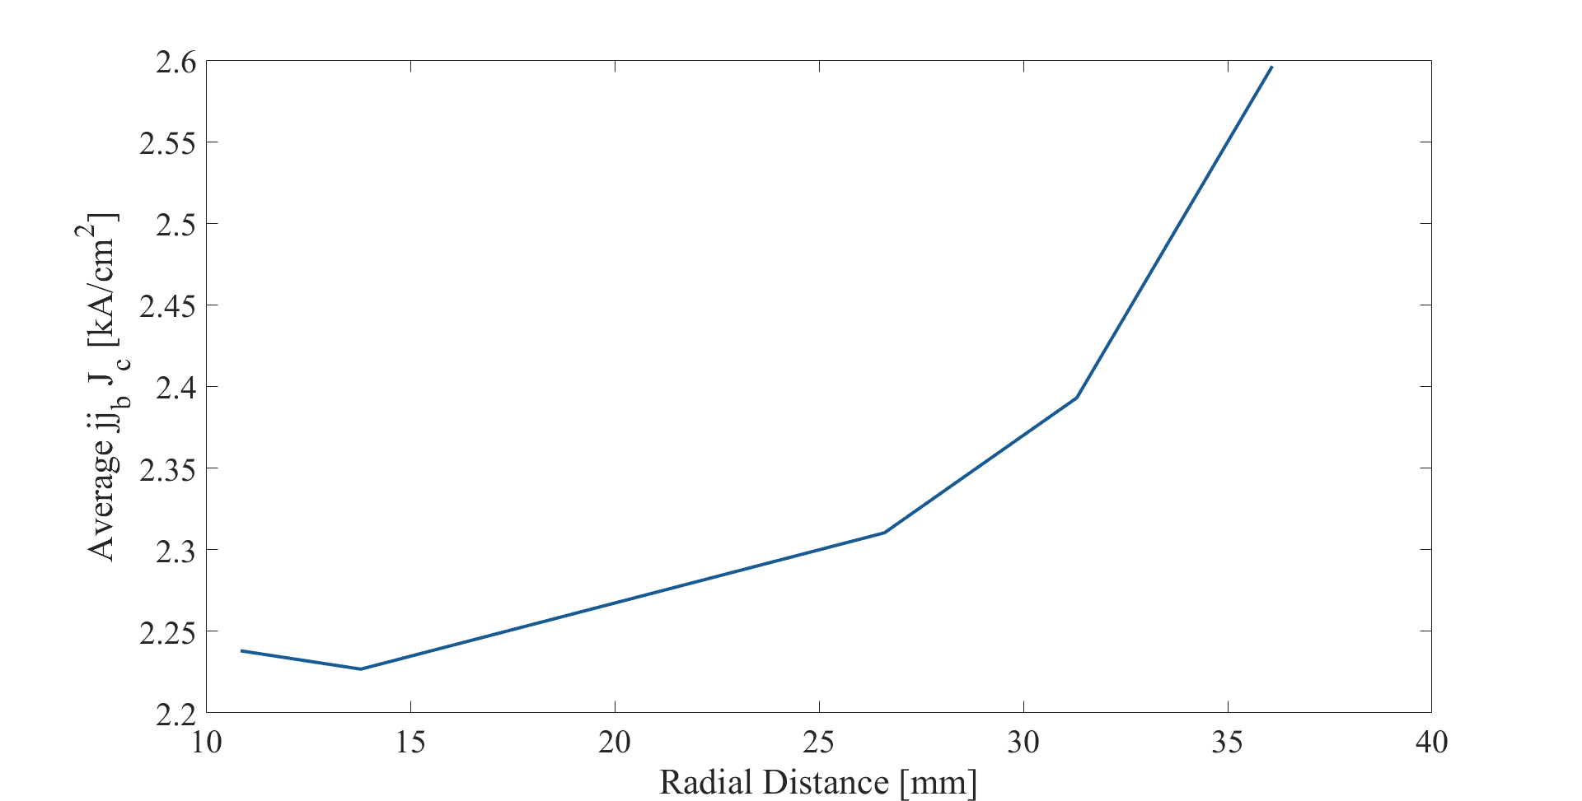
Here is similar data obtained from die intended to have 100uA Ic junctions. The fact that this and the previous plot are very similar is encouraging.

Slide 11
These values of Jc are higher than anticipated by a factor of 3.
David said, “I think that before trying to make new wafers you need to measure directly the values of Ic to verify the relation between cold and room temp. The silicon in the target is slightly doped and its resistance will have some temp dependence and completely freeze out only at low temps.”

Slide 12
Back to chip layout

Slide 13
Now measure JJs cold

Slide 14
Now measure JJs cold
This JJ will have Ic = 40uA if Jc = 2kA/cm²
This JJ will have Ic = 40uA if Jc = 1.5kA/cm²
This JJ will have Ic = 40uA if Jc = 1kA/cm²
This JJ will have Ic = 40uA if Jc = 0.5kA/cm²

Slide 15
Now measure JJs cold
These JJs have 1.15 sq shunt resistors
(βc = 0.3 if Ic = 40uA)
These JJs have 2.05 sq shunt resistors
(βc = 0.95 if Ic = 40uA)

Slide 16
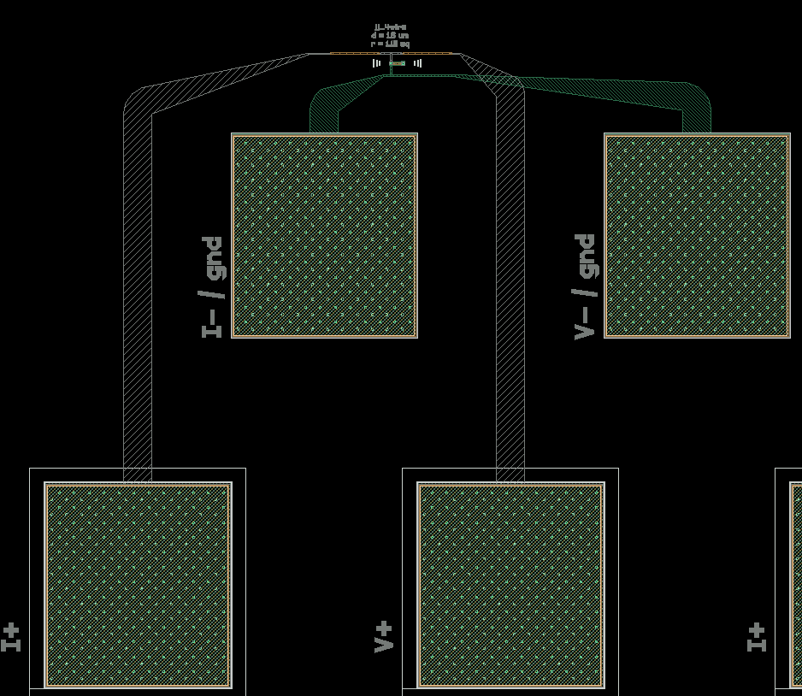
single jjs, 4-wire

Slide 17
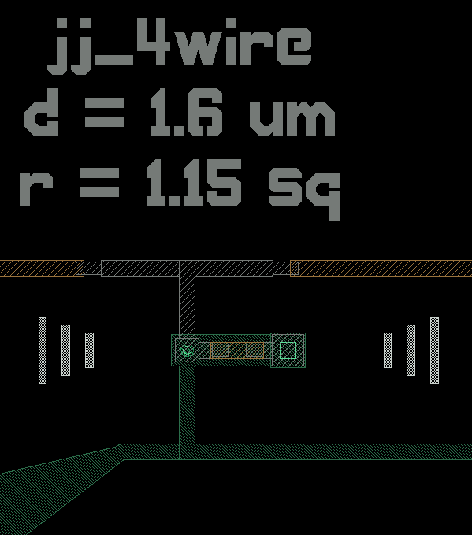
single jjs, 4-wire

Slide 18
die 11, jj 4-wire measurements

Slide 19
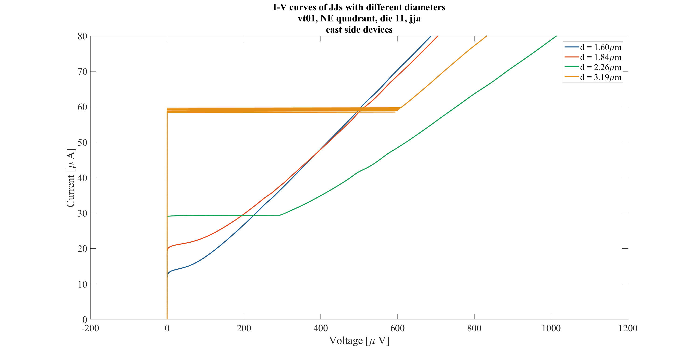

Slide 20
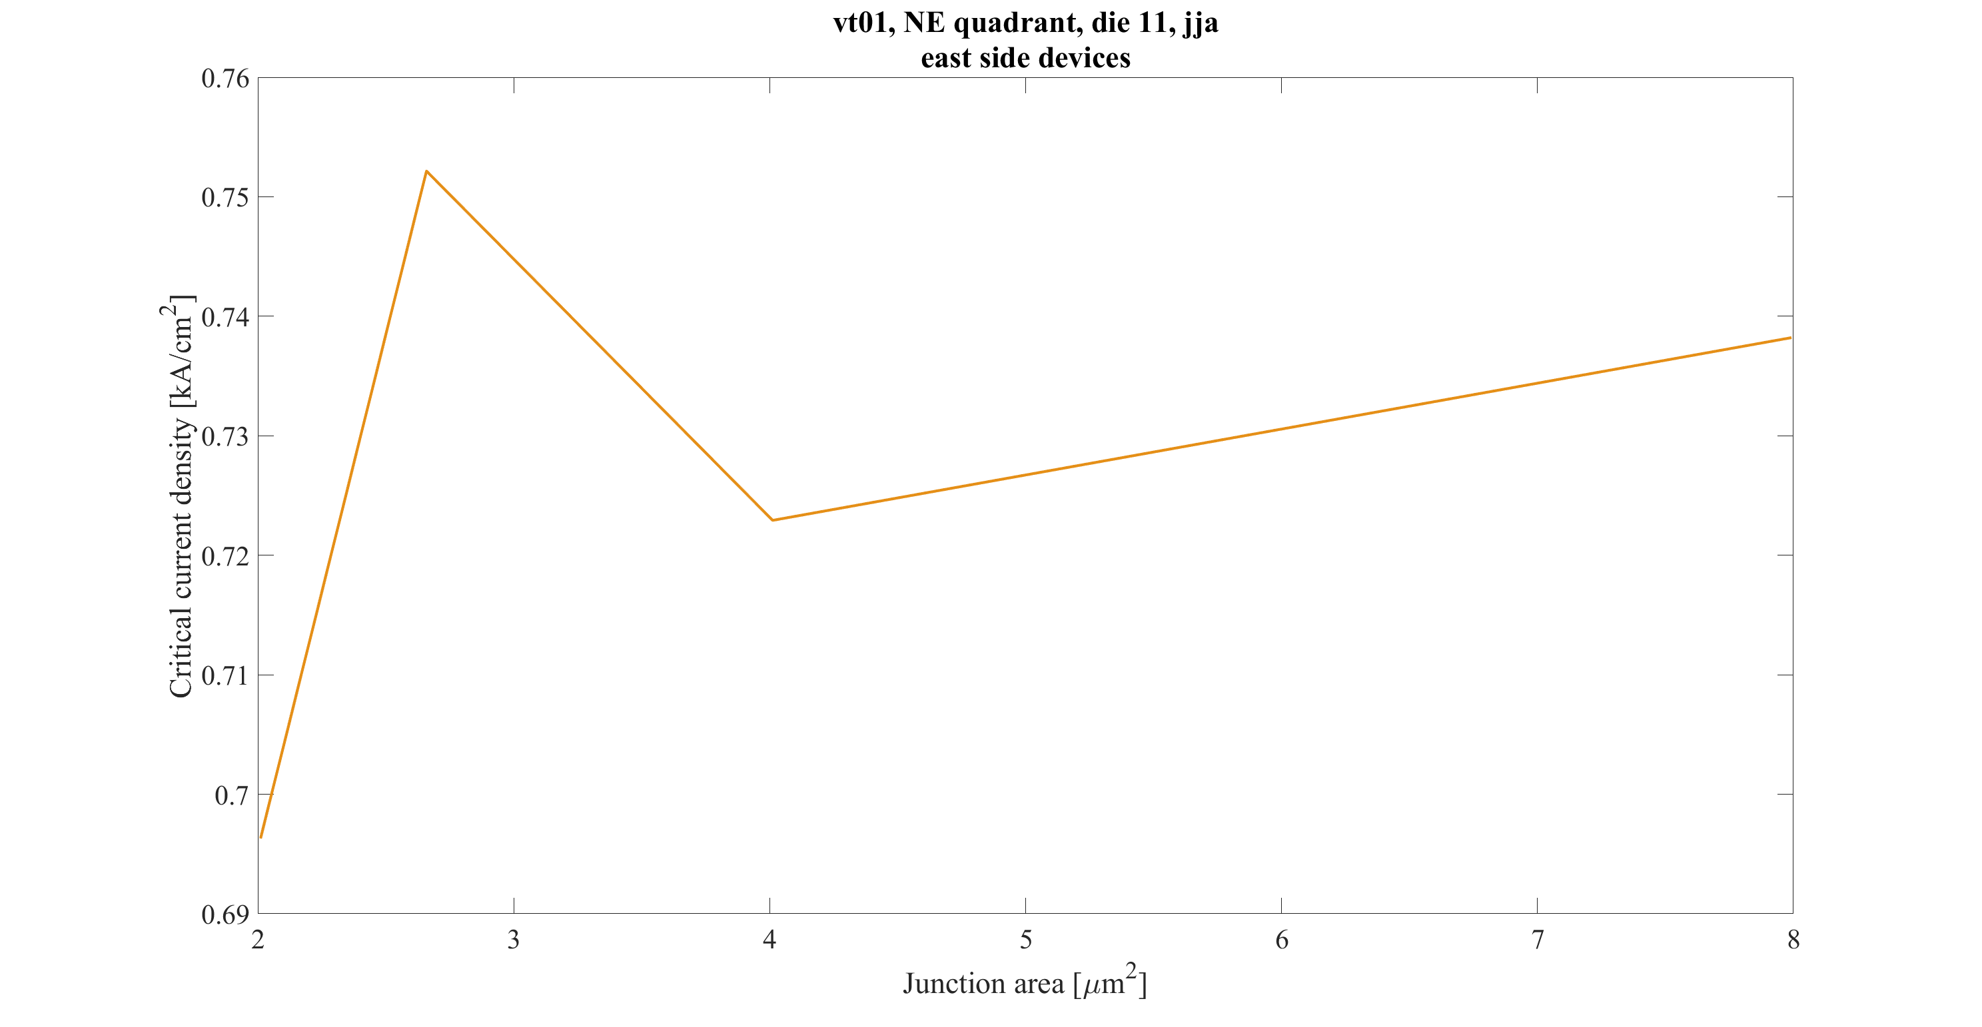

Slide 21
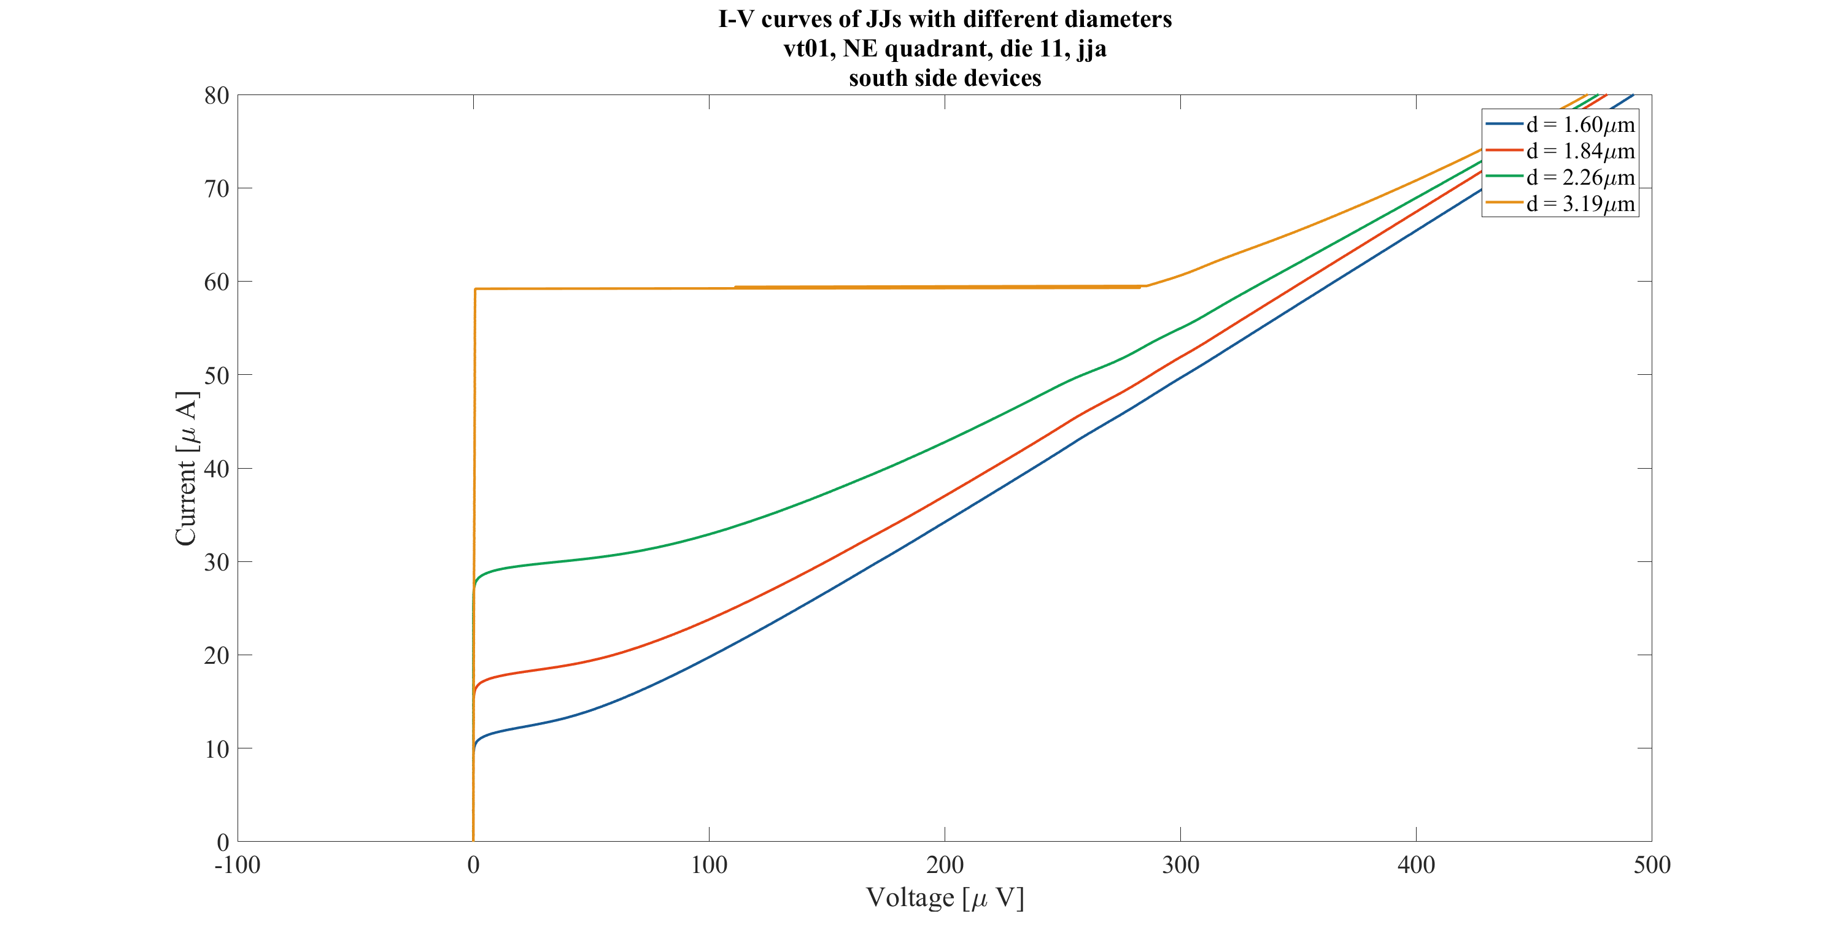

Slide 22
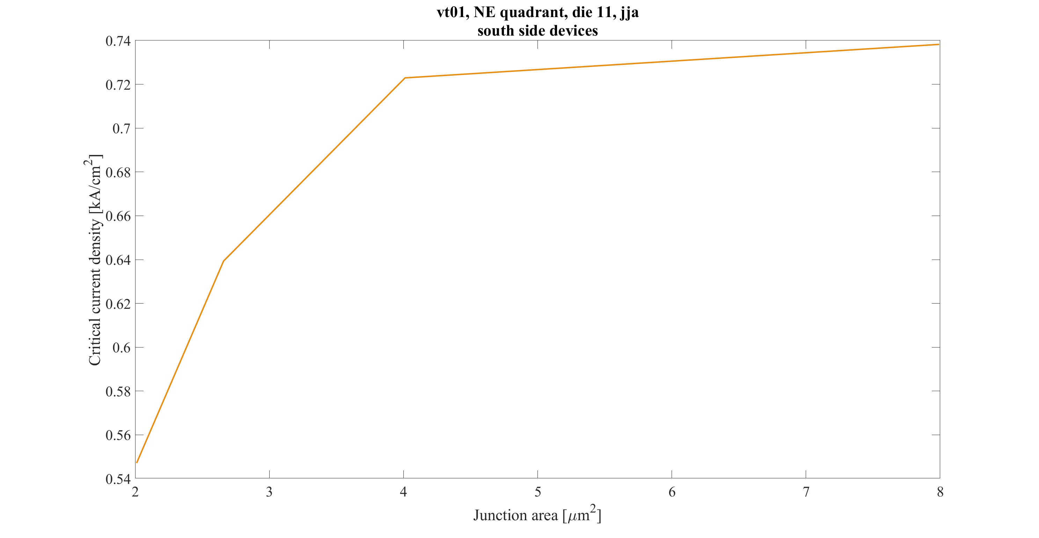

Slide 23
die 15, jj 4-wire measurements

Slide 24
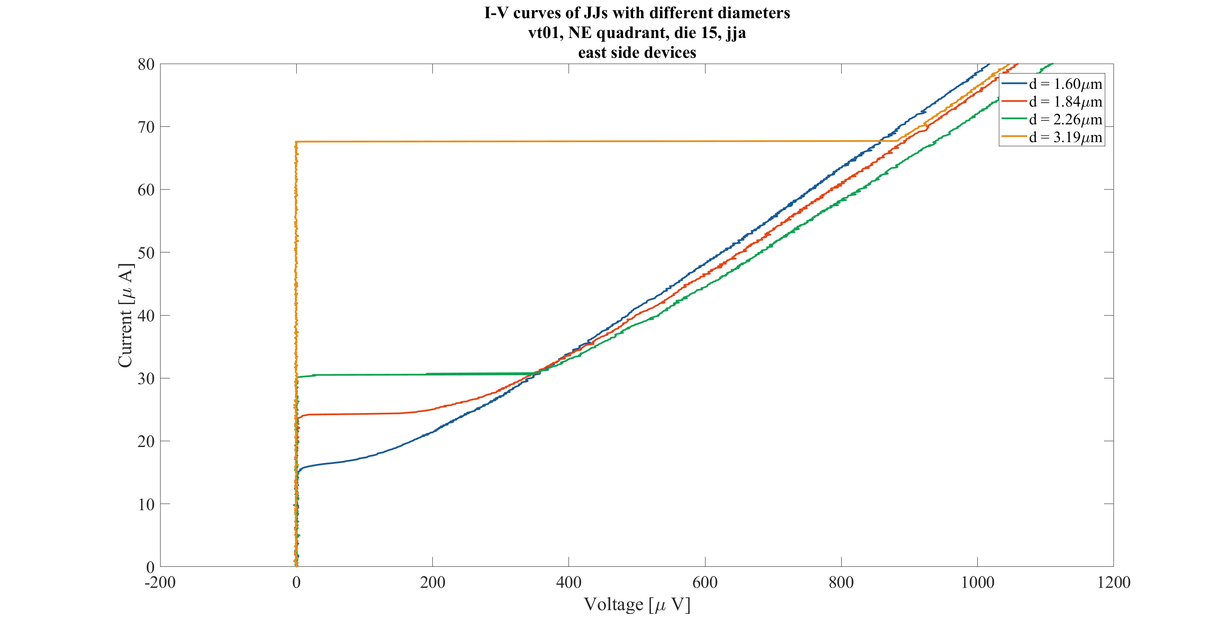

Slide 25
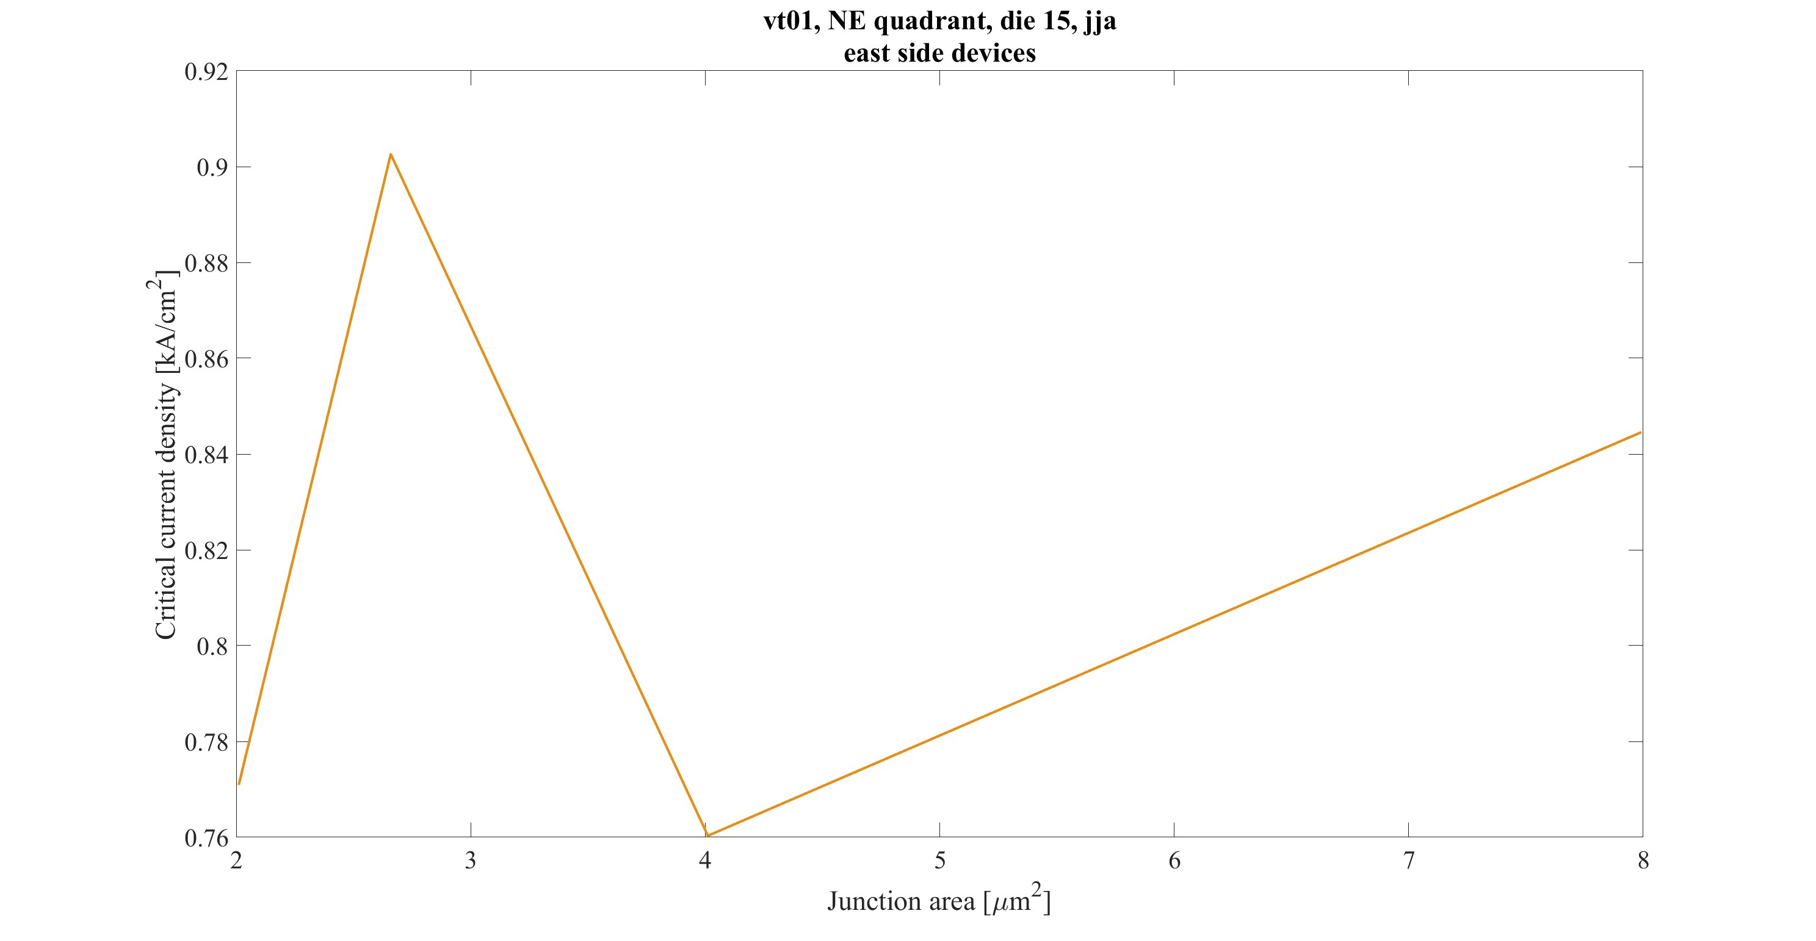

Slide 26
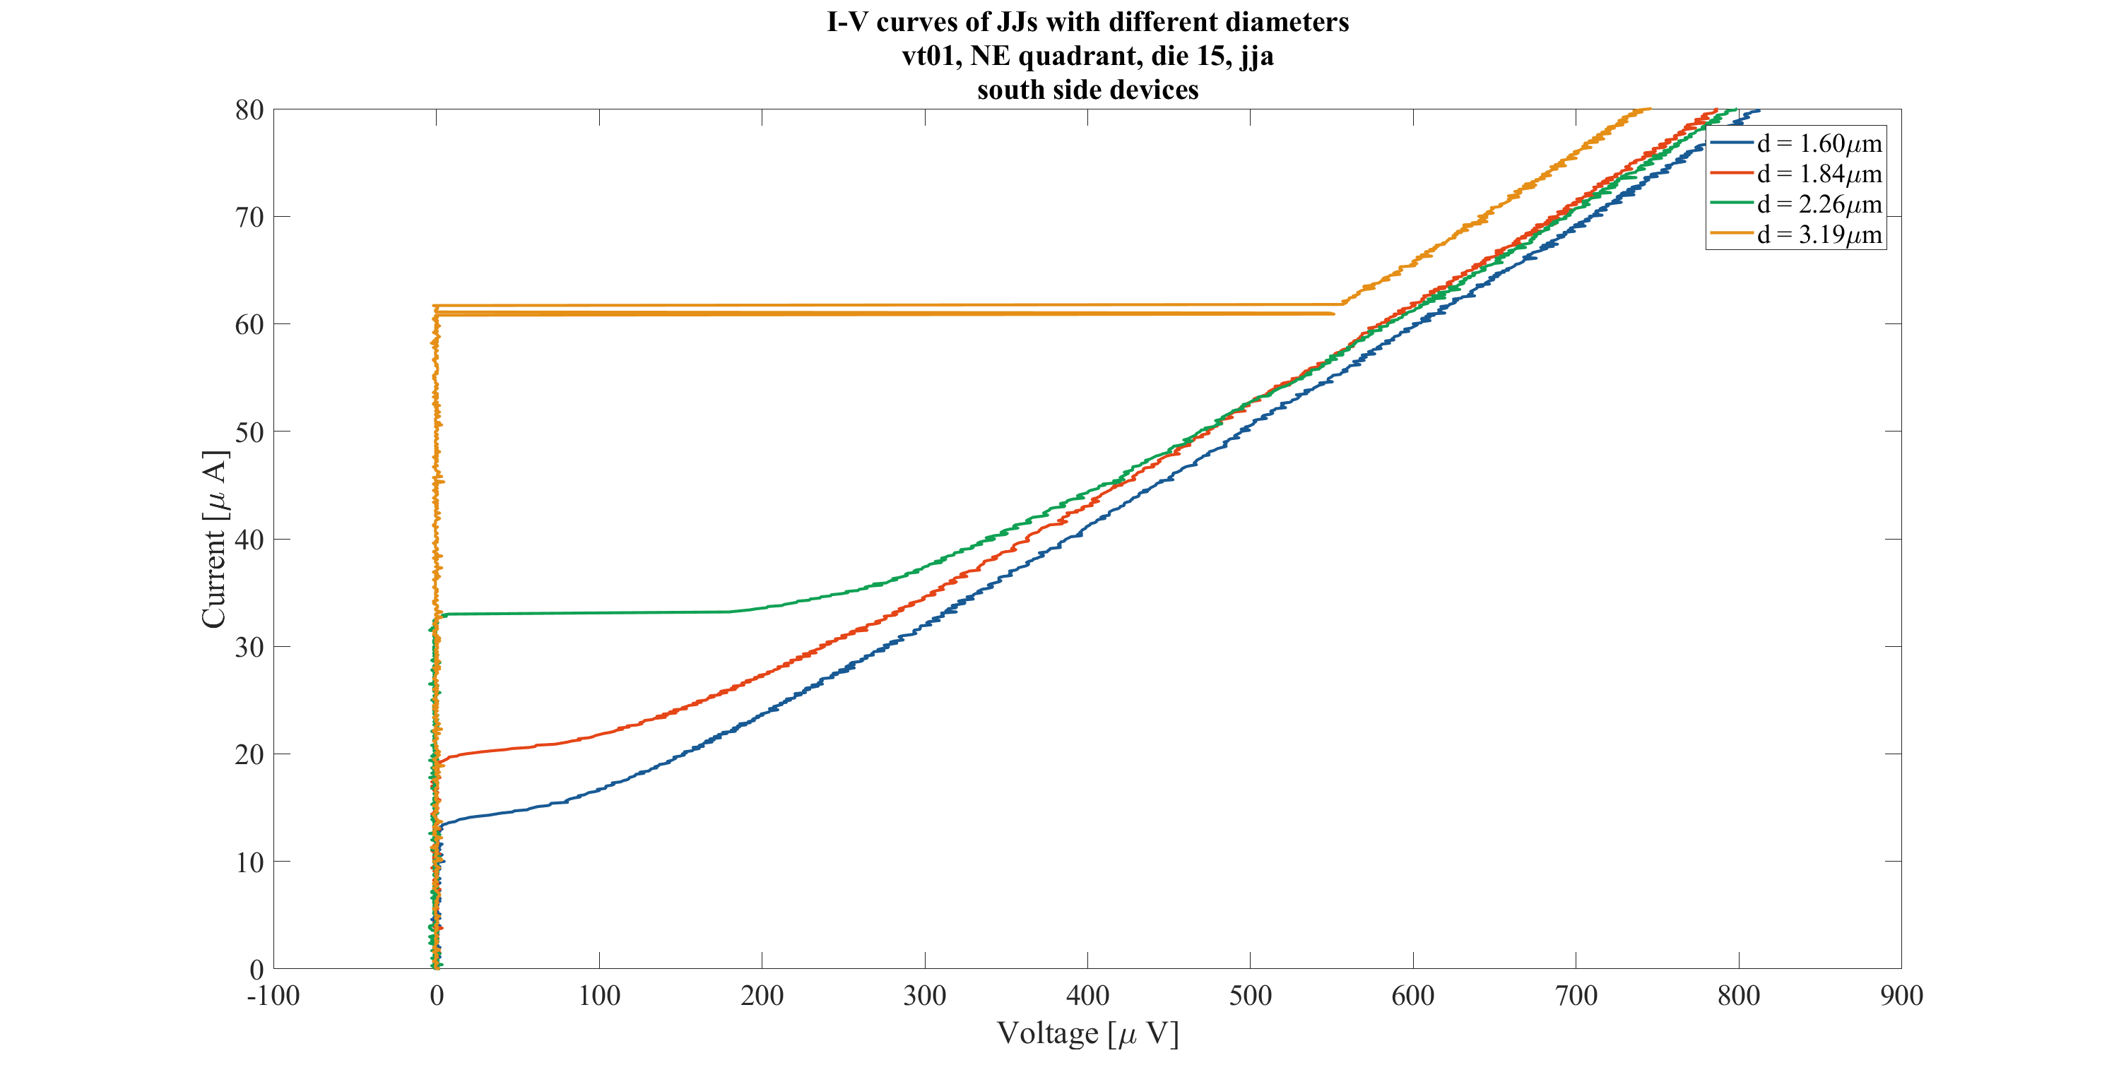

Slide 27
comparing die 11 and 15, jj 4-wire measurements

Slide 28
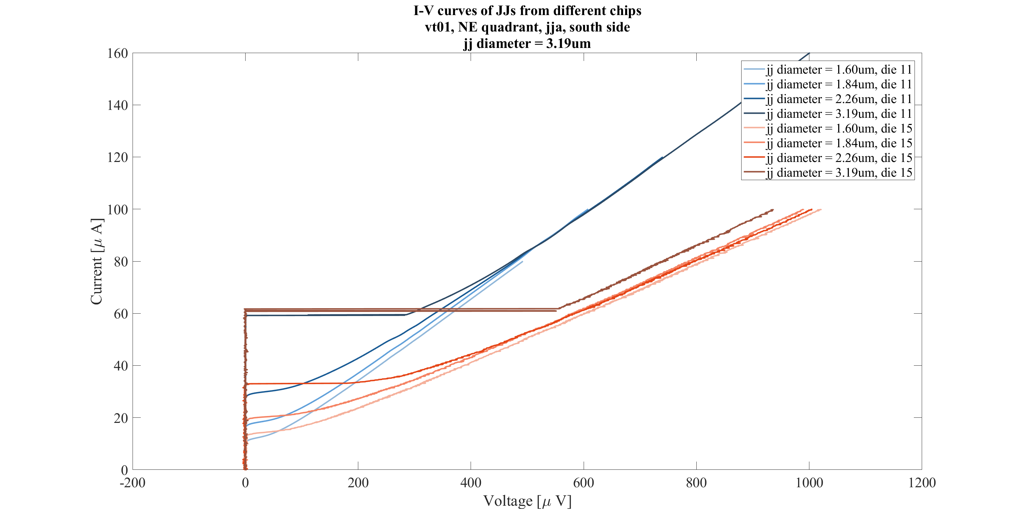

Slide 29
JJ series array tests, shunted, cold

Slide 30
die 11, jj 2-wire series-array measurements

Slide 31
