Slide 1
Votan1
Process Flow
20190823

Slide 2
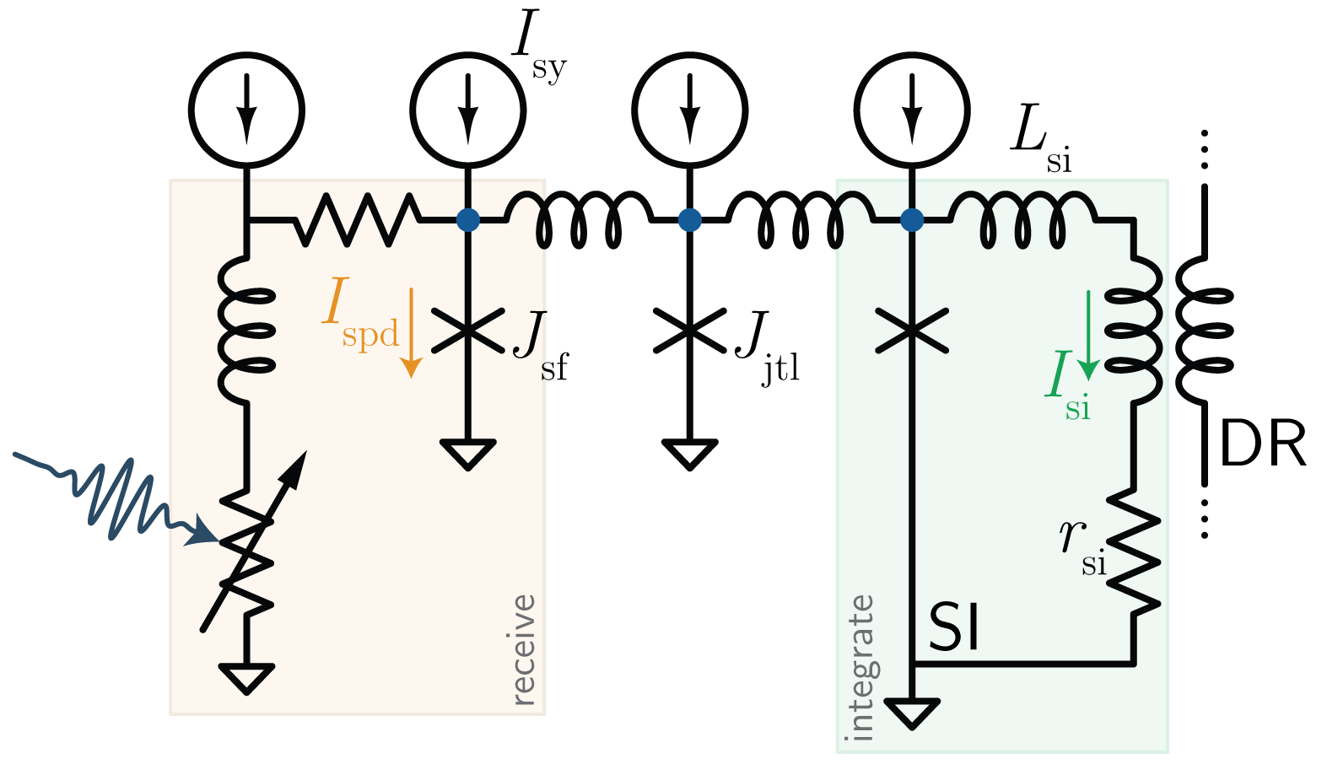
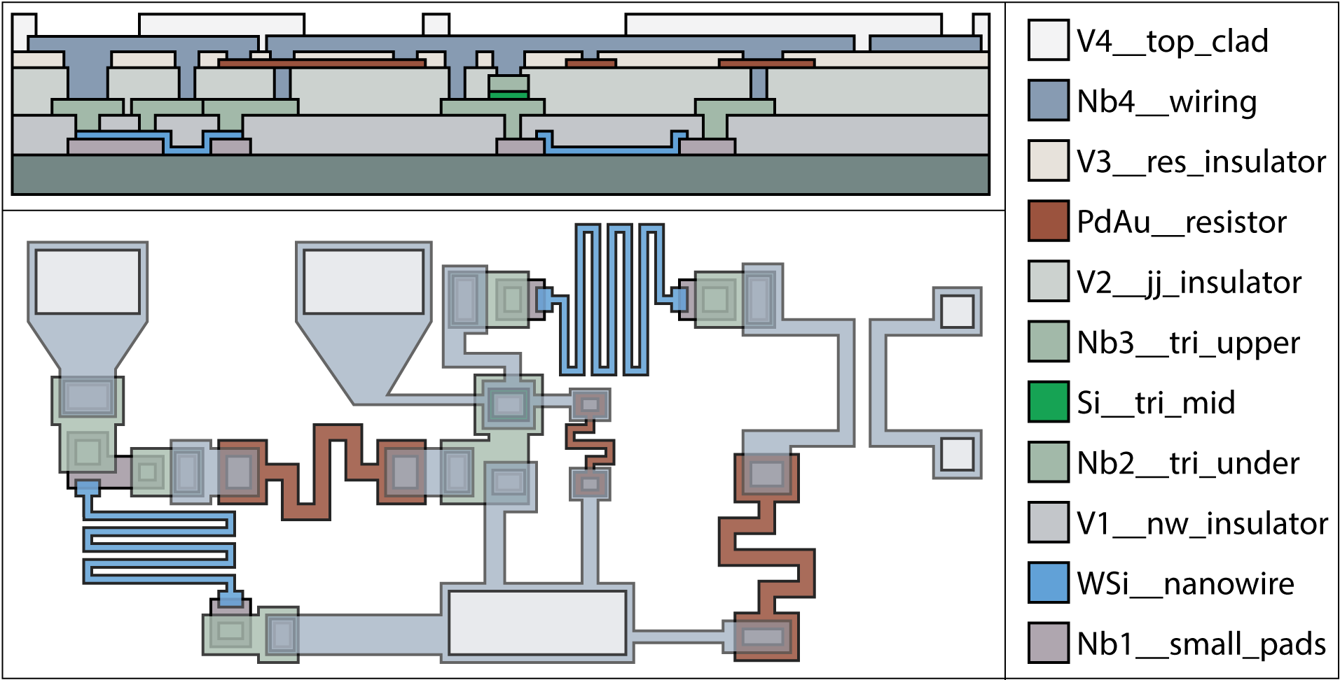

Slide 3
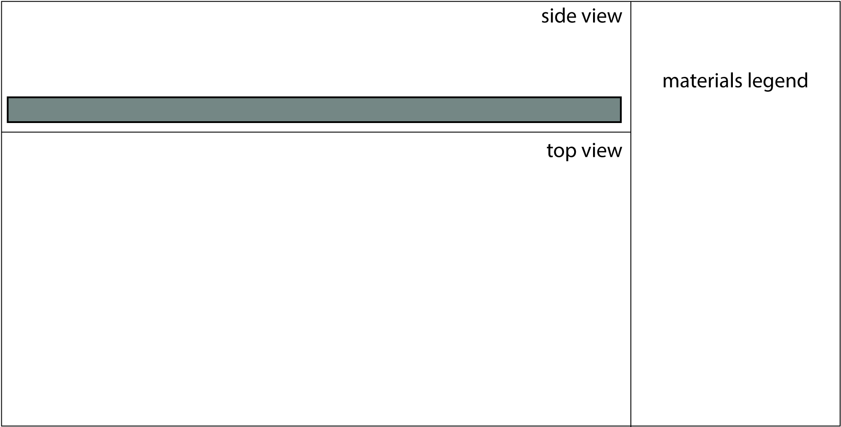

Slide 4
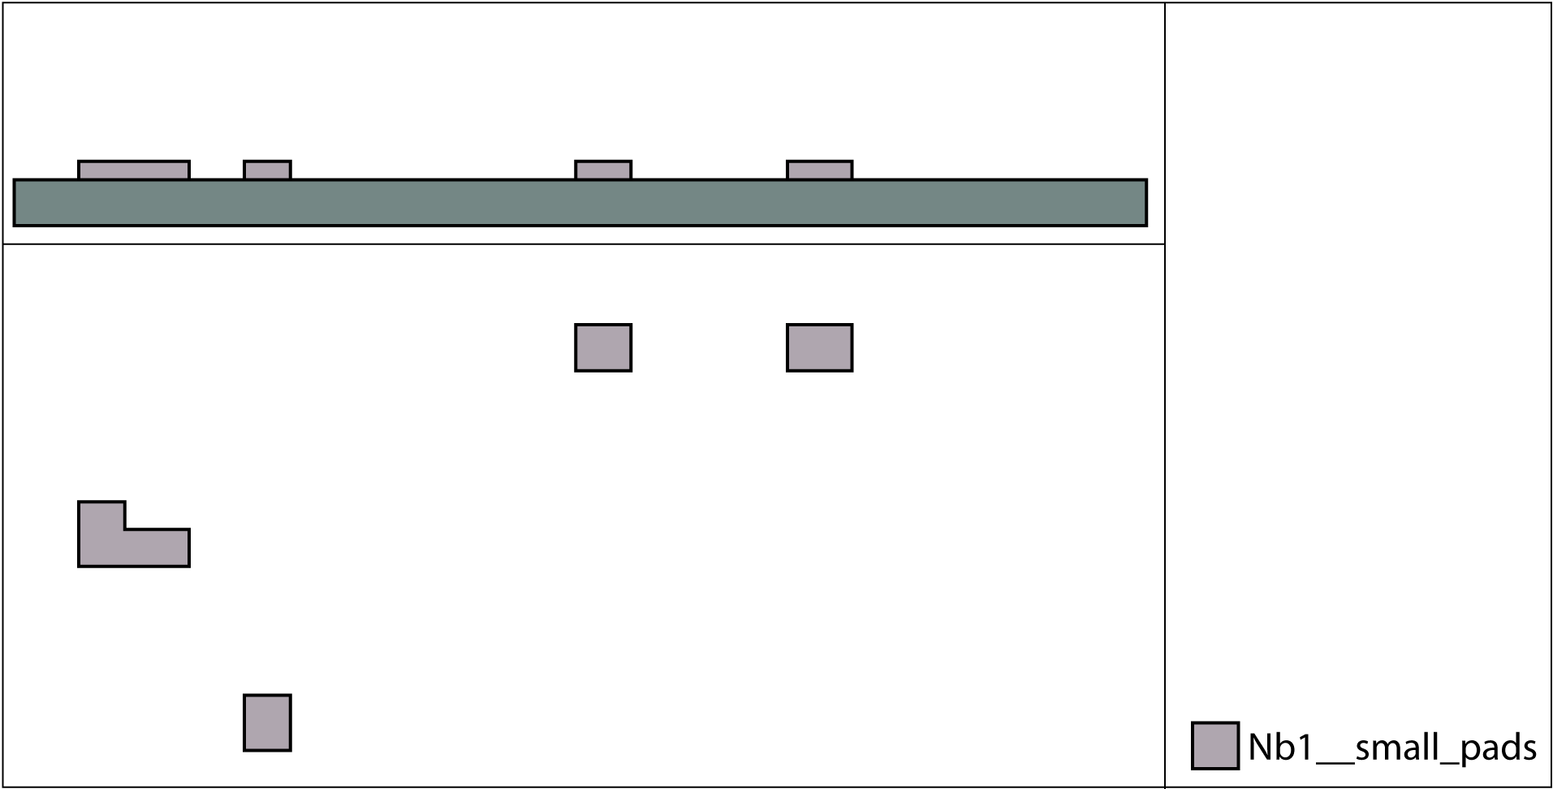

Slide 5
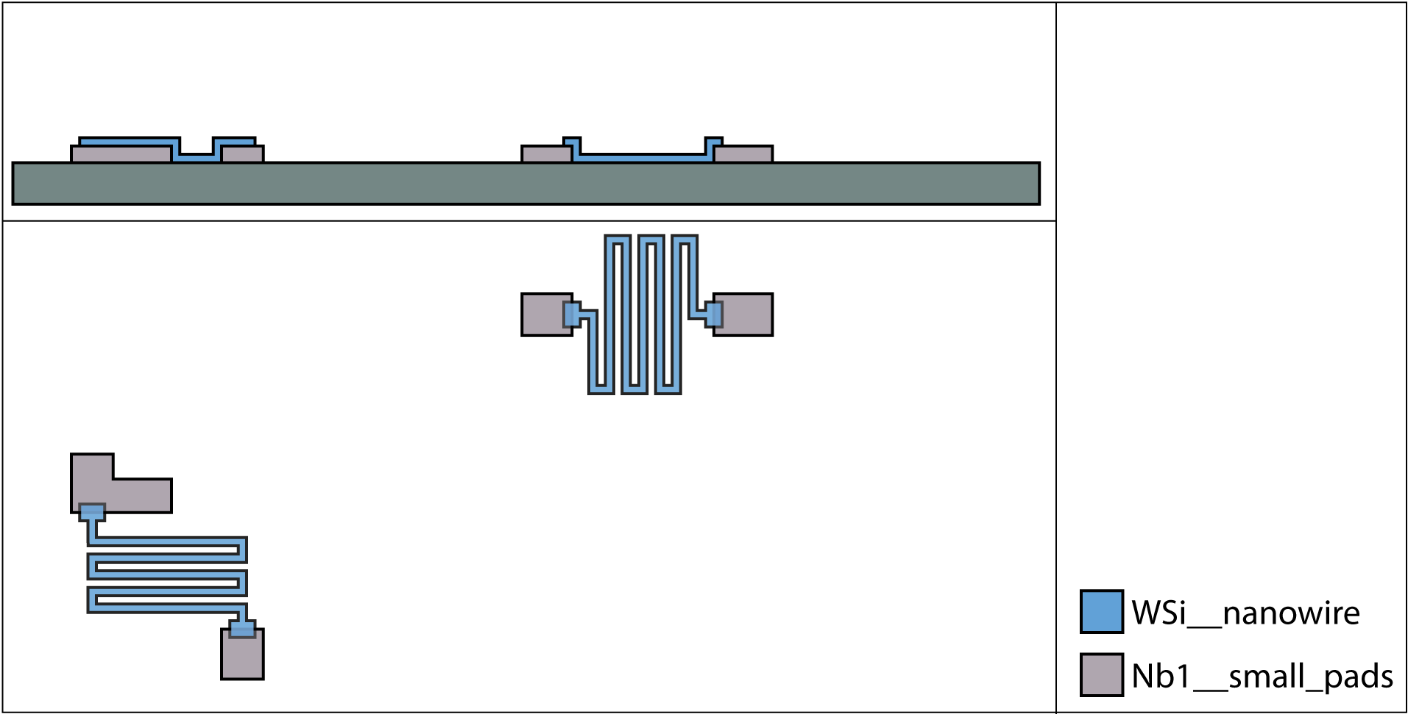

Slide 6
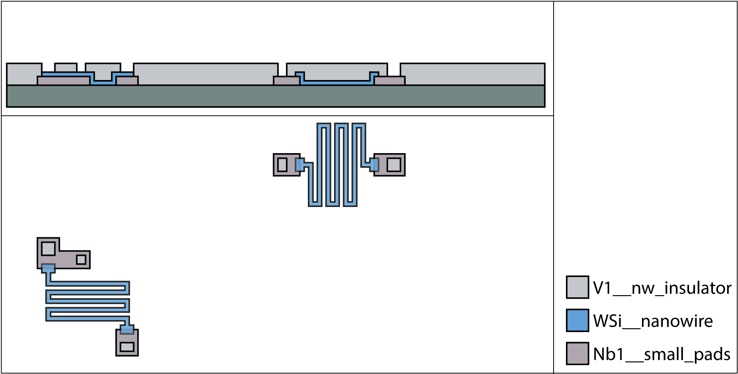

Slide 7
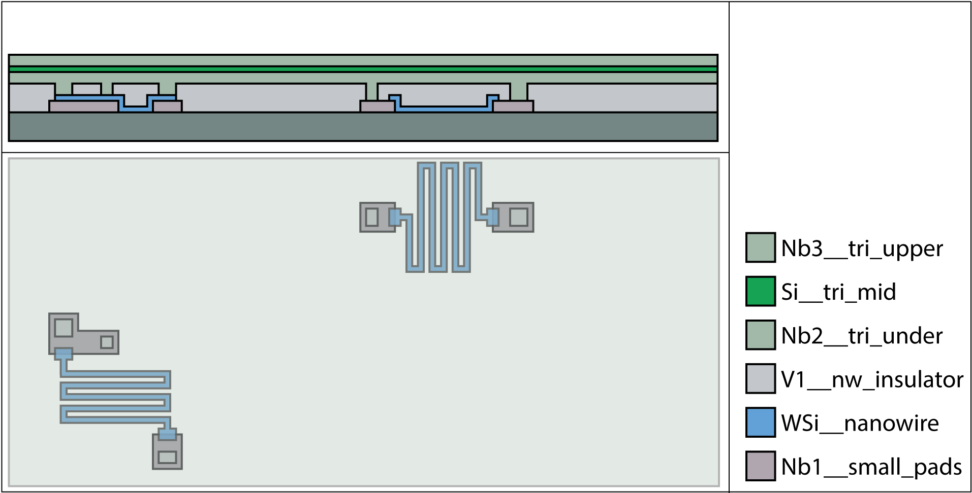

Slide 8
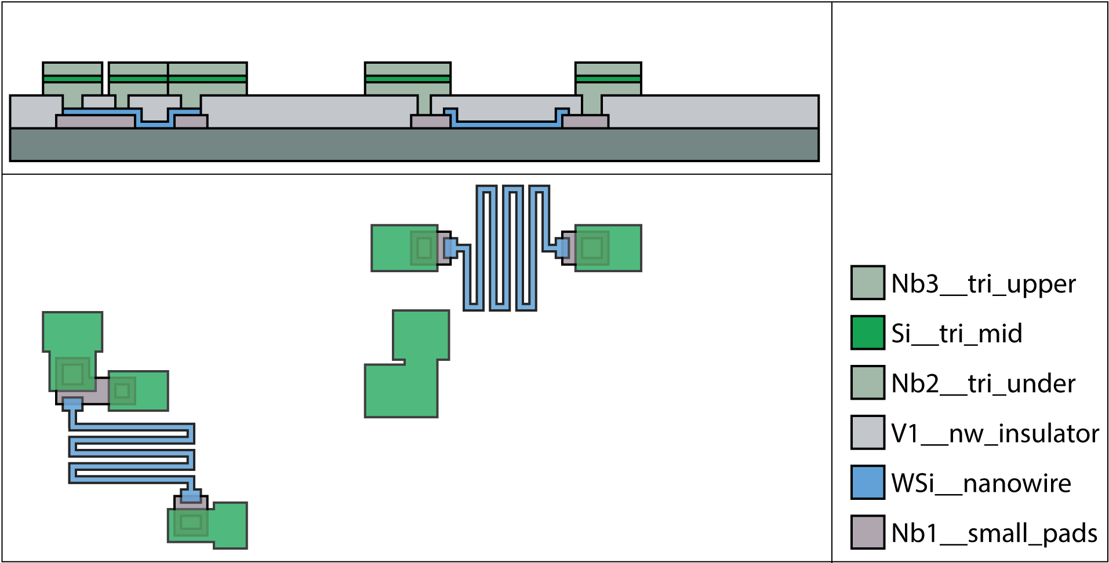

Slide 9
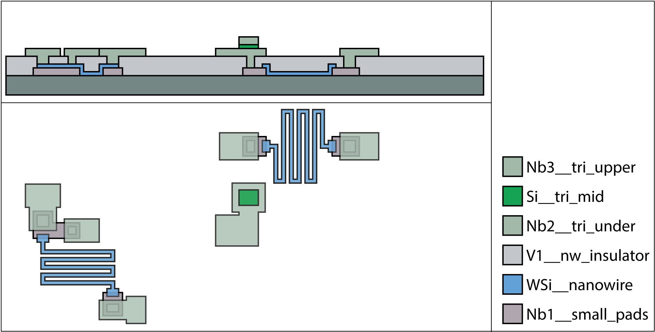
Notes:
The Nb1 layer is not necessary, that function can be done by the Nb2 under connecting the nanowire from the top through vias, unless you are wary of the via etch going through the nanowire since it is thin.

Slide 10
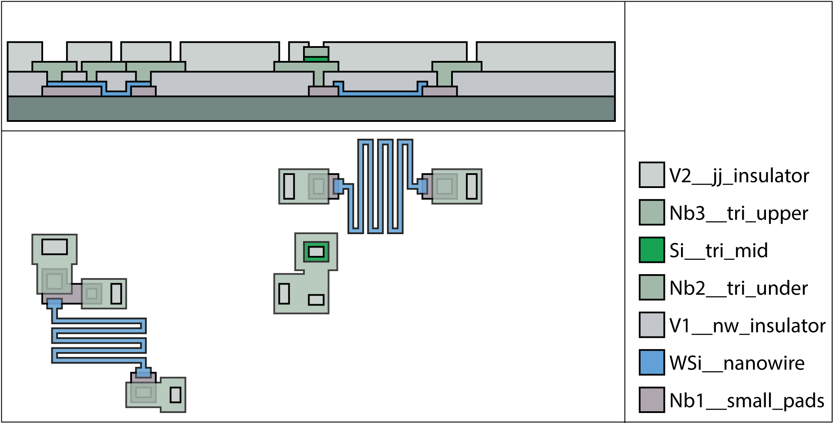

Slide 11
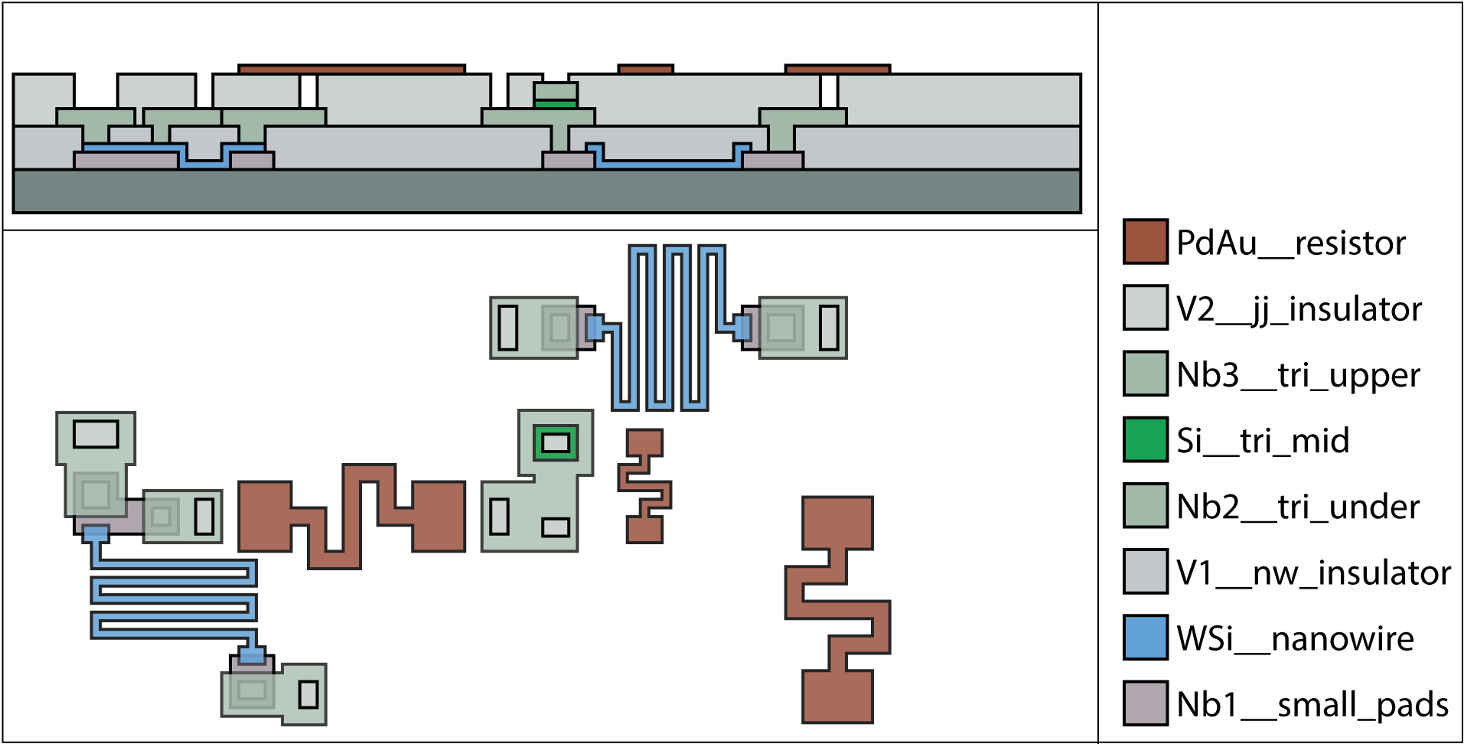

Slide 12
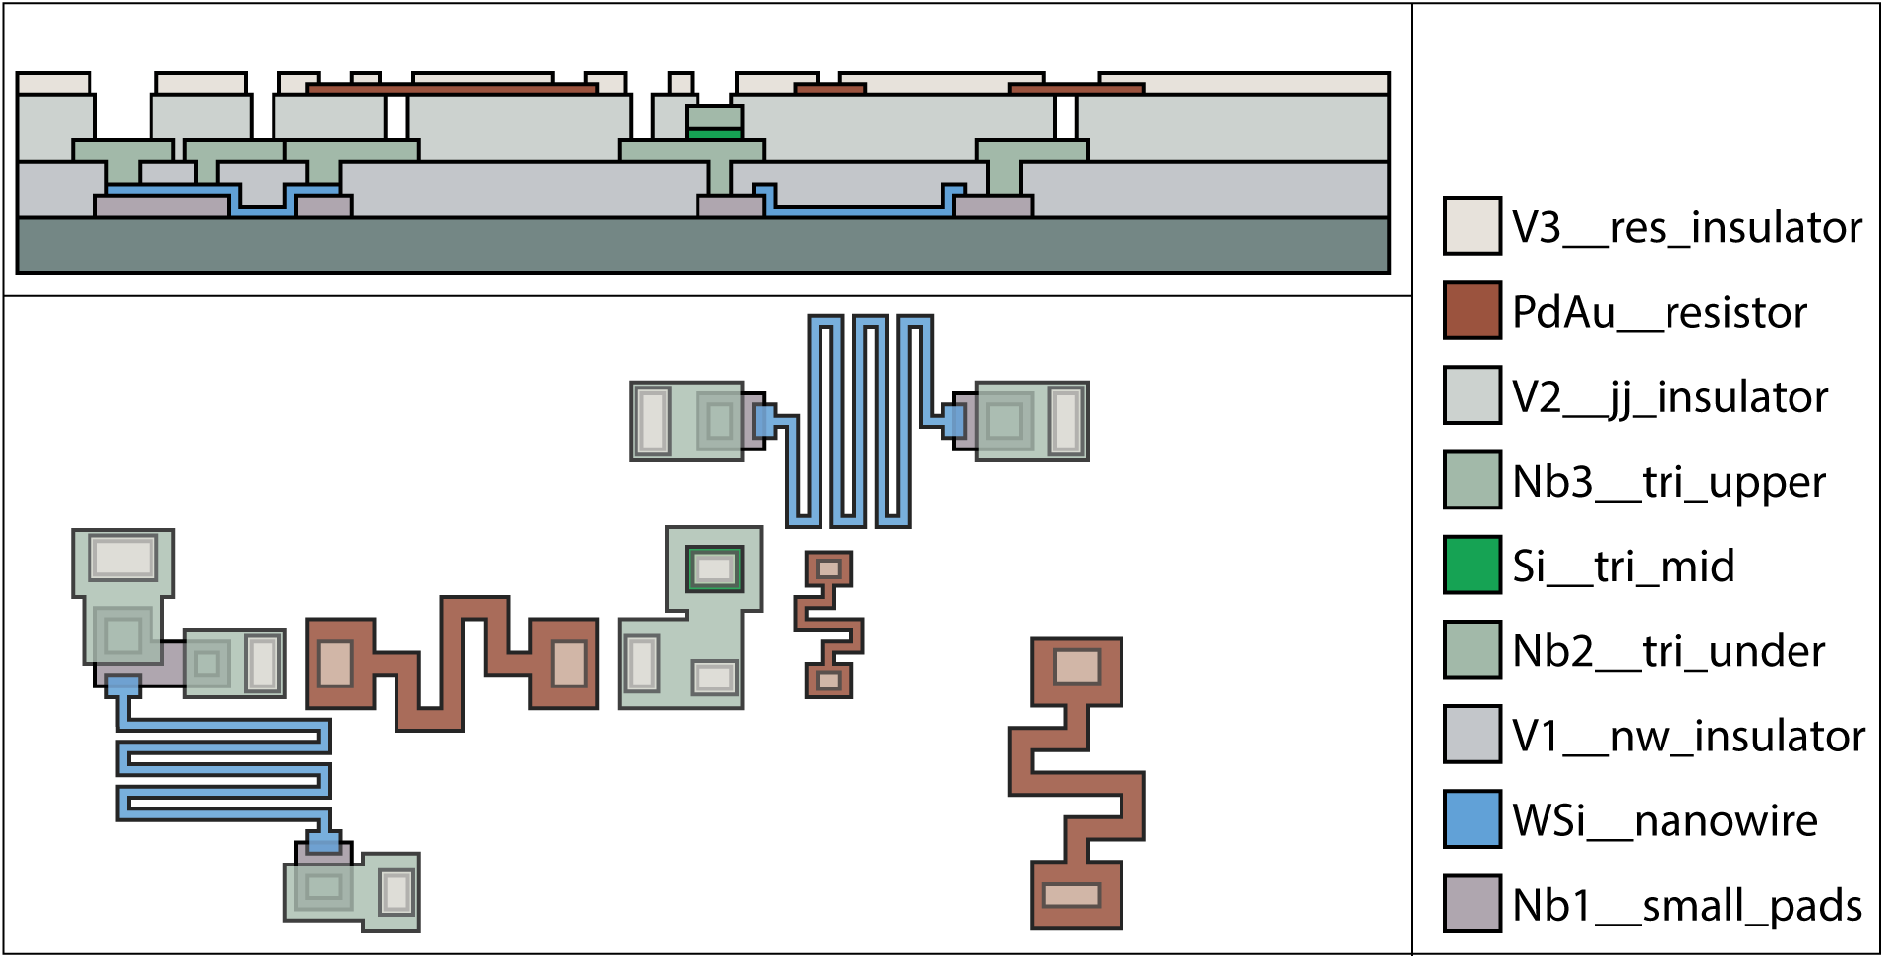
Notes:
There is no need for V3 insulator.

Slide 13
