Slide 1

1.05 Heat Island Mapping
Initial Design Review
Sponsor: Texas State Ingram School of Engineering
Faculty Advisor: Dr. Semih Aslan

Slide 2
Project Overview
We are designing a device to measure the effects of heat islands
Heat islands are urban areas experiencing warmer temperatures than the surrounding rural areas

Slide 3
Problem Statement
In the past 20 years the EPA has noticed increased heat in 48 states setting new records
Increased temperature can lead to a rise in heat related diseases
Between 1979 to 2010 there’s been an estimated 8,000 deaths contributed to heat

Slide 4
Project Goals
Build a handheld device that can:
Record temperature, humidity, location and time for a min 4 hrs
Display recorded data on device
Display location of recorded data on a web application map overlay
Store data on local SD card and cloud storage
Stretch goal: record sunlight data

Slide 5
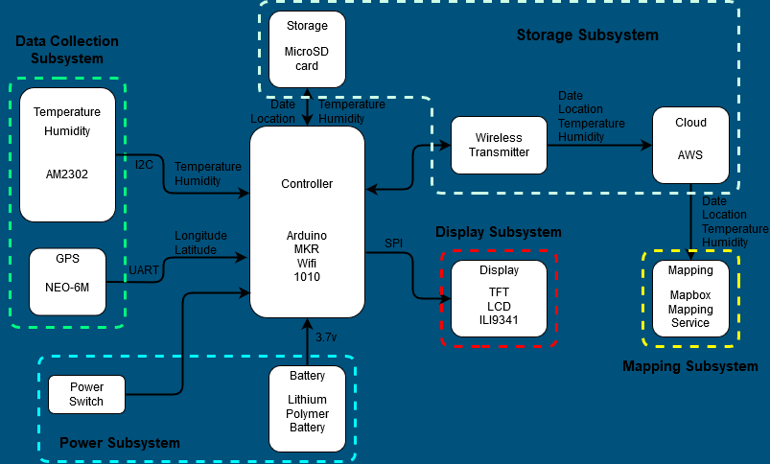
General Block Diagram

Slide 6
Roles & Responsibilities
Member | Role
Jose | Onboard Display
Andrew | Power System, Data Collection
Cameron | Chassis, Mapping Overlay
Gabriel | Local and Cloud Storage

Slide 7
Project Deliverables
Deliverable | DRI
Data Collection | Andrew
Battery Power | Andrew
Chassis | Cameron
Mapping Overlay | Cameron
Cloud Storage | Gabriel
Local Storage | Gabriel
Touchscreen Display | Jose

Slide 8
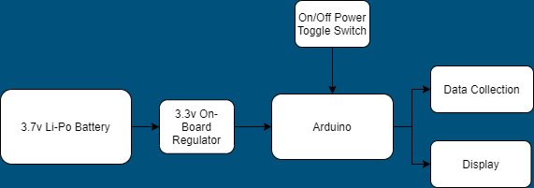
Power Subsystem Diagram
Owned by Andrew Flores

Slide 9
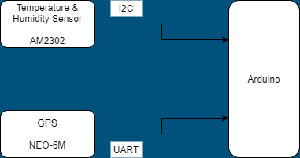
Data Collection Subsystem Diagram
Owned by Andrew Flores

Slide 10
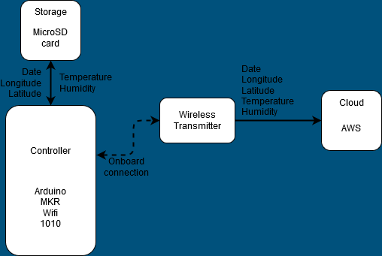
Storage Subsystem
Owned by Gabriel Montero

Slide 11
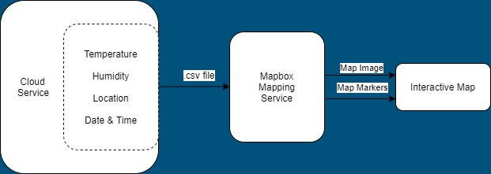
Mapping Subsystem Diagram
Subsystem owned by: Cameron Muir

Slide 12
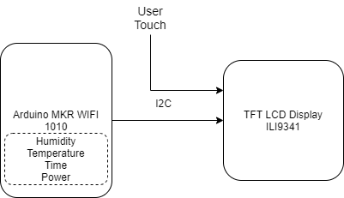
Display Subsystem Diagram
Owned by: Jose Silva

Slide 13
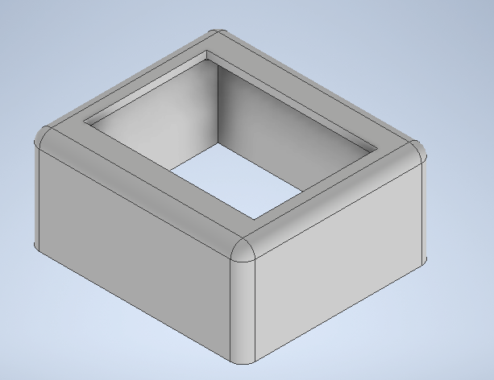
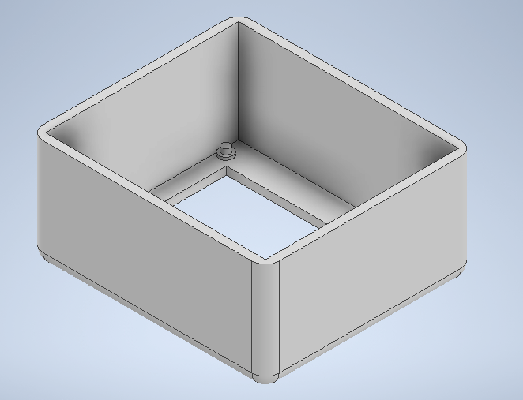
Chassis Design
3D Printed
Dimensions: 87.5 x 77.5 x 41 mm
Friction Fit/Screw Mounting of parts
*Chassis is a work in progress and is not complete

Slide 14
Project Specific Milestones
Milestone | Start Date | End Date
Preliminary Parts Selection | 9/23/20 | 10/20/20
Materials Ordered | 11/11/20 | 12/2/20
Construction and Testing of D1 Subsystems | 11/11/20 | 12/2/20
Integration of Subsystems | 1/25/21 | 2/29/21
Full System Testing | 2/9/21 | 5/2/21
Senior Design Day | 5/2/21 | 5/3/21

Slide 15
Functional Spec Review

Slide 16
2.3 Error Handling
Low Battery Level
Unable to connect to Wifi
SD Card Storage Full
SD Card Not Found
Sensor Read Error

Slide 17
2.4 Safety & Security
No security issues given the information being collected by the device
Information recorded by the device will be used for public research

Slide 18
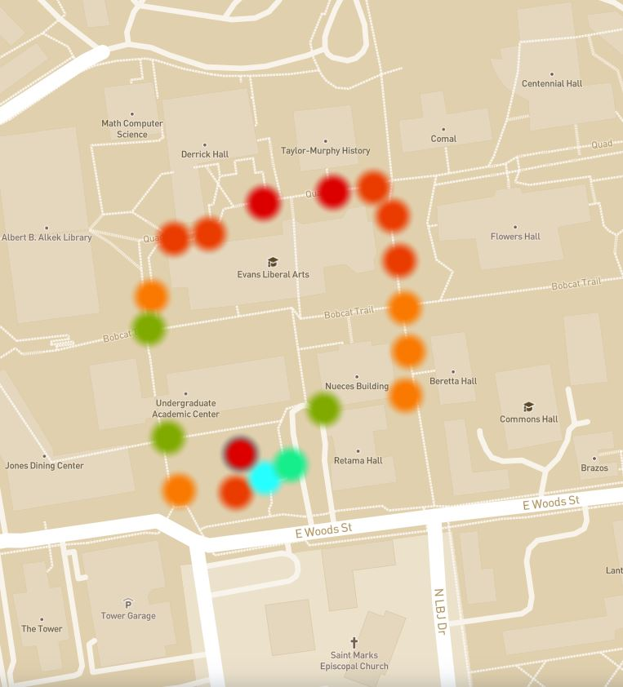
2.6.1 User Interface
1:25 pm
T: 76 ℉
H: 30 %
Mapping Overlay
Hardware:
Touchscreen Display
Power Button
Software:
Mapping Overlay Web Application
Cloud Storage
Cloud Storage

Slide 19
2.6.2 Software Interfaces
Arduino IDE - Device code, written in C/C++
AWS Cloud Service
Mapbox Mapping Service - Mapping overlay, written in Javascript
Autodesk Inventor - Chassis Design

Slide 20
2.9 Software Platforms
The operating system for the Arduino MKR WIFI 1010 will be using Arduino IoT Cloud.
The TFT LCD display will be using Adafruit GFX library for Arduino.
The mapping software Mapbox[2] will be used to create the calculations of the data. The software is based in Javascript.
The cloud storage software is using Amazon Web Service which will provide a URL compatible with web browsers including: Chrome, Safari, Bing, and Firefox.

Slide 21
2.6.3 Hardware Interfaces
TFT LCD with Touchscreen
Arduino MKR Wifi 1010
AM2302
NEO-6M
Micro SD TF Card Memory
Lithium Ion Polymer Battery

Slide 22
2.7 Boundary Conditions & Constraints
Component | Constraint | Bound
Cost | Budget | $100
Chassis | Design | 5” x 5” x 5”
Weight | Design | 3 lb
Battery | Duration 3.7V Nominal Voltage 2500mAh Current | 4 hours a day 3.3V Voltage 2500mAh Current
Sensor | -40 to 80℃ Temperature range 0 to 100.0% Humidity 3.3V to 5V Voltage 2.5mA Current draw | -20 to 50℃ Temperature range 0 to 100.0% Humidity 3.3V Voltage 2.5mA Current draw

Slide 23
2.7 Boundary Conditions & Constraints Cont.
Component | Constraint | Bound
Arduino | -40 to 85℃ Operating Temperature 3.3V to 5V Voltage 7mA Current per I/O pin 1/2/3 Mbps Data Transfer Speed | -20 to 50℃ Operating Temperature 3.3V Voltage 7mA Current per I/O pin 1/2/3 Mbps Data Transfer Speed
LCD Display | Resolution 3.3V to 5V Voltage 150mA Current draw | 240 x 320 pixels 3.3V Voltage 150mA Current draw
MicroSD | Capacity | 8 GB
Completion | Working Product | D2 Senior Design Day

Slide 24
2.8 Performance
Function | Description | How Tested
Battery Life | 3.7V max output, 3.3V Regulated output, 4 Hour minimum battery life | Discharge the battery at maximum current draw and record the time at which performance decreases and eventually powers off.
Data Collection- AM 2302 Sensor | Collect and store temperature and humidity values on-board Arduino, 3.3V, 2.5mA current draw, 0.5 Hz sampling rate. | Run the device with the sensor connected to the arduino board and extract data to the off-board cloud.
Data Collection- NEO-6M GPS | Collect location and store on-board Arduino, 3.3V regulator, 45mA current draw, 1 Hz sampling rate. | Run the device with the GPS connected to the arduino board and extract data to the off-board cloud.

Slide 25
2.8 Performance
Function | Description | How Tested
Display | Display the data recorded, with 2 menu options to reach the mapping overlay and cloud storage. 3.3V regulated voltage, 150mA current draw. | Power on the display and provide it with data, and make sure the display provides the desired URL for the map and cloud storage.
Map Platforms | The map will be able to be viewed on the following platforms: (a). Web (b). Mobile (includes IOS and Android). | When publishing the map, one will use the link given and test it on multiple web browsers and platforms to ensure compatibility
Map Refresh Rate | The map will be refreshed with any new data every hour | To test this one would create a test .csv file and upload it. Then check if it updates the map every hour. making changes between each hour to see any new data changes.

Slide 26
2.10 Service, Support, & Maintenance
Display - Can provide support through the use of warning messages
Chassis - Can be opened, all components will be installed with screws or friction fit for easy replacement and maintenance
Battery - Detachable (if needed) for replacement
Software - Any software updates will be made for the user to download via Github

Slide 27
2.11 Expandability
Chassis Color
Storage Capacity
Network of devices connected to a cloud service

Slide 28
Challenges and Concerns
Low Power Mode of Device
Waterproofing of Display
Costs
Error Handling of Data Transmission

Slide 29
Future Tasks - D2
Subsystem | Task
Power | Full system longevity testing, recharge rate
Data Collection | Implement testing
Mapping | Coding mapping overlay calculation
Storage | Coding storage management of data
Display | Design, Implement Testing

Slide 30

Questions?
Thank you to the following people:
Sponsor: Mr. Lee Hinkle
Faculty Advisor: Dr. Semih Aslan
D2 Team: 2.06

Slide 31
References
A report by the Environmental Protection Agency on heat islands and climate change accessed online at https://www.epa.gov/heatislands/climate-change-and-heat-islands November 7, 2020

