Slide 1
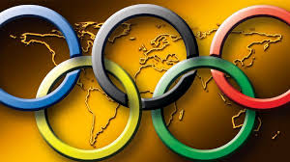
HISTORY OF SUMMER OLYMPICS(1896-2008)
- Janani.R

Slide 2

Timeline
Berlin
Los Angeles
London
Tokyo
Moscow
1916
1932
1948
1964
1980
St. Louis
Antwerp
Berlin
Helsinki
Mexico City
Los Angeles
1904
1920
1936
1952
1968
1984
Athens
London
Paris
Tokyo
Melbourne
Munich
Seoul
2004
1908
1924
1940
1956
1972
1988
Athens
Beijing
1896
Stockholm
Amsterdam
London
Rome
Montreal
Barcelona
2008
1912
1928
1944
1960
1976
1992
Paris
London
1900
2012
1896
1909
1922
1935
1948
1961
1974
1987
2000

Slide 3

PROBLEM STATEMENT
The history of the summer Olympics games for the Years between 1896-2008.
To see the number of medals acquired by individuals and Countries.
KEY PERFORMANCE INDICATOR
Olympic event held in various places for the given years.
Medals acquired the most by different countries and by both genders for a particular year.
Gender to analyze the involvement of female in Olympics
Maximum participation by each gender in various sports

Slide 4

Data Fields:
Olympics
Edition
Sport
Discipline
Athlete
NOC
Gender
Medals
DATA SOURCE :
KAGGLE

Slide 5
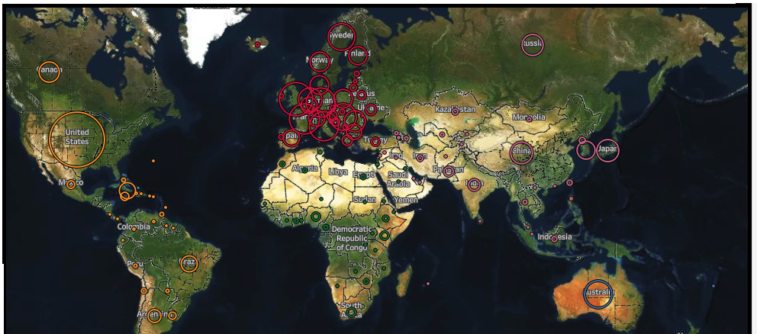
Each Country’s Ring is Sized by its Number of Medals
We(soviet union, UK) take the second and third place
United states has acquired most medals.

Slide 6

Participation of women in Olympics
The rate of participation of women in the Olympics has been increasing since their first participation in 1900. Some sports are considered for women, others are contested by both gender.
The representation of women on the International Olympic Committee has run well behind the rate of female participation, and it continues to miss its target of a 20% minimum presence of women on their committee.
Tennis, Golf and Sailing were the sports that where first introduced for women in 1900 Olympics.

Slide 7
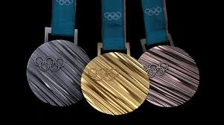
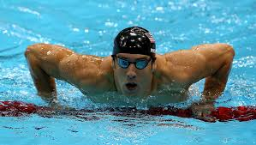
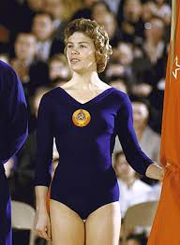
Michael Fred Phelps (born June 30, 1985) is an American retired competitive swimmer and the most successful and most decorated Olympian of all time, with a total of 28 medals. Phelps also holds the all-time records for Olympic gold medals in individual events (13), and Olympic medals in individual events(16).
Larisa Semyonovna Latynina (born 27 December 1934) is a former Soviet artistic gymnast from southern Ukrainian SSR. Between 1956 and 1964 she won 14 individual Olympic medals and four team medals. She holds the record for the most Olympic gold medals by a gymnast, male or female, with 9. Her total of 18 Olympic medals was a record for 48 years. She held the record for individual event medals with 14 for 52 years. She is credited with helping to establish the Soviet Union as a dominant force in gymnastics.

Slide 8

THANK YOU

