Slide 1
人工智慧與資訊安全
期中平時報告
Matplotlib
Data Visualization 資料視覺化技術
報告者:李佳諭
指導教授:偉大的恩師 龍大大

Slide 2
Agenda
Data Visualization資料視覺化
資料視覺化 套件
資料視覺化 實戰

Slide 3
[1].Data Visualization資料視覺化
[2].資料視覺化の套件
[3].Google Colab上的範利
[4].MATPLOTLIB
[5].MATPLOTLIB範例學習
[1]單一圖形
matplotlib.pyplot的許多範例
plot():折線圖(Line chart):matplotlib.pyplot.plot
bar():長條圖|柱狀圖(Bar Chart):matplotlib.pyplot.bar
hist():直方圖(histogram):matplotlib.pyplot.hist
boxplot():箱形圖 (Box plot):matplotlib.pyplot.boxplot
scatter():散佈圖 (Scatter plot): matplotlib.pyplot.scatter
pie():圓餅圖(pie plot):matplotlib.pyplot.pie
[2]多圖形並陳

Slide 4
Data Visualization 資料視覺化

Slide 5
Data Visualization 資料視覺化
https://zh.wikipedia.org/wiki/資料視覺化
藉助於圖形化手段，
清晰有效地傳達與溝通訊息

Slide 6
Data Visualization 資料視覺化の有許多套件 請挑選你熟悉的….深入學習
Data Visualization 資料視覺化
藉助於圖形化手段，
清晰有效地傳達與溝通訊息
Matplotlib(本課程使用)
Seaborn
Ggplot
Bokeh
Pyga
Plotly

Slide 7
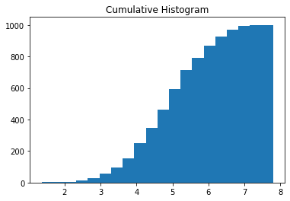
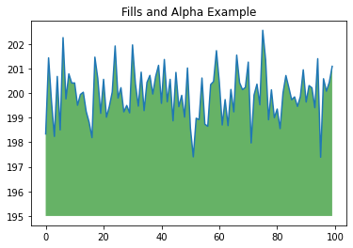
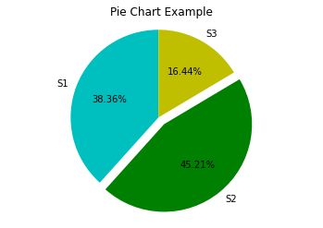
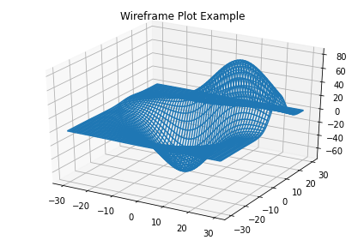
Google Colab有許多範利可以提供你自我學習
Charting in Colaboratory
https://colab.research.google.com/notebooks/charts.ipynb

Slide 8
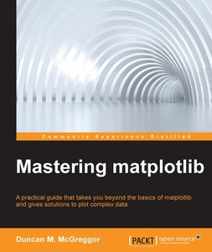
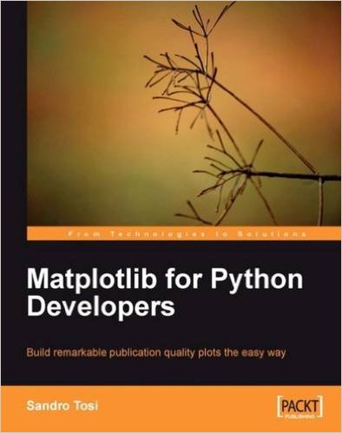
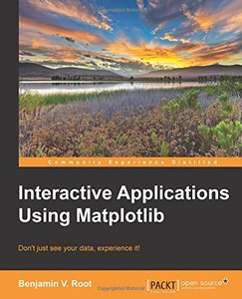


Slide 9
學習的最好參考: https://matplotlib.org/
User‘s Guide https://matplotlib.org/users/index.html

Slide 10
Data Visualization 資料視覺化實戰練習
折線圖plt.plot()

Slide 11
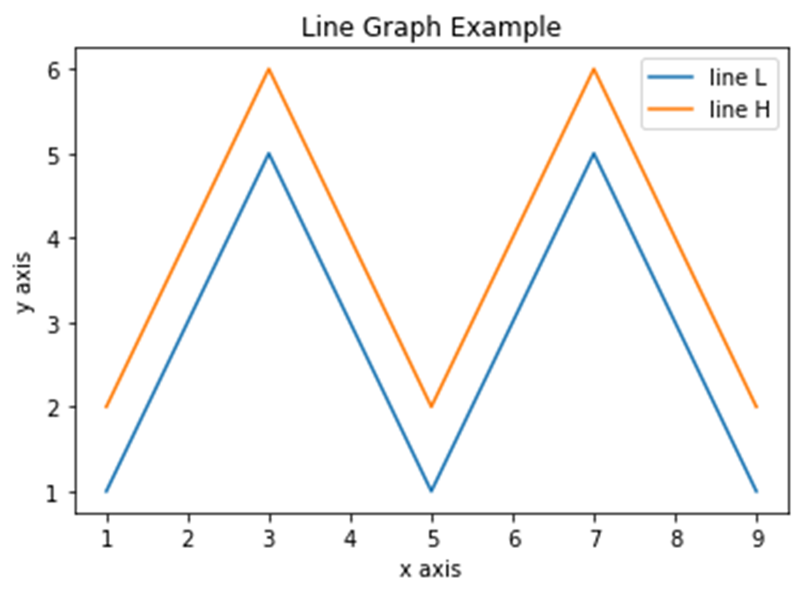
import matplotlib.pyplot as plt
x = [1, 2, 3, 4, 5, 6, 7, 8, 9]
y1 = [1, 3, 5, 3, 1, 3, 5, 3, 1]
y2 = [2, 4, 6, 4, 2, 4, 6, 4, 2]
plt.plot(x, y1, label="line L")
plt.plot(x, y2, label="line H")
plt.xlabel("x axis")
plt.ylabel("y axis")
plt.title("Line Graph Example")
plt.legend()
plt.show()

Slide 12
plt.plot()
plt.plot(x, y)
https://matplotlib.org/3.3.1/api/_as_gen/matplotlib.pyplot.plot.html#matplotlib.pyplot.plot
https://www.tinycorner.tw/2018/08/18/python數據圖形化套件-matplotlib-i/

Slide 13
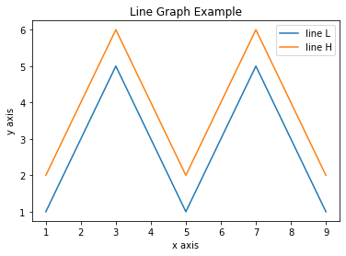
plt.legend()

Slide 14
plt.legend()
loc：(default: 'best’)
('best' for axes, 'upper right' for figures)
值 | 描述 | 數字
best | 最適宜 | 0
upper right | 右上角 | 1
upper left | 左上角 | 2
lower right | 右下角 | 3
lower left | 左下角 | 4
right | 右側 | 5
center left | 左側中間 | 6
center right | 右側中間 | 7
lower center | 下方中間 | 8
upper center | 上方中間 | 9
center | 最適宜 | 10
shadow：(default: False)
facecolor：(default: 'white')
edgecolor：(default: 'black')

Slide 15
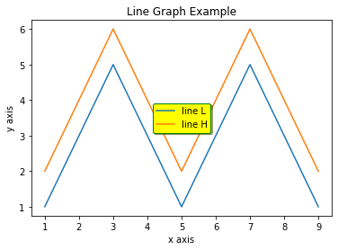
plt.legend(loc=10, shadow=True, facecolor='yellow', edgecolor='green')

Slide 16
Data Visualization 資料視覺化實戰練習
長條圖

Slide 17
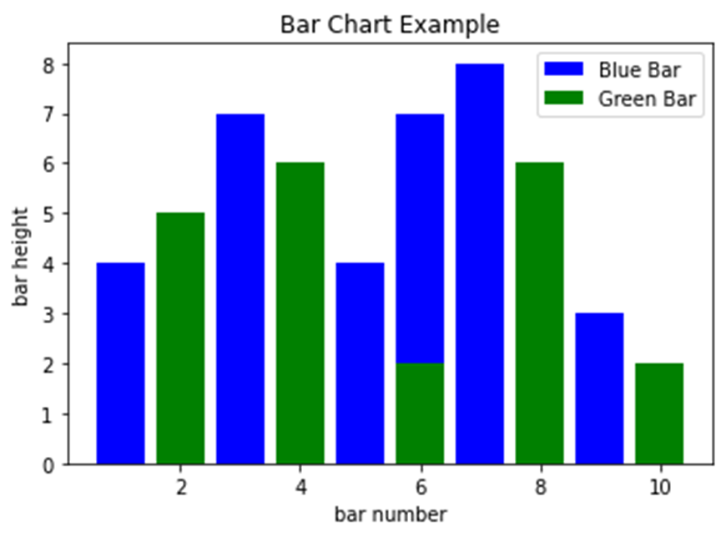
import matplotlib.pyplot as plt
x1 = [1, 3, 4, 5, 6, 7, 9]
y1 = [4, 7, 2, 4, 7, 8, 3]
x2 = [2, 4, 6, 8, 10]
y2 = [5, 6, 2, 6, 2]
plt.bar(x1, y1, label="Blue Bar", color='b')
plt.bar(x2, y2, label="Green Bar", color='g')
plt.xlabel("bar number")
plt.ylabel("bar height")
plt.title("Bar Chart Example")
plt.legend()
plt.show()

Slide 18
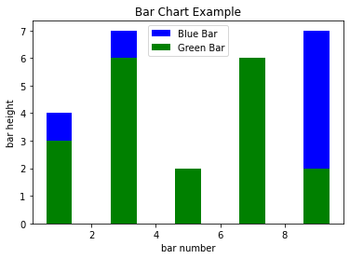
https://www.tinycorner.tw/2018/08/22/python數據圖形化套件-matplotlib-iii/
https://matplotlib.org/3.3.1/api/_as_gen/matplotlib.pyplot.bar.html#matplotlib.pyplot.bar
import matplotlib.pyplot as plt
x1 = [1, 3, 5, 7, 9]
y1 = [4, 7, 2, 4, 7]
x2 = [1, 3, 5, 7, 9]
y2 = [3, 6, 2, 6, 2]
plt.bar(x1, y1, label="Blue Bar", color='b')
plt.bar(x2, y2, label="Green Bar", color='g')
plt.plot()
plt.xlabel("bar number")
plt.ylabel("bar height")
plt.title("Bar Chart Example")
plt.legend()
plt.show()

Slide 19
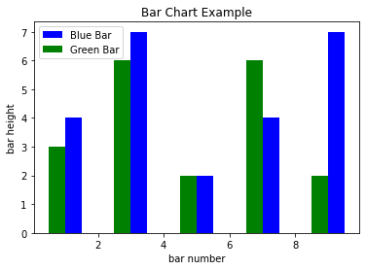
plt.bar(x1, y1, label="Blue Bar", color='b', align='edge', width=0.5)
plt.bar(x2, y2, label="Green Bar", color='g', align='edge', width=-0.5)

Slide 20
Data Visualization 資料視覺化實戰練習
直方圖

Slide 21
import matplotlib.pyplot as plt
import numpy as np
n = 5 + np.random.randn(1000)
m = [m for m in range(len(n))]
plt.bar(m, n)
plt.title("Raw Data")
plt.show()
plt.hist(n, bins=20)
plt.title("Histogram")
plt.show()
plt.hist(n, cumulative=True, bins=20)
plt.title("Cumulative Histogram")
plt.show()

Slide 22
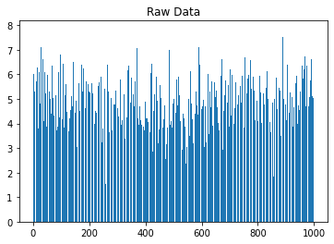
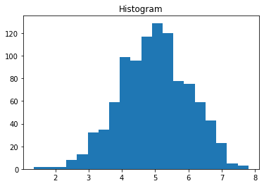

Slide 23
https://kknews.cc/zh-tw/code/3ngaz5a.html
arr: 需要計算直方圖的一維數組；
bins: 直方圖的柱數，可選項，默認為10；
density: : 是否將得到的直方圖向量歸一化。默認為0；
color：顏色序列，默認為None；
facecolor: 直方圖顏色；
edgecolor: 直方圖邊框顏色；
alpha: 透明度；
histtype: 直方圖類型，『bar』, 『barstacked』, 『step』, 『stepfilled』； 原文網址：https://kknews.cc/code/3ngaz5a.html

Slide 24
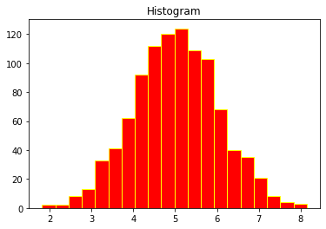
import matplotlib.pyplot as plt
import numpy as np
n = 5 + np.random.randn(1000)
plt.hist(n, bins=20, facecolor='red', edgecolor='yellow')
plt.title("Histogram")
plt.show()

Slide 25
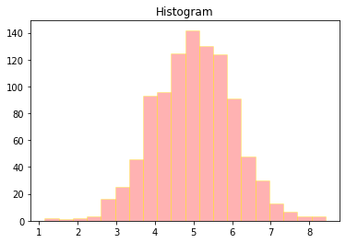
plt.hist(n, bins=20, facecolor='red', edgecolor='yellow', alpha=0.3)

Slide 26
Data Visualization 資料視覺化實戰練習
散佈圖

Slide 27
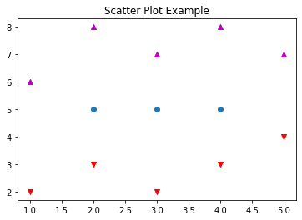
import matplotlib.pyplot as plt
x1 = [2, 3, 4]
y1 = [5, 5, 5]
x2 = [1, 2, 3, 4, 5]
y2 = [2, 3, 2, 3, 4]
y3 = [6, 8, 7, 8, 7]
plt.scatter(x1, y1)
plt.scatter(x2, y2, marker='v', color='r')
plt.scatter(x2, y3, marker='^', color='m')
plt.title('Scatter Plot Example')
plt.show()

Slide 28
Data Visualization 資料視覺化實戰練習
箱形圖

Slide 29
https://www.tutorialspoint.com/matplotlib/matplotlib_box_plot.htm

Slide 30
Data Visualization 資料視覺化實戰練習
堆疊圖

Slide 31
import matplotlib.pyplot as plt
idxes = [ 1, 2, 3, 4, 5, 6, 7, 8, 9]
arr1 = [23, 40, 28, 43, 8, 44, 43, 18, 17]
arr2 = [17, 30, 22, 14, 17, 17, 29, 22, 30]
arr3 = [15, 31, 18, 22, 18, 19, 13, 32, 39]
# Adding legend for stack plots is tricky.
plt.plot([], [], color='r', label = 'D 1')
plt.plot([], [], color='g', label = 'D 2')
plt.plot([], [], color='b', label = 'D 3')
plt.stackplot(idxes, arr1, arr2, arr3, colors= ['r', 'g', 'b'])
plt.title('Stack Plot Example')
plt.legend()
plt.show()

Slide 32
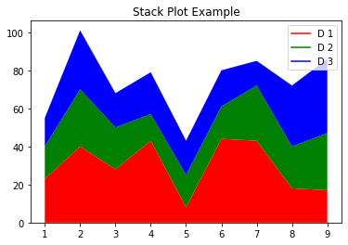

Slide 33
Data Visualization 資料視覺化實戰練習
圓餅圖

Slide 34
import matplotlib.pyplot as plt
labels = 'S1', 'S2', 'S3'
sections = [56, 66, 24]
colors = ['c', 'g', 'y']
plt.pie(sections, labels=labels, colors=colors,
startangle=90,
explode = (0, 0.1, 0),
autopct = '%1.2f%%')
plt.axis('equal') # Try commenting this out.
plt.title('Pie Chart Example')
plt.show()

Slide 35
import matplotlib.pyplot as plt
import numpy as np
ys = 200 + np.random.randn(100)
x = [x for x in range(len(ys))]
plt.plot(x, ys, '-')
plt.fill_between(x, ys, 195, where=(ys > 195), facecolor='g', alpha=0.6)
plt.title("Fills and Alpha Example")
plt.show()

Slide 36
import matplotlib.pyplot as plt
import numpy as np
def random_plots():
xs = []
ys = []
for i in range(20):
x = i
y = np.random.randint(10)
xs.append(x)
ys.append(y)
return xs, ys
fig = plt.figure()
ax1 = plt.subplot2grid((5, 2), (0, 0), rowspan=1, colspan=2)
ax2 = plt.subplot2grid((5, 2), (1, 0), rowspan=3, colspan=2)
ax3 = plt.subplot2grid((5, 2), (4, 0), rowspan=1, colspan=1)
ax4 = plt.subplot2grid((5, 2), (4, 1), rowspan=1, colspan=1)
x, y = random_plots()
ax1.plot(x, y)
x, y = random_plots()
ax2.plot(x, y)
x, y = random_plots()
ax3.plot(x, y)
x, y = random_plots()
ax4.plot(x, y)
plt.tight_layout()
plt.show()

Slide 37
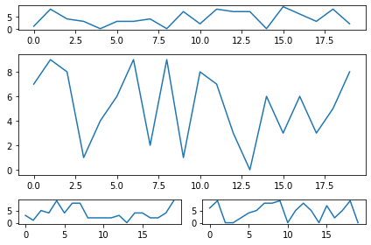

Slide 38
import matplotlib.pyplot as plt
import numpy as np
from mpl_toolkits.mplot3d import axes3d
fig = plt.figure()
ax = fig.add_subplot(111, projection = '3d')
x1 = [1, 2, 3, 4, 5, 6, 7, 8, 9, 10]
y1 = np.random.randint(10, size=10)
z1 = np.random.randint(10, size=10)
x2 = [-1, -2, -3, -4, -5, -6, -7, -8, -9, -10]
y2 = np.random.randint(-10, 0, size=10)
z2 = np.random.randint(10, size=10)
ax.scatter(x1, y1, z1, c='b', marker='o', label='blue')
ax.scatter(x2, y2, z2, c='g', marker='D', label='green')
ax.set_xlabel('x axis')
ax.set_ylabel('y axis')
ax.set_zlabel('z axis')
plt.title("3D Scatter Plot Example")
plt.legend()
plt.tight_layout()
plt.show()

Slide 39
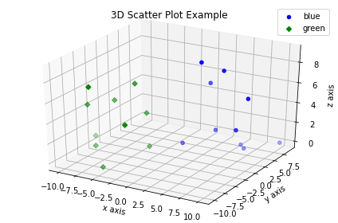

Slide 40
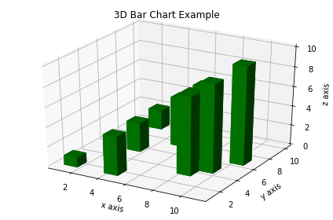
import matplotlib.pyplot as plt
import numpy as np
fig = plt.figure()
ax = fig.add_subplot(111, projection = '3d')
x = [1, 2, 3, 4, 5, 6, 7, 8, 9, 10]
y = np.random.randint(10, size=10)
z = np.zeros(10)
dx = np.ones(10)
dy = np.ones(10)
dz = [1, 2, 3, 4, 5, 6, 7, 8, 9, 10]
ax.bar3d(x, y, z, dx, dy, dz, color='g')
ax.set_xlabel('x axis')
ax.set_ylabel('y axis')
ax.set_zlabel('z axis')
plt.title("3D Bar Chart Example")
plt.tight_layout()
plt.show()

Slide 41
import matplotlib.pyplot as plt
fig = plt.figure()
ax = fig.add_subplot(111, projection = '3d')
x, y, z = axes3d.get_test_data()
ax.plot_wireframe(x, y, z, rstride = 2, cstride = 2)
plt.title("Wireframe Plot Example")
plt.tight_layout()
plt.show()

