Slide 1
Measurable Organizational Value and the Business Case
3-<number>

Slide 2
Objectives
Describe and develop a project’s MOV.
Understand the purpose of a business case.
Prepare a business case.
Distinguish between financial and scoring models.
Understand how projects are selected. _x0013_

Slide 3
Measurable Organizational Value (MOV) and Project Objectives
The MOV is a “Measure of Success”
The MOV must support the organization’s vision, mission, and strategy
Also, the MOV must:
  Be measurable
  Provide value
  Be agreed upon
  Be verifiable
Project Objectives – support the MOV and include:
  Scope (the project work to be completed
  Schedule (time)
  Budget (money)
  Quality (conformance or fitness for use)

Slide 4
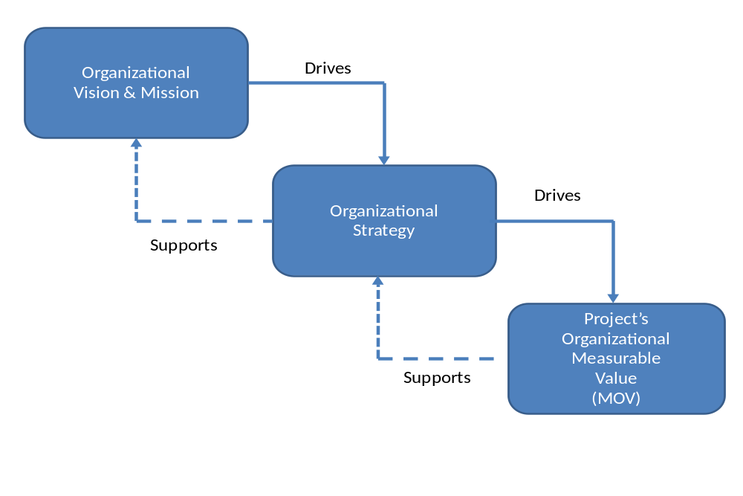
Figure 3.1 – Project Alignment

Slide 5
Project Objectives
Project Objectives – support the MOV and include:
  Scope (the project work to be completed
  Schedule (time)
  Budget (money)
  Quality (conformance or fitness for use)

Slide 6
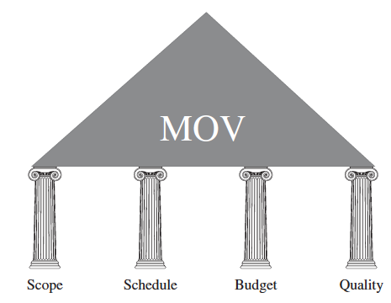
Figure 3.2 – The MOV and Project Objectives

Slide 7
An Example of a Good Goal
I believe that this nation should commit itself to achieving the goal before this decade is out, of landing a man on the moon and returning him safely to Earth.
John F. Kennedy
35th President of the United States
1961-1963

Slide 8
Developing the MOV
Identify the desired area of impact
Potential Areas:
Customer
Strategic
Financial
Operational
Social

Slide 9
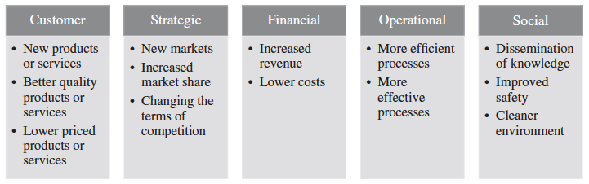
Figure 3-3 – Potential Areas of Project Impact and Examples

Slide 10
Developing the MOV
Identify the desired value of the IT project
Organizational Value:
Better?
Faster?
Cheaper?
Do More? (growth)

Slide 11
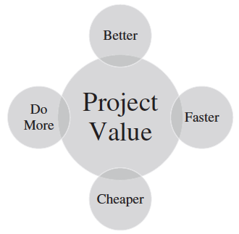
Figure 3-4 – Project Value

Slide 12
Developing the MOV
Develop an Appropriate Metric
  Provides the project team with a performance target or directive
  Sets expectations among all stakeholders
  Affords a means for evaluating whether the project is a success
  Metrics are expressed in …
      Money ($, £, ¥ – increase or decrease)
      Percentage (% – increase or decrease)
      Numeric Values (increase or decrease)

Slide 13
Developing the MOV
Set a time frame for achieving the MOV
    When will these results (the MOV) be achieved?
Verify the MOV and get agreement from the project stakeholders
  Project manager’s responsibility is to guide the process, while the project sponsor must identify and specify the metrics and the acceptable values for the metrics

Slide 14
Developing the MOV
Summarize the MOV in a clear, concise statement or table
This project will be successful if _________________.
MOV: Increase awareness for healthy living by having 250 new subscribers sign up for a weekly newsletter within 6 months.

Slide 15
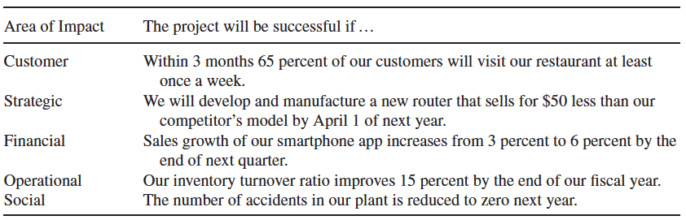
Table 3-1 – Examples of MOV Statements

Slide 16
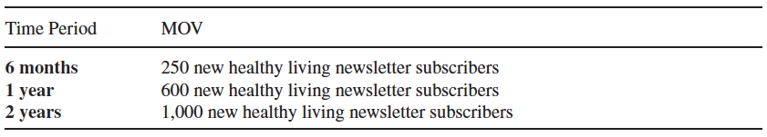
Table 3-2 – Examples of MOV Table Format

Slide 17
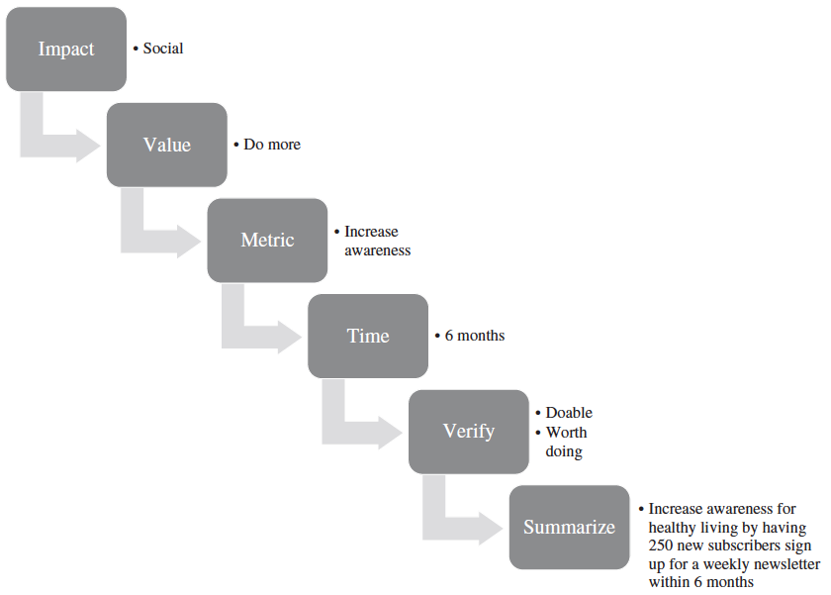
Figure 3-5 – Summary of the Process for Developing MOV to Increase Awareness for Healthy Living

Slide 18
The Business Case
Definition of Business Case: an analysis of the organizational value, feasibility, costs, benefits, and risks of several proposed alternatives or options.
Attributes of a Good Business Case
  Thorough in detailing all possible impacts, costs, and benefits
  Clear and logical in comparing the cost/benefit impact of each alternative
  Objective through including all pertinent information
  Systematic in terms of summarizing findings

Slide 19
Developing the Business Case
Step 1: Define Measurable Organizational Value (MOV)
Step 2: Form a Cross-Functional Business Case Team
Advantages:
    Credibility
    Alignment with organizational goals
    Access to the real costs
    Ownership
    Agreement
    Bridge building

Slide 20
Developing the Business Case
Step 3: Identify Alternatives
  Possible Options
    Change existing process without investing in IT
    Adopting or adapting an application developed by a different area or department within the organization
    Reengineer the existing system
    Purchasing an off-the-shelf application package from a software vendor
    Custom building a new application using internal resources or outsourcing the development to another company

Slide 21
Developing the Business Case
Step 4: Define Feasibility and Assess Risk
  Feasibility (“do able and worth doing?”)
    Economic feasibility
    Technical feasibility
    Organizational feasibility
    Other feasibilities
  Risk
    Identification – What can go wrong? What must go right?
    Assessment – What is the impact of each risk?
    Response – How can the organization avoid or minimize the risk?

Slide 22
Developing the Business Case
Step 5: Define Total Cost of Ownership
  Direct or Up-front costs
  Ongoing Costs
  Indirect Costs
Step 6: Define Total Benefits of Ownership
  Increasing high-value work
  Improving accuracy and efficiency
  Improving decision-making
  Improving customer service

Slide 23
Developing the Business Case
Step 7: Analyze alternatives
  Payback
Payback Period = Initial Investment
Net Cash Flow
= $100,000
$20,000
= 5 years

Slide 24
Developing the Business Case
  Breakeven
Materials (putter head, shaft, grip, etc.) | $12.00
Labor (0.5 hours at $9.00/hr) | $ 4.50
Overhead (rent, insurance, utilities, taxes, etc.) | $ 8.50
Total | $25.00
If you sell a golf putter for $30.00 and it costs $25.00 to make, you have a profit margin of $5.00:
Breakeven Point = Initial Investment / Net Profit Margin
= $100,000 / $5.00
= 20,000 units

Slide 25
Developing the Business Case
  Return on Investment
Project ROI = Total Expected Benefits – Total Expected Costs
Total Expected Costs
= ($115,000 - $100,000)
$100,000
= 15%

Slide 26
Developing the Business Case
  Net Present Value
 | Year 0 | Year 1 | Year 2 | Year 3 | Year 4
Total Cash Inflows | $0 | $150,000 | $200,000 | $250,000 | $300,000
Total Cash Outflows | $200,000 | $85,000 | $125,000 | $150,000 | $200,000
Net Cash Flow | ($200,000) | $65,000 | $75,000 | $100,000 | $100,000
NPV = -I₀ + Σ (Net Cash Flow / (1 + r)^{t})
Where:
I = Total Cost or Investment of the Project
r = discount rate
t = time period

Slide 27
Developing the Business Case
  Net Present Value
Time Period | Calculation | Discounted Cash Flow
Year 0 | ($200,000) | ($200,000)
Year 1 | $65,000/(1 + .08)¹ | $60,185
Year 2 | $75,000/(1 + .08)² | $64,300
Year 3 | $100,000/(1 + .08)³ | $79,383
Year 4 | $100,000/(1 + .08)⁴ | $73,503
Net Present Value (NPV) |  | $77,371

Slide 28
Developing the Business Case
  Scoring models
    provide a method for comparing alternatives or projects based on a weighted score.
    can combine both qualitative and quantitative criteria
    weights and scores can be subjective
  Things to keep in mind about financial and scoring models
    Financial models can be biased toward the short run
    Some criteria are reversed-scored
    Past experience may help create a more realistic business case.

Slide 29
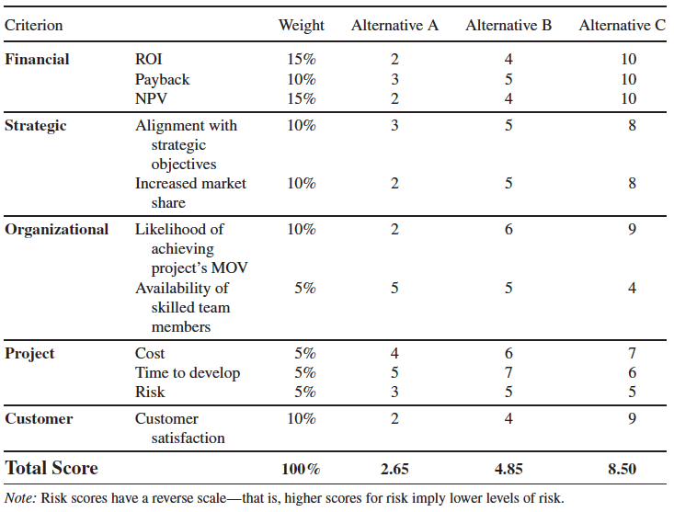
Table 3.3 – Comparison of Project Alternatives
3-<number>
Copyright 2015 John Wiley & Sons, Inc.

Slide 30
Developing the Business Case
Step 8: Propose and Support the Recommendation
  Once the alternatives are identified and analyzed, the last step is to recommend one of the options.

Slide 31
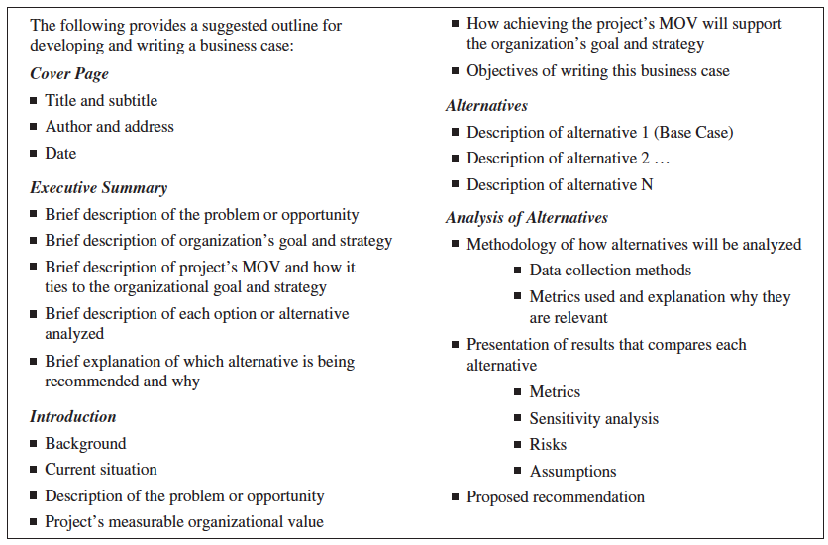
Figure 3.6 – Business Case Template

Slide 32
Project Selection and Approval
The IT Project Selection Process
The Project Selection Decision
  The project must align with the organization’s values, vision, mission, and strategies.
  The project must provide MOV that can be verified at the completion of the project.

