Slide 1
Project Planning: The Schedule and Budget
Dr. Ram Arthanari
6-<number>

Slide 2
Learning Objectives
Develop a GANTT chart.
Develop a project network diagram using a technique called activity on the node (AON).
Identify a project’s critical path and explain why it must be controlled and managed.
Develop a PERT diagram.
Describe the concept of precedence diagramming and identify finish-to-start, start-to-start, finish-to-finish, and start-to-finish activity relationships.
Describe the concept of critical chain project management (CCPM).
Describe the various types of costs that make up the project’s budget.
Define what is meant by the baseline project plan.
6-<number>

Slide 3
Schedule and Budget Development
The project’s schedule can be determined based upon the tasks and time estimates in the WBS
  The schedule will also depend on how these activities are sequenced
The project’s budget can be determined based upon the activities and time estimates from the WBS as well as the cost of the resources assigned to the WBS tasks
Iterations may still be necessary
The objective is to create a realistic project schedule and budget!
6-<number>

Slide 4
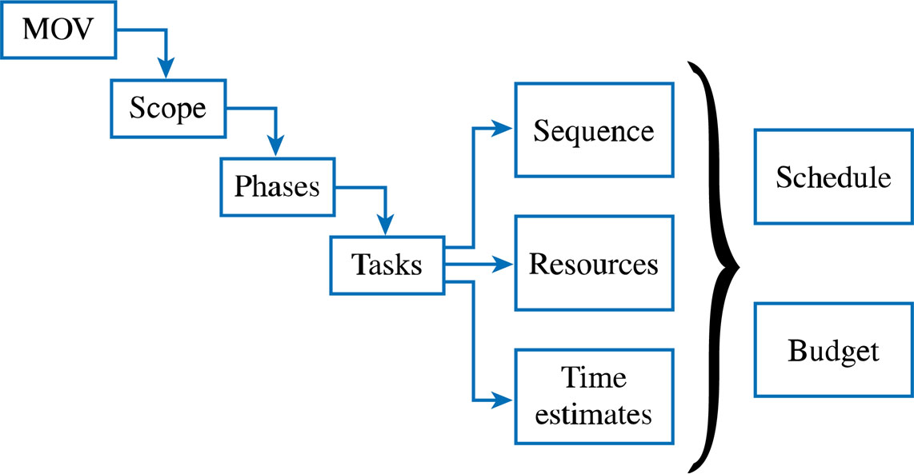
The Project Planning Framework
6-<number>

Slide 5
Developing the Project Schedule
Project Management Tools
  Gantt Charts
  Project Network Diagrams
    Activity on the Node (AON)
    Critical Path Analysis
    Program Evaluation and Review Technique (PERT)
    Precedence Diagramming Method (PDM)
6-<number>

Slide 6
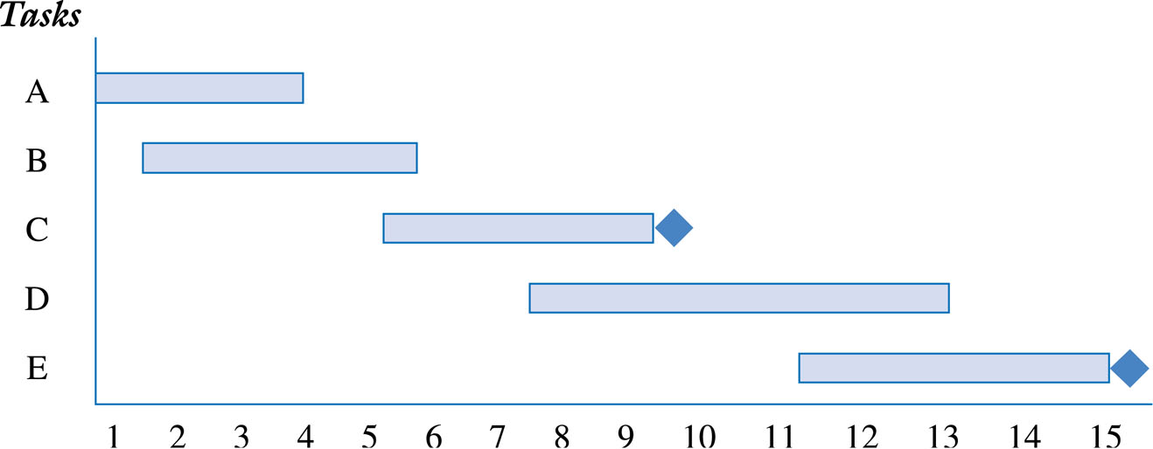
Gantt Chart for Planning
6-<number>

Slide 7
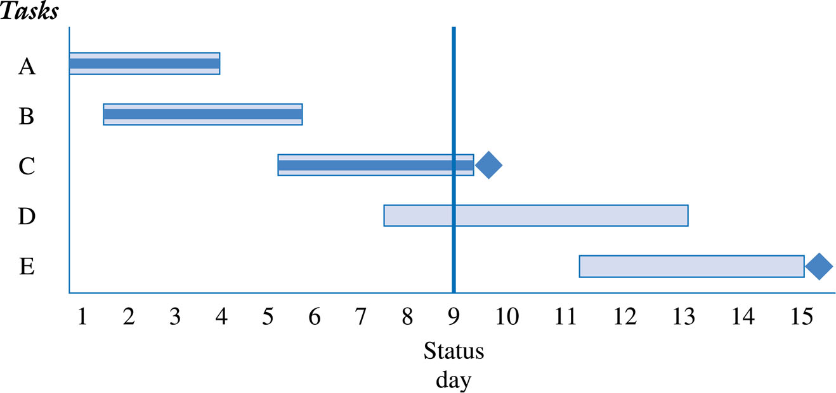
Gantt Chart Reporting
Project’s Progress
6-<number>

Slide 8
Activity Analysis for AON
Activity | Description | Estimated Duration (Days) | Predecessor
A | Evaluate current technology platform | 2 | None
B | Define user requirements | 5 | A
C | Design Web page layouts | 4 | B
D | Set-up Server | 3 | B
E | Estimate Web traffic | 1 | B
F | Test Web pages and links | 4 | C,D
G | Move web pages to production environment | 3 | D,E
H | Write announcement of intranet for corp. newsletter | 2 | F,G
I | Train users | 5 | G
J | Write report to management | 1 | H,I
6-<number>

Slide 9
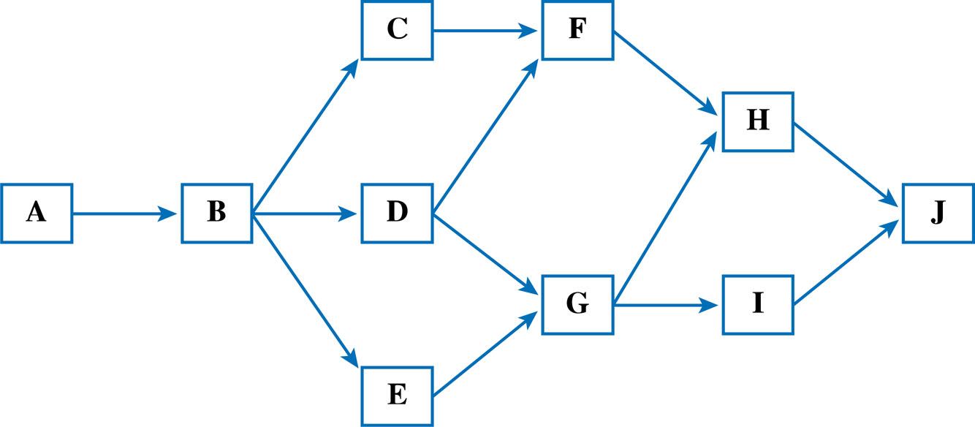
Activity on the Node (AON)
Network Diagram
6-<number>

Slide 10
Possible Activity Paths
Possible Paths | Path | Total
Path 1 | A+B+C+F+H+J | 18
 | 2+5+4+4+2+1
Path 2 | A+B+D+F+H+J | 17
 | 2+5+3+4+2+1
Path 3 | A+B+D+G+H+J | 16
 | 2+5+3+3+2+1
Path 4 | A+B+D+G+I+J | 19*
 | 2+5+3+3+5+1
Path 5 | A+B+E+G+I+J | 17
 | 2+5+1+3+5+1
* The Critical Path
6-<number>

Slide 11
Critical Path
Longest path
Shortest time project can be completed
  Zero slack (or float)
    The amount of time an activity can be delayed before it delays the project
Must be monitored and managed!
  Project manager can expedite or crash by adding resources
  Fast tracking – running activities in parallel which were originally planned as sequential
  The CP can change
  Can have multiple CPs
6-<number>

Slide 12
PERT
Program Evaluation and Review Technique
Developed in 1950s to help manage the Polaris Submarine Project
Developed about the same time as the Critical Path Method
  Often combined as PERT/CPM
Employs both a project network diagram with a statistical distribution
6-<number>

Slide 13
Activity Analysis for PERT
Activity | Predecessor | Optimistic Estimates (Days) | Most Likely Estimates (Days) | Pessimistic Estimates (Days) | Expected Duration (a+4b+c) 6
A | None | 1 | 2 | 4 | 2.2
B | A | 3 | 5 | 8 | 5.2
C | B | 2 | 4 | 5 | 3.8
D | B | 2 | 3 | 6 | 3.3
E | B | 1 | 1 | 1 | 1.0
F | C,D | 2 | 4 | 6 | 4.0
G | D,E | 2 | 3 | 4 | 3.0
H | F,G | 1 | 2 | 5 | 2.3
I | G | 4 | 5 | 9 | 5.5
J | H,I | .5 | 1 | 3 | 1.3
6-<number>

Slide 14
Possible PERT Activity Paths
Possible Paths | Path | Total
Path 1 | A+B+C+F+H+J | 18.8
 | 2.2+5.2+3.8+4.0+2.3+1.3
Path 2 | A+B+D+F+H+J | 18.3
 | 2.2+5.2+3.3+4.0+2.3+1.3
Path 3 | A+B+D+G+H+J | 18.6
 | 2.2+5.2+3.3+3.0+2.3+1.3
Path 4 | A+B+D+G+I+J | 20.5*
 | 2.2+5.2+3.3+3.0+5.5+1.3
Path 5 | A+B+E+G+I+J | 18.2
 | 2.2+5.2+1.0+3.0+5.5+1.3
* The Critical Path
6-<number>

Slide 15
Precedence Diagramming Method - PDM
Based on 4 fundamental relationships
  Finish-To-Start (FS)
  Start-To-Start (SS)
  Finish-To-Finish (FF)
  Start-To-Finish (SF)
6-<number>

Slide 16
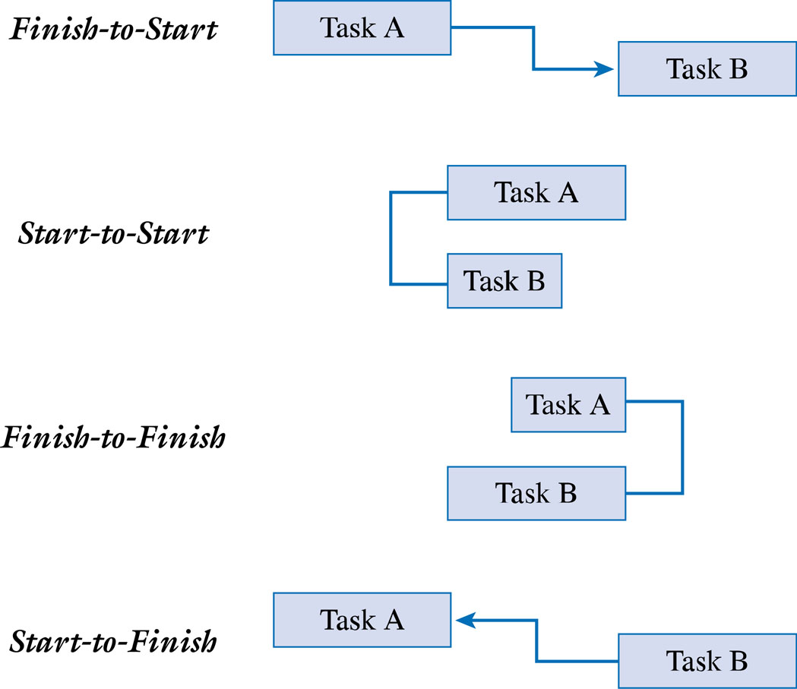
PDM Relationships
6-<number>

Slide 17
Lead and Lag times
Lead is starting the next task before the first task is complete
    Example: Begin installing the operating systems when half of the PCs are set up
Lag (or negative lead) is the adding of a buffer of time before the next task begins
    Example: Once the walls have been painted, wait one day before laying the carpet so that the walls have had a chance to dry
6-<number>

Slide 18
Critical Chain Project Management (CCPM)
Introduced in 1997 in a book called Critical Chain by Eliyahu Goldratt
Based on his previous work called the Theory of Constraints
CCPM is based on the idea that people often inflate or add cushioning to their estimates to create a form of “safety” to compensate for uncertainty or risk because …
  Your work is dependent upon the work of someone else, and you believe that starting your work will be delayed
  Your pessimism from previous experience where things did not go as planned
  Your belief that the project sponsor or customer will cut your project schedule or budget so you inflate your estimates to guard against this cut
6-<number>

Slide 19
If people build safety into their estimates, then …
Why are projects still late?
  Student’s Syndrome or procrastinating until the last minute before starting to work on a task
  Parkinson’s Law or the idea that work expands to fill the time available
    People will rarely report finishing something early because there is little incentive to do so or because they may fear that management will cut their estimates next time
  Multitasking of resources or “resource contention”
    A person is often assigned to more than one project or required to attend meetings, training, etc. As a result, they can no longer devote their time to tasks that are on the critical path
6-<number>

Slide 20
CCPM Assumptions
Begins by asking each person or team working on a task to provide an estimate that would have a 50% chance of being completed as planned
  About half of the project tasks will be completed on time, about half won’t
Instead of adding safety to each task, put that safety in the form of buffers where it is needed most
  Feeding buffers
    Reduce the likelihood of bottlenecks by ensuring that critical tasks will start on time when a task acts as a feeder to another task on the critical path
  Resource buffers
    Reduce resource contention
  End of Project buffers
    Are equal to one-half of the time saved from putting safety into each task
6-<number>

Slide 21
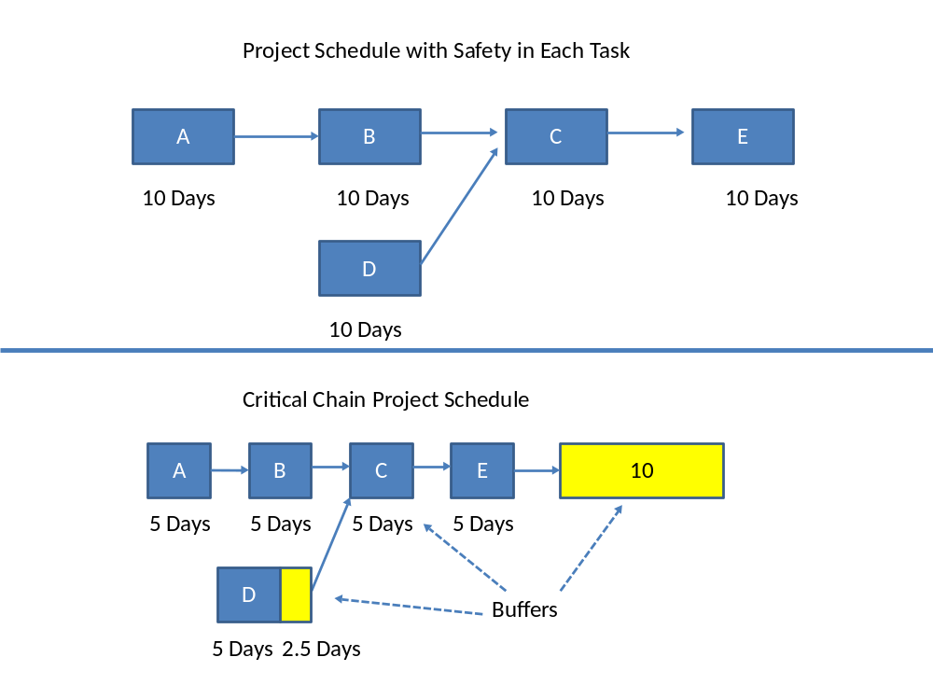
The Critical Chain Project Schedule
6-<number>

Slide 22
Critical Chain Project Management
And the critical path are similar
  The difference is the CCPM takes into account resource contention
Takes a more project portfolio view
  Other projects should be scheduled so that a resource can be dedicated to a particular task
Requires that everyone understand that each project task has a 50% chance of being completed as scheduled, so about half of the tasks will be late.
  This is the reason for having the project buffer.
  Instead of tracking each task individually, we become more concerned with the project buffer –i.e., the project will be late only if it uses more than the allotted project buffer.
Instead of penalties for being late, bonuses or other incentives for completing tasks early may be needed
6-<number>

Slide 23
Project Management Software Tools
A number of project management software tools are available to plan and track the progress of your project
However, having a fundamental understanding of these project management techniques is important to make the most of these software tools
6-<number>

Slide 24
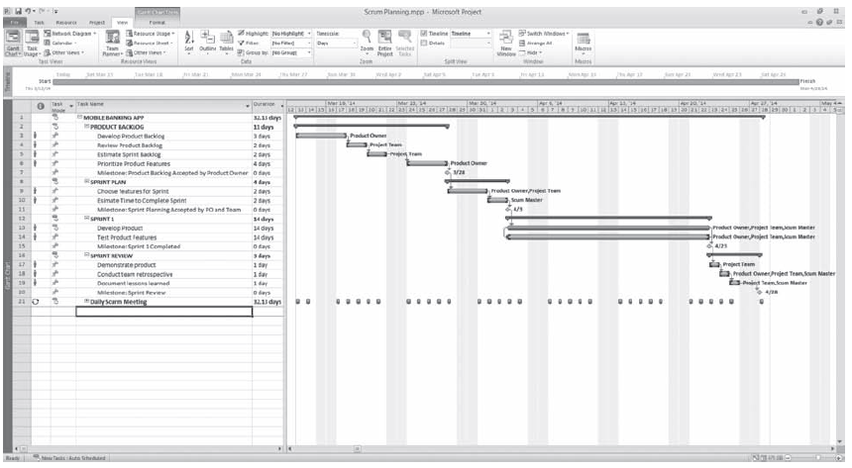
GANTT Chart in Microsoft Project ®
6-<number>

Slide 25
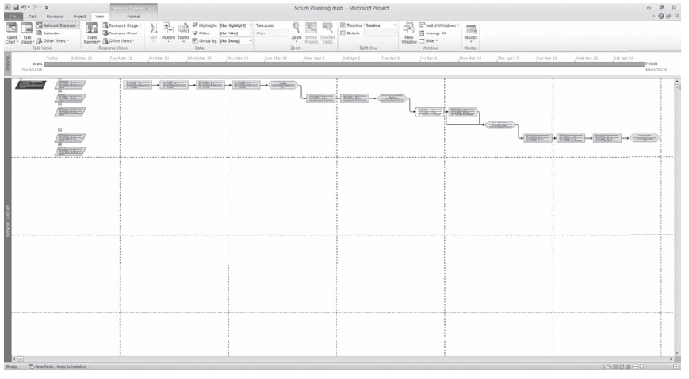
Network Diagram and Critical Path in Microsoft Project ®
6-<number>

Slide 26
Developing the Project Budget
Define what resources will be needed to perform the work
Determine the quantity of resources that are needed
Define the cost of using each resource
Calculate the cost of the task or activity
Ensure that the resources are leveled, that is, not over allocated. An example of over allocation is assigning a project team member to two tasks scheduled at the same time.
6-<number>

Slide 27
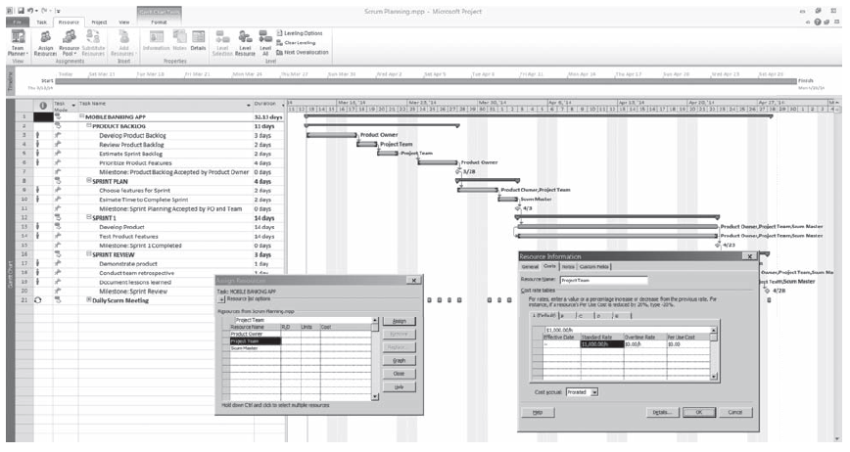
Project Resources Assigned to Project Tasks in Microsoft Project ®
6-<number>

Slide 28
Other Costs
Direct Costs
  The direct cost of labor or other resources
Indirect Costs
  The cost for covering such things as rent, utilities, insurance, etc.
Sunk Costs
  Costs incurred prior to the project, such as a project that has been restarted after a failed attempt
Learning Curve
  Often have to “Build one and throw it away” to understand a problem or a new technology
Prorated Costs
  The idea that there is a cost associated with using a resource
Reserves
  Contingency funds to be used at the discretion of the project manager
6-<number>

Slide 29
Finalizing the Project Schedule and Budget
The project schedule and budget may require several iterations before it is acceptable to the sponsor, the project manager, and the project team.
Resource Allocation – PM reviews project to make sure resources are properly allocated – leveled – not over allocated
Once the project schedule and project plan are accepted, the project plan becomes the baseline plan.
Once accepted, the project manager and project team have the authority to execute or carry out the plan and can have a Kickoff Meeting.
6-<number>

