Slide 1
CT210 Open Server I
Week 4
Managing Software Packages
Navigating and Essential Commands

Slide 2
CT210 Open Server I
Managing Software Packages

Slide 3
Installing Software - Definitions
Software package
  a collection of scripts program files and directories required to install and run an application or utility
  Dependencies - the list of other software package that a package depends on. In other words, scripts and program files that the software package uses that are part of another package.
PMS – Package Management System
  A set of utilities that allows you to install, upgrade, remove, and search software packages easily and in a consistent manner

Slide 4
Installing Software - Definitions
PMS cont’
  Uses a local database to
    Keeps track of all the files that belong to packages
    Keeps track of package dependencies
    Keeps version information for packages
Repositories
  Apt-get downloads package headers and packages from servers called repositories that can reside on the Internet, a DVD, or a local network.

Slide 5
Installing Software - Utilities
A software package utility provides a command line interface to:
  Install software packages
  Remove software packages
  Update or upgrade software packages
  Install/remove dependent packages
  Obtain source code

Slide 6
Managing Software Packages
Understanding Linux Package Management
  Debian packages
  Snap Packages
Managing Debian packages with apt
  apt or Advance Packaging Tool
  Powerful command line tool
  Can be used in automated scripts
Example for installing openssh
  sudo apt install openssh-server
Can install multiple packages at a time
  sudo apt install <package1> <package2> <package3>

Slide 7
Managing Debian packages with apt
Package managers
  dpkg – Debian package management system
    Works with “deb” files; names end with .deb
  APT – Advanced Package Tool
    Downloads packages and then uses dpkg to install them
  The command used is apt (previously apt-get)

Slide 8
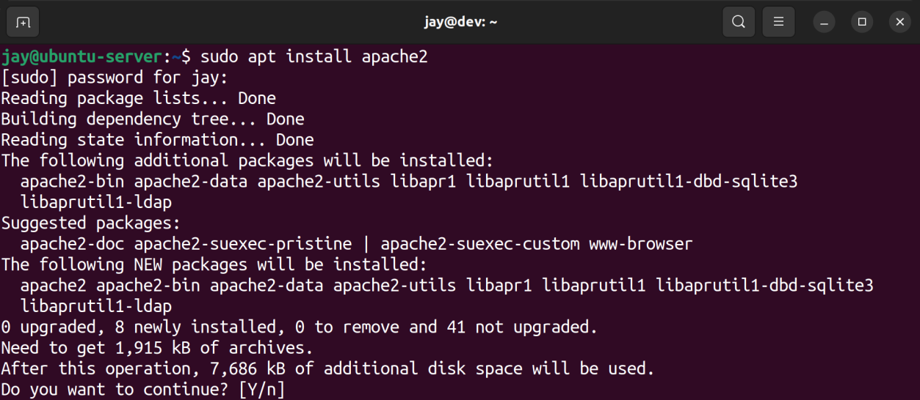
Software Packages - Example
Installing apache web server software

Slide 9
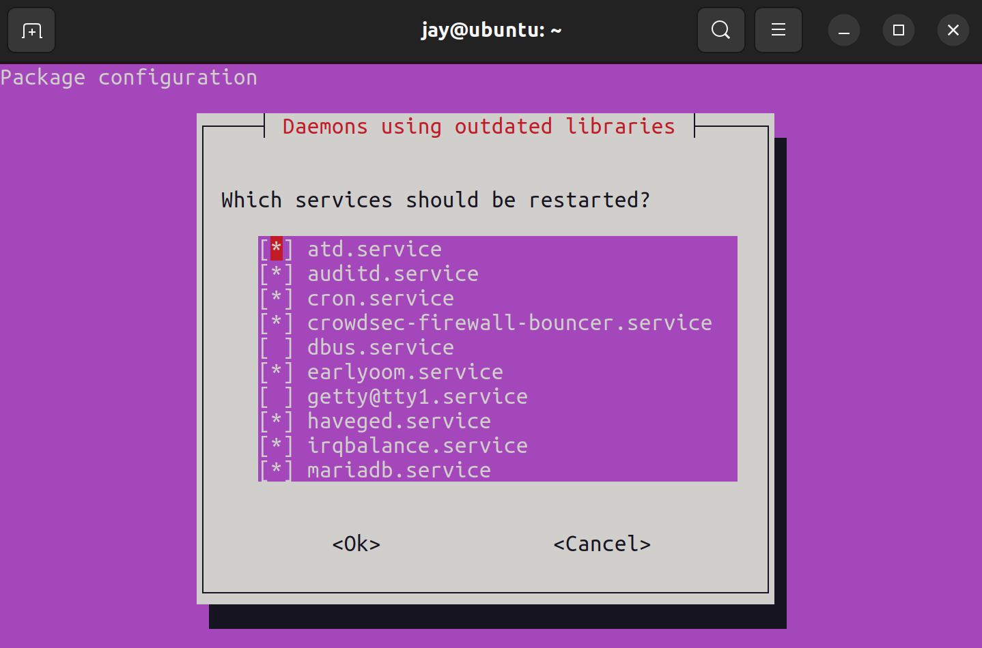
Software Packages

Slide 10
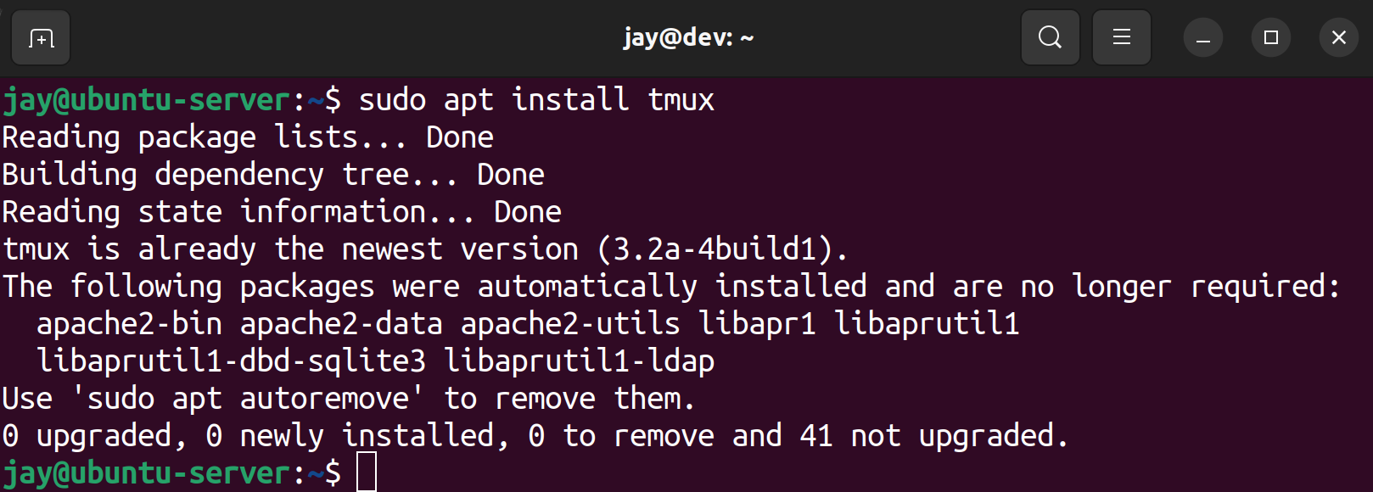
Software Packages
Examining the messages when using apt is a good practice
  To ensure the software was installed correctly
  To understand software dependencies
    Needed or
    No longer required

Slide 11
Software Packages – Debian, Red Hat, Snap
Ubuntu uses Debian packages
  Names that end in .deb
  Use apt and dpkg
CentOS and Red Hat use RPM packages
  Names that end in .dnf command
  Use yum
Snap packages
  Proposed Universal package system for all distributions
  More than one Universal package system
    Flatpaks, AppImages
    Both only provide a GUI interface suited for Desktop images

Slide 12
Managing Packages with apt
Installing software example
sudo apt install openssh-server
Some software packaged depend on having other software installed and apt keeps track of this so it will ask and install any dependencies. To update the list of available packages to your local system type:
sudo apt update
To remove software type:
sudo apt remove openssh-server
Remove does not delete any configuration directories or files for the software package, just the software executables. To remove the configs type:
sudo apt remove –purge openssh-server
Why is the default not to remove configs?

Slide 13
Managing Packages with Snap
Finding and Installing software example
sudo snap find nmap
sudo snap install nmap
To get updates to a package type:
sudo snap refresh nmap
To remove software type:
sudo snap remove nmap

Slide 14
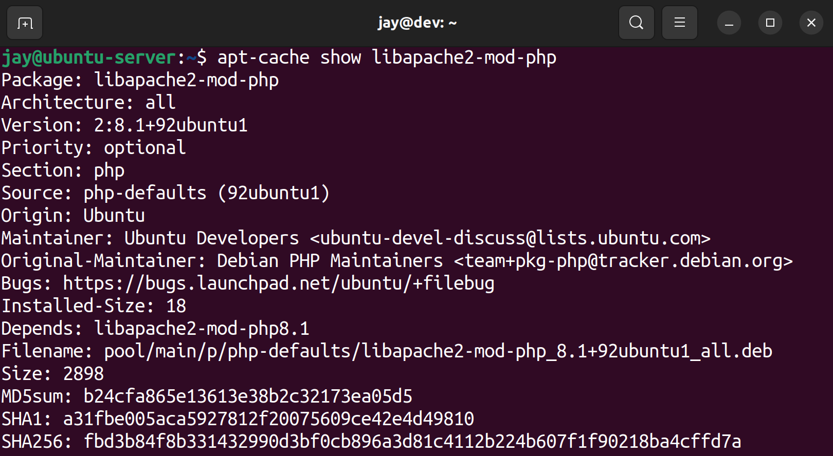
More about apt
Searching for packages using apt
sudo apt search <search term>
To find out more about a package, use apt-cache

Slide 15
More about apt
Software repositories are essentially URLs in a text file. Stored here:
/etc/apt/sources.list
/etc/apt/sources/sources.list.d/
Here is a typical repository line:
  Jammy is what Ubuntu version 22.04 is called
deb http://us.archive.ubuntu.com/ubuntu/ jammy main restricted

Slide 16
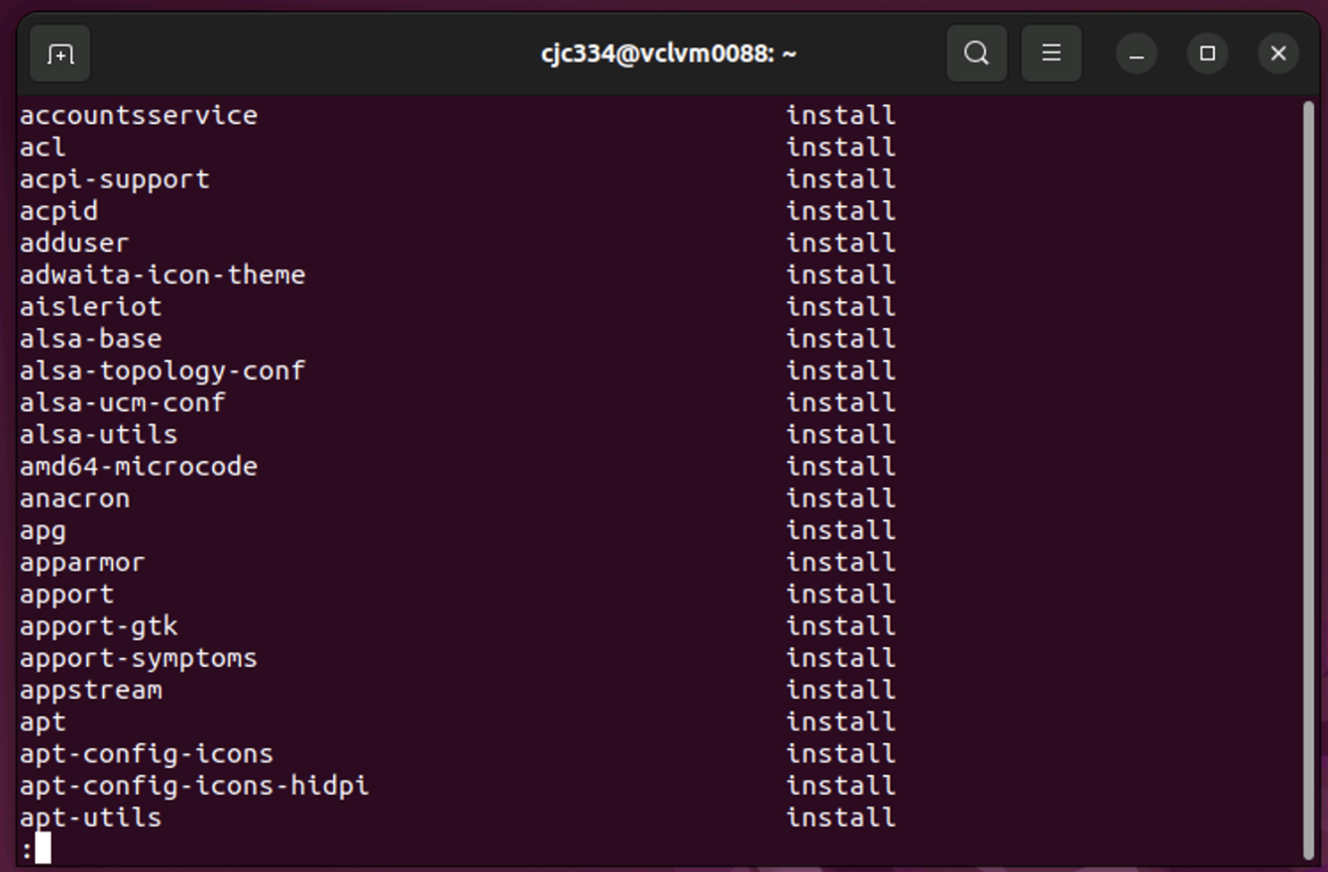
Inventory of Packages on a server
To export a list of installed packages
dpkg --get-slections > list_of_packages.txt

Slide 17
Importance of Inventory
Security
  Many things are required to Secure a server
  First a foremost is to keep the amount of installed software to a minimum, just what is needed for the server to perform its function
  Checking to see what is installed can lead to remove software from a server.
Duplicating a server from bare metal
  Obtain an inventory of software from the old server
  Install the os (possibly the next release of the os)
  Install the list of software packages from the old server onto the new duplicated server.

Slide 18
Importance of Inventory
Server farms
  Large Businesses and Organizations have thousands of servers serving applications
    One company acquires another server engineers wind up supporting the servers from the acquired company
    Staff may leave from the acquired company
    Unknowns about the “inherited” servers
    Check the inventory of installed software packages
    Check for processes and services running
    Schedule a reboot of the servers to ensure startup configurations all functioning

Slide 19
Importing selections onto a new server
From previous slide the list of packages are in a text file named list_of_packages.txt
Update the repositories
sudo apt update
Ensure the dselect package is installed
which dselect !if the output does not show dselect !in the /usr/bin
sudo apt install dselect
Import the saved package list
sudo dselect update
sudo dpkg –set-selections < list_of_packages.list
sudo apt-get dselect-upgrade ! Note apt-get not apt

Slide 20
Cleaning up orphaned apt packages
When a package is removed the dependencies are not removed automatically
Can lead to unused installed package
The apt command will identify no longer required packages; see below

Slide 21
CT210 Open Server I
Navigating and Essential Commands

Slide 22
Navigating and Essential Commands
Tenents from the Unix Philosophy
Learning essential Linux commands
Understanding the Linux filesystem layout
Viewing the contents of files
Viewing log files

Slide 23
Unix Philosophy
Eric Raymond in his book The Art of Unix Programming, The Art of Unix Programming summarizes the Unix philosophy as the widely-used KISS Principle of "Keep it Simple, Stupid.”
He also provides a series of design rules.
Let’s examine a few of these rules that apply to the command line.

Slide 24
Unix Philosophy
Rule of Modularity
  Write simple parts connected by clean interfaces
  This is why Unix is a zillion little specialized programs
Rule of Composition
  Design programs to be connected to other programs
  This will help understand ‘pipes’
Rule of Representation
  Fold knowledge and complexity into data, so program logic can be stupid and robust

Slide 25
The Unix Philosophy
Rule of Simplicity
  Design for simplicity; add complexity only when needed
Rule of Separation
  Separate policy from mechanism; separate interfaces from engines
    Policy (front end) changes often, so keep a sound mechanism (back end) to implement those changes
  This supports tiered application architectures, like client/server or n-tier client/server

Slide 26
The Unix Philosophy
Rule of Least Surprise*
  In interface design, always do the least surprising thing; so know your audience
Rule of Silence
  When a program has nothing surprising to say, it should say nothing
Rule of Repair
  When you must fail, do so as noisily and as soon as possible

Slide 27
The Unix approach
UNIX developers apparently couldn’t type to save themselves – administrative assistants did most of the typing
  Hence use abbreviations even for four letter commands (ls, mv, cp)
  Commands are very terse as a result
Unix is case and space sensitive
  Spaces and punctuation always matter!!
  Even directory listings are case sensitive

Slide 28
Other implications
Unix tradition encourages programs that read and write simple text streams in device-independent format
  Many programs are text filters
    Take one text stream as input, and produce another text stream as output
    Text streams are like messages in networking
  This makes it easier to connect programs

Slide 29
Other implications
Keep programs independent of each other
  Each program should be a black box with a clearly defined purpose
When a GUI is needed, separate interactive parts from computational parts
  Again emphasizing modularity and tiered architecture

Slide 30

In a nutshell
The best app is made from small, simple, beautiful cooperating pieces
  Silence is golden
  Be liberal in what you accept, and conservative in what you send (Jon Postel)
The antithesis of this is bloated, buggy, useless-feature-rich code that doesn’t work because the pieces are too complex and heavily interconnected

Slide 31
Special Characters
Quoting special character
  If you need to use a special character as a regular character, you need to escape it, as in escape it’s special meaning and consider it as a literal character.
  RETURN, SPACE, and TAB
  To quote a special character literally, precede the special character with a backslash \
Examples
  Use \* to represent a literal *
  Use \[ to represent s literal [
  Use \*\* to represent **

Slide 32
Navigating directories
The working directory
  This is the directory where a user resides in the shell
  To display your working directory use:
  $ pwd
  pwd stands for print working directory
  Each user is provided a home directory in the /home partition. IE: /home/userid
  To change directories to your home directory use the ~ character
  $ cd ~

Slide 33
Files in Unix
Everything in Unix is a file in a directory
  Files & directories don’t need extensions
  The highest level directory is the root directory, /
  Even peripherals (CD-ROM, flash drives, etc.) are treated as directories
Based on a text command interface
  Fits with the text stream concept
  GUI just does the text commands for you

Slide 34
Command syntax
General command syntax
  command -options target
  The –options qualifiers and target are arguments specified by the command. For some command these items are optional.
  Every letter in a qualifier is a separate, case sensitive option or modifier for that command
  ls –l mytextfile
    ls represents the command
    -l represents an option
    mytextfile represents the target

Slide 36
Some more basic commands
To copy a file, use cp (cp = copy)
  cp myfile newfile
To rename a file, use mv (mv = move)
  If it stays in the same directory, it can still change name
To move a file, use mv
  mv myfile /home/student/myfile
To delete a file, use rm (rm = remove)
rm –i logfile
  where the –i option asks for confirmation before
  rm –r /home/dscully
  where the –r option removes everything recursively (includes directories) rm by itself does not remove directories

Slide 37
Executing multiple commands
If you want to execute two or more commands consecutively, then you can use a semicolon between them
  command1 ; command2
  Spaces around the semicolon are optional
Like this
  ps -ef;ls

Slide 38
File Systems and Directory trees
Data structures – specified formats for storing, organizing, working with and retrieving data.
Filesystem - a set of data structures that resides on part of a disk that organizes the storage of data such as files and directories.
Hierarchical structure – a structure that takes the form of a tree.
Directory tree – a structure that allows files to be organized so they can be found easier.
Directory trees are normally depicted upside down.

Slide 40
Filenames
The maximum length of a file name depends upon the file system being used by the os.
Most filesystems allow file names up to 255 characters long
  Why 255? How does this relate to bits?
To avoid confusion in file names use
  Alphanumeric symbols
  Underscore, dashes
  Period as a separator to designate the file extension

Slide 41
Linux Filenames
Case sensitive – January, january and JANUARY represent 3 different, distinct files
Spaces or versions in parentheses (n) must use quotes around the filename:
  “homework file”
  “homeworkfile(2)”
Better names for the files above:
  homework_file
  homeworkfile-v2

Slide 42
Directory and Hidden files
Directories are listed similar to files in the shell
Directory files are executable
  This allows users to traverse the directories
  Picture double clicking, (executing the directory file), on a directory to make it your current directory
Hidden files
  A file name that begins with a period
  ls only displays hidden files with the –a option
  Account startup files are hidden; these files are executed each time a user logs in and normally set up or customize a users environment

Slide 43
Pathnames
Pathname – a series of names that trace a path along the branches of a directory tree
Working directory – the directory that a user currently resides
  . represents the working directory
  .. represents the parent of the working directory
  ~ represents the pathname of a user’s home directory
A relative pathname is a path to a file or directory “relative” to the current working directory
  ./subfolder/file1
A absolute pathname is a path to a file or directory from the root directory
  /home/username/file1

Slide 48
Linux standard directories
/ - the root directory is the top directory in the hierarchy
/boot – files for booting the system
/bin – essential command binaries
/dev – device files
/etc – machine local system configuration files
/home – user home directories
/opt – add on (optional) software packages
/root – home directory for the root account
/sbin – essential system binaries
/tmp – temporary files directory
/usr – installed system files
/var – variable data files such as log files

Slide 49
Viewing log files
Use cat to type out a text file
cat testfile.txt ! Types testfile.txt to the screen
cat /var/log/syslog | less ! One screen at a time
Use grep for searching the file for a pattern of text
grep Network /var/log/syslog
Use tail to view the last n lines of a file
  Ideal for log files because the latest log entries are appended to the end of a log file
  Default is 10 lines without using the –n option
tail –n 20 /var/log/syslog ! Displays last 20 lines
The –f option the terminal will display new lines to a log file as they are appended. Used to monitor a log file in real time. Ctrl + c will break out and return to the command prompt

Slide 50
Review of file and directory related commands
pwd – print working directory
cd – change directory
mkdir - make/create a new directory
rmdir – remove/delete a directory
ls – list directories and files
mv – move/rename a file

Slide 51
References
Mastering Ubuntu Server, Fourth Edition by Jay LaCroix, Packt Publishing, 2022
Index of Ubuntu reference documentation
https://ubuntu.com
A Practical Guide to Ubuntu Linux®, Fourth Edition by Mark G. Sobell, Prentice Hall, 2015

