Slide 1
INFO 420
Week 3
Dr. Ram Arthanari

Slide 2

When things went wrong. Course correct…

Slide 3
Case 1: Missed Deadlines and Over Budget
Scenario: The project is significantly behind schedule and has exceeded the budget. The team is demoralized, and stakeholders are losing confidence.
Question: What should the new project manager do to course correct?
Assess the Situation: Conduct a thorough review of the project plan, budget, and current progress. Identify the root causes of delays and budget overruns.
Re-establish Priorities: Work with stakeholders to re-prioritize tasks and features. Focus on delivering the most critical components first.
Revise the Plan: Create a realistic and achievable project plan with clear milestones and deadlines. Ensure the team is aligned with the new plan.
Improve Communication: Establish regular communication channels with the team and stakeholders to provide updates and address concerns promptly.
Boost Morale: Recognize the team’s efforts and provide support to boost morale. Consider team-building activities or incentives to re-energize the team.

Slide 4
Case 2: Poor Quality Deliverables
Scenario: The project deliverables are of poor quality, with numerous bugs and issues reported by users. The team is struggling to maintain quality standards.
Question: What should the new project manager do to course correct?
Conduct a Quality Audit: Review the current quality assurance processes and identify gaps. Analyze the root causes of quality issues.
Implement Quality Standards: Establish clear quality standards and guidelines for the team to follow. Ensure everyone understands the importance of quality.
Enhance Testing: Increase the focus on testing by implementing automated testing tools and conducting thorough manual testing. Allocate sufficient time for testing in the project schedule.
Provide Training: Offer training sessions to the team on best practices for coding, testing, and quality assurance.
Monitor Progress: Regularly monitor the quality of deliverables and provide feedback to the team. Make adjustments as needed to maintain high standards.

Slide 5
Case 3: Scope Creep
Scenario: The project has experienced significant scope creep, with new features and requirements being added continuously. This has led to delays and resource constraints.
Question: What should the new project manager do to course correct?
Define Scope Clearly: Revisit the project scope and ensure it is clearly defined and agreed upon by all stakeholders. Document any changes formally.
Implement Change Control: Establish a change control process to evaluate and approve any new requirements or changes to the project scope.
Prioritize Features: Work with stakeholders to prioritize features and requirements. Focus on delivering the most critical features first.
Communicate Boundaries: Clearly communicate the impact of scope changes on the project timeline and budget to stakeholders. Set realistic expectations.
Monitor Scope: Regularly review the project scope and ensure any changes are managed effectively. Keep the team informed about scope boundaries.

Slide 6
Case 4: Team Conflicts and Low Morale
Scenario: There are conflicts within the team, leading to low morale and decreased productivity. Team members are not collaborating effectively.
Question: What should the new project manager do to course correct?
Identify Issues: Meet with team members individually to understand the root causes of conflicts and low morale. Listen to their concerns and feedback.
Foster Collaboration: Encourage open communication and collaboration within the team. Organize team-building activities to strengthen relationships.
Set Clear Roles: Define clear roles and responsibilities for each team member to avoid confusion and overlap. Ensure everyone understands their contributions.
Provide Support: Offer support and resources to help team members overcome challenges. Address any personal or professional issues that may be affecting their performance.
Recognize Efforts: Acknowledge and appreciate the hard work and contributions of team members. Celebrate successes and milestones to boost morale.

Slide 7
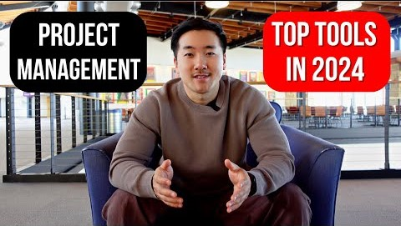

Slide 8
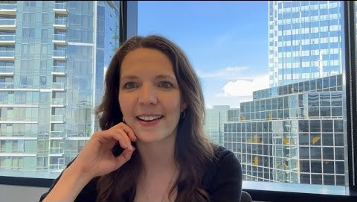

Slide 9


Slide 10
Project Governance
Structure
Authorization
Oversight/Accountability
Decision Making
Resources

Slide 11
The Project Charter
Identification & Stakeholders
Description & Scope
MOV/Budget
Milestones
Assumptions, Risks, Issues
Approval!

Slide 12
Introduction (continued)
Project’s have…
An Infrastructure
A Governance structure
Required Resources (must be obtained)
A Project Charter

Slide 13
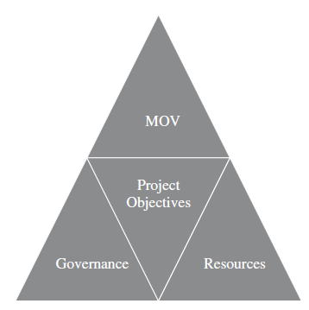
Figure 4.1 – The Project Infrastructure

Slide 14
Project Governance
Should flow from organizational governance
Provides a framework to ensure that a project aligns with a chosen business strategy while ensuring that the time, money, and resources provide real value to the organization.
Projects governance must define:
Structure
Authorization
Oversight and Accountability
Decision Making
Resources

Slide 15
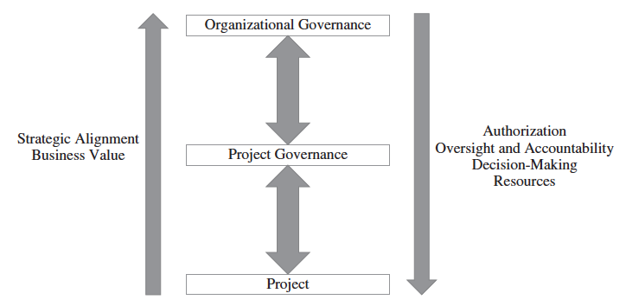
Figure 4.2 Project Governance

Slide 16
The Project Team
The Roles of the Project Manager
Managerial role
Leadership role
Attributes of a successful project manager
ability to communicate with people
ability to deal with people
ability to create and sustain relationships
ability to organize
The Project Team
Technology Skills
Business/organization knowledge
Interpersonal skills

Slide 17
The Formal Organization
Formal groupings & specializations
Published Lines of
Authority
Responsibilities
Reporting Relationships
Communication
Decision-Making

Slide 18
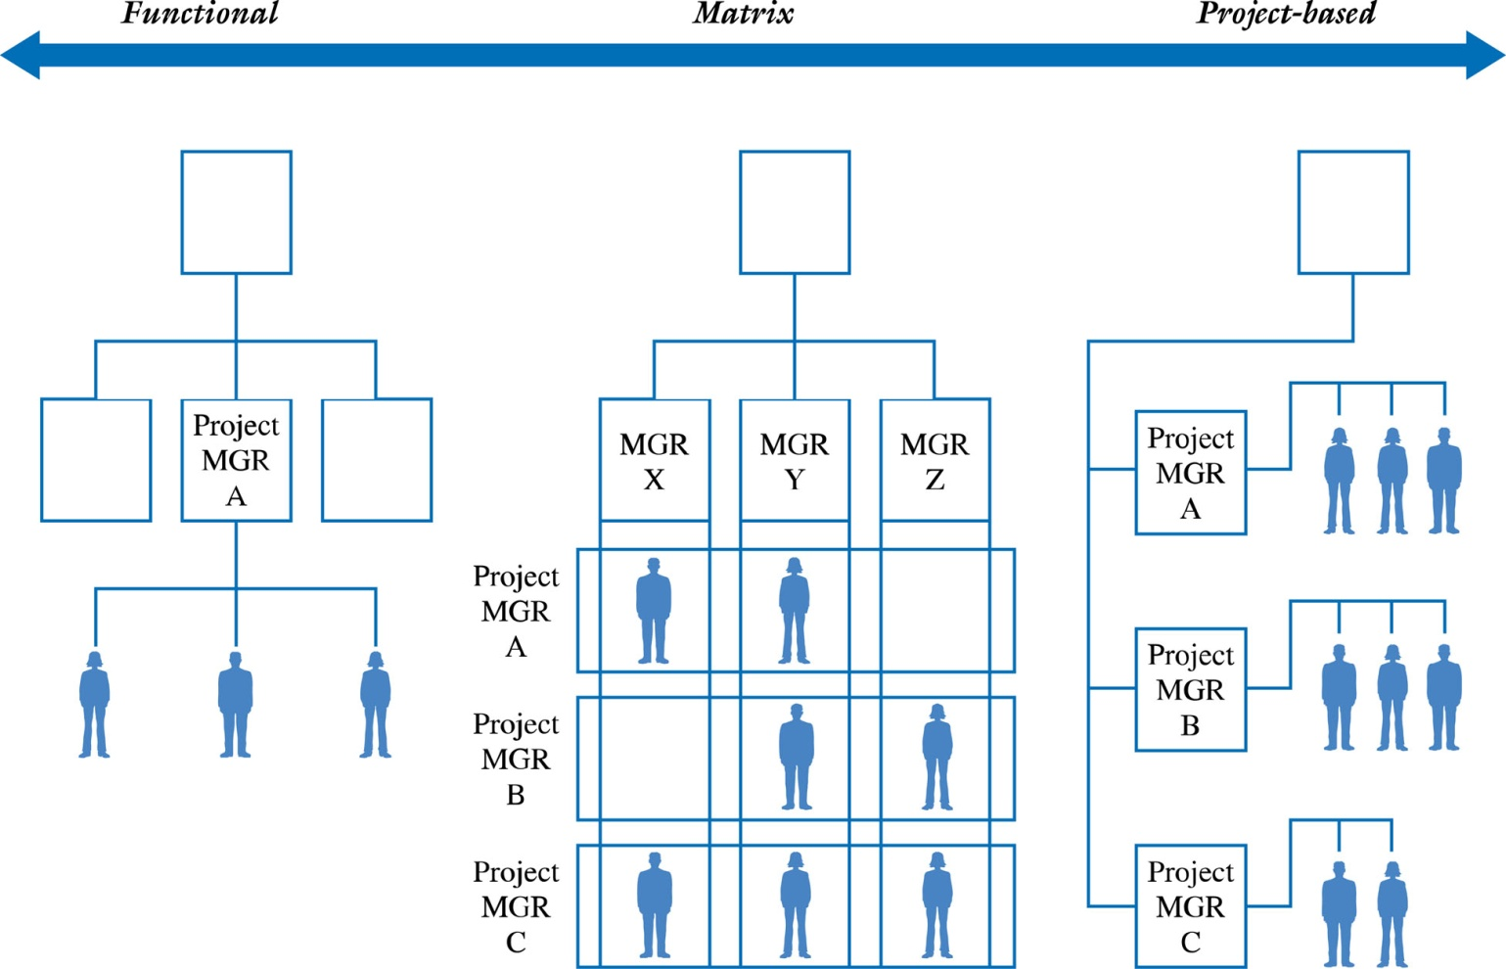
Figure 4.3 – The Organization and Project Resources

Slide 19
The Functional Organization
Advantages
Increased Flexibility
Breadth & Depth of Knowledge & Experience
Less Duplication
Disadvantages
Determining Authority & Responsibility
Poor Response Time
Poor Integration

Slide 20
The Project-Based Organization
Advantages
Clear Authority & Responsibility
Improved Communication
High Level of Integration
Disadvantages
Project Isolation
Duplication of Effort
“Projectitis”

Slide 21
The Matrix Organization
Advantages
High Level of Integration
Improved Communication
Increased Project Focus
Disadvantages
Higher potential for conflict
Team members may wonder “Who’s my boss?”
Poorer Response Time

Slide 22
Procuring External Project Resources
Project resources can be internal or externally acquired.
The decision depends on
The project scope
Availability of the products and services in the marketplace
Cost
Quality
Terms and Conditions
Experience and skills of the project team
Similar to a “make” or “buy” decision
Business process outsourcing, including offshoring, is one option for acquiring external resources

Slide 23
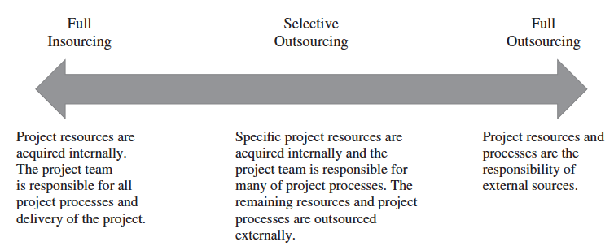
Figure 4.4 – The Project Outsourcing Model

Slide 24
Procurement Planning
Begins by determining which project needs can be fulfilled internally or externally by the project team
Focuses on not only what can best be filled internally or externally, but
How
When
How Many
And Where these products or services will be acquired
A Request for Proposal (RFP) may be developed and used to solicit bids, quotes, or proposals for services or goods from prospective sellers.

Slide 25
Contracts Between Sellers and Buyers
Once a seller is selected, the buyer may enter into contract negotiations so that a mutual agreement can be reached
A contract is a document signed by the buyer and seller that defines the terms and conditions of the buyer-seller relationship. IT serves as a legally binding agreement that obligates seller to provide specific products, services, or even results, while obligating the buyer to provide specific monetary or other consideration.

Slide 26
General Categories of Procurement-type Contracts
Fixed-Price or Lump-Sum Contracts
A total or fixed price is negotiated or set as the final price for a product or service
May include incentives for meeting certain performance objectives or penalties if those objectives are not met

Slide 27
Categories for Procurement-Type Contracts
Cost-Reimbursable Contracts
Payment or reimbursement is made to the seller to cover the seller’s actual direct costs (i.e., labor, materials, etc.) and indirect costs (i.e., admin. salaries, rent, utilities, etc.)
May include incentives for meeting certain objectives or penalties if those objectives are not met
Types
Cost-Plus- Fee (CPF) or Cost-Plus-Percentage (CPPC)
Cost-Plus-Fixed-Fee (CPFF)
Cost-Plus-Incentive-Fee (CPIF)

Slide 28
Types of Cost-Reimbursable Contracts
Cost-Plus-Fee (CPF) or Cost-Plus-Percentage Cost (CPPC)
The seller is paid for the costs incurred in performing the work as well as a fee based upon an agreed on percentage of the costs
Cost-Plus-Fixed-Fee (CPFF)
The seller is reimbursed for the total direct and indirect costs of doing the work, but receives a fixed amount that does not change unless the project’s scope changes
Cost-Plus-Incentive-Fee (CPIF)
The seller is reimbursed for the costs incurred in doing the work and receives a predetermined fee plus an incentive bonus for meeting certain objectives

Slide 29
Categories for Procurement-Type Contracts
Time and Materials (T&M) Contracts
A hybrid of cost-reimbursable and fixed-price contracts
The buyer pays the seller for both the time and materials required to complete the work
Resembles a cost-reimbursable contract because it is open-ended and full cost of project is not predetermined
But can resemble a fixed-price contract if unit rates are set

Slide 30
The Project Environment
A place to call home
Technology
Office supplies
Culture
What is expected from each team member?
What role will each team member play?
How will conflicts be resolved?

Slide 31
The Project Charter
Serves as an agreement and as a communication tool for all of the project stakeholders
Documents the project’s MOV
Defines the project’s infrastructure
Summarizes the details of the project plan
Defines the project’s governance structure
Shows explicit commitment to the project
See Figure 4-5 (next slide) for the typical areas of a project charter

Slide 32
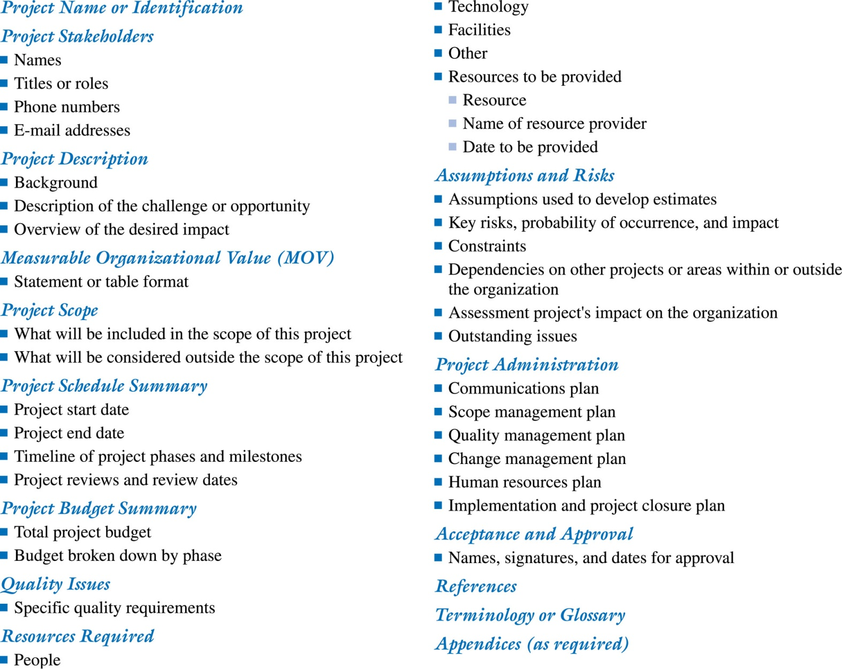
Figure 4.5 A Project Charter Template

