Slide 1
Introduction Service Oriented Architecture
Oxford University
Software Engineering Programme
December 2018

Slide 2
Introduction
Aims
Pre-requisites
Contents
Connections
Resources
Rules of Engagement
Introductions

Slide 3
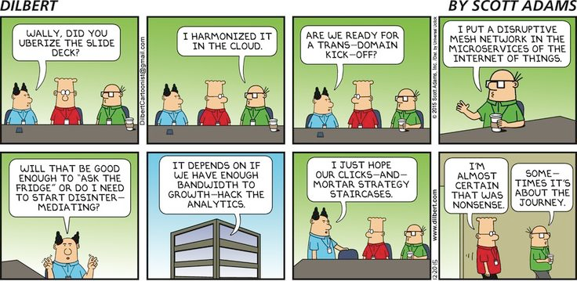

Slide 4
Apologies for the Jargon
There is a lot!
Microservices, SOA, DevOps, REST, SOAP, WSDL, Swagger, JSON, XML, OAuth2, TLS, etc
Please ask if I fail to explain an acronym

Slide 5
Aims
To understand:
Benefits and challenges of SOA
Services, Microservices and APIs
Security models
Mediation, Composition, Governance
Implementation of
REST based services
Event based architectures
gRPC and binary protocol based services
Microservices
Mediation and BPMN flows
OAuth2 and SSL secured services
API Gateways and clients

Slide 6
Pre-requisites (Some familiarity required)
Languages: Java, Node, Python
Data formats: JSON and XML
Tools: Unix shell, Eclipse, Text editors

Slide 7
Contents
Overview and course outline
Case studies and motivations
REST introduction
REST example flows
Advanced REST
SOAP and WSDL
Microservices architecture
Event Architectures
gRPC and binary protocols
Deployment, DevOps, containers and cloud-native applications
Integration and ESBs
Security
API and API Management
Orchestration and Choreography
Governance
Overview, futures, recap

Slide 8
Practicals
My aim is to have more practicals than is reasonable:
Some people finish early, so there are extensions and bonus practicals for them.
You might even wish to do more at home?!?
The practicals are quite directive to start with:
This is a complex area with a lot to cover.
Extensions are more freeform.
You need to think and not just do as I say to get the most out of them.

Slide 9
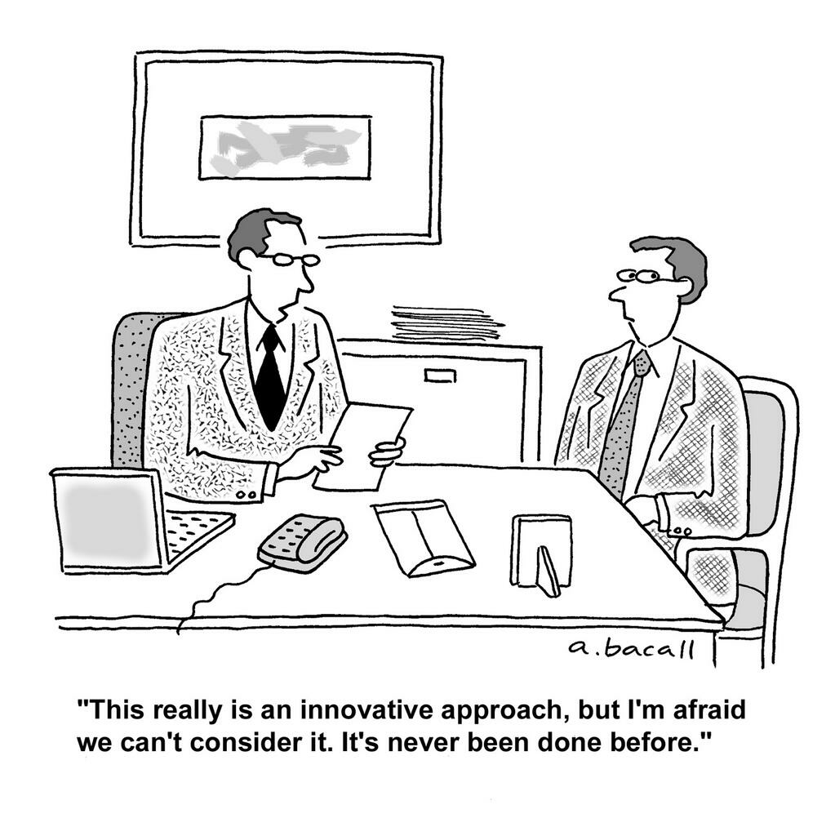

Slide 10
Practicals
Basic HTTP server and client
HTTP service in Java
Evolving the Richardson Maturity Model towards a RESTful service
Microservice and Docker deployment
SOAP interaction
Mediation flow with SOAP
SSL and OAuth2 security
API Management and Analytics
BPMN workflows
Plus some bonus exercises

Slide 11
Resources
Weerawarana et al, Web Services Platform Architecture, (Pearson, 2005)
Erl, SOA (Prentice-Hall, 2005)
Richardson and Ruby, RESTful Web Services (O’Reilly, 2007)
Webber et al, REST in Practice (O’Reilly, 2010)
Fielding, Architectural Styles and the Design of Network-based Software Architectures, (University of California, 2000)
Various W3C, OASIS, IETF, OMG standards

Slide 12
Rules of Engagement
Ask questions as we go along
We will “park” any that are better answered later
Don’t wait till the end to ask or raise concerns
Timings are flexible
Please keep mobile phones silent or better still turned off
If you have improvements or bug reports, please submit issues or pull requests:
https://github.com/pzfreo/ox-soa2/issues/new

Slide 13
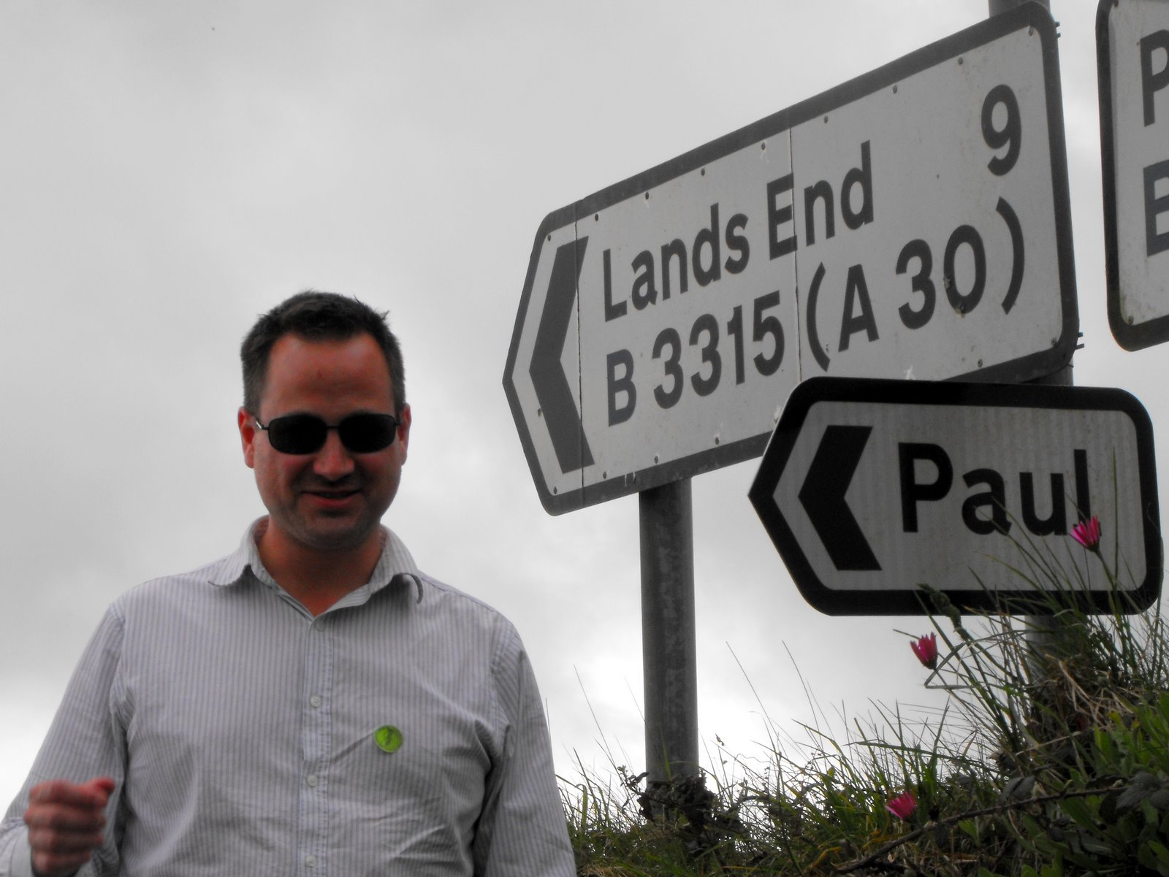
Paul Fremantle
CTO and Co-Founder of WSO2
An Open Source SOA and API focused company
Previously Senior Technical Staff Member, IBM WebSphere architecture
Co-Chair Web Services Reliable eXchange at OASIS (WSRM)
VP, Apache Synapse and Member of ASF
MA in Maths and Philosophy
MSc in Computation (here)
PhD in Computing – IoT privacy and security

Slide 14
You?

Slide 15
Approximate Schedule
Monday | Tuesday | Wednesday | Thursday | Friday
Introduction | Evolving REST practicals | Docker and DevOps | API Manage-ment | Design Exercise
Case Studies and motivation | REST Description Advanced REST | Async and Events | Integration | Conclusions
REST Introduction | SOAP and XML | Binary / gRPC | Composition
REST example flow | Microservices | Security | Governance and Org

Slide 16

Let’s get started

