Slide 1
SOAP implementation technologies
Oxford University
Software Engineering Programme
January 2018

Slide 2
Why use a library?
WSDL tooling
Make it quick and easy
WS-* extensions
WS-Security and related
Much less: WS-RM, WS-AT, WS-Addressing

Slide 3
The two major toolkits
.NET WCF
Two implementations
Windows
Mono
JAX-WS
Multiple implementations
Sun, CXF, Axis2, etc

Slide 4
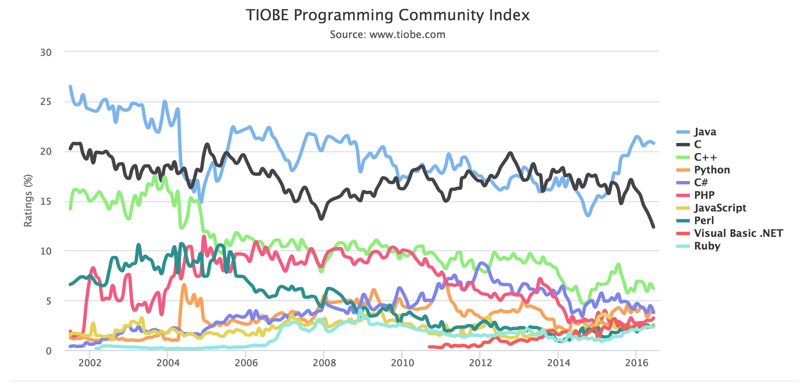
Poor support in other languages is one reason for SOAP’s decline

Slide 5
JAX-WS Motivation
Java API for XML Web Services
Currently version 2.2
Create a standard Java approach to creating and consuming SOAP/WSDL web services
Based on annotations
Work with WS-I Basic Profile
Work with JAX-B (Java API for XML Binding)
Replaced the (broken) JAX-RPC specification

Slide 6
Two approaches
Code first:
Create Java code, annotate
Run Java2WS to create WSDL / XSD etc
Contract first:
Create (or re-use) WSDL / XSD etc
run WSDL2Java to create the Java artefacts

Slide 7
Code first (annotated POJOs)
Start with a Plain Old Java Object
Create annotations that document the service definition, binding approach, etc

Slide 8
Common Annotations
@WebService
@SOAPBinding
@WebMethod
@WebParam
@OneWay
@HandlerChain

Slide 9
WebService
Applies to class or interface
All parameters are optional
@WebService
(name = “OrderService”,
serviceName = "OrderProcess",
portName = "OrderProcessPort", targetNamespace = "http://freo.me/order",
wsdlLocation=“path to existing wsdl”)

Slide 10
WebService continued
@WebService(endpointInterface = “me.freo.OrderProcess") applies to class only
This allows you to create an interface defining the service/WSDL and a separate implementation. This is especially important for WSDL first operation

Slide 11
SOAPBinding
Applies to class or interface
@SOAPBinding(
style=SOAPBinding.Style.DOCUMENT,
use=SOAPBinding.Use.LITERAL,
parameterStyle= SOAPBinding.ParameterStyle.WRAPPED)
My hint: ALWAYS use Doc/Lit/Wrapped
see http://pzf.fremantle.org/2007/05/handlign.html
Second hint: this is the default so don’t use @SOAPBinding!

Slide 12
WebMethod
Applies to Method
@WebMethod(
action=“MySOAPAction”, //optional
operationName=“myWSDLop”,
exclude=true) // do NOT expose this // inherited method

Slide 13
OneWay
Applies to a method that is marked @WebMethod
Indicates that there is no response expected
Assuming this is over HTTP, there should just be a HTTP 202 Accepted response
Over JMS, no response message expected

Slide 14
WebParam
A way of defining the mapping between the XML/SOAP message and the Java Parameters
@WebParam( name=“nameOfXMLElement”,
partName=“nameOfWSDLPart”,
targetNamespace=“xmlNamespace”,
mode=“IN|OUT|INOUT”,
header=true|false)

Slide 15
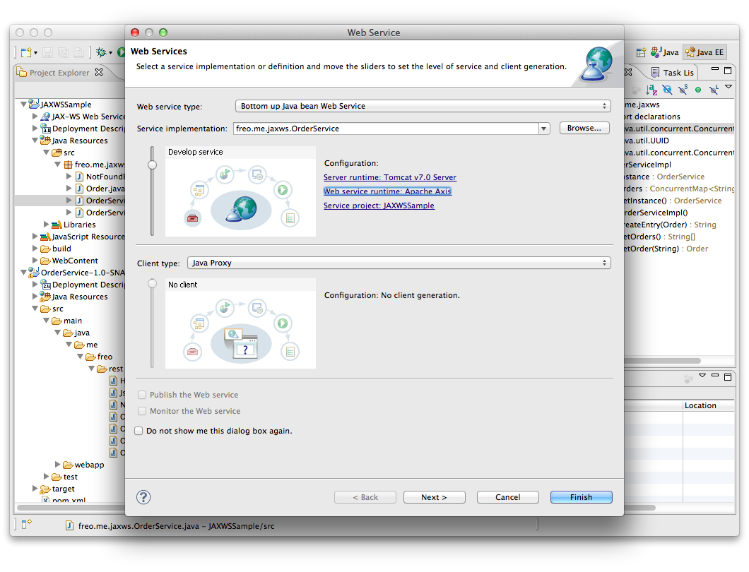
Eclipse Web Tools platform

Slide 16
WSDL first
Again there is a tool for this
You might want to create a service
Contract-first (design the WSDL, then implement)
Implement a standard WSDL
Re-architect an existing service
Copy a competitor’s service (though this is a thorny issue!)
Very likely you need to call a service

Slide 17
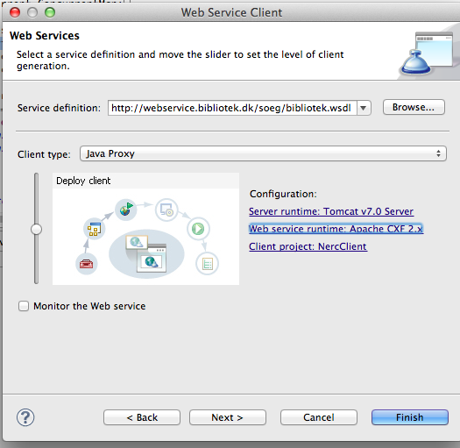
Eclipse tooling

Slide 18
Resources
The Labs
The Spec
http://jcp.org/aboutJava/communityprocess/mrel/jsr224/index3.html
The CXF documentation
http://cxf.apache.org/docs/a-simple-jax-ws-service.html
The Reference Implementation
http://jax-ws.java.net/

