Slide 1
Advanced REST
Oxford University
Software Engineering Programme
January 2018

Slide 2
Another way of looking at REST
Taking HTTP seriously

Slide 3
REST
Roy Fielding, a principal author of HTTP
PhD thesis Architectural Styles and the Design of Network-based
Subsequent article Principled Design of the Modern Web Architecture (ACM TOIT 2:2, 2002)
Richardson & Ruby, RESTful Web Services architectural patterns of the web

Slide 4
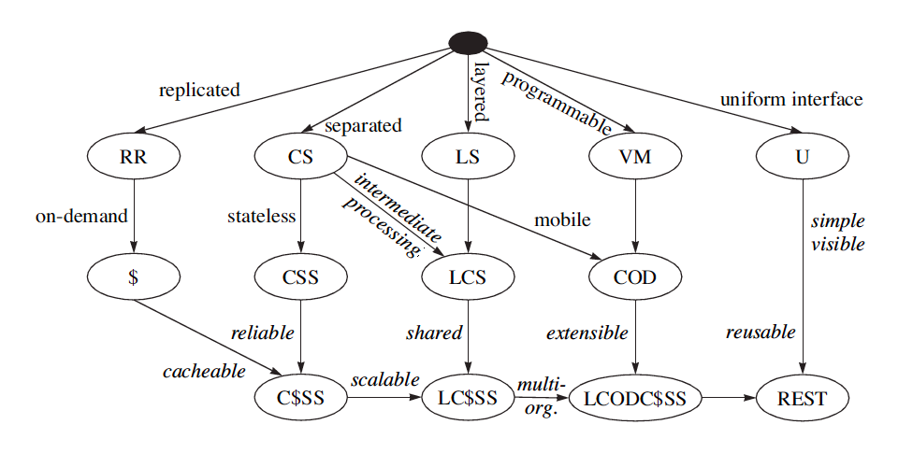
REST Derivation from Style Constraint

Slide 5
Key concepts
Client Server
Cacheing
Replicable
Stateless
Layered
Uniform interface

Slide 6
Cacheing
Large scale network systems often rely on cacheing
Reduce traffic
Localised access
Reduced processing
Akamai and others make the web work effectively
Caching relies on differentiating between cacheable and not cacheable traffic
Also understanding the lifetime and status of cacheable objects

Slide 7
HTTP cacheing features
Expires header
Cache-control header
If-modified-since / Not modified
ETags (Entity Tags)
Uuids for content
Strong and Weak
If None Match
Unfortunately some websites are using Etags to track users instead of cookies!

Slide 8
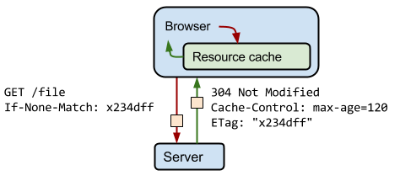
ETags
https://developers.google.com/web/fundamentals/performance/optimizing-content-efficiency/images/http-cache-control.png

Slide 9


Slide 10
Statelessness
Of course there is state!
The only question is where the state is kept.
Traditional CS systems required the client and server to be kept in sync
The web uses cookies

Slide 11
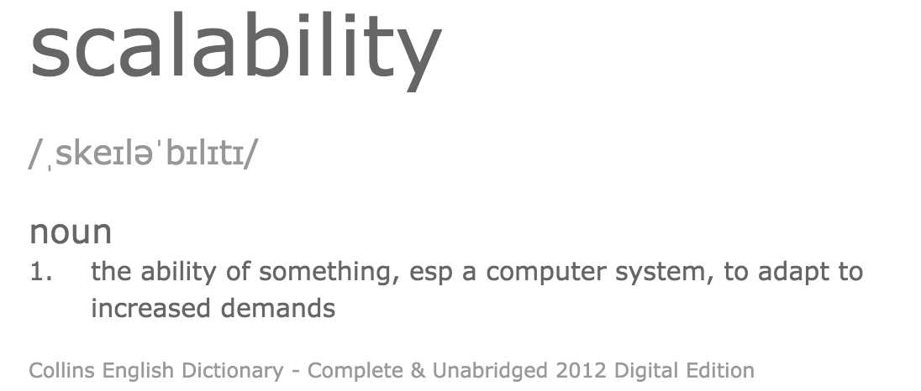

Slide 12
Speedup
The speedup is defined as the performance of new / performance of old
e.g. move from 1 -> 2 servers
New system is 1.8 x faster than the old
In terms of transactions/sec (throughput)
Speedup = 1.8

Slide 13
What inhibits speedup?
In general you can split work into
Parallelizable and
Serial parts
The serial parts stop you from scaling

Slide 14
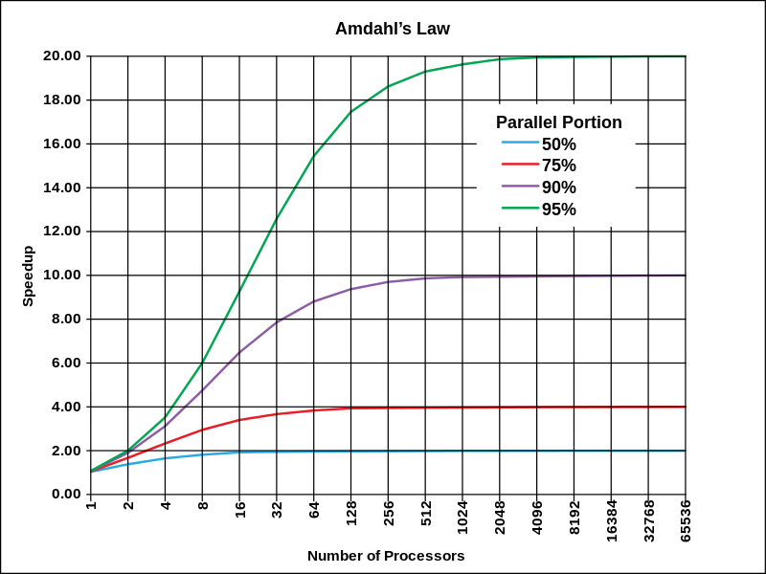
Amdahl’s Law Theoretical speedup given a fixed data size
The speedup of a program using multiple processors in parallel computing is limited by the time needed for the serial fraction of the program, given a fixed size of data

Slide 15
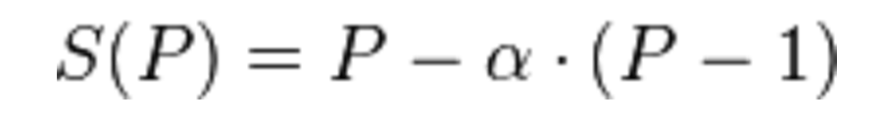
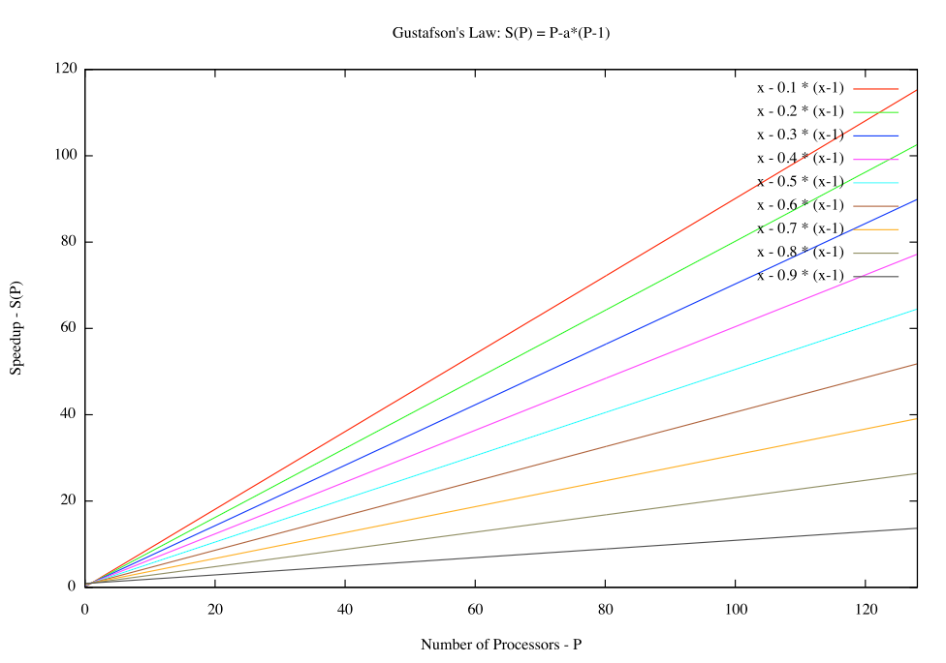
Gustafson’s Law What if the data increases too?
α is the largest
non-parallelizable fraction

Slide 16
A driving metaphor
Amdahl’s Law
You are travelling to London (60 miles)
30 miles in you have spent one hour
You can never average > 60 mph
Gustafson’s Law
You are travelling across the US
You’ve spent an hour at 30 mph
You can achieve any average speed given enough time and distance

Slide 17
Performance Single system under increasing load
Good
Performance
Bad
Resource contention
causes slowdown
Load

Slide 18
Performance Scaling servers when fully loaded
Best
The performance of n servers is equal to
n x the single server performance
Performance
Not bad
Additional servers scale linearly,
but there is a cost to scaling
Bad
System performance
reaches a maximum no matter how many
servers are added
1 server
1 server
Number of servers

Slide 19
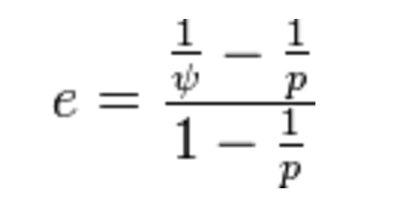
Karp-Flatt Metric
e is the Karp-Flatt Metric
ψ is the speedup
p is the number of processors
e = 0 is the best
e = 1 indicates no speedup
e > 1 indicates adding processors
slows down the system!!!

Slide 20
Karp-Flatt metric
e=0
e=0.3
Performance
e→1 as p increases
1 server
1 server
Number of servers

Slide 21


Shared Nothing Architecture
Server
Disk
Load Balancer
Server
Disk
Server
Disk

Slide 22
Shared Nothing Architecture
Implies there is no serial part to the computation
Karp-Flatt Metric of 0
Assuming 100% efficient load balancing
In practice, this is difficult!

Slide 23
Partitioning / Sharding
A-I
Server
Disk
J-R
Load Balancer
Server
Disk
S-Z
Server
Disk

Slide 24
Problems with Sharding
Imbalance
Fewer S-Z’s than A-I’s
Failover
Adding new servers requires a re-balance
Is this automatic or manual?!

Slide 25

Load Balancer-based elastic scaling
Worker pool
Client
Load Balancer
Elastic scale
Cloud Controller
Monitoring
Topology update

Slide 26
Statelessness is hard
There is a lot of intermediate calculation in most web systems that needs to be stored between transactions.
The exemplar is the shopping cart

Slide 27
Intermediate state storage
In-memory
Breaks statelessness, limits scalability
In the client
OK for some APIs but can be slow and hard to program
In the database
Slow and expensive
Cache servers:
The client keeps a cookie, which is the key to the datastore
The usual practise
Redis, memcached, Hazelcast, Infinispan

Slide 28
Cache
Disk
Server
Disk
Load Balancer
Server
Disk
Server
Cache Server

Slide 29
Layered systems
Reverse proxies
Composable
E.g. my business process is a service that exposes a REST interface and co-ordinates other services
Compare with web scraping

Slide 30
Principles of REST Architecture
REST isn't protocol specific, but in practice means the RESTful usage of HTTP
CoAP is an example of a non-HTTP restful interface
HTTP is very rich:
Content negotiation
Distributed caching.
HTTP verbs nicely map to CRUD operations of data
RESTful web services
Try to use all of HTTP as an application protocol

Slide 31
Resources and Uniform Interface
Addressable Resources. Every “object” on your network should have a unique ID.
An important aspect is that each “object” or resource has its own specific URI where it can be addressed
The URI should have a lifetime equivalent to the resource it represents
(I’ve had the same bank account for 20+ years)

Slide 32
Representation
State of resource captured and transferred between components
Might be current or desired future state
Represented as data plus metadata (name–value pairs)
Metadata includes control data, media type
The Content-Type of the resource should be useful and meaningful (self-description)
One resource might have several representations
Selected via separate URIs, or via content negotiation

Slide 33
Uniform Interface
A Uniform, Constrained Interface. When applying REST over HTTP, stick to the methods provided by the protocol
GET, POST, PUT, and DELETE.
These should be used properly
GET should have no side effects or change on state
PUT should update the resource “in-place”

Slide 34
REST Standards
HTTP 1.1
URI
URI Template
WebSockets
XML, JSON, etc
Atom/AtomPub
OData
OpenId
OAuth 1 / 2
SAML/SAML2
JSON Web Tokens
WADL
Swagger
Json Home
Json Web Encryption
Json Web Signature
Json Patch
SPDY
HTTPbis
HTTP Link Header
Microformats
RDDL
…

Slide 35
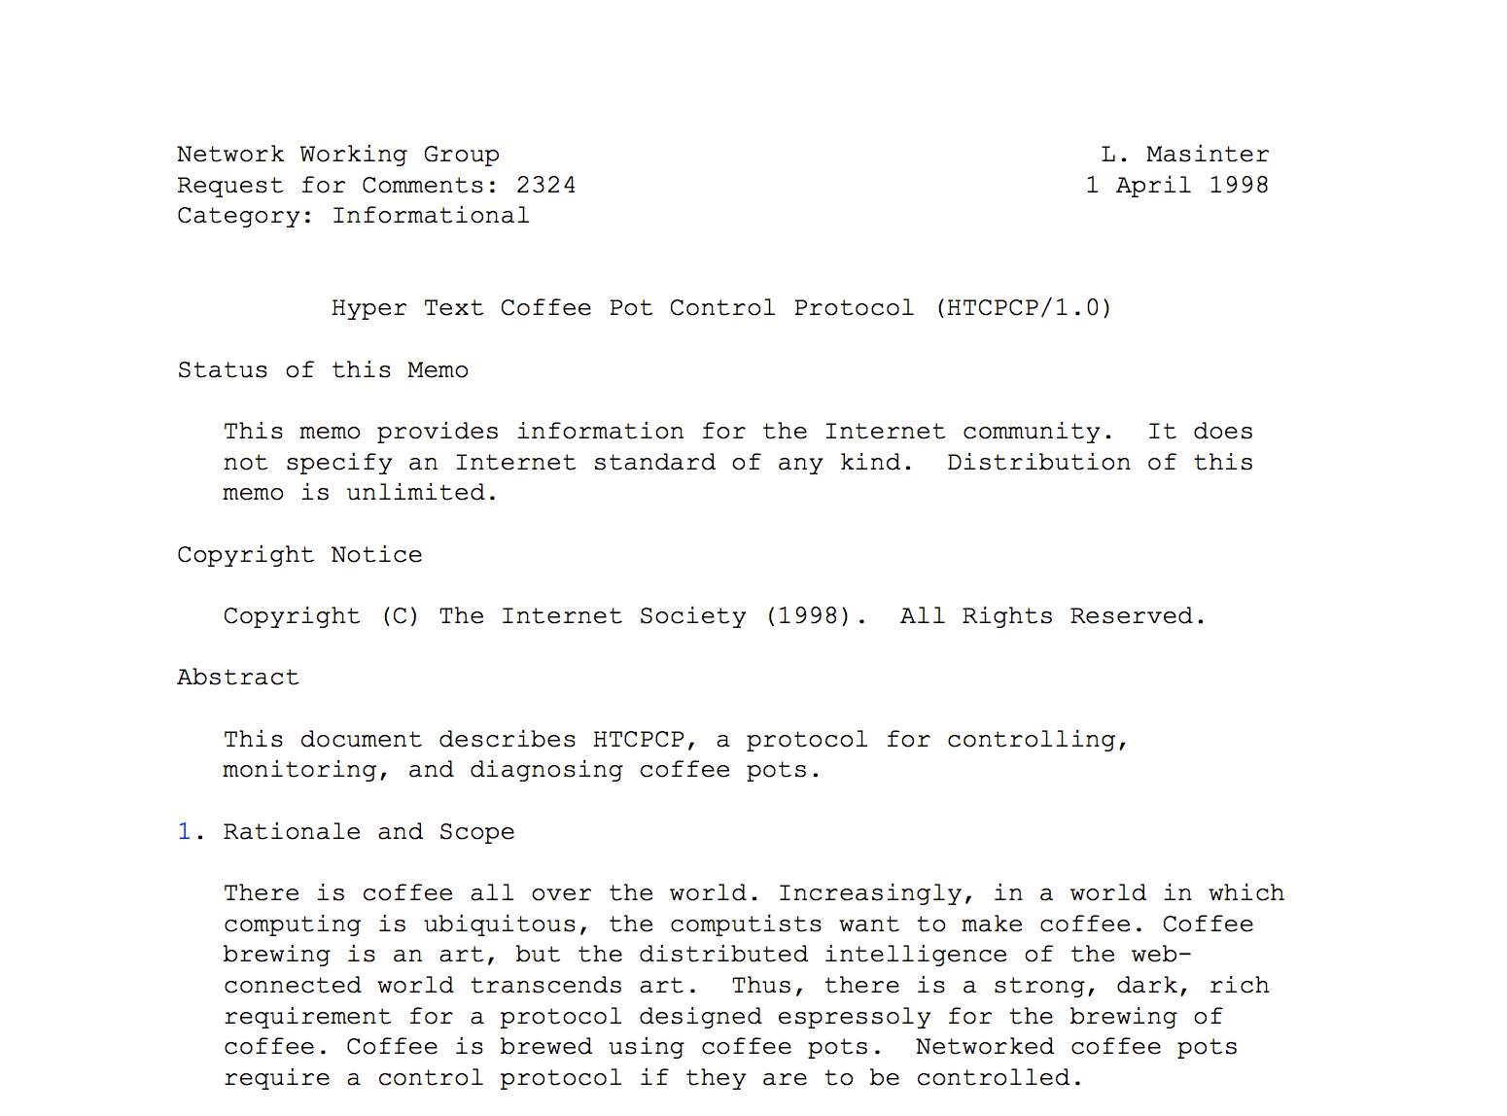
HTCPCP 1.0

Slide 36


GraphQL

Slide 37
GraphQL
A Facebook developed language
Supports getting many resources with a single call
Allows the caller to specify what data is needed
A single endpoint to access multiple resources with a well defined type system

Slide 38
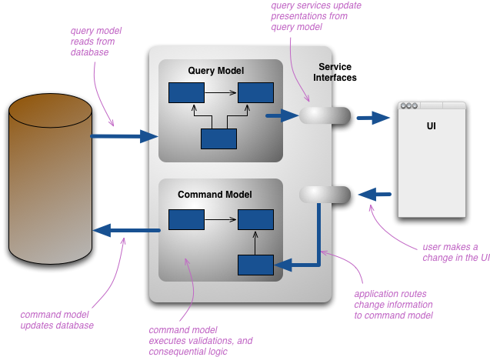
Command Query Responsibility Separation
https://martinfowler.com/bliki/CQRS.html

Slide 39
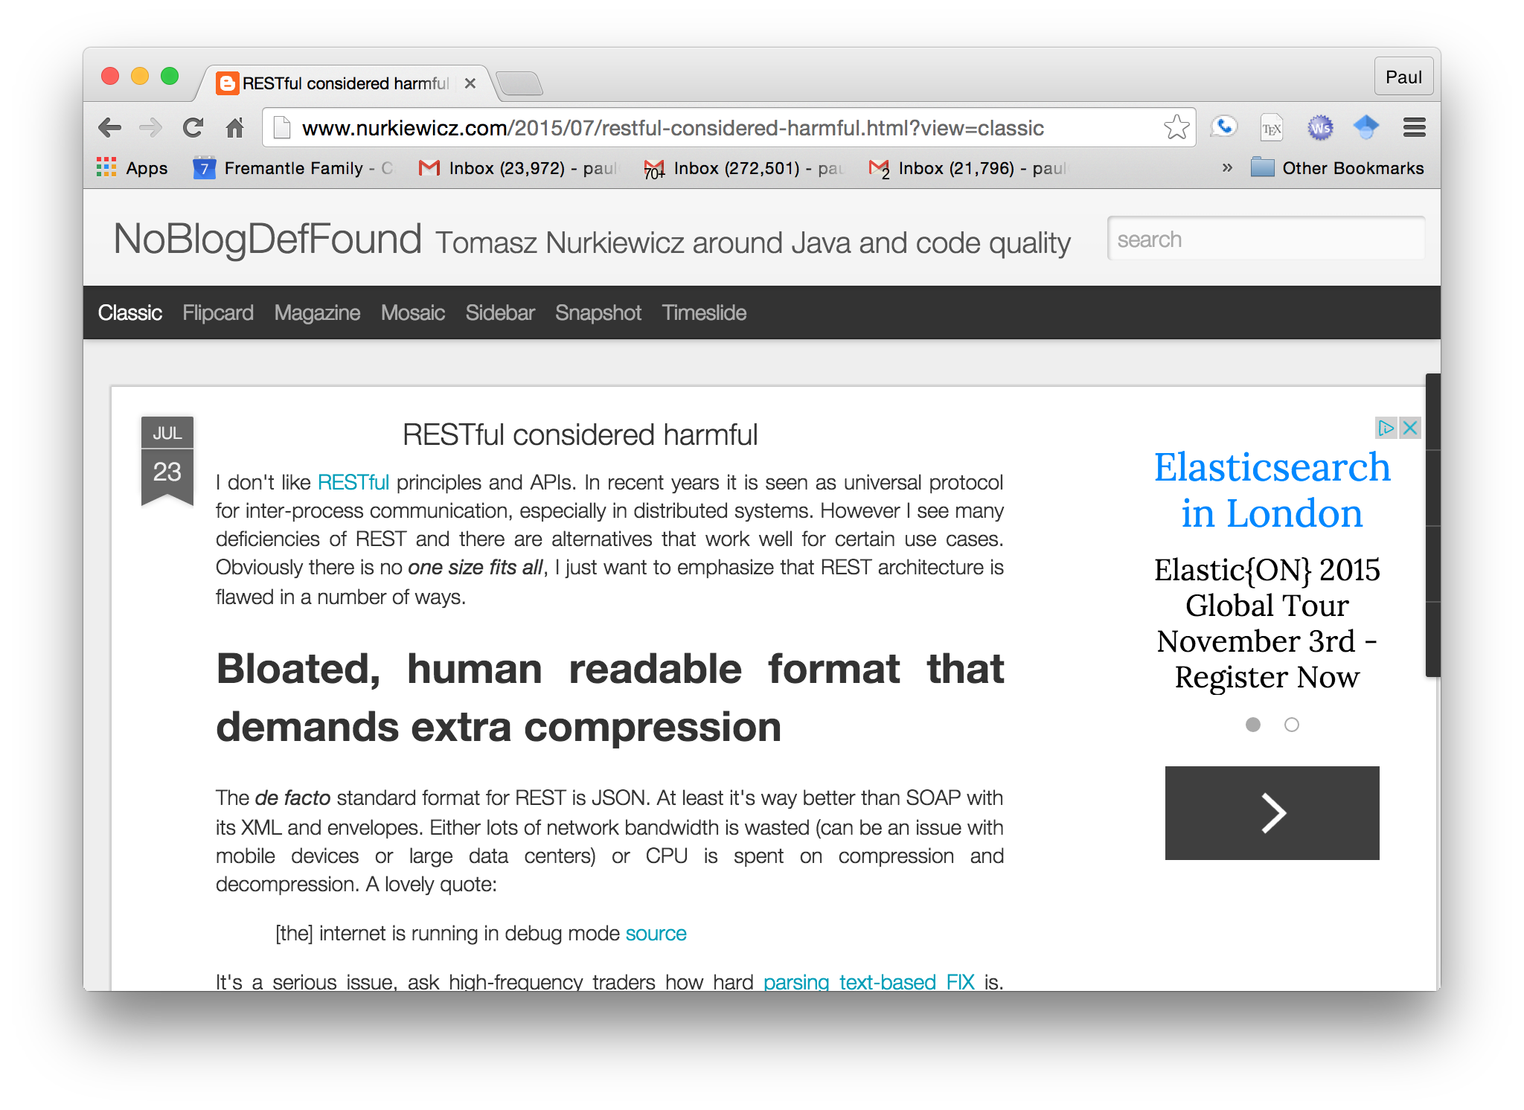
Not everyone agrees: http://www.nurkiewicz.com/2015/07/restful-considered-harmful.html

Slide 40
Anti-REST concerns
Bloated formats (equally applies to SOAP)
Neither Schema nor Contract
APIs and discovery instead of clear published machine-readable documentation
No inbuilt batching, paging, sorting, etc
CRUD only
HTTP Status codes mixed with business replies
Temporal Coupling
Not clear enough what is REST and what isn’t!
Backwards compatibility

Slide 41
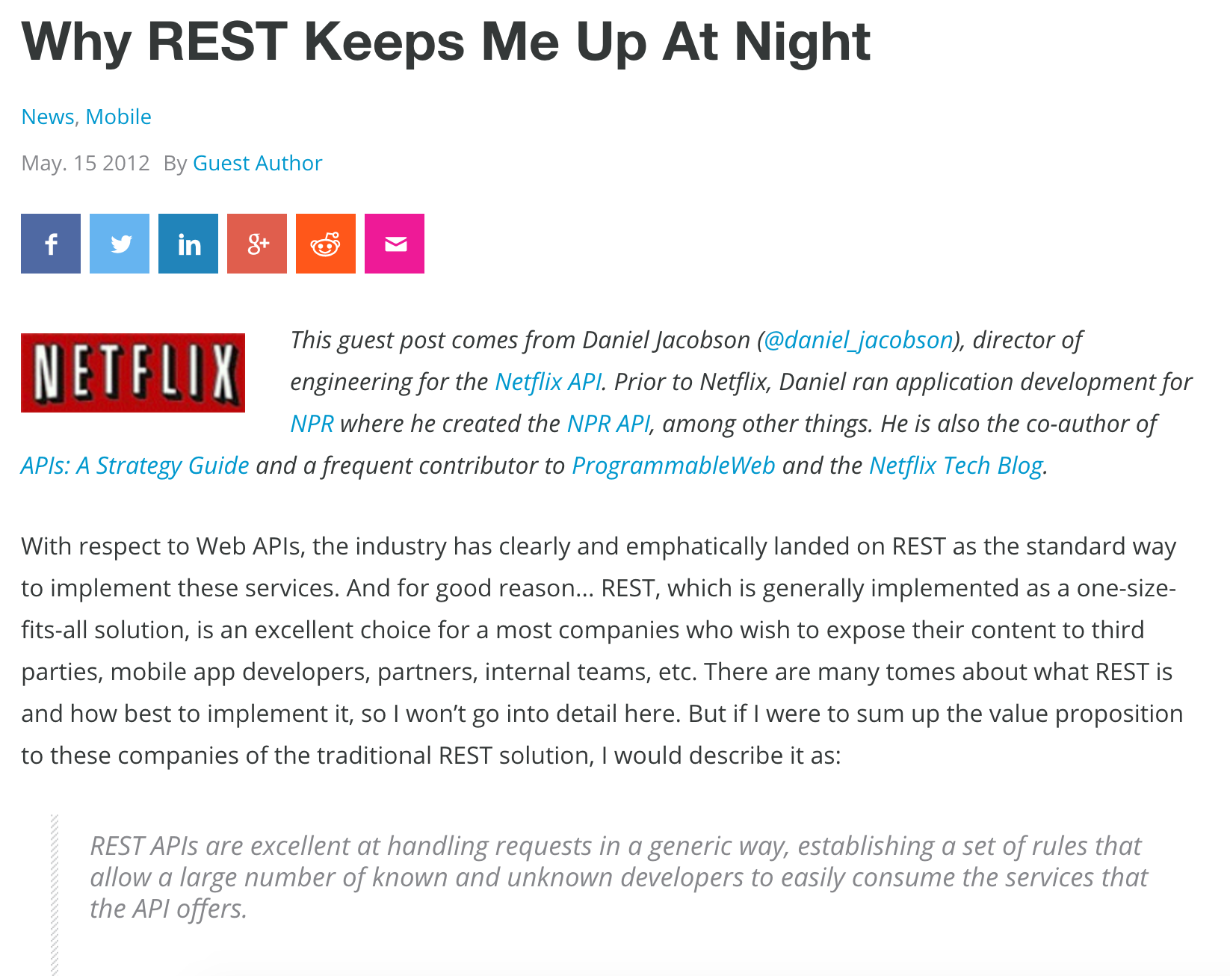
http://www.programmableweb.com/news/why-rest-keeps-me-night/2012/05/15

Slide 42
Questions?

