Slide 1
SOA integration and mediation
Oxford University
Software Engineering Programme
May 2017

Slide 2
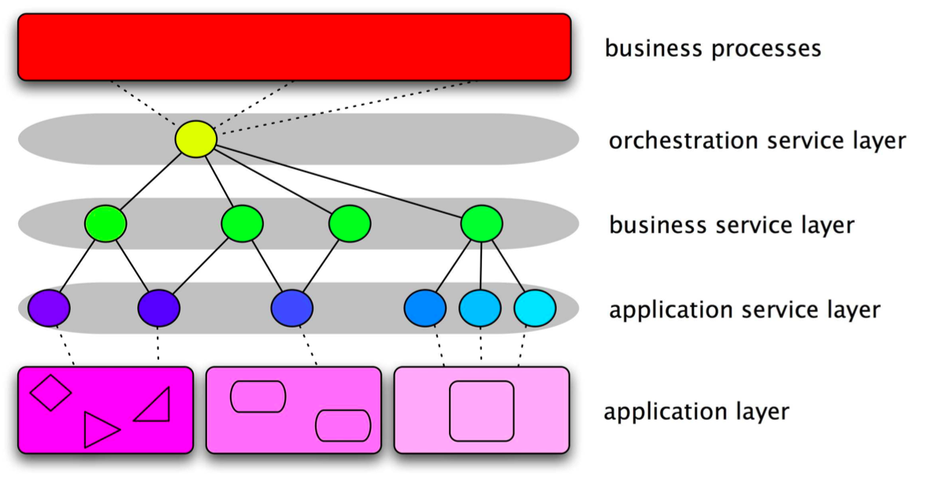
Recap on SOA model

Slide 3
Enterprise Service Bus (ESB)
A software architecture
A logical intermediary through which every message flows
Offers a policy based approach to decide what to do to each message or interaction
The benefits of the gateway model
Without a physical hub and spoke
Many vendors offer ESB products
Often a layer over an existing messaging framework

Slide 4
ESB as the implementation of SOA
Service
Service
Service
Contract
Contract
Contract
Enterprise Service Bus
Routing, Logging, Versioning, Transformation, Mgmt
Process
Management
Portal
Call Center

Slide 5
Different approaches
Point to Point
Traditional EAI
ESB
Event Driven Architecture

Slide 6
Pros and Cons of an ESB
Pros
Faster and cheaper accommodation of existing systems
Increased flexibility: easier to change as requirements change
Standards-based
Scales to enterprise wide deployment
Configuration rather than coding
No central broker
Cons
May end up with a proprietary solution
no common standards for the overall config and policies yet
Requires more hardware to run
New skills to learn to configure ESB
Hard to get ROI on a small number of projects

Slide 7
ESB options
Proprietary
IBM, Oracle, Tibco, SAP
Open Source
Mule, Fuse, WSO2
Apache ServiceMix, Apache Synapse, Apache Camel

Slide 8
ESB models
Almost all ESBs work on the same principle
Message arrives
Sequence of actions (Pipeline)
Message is sent on

Slide 9
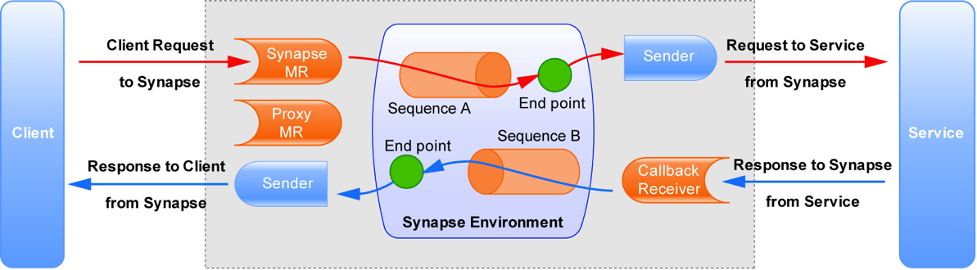
Graphically Apache Synapse terminology used

Slide 10
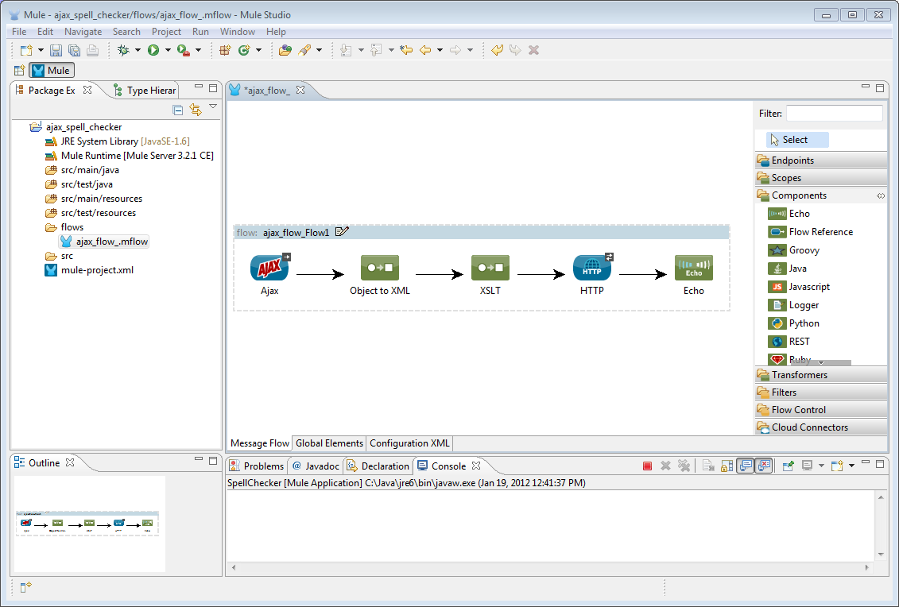
From some tooling

Slide 11
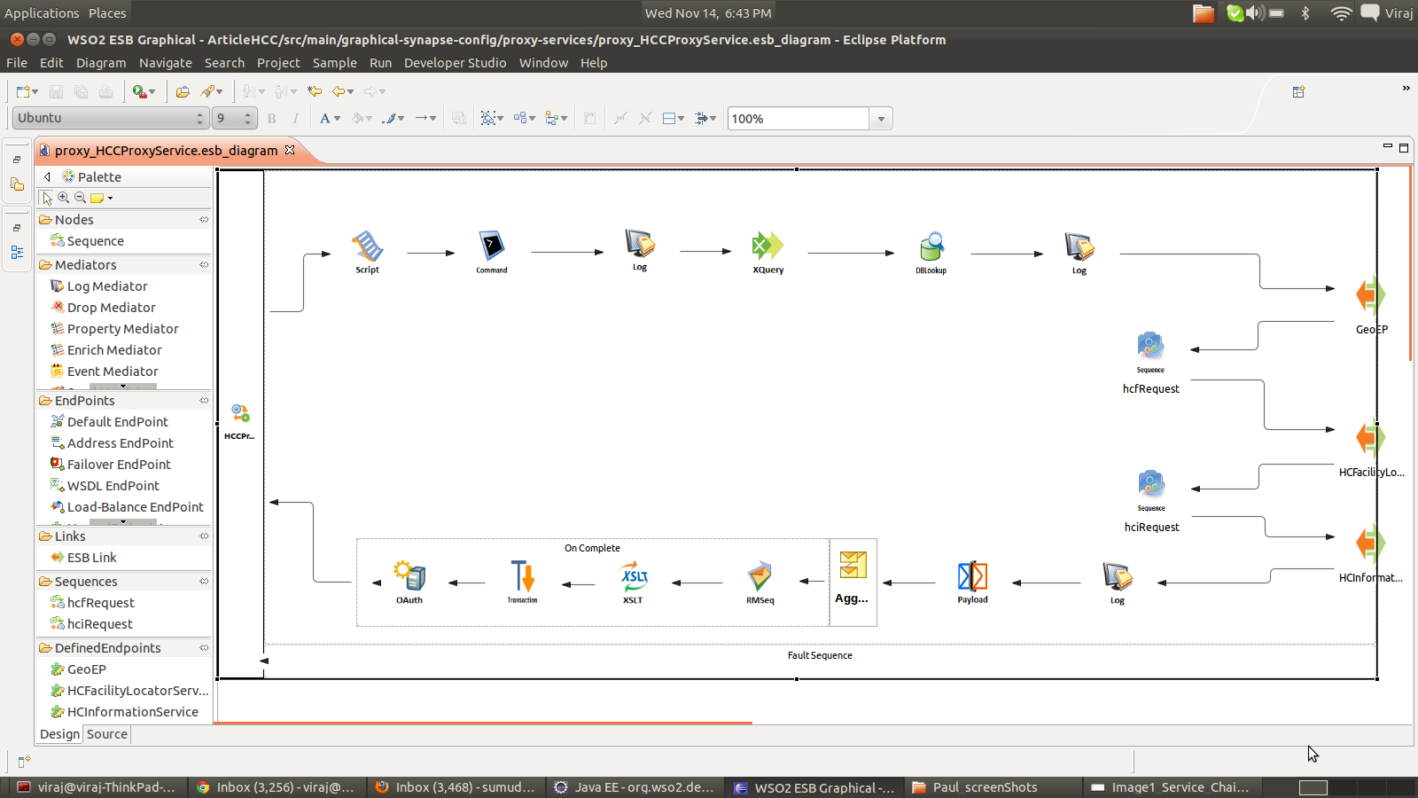
More Tooling

Slide 12
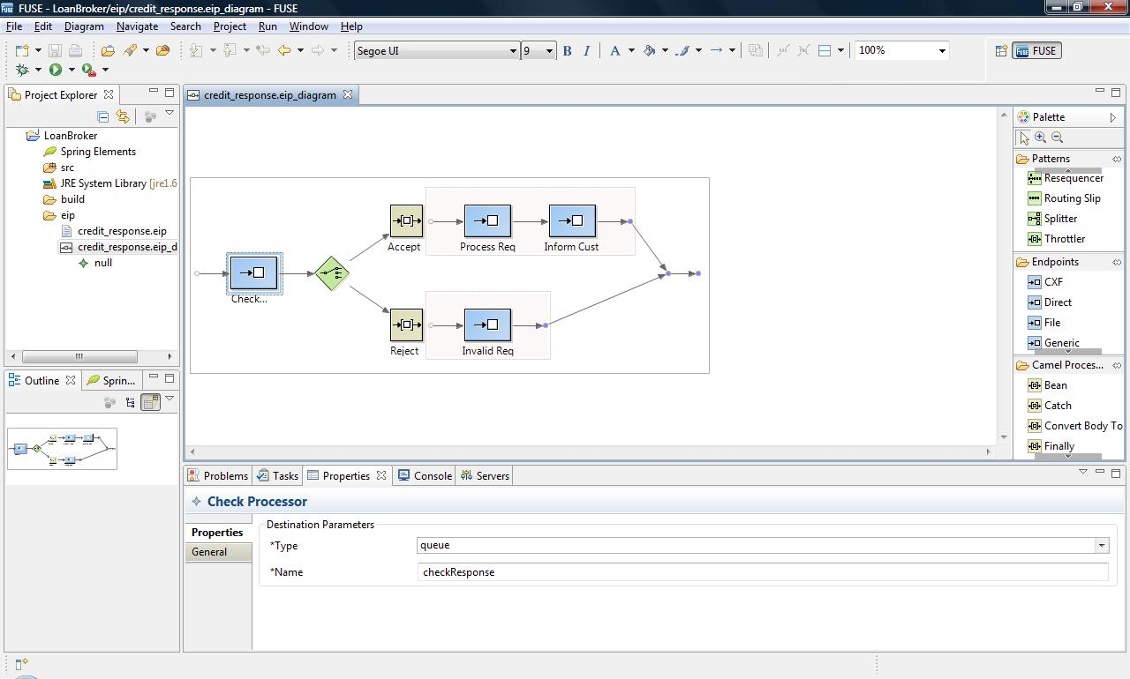

Slide 13
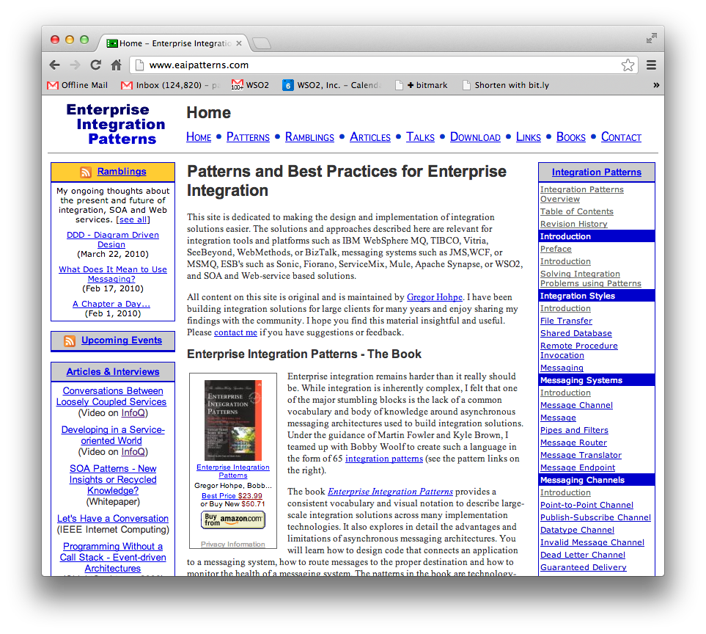
Enterprise Integration Patterns

Slide 14
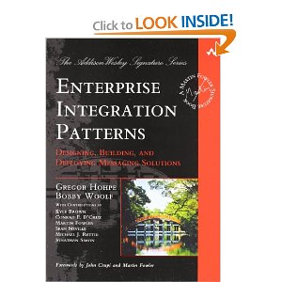
Enterprise Integration Patterns
http://www.eaipatterns.com/
The book
Enterprise Integration Patterns
Gregor Hohpe, Bobby Woolf

Slide 15
What actions
The aim is to re-use existing adapters, transports and mediators/transformers
Why?
Minimize custom coding
Utilize optimal components
e.g. streaming high-performance
Shorten test cycles
Be more agile

Slide 16
Common mediators
Logging
Routing
Transformation
XSLT
Xquery
Template-ing
Split/Aggregate
Filter
Clone/Tee
Callout
Enrich
Drop
Fault
etc

Slide 17
Apache Synapse
Designed to be simple to use and manage
XML configuration
No complex deployment
Hot deploy and update if needed
Separation of configs for different teams
Highly performant and scalable
Asynchronous core / non-blocking model

Slide 18
C10k Problem
How to handle 10k concurrent requests
Without 10k concurrent threads ☺
Need to disassociate the socket from the thread
Async handling
Reactor pattern

Slide 19
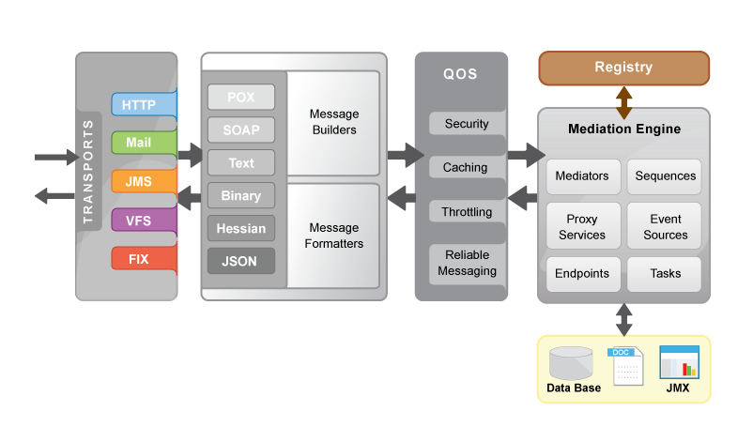
Apache Synapse

Slide 20
WSO2 ESB
Also Apache License Open Source
Adds a Graphical Web Interface
Registry/Repository
Deployment management/synchronization
Other pluggable components

Slide 21
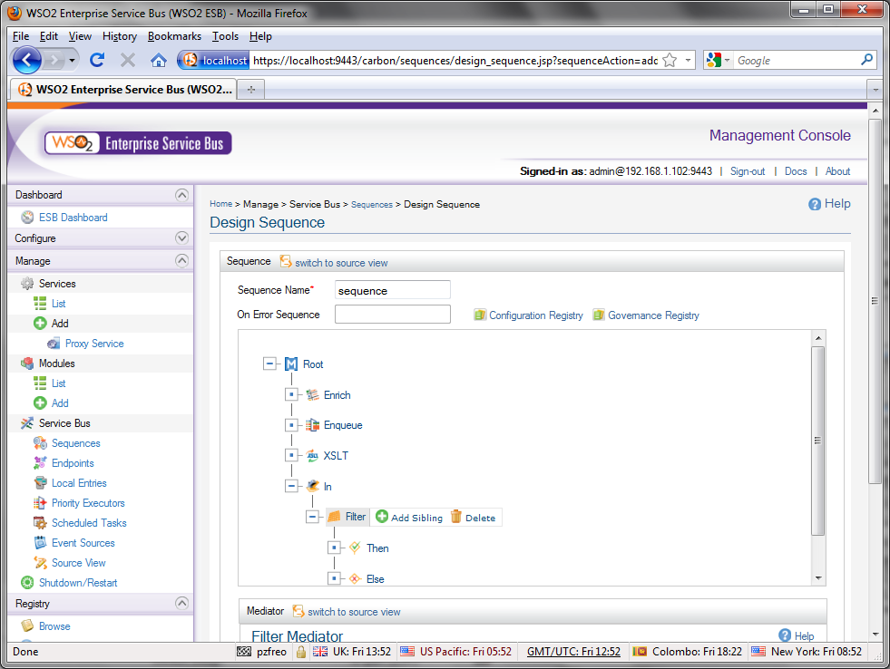
ESB UI

Slide 22
Transformation
Transform via XSLT, XQuery, or Smooks
Enrich via XPATH
URL/Headers Management
Name | Description
XSLT Mediator | Invokes XSLT transformation on current message (v1.0 and v2.0 are supported)
XQuery Mediator | Invokes XQuery transformation on current message
Smooks Mediator | Invokes embedded Smooks Engine (v1.5) - Supports binary transformations (EDI, CSV, etc.)
Enrich Mediator | Enrich message contents using XPATH (replace, append, remove)
URL Rewrite Mediator | Rewrite protocol / URL contents
Header Mediator | Set / Remove Headers
Payload Factory | Override Message Contents

Slide 23
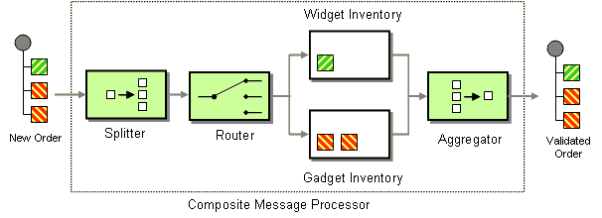
Enterprise Integration Patterns
Native Support for Common EIP
Content-based Router
Command Message
Message Filter
Message Splitter
Message Aggregator
Name | Description
Route Mediator | Routes message to given endpoint
POJOCommand | Creates instance of specific command class.
Iterate Mediator | Iterates over message and splits it into number of different messages derived from the parent message using XPATH.
Clone Mediator | Clones the entire message N times, each message is then treated in parallel
Aggregate | Aggregates multiple responses or messages, using XPATH.
Filter Mediator | Executes action based on evaluation of message contents against regular expression.

Slide 24
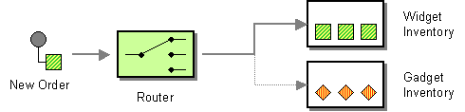
Content-Based Router
<router> mediator

Slide 25
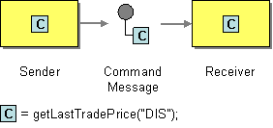
Command Message
<call> mediator

Slide 26
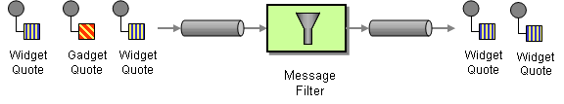
Message Filter
<filter> mediator (with <drop> mediator)

Slide 27
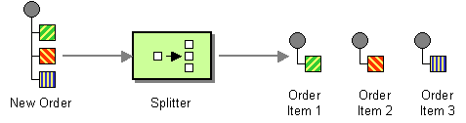
Splitter
Iterate Mediator

Slide 28
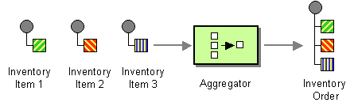
Aggregator
Aggregate mediator

Slide 29
Composed Message Processor
<sequence>

Slide 30
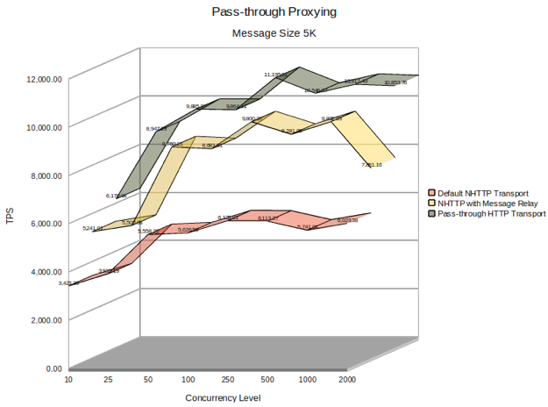
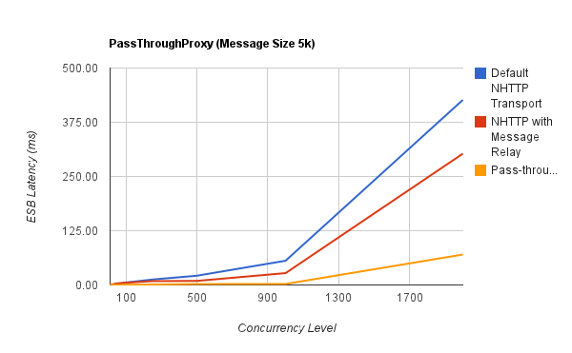
High Performance and Stability
Supports 1000s of concurrent non-blocking HTTP transaction per server
Pure streaming and Optimization using Message relay (on-demand processing of messages)
Very Low latency (0.5 ms for Non-Blocking IO transport)
Long Term Execution Stability with Low Resources Utilization
Response Caching
Latency
TPS

Slide 31
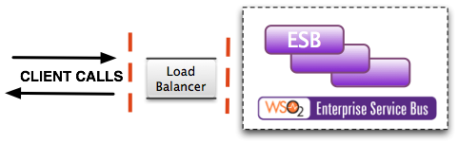
High Availability and Scalability
Supports Active/Active, Active/Passive Scenarios
ESB itself can act as load-balancer.
Auto-scaling using Load Balancer component
Deployment Synchronizer can be used to maintain configuration across clusters.

Slide 32
How does mediation / integration fit into Microservices / Containers?
One view:
Smart endpoints and dumb pipes
Another approach
Micro-integrations
Each container just handles a single flow
Apache Camel with Java DSL is good for this
In some scenarios
Where is the canonical model in this world?
Do we still need declarative languages with better DevOps?

Slide 33
Ballerina Language
A new integration language and framework for Microservices, RESTful SOA
Based on Swagger and Sequence Diagrams
Textual and graphical are 100% interchangeable
http://ballerinalang.org

Slide 34
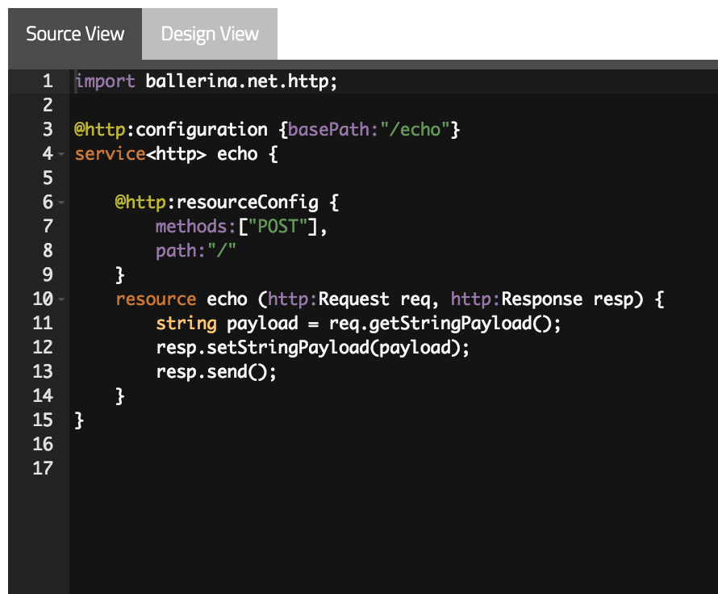
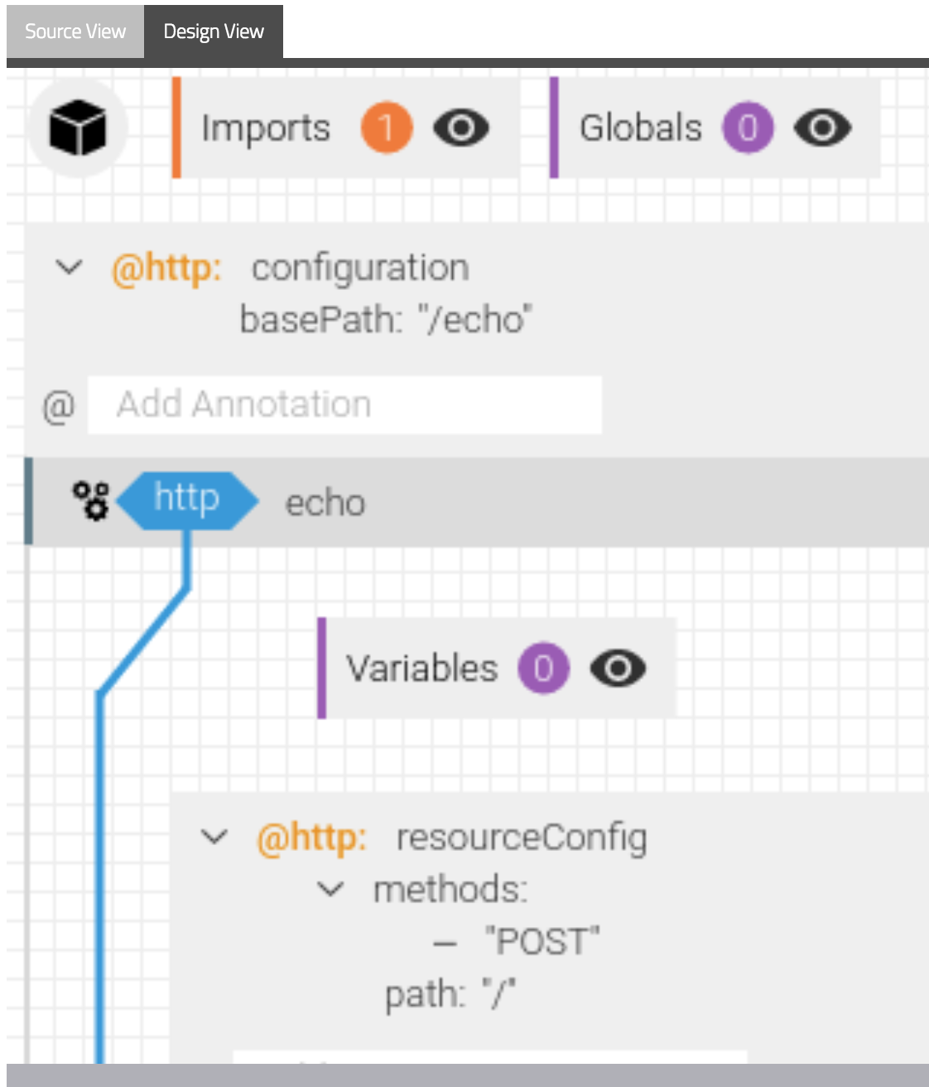
Ballerina diagram and language

Slide 35
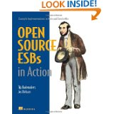
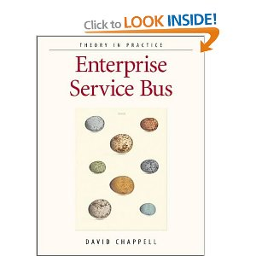
Resources
Wikipedia!
http://en.wikipedia.org/wiki/Enterprise_service_bus
Books
David Chappell: ESB
Open Source ESBs in Action
Open Source
synapse.apache.org
wso2.com/products/enterprise-service-bus
servicemix.apache.org

