Slide 1
Understanding HTTP and REST
Oxford University
Software Engineering Programme
May 2017

Slide 2

World Wide Web
navigating document collections
multimedia documents
hypertext cross-references
hypertext markup language
(HTML)
hypertext transfer protocol
(HTTP)
Tim Berners-Lee at CERN, 1989–1992

Slide 3
HTTP
two-way transmission of requests and responses
layered over TCP
essentially stateless (but. . . )
standard extensions for security

Slide 4
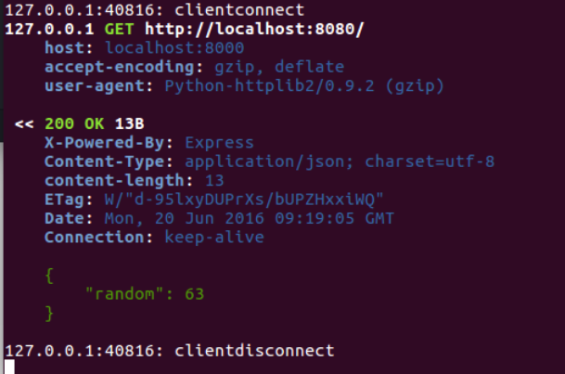

Slide 5
HTTP “Verbs”
GET uri
read a document; should be “safe”
PUT uri, data
create or modify a resource; should be idempotent
POST uri, data
create a subordinate resource
DELETE uri
delete a resource; should be idempotent
(also HEAD, TRACE, OPTIONS, CONNECT and now PATCH)

Slide 6
URIs, URNs, URLs
uniform resource identifier (URI)
uniform resource locator (URL)
uniform resource name (URN)
http://fremantle.org/hello
Is it a URI? URL? URN?

Slide 7
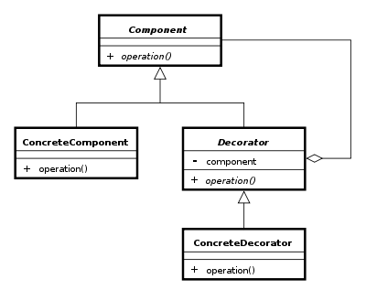
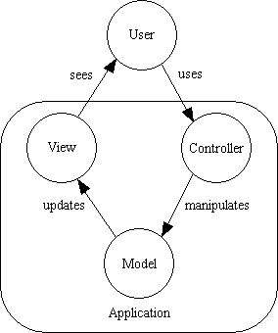
Examples of Design Patterns

Slide 8
REST is a design pattern
Also characterized as an Architectural Style (aka an architecture design pattern)

Slide 9
Resource Oriented Architecture
Resource-oriented architecture
after Richardson & Ruby, RESTful WS
action identified in HTTP method, not in payload
scoping information in URI

Slide 10
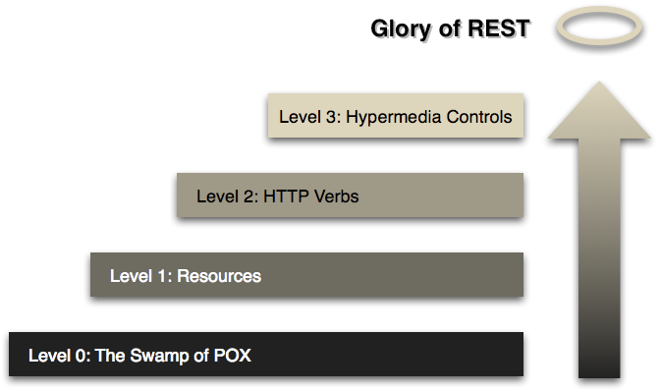
Richardson’s Maturity Model

Slide 11
HTTP good bad and ugly
Good
GET reports/open-bugs HTTP/1.1
in contrast to RPC-style interaction
Bad
POST /rpc HTTP/1.1 Host: www.upcdatabase.com <?xml version="1.0”> <methodCall> <methodName>lookupUPC</methodName> … </methodCall>
Ugly
http://www.flickr.com/services/rest?method=search&tags=cat

Slide 12
PUT vs POST
PUT vs POST
creation by either PUT to new URI or POST to existing URI
typically, create a subordinate resource with a POST to its parent
use PUT when client chooses URI; use POST when server chooses
successful POST returns code 201 ‘Created’ with Location header
(POST also sometimes used for form submission, but this can be non-uniform)

Slide 13
Resource Representations and States
Interact with services using representations of resources.
An XML representation
A JSON representation
An object referenced by one URI can have different formats available. Different platforms need different formats.
A mobile application may need JSON
A Java application may need XML.
Utilize the Content-Type header
And the Accept: header
Communicate in a stateless manner
Stateless applications are far more scaleable

Slide 14
Hypertext as the Engine of Application State
Resources are identified by URIs
↓
Clients communicate with resources via requests using a
standard set of methods
↓
Requests and responses contain resource representations
in formats identified by media types
↓
Responses contain URIs that link to further resources
↓
Beginning

Slide 15
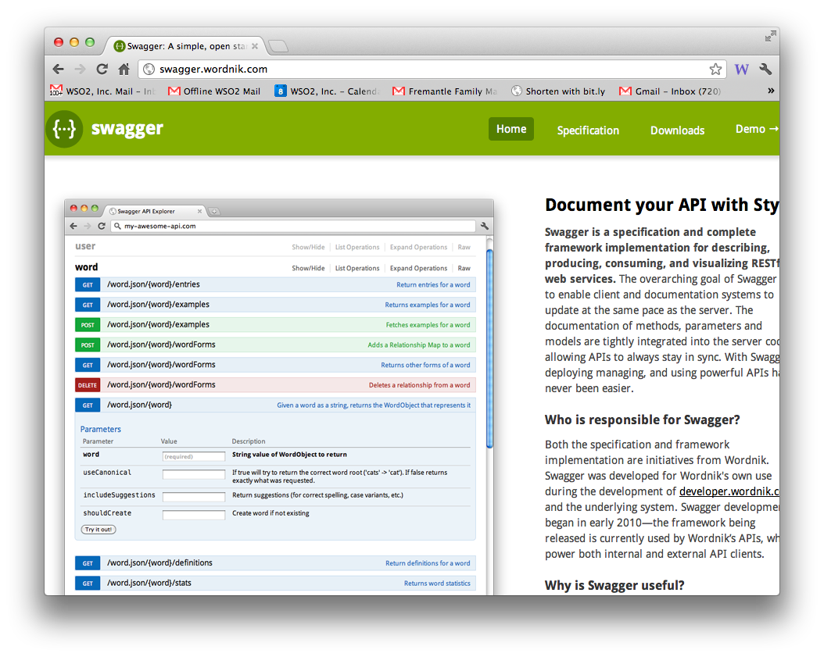
REST description

Slide 16
JSON
A simple notation that originated in JavaScript
var x = {a:1, b:2, c:3}
equivalent to:
x.a = 1; x.b = 2; x.c = 3
Can be done “dynamically”
var x = “{a:1, b:2, c:3}”
// imagine this actually
// comes from a webserver
var z = eval(‘(‘+x+’)’)
assert(z.a == 1)

Slide 17
Return codes
Good RESTful design means proper use of return codes…
Why?

Slide 18
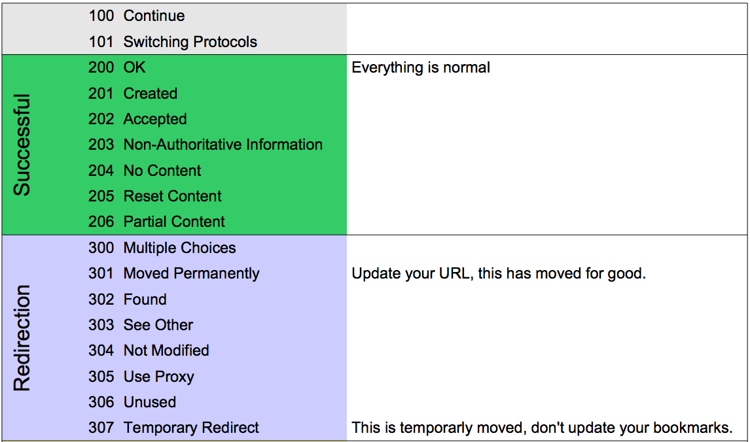
HTTP return codes
http://www.cheat-sheets.org/saved-copy/http-response-codes-1.pdf

Slide 19
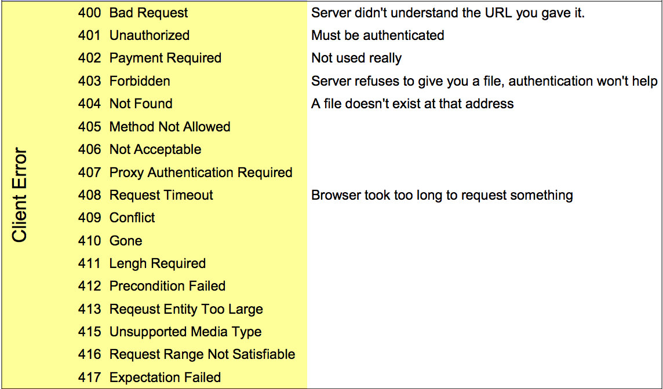
Client Error Codes

Slide 20
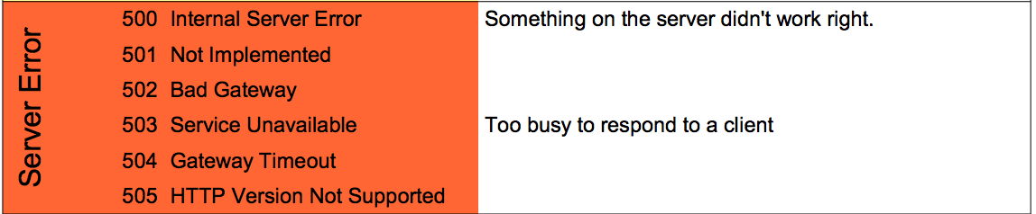
Server Error Codes

Slide 21
Summary
Basic REST concepts:
Use the right VERB
Use the right return code
Use well defined media types
Resource representation
Use hyperlinks for HATEOAS

Slide 22
Our sample Purchase service

Slide 23
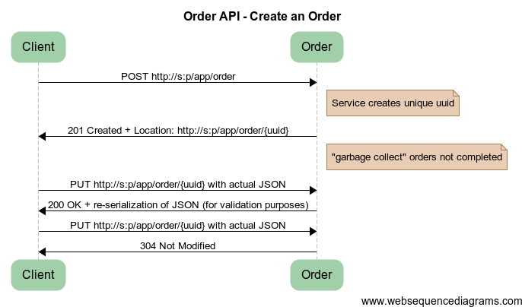
Create an Order
Notes:
title Order API - Create an Order
Client -> Order: POST http://s:p/app/order
note right of Order: Service creates unique uuid
Order -> Client: 201 Created + Location: http://s:p/app/order/{uuid}
note right of Order: "garbage collect" orders not completed
Client -> Order: PUT http://s:p/app/order/{uuid} with actual JSON
Order -> Client: 200 OK + re-serialization of JSON (for validation purposes)
Client -> Order: PUT http://s:p/app/order/{uuid} with actual JSON
Order -> Client: 304 Not Modified

Slide 24
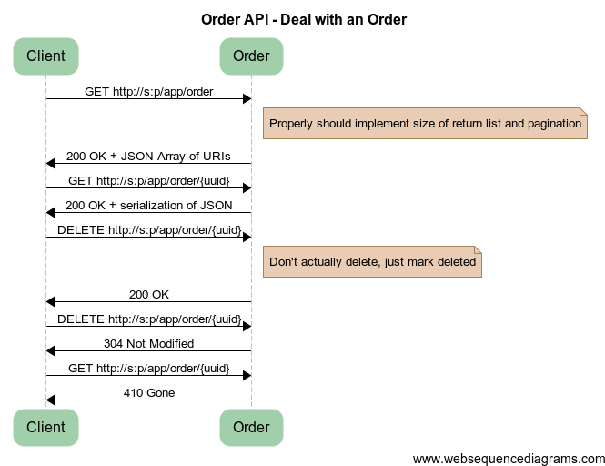
Notes:
title Order API - Deal with an Order
Client -> Order: GET http://s:p/app/order
note right of Order: Properly should implement size of return list and pagination
Order -> Client: 200 OK + JSON Array of URIs
Client -> Order: GET http://s:p/app/order/{uuid}
Order -> Client: 200 OK + serialization of JSON
Client -> Order: DELETE http://s:p/app/order/{uuid}
note right of Order: Don't actually delete, just mark deleted
Order -> Client: 200 OK
Client -> Order: DELETE http://s:p/app/order/{uuid}
Order -> Client: 304 Not Modified
Client -> Order: GET http://s:p/app/order/{uuid}
Order -> Client: 410 Gone

Slide 25
Questions?

