Slide 1
Microservices and Service Mesh
Oxford University
Software Engineering Programme
December 2019

Slide 2
Agenda
Why?
History and evolution
Architecture
Pros and Cons
More resources

Slide 3
Microservices
Building a single app from multiple services
Each service in its own process
Lightweight communications between each other
HTTP REST or Async models (ZeroMQ, Kafka, RabbitMQ, etc)

Slide 4
Microservices Characteristics (Martin Fowler)
Componentization
Replacability
Organisation
around business capabilities instead of around technology.
Smart endpoints and dumb pipes
explicitly avoiding the use of an Enterprise Service Bus (ESB)
Decentralised data management
with one database for each service instead of one database for a whole company.
Infrastructure automation
with continuous delivery being mandatory.
http://martinfowler.com/articles/microservices.html

Slide 5
You build it you run it
Amazon story
2001
Exactly equal to Microservices!
(this isn’t new!)

Slide 6
Benefits of Microservices
Independent organization makes it easier for developers
Separation of concern
Simple code
Simple test cases
Simple scaling
Faster to build, deploy and test

Slide 7
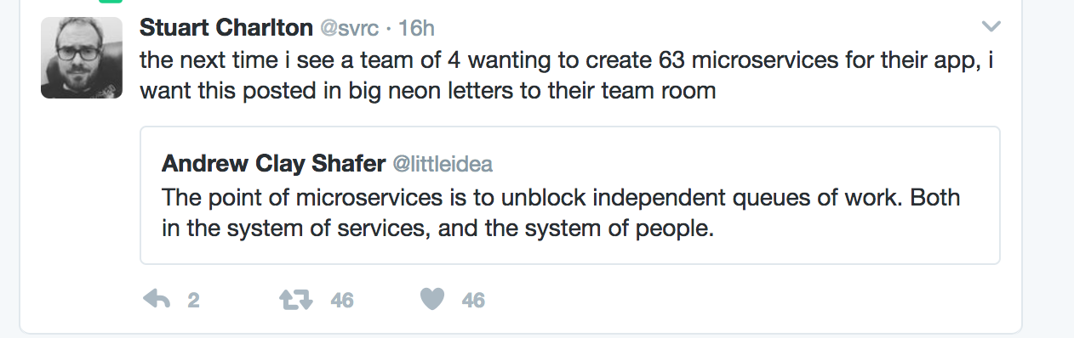

Slide 8
Microservices deployment model
Increasingly fitting with “containerisation”
Docker
CoreOS
Kubernetes
Etc
Container model is lightweight virtualization with each “VM” running a single process

Slide 9
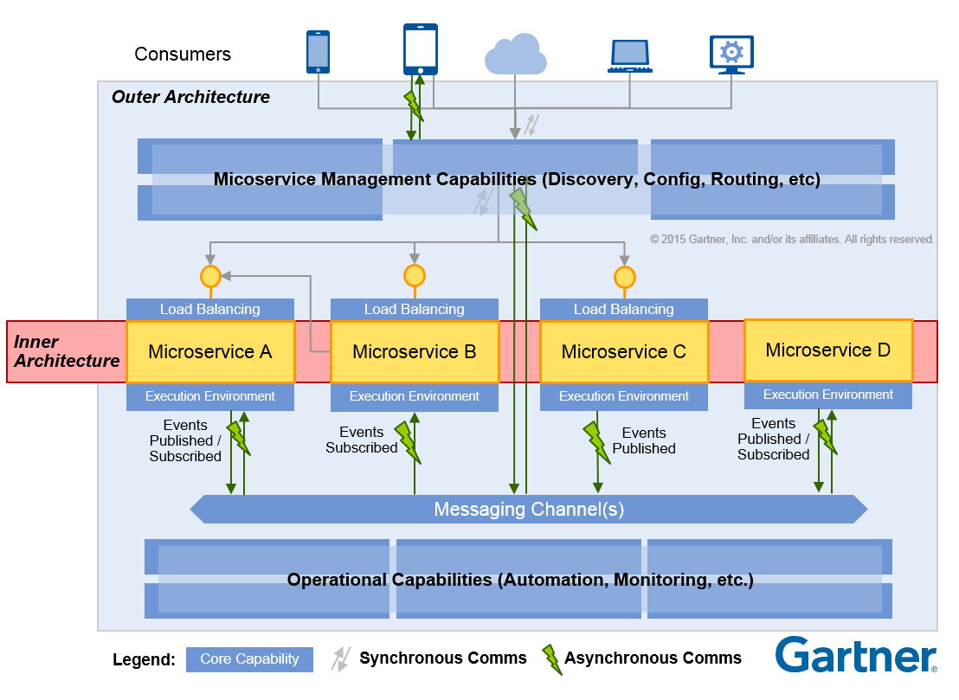

Slide 10
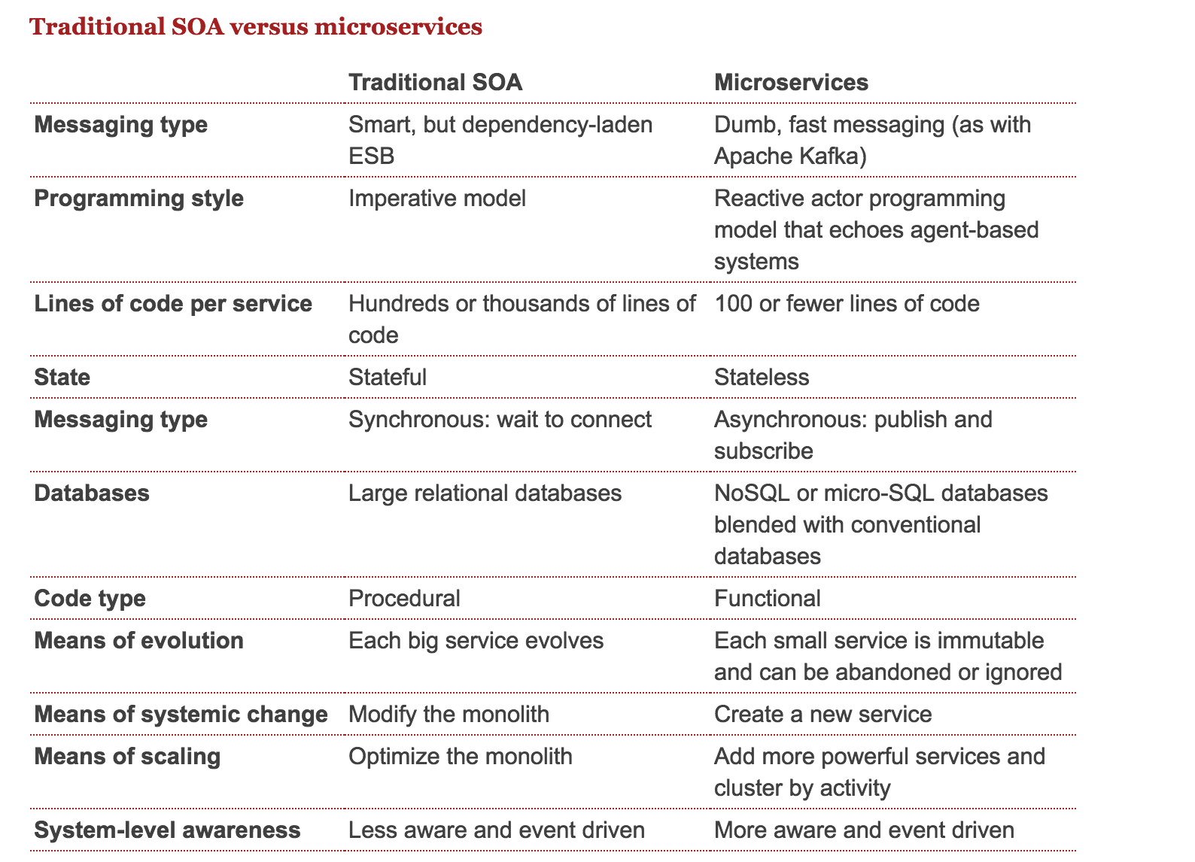

Slide 11
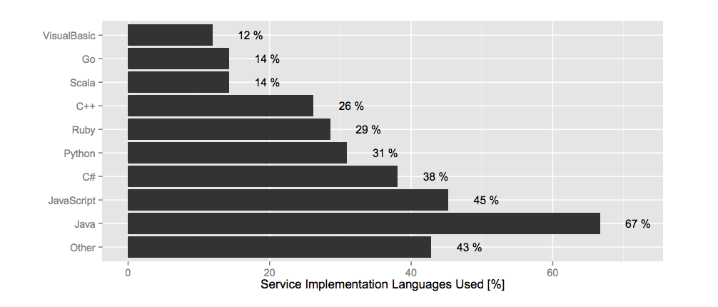
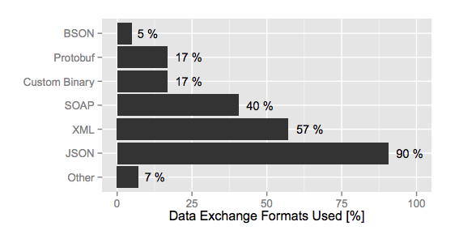
What are services like in reality?
Most services (51%) were 1,000-10,000 LoC
Only 3% of services in the survey were <100 LoC
43% 100-1,000 LoC
All the Services Large and Micro: Revisiting Industrial Practice in Services Computing
https://peerj.com/preprints/1291.pdf

Slide 12
Real world examples
The previous case studies are in many cases microservices
eBay, Netflix, Amazon
Many more out there and growing rapidly

Slide 13
Polyglot
Microservices can be built in multiple languages
Hackathon last year I built a simple app
Node, Python and MQTT
One day’s effort
Microservice architecture
http://pzf.fremantle.org/2013/12/commshack.html

Slide 14
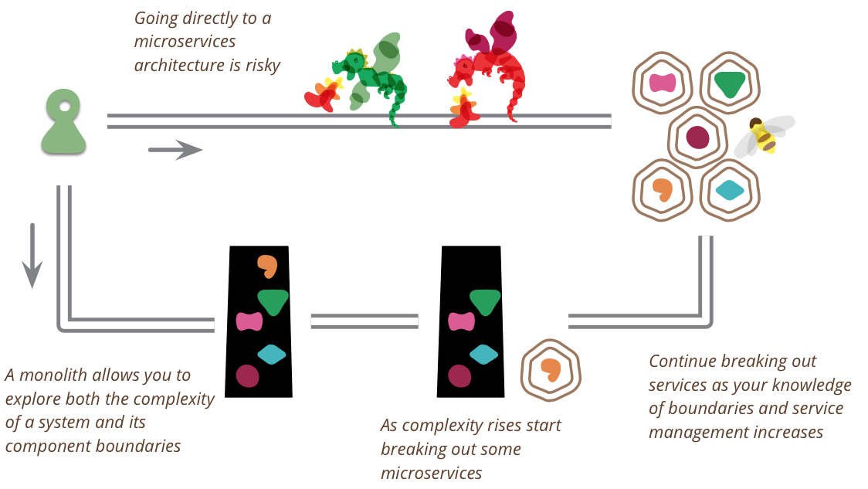
Start with a Monolith?
http://martinfowler.com/bliki/MonolithFirst.html

Slide 15
Cons!
Debugging
Deployment and devops
Operations overhead
Implicit interfaces and contracts
Latency
Transactions
Etc.!

Slide 16
Smart endpoints and dumb pipes
Microservices are based on the idea of simple RESTful APIs directly implemented
Need to manage contracts cleanly and carefully
ESB is not part of this architecture
But an API Gateway might be
Don’t confuse the application architecture with the Enterprise architecture

Slide 17
Micro and Macro Services
API Facade
API Facade
API Facade

Slide 18
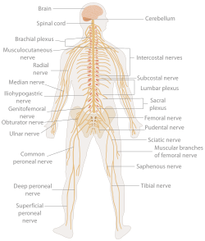
Control Plane

Slide 19
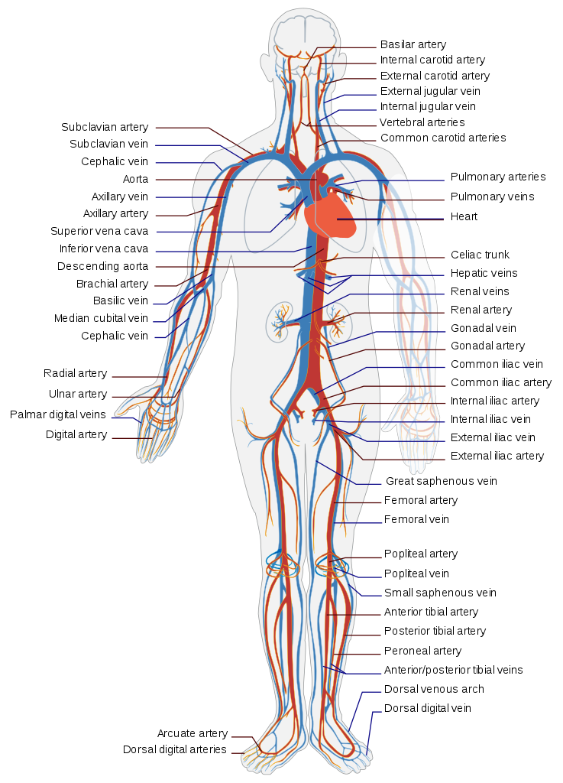
Data Plane

Slide 20
API Gateway and Microservices
Versioning
Single URI structure out of many independent backends
Contracts and documentation
More discussion later

Slide 21
Service Mesh
How do I guarantee resilience in a microservices environment?
Load-balancing, failover, discovery
Building it into code is complex
Libraries such as Hystrix help
But inhibits polyglot
Each language needs its own approach

Slide 22
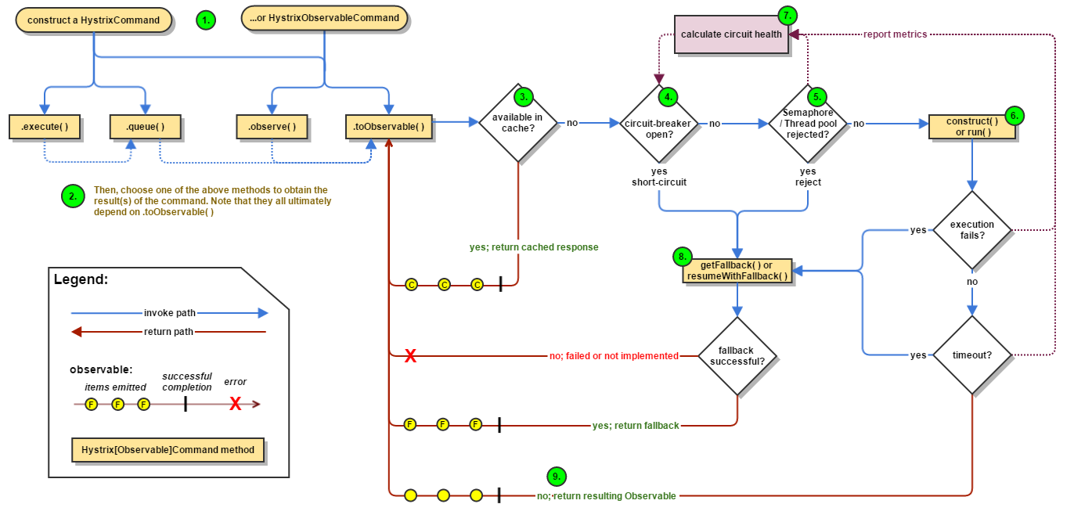
https://github.com/Netflix/Hystrix/wiki/How-it-Works

Slide 23
Service Mesh
Sidecar architecture
Container
Container
Microservice
Microservice
Service Mesh
Sidecar
Service Mesh
Sidecar

Slide 24
Service Mesh
Load-balancing, circuit breakers
Discovery / Naming
Traffic control
Per-request/content-based routing
Timeouts and deadlines
Mutual TLS
Observability

Slide 25
Service Mesh implementations
Envoy
And hence Istio
Linkerd
Consul

Slide 26
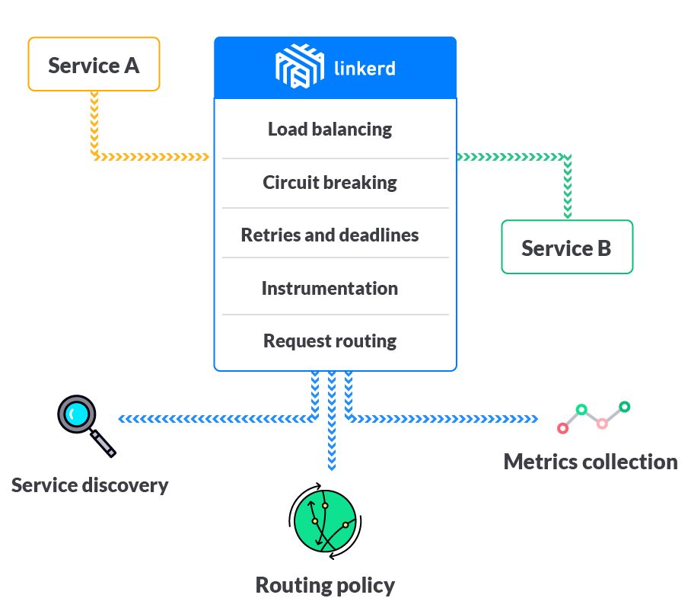
Linkerd

Slide 27
The cell is the basic structural, functional, and
biological unit of all known living organisms

Slide 28
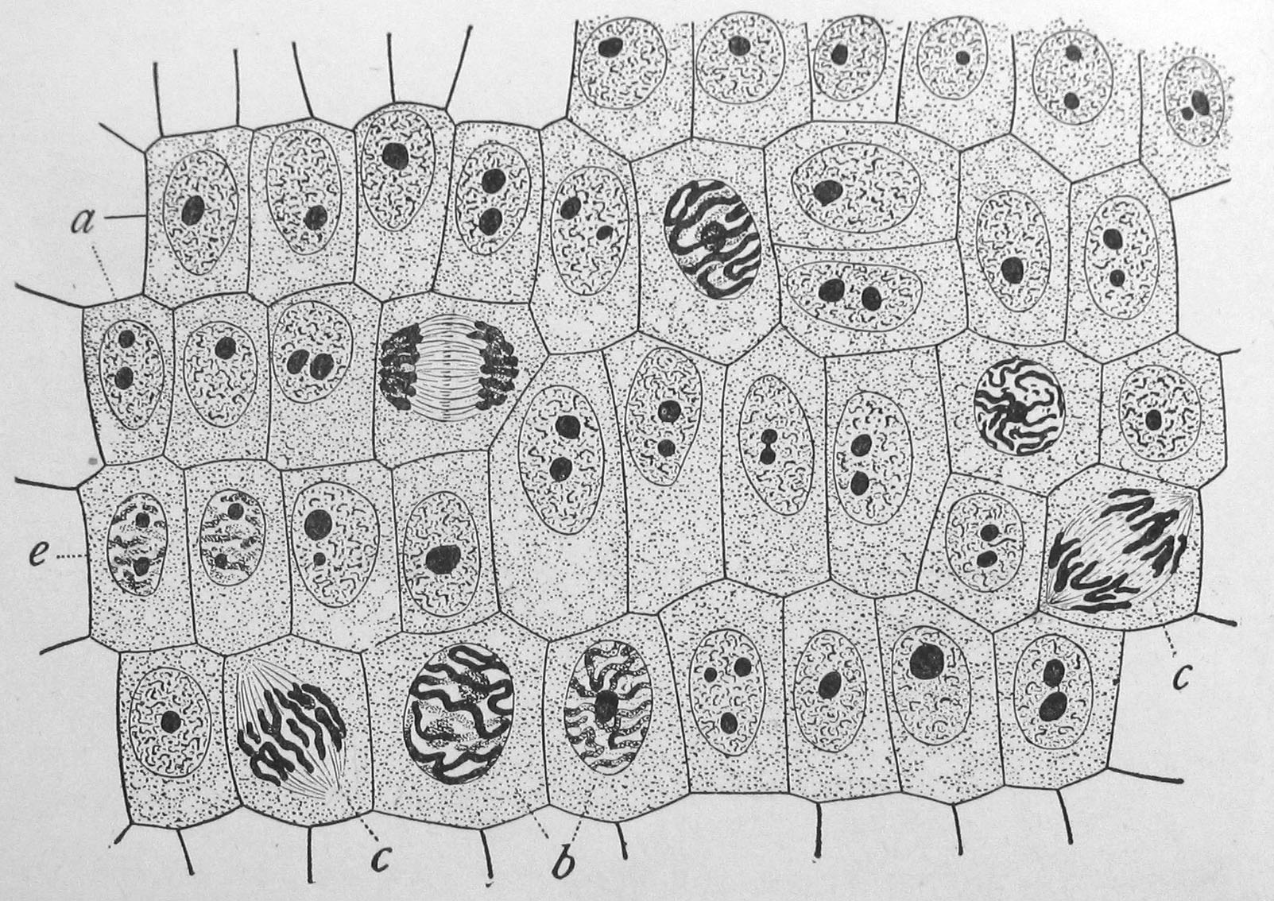

Slide 29
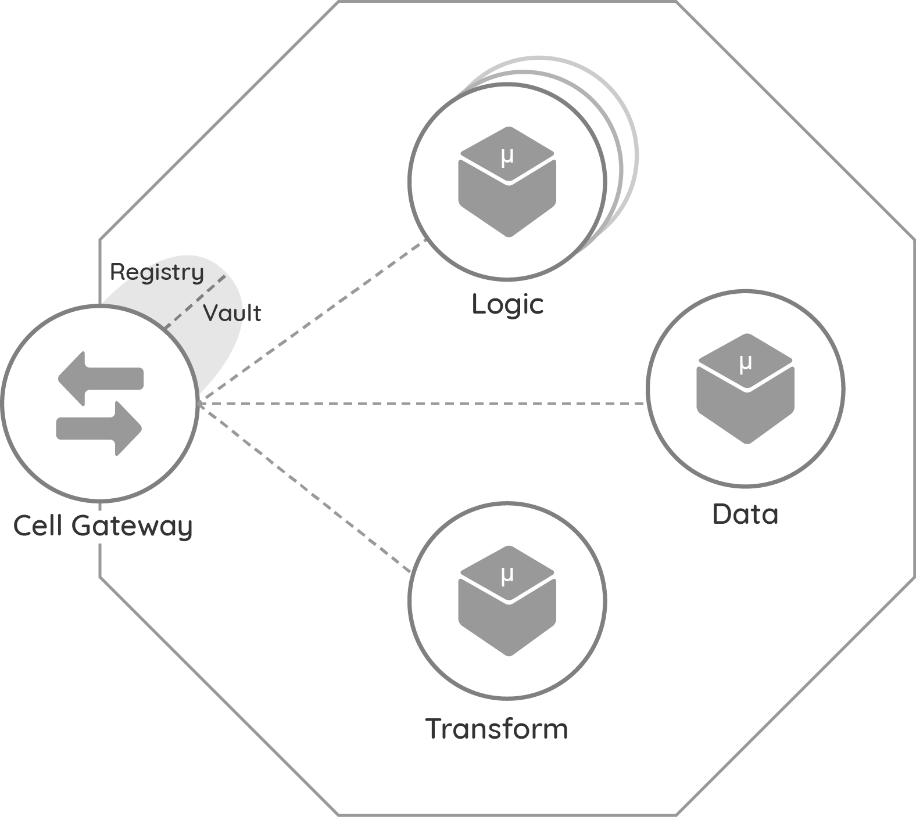
Cells Are Building Blocks For The Composable Enterprise
https://github.com/wso2/reference-architecture/blob/master/reference-architecture-cell-based.md
Self-contained
Deployable as a unit
Independently elastic
Data plane and control plane

Slide 30
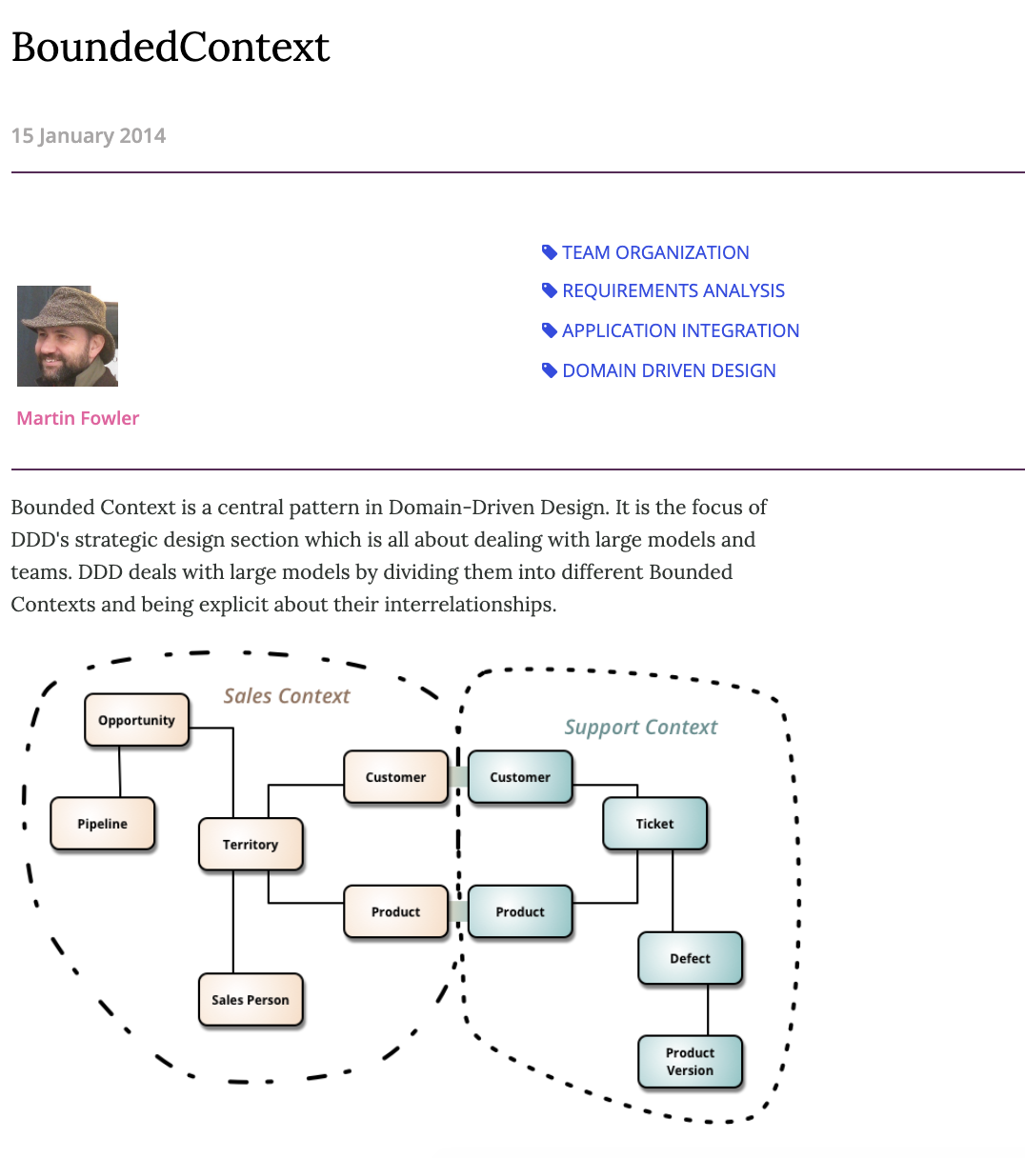

Slide 31
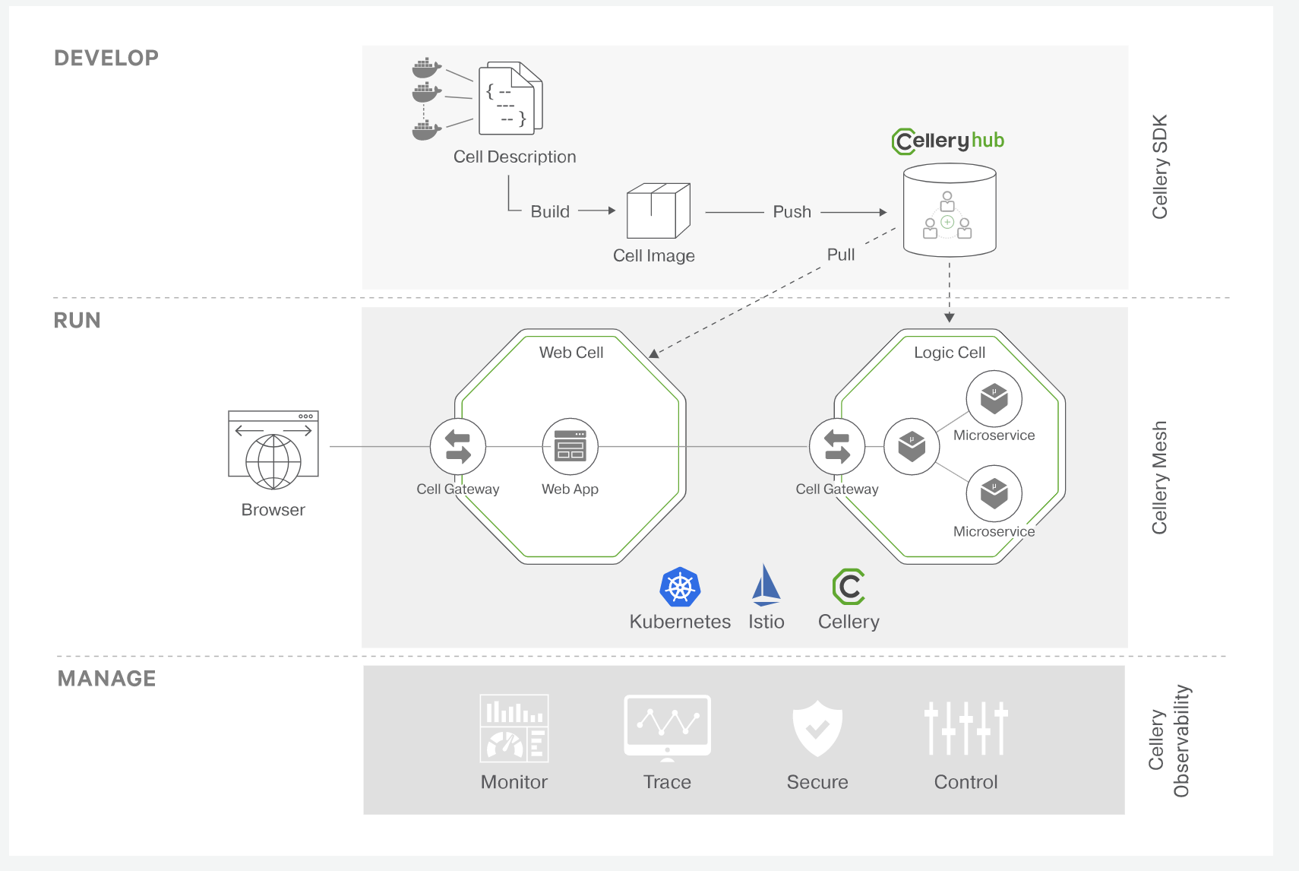
Cellery https://celery.io

Slide 32
Resources
http://www.slideshare.net/chris.e.richardson
http://martinfowler.com/articles/microservices.html
http://www.thoughtworks.com/insights/blog/microservices-nutshell

