Slide 1
Conclusions, Evolution of SOA, Futures
Oxford University
Software Engineering Programme
May 2017

Slide 2
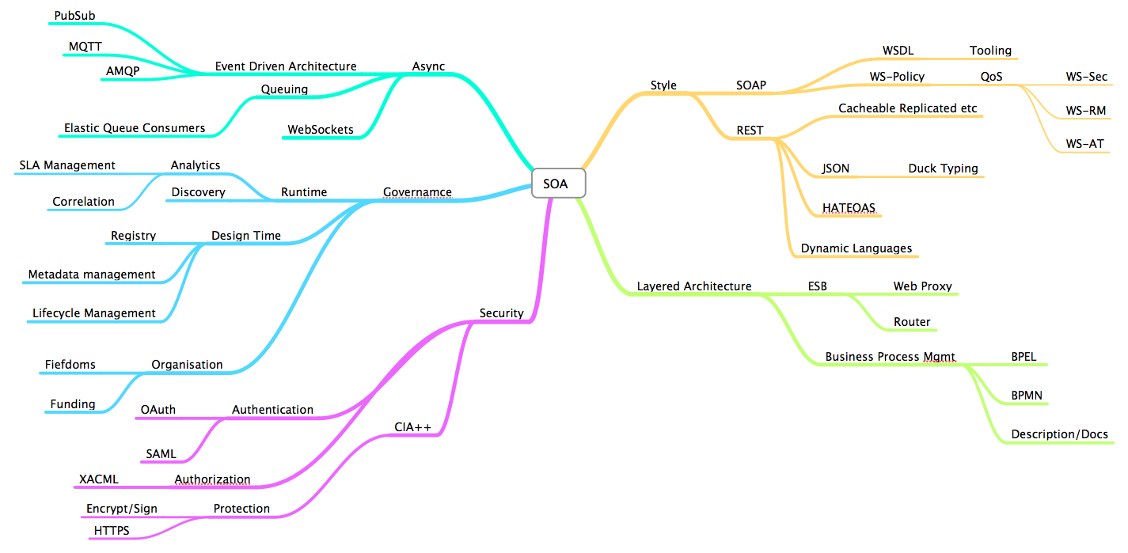

Slide 3
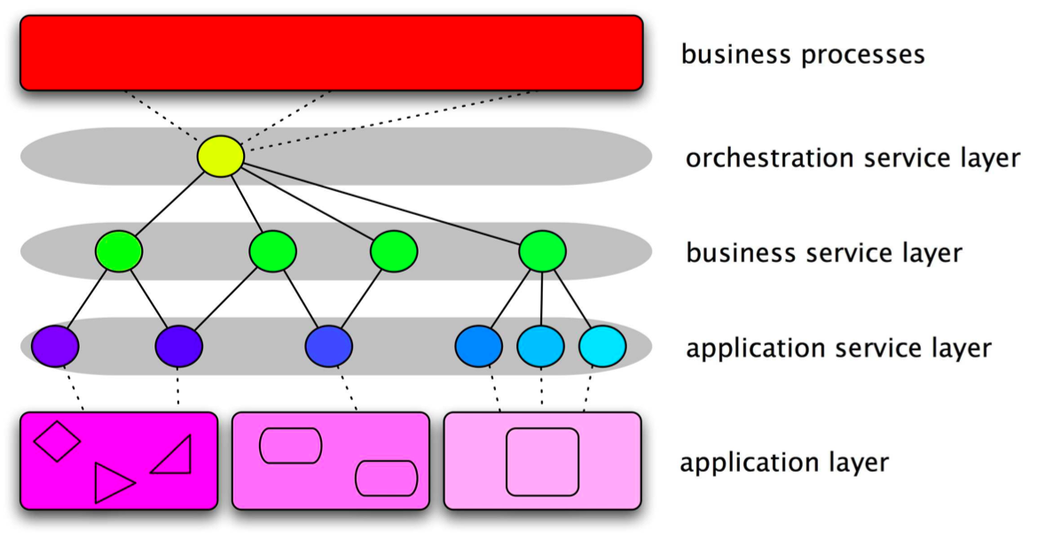
SOA

Slide 4
SOAP and WS-*
Composable
WS-Security, ReliableMessaging, etc
Transport independent
Tooling
Schemas and WSDLs
Governance

Slide 5
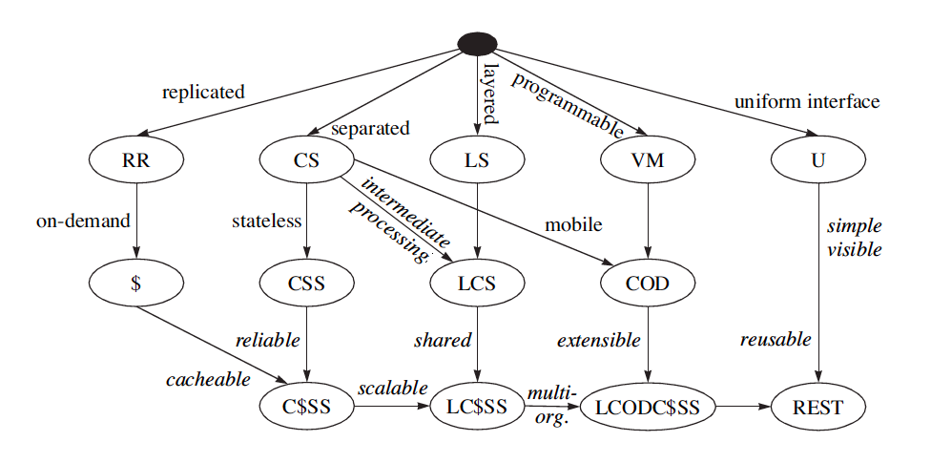
REST

Slide 6
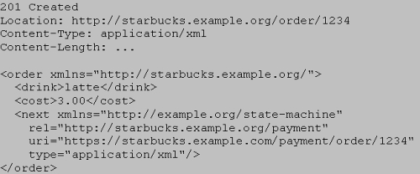
HATEOAS

Slide 7
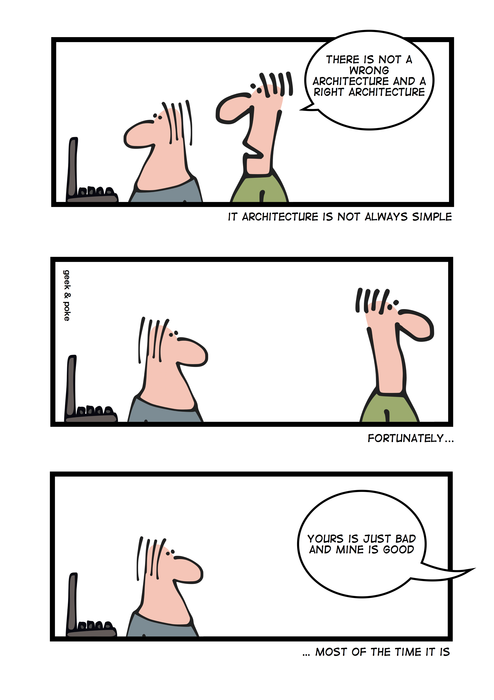

Slide 8
Design Governance
Interfacing SOA into the build/test/production
Encouraging Service Re-Use
Lifecycle and Dependency Management
Notification

Slide 9
Runtime Governance
Monitoring
SLA management
Correlation of activities into flows
How do you maintain a running application when it depends on 10s, 100s or 1000s of remote services?

Slide 10
Services vs APIs
Focus on the consumer
Self-signup and subscription
Tracking and usage
Developer portals and ease-of-use
Monetization

Slide 11
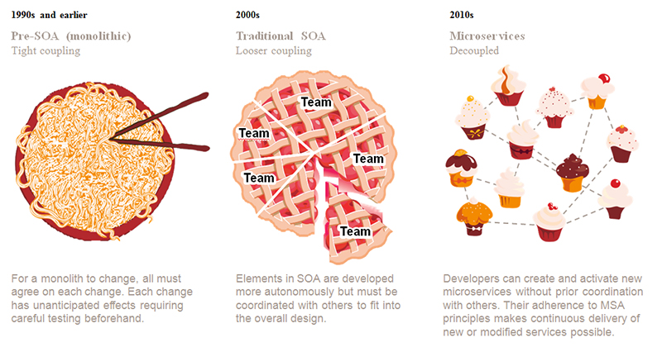
Source: PwC

Slide 12
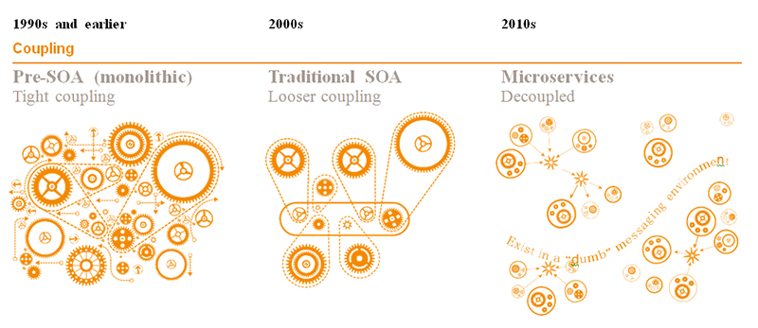
Source: PwC

Slide 13
ESBs and Intermediaries
ESB Patterns
Façade
Hub
Federated
Monitoring point
Transformation
ESB vs Registry or both?
Or a utopia where every service works directly with every other?

Slide 14
Orchestration and Composition
BPMN, BPEL
Executable Documentation?
Visibility and Monitoring

Slide 15
Design Considerations
Granularity of Services
Microservices
Monolith First? Microservice First?
Ensuring that SOA is being used for a good reason:
Scale
Organizational boundaries
Evolvability
Where to draw the boundaries?
Between services
Between microservices and services
Between ESB and BPM
Between organizations
Are your layers right?

Slide 16
Organizational issues
Funding models
Fiefdoms
Ecosystems / Value Webs
Shadow IT / Cloud

Slide 17
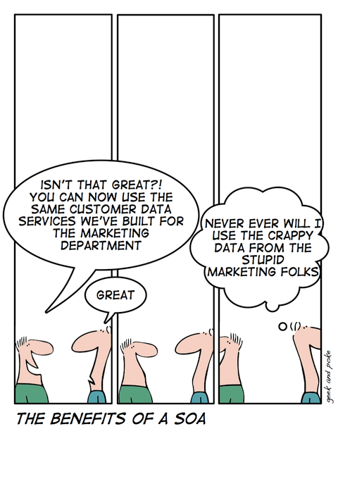

Slide 18
SOA and Cloud
SOA is loose-coupling between applications and applications
Cloud is loose-coupling between applications and infrastructure

Slide 19
What else?

Slide 20
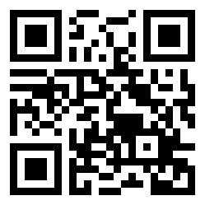
Thanks!
paul@fremantle.org
@pzfreo
LinkedIn/Facebook/Slideshare/Github

