Slide 1
Binary protocols
Oxford University
Software Engineering Programme
December 2019

Slide 2
Data Serialisation
Data in memory needs to be stored on disk or transferred over the wire
Lots of different approaches:
XML
JSON
MsgPack
Thrift
Etc

Slide 3
XML
<?xml version="1.0" encoding="UTF-8"?>
<book>
<isbn>9780262510875</isbn>
<title>Structure and Interpretation of Computer Programs - 2nd Edition
</title>
</book>

Slide 4
JSON
{
"isbn": 9780262510875,
"title": "Structure and Interpretation of Computer Programs - 2nd Edition”
}

Slide 5
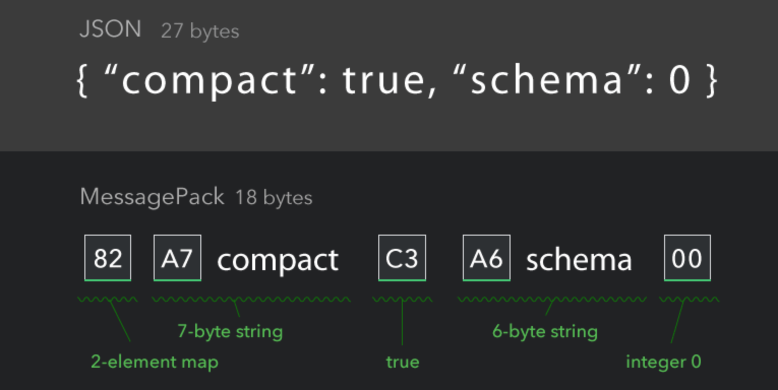
MsgPack

Slide 6
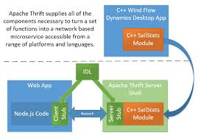
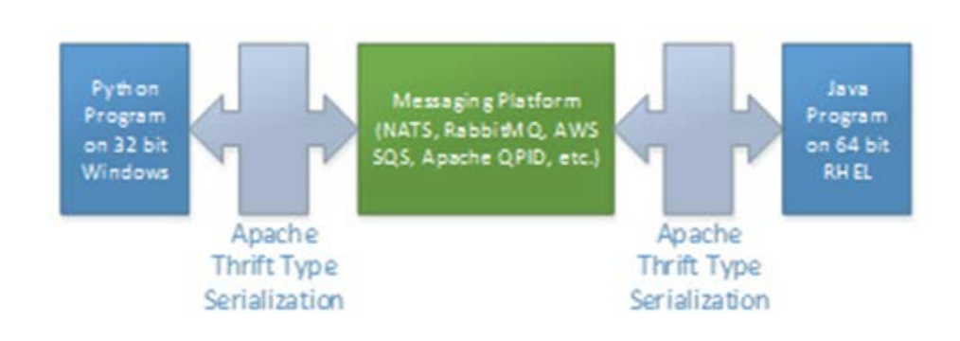
Apache Thrift
Source: The Programmer’s Guide to Apache Thrift

Slide 7
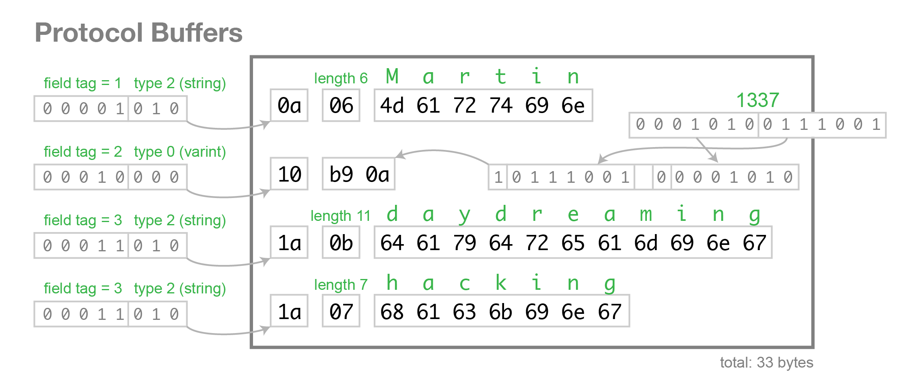
ProtoBuf

Slide 8
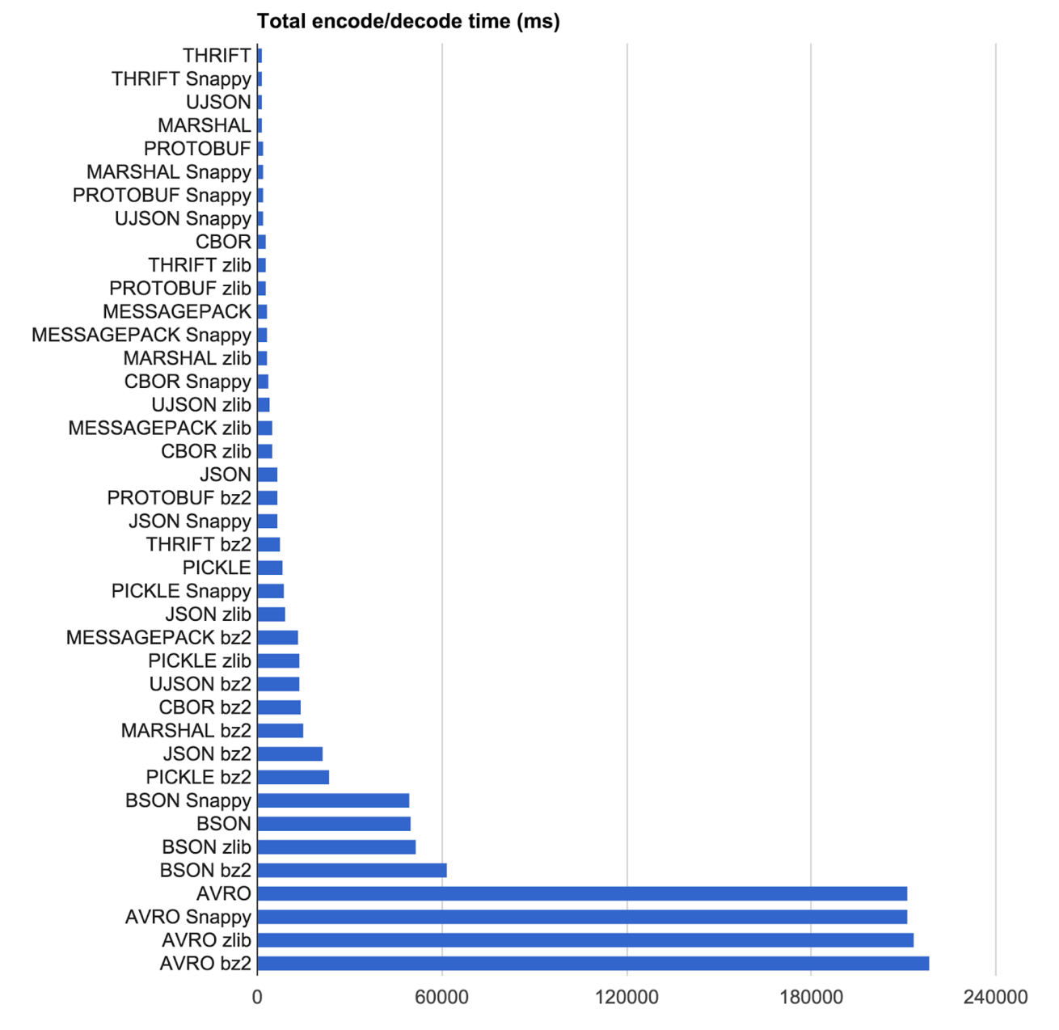
Performance https://eng.uber.com/trip-data-squeeze/

Slide 9
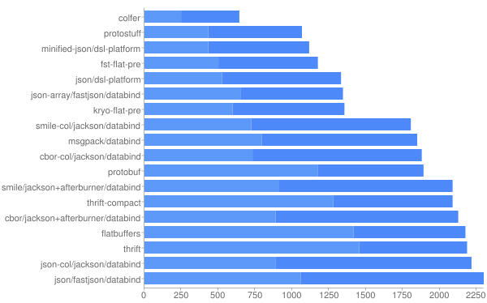
More performance https://github.com/eishay/jvm-serializers/wiki

Slide 10
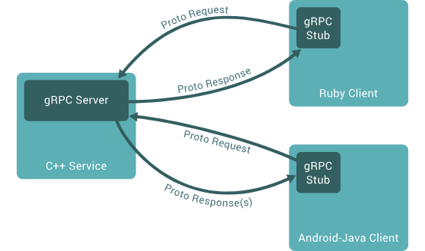
gRPC

Slide 11
gRPC
ProtoBuf over HTTP/2
Supports:
One-way
Request-Response
Request-Stream Response
Bidirectional Stream

Slide 12
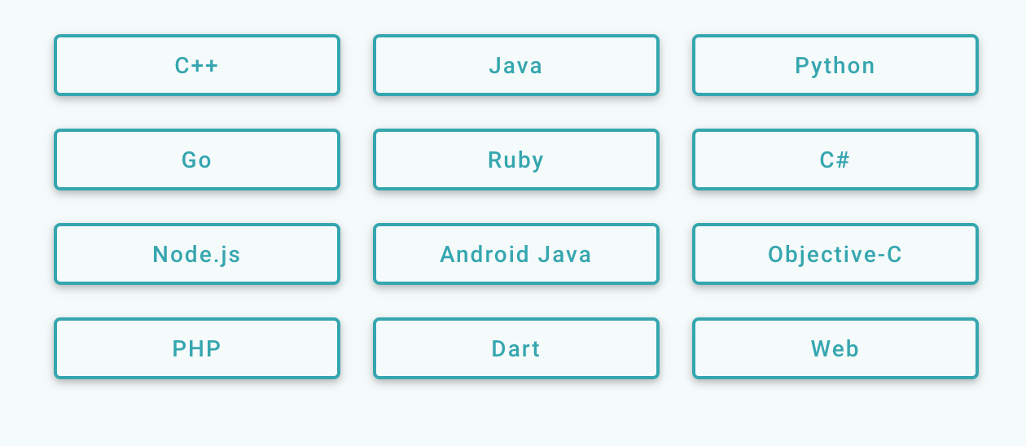

gRPC Language Support

Slide 13
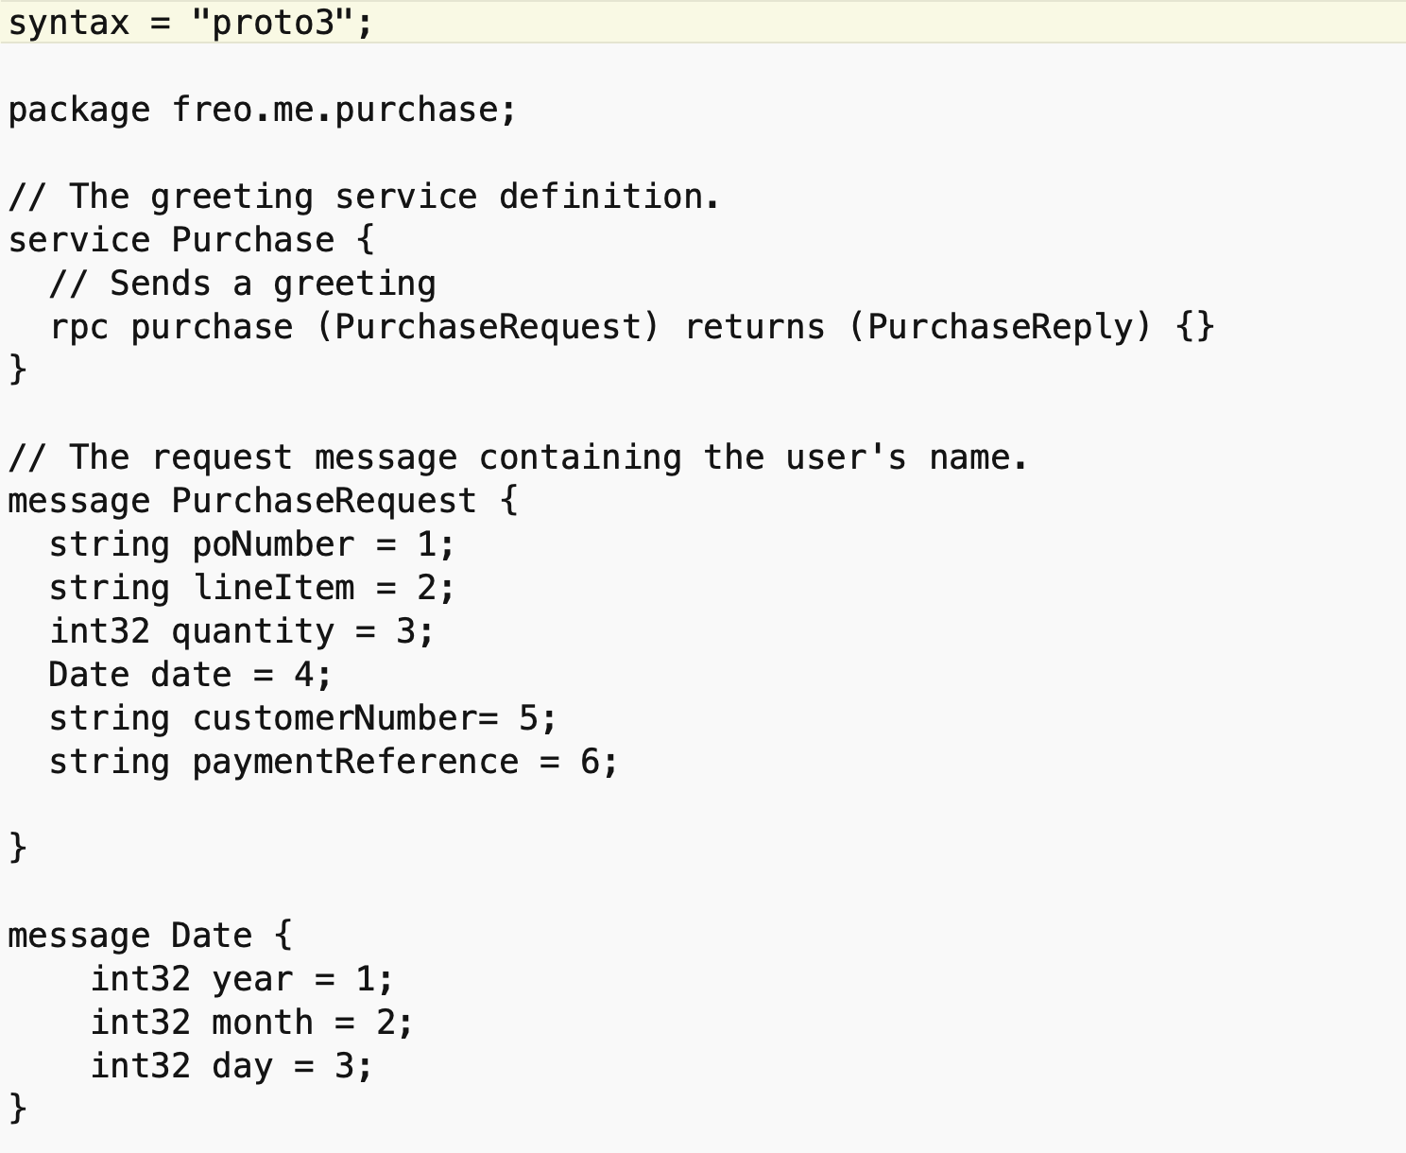

Slide 14
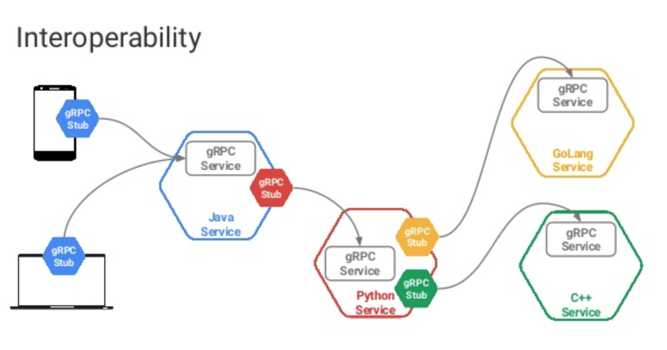
https://in.pycon.org/cfp/2017/proposals/boosting-python-web-applications-with-protocol-buffers-and-grpc~egQZb/

Slide 15
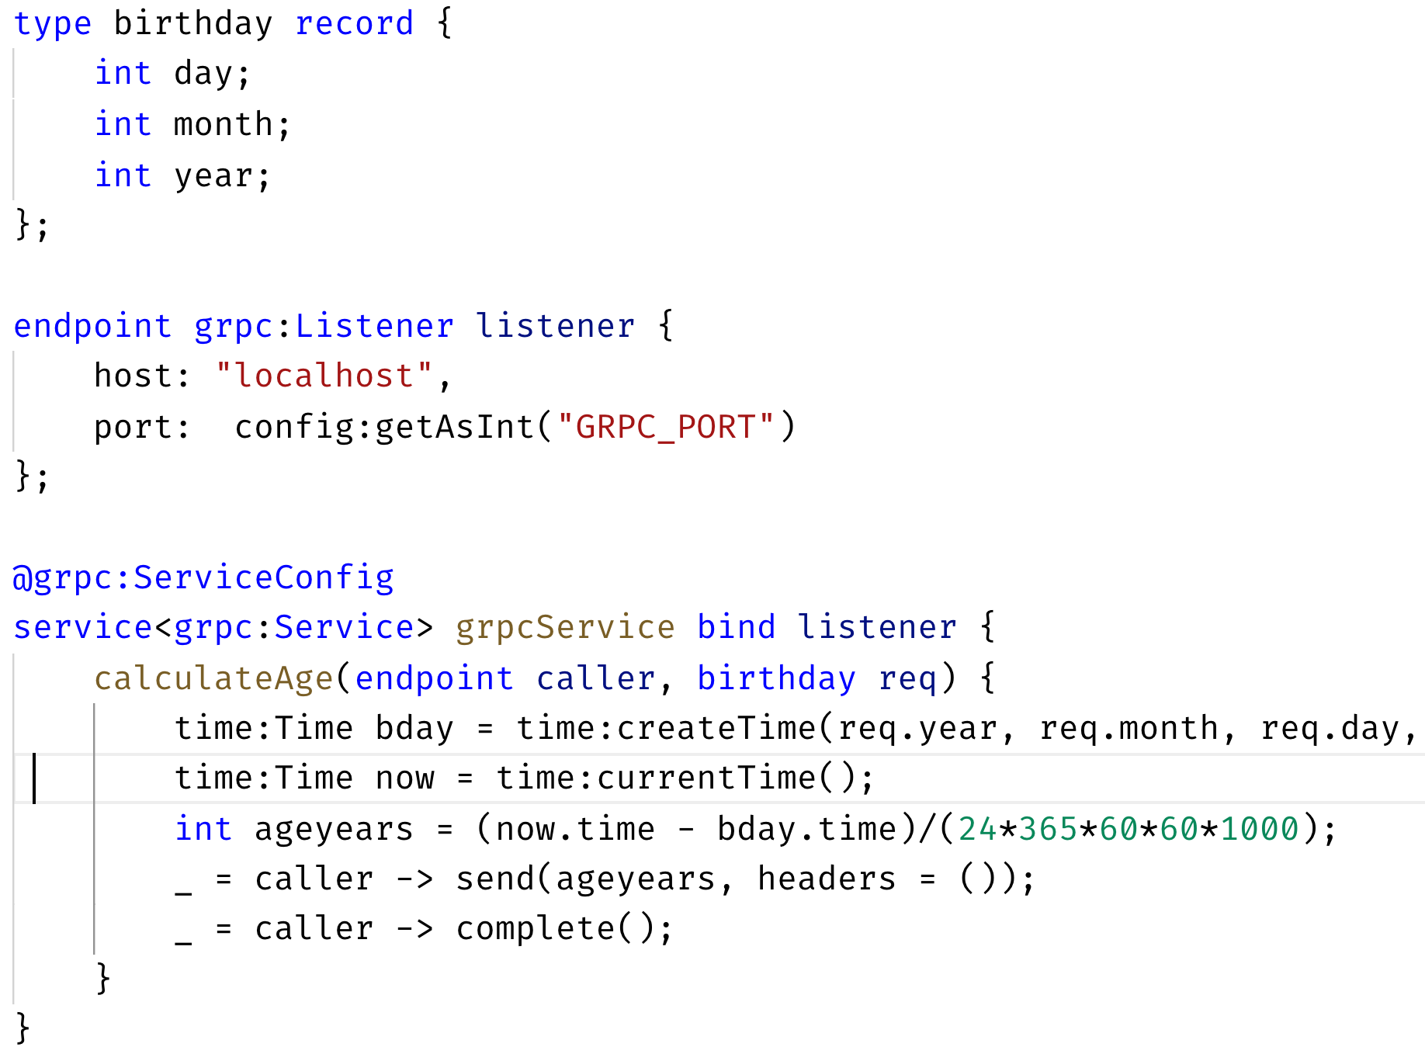
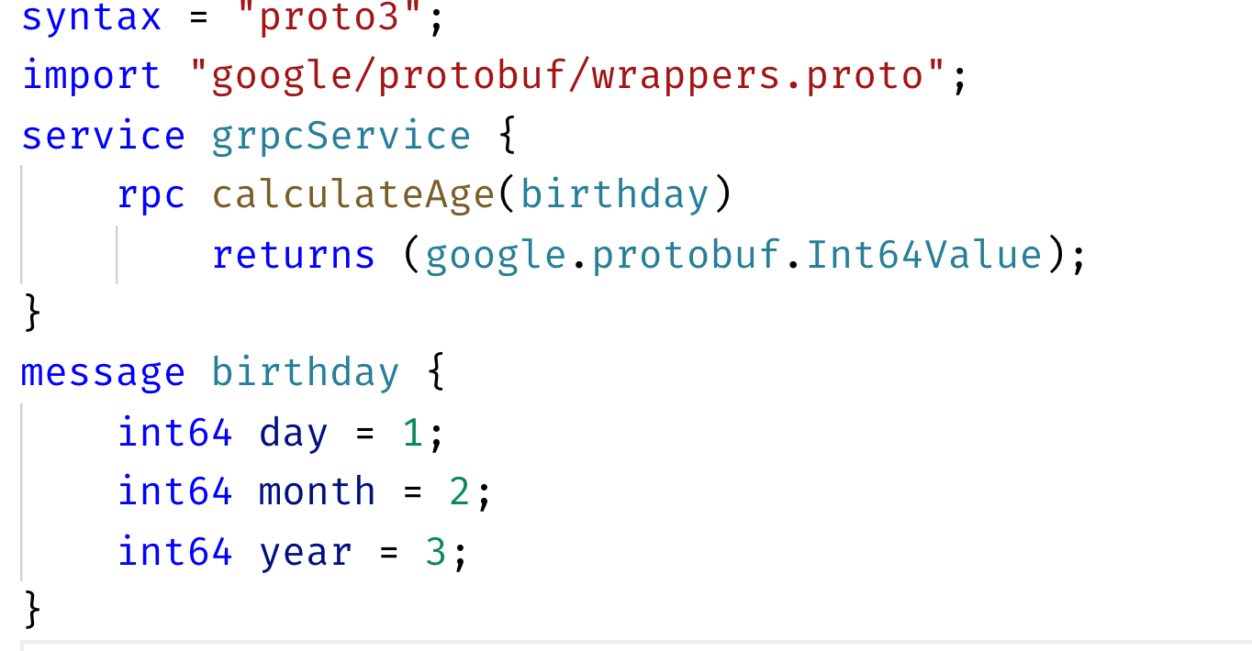
Ballerina and gRPC
Automatically creates this .proto

Slide 16
Questions

