Slide 1
REST description
Oxford University
Software Engineering Programme
January 2018

Slide 2
SOA contracts
Description /
Registry
Client
API or Service

Slide 3
SOAP + WSDL
Enabled a lot of tooling
Very powerful
Built in from day 1
Not perfect
WSDL 1.1 vs 2.0, doc/lit, rpc/lit, rpc/encoded
Not always interoperable

Slide 4
REST description
Do we need it?

Slide 5

2007
Joe Gregorio, REST proponent, bitworking.org

Slide 6
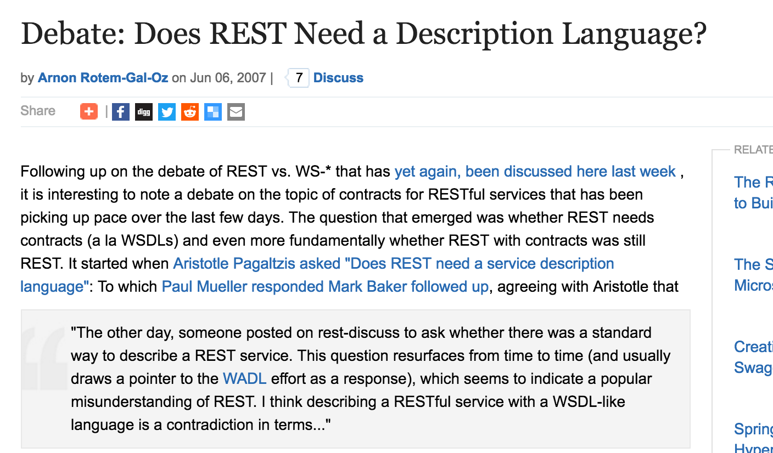
More info
https://www.infoq.com/news/2007/06/rest-description-language

Slide 7
The world has moved on
WADL (pretty much dead)
RAML
www.raml.org
Swagger (aka OpenAPI)
www.swagger.io
https://github.com/OAI/OpenAPI-Specification
API Blueprint
www.apiblueprint.org

Slide 8
Top down or bottom up
Just like WSDL, we can use these for design as well as description
Language neutral way of creating prototype interfaces
More in the API management section

Slide 9
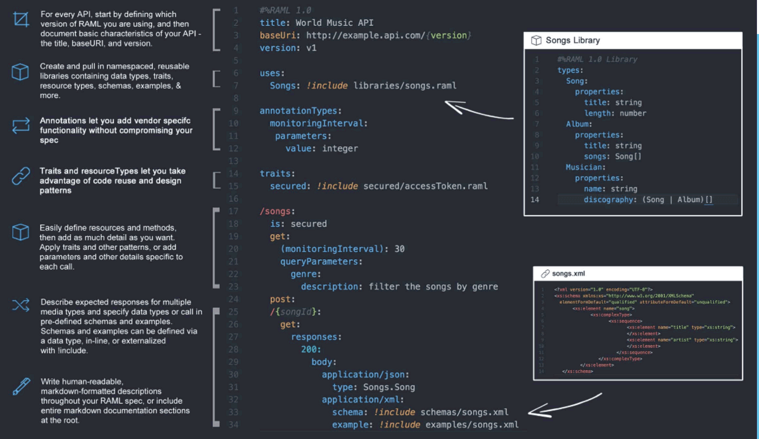
RAML

Slide 10
RAML
YAML language
Easy
Industry support
Basically a Mule project, with some supporters
API console, tooling, etc
All good

Slide 11
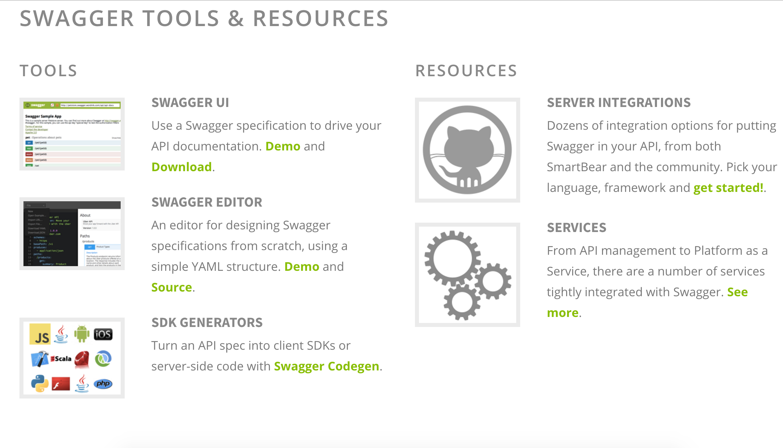
Swagger

Slide 12
Swagger
JSON format is the standard
Now supports YAML too
Now the OpenAPI Initiative
Much wider industry support
Nice editor for design first
Admission: this is the choice of WSO2

Slide 13
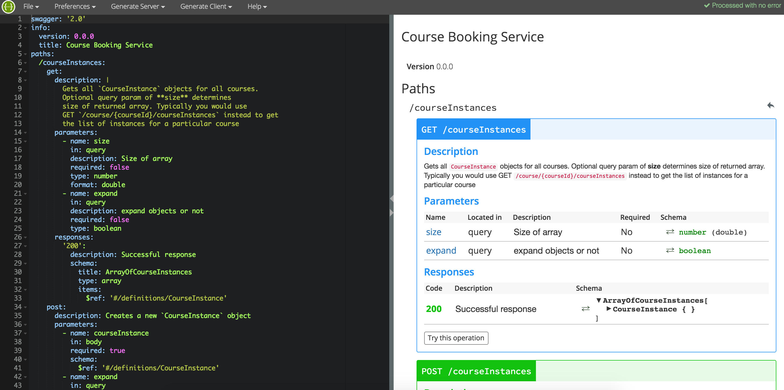
Swagger Editor

Slide 14
Editor features
YAML based
Allows you to dynamically design APIs / RESTful services
Creates skeleton projects in many languages
including Node and JAX-RS
Creates clients in many languages
Too many to list
Import/export JSON

Slide 15
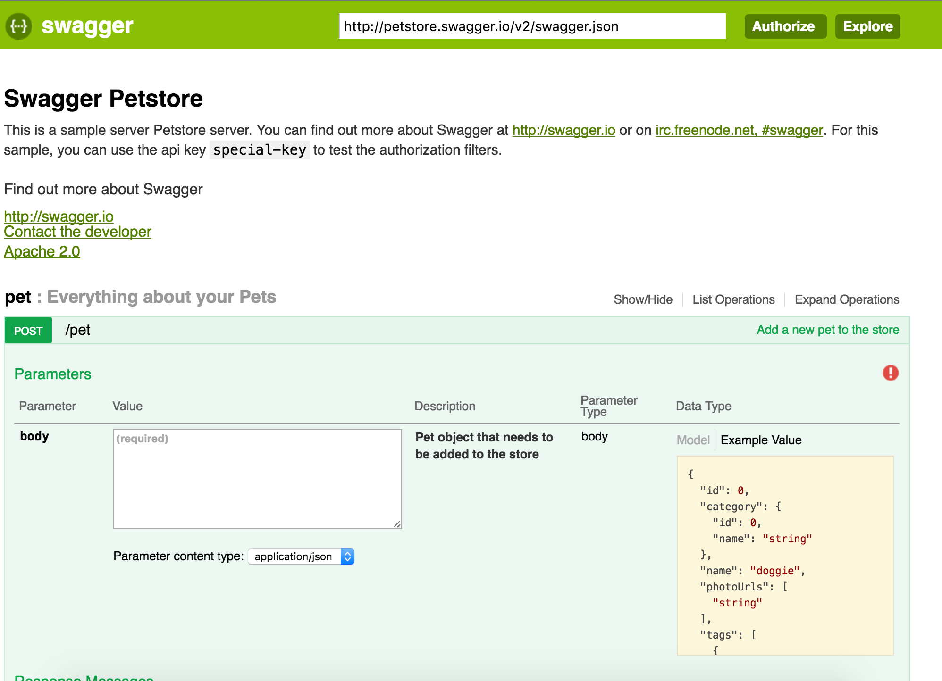
Swagger UI

Slide 16
Questions?

