Slide 1
Choreography and Orchestration of Services
Oxford University
Software Engineering Programme
January 2018

Slide 2
Business Process Management
Hammer & Champy [1993] “A collection of activities that takes one or more kinds of input and creates an output that is of value to the customer.”
Davenport [1992] “A structured, measured set of activities designed to produce a specific output for a particular customer or market. It implies a strong emphasis on how work is done within an organization, in contrast to a product focus’s emphasis on what.”

Slide 3
Composition
Services provide platform- and language-independent access to software components
But these components are isolated: they need to be assembled into service-oriented architectures
Ideally, they should be recursively composable to form composite services in their own right
Workflow languages for scripting or ‘glue’ between individual services
BPMN, WSCI, WSFL, XLANG, BPEL. . .
beyond mere business protocol specifications like RosettaNet, which are essentially paper specifications so can’t be automated and won’t scale

Slide 4
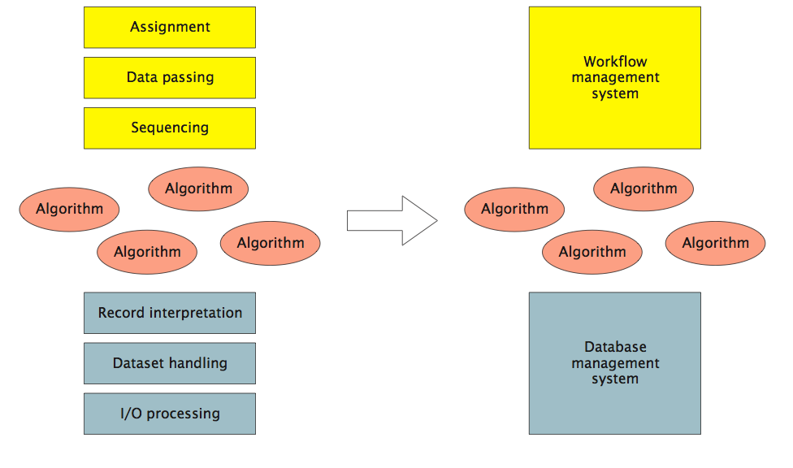
Removal of Dependencies (Leymann and Roller)
DBMS provides independence from data representation; workflow provides independence from control or data flow.

Slide 5
Heritage
Enterprise application integration (EAI)
resolving heterogeneity, typically via asynchronous message brokers
Workflow management systems (WfMS): automating interactions
origins in office automation: admin processes
Production workflows: from information between people to integration of systems
often associated with business process re-engineering: assessment, analysis, modelling, definition, implementation
Service composition = EAI + WfMS

Slide 6
Motivations
Model Business Processes
Understand what happens?
Who is responsible?
What is involved?
Simulate
Improve and model
Execute
Automate processes
Improve them more quickly
Monitor
Get a real-time health status of processes

Slide 7


Orchestration vs Choreography
http://www.flickr.com/photos/herrolm/
http://www.flickr.com/photos/tasuki/

Slide 8
Orchestration vs Choreography
Orchestration
Describes procedure
instructs participants globally – imperative; centralized
typically deterministic: ‘must’
Choreography
Describes protocol
Constraints on interaction, but participants act locally – declarative; no ‘current state’
Usually non-deterministic: ‘may’
Orchestra has a conductor, Ballet does not

Slide 9
WS-Choreography Description Language
http://www.w3.org/TR/ws-cdl-10/
Never got past Candidate Recommendation
Captures the flow of messages between parties
Temporal and logical dependencies between messages
features sequencing rules, correlation, exception handling and transactions
Not executable

Slide 10
BPMN 1.1
Designed to allow process designers to communicate
Think UML
Activities, Gateways, Events
Control and Data Flow
Organization modelling (Pools, Swimlanes)

Slide 11
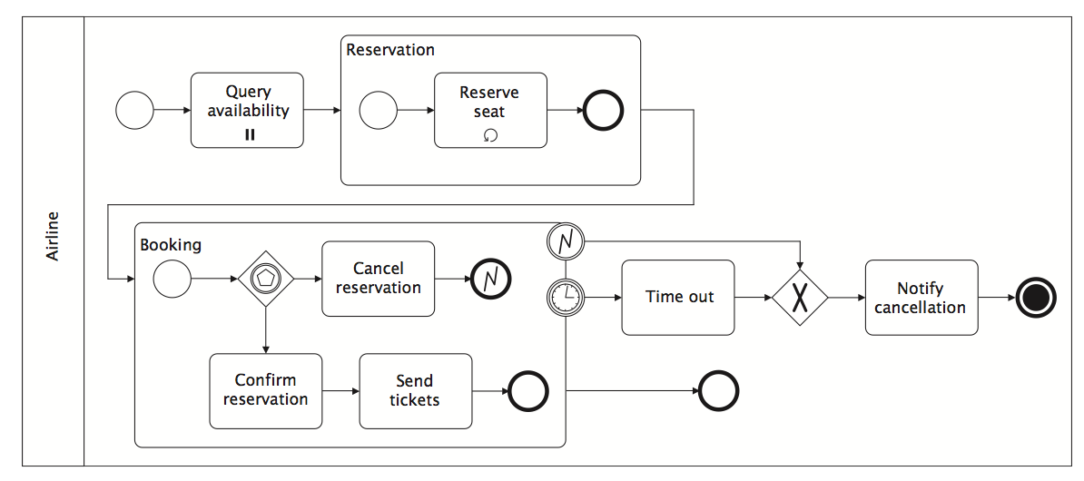
BPMN Example

Slide 12
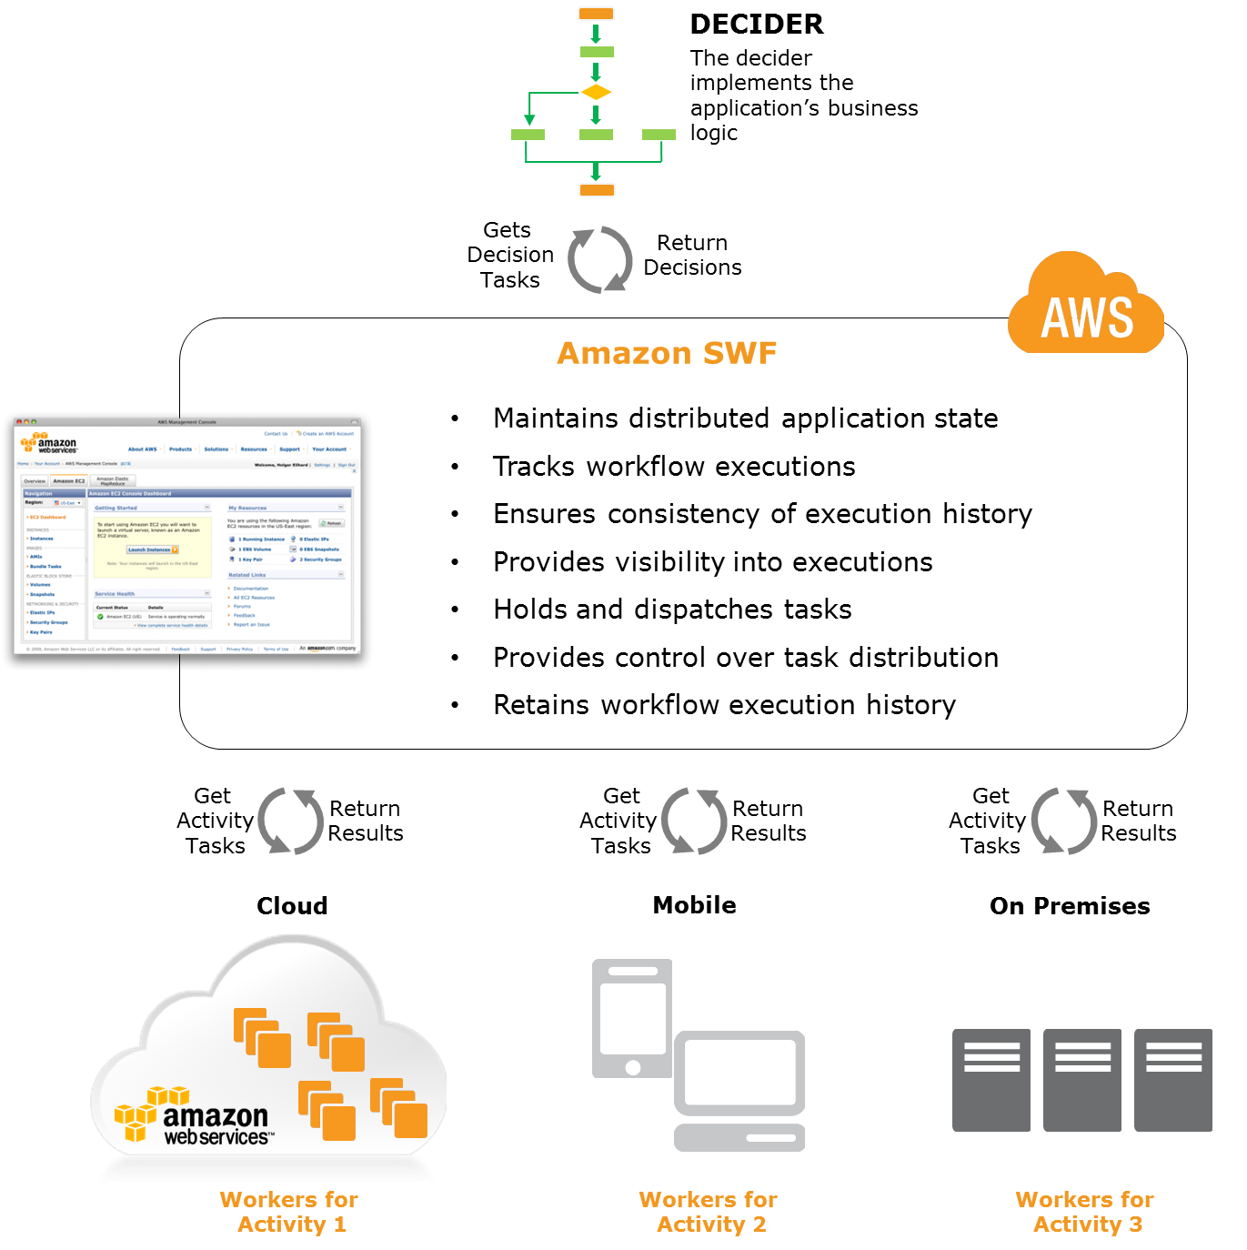
Amazon Simple Workflow Service
http://aws.amazon.com/swf/

Slide 13
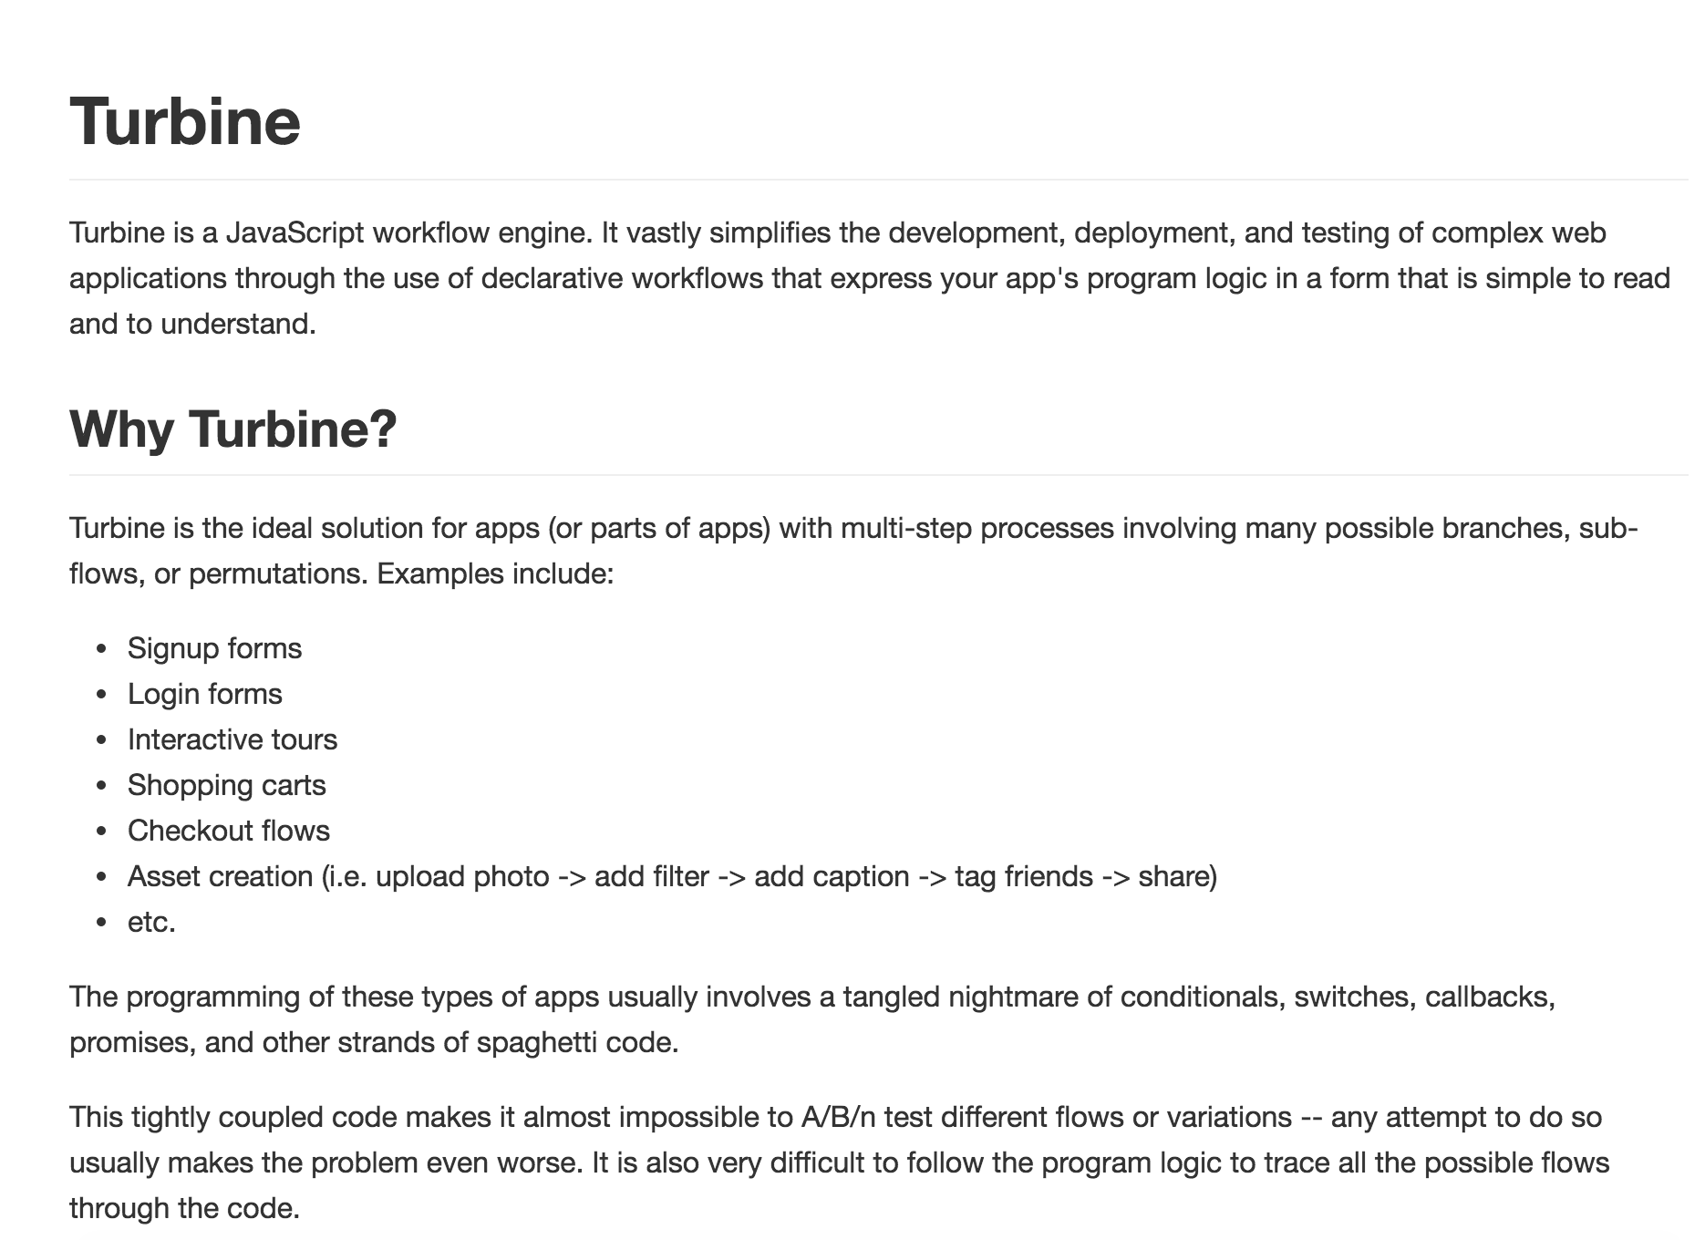

Slide 14
Business Process Execution Language (BPEL)
Standardised XML language for executable processes
Well defined execution
No deadlocks
Graphs must be acyclic
Tied to WSDL concepts
No built in support for human activities (though this has been added)
No graphical notation

Slide 15
The main strength of BPEL (IMO)
BPEL is a completely executable standalone language
PartnerLinks define places where you can call WSDL services
Or where other parties can call WSDL Services into the process
Deployment descriptor + BPEL can be executed without any Java or other language

Slide 16
The main weaknesses of BPEL (IMO)
Too much like a programming language
Need WS-HumanTask, BPEL4People and script or Java extensions to make it useful for real processes
No swimlanes (explained in a minute)
No common visual notation

Slide 17
BPMN + BPEL
In theory:
Process experts design and model in BPMN
Developers/Implementors implement in BPEL
No standard bridging/mapping
Double the effort

Slide 18
BPMN 2.0
A notation for a subset of BPEL
Execution semantics for BPMN
Notational support for choreography
The best of both worlds?
Cons:
Need to write external logic in another language to implement a process

Slide 19
CMMN Case Management and Modelling Notation
A specification from OMG for modelling how to handle cases
A more flexible approach to workflow that BPMN or BPEL
Certain workflows are very clear
Building a car
Others are more flexible
Hand building a mandolin
Imperative vs “Causative”

Slide 20
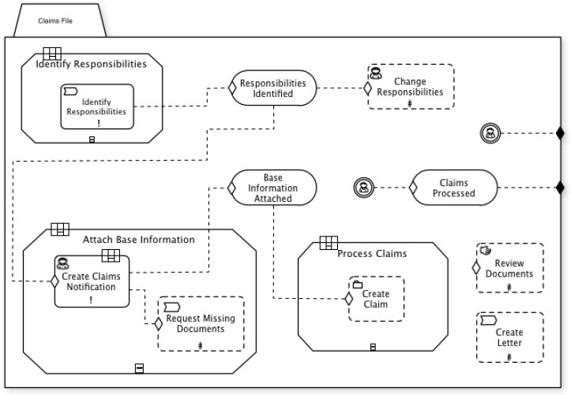
CMMN example Source: http://brsilver.com/bpmn-cmmn-compared/

Slide 21
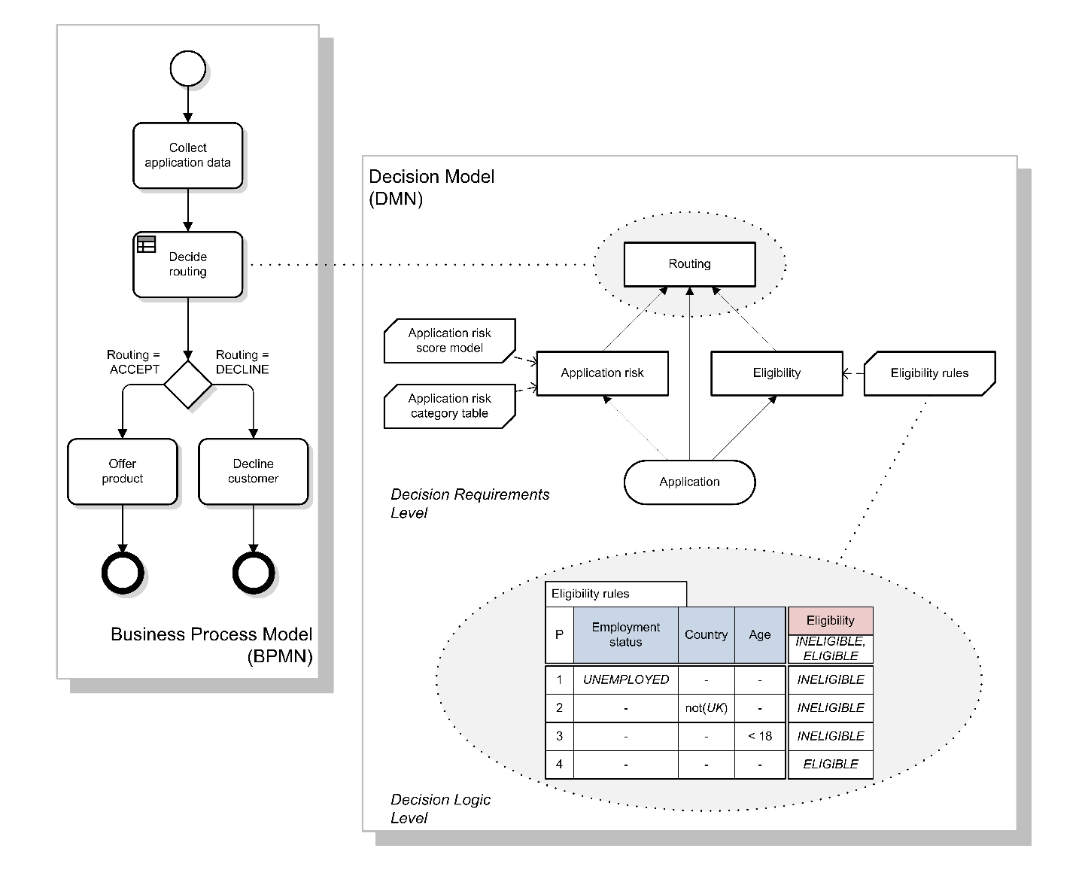
Decision Modeling Notation DMN 1.1

Slide 22
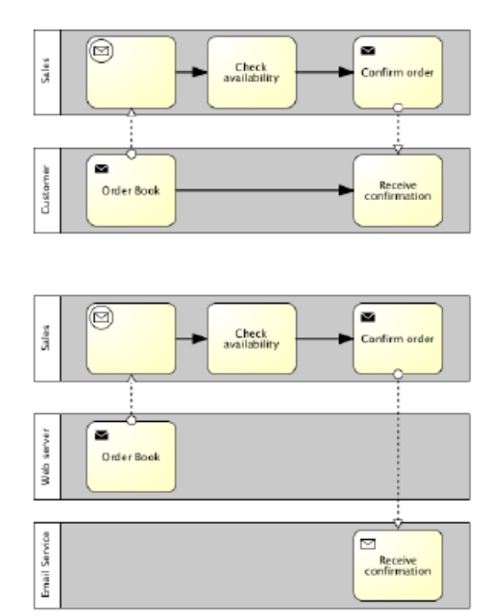
BPMN 2.0

Slide 23
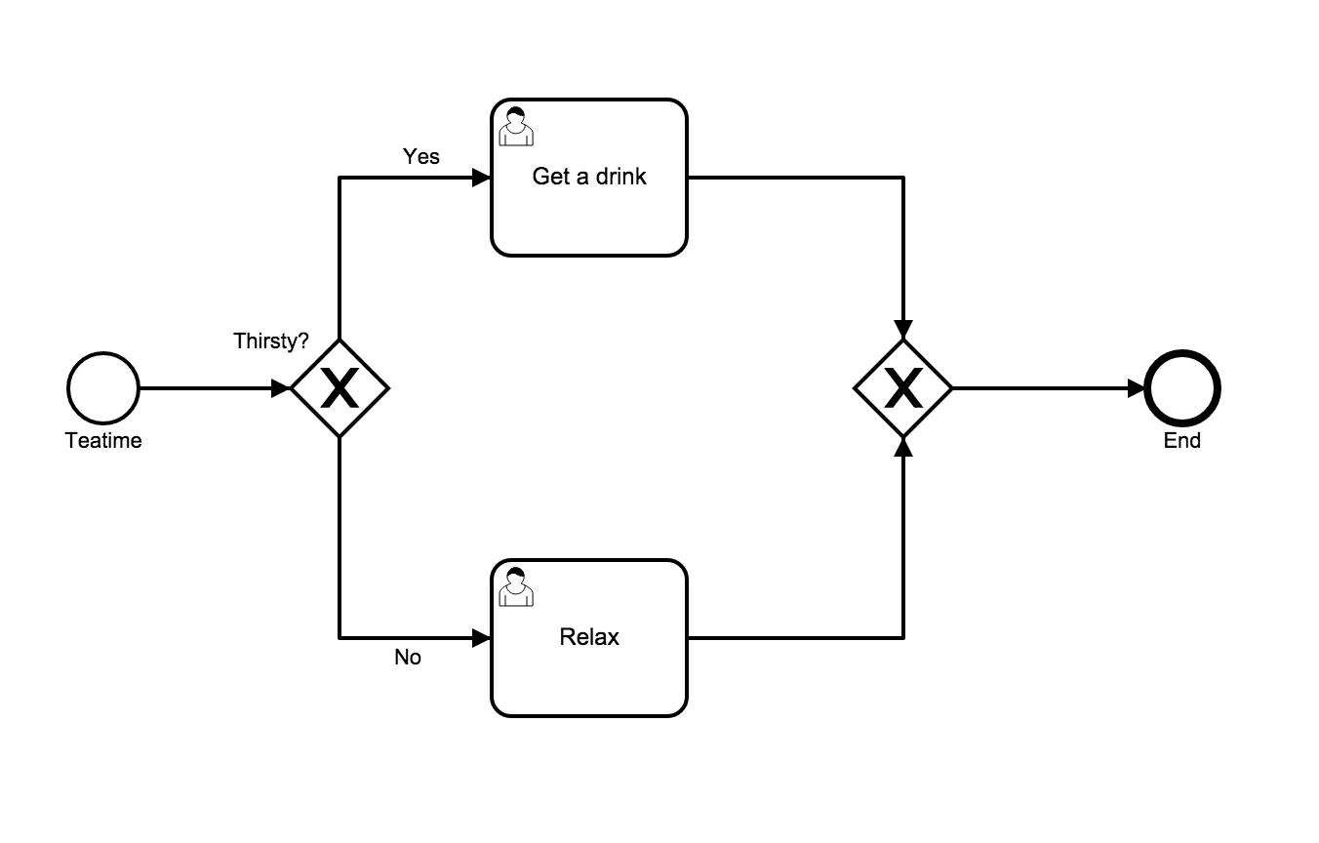
BPMN 2.0 Basics

Slide 24




BPMN Basic Constructs
Events
Activities
Gateways
Sequence Flows

Slide 25
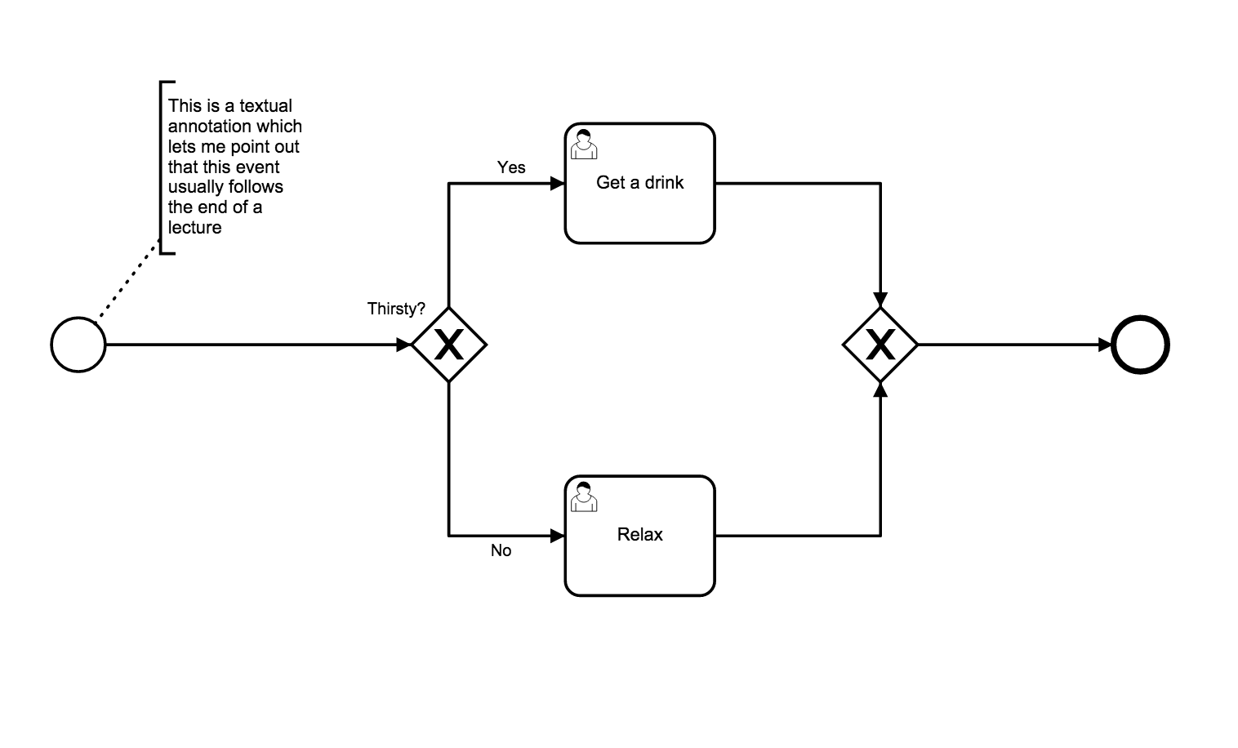
Text Annotations
How you document your processes

Slide 26





Start Events
Start Event
Message Start
Timer Start
Conditional Start
Signal Start

Slide 27

Some Intermediate Events
Basic Intermediate Event
Message Catch
Message Throw
Timer
Escalation

Slide 28
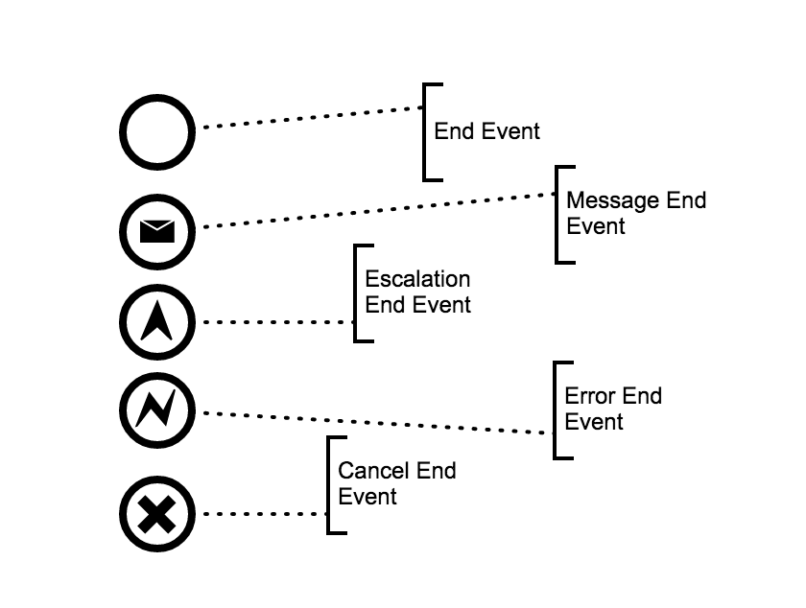
Some End Events

Slide 29
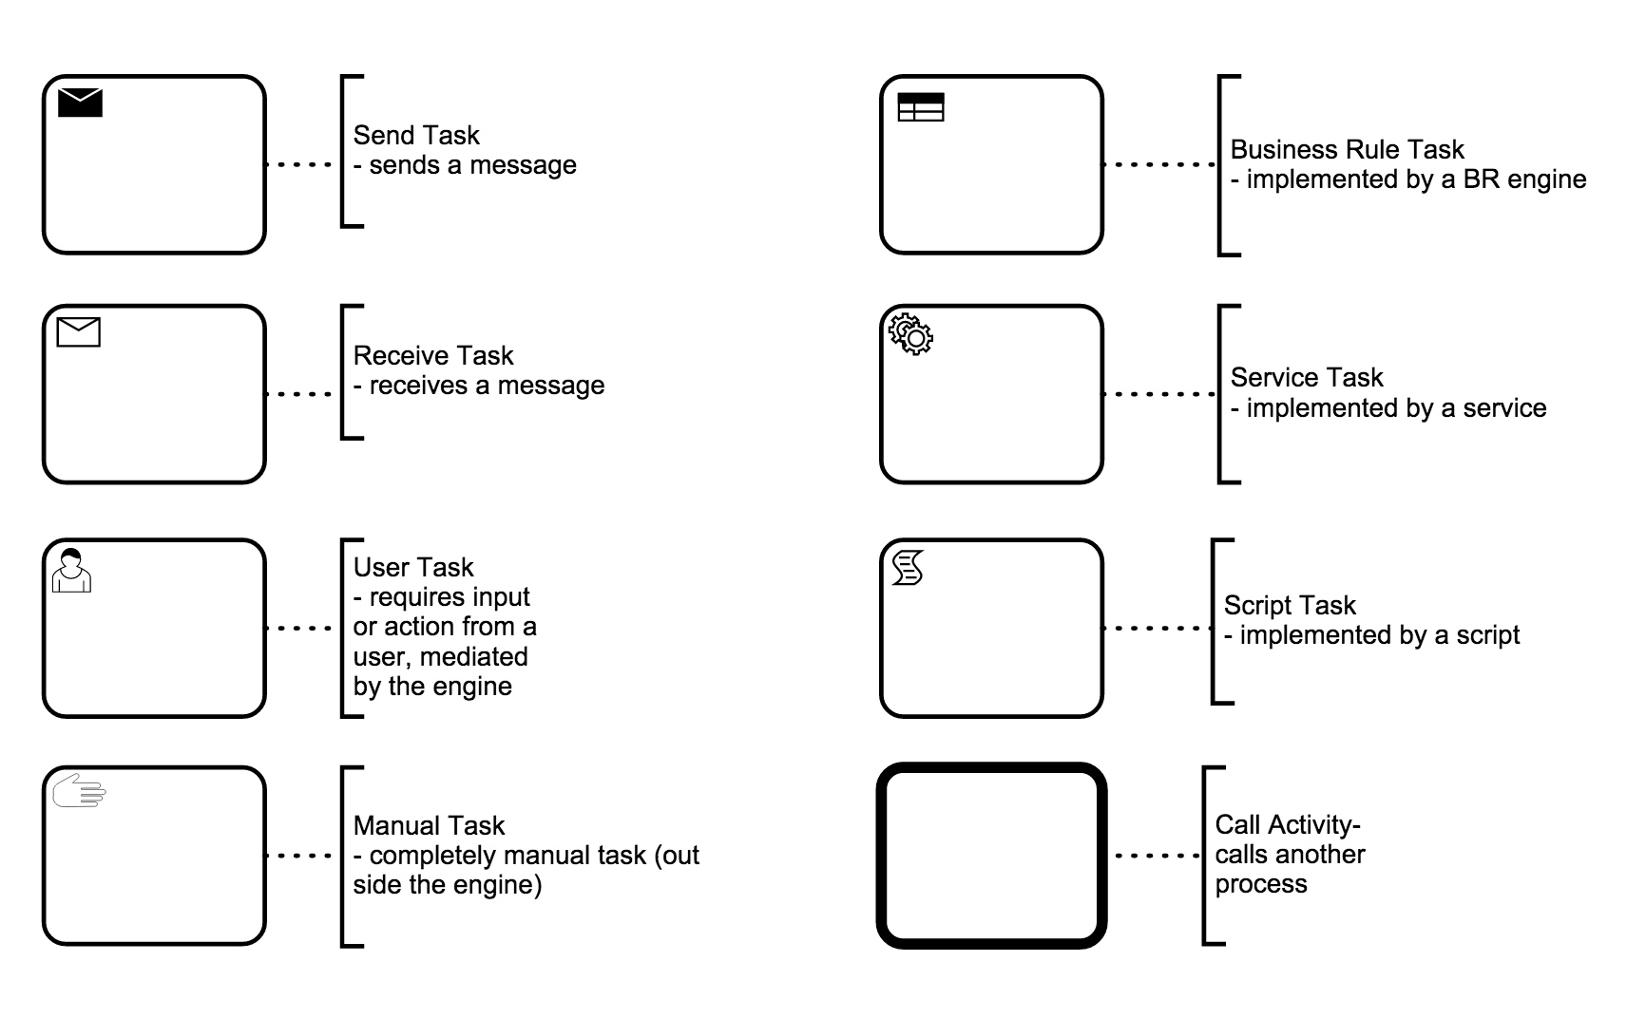
Activities

Slide 30
Service Task
Call a service
Unlike BPEL there is no direct way of capturing the actual service
Typically need to write some code (e.g. Java) to capture that

Slide 31
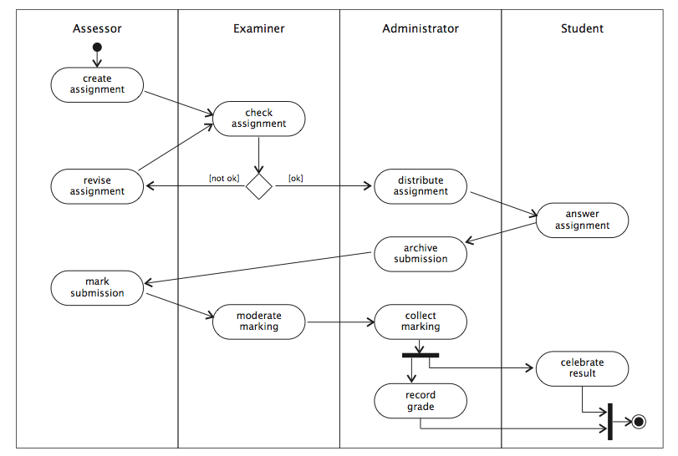
Swimlanes: partition an activity diagram into the responsibilities of different entities

Slide 32
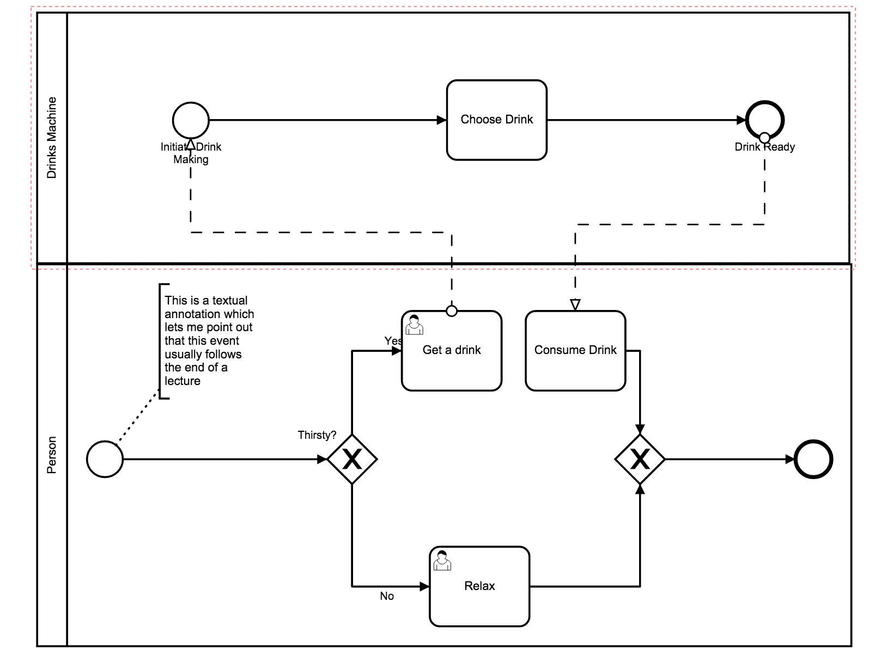
Swimlanes represent different participants

Slide 33
Data Flow
Transitions between activities represent control dependencies: one activity must complete before another can start
Workflows also have data dependencies: one activity produces a result that another requires
UML activity diagrams allow object flow as well as control flow
Dependent data is shown as an object icon (rectangle with underlined name and type)
dependencies shown as dashed arrows from generating activity to object, and from object to consuming activity(s)
same object may occur multiple times in an activity diagram, typically in different states (shown in square brackets after object name)

Slide 34
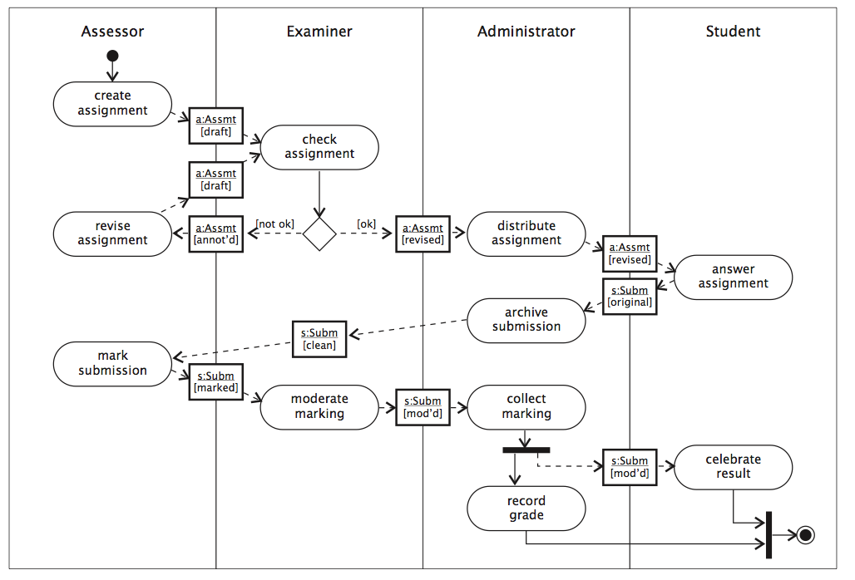
Example Object Flow

Slide 35
Flows
Sequence
Message
Sequence flows are within a
Swimlane
Message flows between
swimlanes

Slide 36


Gateways
Exclusive Gateway
Fork – choose one path (if/else)
Join – wait for a single event
Parallel Gateway
Fork – do both / all paths
Join – wait for all inputs

Slide 37
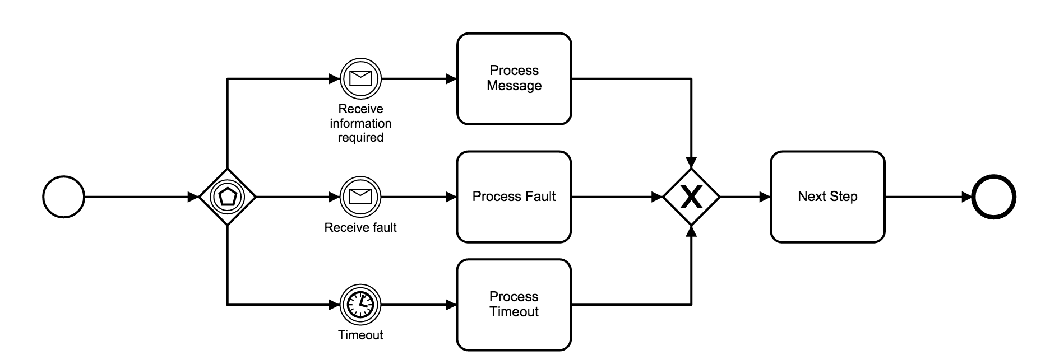
Event Gateway
An Event Gateway allows different events to trigger different actions

Slide 38
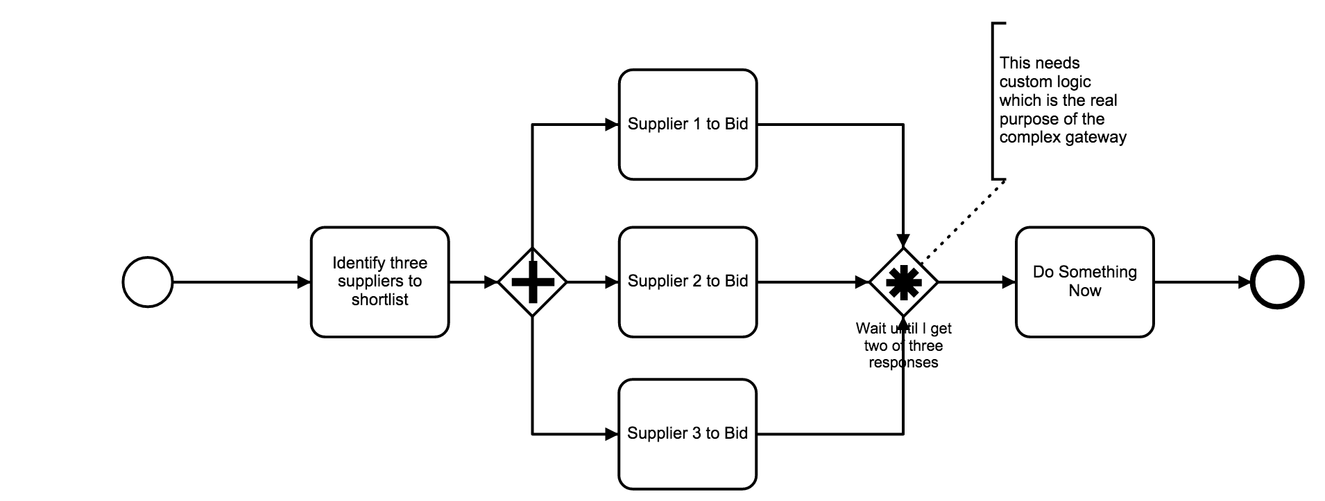
Complex Gateway

Slide 39
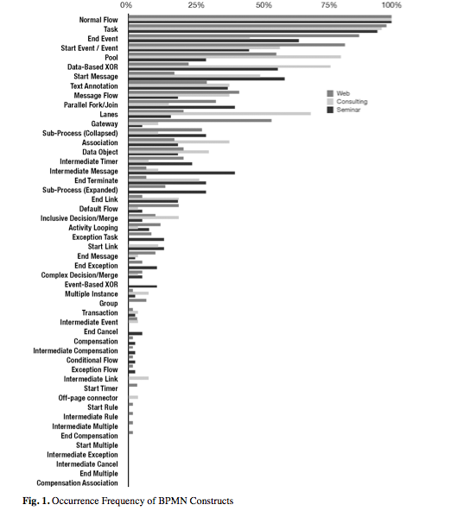
How much BPMN do you need?
How Much Language is Enough? Theoretical and Practical Use of the Business Process Management Notation
http://papers.ssrn.com/sol3/ papers.cfm?abstract_id=2038665

Slide 40
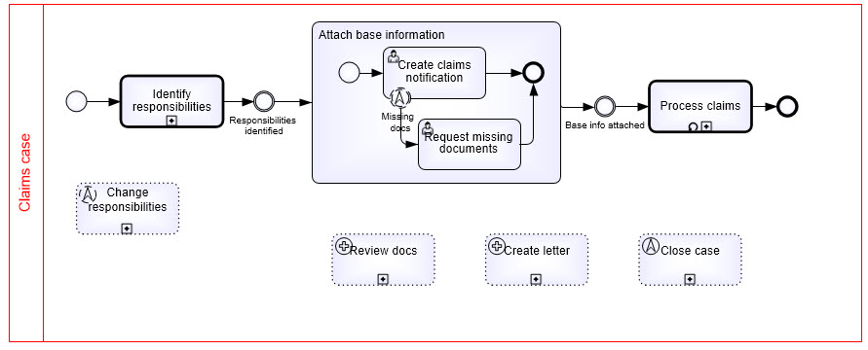
BPMN Case example Source: http://brsilver.com/bpmn-cmmn-compared/

Slide 41
Summary
Process Management has a strong place in composing SOA systems
Externalising dependencies
Agility
Sharing with the business owners
BPEL is still widely used, but
BPMN 2.0 is gaining a lot of mindshare
CMMN also has a smaller but active following
Other approaches like Turbine are gaining traction

