Slide 1
洋流觀測分析 Ocean Current Observation and Analysis 曹俊和 kilmerchow@gmail.com
可以吃東西
可以用手機
可自由走動
需要用筆電

Slide 2
About you (大約30分鐘，在A4紙作答) (若無法回答就寫不知道，註明姓名)
What you know best about oceanography or physical oceanography? (你對海洋學或物理海洋學了解多少? 請說明一個你最熟悉的專有名詞。)
What is Kuroshio? (什麼是黑潮? )
What are your interests in oceanography? (你對海洋學有哪放面的興趣?)
What are your interests in life? (你平時有哪些嗜好?)
What are your dreams/plans in life? (你有哪些夢想?)
Why you want to take this course? (你為什麼要選修這門課?)
這門課有搭新海研二號的機會，你是否願意出海實習(大約半天~1天)? 願意者，請寫下你本學期每周通常比較有空的時間。

Slide 3
What are we going to learn in this class from now to June? (我們將從這門課學到什麼?)
分3組 (每組2~3人，學生自行分組)
在A4紙(每組一張)寫下討論結果
(註明組員姓名)
(大約30分鐘討論和寫)

Slide 4
看講義 (30分鐘)
看完講義後(也可及時上網查資料)，請回答以下問題:
如何測量海流?
測量海流時需觀測哪些參數?

Slide 5
Outline
洋流觀測的方法與其發展過程
分析各式洋流觀測資料：錨碇流速儀、聲波流剖儀(ADCP, Acoustic Doppler Current Profiler)、GPS浮標追蹤等
討論海上實驗之架構概念(現場觀測實驗設計)
國際海洋資料庫
處理資料、繪圖及分析討論觀測洋流的結果

Slide 6
教學進度 (期中考前) Schedule (Before mid-term)
Introduction: Why do we need to observe ocean currents?
Some basic tools for programming and scientific plotting: Matlab, Python, Julia Language, GMT, Ocean Data View (additional topics for students) & some required mathematics (下周)
Methods of observing currents: In-situ and satellite observations (1~2週)
Data and links of observations for ocean currents (1~2週)
Drifter data analysis

Slide 7
教學進度 (期中考後) Schedule (After mid-term)
ADCP data analysis
Shipboard ADCP calibration (data processing for bottom-track ship velocities)
Shipboard ADCP calibration (data processing for GPS ship velocities)
Current Meters
Hydrographic (CTD, XBT, ARGO) data analysis
Wind-driven Circulation

Slide 8
評量方式(可討論調整) Grading
1.作業(Homework)：30% 2.課堂討論和發問(Discussion): 30% (0.3%/time) 3.個人報告(Reports)：20%
4.分組討論及報告:20%

Slide 9
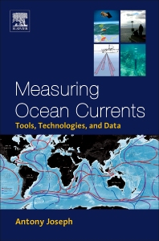
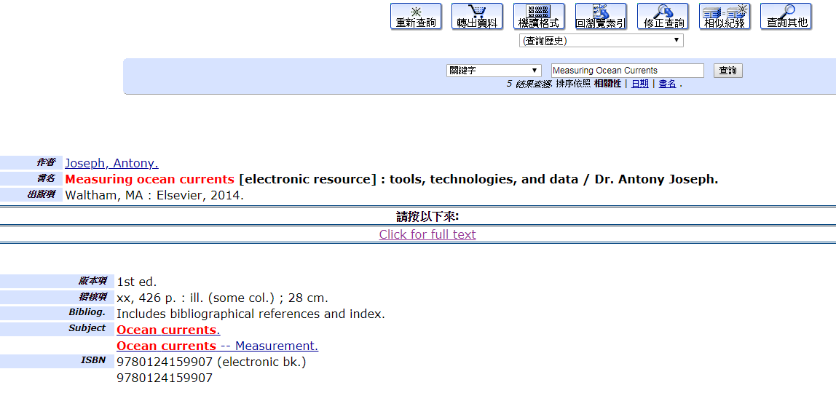
Books
Antony Joseph (2014), Measuring Ocean Currents: Tools, Technologies, and Data,
Ebook in lib.

Slide 10
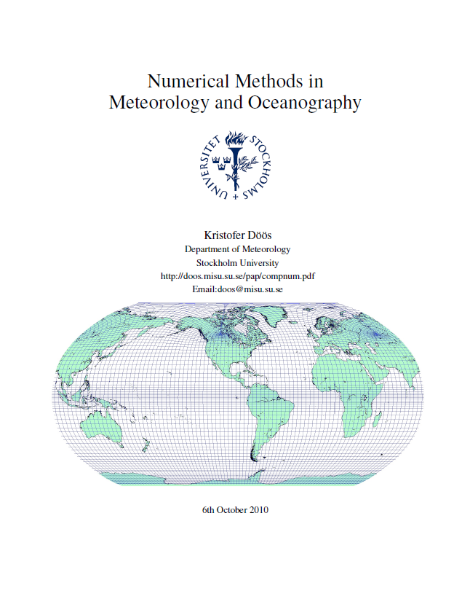
Kristofer Doos, Numerical Methods in Meteorology and Oceanography, 2010, Sweden.
https://www.researchgate.net/publication/228819984_Numerical_Methods_in_Meteorology_and_Oceanography
And also some scientific papers

Slide 11
Homework #1 Due Date (繳交期限): 2020/3/10
Ask one question with “why”, that you are interested in about ocean currents/anything. (問任何你有興趣的為什麼問題，可與海流無關)
Try to give an answer.
Please do your work in a “word” file (filename: hw01_yourname.docx) and send it to https://driveuploader.com/upload/lVD4ycOKfP/
(pdf and odt files are acceptable)

Slide 12
More about you

Slide 13
Grouping
Bio. | Che. | Phy. | other
3 | 2 | 6 | 1: Astronomy 2: Geology 3: Atmosphere
With laptops | Without laptops
7

Slide 14
學過的程式語言
Fortran,C/C++ | Matlab, Python, Julia | Others (GMT, Basic, Latex)
5 | 5 | 4 GMT, VB,

Slide 15
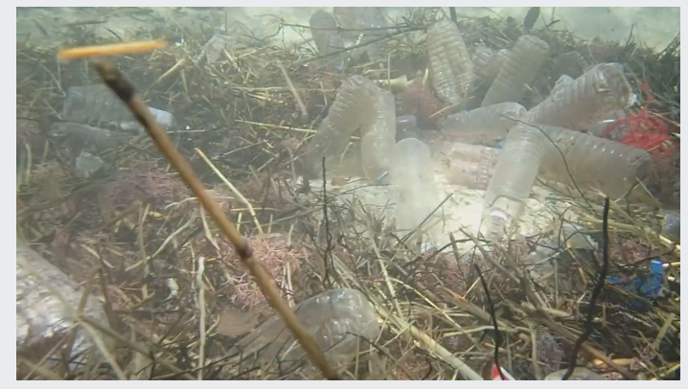
想法?
https://www.facebook.com/islander.taiwan/videos/1616795795038181/

Slide 16
Think?
What are ocean currents and circulation?

Slide 17
What are ocean currents and circulation?
Movement of water in the ocean (ocean system).
Ocean system of earth is like the blood system of ours
(transports heat vs oxygen)

Slide 18
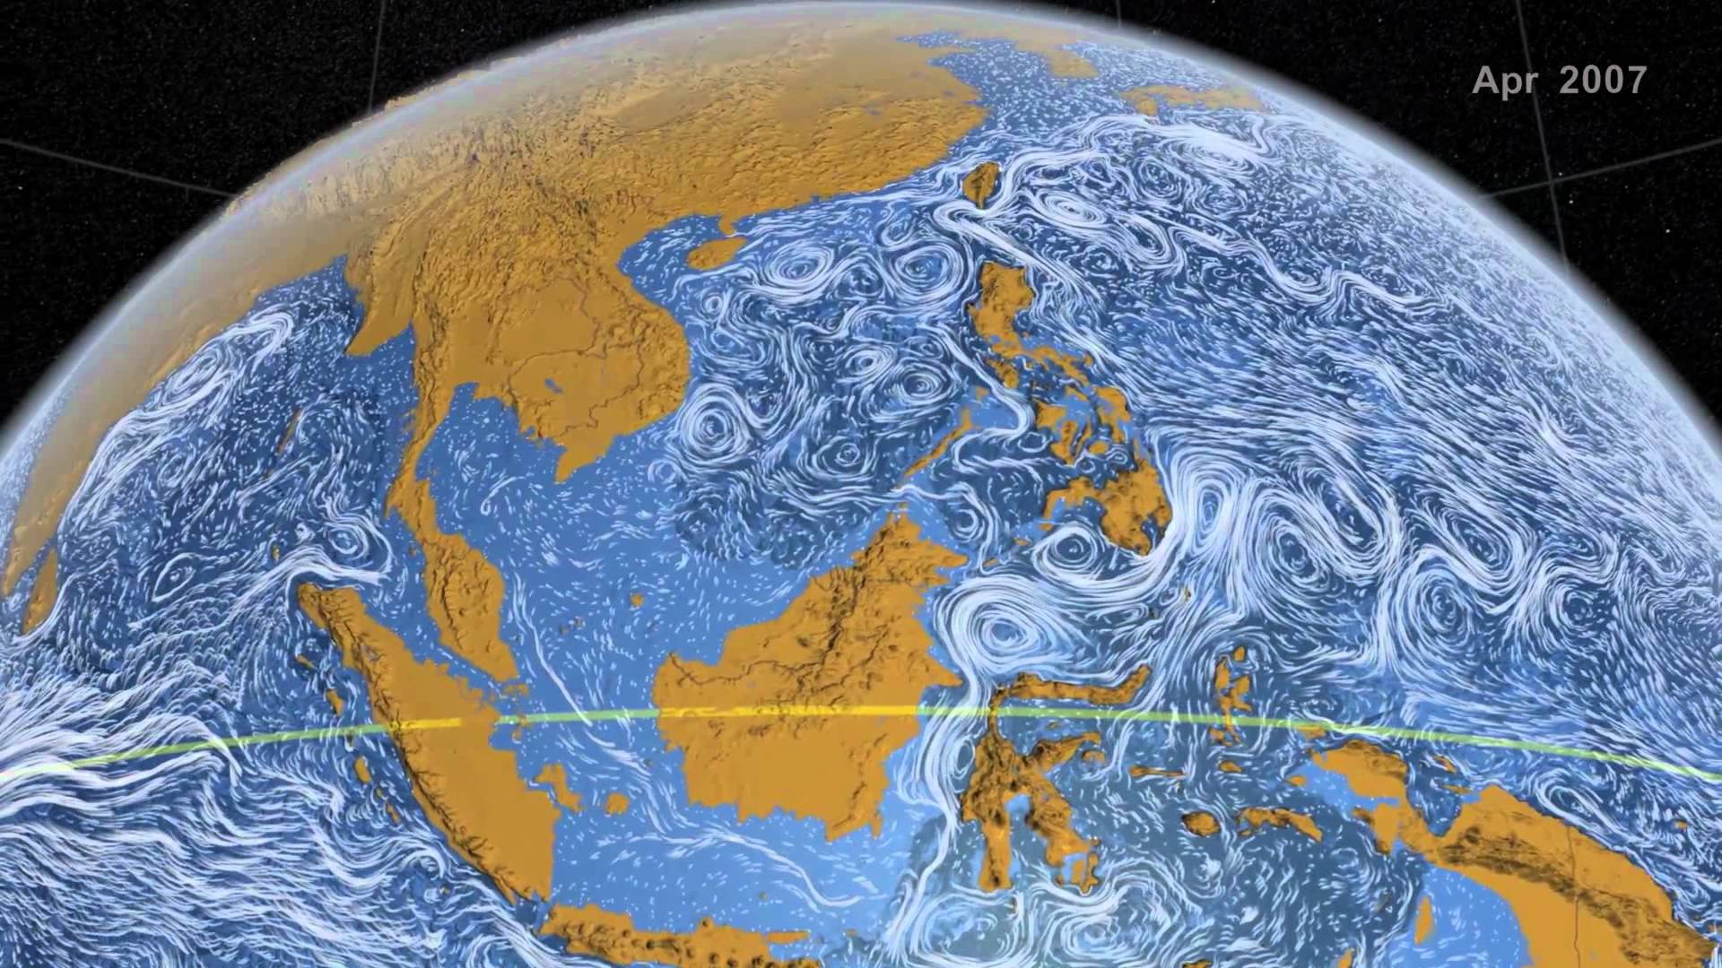
Ocean-current Movie (The real ocean currents are more fun than that)
svs.gsfc.nasa.gov
https://svs.gsfc.nasa.gov/3827

Slide 19
Why are ocean currents & circulation so important?
Why do we care about ocean motion (currents and circulation)? Or, why are ocean currents & circulation so important to humankind?

Slide 20
Why are ocean currents & circulation so important?
Very important for transportation!!
motion of waters carries stuff (such as mass, heat, salt, carbon, etc)

Slide 21
Heat → vapor (air-sea interaction) → Rain, Snow & Typhoon
Big impact on Weather (Local Ocean Currents)
Big impact on Climate (basin-scale ocean currents)
Big impact on Climate (Global ocean Currents)

Slide 22
Why do we need to observe ocean currents and analyze them?
Please think, discuss or ask.

Slide 23
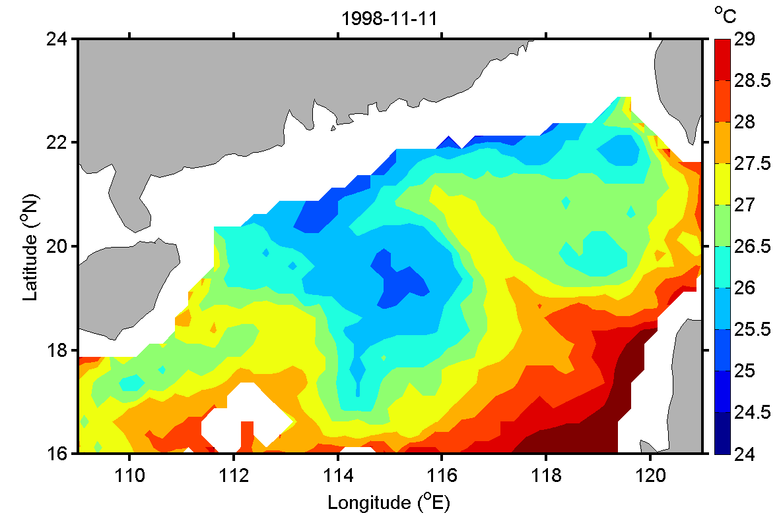
Warm & Cold SST Tongues
TMI SST
2 ºC

Slide 24
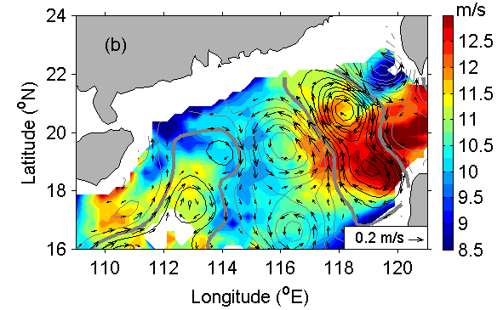

Slide 25
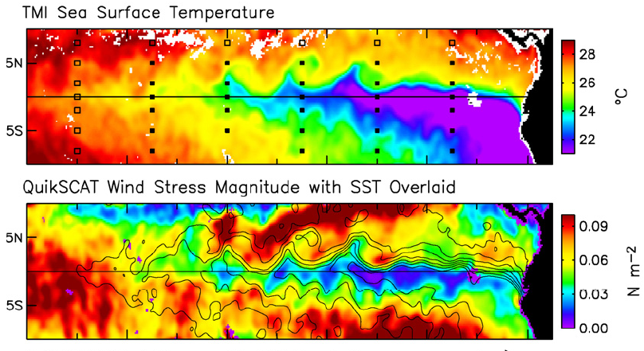
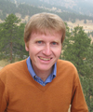

SST Effect on Surface Wind in
the Front Regions
[Small et al., 2008]

Slide 26
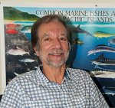
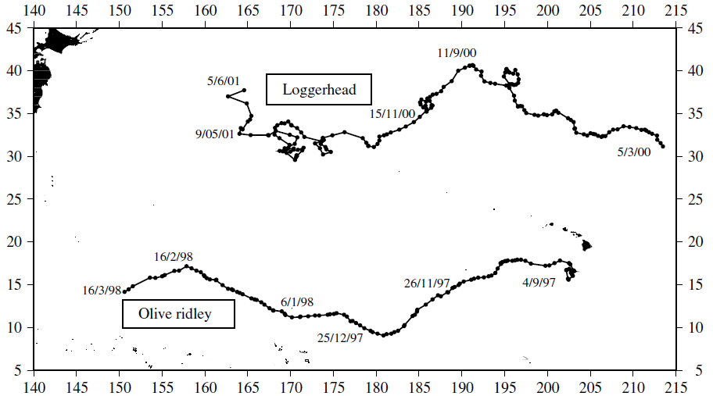
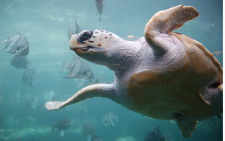
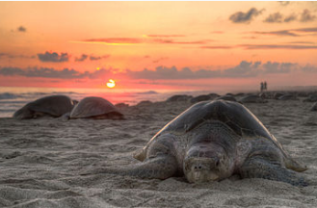
Jeffrey Polovina
紅蠵龜
麗龜
Polovina, J. J., G. H. Balazs, E. A. Howell, D. M. Parker, M. P. Seki, and P. H. Dutton
(2004). Forage and migration habitat of loggerhead (Caretta caretta) and olive ridley
(Lepidochelys olivacea) sea turtles in the central North Pacific Ocean. Fish. Oceanogr.,
13, 36–51.

Slide 27
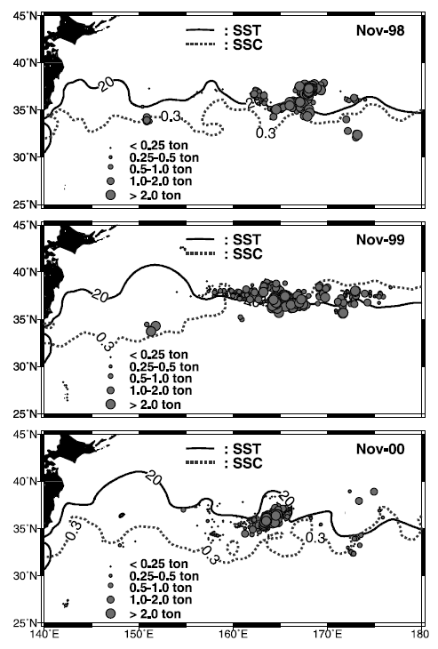
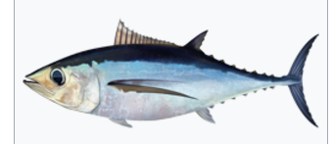
Ocean currents and Fish
albacore tuna
(長鰭金槍魚)
Zainuddin, M., S.-I. Saitoh, and K. Saitoh (2004), Detection of potential fishing ground for
albacore tuna using synoptic measurements of ocean color and thermal remote sensing in
the northwestern North Pacific. Geophys. Res. Lett., 31(20), L20311.

Slide 28
白板紀錄

Slide 29
分三組討論紀錄(2020/3/5)

