Slide 1
Homework 6 (Discussion)
Using the ADCP data (cr2247001_000000.LTA) given in the server, plot the ship track. How long did the ship sail (in hours) based on these ADCP data?
18~19 hours

Slide 2
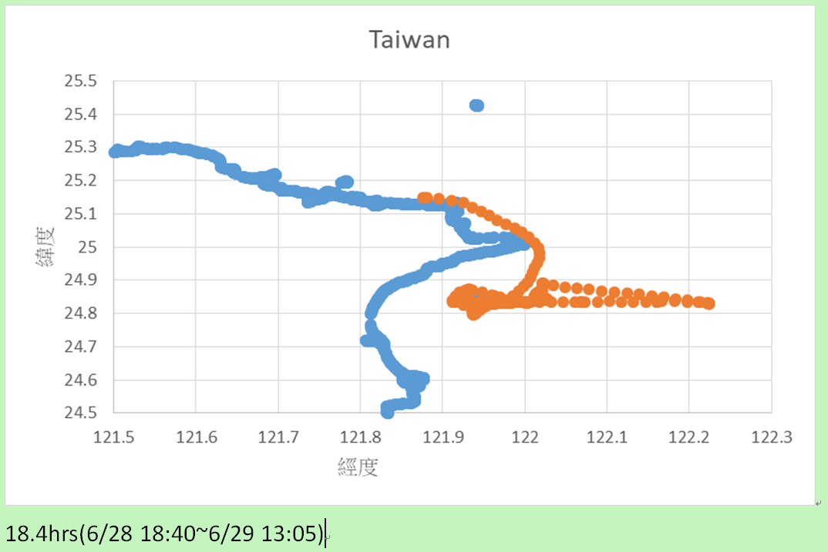

Slide 4
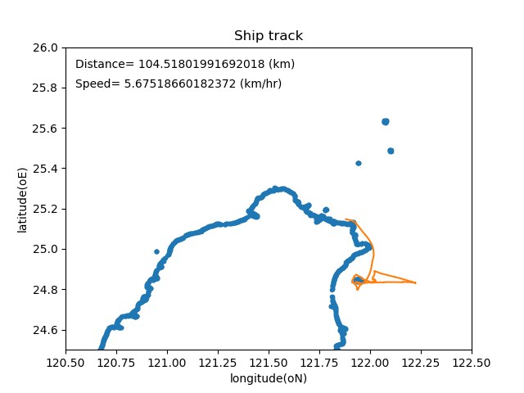

Slide 5
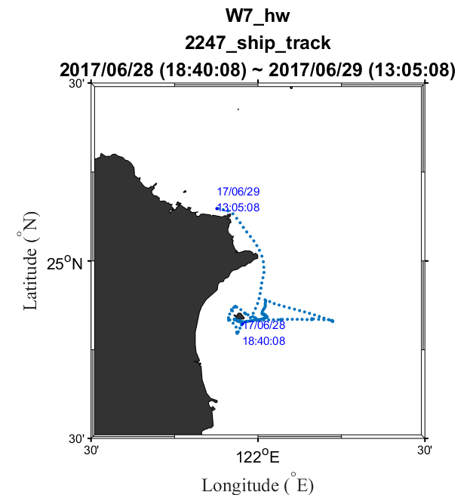
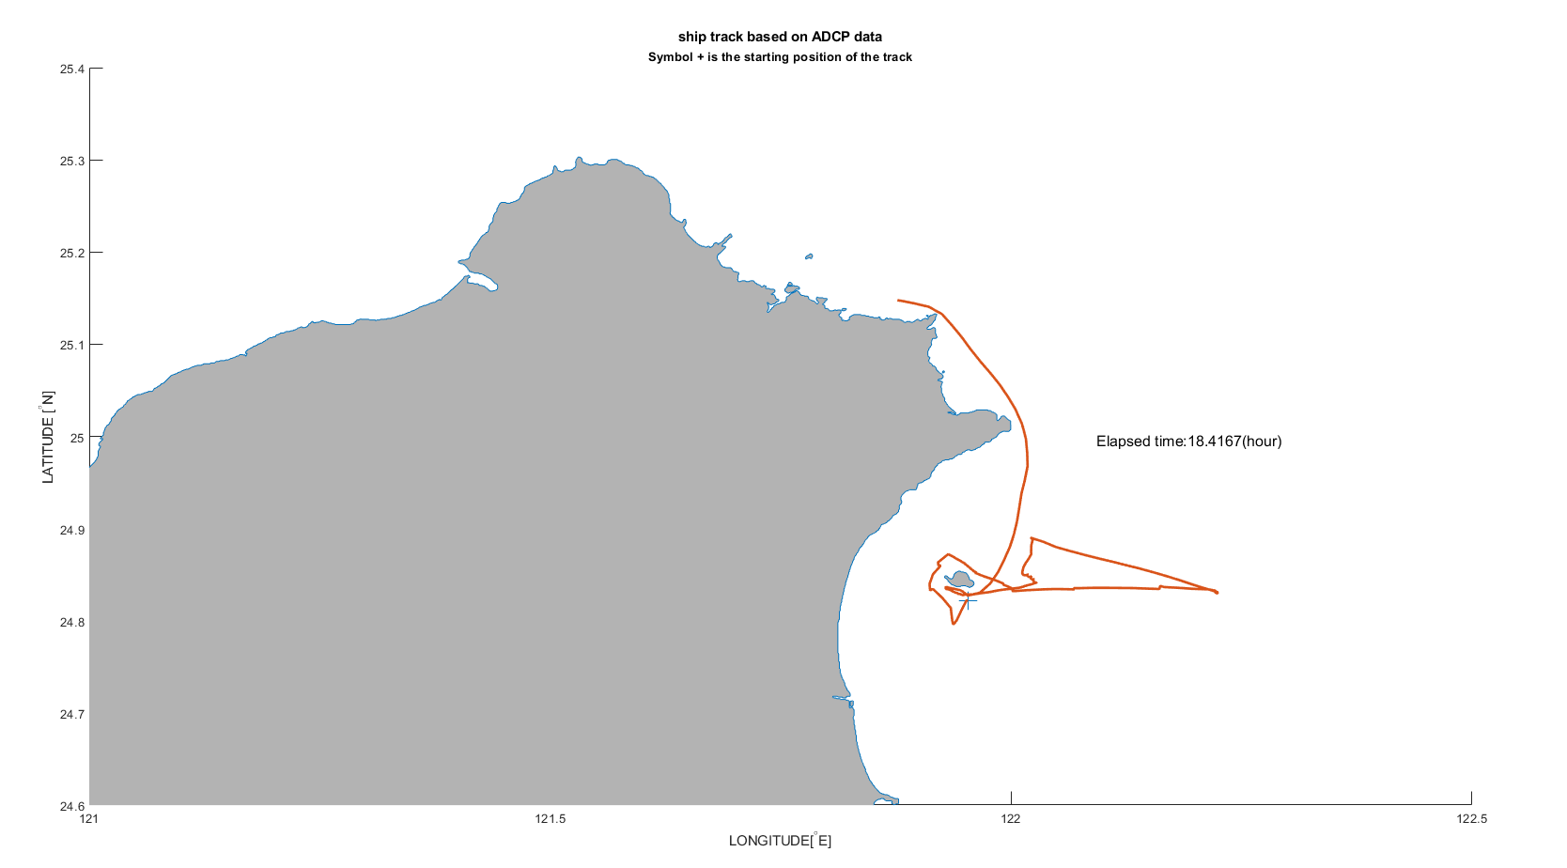
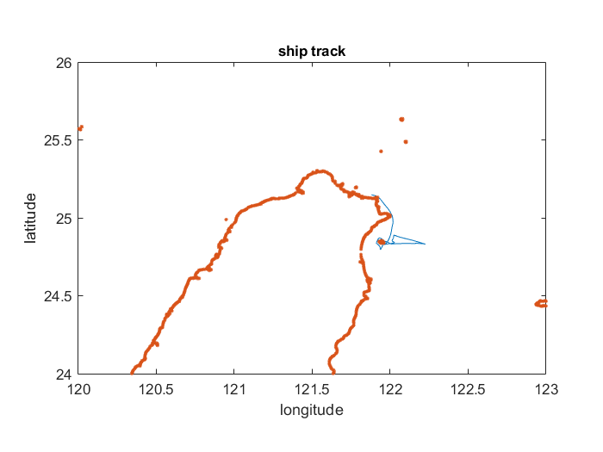

Slide 6
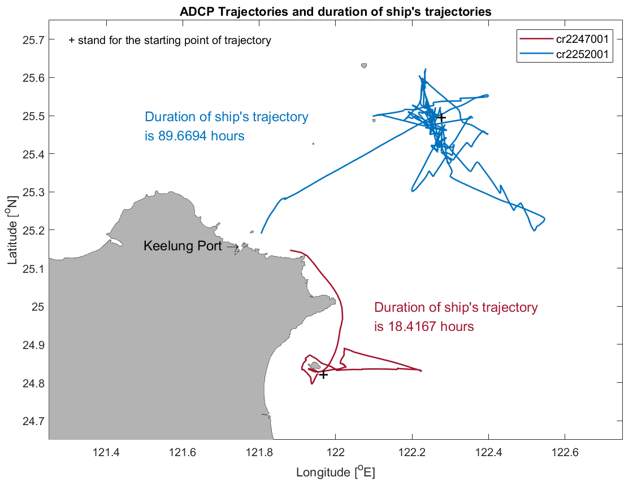

Slide 7
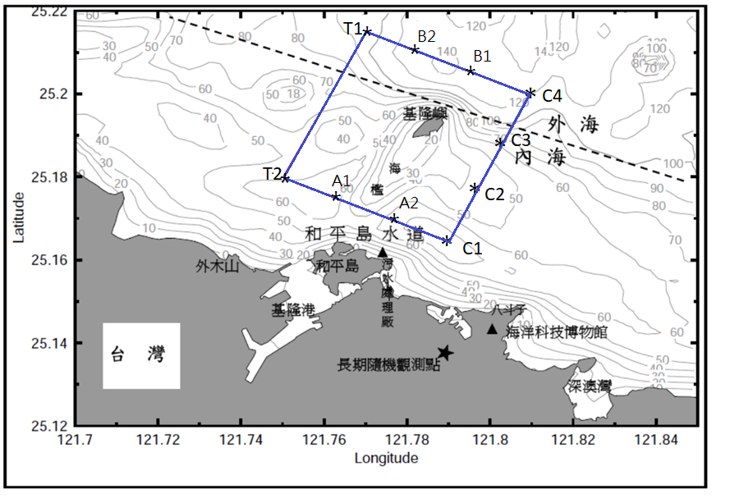
4/30 sea-going experiment

Slide 8
Data process and analysis for ship-mounted ADCP (part 2)
data processing (current velocities obtained from the measurement of ship-mounted ADCP)

Slide 9
Outline
Demonstrate the WinADCP software (using the data “cr2252001_000000.LTA”) (Review)
Remove ship velocities (based on bottom-track and GPS) from the ADCP data to get the ocean-current velocities. (using the data of “cr2247001_000000.LTA”)
Plot the measured current velocities on the ship track. (using the data of “cr2247001_000000.LTA”)

Slide 10
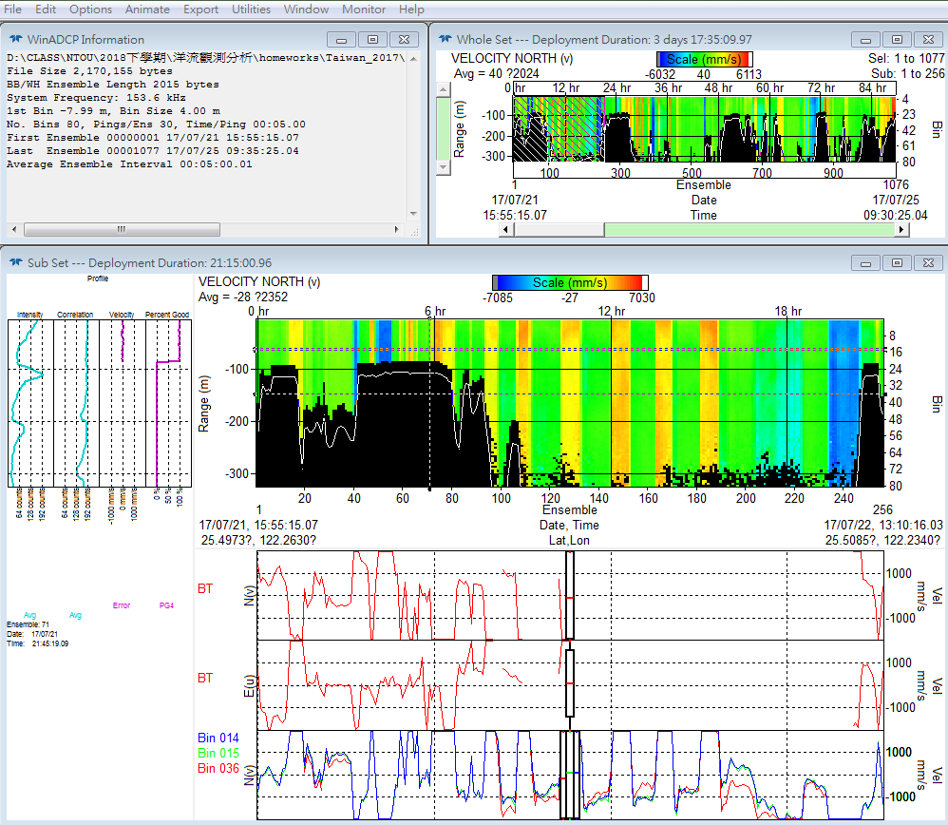
Reading data & Whole View (Review)
OR2_2252_20170721

Slide 11
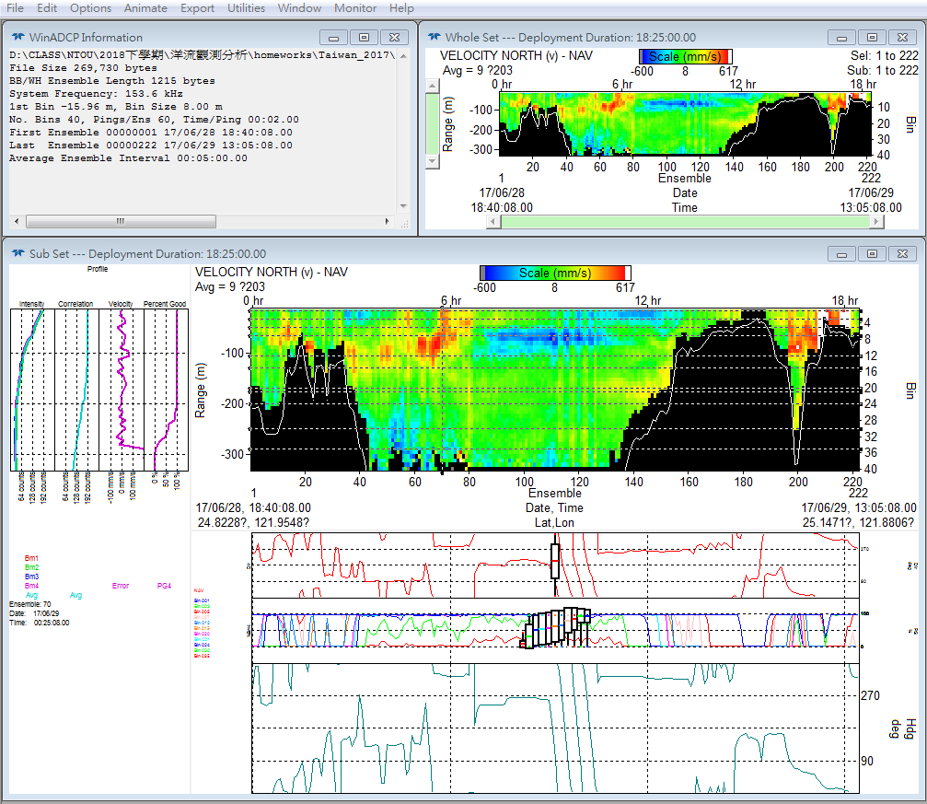
Function Bar (Review)

Slide 12
“Information” Window (Review)

Slide 13
“Whole Set” Window (Review)
Practice to show different variables

Slide 14
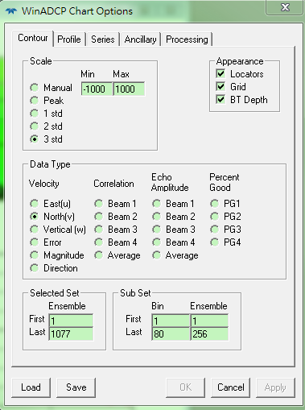
“Whole Set” Window (Review)
Select “Contour” tab

Slide 15
“Sub Set” Window (Review)
Three parts for the “sub set” window

Slide 16
Selected Set (Review)
Practice to show different variables
(Same as the “Whole Set”)

Slide 17
Profile Chart (Review)
1) Practice to show different variables.
2) Practice to select different profiles.

Slide 18
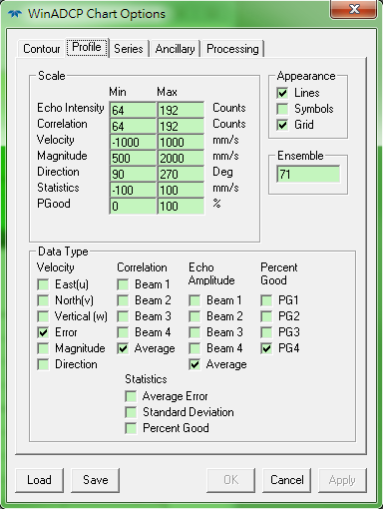
Profile Chart (Review)
Select “Profile” tab

Slide 19
Chart of Time-Series & Ancillary
1) Practice to show different variables.
2) Practice to select different profiles.

Slide 20
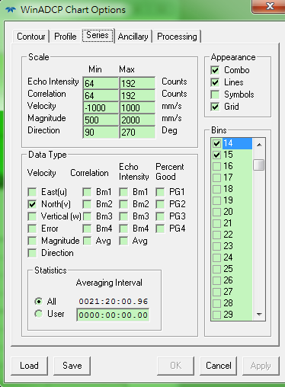
Chart of Time-Series & Ancillary
Select “Series” or “Ancillary” tab

Slide 21
Remove ship velocities (using the data “cr2247001_000000.LTA”)

Slide 22
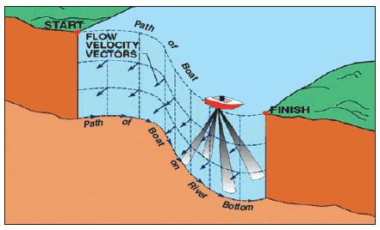
Ship Velocity
Navigation (for shallow and deep regions)
Bottom track (normally better, but for shallow regions where the ADCP’s sound waves can reach the bottom)

Slide 23
Absolute Current Velocity
Removing the best estimate of ship velocities

Slide 24
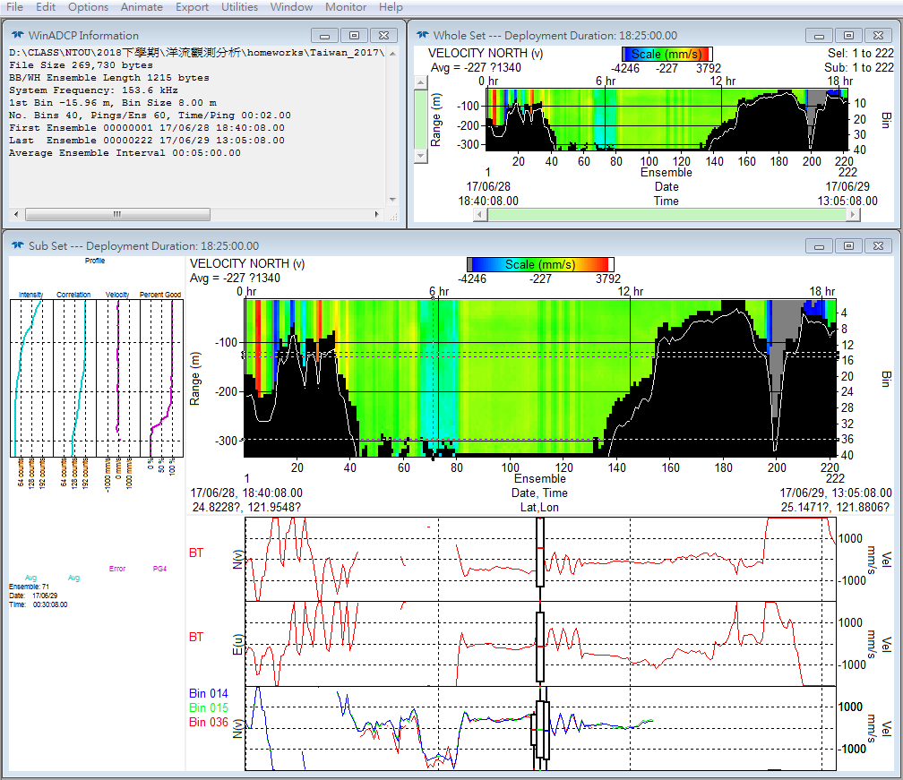
Reading data “cr2247001_000000.LTA”

Slide 25
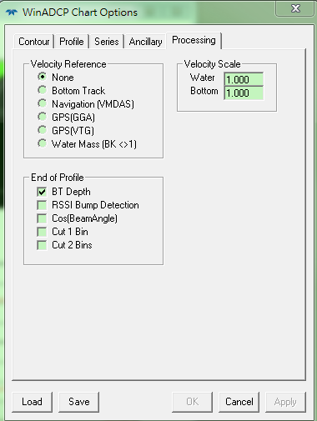
Removing Ship Velocities
Select “Processing” tab
Select “Bottom Track” to remove
ship velocities obtained from
the bottom-track measurement.
Select “Navigation” to remove
ship velocities obtained from
the GPS measurement.

Slide 26
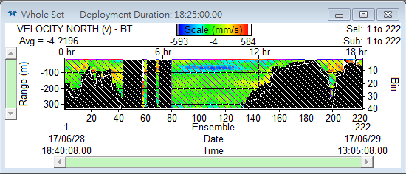
Remove “bottom-track” ship velocities

Slide 27
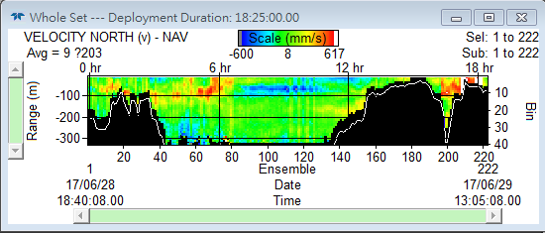
Remove “GPS” ship velocities

Slide 28
Comparison
GPS
Bottom Track

Slide 29
Export velocity data

Slide 30
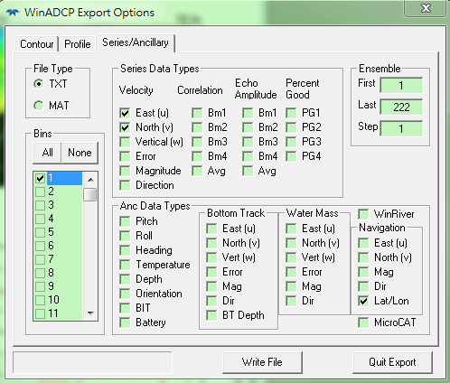
Remove “GPS” ship velocities
Export data: 1st bin, Velocity (East and North) and Lat/Lon. (save file as “uv_gps.txt” for an example)

Slide 31
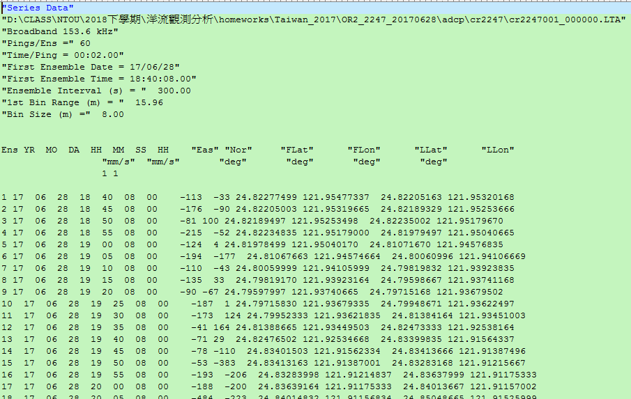
Data View

Slide 32
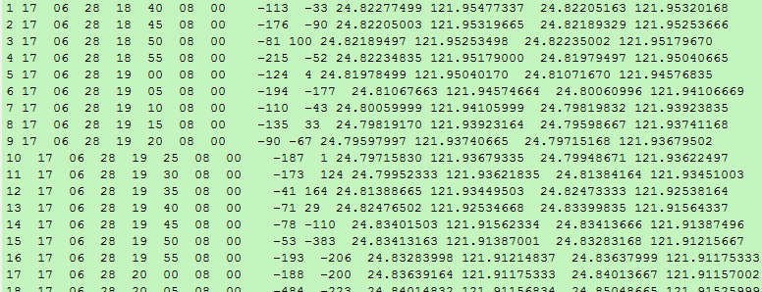
Delete the Headers

Slide 33
Plot velocity arrows on the ship track. (using the data “cr2247001_000000.LTA”)
Using your plotting tool

Slide 34
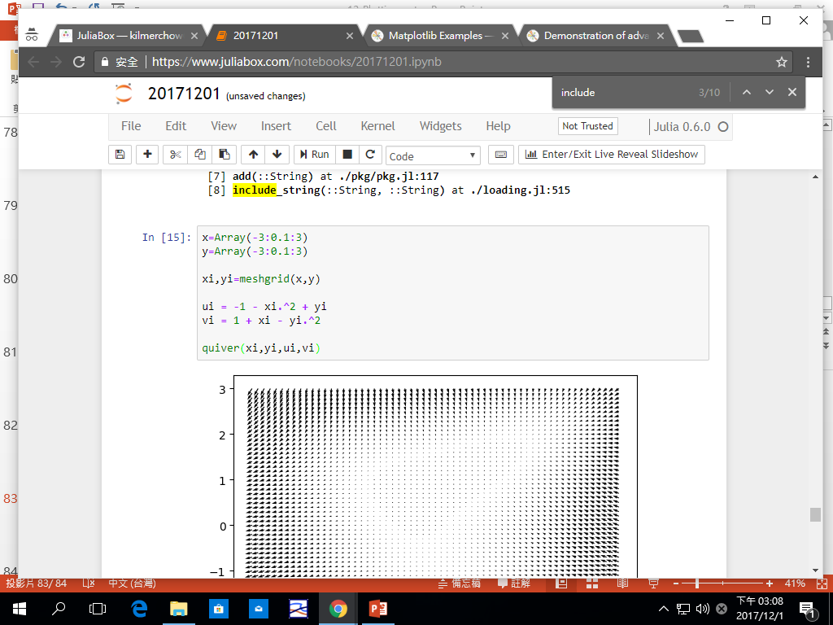
Matlab or Julia Language
Longitude, Latitude, East Velocity, North Velocity

Slide 35
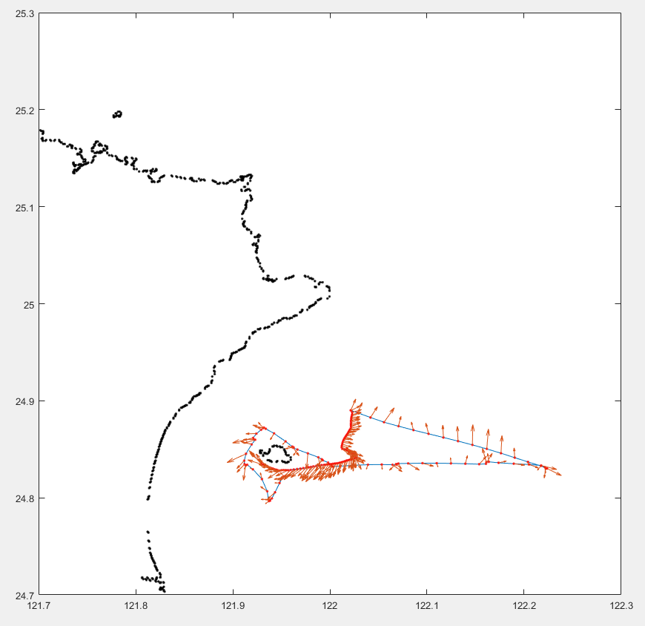

Slide 36
Homework 7 (do in class for a few minutes)
Using the data “cr2247001_000000.LTA”, output the current velocities from the 90th ensemble to the 120th ensemble, after removing the “bottom-track” ship velocities. Show the ship track and current velocities on a map.
Compare the current velocities to those after removing the “GPS” ship velocities.
For those MAC users, you could direct use the files “uv_gps_90_120.txt” and “uv_bt_90_120” given in the class-file server (http://gofile.me/3P3ad/K8rdSnYve).

Slide 37
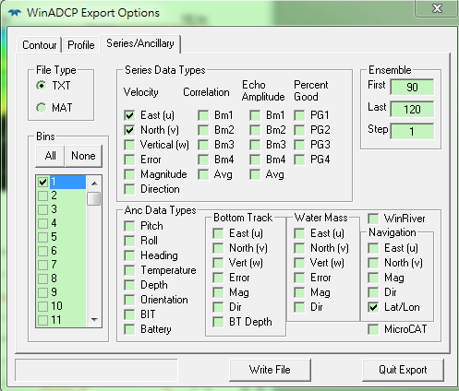
the 90th ensemble to the 120th ensemble

