Slide 1
Homework 7 (Discussion)
Using the data “cr2247001_000000.LTA”, output the current velocities from the 90th ensemble to the 120th ensemble, after removing the “bottom-track” ship velocities. Show the ship track and current velocities on a map.
Compare the current velocities to those after removing the “GPS” ship velocities.
For those MAC users, you could direct use the files “uv_gps_90_120.txt” and “uv_bt_90_120” given in the class-file server (http://gofile.me/3P3ad/K8rdSnYve).

Slide 2
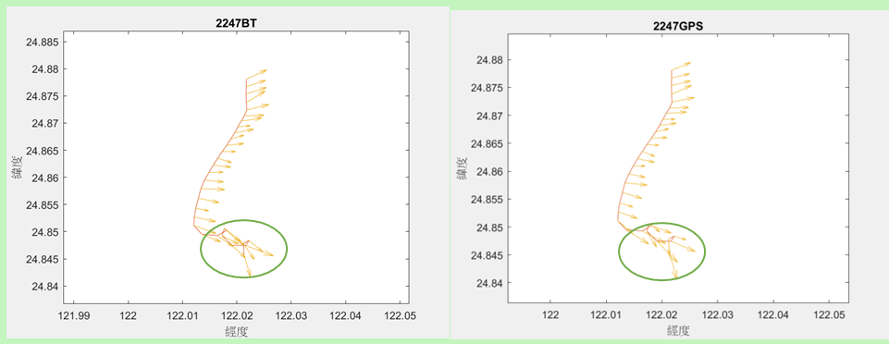
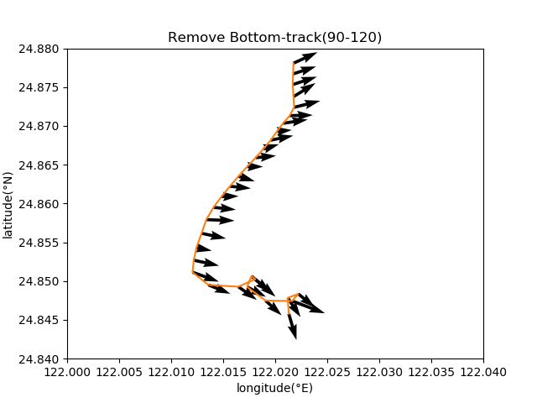

兩邊經緯度的範圍不一樣且框框內的箭頭長度及方向不一樣

Slide 3
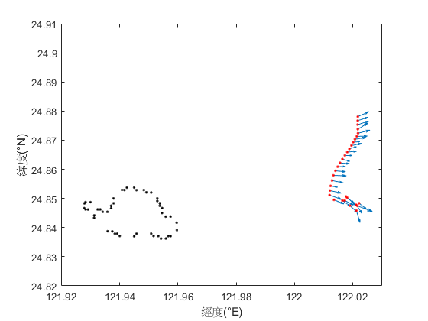
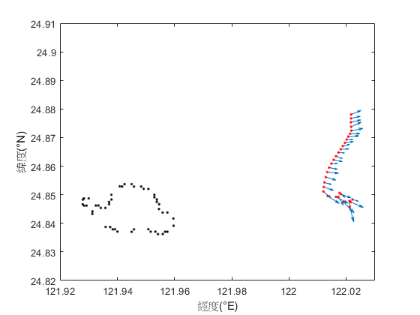
Only difference I could see is at the bottom of the ship track (24.843°N 122.02°"E) the current velocities seems different.

Slide 4
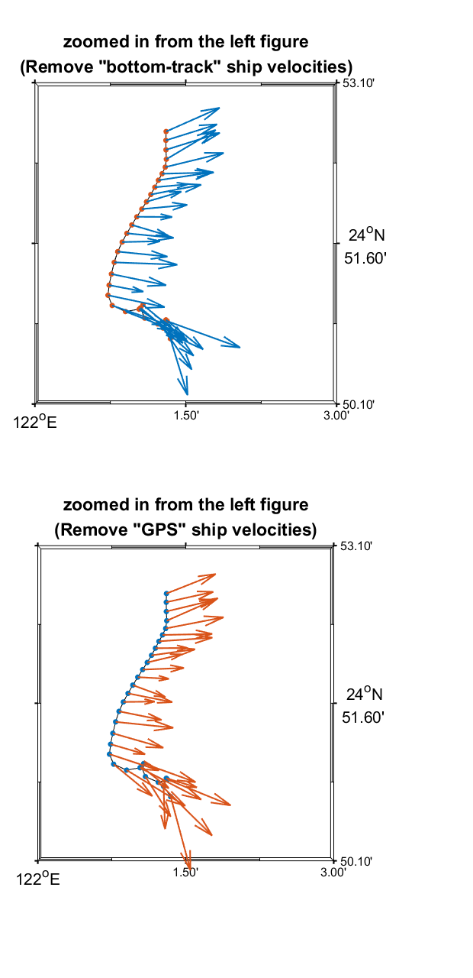
上圖流矢的分布相較下圖集中，而下圖流矢的分布相較上圖分散。比較兩圖最下方最突出的流矢(2017/06/29 02:05:08 , the 90th ensemble)，下圖的流速較快。以及兩圖的94th ensemble(2017/06/29 02:25:08)流矢也有不同的表現。

Slide 5
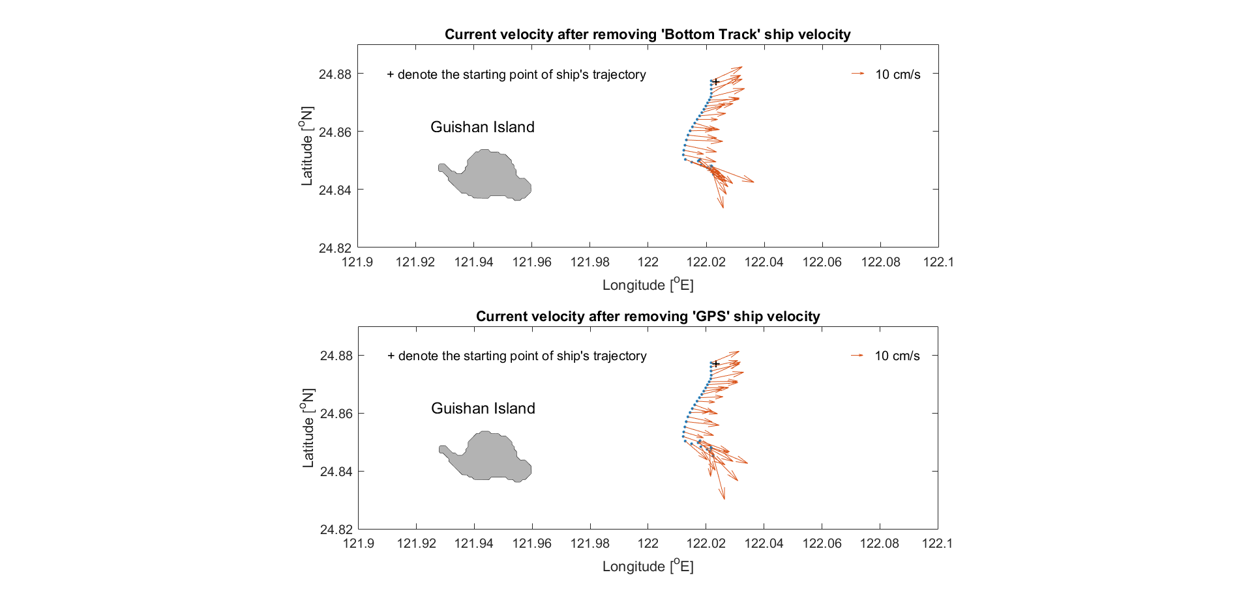
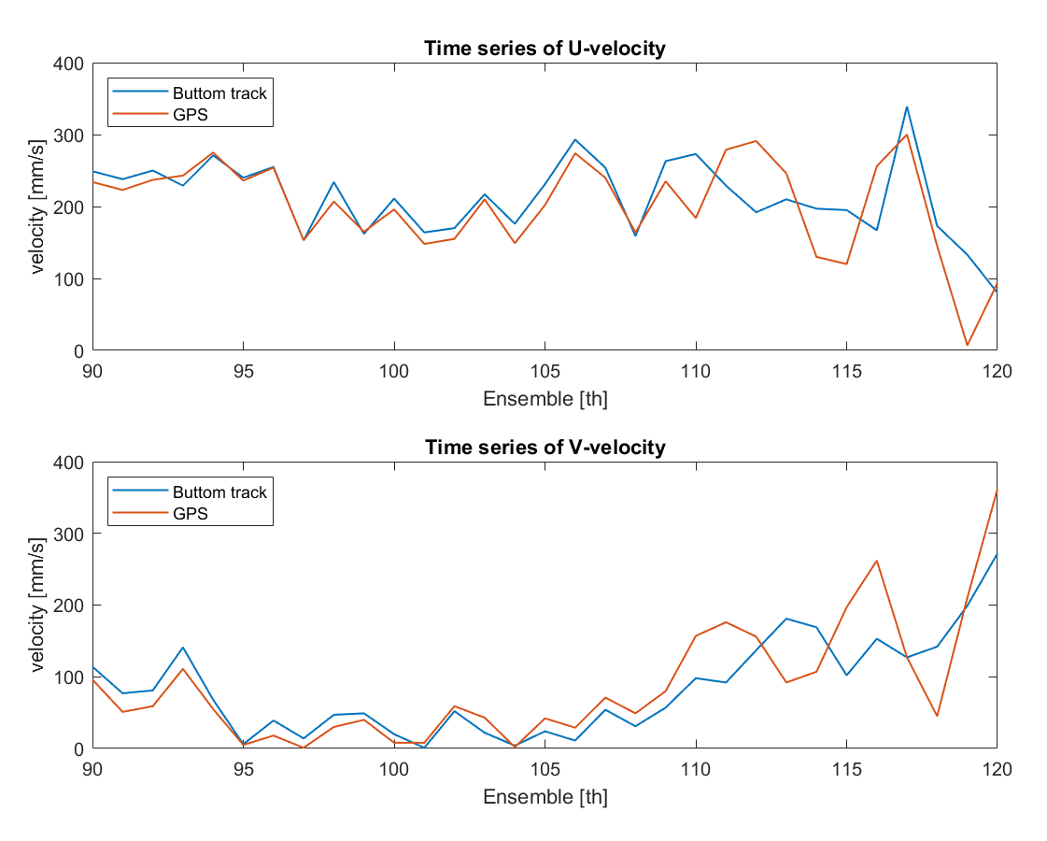
洋流流速及流向皆略有不同。

Slide 6
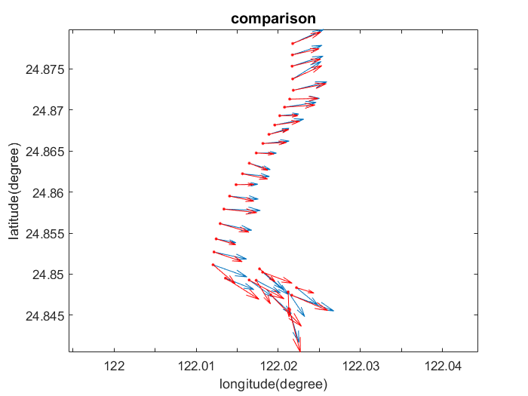
紅線為移除gps的速度；藍線則為移除bottom track的速度
可看出上半部的紅線幾乎和藍線重疊，但下半部兩顏色的線除方向不同，速度也不盡相同，藍線看起來也許是船體受到慣性影響，因此方向改變的較緩慢。

Slide 7
平均流速
Remove Bottom-track : 239.4708 (mm/s)
Remove GPS : 235.9008 (mm/s)
流速減平均流速的誤差（平均）
Remove Bottom-track : 35.0188
Remove GPS : 49.4029

Slide 8
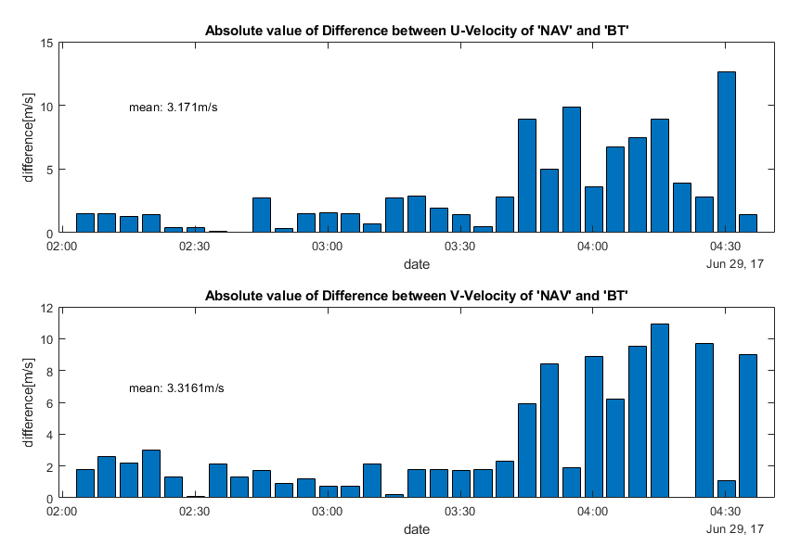

Slide 9
ADCP Calibration
Bottom track and Navigation (GPS)

Slide 10
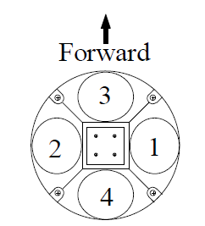
Error sources of ADCP measurement
Noise of instruments
Sound absorption
Misalignment of the transducer relative to the ship’s keel
Interference by physical objects and ship‐induced turbulence
Ship motion

Slide 11
Error sources of ADCP measurement
Noise of instruments
Sound absorption
Misalignment of the transducer relative to the ship’s keel
Interference by physical objects and ship‐induced turbulence
Ship motion

Slide 12
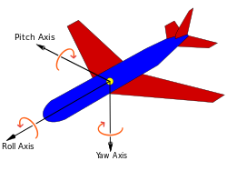
Affecting the accuracy of ADCP
Misalignment Angle
Ship’s motion: Pitch and Roll
(Heading axis)
https://en.wikipedia.org/wiki/Aircraft_principal_axes

Slide 13
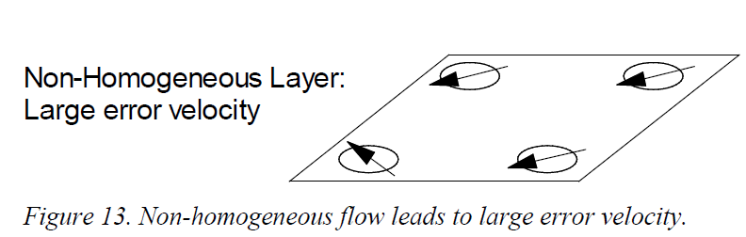
Ocean-Current Homogeneity in a Horizontal Layer (REVIEW)
Error velocity: the difference between the two estimates of velocity
Non-homogeneous currents → large error vel.
Large errors of Pitch and Roll → large error vel.

Slide 14
Velocity data (REVIEW)
Based on different kind of coordinates:
Beam coordinates: Velocity is parallel to each beam.
Earth coordinates: Velocity in north, east and up (We want this)
ADCP coordinates: Similar to earth coordinates but the velocity is relative to ADCP
Ship coordinates: Similar to ADCP coordinates except that heading is rotated into ship‘s forward and sideways.
Sources: ADCP Principles of Operation
(A Practical Primer), RDI, 2011

Slide 15
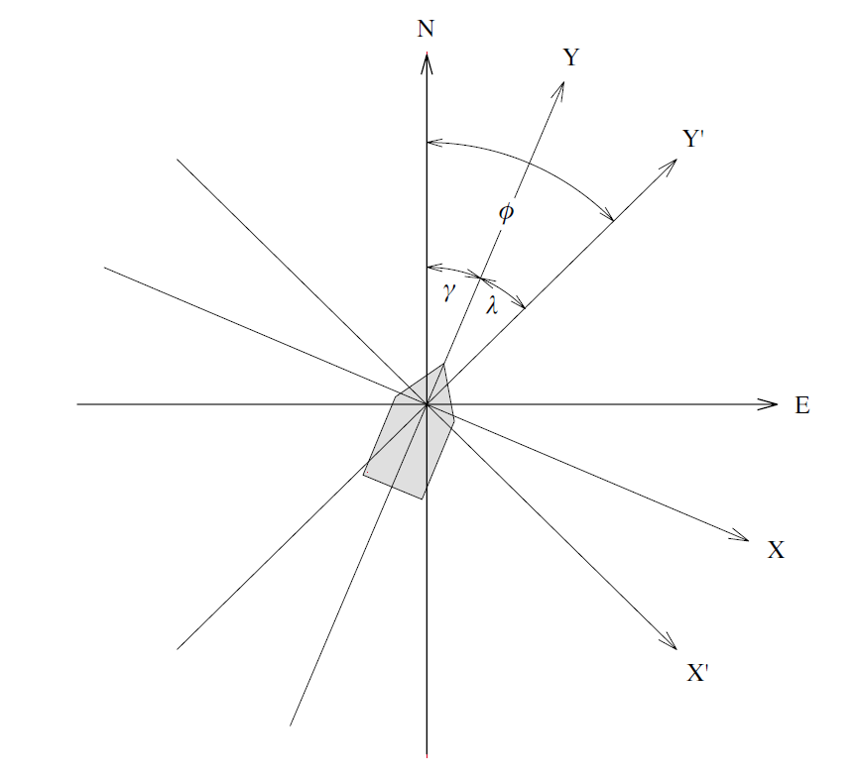
Misalignment Angle
NE: earth coordinates
γ: the angle of (X, Y) relative to (N, E) measured by the gyrocompass, because the the ship heading is not always along the ship track.
XY: ship coordinates
X’Y’: ADCP coordinates
λ : mounting angle of ADCP to ship’s keel (船骨)
wind
Misalignment Angle
α = γ +λ
(positive for counterclockwise)
Osiński [Oceanologia, 2000]

Slide 16

Velocity variables for different references
${\text{B}\text{ottom}\text{−}\text{track} \text{ship} \text{velocities}\text{:} (u}_{b} ,v_{b})$
${\text{G}\text{PS} \text{ship} \text{velocities}\text{:} (u}_{g} ,v_{g})$
$Relative water velocities referring to the moving ADCP: {(u}_{r} ,v_{r})$
${\text{Absolute} \text{water} \text{velocities}\text{:} (u}_{w} ,v_{w})$

Slide 17
Misalignment Angle
NE: earth coordinates (u_{g}, v_{g})
γ: the angle of (X, Y) relative to (N, E) measured by the gyrocompass, because the the ship heading is not always along the ship track.
XY: ship coordinates (u_{b}, v_{b})
X’Y’: ADCP coordinates (u_{r},v_{r})
λ : mounting angle of ADCP to ship’s keel (船骨)
Misalignment Angle
α = γ +λ
(positive for counterclockwise)
Osiński [Oceanologia, 2000]

Slide 18
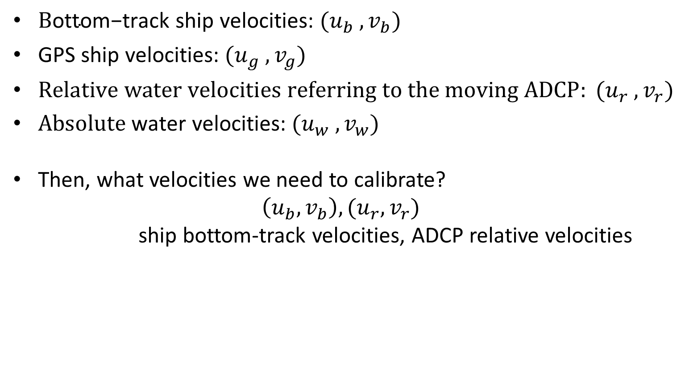
Velocity variables for different references
${\text{B}\text{ottom}\text{−}\text{track} \text{ship} \text{velocities}\text{:} (u}_{b} ,v_{b})$
${\text{G}\text{PS} \text{ship} \text{velocities}\text{:} (u}_{g} ,v_{g})$
$Relative water velocities referring to the moving ADCP: {(u}_{r} ,v_{r})$
${\text{Absolute} \text{water} \text{velocities}\text{:} (u}_{w} ,v_{w})$
Then, what velocities we need to calibrate?
$$\left(u_{b},v_{b}\right),(u_{r},v_{r})$$
ship bottom-track velocities, ADCP relative velocities
Bottom-
track

Slide 19
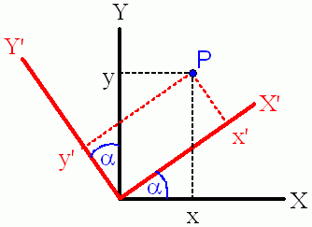
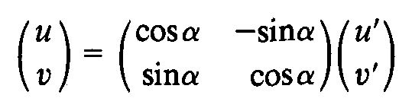
Coordinate Rotating (Fixing Misalignment Angle, α )

Slide 20
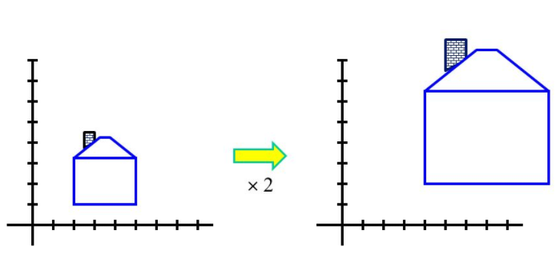
Coordinate Scaling (uniform) (Fixing pitch & roll, β)
A value, 0.3º, of the beam orientation from the vertical results in a |β| of 1.01.
β

Slide 21
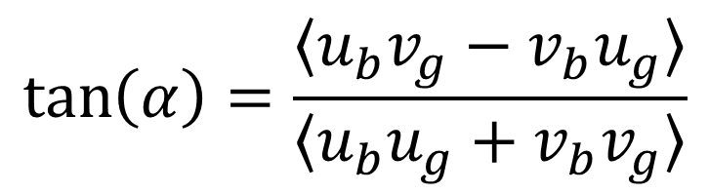


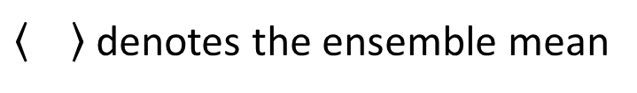
Calculating α and β
Assume that ${(u}_{b} ,v_{b})$ are the ship velocities measured by the ADCP bottom track and ${(u}_{g} ,v_{g})$ are the ship velocities measured by the ship GPS. Then,
$$\tan\left(α\right)=\frac{〈u_{b}v_{g}−v_{b}u_{g}〉}{〈u_{b}u_{g}+v_{b}v_{g}〉}$$
$$β=\sqrt{\frac{〈{u_{g}}^{2}{{+ v}_{g}}^{2}〉}{〈{u_{b}}^{2}{{+ v}_{b}}^{2}〉}}$$
denotes the ensemble mean

Slide 22
References
Joyce, T. M., 1989. On in Situ “Calibration” of Shipboard ADCPs. Journal of Atmospheric and Oceanic Technology, 6, 169-172.
Tang, T.-Y. and J.-C. Ma, 1995. A note on the accuracy of shipboard ADCP on Ocean Researcher I. Acta Oceanographica Taiwanica, 34, 71-81.
Osiński R.,2000. The misalignment angle in vessel-mounted ADCP. Oceanologia, 42 (3), 385-394.

Slide 23
Start doing some practical exercises in class to calculate the α and β
Using the OR2_2247_20170628 data from the 90th ensemble to the 109th ensemble

Slide 24
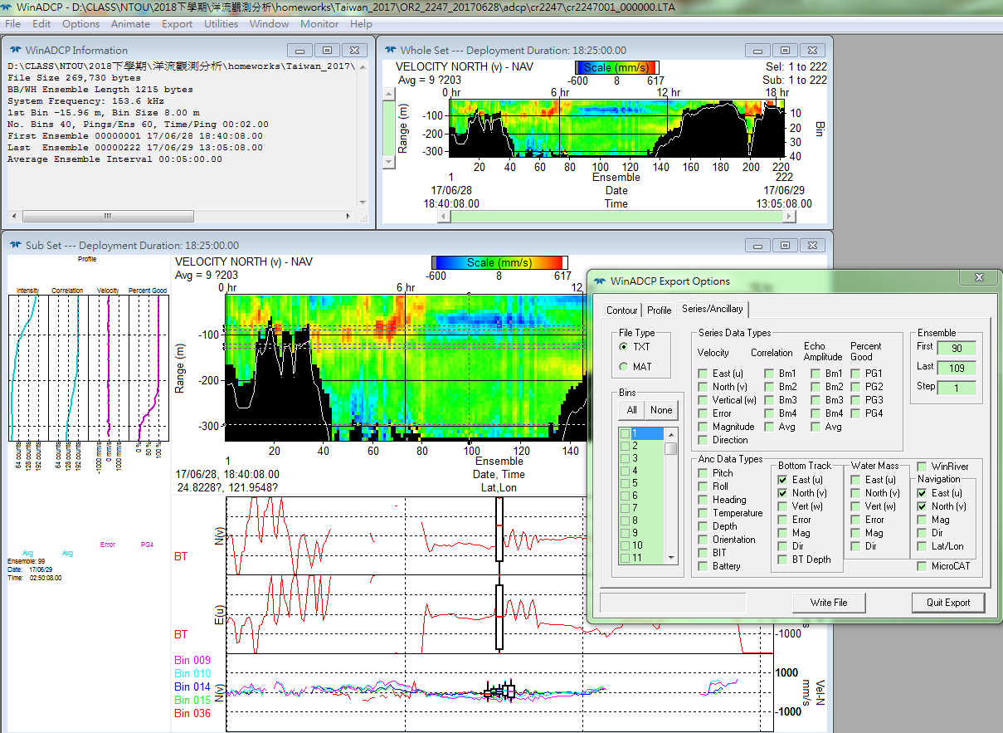
Getting ship velocities from WinADCP (5~10 mins)
Open “cr2247001_000000.LTA”
Output the ship velocities measured by the bottom track and GPS

Slide 25
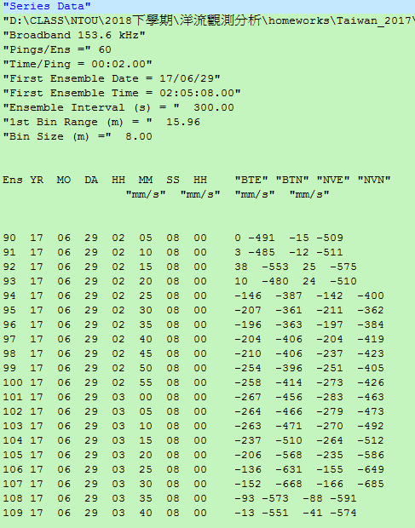


Looking at the ship velocity data
$${(u}_{b} ,v_{b})$$
${(u}_{g} ,v_{g})$

Slide 26
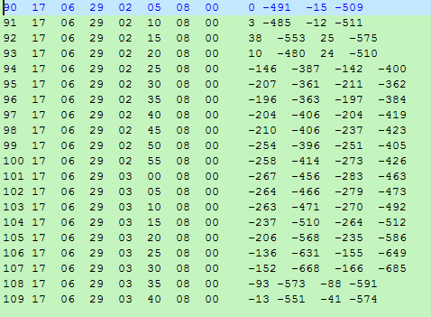
Deleting the heading

Slide 27
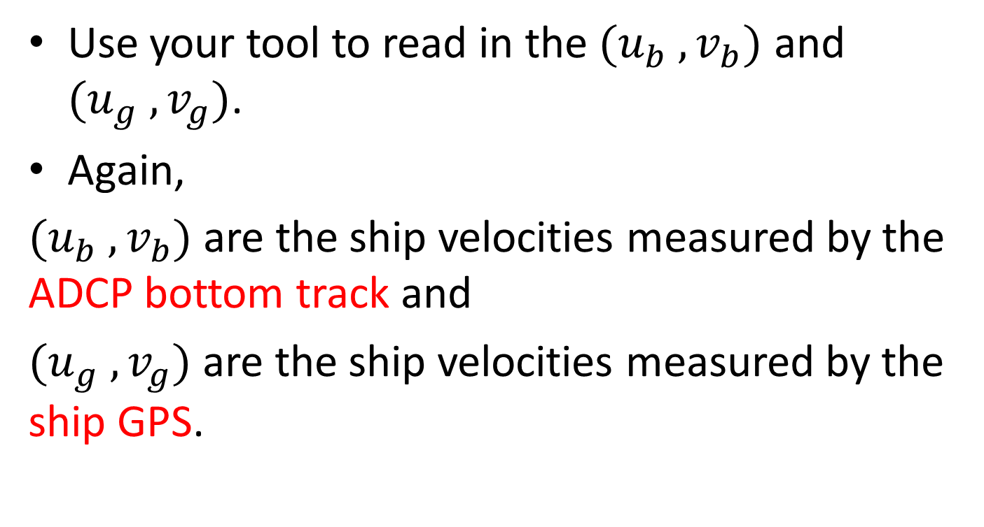
Read in data to PC (15 mins)
Use your tool to read in the ${(u}_{b} ,v_{b})$ and ${(u}_{g} ,v_{g})$.
Again,
${(u}_{b} ,v_{b})$ are the ship velocities measured by the ADCP bottom track and
${(u}_{g} ,v_{g})$ are the ship velocities measured by the ship GPS.

Slide 28
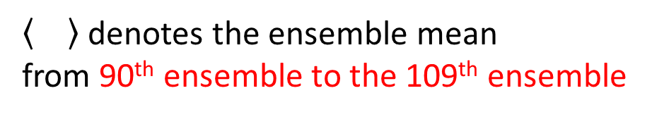
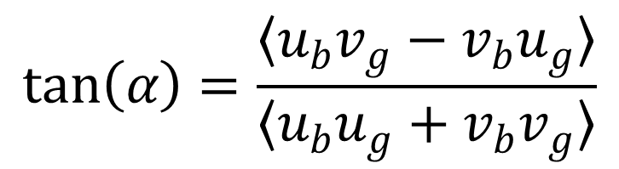
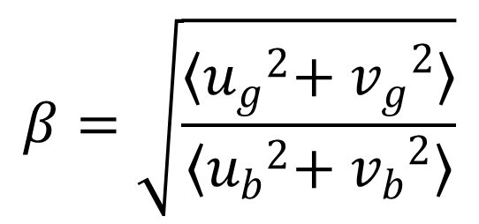
Calculating α and β (30 mins)
$$\tan\left(α\right)=\frac{〈u_{b}v_{g}−v_{b}u_{g}〉}{〈u_{b}u_{g}+v_{b}v_{g}〉}$$
$$β=\sqrt{\frac{〈{u_{g}}^{2}{{+ v}_{g}}^{2}〉}{〈{u_{b}}^{2}{{+ v}_{b}}^{2}〉}}$$
denotes the ensemble mean
from 90th ensemble to the 109th ensemble

Slide 29
Calculating α and β (MATLAB codes)
d=load('ship_vel_gps_bt_ok');
ub=d(:,9);
vb=d(:,10);
ug=d(:,11);
vg=d(:,12);
tan_alpha=mean(ub.*vg-vb.*ug)/mean(ub.*ug+vb.*vg);
alpha=atand(tan_alpha)
beta=sqrt(mean(ug.^2+vg.^2)/mean(ub.^2+vb.^2))
## alpha=-0.77º, beta=1.0353.

Slide 30
How to calibrate the current velocities using the α and β
Calculate the current velocities from the velocities relative to ADCP

Slide 31
Velocity variables for different references
${\text{B}\text{ottom}\text{−}\text{track} \text{ship} \text{velocities}\text{:} (u}_{b} ,v_{b})$
${\text{G}\text{PS} \text{ship} \text{velocities}\text{:} (u}_{g} ,v_{g})$
$Relative water velocities referring to the moving ADCP: {(u}_{r} ,v_{r})$
${\text{Absolute} \text{water} \text{velocities}\text{:} (u}_{w} ,v_{w})$

Slide 32
Velocity variables for different references
${\text{B}\text{ottom}\text{−}\text{track} \text{ship} \text{velocities}\text{:} (u}_{b} ,v_{b})$
${\text{G}\text{PS} \text{ship} \text{velocities}\text{:} (u}_{g} ,v_{g})$
$Relative water velocities referring to the moving ADCP: {(u}_{r} ,v_{r})$
${\text{Absolute} \text{water} \text{velocities}\text{:} (u}_{w} ,v_{w})$
Then, what velocities we need to calibrate?
$$\left(u_{b},v_{b}\right),(u_{r},v_{r})$$
ship bottom-track velocities, ADCP relative velocities
Bottom-
track

Slide 33
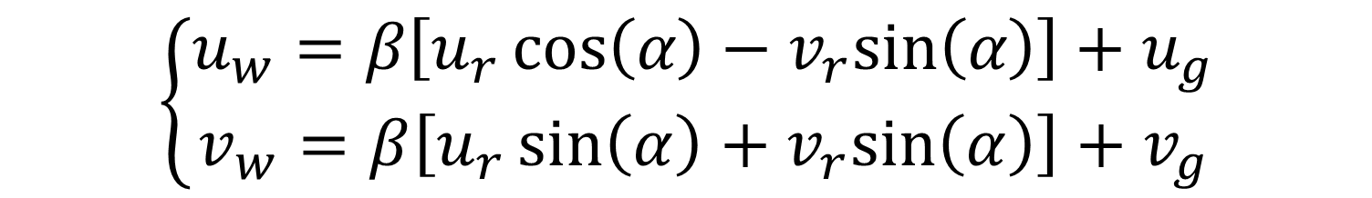
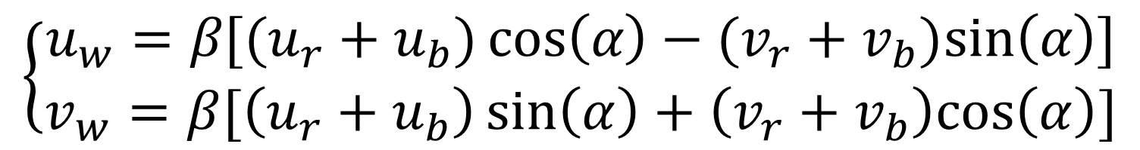
Calculating the absolute water velocities after calibration
Removing bottom-track ship velocities:
$$\left\{\begin{aligned}u_{w}=β[(u_{r}+u_{b})\cos\left(α\right)−(v_{r}+v_{b})sin\left(α\right)] \\ v_{w}=β[\left(u_{r}+u_{b}\right)\sin\left(α\right)+\left(v_{r}+v_{b}\right)cos\left(α\right)]\end{aligned}\right.$$
Removing GPS ship velocities:
$$\left\{\begin{aligned}u_{w}=β\left[u_{r}\cos\left(α\right)−v_{r}sin\left(α\right)\right]+u_{g} \\ v_{w}=β\left[u_{r}\sin\left(α\right)+v_{r}sin\left(α\right)\right]+v_{g}\end{aligned}\right.$$

Slide 34
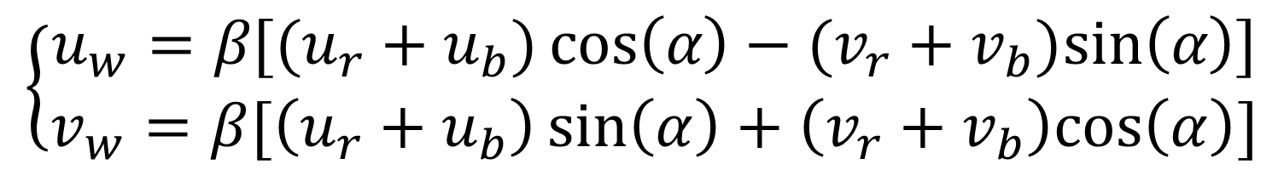

Velocity variables for different references
${\text{B}\text{ottom}\text{−}\text{track} \text{ship} \text{velocities}\text{:} (u}_{b} ,v_{b})$ {outputted}
${\text{G}\text{PS} \text{ship} \text{velocities}\text{:} (u}_{g} ,v_{g})$ {outputted}
$Relative water velocities referring to the moving ADCP: {(u}_{r} ,v_{r})$
${\text{Absolute} \text{water} \text{velocities}\text{:} (u}_{w} ,v_{w})$
Removing bottom-track ship velocities:
$$\left\{\begin{aligned}u_{w}=β[(u_{r}+u_{b})\cos\left(α\right)−(v_{r}+v_{b})sin\left(α\right)] \\ v_{w}=β[\left(u_{r}+u_{b}\right)\sin\left(α\right)+\left(v_{r}+v_{b}\right)cos\left(α\right)]\end{aligned}\right.$$

Slide 35
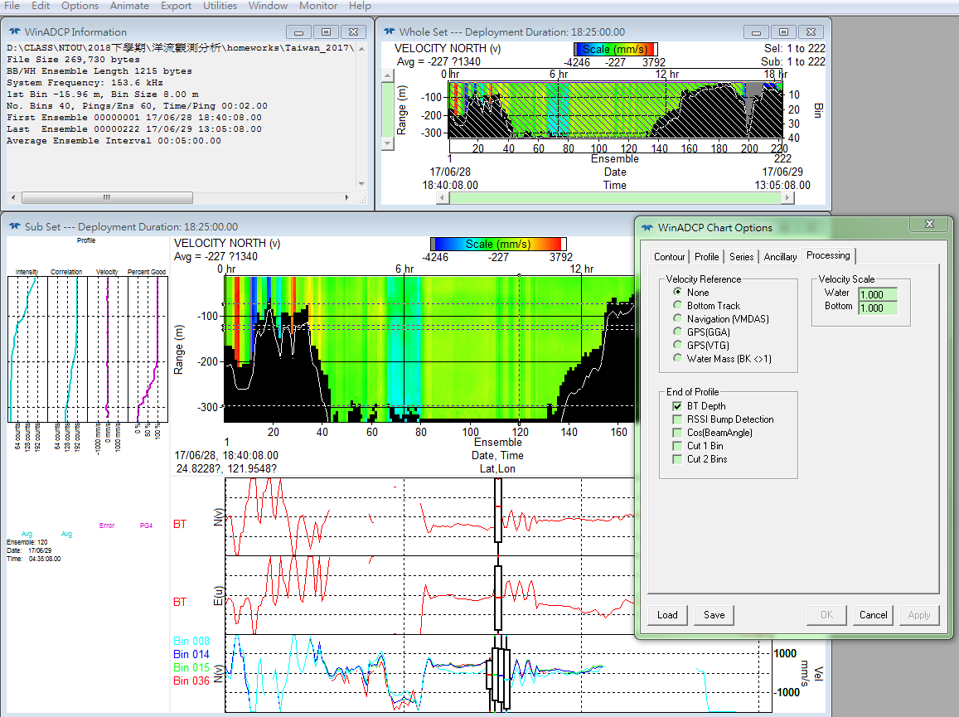
Getting the relative water velocities from WinADCP (5~10 mins)

Slide 36
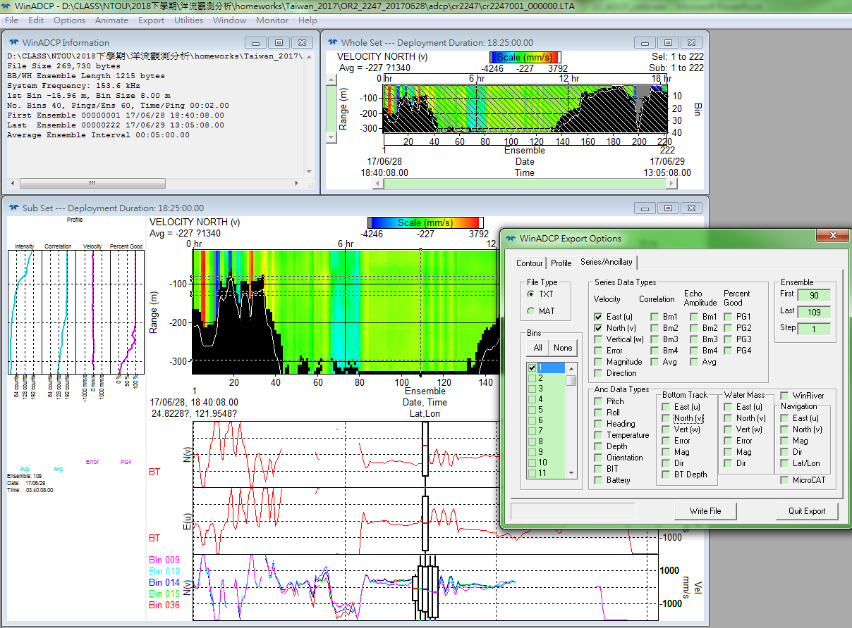
Outputting the relative water velocities from WinADCP (5~10 mins)

Slide 37
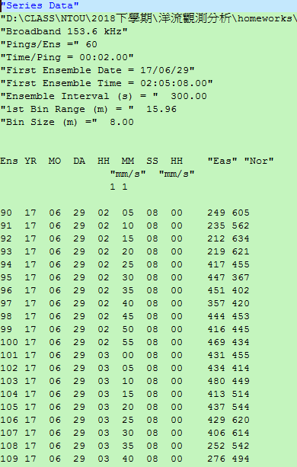

Looking at the data of relative water velocities
${(u}_{r} ,v_{r})$

Slide 38
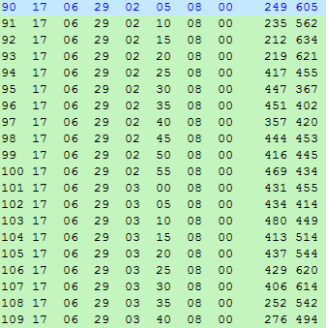
Deleting the heading

Slide 39
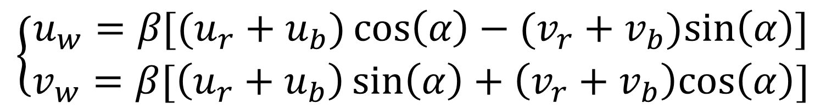
Calculating the absolute water velocities (bottom track)
Removing bottom-track ship velocities:
$$\left\{\begin{aligned}u_{w}=β[(u_{r}+u_{b})\cos\left(α\right)−(v_{r}+v_{b})sin\left(α\right)] \\ v_{w}=β[\left(u_{r}+u_{b}\right)\sin\left(α\right)+\left(v_{r}+v_{b}\right)cos\left(α\right)]\end{aligned}\right.$$

Slide 40
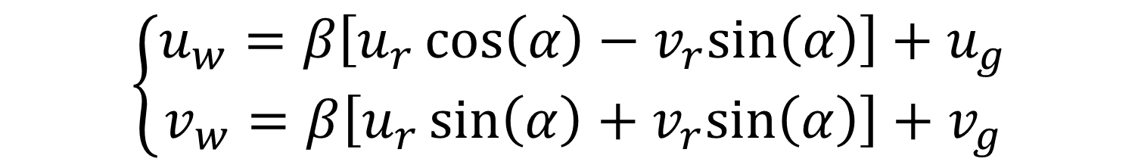
Calculating the absolute water velocities (GPS)
Removing GPS ship velocities:
$$\left\{\begin{aligned}u_{w}=β\left[u_{r}\cos\left(α\right)−v_{r}sin\left(α\right)\right]+u_{g} \\ v_{w}=β\left[u_{r}\sin\left(α\right)+v_{r}sin\left(α\right)\right]+v_{g}\end{aligned}\right.$$

Slide 41
Calculating the absolute water velocities (MATLAB codes)
d=load('uv_2247_no_ok.txt');
ur=d(:,9);
vr=d(:,10);
uw_bt=beta*((ur+ub)*cosd(alpha)-(vr+vb)*sind(alpha));
vw_bt=beta*((ur+ub)*sind(alpha)+(vr+vb)*cosd(alpha));
uw_gps=beta*(ur*cosd(alpha)-vr*sind(alpha))+ug;
vw_gps=beta*(ur*sind(alpha)+vr*cosd(alpha))+vg

Slide 42
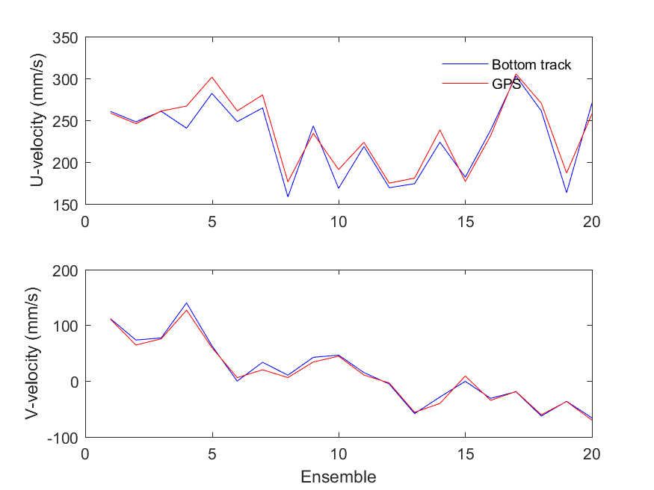
Plot results
Comparing the current velocities after removing bottom-tracked ship velocities and GPS ship velocities.

