Slide 1
教學進度 (期中考前) Schedule (Before mid-term)
Introduction: Why do we need to observe ocean currents?
Some basic tools for programming and scientific plotting: Matlab, Python, Julia Language, GMT, Ocean Data View (additional topics for students) & some required mathematics
Methods of observing currents: In-situ and satellite observations
Data and links of observations for ocean currents
Drifter data analysis

Slide 2
教學進度 (期中考後) Schedule (After mid-term)
6/21日週周日出海實習
ADCP data analysis
Shipboard ADCP calibration (data processing for bottom-track ship velocities)
Shipboard ADCP calibration (data processing for GPS ship velocities)
Current Meters
Hydrographic (CTD, XBT, ARGO) data analysis
Wind-driven Circulation

Slide 3
Reviews
Why do we care about ocean motion (currents and circulation)?
Why do we need to observe ocean currents?
What methods that you know to observe ocean currents?
What are the Lagrangian and Eulerian measurements?
What are the disadvantages of drifter observation?
What are the disadvantages of ADCP observation?

Slide 4
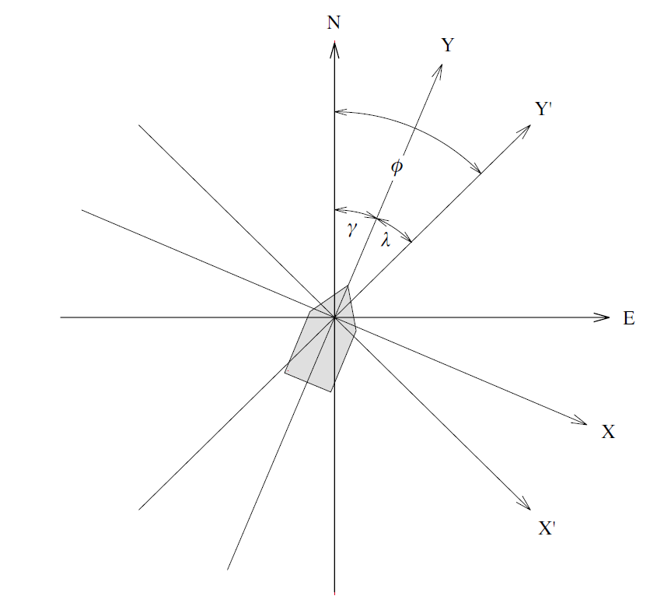
Misalignment Angle (Review)
NE: earth coordinates (u_{g}, v_{g})
γ: the angle of (X, Y) relative to (N, E) measured by the gyrocompass, because the the ship heading is not always along the ship track.
XY: ship coordinates (u_{b}, v_{b})
X’Y’: ADCP coordinates (u_{r},v_{r})
λ : mounting angle of ADCP to ship’s keel (船骨)
Misalignment Angle
α = γ +λ
(positive for counterclockwise)
Osiński [Oceanologia, 2000]

Slide 5
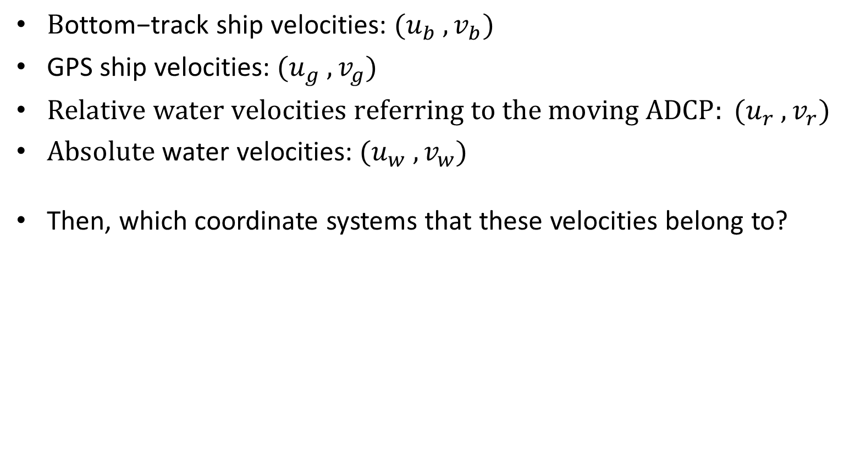
Velocity variables for different references (Review)
${\text{B}\text{ottom}\text{−}\text{track} \text{ship} \text{velocities}\text{:} (u}_{b} ,v_{b})$
${\text{G}\text{PS} \text{ship} \text{velocities}\text{:} (u}_{g} ,v_{g})$
$Relative water velocities referring to the moving ADCP: {(u}_{r} ,v_{r})$
${\text{Absolute} \text{water} \text{velocities}\text{:} (u}_{w} ,v_{w})$
Then, which coordinate systems that these velocities belong to?

Slide 6
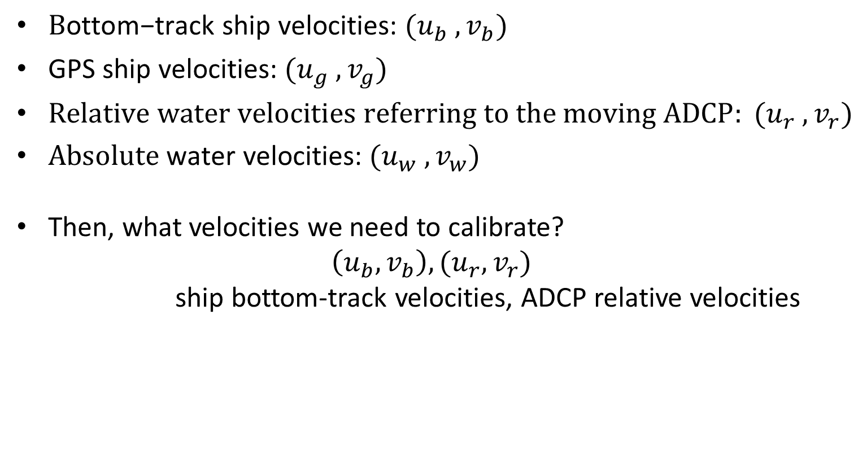
Velocity variables for different references
${\text{B}\text{ottom}\text{−}\text{track} \text{ship} \text{velocities}\text{:} (u}_{b} ,v_{b})$
${\text{G}\text{PS} \text{ship} \text{velocities}\text{:} (u}_{g} ,v_{g})$
$Relative water velocities referring to the moving ADCP: {(u}_{r} ,v_{r})$
${\text{Absolute} \text{water} \text{velocities}\text{:} (u}_{w} ,v_{w})$
Then, what velocities we need to calibrate?
$$\left(u_{b},v_{b}\right),(u_{r},v_{r})$$
ship bottom-track velocities, ADCP relative velocities

Slide 7
教學進度 (期中考前) Schedule (Before mid-term)
Introduction: Why do we need to observe ocean currents?
Some basic tools for programming and scientific plotting: Matlab, Python, Julia Language, GMT, Ocean Data View (additional topics for students) & some required mathematics
Methods of observing currents: In-situ and satellite observations
Data and links of observations for ocean currents
Drifter data analysis

Slide 8
教學進度 (期中考後) Schedule (After mid-term)
6/21日週周日出海實習
ADCP data analysis
Shipboard ADCP calibration (data processing for bottom-track ship velocities)
Shipboard ADCP calibration (data processing for GPS ship velocities)
Current Meters
Hydrographic (CTD, XBT, ARGO) data analysis
Wind-driven Circulation

Slide 9
Current Meters
What are these?

Slide 10
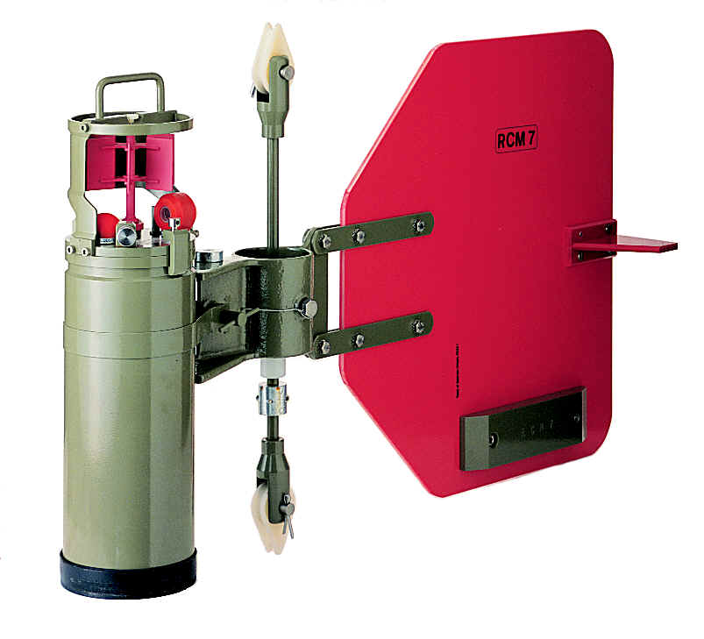
Current Meters
Rotor Current Meters (RCM):
time,u,v,temperature,salinity, pressure, tilting
www.physocean.icm.csic.es

Slide 11
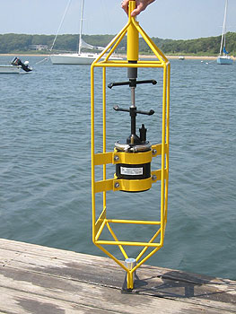
Acoustic Current Meters
(ACM)
time,u,v,(w), temperature, salinity, pressure, tilting

Slide 12
Lagrangian or Eulerian
Current meters belong to
Lagrangian measurements
Or
Eulerian measurements ?

Slide 13
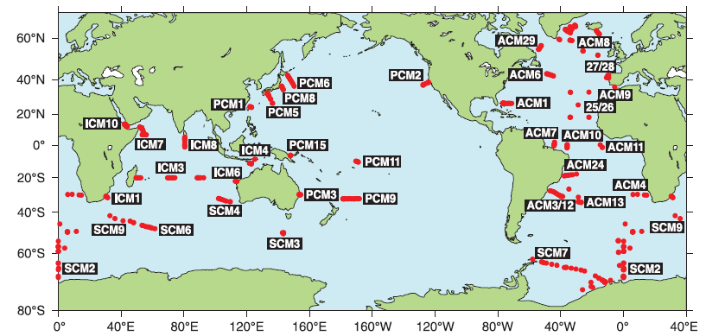
WOCE moored current meter arrays
WOCE: World Ocean Circulation Experiment

Slide 14
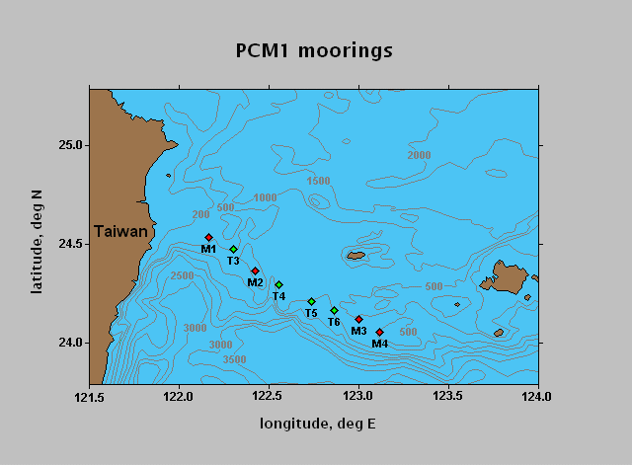
Using the PCM1 data

Slide 15

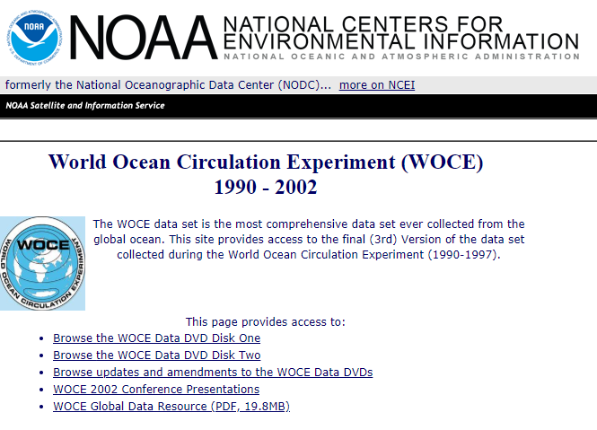
Link to the PCM1 data
Google

Slide 16
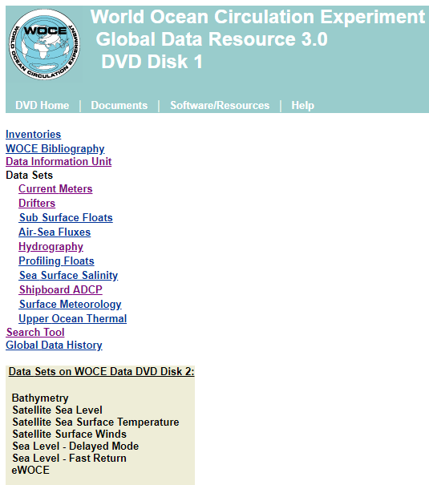
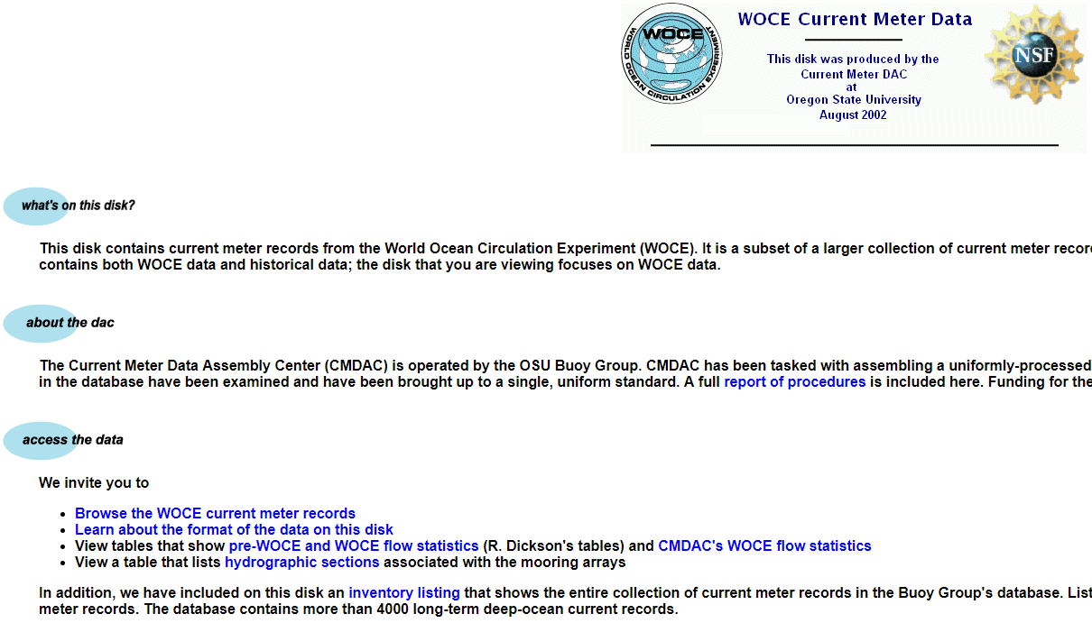
Link to the PCM1 data

Slide 17
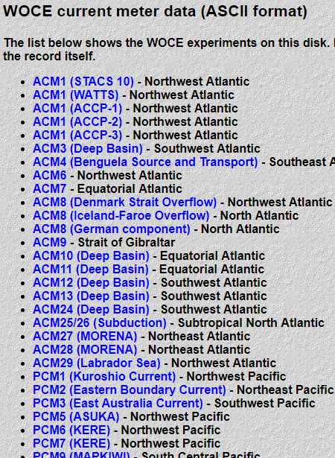
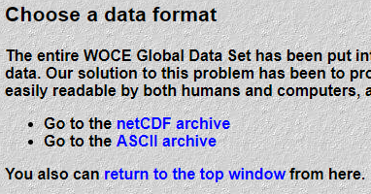
Link to the PCM1 data

Slide 18
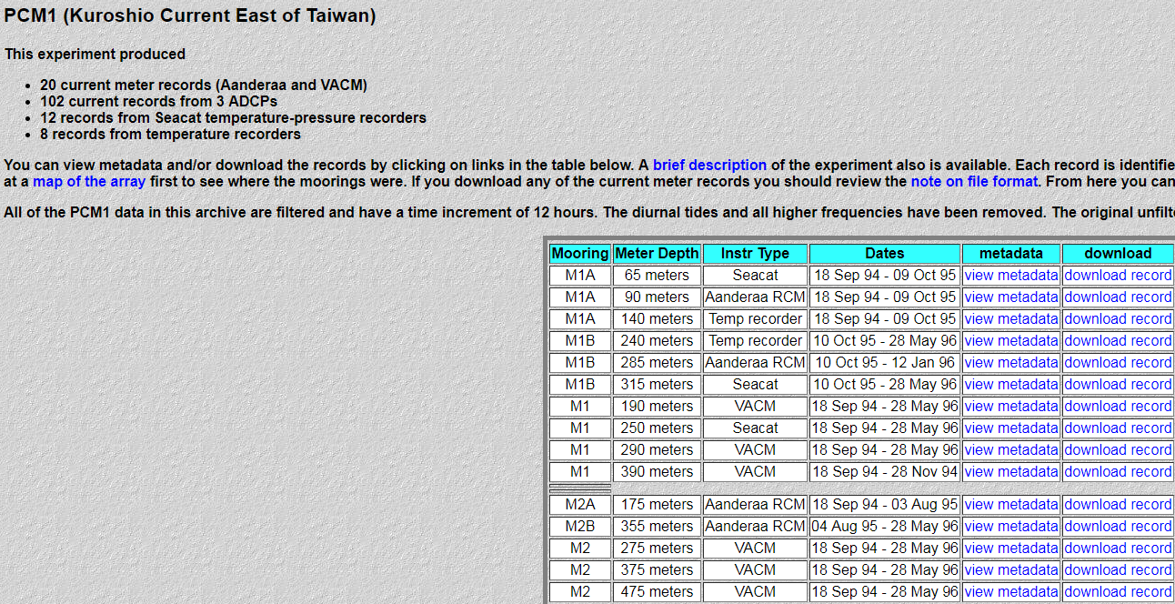
Link to the PCM1 data

Slide 19
Downloading data

Slide 20


Unzip and rename

Slide 21
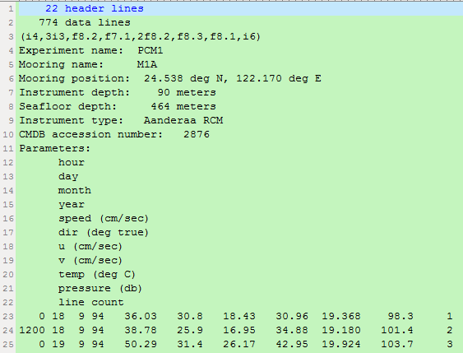
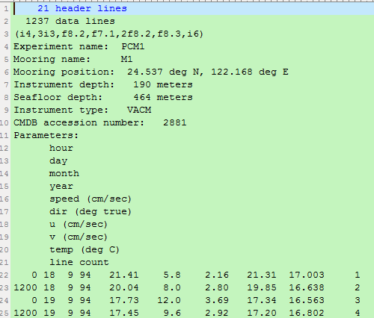
Viewing the data
M1 at 90 m M1 at 190 m

Slide 22
Exercise in class (using M1 at 90 m)
Analyze the PCM1 data at the M1 station from 1994 to 1996, to study the temporal variation of Kuroshio speeds at different depth.

Slide 23
Viewing the data
M1 at 90 m

Slide 24
Skip the heading
MATLAB:
filename='rcm02876_m1_90.str';
fid = fopen(filename, 'r');
Data = textscan(fid, [repmat('%f',1,11)], 'headerLines', 22);
fclose(fid);
Data= cell2mat( Data);

Slide 25
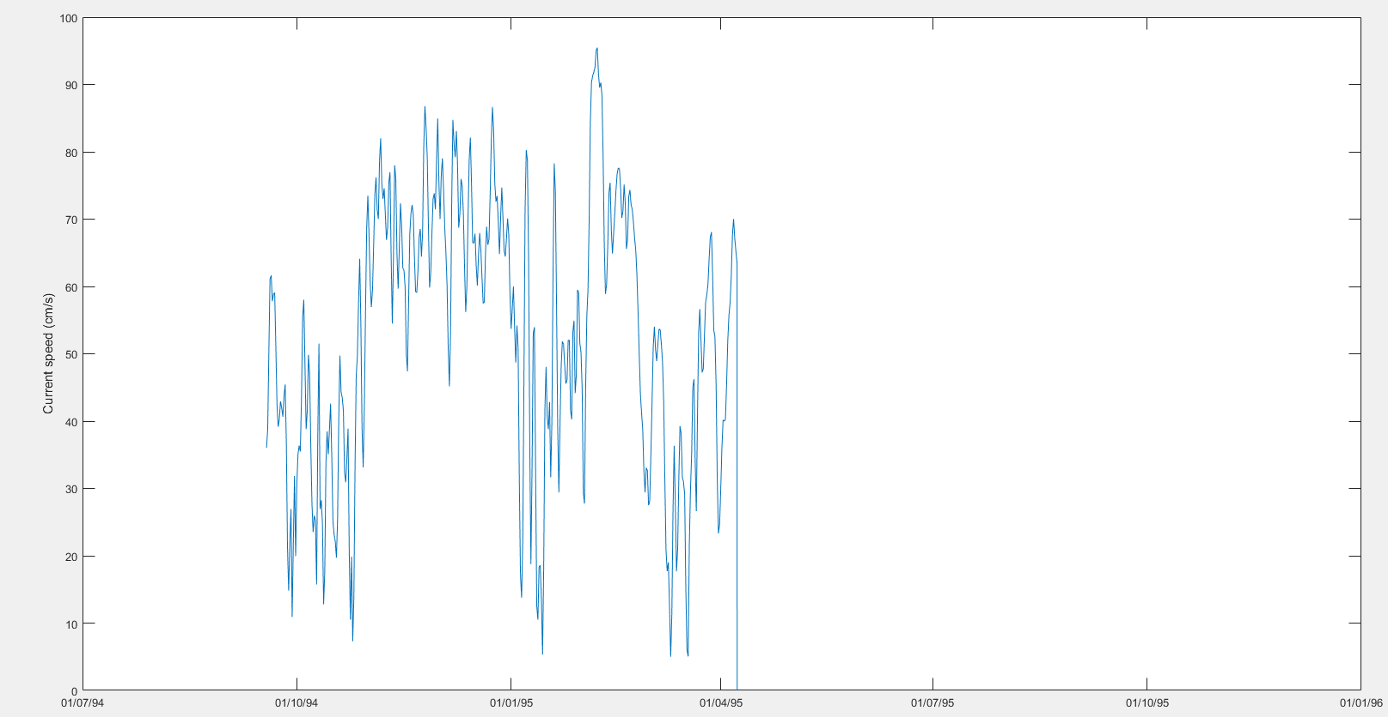
Read and plot the data from each RCM
Data we need: year, month, date, hour, speeds.

Slide 26
Set variables and time
(for MATLAB)
hr=Data(:,1)/100;
dd=Data(:,2);
mm=Data(:,3);
yy=Data(:,4);
spd=Data(:,5);
time=datenum(yy,mm,dd,hr,0,0);
Convert date and time to serial date number
Notes:
http://julia-programming-language.2336112.n4.nabble.com/PyPlot-plot-date-How-do-I-alter-the-time-format-td8035.html

Slide 27
Plot the time series of speeds by showing the dates at the xaxis
MATLAB:
plot(time,spd)
hold on
set(gca,'ylim',[0 100],'xlim',[datenum(94,9,1) datenum(96,7,1)])
datetick('x',20,'keeplimits','keepticks')

Slide 28
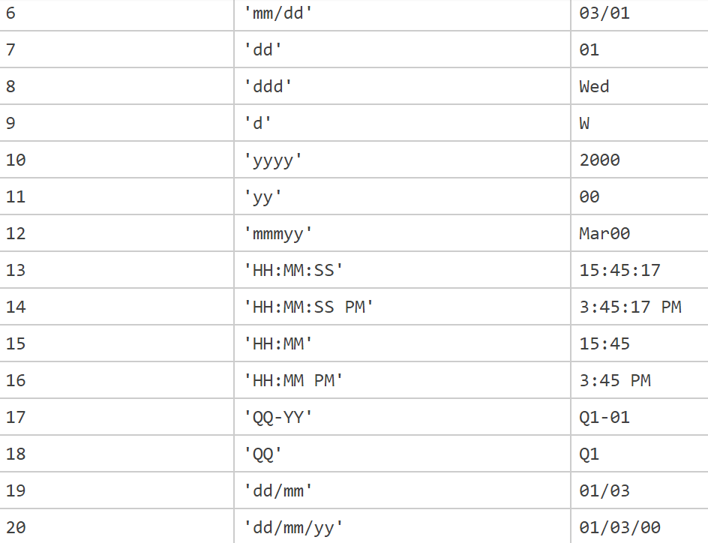
Matlab help for “datetick”
datetick('x',20,'keeplimits','keepticks')

Slide 29
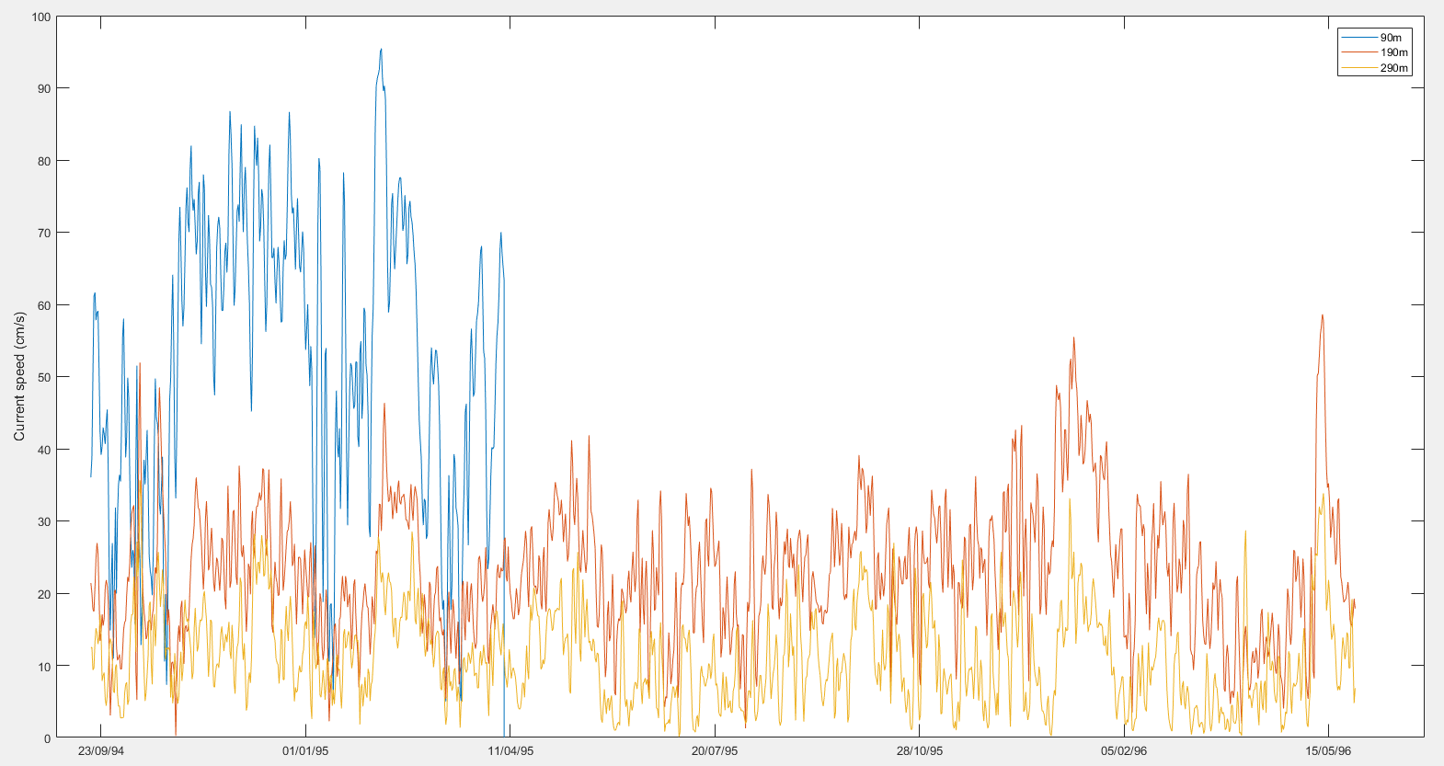
Add in the curves for the speeds at 190 m and 290 m (~30 mins)
What can we learn from this figure, about the spatial and temporal variations?

Slide 30
Homework 8
Analyze the PCM1 data at the M1 and M3 stations from 1994 to 1996, to study the spatial and temporal variations of Kuroshio speeds.

Slide 31
How to study the spatial and temporal variations of Kuroshio Current?
By comparing the speeds of Kuroshio between the M1 and M3 stations at different depths.

Slide 32
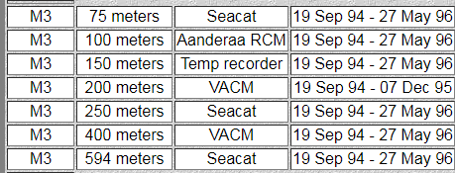
The data we need to download
M1: 90m, 190m and 290m
M3: 100m, 200m and 400 m
Think about how to compare the speeds of Kuroshio at different location?
(Discussion)

Slide 33
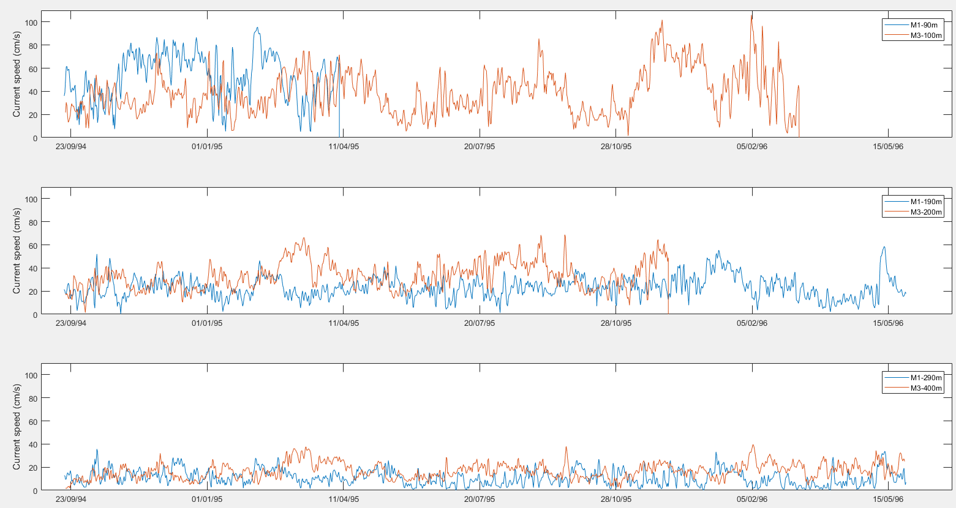
How to compare? (MATLAB)
Observe faster and slower speeds, and observe the higher and smaller vibrations

Slide 34
Homework 8 (due date: 2020/05/07)
Plot the time series of Kuroshio speeds at the stations:
M1: 90m, 190m and 290m
M3: 100m, 200m and 400 m
(as shown in Page 31)
Paste the figure of the speed time series into a word file.
Observe the time series carefully.
Where and when the Kuroshio has a faster and slower speed, and, where and when the Kuroshio has a higher and smaller vibrations?

