Slide 1
Eddy currents
From Satellite Altimeters
Sea Level Anomalies

Slide 2
The figure of today

Slide 3
Ocean Eddies
Circular or spiral movement of sea water
Turbulence in the ocean
Horizontal spinning
Notes:
http://www.fearlessflight.com/blog/can-planes-crash-from-turbulence/
http://nautil.us/blog/the-beautiful-unpredictability-of-coffee-clouds-and-fire

Slide 4
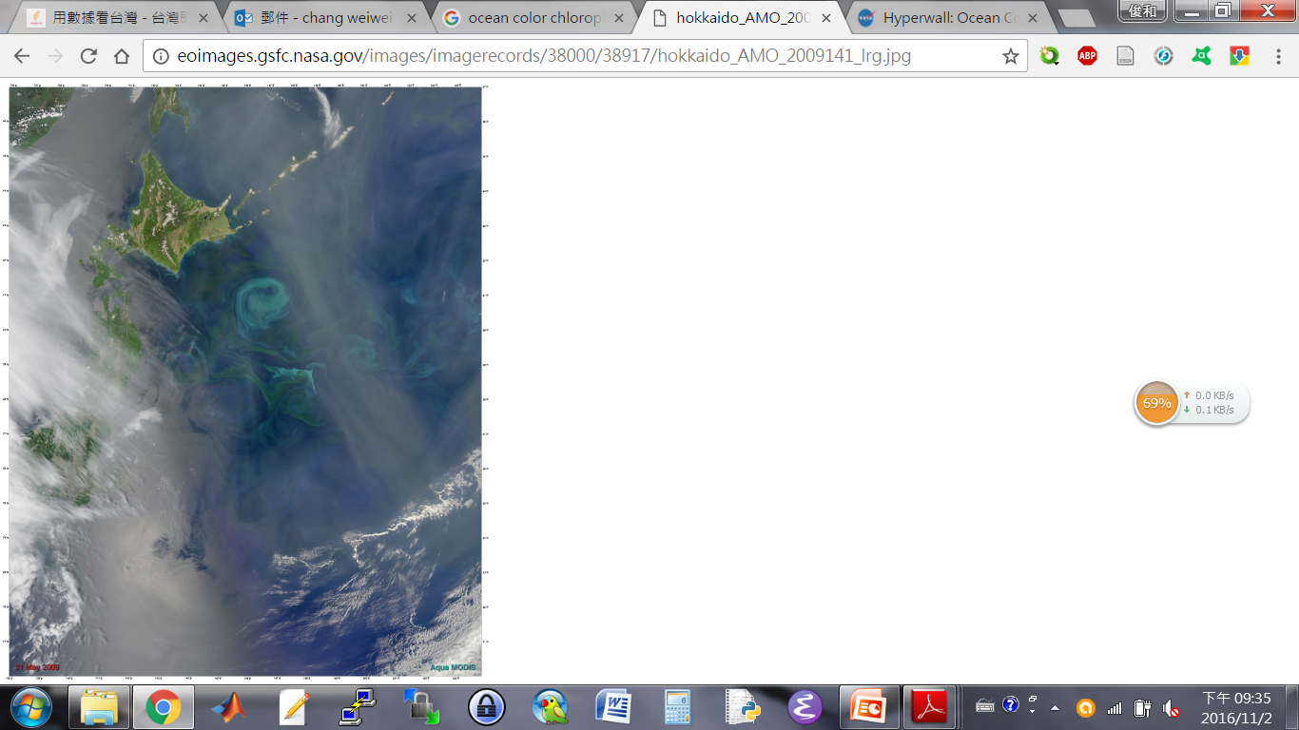
Eddies From Satellites
https://earthobservatory.nasa.gov/IOTD/view.php?id=38917

Slide 5
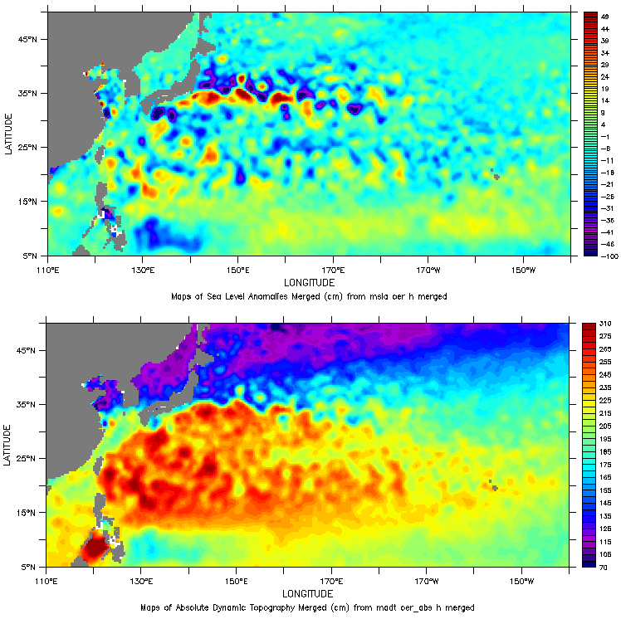
SLA vs ADT?
SLA (sea level anomaly: the variable part of sea surface height)
ADT (absolute dynamic topography: the sum of the variable part and of the constant part)

Slide 6
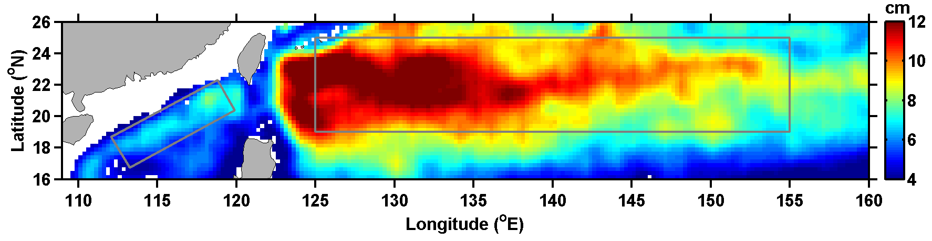
Eddy Active regions around Taiwan
Period of 100 days
Period of 100 days

Slide 7
Mesoscale Eddies
Mesoscale eddies are geostrophic currents also, same as the Kuroshio, but were not necessary driven by winds.

Slide 8
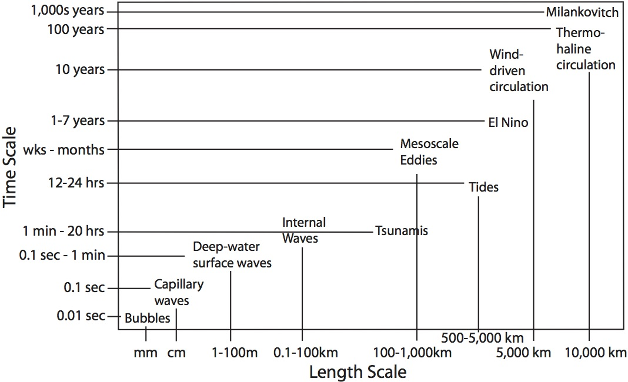
Mesoscale?
www.rsmas.miami.edu

Slide 9
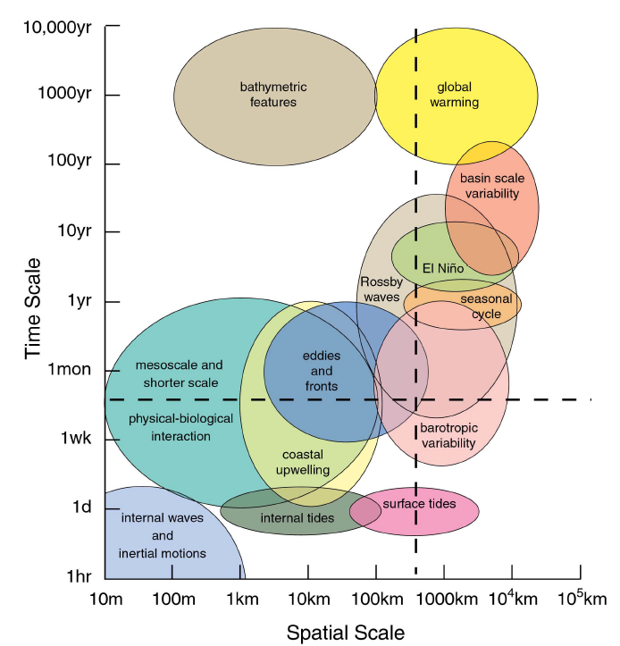
Mesoscale?
[Chelton, 2001]

Slide 10
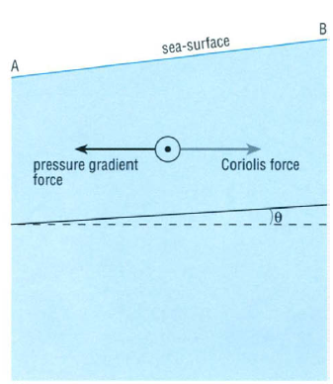
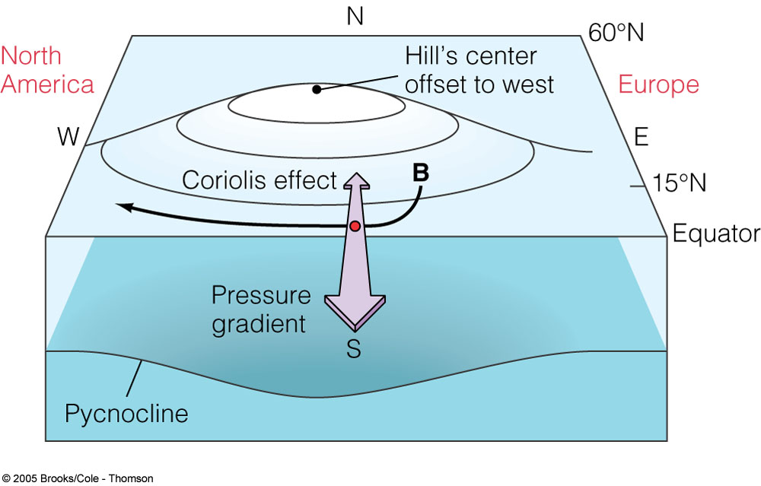
Geostrophic Currents (REVIEW)
pressure gradients force = Coriolis force
(The balance between pressure gradients force and Coriolis Force)

Slide 11
The Equations of Geostrophic Currents (REVIEW)
Basic Idea:
1) Balance between pressure-gradient force and Coriolis force
2) Current velocities are proportional to pressure gradients

Slide 12
The equations of today
h: sea surface height
f: Coriolis parameter (2*omega*sin(lat))
g: 9.8 m/s²
x and y: longitude and latitude
We can use these equations to calculate the eddy-current velocities at the ocean surface, if we have the sea surface height data

Slide 13
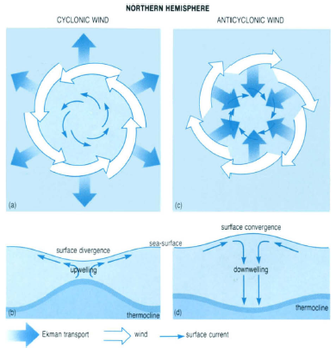
Warmer
Warmer
Colder
Warmer
Colder
Colder

Slide 14
Parameters to observe eddies
SSH: altimeters
SST: microwave or infrared sensors
Cyclonic eddies (cold eddies)
Anticyclonic eddies (warm eddies)
Warmer
Warmer
Colder
Warmer
Colder
Colder

Slide 15
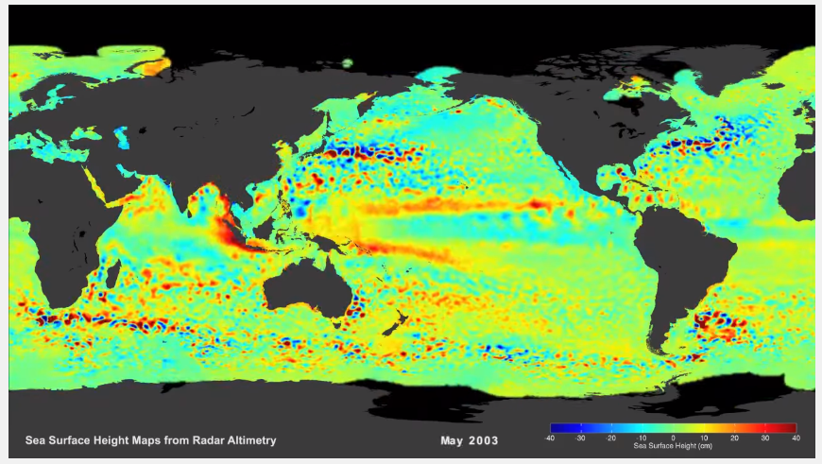
Sea surface height from space (REVIEW)
https://www.youtube.com/watch?v=F8zYKb2GoR4
Focusing on the eddy propagation east of Taiwan

Slide 16
Exercise 1
Obtain data of SLA
Calculate the geostrophic velocities
Plot figures

Slide 17
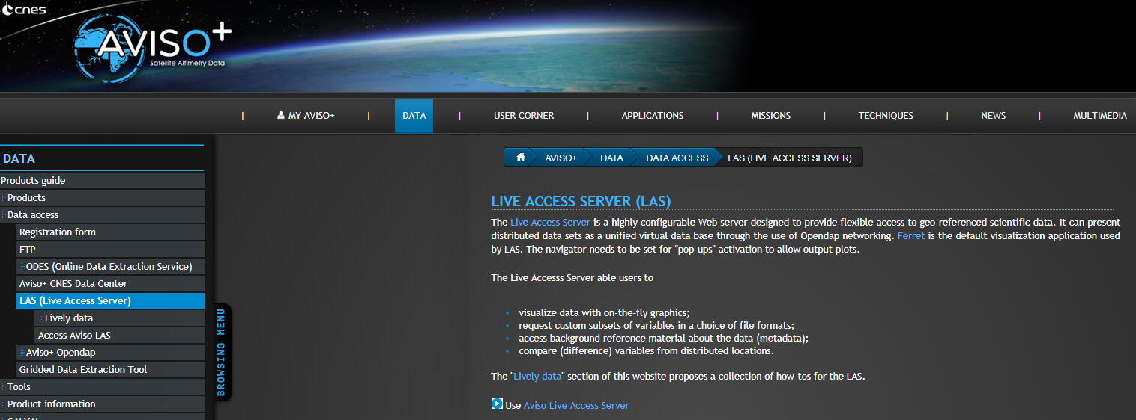
Satellite altimeter data from AVISO
Google Keywords: AVISO LIVE ACCESS SERVER

Slide 18
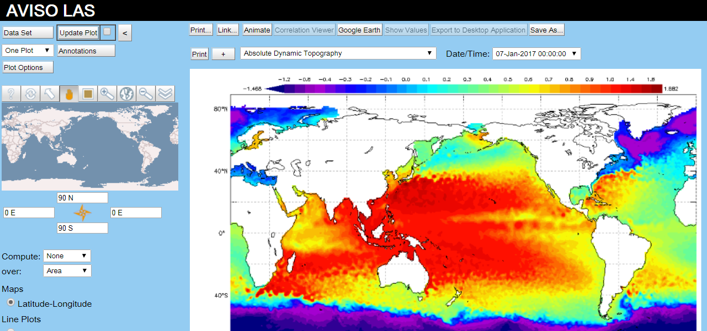
Satellite altimeter data from AVISO

Slide 19
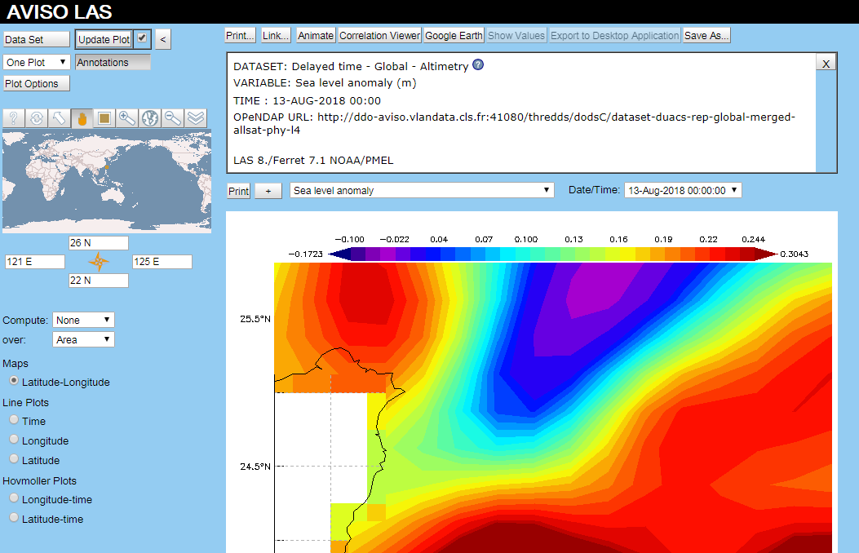
Demo (5~10 mins)

Slide 20
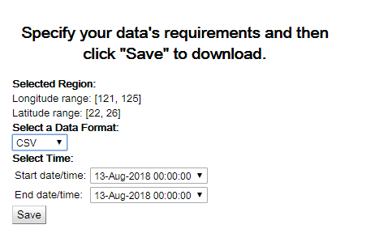
Download CSV file
13th of August, 2018
Rename file to “20180813_sla.txt”

Slide 21
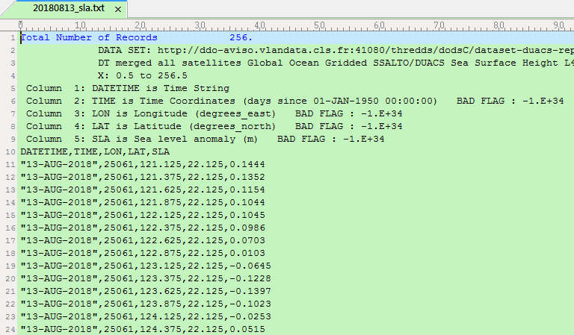
Viewing the data

Slide 22
Skip the heading
filename='20180813_sla.txt';
fid = fopen(filename, 'r');
Data = textscan(fid, '%s %f %f %f %f', 'headerLines', 10,'Delimiter',',');
fclose(fid);
Data= cell2mat(Data(3:5));

Slide 23
Set variables
xlon=Data(:,1);
ylat=Data(:,2);
sla=Data(:,3);
Check the size of these variables

Slide 24
Reshape variables and fix data on land
xlon=reshape(xlon,16,16); %% change size to: 16x16
ylat=reshape(ylat,16,16); %% change size to: 16x16
sla=reshape(sla,16,16); %% change size to: 16x16
I=find(sla<-10000);
sla(I)=NaN;

Slide 25
Plot SLA map
pcolor(xlon,ylat,sla); shading flat
axis equal
colorbar

Slide 26
High
Low
Pressure Gradient

Slide 27
The equations of today
h: sea surface height
f: Coriolis parameter (2*omega*sin(lat))
g: 9.8 m/s²
x and y: longitude and latitude
We can use these equations to calculate the eddy-current velocities at the ocean surface, if we have the sea surface height data

Slide 28
Geostrophic Equations (height gradients)
Height → height gradients
4x4 data → 3x3 data

Slide 29

Geostrophic Equations (height gradients)
Height → height gradients
4x4 data → 3x3 data
using backward difference scheme (a numerical method)
(1,1)
(1,4)
x-direction
(3,4)
$$\frac{∂h}{∂y}≈\frac{h_{4,4}−h_{4,3}}{∆y}$$
$$\frac{∂h}{∂x}≈\frac{h_{4,4}−h_{3,4}}{∆x}$$
(4,1)
(4,4)
(4,3)
y-direction

Slide 30

Geostrophic Equations (height gradients)
Height → height gradients
4x4 data → 3x3 data
using backward difference scheme (a numerical method)
(1,1)
(1,4)
x-direction, (i)
(3,4)
$$\frac{∂h}{∂y}≈\frac{h_{i,j}−h_{i,j−1}}{∆y}$$
$$\frac{∂h}{∂x}≈\frac{h_{i,j}−h_{i−1,j}}{∆x}$$
(4,1)
(4,4)
(4,3)
y-direction (j)

Slide 31
Geostrophic Equations (height gradients)
Height → height gradients
4x4 data → 3x3 data
using backward difference scheme (a numerical method)
(1,1)
(1,4)
x-direction, (i)
(3,4)
$$\frac{∂h}{∂y}≈\frac{h_{i,j}−h_{i,j−1}}{∆y}$$
$$\frac{∂h}{∂x}≈\frac{h_{i,j}−h_{i−1,j}}{∆x}$$
(4,1)
(4,4)
(4,3)
y-direction (j)

Slide 32

Geostrophic Equations (height gradients)
Height → height gradients
4x4 data → 3x3 data
using backward difference scheme (a numerical method)
(1,1)
(1,4)
x-direction, (i)
(3,4)
[2:end]
$$\frac{∂h}{∂y}≈\frac{h_{i,j}−h_{i,j−1}}{∆y}$$
$$\frac{∂h}{∂x}≈\frac{h_{i,j}−h_{i−1,j}}{∆x}$$
(4,1)
(4,4)
(4,3)
y-direction (j)

Slide 33

Geostrophic Equations (height gradients)
Height → height gradients
4x4 data → 3x3 data
using backward difference scheme (a numerical method)
(1,1)
(1,4)
x-direction, (i)
(3,4)
[2:end]
[1:end-1]
$$\frac{∂h}{∂y}≈\frac{h_{i,j}−h_{i,j−1}}{∆y}$$
$$\frac{∂h}{∂x}≈\frac{h_{i,j}−h_{i−1,j}}{∆x}$$
(4,1)
(4,4)
(4,3)
y-direction (j)

Slide 34
Geostrophic Equations (height gradients)
Height → height gradients
4x4 data → 3x3 data
using backward difference scheme (a numerical method)
(1,1)
(1,4)
x-direction, (i)
(3,4)
[2:end]
[1:end-1]
$$\frac{∂h}{∂y}≈\frac{h_{i,j}−h_{i,j−1}}{∆y}$$
$$\frac{∂h}{∂x}≈\frac{h_{i,j}−h_{i−1,j}}{∆x}$$
(4,1)
(4,4)
(4,3)
y-direction (j)

Slide 35

Geostrophic Equations (height gradients)
dx=0.25*110*1000; dy=0.25*110*1000;
% Calculate the gradient of sla in x and y-dir
dhdy=(sla(:,2:end)-sla(:,1:end-1))/dy; %% size: 16x15
dhdx=(sla(2:end,:)-sla(1:end-1,:))/dx; %% size: 15x16
dhdy=dhdy(2:end,:); %% change size to:15x15
dhdx=dhdx(:,2:end); %% change size to: 15x15
[i,j]
[:,2:end]
[:,1:end-1]
$$\frac{∂h}{∂y}≈\frac{h_{i,j}−h_{i,j−1}}{∆y}$$
$$\frac{∂h}{∂x}≈\frac{h_{i,j}−h_{i−1,j}}{∆x}$$

Slide 36
Geostrophic Equations (Set Parameters)
ome=7.29115*10^-5; g=9.8;
f=2*ome*sind(ylat(2:end,2:end)); %% size: 15x15

Slide 37
Geostrophic Equations (Calculate velocities and speeds)
v=g*dhdx./f;
u=-g*dhdy./f;
spd=sqrt(u.^2+v.^2);

Slide 38
Show estimated speed (colors) and velocities (vectors) in a figure
xlon=xlon(2:end,2:end); %% change size to: 15x15
ylat=ylat(2:end,2:end); %% change size to: 15x15
figure
pcolor(xlon,ylat,spd);
shading flat
axis equal
colorbar
hold on
quiver(xlon,ylat,u,v,'k')

Slide 39
The figure of today
How large is the maximum speed about?

Slide 40
The figure of today (SLA vs Geostrophic Currents)

Slide 41
Homework 09 (due date: 2020/05/26)
Redo Exercise 1 but now using the SLA data on the 15th of January, 2018.
Add in the Taiwan coastline into the figures.
Compare the eddy-current speed in winter and summer, based on the results obtained from this homework (2018/1/15 in winter) and from Exercise 1 (2018/8/13 in summer)
Are the eddy currents faster in winter or in summer, in the regions east of Taiwan? Show and describe your proof.

