Slide 1
Hydrographic data
CTD
Profiles of temperature, salinity and pressure

Slide 2
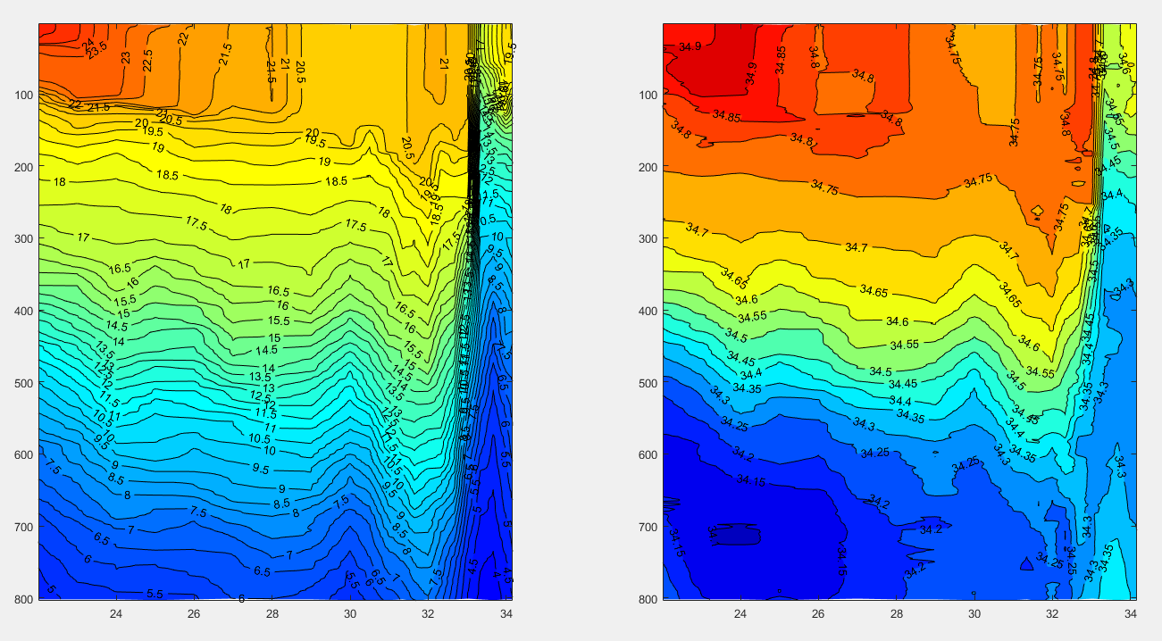
The goal of today
Preliminary study the vertical structure of Kuroshio using CTD data.

Slide 3

Data of today
Google Keywords: coriolis data selection

Slide 4
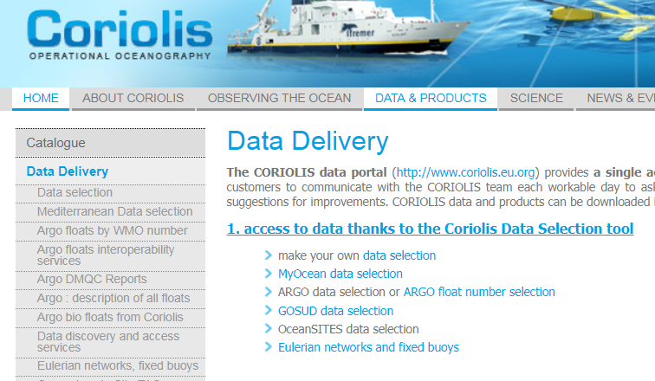
Website of Coriolis data center

Slide 5
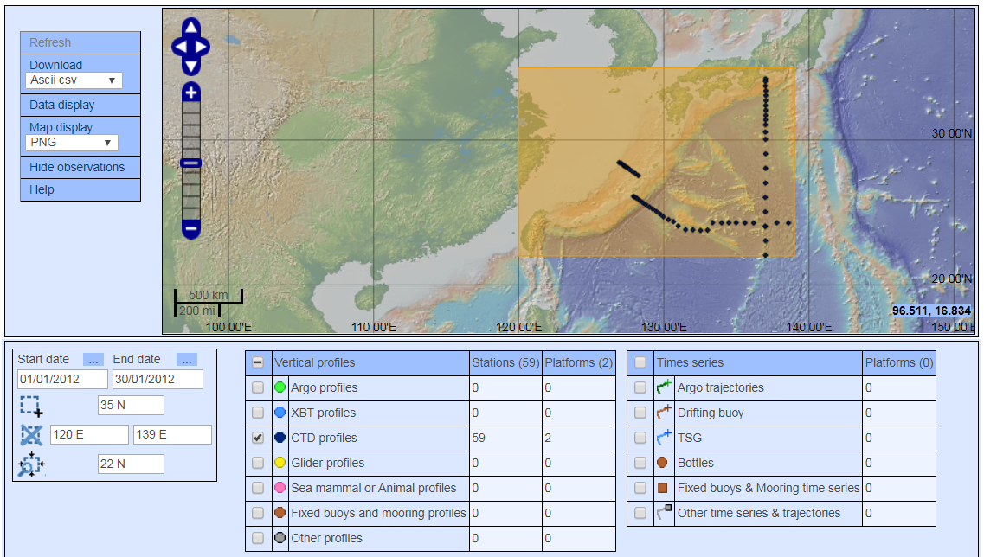
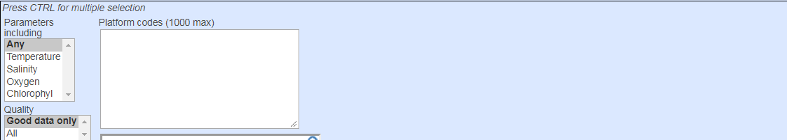
Website of Coriolis data center (Data Selection)

Slide 6
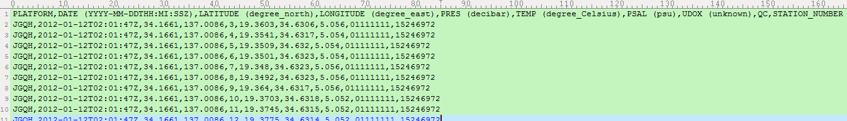
Viewing data (ctd-profiles-JGQH)
JGQH platform

Slide 7
Read data and skip heading lines
filename='ctd-profiles-JGQH.csv';
fid = fopen(filename, 'r');
Data = textscan(fid, %s %s %f %f %f %f %f %f %f %f', 'headerLines', 1,'Delimiter',',');
fclose(fid);
ylat=Data{:,3};
xlon=Data{:,4};
8

Slide 8
Confirm the locations of CTD stations

Slide 9

Read Pressure, Temperature, Salinity (JGQH)
P=Data{:,5};
T=Data{:,6};
S=Data{:,7};
id=Data{:,10}; ## station ID

Slide 10
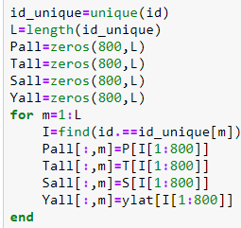
Separate each profile into column data
id_unique=unique(id);
for m=1:length(id_unique)
I=find(id==id_unique(m));
Pall(:,m)=P(I(1:800));
Tall(:,m)=T(I(1:800));
Sall(:,m)=S(I(1:800));
Yall(:,m)=ylat(I(1:800));
end

Slide 11

Plot contour fill for the section of temperature profiles
contourf(Yall,Pall,Tall,[2:0.5:30],'linecolor','none')
caxis([0 30]); hold on
colormap jet
[C,h]=contour(Yall,Pall,Tall,[2:0.5:30],'linecolor','k');
clabel(C,h); set(gca,'ydir','reverse')

Slide 12
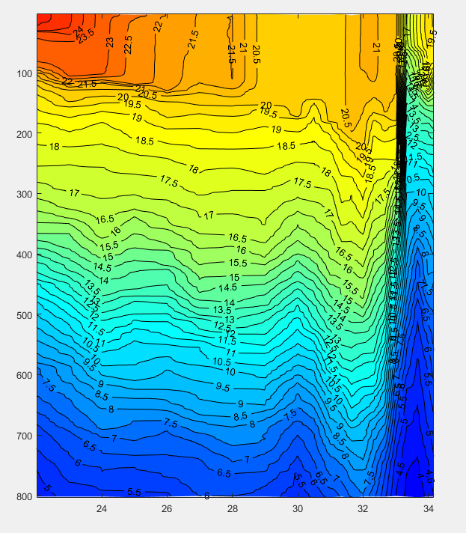

Slide 13
Profiles for temperature and salinity (Where is the Kuroshio?)

Slide 14
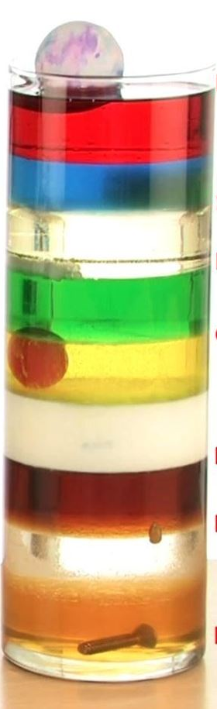
Thermocline ?

Slide 15
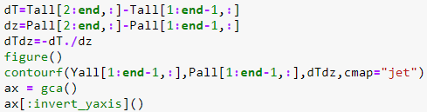
Calculate Temperature Vertical Gradient (dT/dz)
dTdz=diff(Tall,1,1)./diff(Pall,1,1);
contourf(Yall(1:end-1,:),Pall(1:end-1,:),-dTdz,[-0.1:0.05:0.3],
'linecolor','none')
caxis([-0.1 0.3])
set(gca,'ydir','reverse')

Slide 16
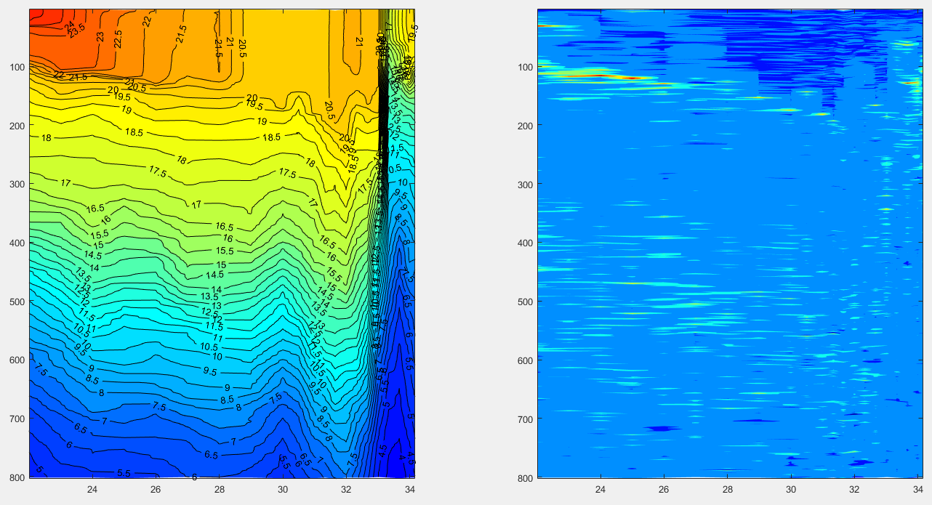
Thermocline ?

Slide 17
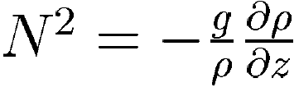
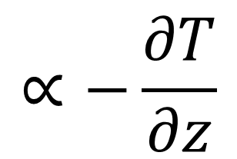
Buoyancy Frequency vs Temperature vertical gradient
$$∝−\frac{∂T}{∂z}$$

Slide 18
Higher frequency = More Stratified
If the water is more stratified, this frequency is higher (more stable is high density at below).
If less stratified, frequency is lower (less stable is high density at below).

Slide 19
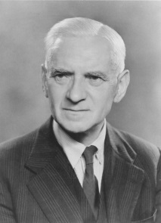
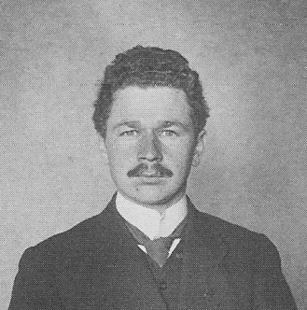
ocean stratification
The ocean stratification is quantified by the measured value of Δρ /Δz
If water is displaced vertically, it oscillates in an internal wave with frequency. This frequency is called Buoyancy Frequency or Brunt-Väisälä frequency.
David Brunt & Vilho Väisälä (meteorologist)

Slide 20
See the Buoyancy Frequency
https://www.youtube.com/watch?v=XQJHjZp1NtY
https://www.youtube.com/watch?v=r16T2QAlueg (1:43)

Slide 21
Final Report using “cr2370.zip” (Due date: 6/19)
(25%) What are the main direction of the observed currents around the Keelung Island during the cruise experiment of CR2370 (using “cr2370000_000000.LTA”)?
(25%) Describe the ocean currents during the cruise experiment.
(25%) Guess: what is the main force that drives the observed currents around the Keelung Island?
(25%) Describe the ocean vertical structure during the cruise experiment (using “c*-1.txt”). Could we find the thermocline?

Slide 22
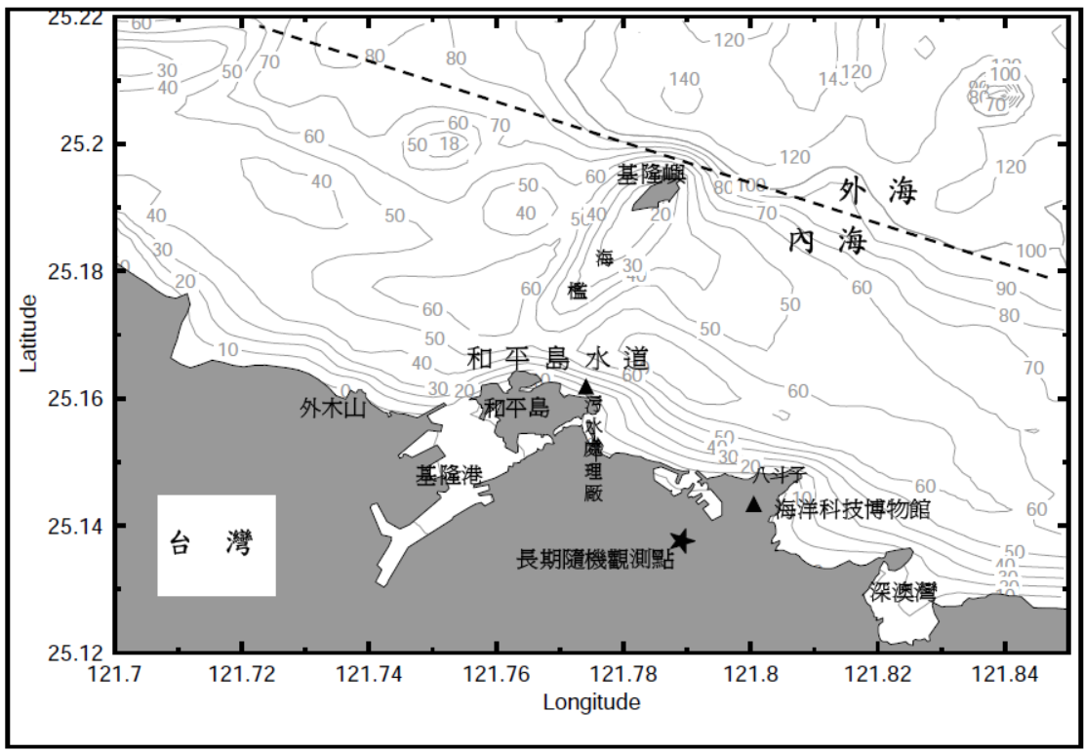
T1
*
C4
*
C3
T2
*
C2
*
C1

