Slide 1

Self Inventory presentation
SpEAKER: Jack

Slide 2
Outline
My Background
A brief story about me
Traits and hobbies

Slide 3
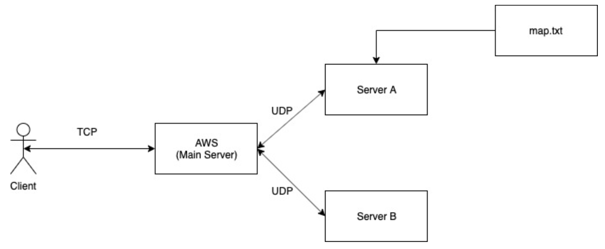
My Background
Major: electrical engineering
Software engineering intern
Socket - Programming
Be an instructor in science camp

Slide 4
My little story
My goal:
Complete a project
Obstacle:
Knowledge is not enough to solve problems
Resolve:
Do research in library
Learn from Internet
Find TAs

Slide 5
Knowing me from the story
The people who I like to work with
Diligent
Honest
Active
The place where I like to work in:
Quiet
Stable
Free

Slide 6
Some of my traits and hobbies
Traits:
good at coordinate with others, inspirational, leadership skills
Hobbies:
exercise, watching movies, playing computer games

Slide 7
The person you want to find
Interest
Experience
Traits
Hobbies
Self improvement

Slide 8
Thanks for listening

