Slide 1
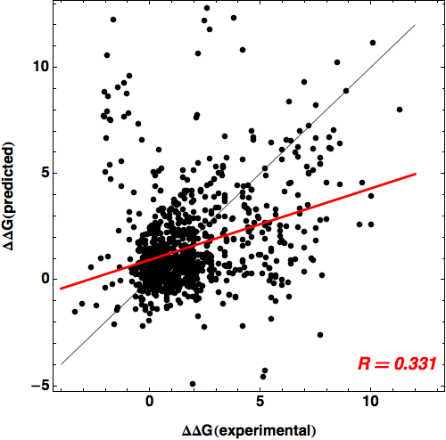
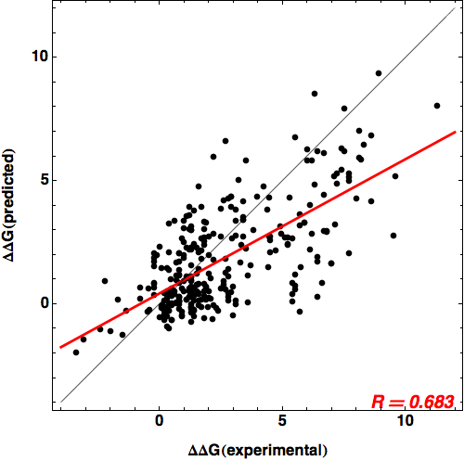
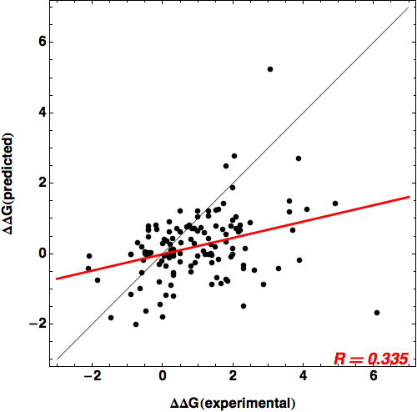
All mutations: score12
“Good” structures: score12
Ras structures: score12

Slide 2
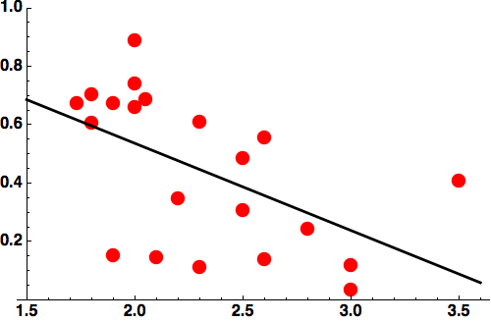
Score12 correlation values for all structures with more than 15 mutations
see file: structs_overview.xls for details
R=0.54
R-value
X-ray resolution (Å)

