Slide 1
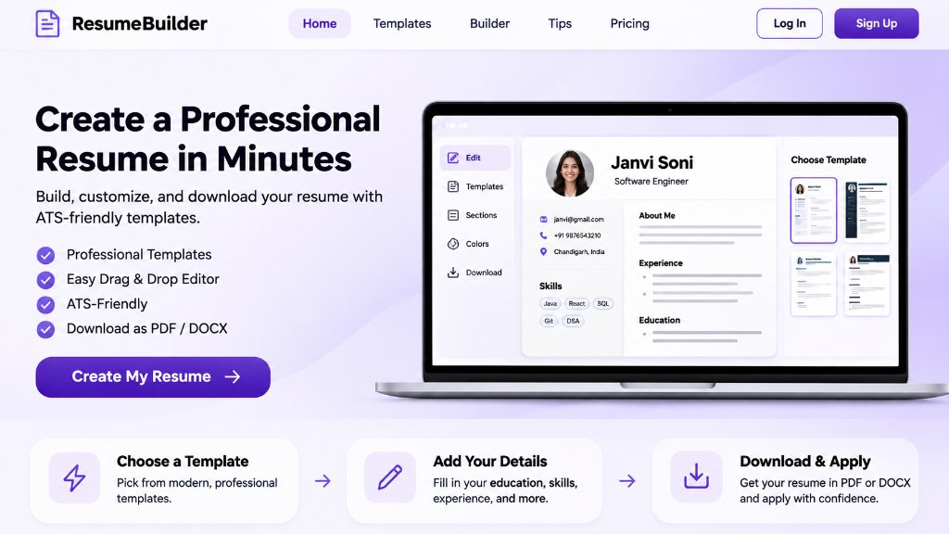
UNIVERSITY MINI PROJECT • EXP 10
ResumeBuilder
Smart Resume Builder Using MERN Stack
A full-stack, cloud-persisted web application with interactive live A4 preview, dynamic multi-section editing, and vector PDF generation.
Student Name:
Janvi Soni
UID / Roll No:
[22BCS10xxx / Student UID]
Course & Branch:
B.E. Computer Science & Engineering
University:
Chandigarh University
Submitted To:
[Faculty Mentor / Supervisor Name]
Actual Application UI & Live Editor Preview

Slide 2
PROJECT BACKGROUND & GOALS
MERN STACK
Introduction & Project Objectives
Understanding the motivation, user challenges, and primary engineering objectives.
⚠️ Problems with Traditional Resume Building
✨ The ResumeBuilder Solution
• Formatting Fragility: Manual word processors (Word/Docs) easily break margins, bullet alignments, and page breaks.
✓ Interactive Live A4 Preview: Side-by-side view updates instantly as the user types.
• Hidden Paywalls: Existing commercial builders lock PDF export and template choices behind costly subscriptions.
✓ Unified Data Across Templates: Switch between Modern, Professional, and Minimal styles with zero data re-entry.
• ATS Incompatibility: Cluttered graphics and complex multi-column tables fail ATS parser software.
✓ High-Fidelity Vector PDF: Direct client-side A4 export with crisp print margins using html2pdf.js.
• No Live Synchronization: Users must repeatedly download test files to view layout changes.
✓ Cloud Persistence & Privacy: Secure user authentication (JWT + bcryptjs) with user-isolated MongoDB storage.
🎯 Key Project Objectives:
01. Easy Resume Creation
02. Multiple Templates
03. Full Cloud CRUD
04. Instant Vector PDF
Modular forms for personal, education, skills, projects, and experience.
3 ATS-friendly designs: Modern SaaS, Classic Professional, and Minimal.
Create, read, update, and delete multiple resumes with MongoDB persistence.
Download standard A4 print-ready PDF resumes directly from the browser.

Slide 3
TECHNICAL FOUNDATIONS
MERN STACK
Technology Stack & System Architecture
Verified MERN stack ecosystem and request-response lifecycle.
FRONTEND TIER
System Communication & Architecture Flow
React 18 • Vite • Tailwind CSS • Lucide Icons
Declarative component hierarchy, custom hooks, reactive state, and client-side routing.
👤 User / Web Browser
Port 5173 / Vercel SPA
User interacts with responsive UI, inputs form data, triggers PDF export
BACKEND API TIER
↓
Node.js • Express.js • REST Architecture
⚛️ React 18 Frontend Layer
Vite • React Router v6
Modular routers, request logger middleware, centralized error handling, and JSON parsing.
Manages state (useState), triggers fetch() API calls with JWT Bearer header
↓
DATABASE TIER
⚡ Express.js REST API & Middleware
Port 5000 / Serverless
MongoDB Atlas • Mongoose ODM
Custom logger, CORS, body parser, and auth middleware verify JWT signature
Structured schemas, field validations, relational references (userId), and .populate().
↓
🍃 MongoDB Database (Mongoose ODM)
Atlas Cloud Cluster
SECURITY & AUTH
Executes CRUD queries on isolated collections: Users & Resumes with schema validation
JSON Web Tokens (JWT) • bcryptjs
10-round salted password hashing, stateless 7-day JWT tokens, and Bearer middleware.
🔒 End-to-end security: Passwords hashed with bcryptjs (10 rounds) • Stateless JWT auth header

Slide 4
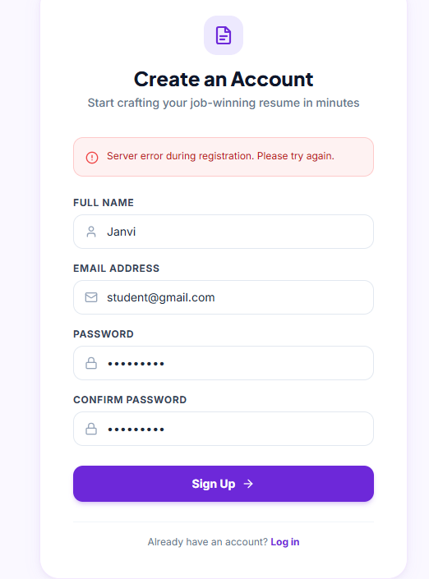
APPLICATION CAPABILITIES
MERN STACK
Key Features & Real Application UI
Showcasing core user modules and live screenshots of ResumeBuilder.
🔐 Authentication & Session Security
User signup and login with bcryptjs password hashing and JWT issuance for protected routes.
📋 Dynamic Multi-Section Editor
Add/remove unlimited education, skills, projects, experience, and certifications with React state.
🎨 3 Professional Resume Templates
Modern (violet accents), Professional (formal serif), and Minimal (ATS black-and-white).
👁️ Real-Time Live A4 Preview
Landing Page & Interactive Laptop Editor Mockup
Immediate side-by-side visual synchronization as user types, rendered in exact A4 proportions.
Secure Authentication UI
📄 Client-Side Vector PDF Export
One-click instant PDF generation powered by html2pdf.js with standard 10mm print margins.
• Name, Email, Password fields
• bcryptjs salt (10 rounds)
• Auto JWT token storage
• Form error handling alerts
💾 Cloud CRUD & Resume Management
Save multiple resumes to MongoDB, edit previously saved drafts, or delete old versions.

Slide 5
CURRICULUM ALIGNMENT
MERN STACK
Technical Implementation & Syllabus Concepts
Direct connection to university curriculum: React hooks, Express APIs, and JWT security.
FRONTEND CONCEPTS
BACKEND ARCHITECTURE
SECURITY & SESSIONS
React.js & State Logic
Node.js & Express REST
Authentication & JWT
Experiments 1, 2, 3 & 4
Experiments 5 & 6
Experiment 7
• Functional Components & JSX: Reusable components (Navbar, ResumePreview, TemplateSelector, Form sections).
• HTTP Server Creation: Express application instance supporting both local server and Vercel serverless.
• bcryptjs Password Hashing: 10 salt rounds used before persisting user credentials; no plain text passwords.
• useState Hook: Dynamic arrays for skills[], education[], projects[], and multi-nested resume state.
• RESTful Routing: Clear separation of controllers, routes, and models (/api/auth, /api/resumes).
• Password Verification: bcrypt.compare() validates hashes during user login attempts.
• useEffect Hook: Asynchronous data fetching from Express API on route change (/editor/:id).
• Custom Logger Middleware: Intercepts all requests, logging HTTP method, path, and UTC timestamps.
• JWT Token Generation: jsonwebtoken creates signed tokens carrying { userId } with 7-day expiration.
• Conditional Rendering: Dynamic template rendering (Modern, Professional, Minimal) and auth navigation.
• CRUD HTTP Verbs: Implemented GET (list/detail), POST (create), PUT (update), and DELETE (remove).
• Bearer Verification Middleware: auth.js inspects HTTP Authorization header and extracts token.
• Array.map() with Unique Keys: Seamlessly mapping array entries to editable form rows and preview items.
• Centralized Error Handling: Standardized JSON responses ({ success, message, data }) and status codes.
• Route Protection: Private routes reject unauthorized requests with HTTP 401 Unauthorized status.
• React Router DOM v6: Protected routes (ProtectedRoute.jsx), dynamic routing, and SPA navigation.
• Environment Variables: dotenv configuration for PORT, MONGODB_URI, and JWT_SECRET.
• User Data Isolation: Controller verifies resume.userId === req.user.id to enforce strict ownership.

Slide 6
DATA PERSISTENCE & VERIFICATION
MERN STACK
Database Modeling, Testing & Deployment
MongoDB Atlas schemas, comprehensive testing methodology, and Vercel hosting.
🍃 Database & Mongoose
🧪 Testing & Validation
☁️ Live Cloud Deployment
Experiment 8 – Data Schemas
Experiment 9 & 10 – Verification
Production Infrastructure
• User Model: Schema with name, email (unique, lowercase), password (hashed), and timestamps.
✓ Auth Testing: Verified user registration with duplicate email rejection and bcrypt password verification.
▲ VERCEL (FULL-STACK)
Frontend SPA build + Express REST API running as Serverless Functions via /api/index.js.
• Resume Model: References User via userId: { type: ObjectId, ref: "User" } with required validation.
✓ CRUD Lifecycle: Successfully tested creation, dynamic editing, cloud updating, and deletion of resumes.
● Live & Operational
• Sub-Documents: Nested arrays for education, skills, projects, experience, and certifications.
✓ Security Verification: Confirmed unauthenticated requests to /api/resumes return HTTP 401 Unauthorized.
🍃 MONGODB ATLAS
Cloud managed NoSQL database cluster with encrypted connections and automated replicas.
• Mongoose CRUD: Uses find(), findById(), findByIdAndUpdate(), and findByIdAndDelete().
✓ Template Consistency: Verified template switching from Modern to Minimal preserves 100% form data.
● Cloud Connected
💻 LOCALHOST ENVIRONMENT
• Relational Populate: Implements .populate("userId") to demonstrate Mongoose schema relationships.
✓ PDF Print Fidelity: Tested vector rendering using html2pdf.js ensuring standard A4 margins and zero text cutoff.
Port 5173 (Vite HMR) & Port 5000 (Express API) with local fallback for viva evaluation.
• Local Fallback: Automatic fallback store ensures offline capability during local evaluation.
✓ CORS & Headers: Verified proper Cross-Origin headers and preflight handling across endpoints.
● Ready on Localhost
🔗 Live URL: resume-builder-janvi-0e3d.vercel.app

Slide 7
PROJECT SUMMARY & ROADMAP
MERN STACK
Conclusion & Future Scope
Academic accomplishments, engineering takeaways, and future development directions.
🏆 Project Achievements & Conclusion
🚀 Future Scope & Enhancements
✓ Eliminated Formatting Friction: Users can build professional resumes in minutes with real-time A4 visual feedback.
• AI Summary Suggestions: Integration of LLMs to suggest job-specific bullet points and action verbs.
✓ Syllabus Mastery: Successfully implemented and defended all 10 prescribed experiments in the university MERN curriculum.
• Real-Time ATS Score Meter: Keyword matching against uploaded job descriptions to estimate interview match score.
✓ Reusable Template System: Engineered clean separation between resume data and template rendering components.
• Expanded Template Library: Addition of academic CV, executive two-column, and creative designer formats.
✓ High Quality PDF Generation: Direct client-side vector generation ensures accurate ATS readability without server costs.
• OAuth & Profile Import: One-click profile auto-fill via LinkedIn API and GitHub profile parsing.
✓ Clean Human-Written Codebase: Modular, readable architecture structured for practical viva defense and future extension.
• Multi-Page Pagination: Intelligent page-break detection for multi-page resumes and academic curricula vitae.
THANK YOU!
Questions & Answers • Practical Examination & Viva-Voce
🌐 Live Demo: https://resume-builder-janvi-0e3d.vercel.app • 💻 GitHub: github.com/jaaanviiiii/resume-builder

