Slide 1
CS478 Assignment4
ONNX
Dec 15th, 2020

Slide 2
Project
Project Name
ONNX (Open Neural Network Exchange)
Abstract
ONNX is an open-source project which is mainly an intermediate representation in the form of a file format which maps the high-level graphs of a model in specific frameworks to a similar graph in the ONNX file format. For AI models, ONNX offers an open-source format allowing users to interchange between various ML frameworks and tools as well as definitions of built-in operators and regular data types.

Slide 3
Team and their roles
Sanjana Balasubramanian - What is ONNX?
Julian Jaramillo - Example workflow
Vinayak Jethe - How ONNX works?
Jaabaal Shah - Why should ONNX be used?

Slide 4
Deliverables
Code Repo (if any) (URL): https://github.com/jaabaal/ONNX_Report
Presentation Slides (URL): https://github.com/jaabaal/ONNX_Report
Demo/Presentation Video URL (Optional): https://www.youtube.com/watch?v=_nsnO5im7j8&feature=youtu.be&ab_channel=SanjanaBalasubramanian

Slide 5
Project Summary
What it is and what research/investigation we did?
ONNX is an open-source artificial intelligence ecosystem. Facebook, AWS and Microsoft introduced a system for switching between machine Learning frameworks such as PyTorch and Caffe2. Later, IBM, Huawei, Intel, AMD, ARM and Qualcomm announced support for the initiative.
What results we got?
ONNX provides building blocks for Deep Learning and Machine Learning model, enabling AI developers to work with different kinds of frameworks, tools, runtimes and compilers.

Slide 6
Design Philosophy
Built initially to support DNN but also capable to provide support for traditional ML.
Flexible enough to keep up with rapid advances and enhancements.
Compact and cross-platform representation.
Allow interoperability/portability by enabling the users to export a fully trained model in a certain framework to be imported to a different framework.

Slide 7
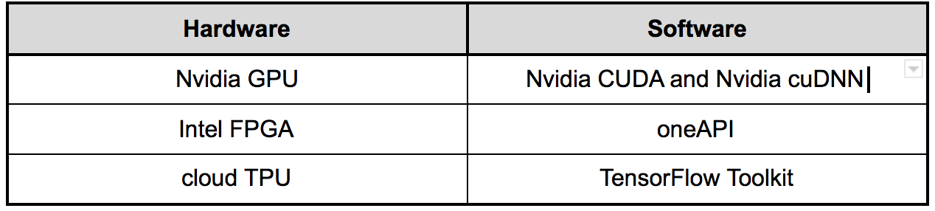
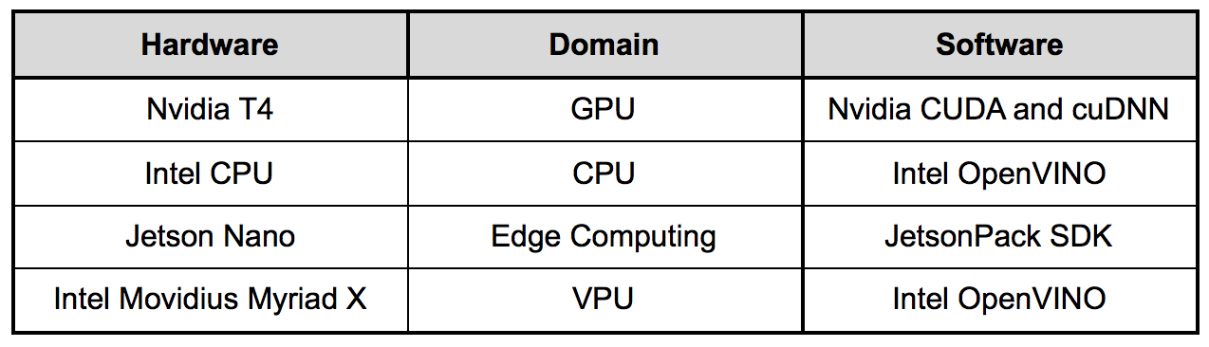
Fragmentation in Training and Deployment Tools:
Training
Deployment

Slide 8
Purpose of ONNX
The major challenge to the current deep learning domain is that the trained models cannot be deployed directly as they need to be optimized depending upon the target environment they are going to be deployed on.
“There is no interoperability which exists among the various frameworks.”
“The ONNX file format is to DNN what CLR is to programming languages.”

Slide 9
Machine Learning Aspects - Overview
ONNX is basically having different versions.
The basic ONNX model was built to support deep learning.
An extension to ONNX, called ONNX-ML is specifically build to support traditional classical Machine Learning problems.

Slide 10
Machine Learning Aspects- Model and Training
ONNX Model Zoo
This contains several Pre-trained ONNX models for different types of tasks.The developer can download a version that is supported by Windows ML.
Native export from ML training frameworks
Several training frameworks support native export functionality to ONNX, like Chainer, Caffee2, and PyTorch, allowing you to save your trained model to specific versions of the ONNX format.
In addition, services such as Azure Machine Learning and Azure Custom Vision also provide native ONNX export.

Slide 11
Machine Learning Aspects - Model and Training
Convert existing models using WinML tools
This Python package allows models to be converted from several training framework formats to ONNX.
As a developer, you can specify which version of ONNX you would like to convert your model to, depending on Windows builds of the application targets.

Slide 12
Machine Learning Aspects - Inference
ONNX Runtime is a cross-platform inferencing and training accelerator compatible with many popular Machine Learning or Deep neural networks, including PyTorch, TensorFlow/Keras, scikit-learn, and many more.
Benefits from ONNX Runtime include the following:
Improve inference performance for a wide variety of ML models
Reduce time and cost of training large models
Train in Python but deploy into a C#/C++/Java app
Run on different hardware and operating systems
Support models created in several different frameworks

Slide 13
Software Aspects
ONNX is supported by various Architectures/Languages/Providers such as:
Operating System
Windows, Linux and Mac
Language
Python(3.5 to 3.7), C++, C#, C
Architecture
x64, x86, ARM64, ARM32
Software
CUDA, TensorRT, DirectML, MKL-DNN, MKL-ML, nGraph, NUPHAR, OpenVINO
Hardware
CPU, Nvidia T4 (GPU), Movidius Myriad X (VPU), Google Cloud TPU (TPU), Jetson Nano (Edge Computing)

Slide 14
Software Aspects - Design Principles
Supports both DNN and Traditional Machine Learning.
Interoperable
Backward Compatible - Important for production usage.
Compact and cross-platform representation for serialization.
ONNX specifications consist of the following:
A definition of an extensible computation graph model.
Definitions of standard data types.
Definition of built-in operators( which belong to a versioned operator set).

Slide 15
Software Aspects - Architecture
In ONNX architecture, the nodes architecture is very much similar to a structure of Convolutional Neural Network. The basic components are as follows:
Model
Version Information - Producer to keep track of which version of the model we are producing at different time.
Metadata associated with the model
Acyclic computation dataflow graph which is the important part consisting of inputs, outputs, names of the graphs and the list of computational nodes.
Graph
Inputs and Outputs
List of computational nodes
Graph name

Slide 16
Software Aspects - Architecture
Computation Node
Zero or more I/p of defined types.
Operator.
Operator parameter.
Basically, the models are collection of graphs and graphs are collection of several computational nodes.
Every node here is self-sustained. It actually provides operators. Each operator is mapped to a deep learning conventions.

Slide 17
Software Aspects - UI
User Interface
For the UI in ONNX developers can use ONNXIFI which is the Interface for Framework Integration. ONNXIFI is a cross-platform API for loading and executing ONNX graphs on optimized backends.
Core features
Standardized interface for neural network inference on special-purpose accelerators (NPUs), CPUs, GPUs, DSPs, and FPGAs
Based on widely supported technologies
C API for function calls
ONNX format for passing model graphs
NCHW tensor layout for passing inputs and outputs
Dynamic discovery of available backends for model execution
Multiple backends from different vendors can co-exist on the same system
Dynamic discovery of supported ONNX Operators on each backend

Slide 18
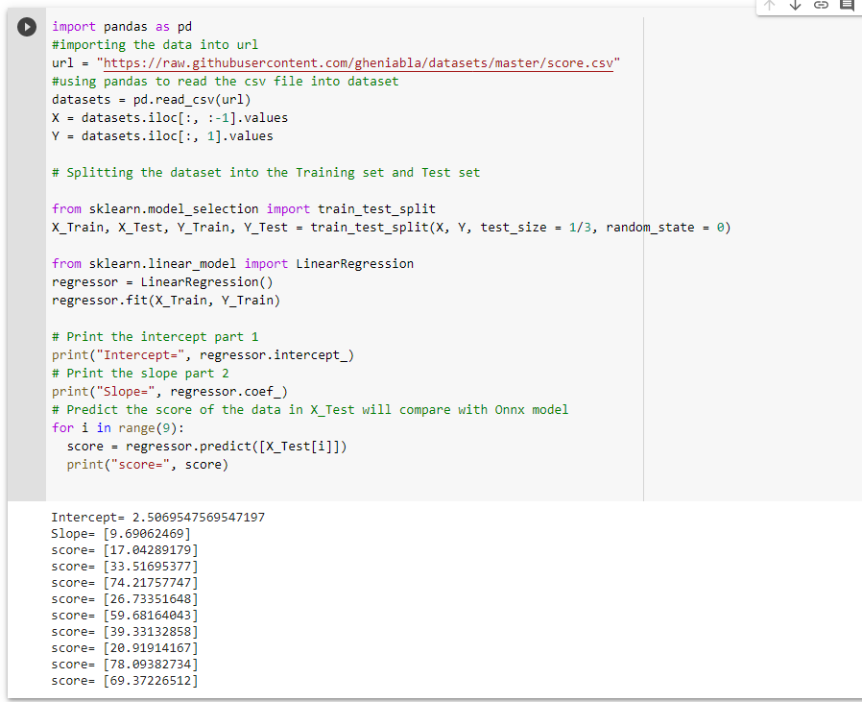
Sklearn to ONNX

Slide 19
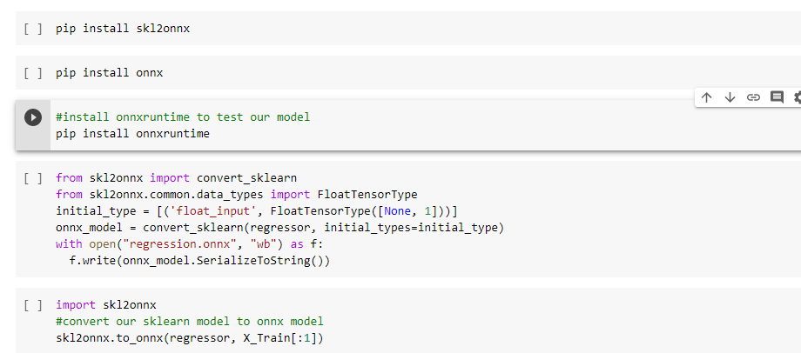
Sklearn to ONNX
Simple!

Slide 20
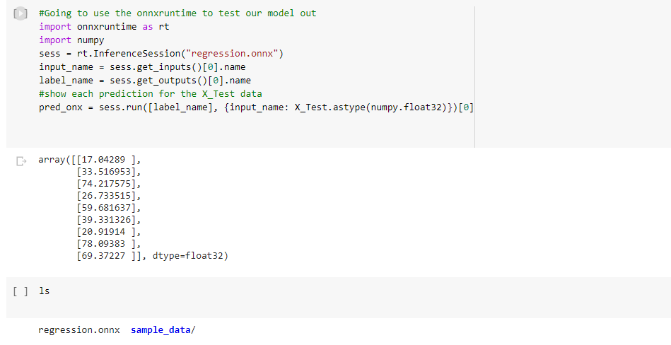
ONNX Runtime for testing

Slide 21
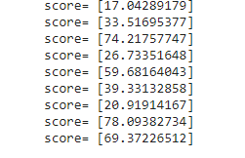
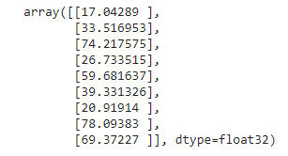
Let’s compare results!
Sklearn Model Onnx Model

Slide 22
Resources
https://github.com/onnx/keras-onnx
https://github.com/onnx/sklearn-onnx
https://www.youtube.com/watch?v=Ij5MoUnLQ0E
https://www.youtube.com/watch?v=cK5AyawZSUI
https://www.youtube.com/watch?v=Mvnn_Iy29es
https://github.com/Jaram021/Onnx_examples
https://www.onnxruntime.ai/
https://onnx.ai/index.html
https://onnx.ai/get-started.html
https://github.com/onnx/onnx/blob/master/docs/ONNXIFI.md
https://github.com/microsoft/onnxruntime/tree/master/samples#CC

