Slide 1
OsoFit

Slide 2
OsoFit- Unified Health & Fitness App
What are we making?
A mobile app for fitness tracking, goal setting and trainer-led plans
Who is the target audience?
Health-focused individuals, trainers, admins
Why better than competitors?
Combines tracking, reporting, and social features into one unified platform

Slide 3
Problem & Solution
Problem Statement: Inconsistent health tracking & poor goal monitoring
Impact: Users and trainers lack unified, guided tools
Solution: OsoFit integrates tracking, structured plans, reporting, and community features
Competitors: Fitbit, strava, whoop
Advantage: Single platform for all goals

Slide 4

fa C ?!'0®
*
OsoFit
v
+2
<:,J
f
="
&
g+ Share
Currently Working On
•••
Today
• •
This Week
••
Later
•••
Iteration 1
Iteration 2
••
+ Add a card
Q
+ Add a card
Q
Begin Iterat1on 2
+ Add a card
C
$ Make Gantt diagram
+ Add a card
tl
+ Add a card
fQ
$ Update Use cases (bring at least one of your use cases to fully dressed form by sunday)
$ Operation Contracts (2 Per person
C, Project Vision Board
C, Dannis: Iteration 1 (all responsibilities)
C, Connor: Iteration 1 (all responsibilities)
C, Connor: Wireframe drafts, use cases (2), operation contracts (2), SSD (2)
C, Mason: Iteration 1 (all responsibilities)
$ Ethan: Iteration 1 (all responsibilities)
$ Savann<1h: Iteration 1 (all responsibilities)
+ Add a card
"

Slide 5
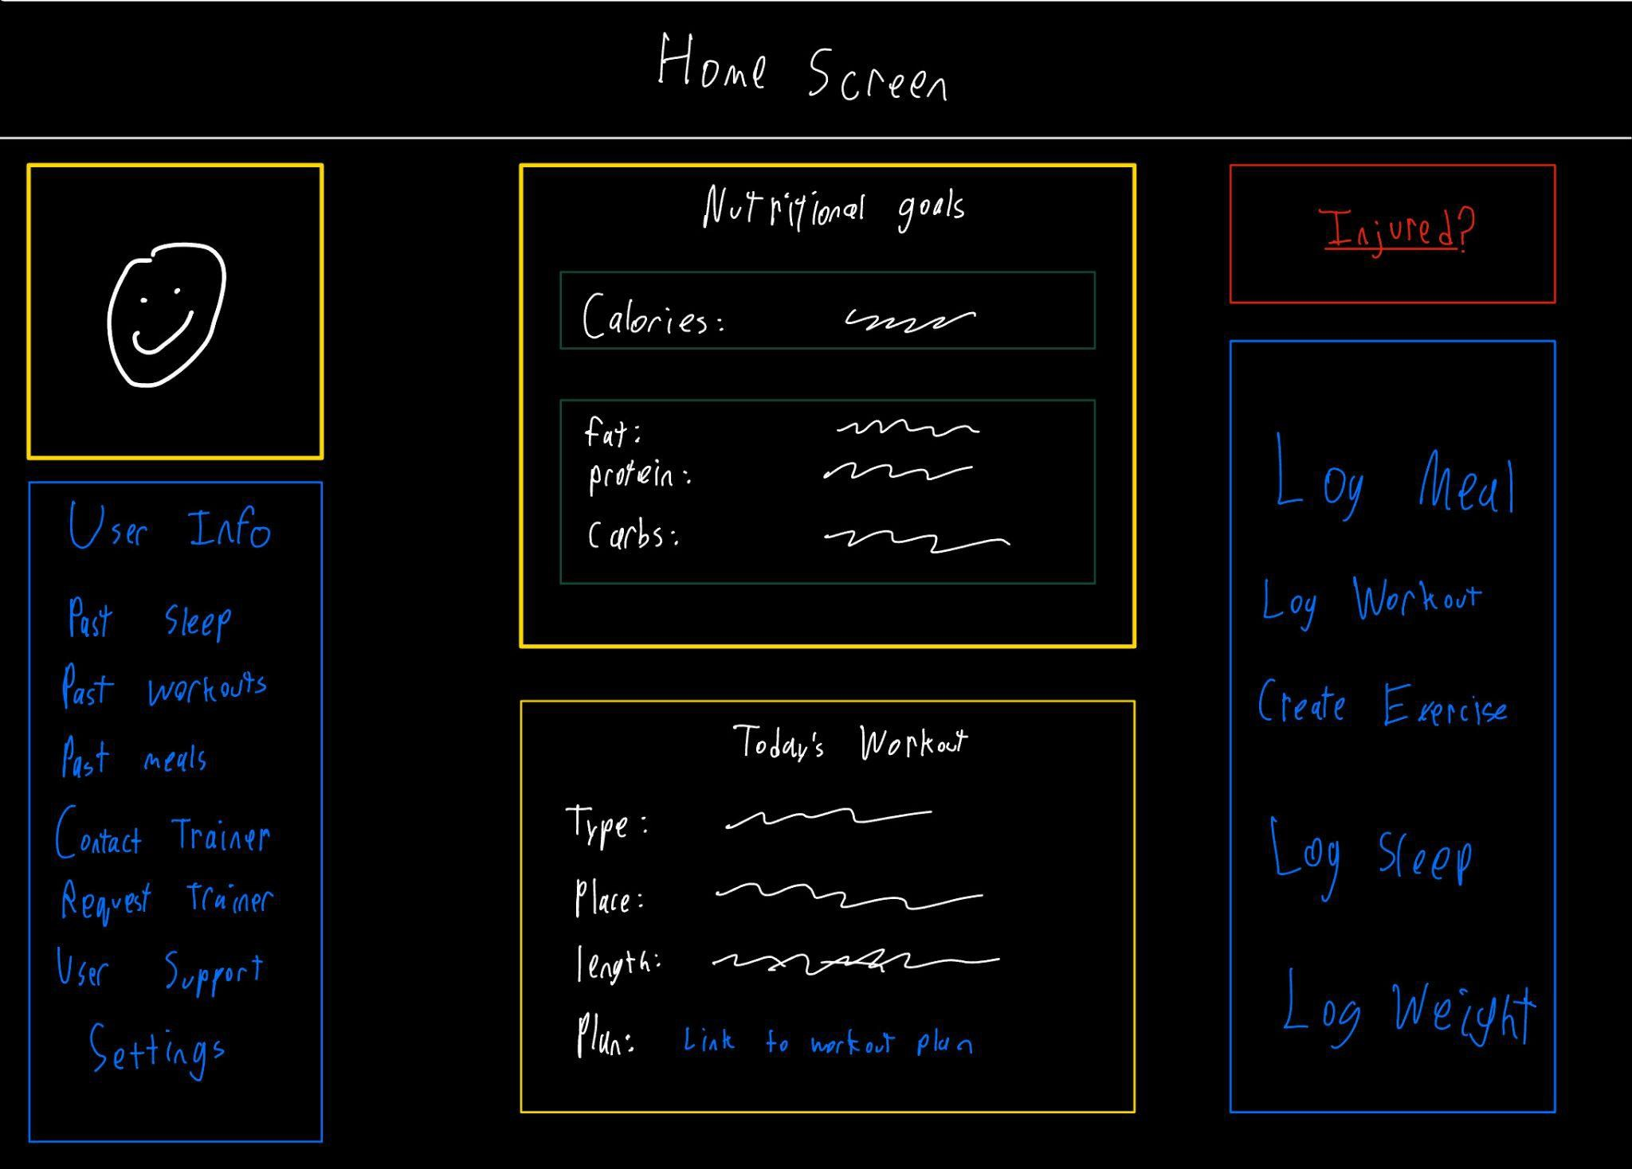
Wireframes

Slide 6
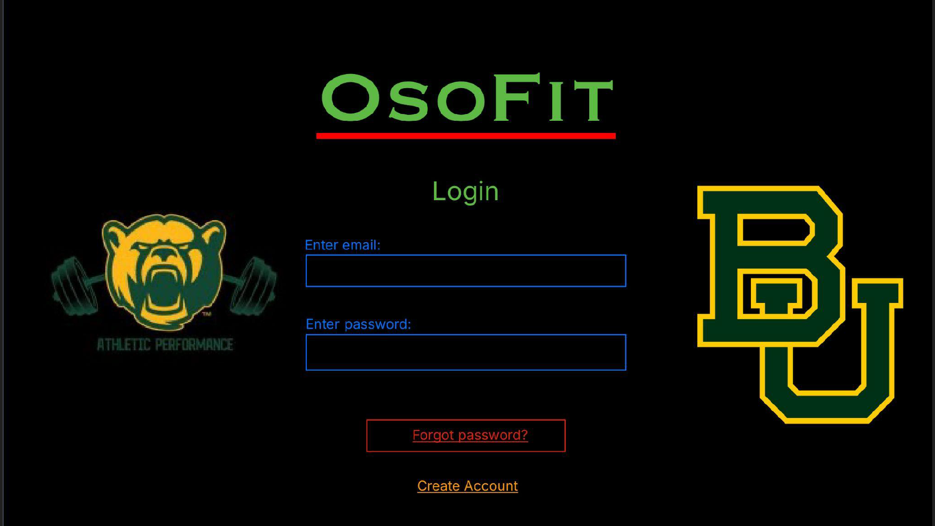

Slide 7
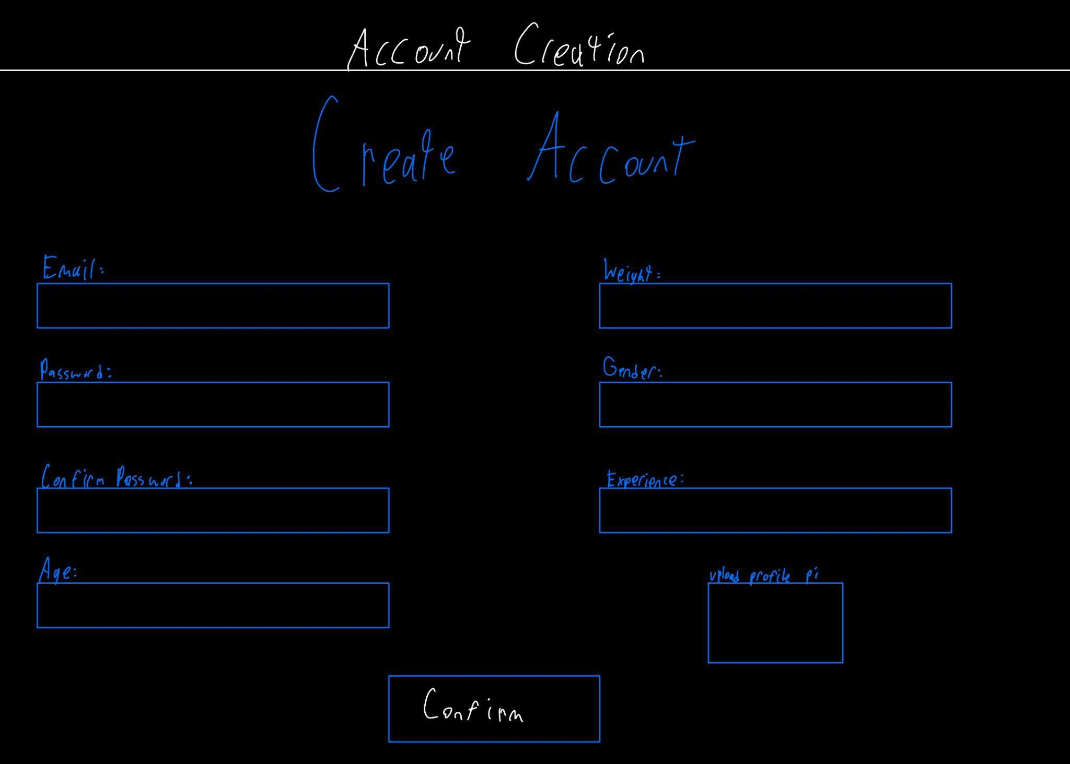

Slide 8
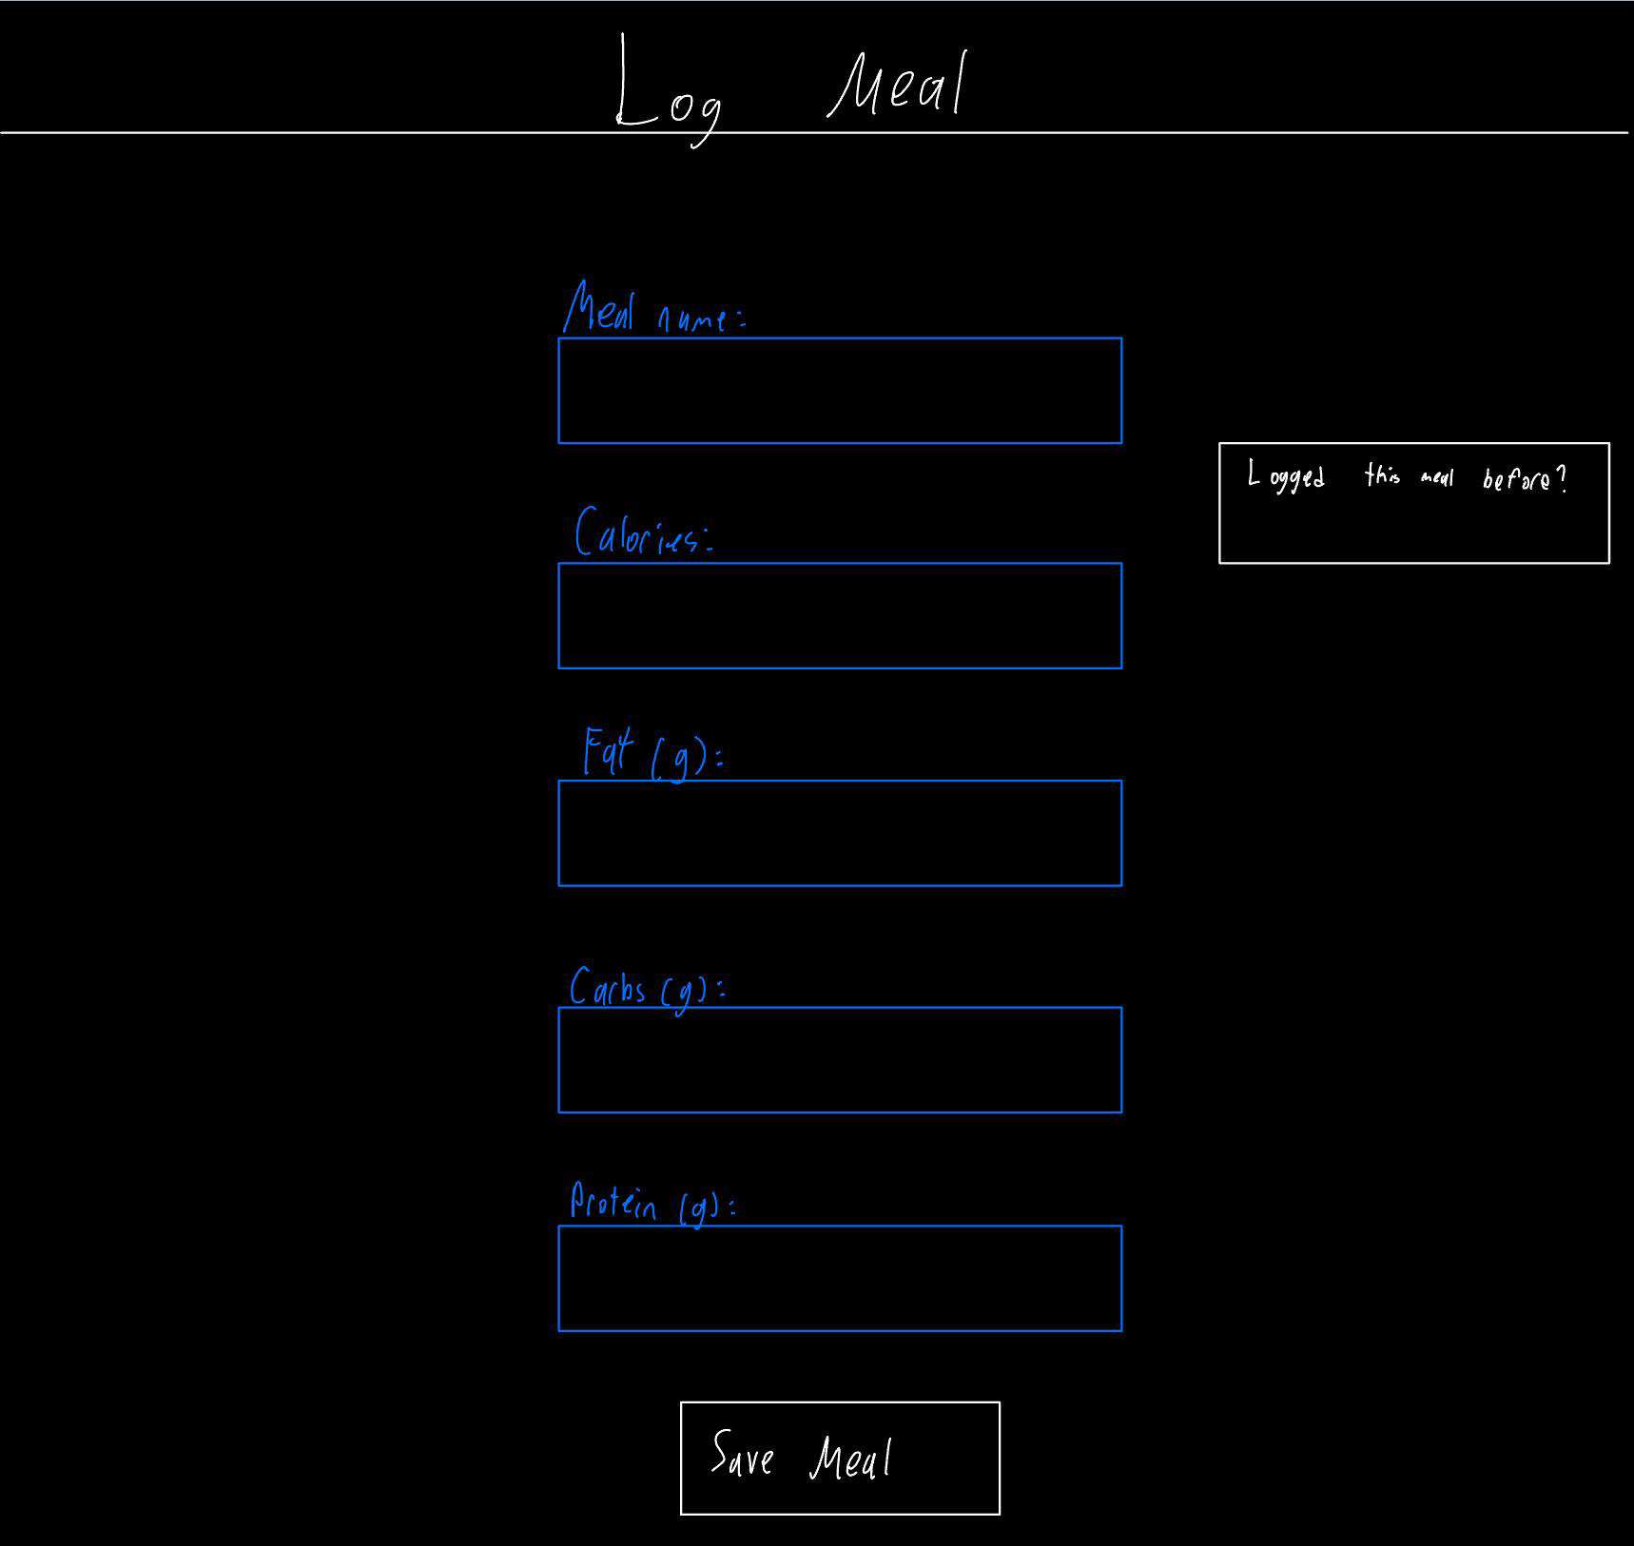

Slide 9
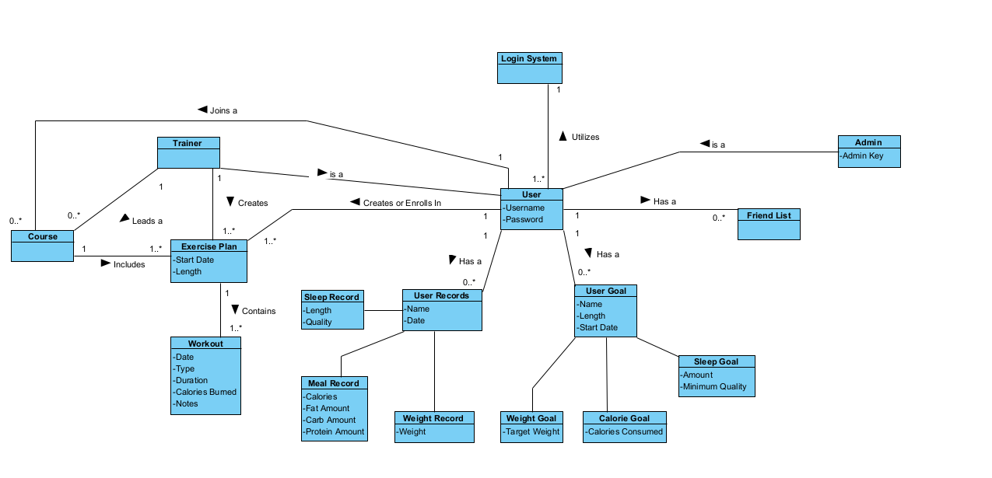
Domain Model

Slide 10
Use Case 1 (Example: Log Workout)
Title: Use Case: Log Workout Session
Actors: User, System.
Precondition: User authenticated.
Postcondition: Workout saved, dashboard updated.
Main Flow (summarized):
User opens workout page.
Enters type, duration, calories.
Clicks save.
System validates, stores, updates dashboard.
Alternates: Missing field, invalid entry, or system unavailable.

Slide 11
SSD for Use Case 1
User → System: openWorkoutPage()
System → User: displayWorkoutForm()
User → System: createWorkout(type, duration, calories, notes)
System: validate(), saveWorkout(), updateDashboard()
System responds with updated dashboard reflecting workout progress.

Slide 12
Contract for Use Case 1
Operation: createWorkout(userId, type, durationMin, calories, notes, dateTime)
Preconditions: user authenticated, valid inputs.
Postconditions:
Workout object created.
Dashboard aggregates recalculated.
Confirmation message returned.
Exceptions: ValidationError, DuplicateWarning, ConnectionError.

Slide 13
Use Case 2 (Example: Register for class)
Title: Use Case: Register for a Class
Actors: User, System.
Precondition: User logged in.
Postcondition: User enrolled in class or waitlisted.
Main Flow:
User browses classes.
Checks capacity/prereqs.
Registers.
System confirms enrollment.
Alternates: Class full → waitlist, unqualified → error message.

Slide 14
SSD for Use Case 2
Diagram:
User → System: viewClasses()
System → User: displayClassList()
User → System: registerClass(classId)
System: validateCapacity(), validatePrereqs(), confirmRegistration()
Caption: System confirms registration or shows error/waitlist notification.

Slide 15
Contract for Use Case 2
Operation: registerClass(userId, classId)
Preconditions: user logged in, class exists.
Postconditions:
Enrollment created OR waitlist updated.
User’s dashboard updated with upcoming session.
Exceptions:
ClassFull, NotQualified, ClassPendingReview.

Slide 16
Next steps (Iteration 2)
Polish wireframes into mid-fi prototypes.
Refine SSDs with more detail.
Expand reporting features and add missing requirements clarifications. Prepare refined demo for presentation.

