Slide 1


INVERSE RANDOM UNDER SAMPLING(STROKE DATA)
Group Members:
Jaafar Bin Farooq
18k-1294
Muhammad Irham Rahim
18k-0150
Muhammad Hasan
18k-0294

Slide 2

RESEARCH GOAL.
According to the World Health Organization (WHO) stroke is the 2nd leading cause of death globally, responsible for approximately 11% of total deaths.
This dataset is used to predict whether a patient is likely to get stroke

Slide 3
RETRIEVING DATA
Dataset was picked from https://www.kaggle.com/datasets/fedesoriano/stroke-prediction-dataset
95 % did not have stroke 5% had stroke
11 features 1 Target Variable
Attribute Information
1) id: unique identifier 2) gender: "Male", "Female" or "Other" 3) age: age of the patient 4) hypertension: 0 if the patient doesn't have hypertension, 1 if the patient has hypertension 5) heart_disease: 0 if the patient doesn't have any heart diseases, 1 if the patient has a heart disease 6) ever_married: "No" or "Yes" 7) work_type: "children", "Govt_jov", "Never_worked", "Private" or "Self-employed" 8) Residence_type: "Rural" or "Urban" 9) avg_glucose_level: average glucose level in blood 10) bmi: body mass index 11) smoking_status: "formerly smoked", "never smoked", "smokes" or "Unknown"* 12) stroke: 1 if the patient had a stroke or 0 if not *Note: "Unknown" in smoking_status means that the information is unavailable for this patient

Slide 4
DATA PREPARATION
Replaced null values in BMI with mean
Replaced missing values in smoking_status using KNNImputer
Feature Selection based on correlation
One hot encoding on categorical variables

Slide 5
DATA EXPLORATION
Distribution and Box plot was used for continuous/Numeric features
Being unmarried reduces your risk of a stroke
Being a smoker or a formerly smoker increases your risk of having a stroke
more than 25% of stroke cases They had hypertension
Female and male both have equal number of stroke cases while there is not any single case of stroke in other gender type.
Patient with private job have more number stroke cases then patient who are self employed or have a government job
Stroke has the highest correlation with age.
Patients with stroke having higher avg_glucose_level
Count plot was used for discrete features

Slide 6


DATA MODELING
IRUS Algorithm was applied
24 base classifier with 4 different Algorithms
Classification Algorithms used:
DecisionTreeClassifier
RandomForestClassifier
Artificial Neural Networks
LogisticRegression

Slide 7
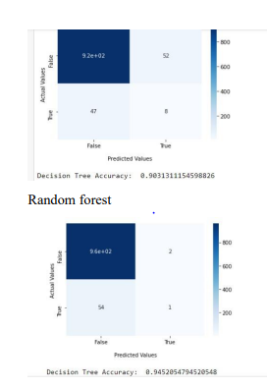
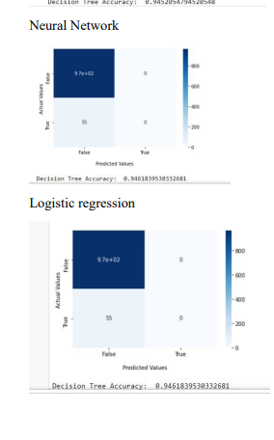

Slide 8
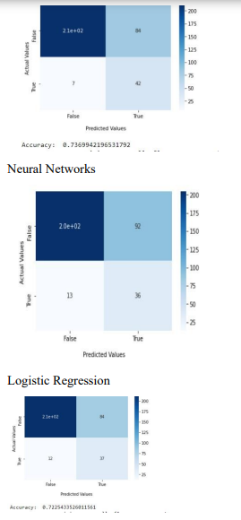
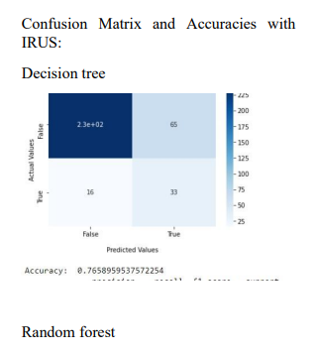

Slide 9

CONCLUSION
After applying IRUS the minority class of our dataset (stroke: 1) is more correctly classified than before and therefore we have catered the problems caused by this class imbalanced dataset

