Slide 1

Exploratory Data Analysis on AMCAT Dataset

Slide 2
About me
Name: Shaik Jaakeer Basha
Qualification: Pursuing Integrated M.tech in Software Engineering in VIT-AP University.
Work Experience: Fresher
Linkedin: www.linkedin.com/in/jaakeershaik
Github: https://github.com/jaakeerhn/AMCAT-Data-EDA/blob/main/AMCAT%20PROJECT%20JAAKEER.ipynb

Slide 3
Objective:
Explore the dataset to identify the key factors that Significantly affect the salary levels among the job seekers. That Includes factors such as education, skills, location, experience.
Key Objectives:
Identifying the trends or patterns in salary distributions across different job designations and cities.
Correlation among the key factors such as education, gender, designation, skills, experience and personal characteristics which effects salary.
Make some claims and try to prove through Statistical methods.

Slide 4
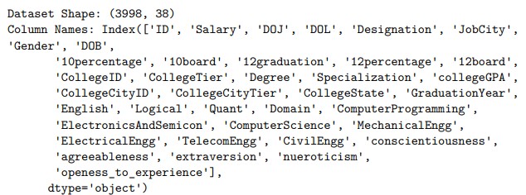
Data Description:
The dataset was released by Aspiring Minds from the Aspiring Mind Employment Outcome 2015 (AMEO). The study is primarily limited only to students with engineering disciplines. The dataset contains the employment outcomes of engineering graduates as dependent variables (Salary, Job Titles, and Job Locations) along with the standardized scores from three different areas – cognitive skills, technical skills and personality skills. The dataset also contains demographic features. The dataset contains around 40 independent variables and 4000 data points. The independent variables are both continuous and categorical in nature. The dataset contains a unique identifier for each candidate.
The Dataset contains 3998 records(rows).
38 features(columns)
25 features are numerical
10 features are categorical
3 features are datetime

Slide 5
Libraries Used:
Pandas
Numpy
Matplotlib
Seaborn
Scipy

Slide 6
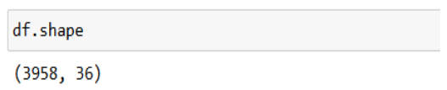
Data Cleaning and Manipulation
Removing Unwanted columns (Unnamed) from dataset
DOJ,DOL,DOB are given in timestamp format convert to datetime format by using datetime library
Collapsed and mapping the categorical columns with specific values.
After Cleaning Data:

Slide 7
Univariate Analysis:
Univariant Analysis means analysis of single variable. Here we used
1.Numerical Analysis
Non-Visual Analysis:
For Numerical columns we analyse
Min
Max
Mean
Median
Std
Skew
Kurtosis
Visual Analysis:
Histogram
Count plot
Box plot

Slide 8
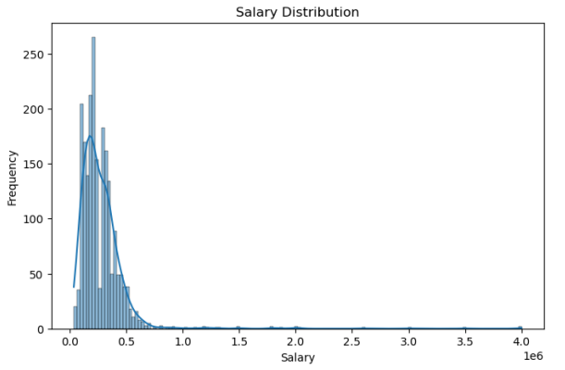
Insights:
The salary distribution shows a right-skewed pattern, meaning the majority of the candidates earn salary in the lower range, with a few earning significantly higher salaries. Most salaries fall between 100,000 and 400,000, but some go as high as 4,000,000

Slide 9
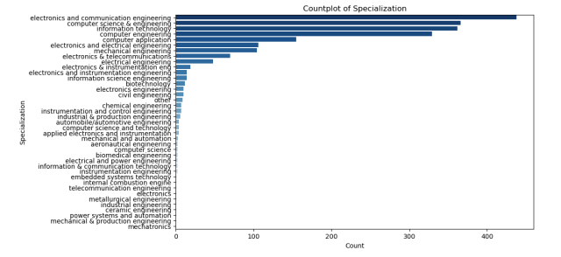
Insights:
Certain specializations like “Electronics and Communication”, “Computer Science Engineering”, and “Mechanical Engineering” dominate the dataset. This indicates that these fields are more popular among candidates, which might also impact salary distribution based on the demand for certain specializations.

Slide 10
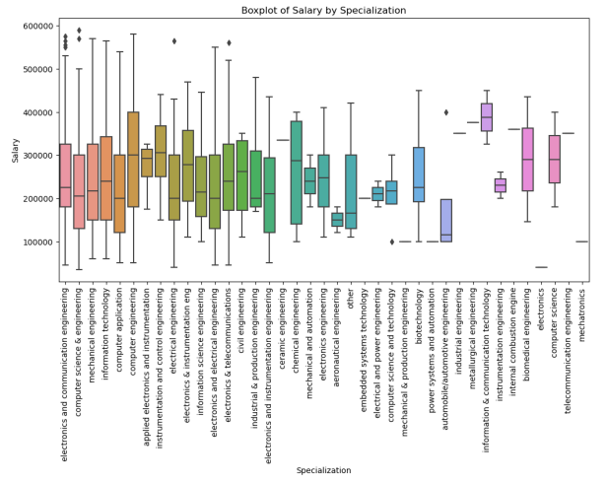
Insights:
This boxplot shows the salary distribution for different specializations. Specializations like “Information Technology” and “Computer Science” have a broader salary range with higher medians, indicating more lucrative career options. Specializations with tighter boxplots and lower medians suggest less variation in salary.

Slide 11
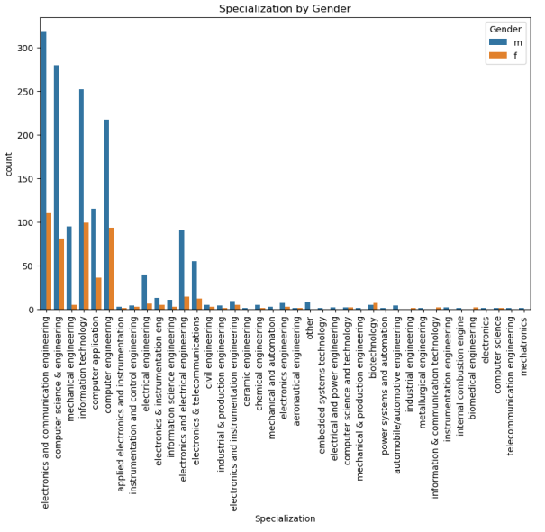
Bivariate Analysis:
Count plot on
Specialisation v/s Gender (Cat v/s Cat):
Insights:
This plot reveals that the representation of gender varies by specialization. Fields like "Mechanical Engineering" and "Computer Science" are male-dominated, while others like "Biotechnology" may have a higher female representation. This indicates a relationship between gender and specialization choice.

Slide 12
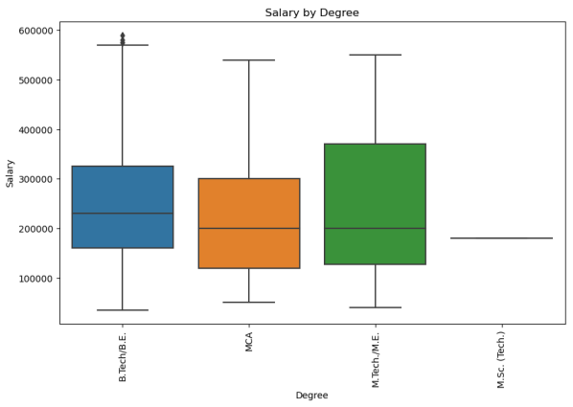
Bivariate Analysis:
Box plot on Degree v/s Salary (Num v/s Cat)
Insights:
This plot shows how salary varies with different degrees. For example, certain degrees, like those in engineering or technical fields, might display a wider range of salaries with higher median values, suggesting that these degrees are more lucrative compared to others.

Slide 13
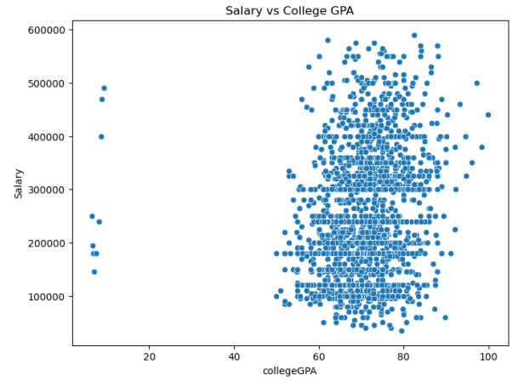
Bivariate Analysis:
Scatter Plot on CollegeGPA v/s Salary (Num v/s Num)
Insights:
The scatter plot suggests a weak positive correlation between college GPA and salary. Although higher GPAs are somewhat associated with higher salaries, this relationship isn't strong, implying that other factors, such as job role or specialization, may have a more significant impact on salary.

Slide 14
Conclusion:
My analysis has shown me that salary is influenced by multiple factors, including specialization, gender, and degree type.
Specializations in technology and engineering fields, combined with a high college GPA, generally lead to better salary outcomes, though GPA alone is not a strong predictor.
Gender plays a significant role in the selection of specialization, reflecting broader societal trends.
The dataset also showing a male dominance, particularly in more technical fields, which may contribute to differences in employability and salary distribution.
The employability and salary of candidates are largely shaped by their choice of specialization, with technical fields providing the most abundant opportunities.
Ultimately, candidates positioned in high-demand fields with practical skills are likely to benefit the most in terms of employability and compensation.

Slide 15
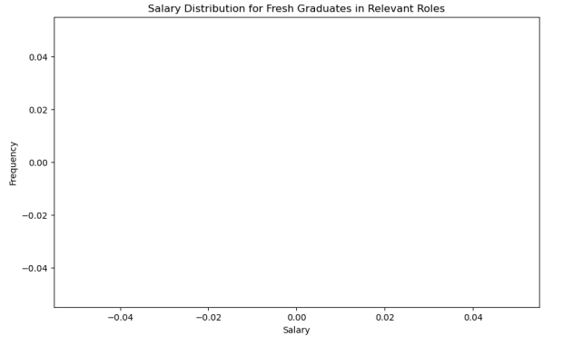
Research Questions:
Times of India article dated Jan 18, 2019 states that “After doing your Computer Science Engineering if you take up jobs as a Programming Analyst, Software Engineer, Hardware Engineer and Associate Engineer you can earn up to 2.5-3 lakhs as a fresh graduate.” Test this claim with the data given to you.
Insights:
The data supports the claim made by the Times of India article. Graduates in roles such as Programming Analyst and Software Engineer do indeed typically earn salaries within the range of 2.5-3 lakhs as fresh graduates.
The histogram shows a clustering of salaries around this range, confirming that it is a common starting salary for these technical roles.
Distribution Analysis:
The salary distribution for these roles showed that a significant number of fresh graduates earned within the claimed salary range of 2.5-3 lakhs, with salaries clustering around this range.
T-Test Result:
A t-test was conducted to verify the claim. The results indicated that the null hypothesis (which suggests that the actual salaries differ from the claimed range) could not be rejected. Thus, the data does not provide strong enough evidence to conclude that salaries significantly differ from the 2.5-3 lakhs range stated in the article.

Slide 16
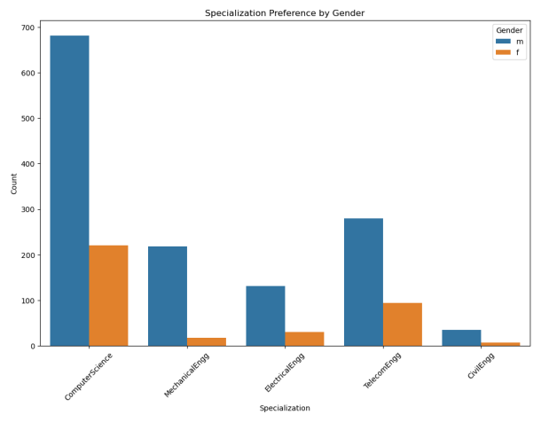
Research Questions:
Is there a relationship between gender and specialization? (i.e. Does the preference of Specialisation depend on the Gender?)
Insights:
The analysis reveals that gender does influence the choice of specialization.
Male candidates are more likely to choose technical fields like Mechanical Engineering and Computer Science, while female representation is lower in these fields.
The chi-square test further confirms a strong association between gender and specialization, implying that societal factors and possibly gender stereotypes might influence career choices in technical education.
Gender Imbalance in Specializations:
The plot shows a significant gender disparity across certain specializations. Fields like Mechanical Engineering and Computer Science have a much higher male representation, while female candidates tend to be less represented in these technical specializations.
Statistical Test:
A chi-square test was conducted to examine the relationship between gender and specialization. The resulting p-value was smaller than 0.05, indicating a statistically significant relationship between gender and specialization.

Slide 17

THANK YOU

