Slide 1




r/place 2023 Analysis V2
Ashkan T, Jake A, Nick S

Slide 2




DATA OVERVIEW
Stored 53 .csv files into Amazon S3 Bucket
Merged into 6 parquet files
Five with 10 csv files
One with 3 csv files
Analyzed at the daily level
Six data frames, each containing a day from (20th-25th)
Analyzed each day using Amazon SageMaker

Slide 3
BOT CRITERIA
Admins
Cool Down Period - An average of a 5 minute cool down before placing a pixel
Given r/place was available for 120 hours (5 days), this would equate to 1440 total pixel changes
Pixel Contribution
Threshold of minimum 2 pixels changed
Variance
Coordinates - bots are more likely to place pixels in the same place
Timestamps - bots are more likely to place pixels in a uniformed time
Variance of Differences Metric

Slide 4

VARIANCE OF DIFFERENCES METRIC
5 min
5 min
5 min
10:00AM
10:05AM
10:10AM
10:15AM
Variance of [5, 5, 5] = 0
Lower Variance is indicative of “uniformed” activity
Assumption: Users with lower Variance of Differences are likely to be bots
Investigated at the seconds level
Any user with a Variance below 1 was classified as a bot

Slide 5
RESULTS
Total of
Our Analysis Flagged
Contributing to
8,589,732
26,938
160,423
Users interacted with r/place 2023
Of the users having bot activity
Total Pixel Changes

Slide 6
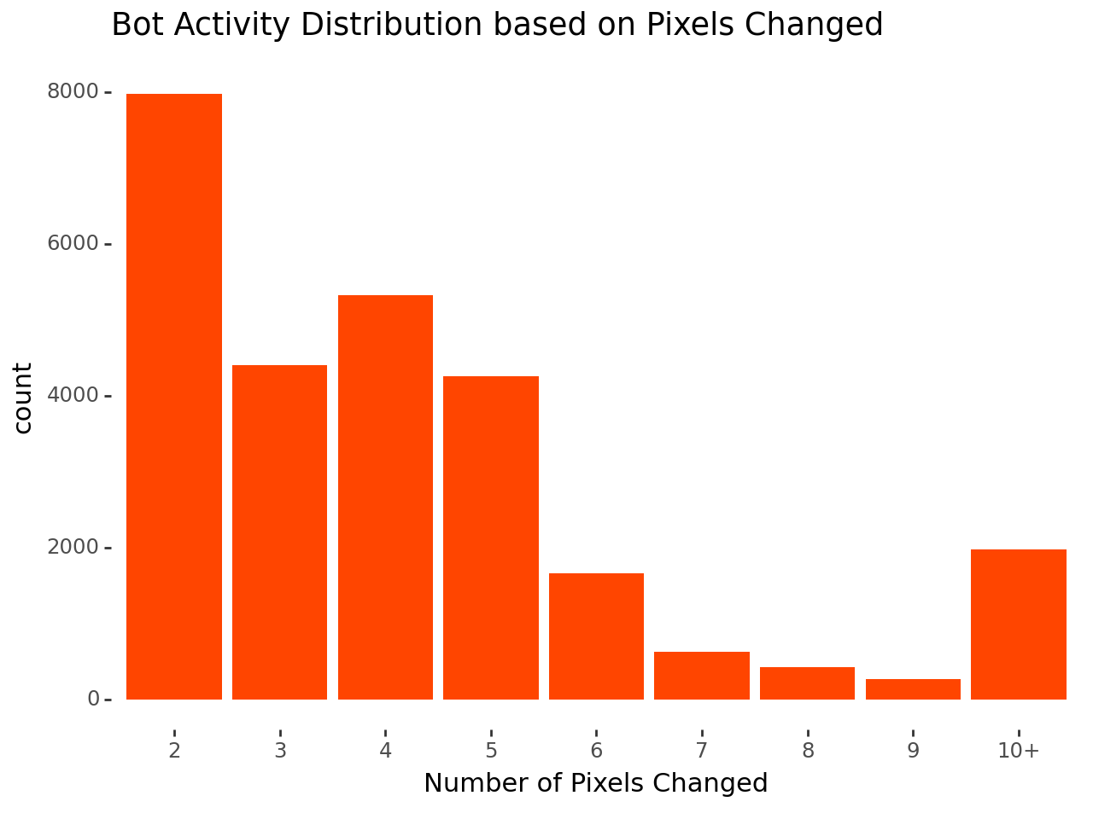
Many bots changed only a few pixels
Thoughts: Bots were deployed to add a few points to r/place before being shut down

Slide 7
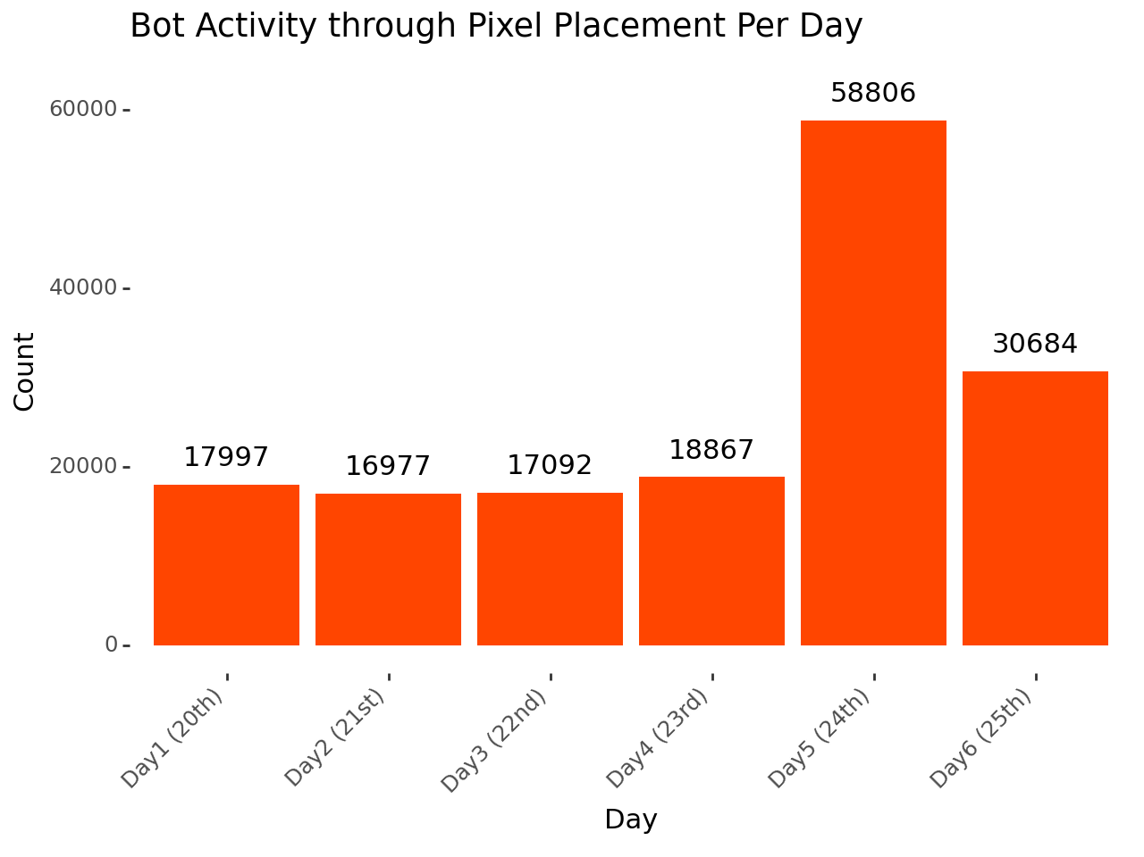
Bots were most active on July 24th
Thoughts: Bots were more active towards the end of r/place to ensure their artwork was represented

Slide 8
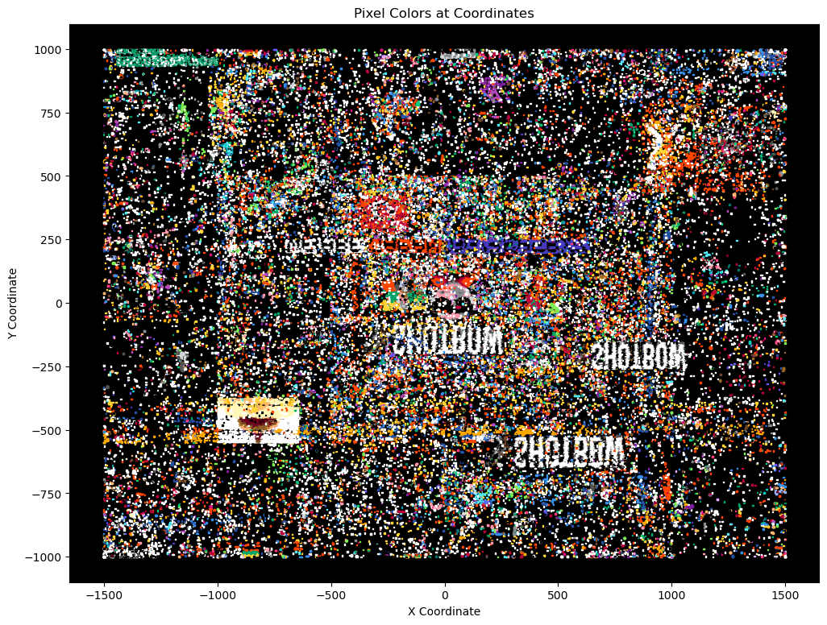

Slide 9
THANK YOU
Have any questions?

Slide 10
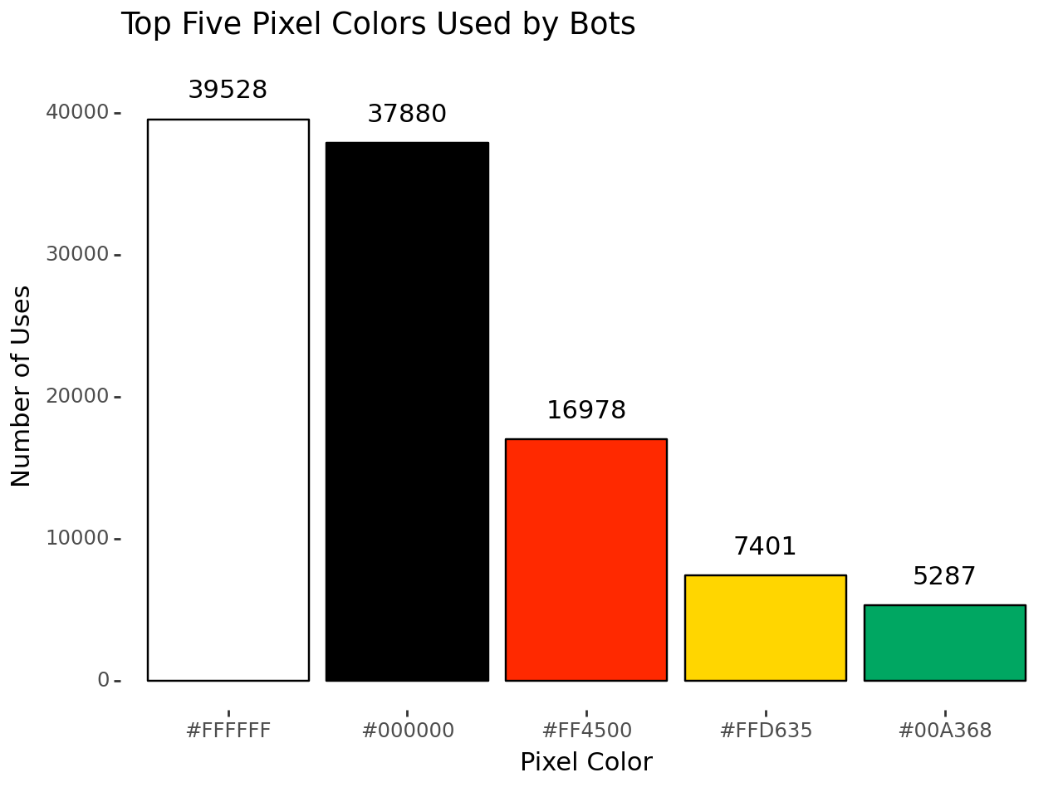
Most used colors by bots were black and white

