Slide 1
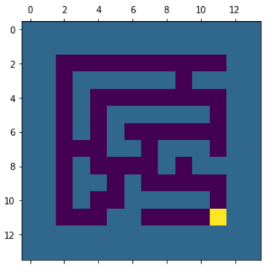
1
Distance = 2
1
2
Distance = 8
3
Distance = 4
3
2

