Slide 1
Escape a Maze with PDDL
MET CS 664 Project 2: Final Presentation
Allemann, Jan
https://www.speakgif.com/confused-travolta-original-pulp-fiction-animated-gif/

Slide 2
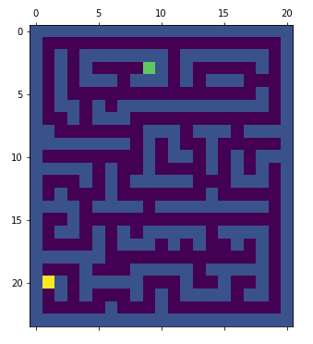
Project Context
Coordinates
Starting point
Target point
Move
from x = 10, y = 5
to x = 10, y = 6
Move
from x = 10, y = 6
to x = 11, y = 6

Slide 3
Requirements
 | Description | Fulfilled?
D1 | Translate a maze in a problem description for PDDL | Yes
D2 | PDDL scripts can find a valid plan to escape the maze | Yes, but…
D3 | The plan is validated using an A* algorithm | Yes
N1 | Display the plan | Yes
N2 | Scale up to more complex mazes | Yes

Slide 4

Design (simplified)
Can solve any maze
Input maze as list of lists containing 0,1
Where 0=empty; 1=blocked
Translate maze into set of initial states and constraints
Define actions in PDDL domain
Solve maze using A*
PDDL
PDDL problem
PDDL
PLAN
PDDL
Compare the output

Slide 5

Live Demo

Slide 6
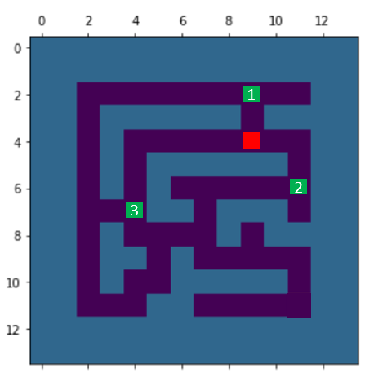
Room for improvement
Solver goes form field to direct neighbors
There is a more sophisticated way to move around a maze:
Distance = 2
1
Distance = 8
Distance = 4
2
3

Slide 7

What went well
Got familiar with and learned to like PDDL
All requirements are fulfilled

