Slide 1
Society for Computer Technology & Research's
PUNE INSTITUTE OF COMPUTER TECHNOLOGY, PUNE.
DEPARTMENT OF INFORMATION AND TECHNOLOGY
Audit Course Presentation
on
“Banking And Insurance"
IT Dept-Audit Course Coordinator
Prof. Tushar A. Rane
Presented by:
Sahil Katkamwar 33331,
TEII
T1900508619
Dr.Ganesh S. Pise

Slide 2
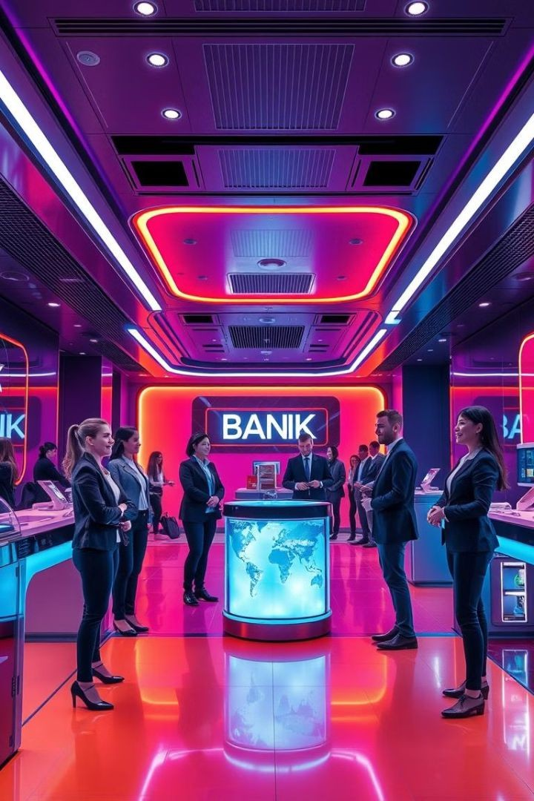
Banking and Insurance: Powering the Financial Landscape
The banking and insurance sectors are pillars of the global economy.
They provide essential services that enable individuals and businesses to thrive.
By Sahil Katkamwar

Slide 3
Introduction to the Banking Sector: A Pillar of the Economy
Traditional Banking
Traditional banking involves physical branches with
in-person interactions. This model offers personalized services and trust built through relationships.
Digital Banking
Digital banking utilizes online platforms and mobile apps for transactions, account management, and customer support. It offers convenience and accessibility.

Slide 4

Retail Banking Services: Catering to Individual
NCheeeckdingsand Savings Accounts
Checking accounts provide
easy access to funds, while savings accounts offer secure options for building wealth.
Loans and Credit
PCearrsodnsal loans and credit cards provide financing for
various needs, from home improvements to travel.
Investment Products
Investment products, like mutual funds and retirement accounts, help individuals grow their savings for the future.

Slide 5
Commercial Banking: Fueling Business
^{G}Len^{r}dºing^{w}Se^{t}rv^{h}ices
Commercial banks provide loans to businesses for various purposes, including expansion, equipment purchases, and working capital.
Deposit Services
Businesses can deposit funds into commercial accounts, earning interest and managing cash flow effectively.

Slide 6

Investment Banking: Driving Financial Innovation
2
Mergers and
Investment banks facilitate M&AAtrcaqnusaicstiitoinosnbsy connecting buyers and sellers.
500B
Capital Markets
Investment banks raise capital for companies through IPOs and debt offerings.
10K
Advisory Services
Investment banks provide strategic advice on financial matters, including restructuring and valuations.

Slide 7
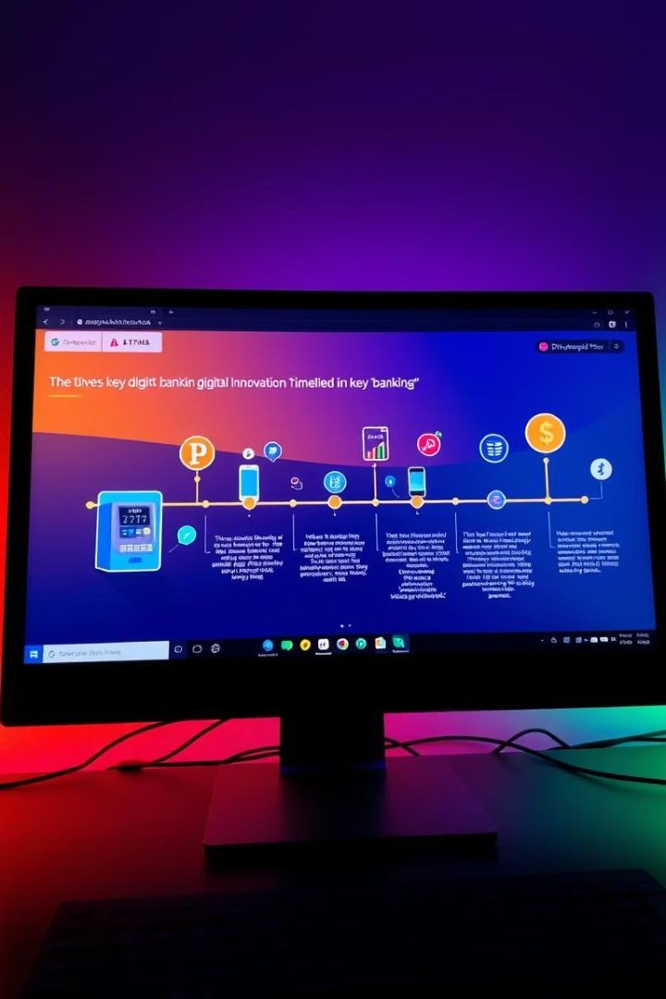
The Evolving Role of Digital Banking
Early Stages: ATMs and Online
EBaarnlykdiignitgal banking introduced ATMs and online banking platforms, offering greater convenience and access.
1
Mobile Banking
RMeobvioleluaptiposntransformed banking, allowing customers to manage accounts, make payments, and access services anytime, anywhere.
2
Emerging Technologies: Blockchain and
ABlIockchain technology and artificial intelligence (AI) are shaping the future of banking, enabling secure transactions and personalized
services.
3

Slide 8

Insurance Fundamentals: Mitigating
^{Ris}R^{k}isk^{s}Transfer
Pooling of Risks
Insurers collect premiums from a large pool of individuals, enabling them to cover losses experienced by a few.
Contractual
AInsgurreaenmceeisnbtased on a contract where insurers agree to provide
financial protection in exchange for premiums.
1
2
3
Insurance is a mechanism to
transfer risk from individuals to insurers. It involves paying premiums for coverage against potential losses.

Slide 9


Life Insurance: Securing ^{ur}T^{e}er^{s}m Life Insurance
Fut
Provides coverage for a specific period, typically 10-30 years, with
lower premiums.
Whole Life Insurance
Offers lifetime coverage, combining death benefit with cash value that grows over time.
Universal Life
PInrosvuidreasnfcleexible premiums and death benefits, allowing policyholders to adjust coverage based on changing needs.
Variable Life
ICnosmubrinaenscdeeath benefits with investment options, where policyholders can choose how to allocate their cash value.

Slide 10
Property and Casualty Insurance: Protecting
Assets
1
Homeowners
PInrosvuidreasnficneancial protection for homeowners against property damage from perils like fire, theft, and natural disasters.
Auto Insurance
Covers financial losses arising from accidents involving vehicles, including liability for injuries and property damage.
2
Renters Insurance
Protects renters' personal belongings from theft, damage, and other perils.
3
Commercial Property
PInrosvuidreasnccoeverage for businesses against property damage, liability, and other risks.
4

Slide 11
The Intersection of Banking and Insurance: Synergies and Opportunities
Enhanced Customer
^{V}Thªis^{lu}c^{e}onvergence offers customers greater convenience, personalized services, and a wider range of financial protection.
Combined Offerings
Financial institutions are integrating banking and insurance products, creating comprehensive solutions for customers.

