Slide 1
Docker for researchers
Jørgen Aarmo Lund

Slide 2
Introduction
Jørgen Aarmo Lund, industry PhD student at the UiT Machine Learning group for DIPS AS
“Data-driven pathways”: inferring usage patterns in patient record systems from auditing logs
Researching explainability, natural language processing
DIPS develops e-health systems: patient records, laboratory services, hospital kiosks, and more
Gradually moving over applications to containers

Slide 3
Agenda
Part 1: Introduction to containers
What are containers?
Why are they useful for ML research?
Getting started with Docker
Part 2: Putting together our own container images
Basic Dockerfile syntax
Where does the model go?
Debugging tips
Part 3: Deploying containers for ML research
GPU and device access
Deploying to UiT’s GPU cluster
Deploying to NRIS HPC clusters

Slide 4
Follow along
Files available on
https://github.com/jaalu/vigs-docker-workshop
Notes:
So this workshop is on Docker for ML researchers. Most tutorials on containers are aimed at software developers who are developing web services, and
Even though many of you from UiT may be implicitly familiar with Docker since Springfield requires it, this workshop doesn’t assume any familiarity with Docker. It is going to involve a little command line usage and Python, but I will try to explain what I am doing and you are free to pose questions during the talk and in the breaks afterwards.
This workshop is going to be divided into three 30-minute blocks with 15 minute breaks afterwards for questions, testing and coffee breaks.
The first block is going to be a brief introduction to containers, what sort of problems they try to solve and why they can be useful for researchers, and how we set up and run the containers.
The second block is going to go into putting together our own images, and how we
The last block is going to talk about ML-specific topics like getting CUDA working, deploying containers to clusters

Slide 5
Motivation for software developers
IT around 2008¹: developers handing applications to sysadmins maintaining long-lived servers
Downtime for manual installation
Server and application maintenance intertwined
Conflicts between dependencies
Containers allow isolating applications and running them with their own set of dependencies
Notes:
Not too long ago the convention was (and still is, in places) that programming and server maintenance were two completely different disciplines: the programmers’ job was to finish programs and the sysadmins’ job was to ensure the servers were running. When it was time to upgrade, an admin set aside time to upgrade to take the server offline and install the upgrade. If the upgrade failed, the server would be out of commission until the upgrade was rolled back or a hotfix was hastily delivered. And if it turned out that they had two applications which depended on different versions of the same service, well, they had a problem.
Around this time people figured out that Linux had good tools to try and isolate the resources programs had access to, and used them to put together isolated container environments which both let them limit the fallout of a service failing, and let them maintain separate dependency sets for each service.

Slide 6
Motivation for ML researchers
Replicability: making experimental conditions visible
Flexibility: easing transition from laptop tests to HPC training
Reusability: showing findings work in other settings too!
Notes:
So how does this help us do research?

Slide 7
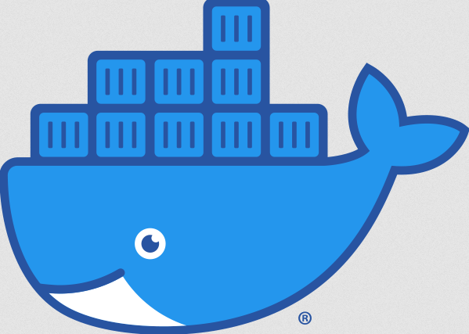
Docker
Docker allows isolating your script into a container, which:
Runs isolated from other processes while sharing the OS
Can package their own set of dependencies
Can be packaged and started on other servers, including HPC clusters
Maintained by Docker Inc., runtime open source
Docker Desktop packages the software with a GUI, free for researchers

Slide 8
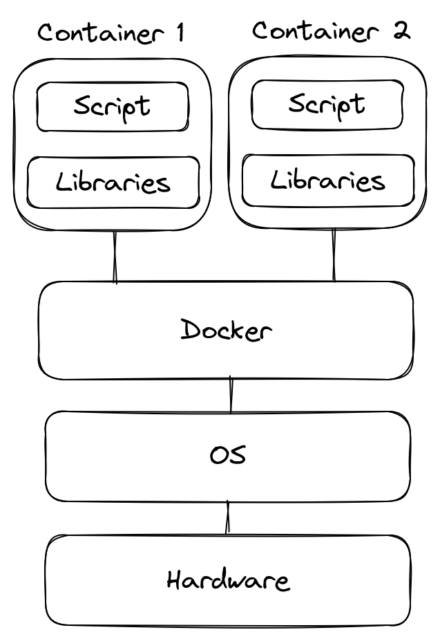
Docker - structure

Slide 9
Key concepts
We separate between containers and images:
A container is a standalone environment with your script and the dependencies it needs
An image is the template for making your container
Images can be saved to a registry, like Docker Hub
Containers are meant to be disposable: changes you want to keep - like your trained model - should be outside of the container!

Slide 10
Installing Docker - options
Docker Desktop: https://www.docker.com/
Play With Docker: https://labs.play-with-docker.com
Free online lab with VMs provisioned
Docker also provides an apt repository

Slide 11
Checking that Docker works
When Docker is running, we can get a list of running containers with
$ docker ps CONTAINER ID IMAGE COMMAND CREATED STATUS PORTS NAMES
We can then retrieve an image with docker pull:
$ docker pull hello-world
We can then build a container from the image with docker run:
$ docker run hello-world

Slide 12
Running containers - custom commands
Images specify a default command, but we can specify one ourselves in docker run:
$ docker run ubuntu echo Hello! Hello!

Slide 13
Running containers - detached
Default: containers do not accept any input, but write to the terminal
More likely you want a container which runs detached in the background, with --detach or -d:
$ docker run -d hello-world $ docker ps -a CONTAINER ID IMAGE COMMAND CREATED STATUS PORTS NAMES d3a5ee04babd hello-world "/hello" About a minute ago Exited (0) About a minute ago elated_feistel $ docker logs elated_feistel
NOTE: Docker options placed before the container image and the command

Slide 14
Running containers - interactive
Alternatively, we can specify that the container should set up a shell and accept input with --interactive --tty, or -it for short:
$ docker run -it python:3.9 Python 3.9.16 (main, May 4 2023, 06:16:43) [GCC 10.2.1 20210110] on linux Type "help", "copyright", "credits" or "license" for more information.

Slide 15
Running containers - cleaning up:
Containers will stick around after they finish running
Nice for checking logs, restarting, but list easily clogged
Passing --rm will delete the container after it exits:
$ docker run --rm hello-world $ docker ps -a

Slide 16
Running containers - configuration
We can set environment variables in the container with --env or -e:
$ docker run -e MODEL_ARCH=resnet ubuntu
If we want to expose network ports (e.g. for dashboards) we can map ports from the container to the host with -p:
$ docker run -p 8080:80 httpd
NOTE: the order is host-container, so -p 8080:80 will connect port 80 on the container to port 8080 on the host

Slide 17
Where do we keep the model?
“Containers are meant to be disposable: changes you want to keep should be outside of the container”
So where do we store the trained models?

Slide 18
Where could we keep the model?
Embed it as part of the image
Not an option for training, gives us large images
Copy it to/from the container after start
docker cp can copy files
Can bump into runtime storage limits
Upload to/download from online server
Extra warmup time, network traffic
Weights & Biases, Hugging Face libraries provide functionality for this

Slide 19
Where should we keep the model?
Bind mounts
Creates a temporary link between a directory on the host PC and a directory in the container
Pros: Can see the directory, pull files quickly
Cons: Assumes the storage is on your PC, not as flexible as volumes
Volumes
Docker creates and manages a persistent directory
Pros: More flexible, can set up plugins to mount cloud storage as volumes
Cons: Requires a running (temporary) container to copy files to host

Slide 20
Mapping bind mounts
To mount a directory with a bind mount we can use --mount:
$ docker run --mount type=bind,source=$(pwd)/assets/,target=/pictures/ ubuntu
source points to the folder on the host (assets in the working directory), and target is the folder it will appear as in the container (/pictures/)

Slide 21
Setting up a volume
To set up a volume we run docker volume create:
$ docker volume create my-volume $ docker volume inspect my-volume
We can then mount it in the same way, but with type=volume:
$ docker run --mount type=volume,source=my-volume,target=/results/ ubuntu

Slide 22
Break

Slide 23
Creating an image - FROM
Template file conventionally named Dockerfile (no extension)
Images start with a FROM statement, which specifies which image (ubuntu) and tag (22.04) to build on:
FROM ubuntu:22.04
If you omit the tag, Docker will automatically use latest - but use one if you can!

Slide 24
Building an image
This turns out to be a complete Dockerfile:
FROM ubuntu:22.04
Save this as Dockerfile (no extension!) in a project directory, and run
$ docker build . -t my-image
docker build expects a build context - the directory to pull project files from when building the image - like the current directory .
-t ties the new image to a name and a tag

Slide 25
Creating an image - RUN
Once we have a base, we specify which commands to run to build the environment
RUN statements are followed by commands to run - for instance, we can install packages:
RUN apt-get update && apt-get install -y python3

Slide 26
Creating an image - COPY
Earlier, we specified the build context (usually the project directory)
COPY copies files from the build context to the container:
COPY train.py /experiment/train.py
We can set the working directory in the container with WORKDIR
WORKDIR /experiment/
The .dockerignore file specifies which files not to copy from the context

Slide 27
Creating an image - ENV
We can also specify which settings the container expects/respects when it runs - conventionally done through environment variables
ENV sets the default value for an environment variable:
Default values can be overridden with docker run -e

Slide 28
Creating an image - CMD
Finally, we specify what should happen when the container starts with CMD:
CMD python train.py

Slide 29
Full image example
Using all of the commands:
FROM ubuntu:22.04 ENV BATCH_SIZE=128 RUN apt-get update && apt-get install -y python3 COPY train.py /experiment/train.py CMD python3 /experiment/train.py

Slide 30
Debugging tip 1
What if: your image fails to build on step 14?
You can turn off Buildkit to get intermediate images for each layer: On Linux:
$ DOCKER_BUILDKIT=0 docker build .
On Windows:
set DOCKER_BUILDKIT=0& docker build .
You can create a container from the intermediate image and retry the step:
$ docker exec -it bash # pip install ...

Slide 31
Debugging tip 2
What if: the training suddenly stops and nothing happens?
Find the running container
$ docker ps -a e593fff04794 postgres "docker-entrypoint.s…" 10 seconds ago Up 9 seconds 5432/tcp stupefied_elion
and start an interactive shell inside it:
$ docker exec -it stupefied_elion bash

Slide 32
Archiving images
You can also save images as archives with docker save
$ docker save mnist-demo > mnist-demo.tar
and load them with docker load
$ docker load < mnist-demo.tar

Slide 33
Making cache-friendly images
Images are composed of multiple layers: each set of changes made by RUN and COPY makes up a layer. Try:
$ docker image inspect python
To avoid new images for every build, Docker saves extra info for each layer:
For RUN, the command is saved
For COPY, a checksum of the added files is saved
If the commands run/the files added by the layer are the same, and the last layer is the same, the layer is reused

Slide 34
Making cache-friendly images pt. 2
For this reason, the most frequent and smallest changes should come last in your image, e.g.
Installing system packages
Installing Python packages
Adding your script
Running your script
The commands should, as far as possible, have the same results each time you run them

Slide 35
System package installation
When using apt, group together updating and package installation:
apt-get update && apt-get install -y python3
NOTE: This doesn’t guarantee that you get the latest packages every time you build, but makes sure the package index makes sense when you install the packages
Possible to lock apt packages to specific versions, but specifying the distro usually sufficient

Slide 36
Language package installation
Generally we want a lock file with exact package versions, which we can then restore as part of building the image
In Python, pip freeze produces a list of all packages installed
$ pip freeze > requirements.txt
Good practice to set up a virtual environment with venv to isolate exactly which packages the project needs
In R, renv (formerly packrat) can create similar virtual environments with lock files:
renv::snapshot() # saves project deps to renv.lock renv::restore() # restores deps from renv.lock

Slide 37
M1 Mac: installing amd64 packages
Common problem on M1 Macs: older packages/libraries without ARM binaries
We can ask Docker to have the container act as an Intel Mac with --platform=linux/amd64:
docker run --platform=linux/amd64 ubuntu uname -a

Slide 38
Building images - conclusion
Order changes from least to most frequent
Commands should be deterministic
Virtual environments and lock files useful to have reproducible containers

Slide 39
GPU/device access
Nvidia Container Runtime lets you run CUDA code in containers:
$ apt-get install nvidia-container-runtime
Can use the --gpus switch to grant access to GPU:
$ docker run --gpus all ubuntu
Windows: requires WSL 2, newer CUDA driver
Premade CUDA Docker images: https://github.com/NVIDIA/nvidia-docker/wiki/CUDA
Also possible to grant access to USB/hardware devices with --device

Slide 40
Packaging for cloud services
You can set up your own container registry with the cloud provider:
Amazon ECR
Azure Container Registry
Google Cloud Container Registry
To push the image to your cloud registry, tag your image with the URL of the registry and push:
$ docker tag mnist-demo jludemo.azurecr.io/mnist-demo $ docker push jludemo.azurecro.io/mnist.demo

Slide 41
Packaging for Springfield (UiT)
UiT’s Springfield cluster uses Kubernetes for orchestration across multiple nodes
Docker Desktop allows setting up your PC as a single-node Kubernetes cluster
Kubernetes lets us define a Job which runs one or more containers until completion:
kind: Job apiVersion: batch/v1 metadata: name: your-training-job spec: template: spec: containers: - name: your-training image: "your-training-image" workingDir: /storage command: ["sh", "train.sh"] volumeMounts: - name: storage mountPath: /storage volumes: - name: storage persistentVolumeClaim: claimName: storage restartPolicy: OnFailure backoffLimit: 0

Slide 42
Packaging for NRIS HPC (Betzy, LUMI)
We can push
However: container libraries most likely not tuned for the HPC cluster
If libraries are available as Lmod modules, the modules will be faster
But containers are still useful for
Portability
Specifying package/library versions

Slide 43
Packaging for NRIS HPC - Singularity (Betzy, LUMI)
Singularity, the container runtime installed on NRIS HPC computers, supports converting Docker images to Singularity .sif images. Running
$ singularity pull --name train.sif docker://jlu015/train:latest
will retrieve the image jlu015/train from Docker Hub and save it as train.sif
To run the default command specified by CMD, we can call singularity run with the image:
$ singularity run train.sif
Alternatively, singularity exec will run a specific command:
$ singularity exec train.sif echo Hello world!

Slide 44
Packaging for NRIS HPC - Writing a SLURM job (Betzy, LUMI)

Slide 45
Resources
Docker in Y Minutes:
https://learnxinyminutes.com/docs/docker/
The Play with Docker exercises:
https://training.play-with-docker.com/
NRIS’ documentation on containers:
https://documentation.sigma2.no/

Slide 46
Notes
1. https://www.atlassian.com/devops/what-is-devops/history-of-devops

