Slide 1
Attention in mixed-type Clustering
Bachelor Thesis
Jaanis Fehling
22.11.2023
Wissenschaftlicher Betreuer:
Walid Durani
Verantwortlicher Professor:
Prof. Dr. Christian Böhm

Slide 2
Table of Contents
Classical methods for mixed-type data
k-means, k-means + one-hot encoding
k-modes/k-prototypes
Gower distance
Autoencoder
Categorical Embeddings
Attention
Transformer
Deep Clustering

Slide 3
Mixed-type data
Composed of continuous and categorical features
Classical clustering methods handle continuous data only
Hard to measure similarity between classes in categorical features (e.g., blue ⬄ green)
Clustering algorithms for mixed-type data?

Slide 4
k-means
Common algorithm for numerical data
Find optimal centroids that minimize the Euclidean distance to each point
Efficient and powerful, but only for continuous, numerical data
One-hot encoding for categorical features?
Curse of dimensionality
Poor characteristics of binary features

Slide 5

k-modes/k-prototypes
Use the Kronecker-Delta as dissimilarity measure for categorical features:
k-modes for continuous features + k-means for categorical features => k-prototypes
Slow and does not perform well

Slide 6
Gower distance
Different similarity measures for different types of data
Creates a distance matrix that can be used for Hierarchical Clustering
Slow
Falsely assigns most instances to one cluster

Slide 7
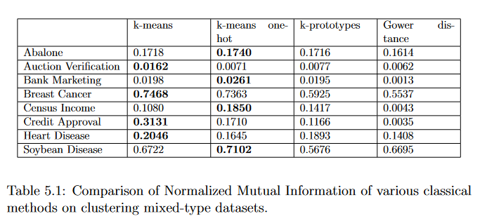
Comparison of classical methods

Slide 8
Mixed-type data with neural networks
Learn representation of data through neural network
Use representation in combination with classical distance-based clustering algorithm (e.g., k-means)

Slide 9
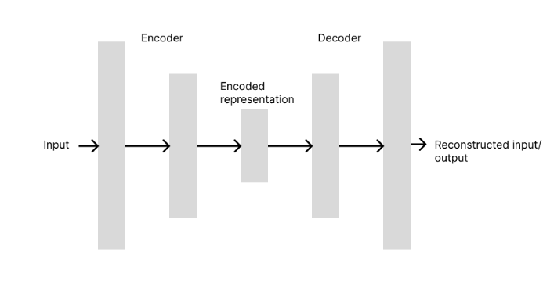
Autoencoder
Neural network that learns efficient encoding of data
Unsupervised: during training, we try to reconstruct the input
For clustering, we can use the encoded representation

Slide 10
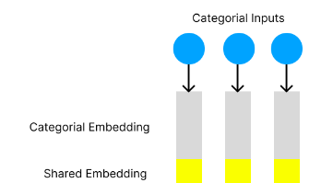
Categorical Embeddings
Learnable embedding for each categorical feature
Shared embedding for all features (1/8 of embedding) to differentiate classes of different features (Idea by Huang et al, 2020)

Slide 11
Attention
Mechanism used in NLP to compute relationships between tokens
We can use attention to compute relationships between features

Slide 12
Attention
We use Attention before feeding the tensors into the autoencoder
We use 3 different learnable representations for the input
The resulting representations are called Queries (Q), Keys (K) and Values (V)

Slide 13



Attention
Calculate Attention Weights:
Scale by embedding dimension:
Apply softmax and multiply with input again:

Slide 14
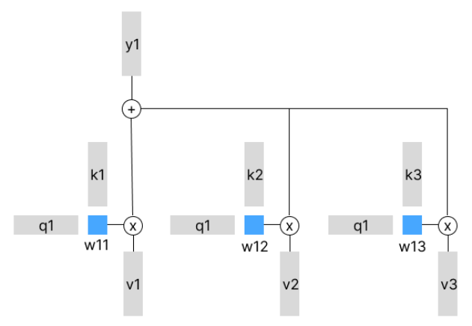
Attention
Outputs
Keys
Queries
Values

Slide 15
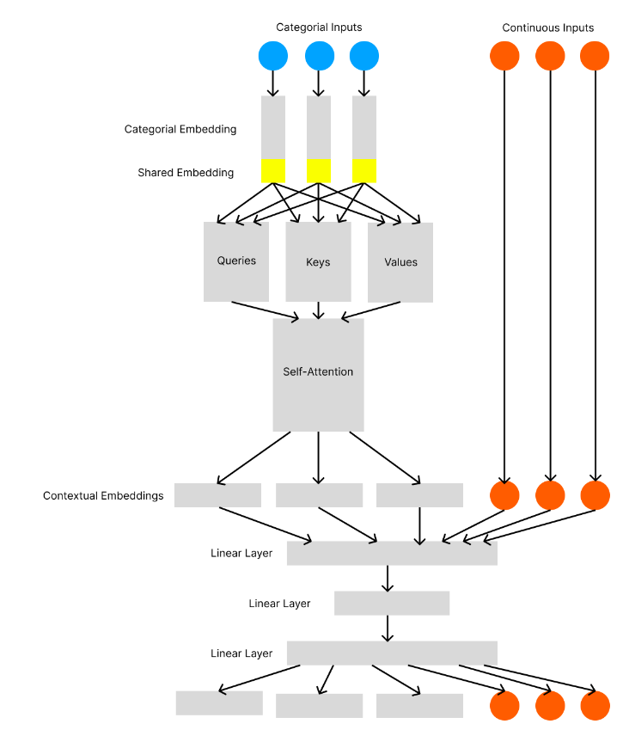

Slide 16
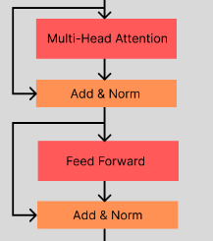
The Transformer
Extension of Attention into a full model
Uses multi-head attention to attend different subspaces of the input
Combines Attention with linear layers and layer normalization
Is used multiple times sequentially

Slide 17
Transformer as a supervised mixed-type data classifier
TabTransformer by Huang et al, 2020
Uses shared embedding
Only categorical features used in transformer
FT-Transformer by Gorishniy et al, 2021
Embeddings for continuous featues
Both types of features used in transformer

Slide 18
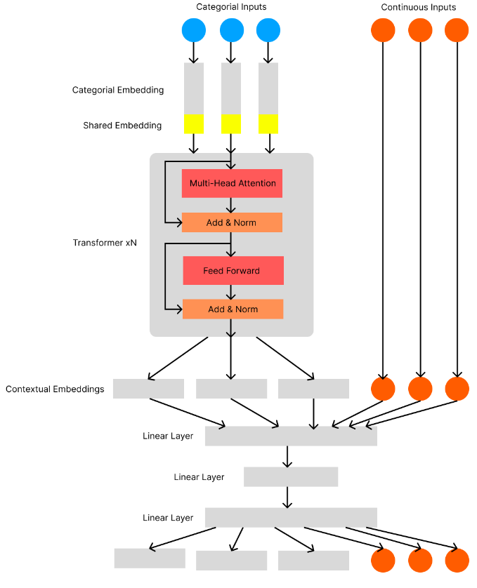

Slide 19
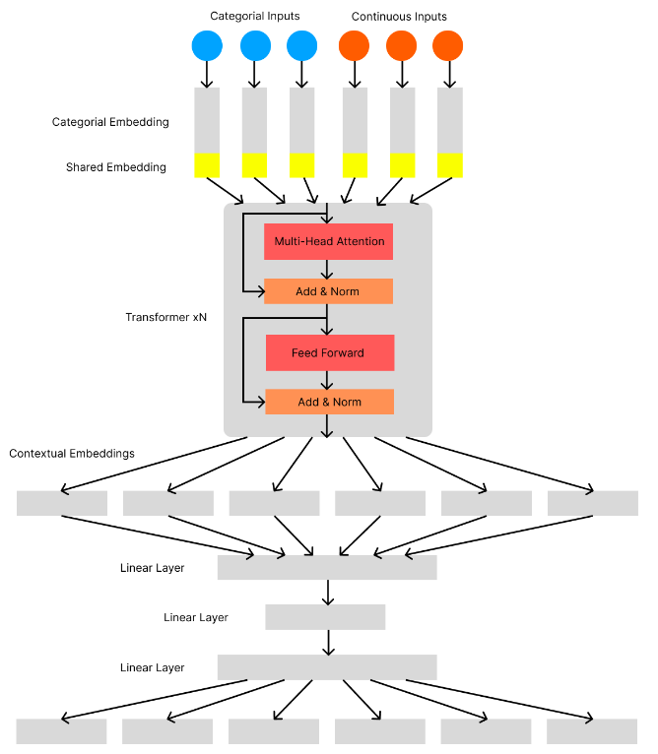

Slide 20
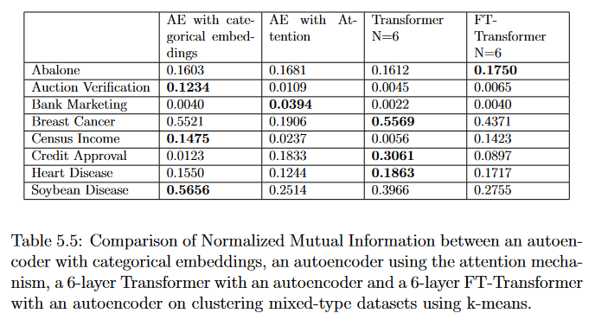
Comparison

Slide 21
Deep Clustering
Combine feature representation learning and clustering using a custom loss function, instead of a two-step process
DEC: Iterative algorithm to produce cluster friendly representations in the encoder
IDEC: Includes autoencoder reconstruction loss in DEC
DCN: Alternates between updating network parameters and cluster assignments

Slide 22
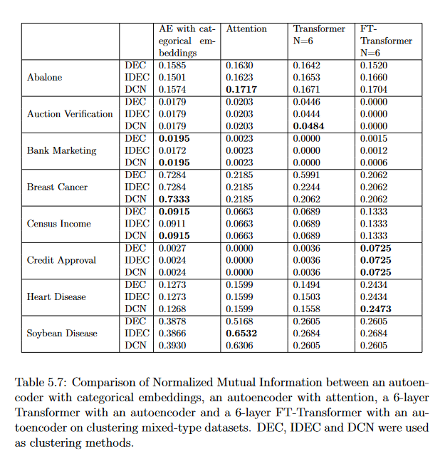

Slide 23
Conclusion
Successful demonstration of Attention- and Transformer-based clustering modules
Attention/Transformer-based networks can improve performance on some datasets
Additional computational resources needed
Clustering mixed-type data remains challenging

Slide 24
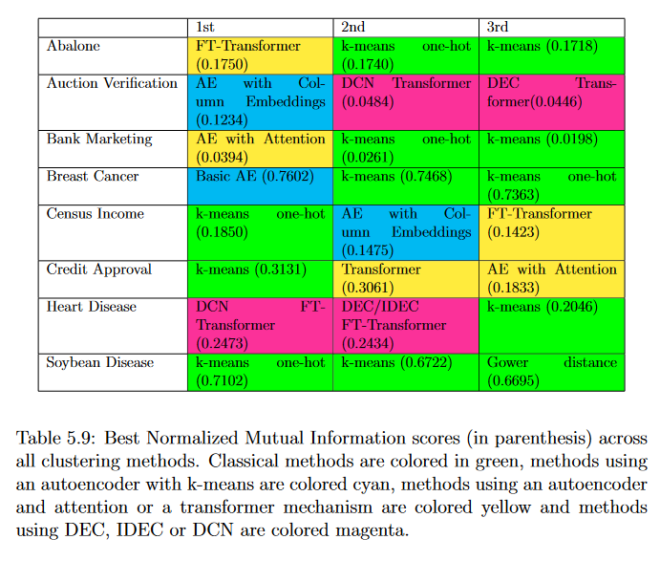

Slide 25
Outlook
Conduct more tests (with more computing power)
Method could be explored that estimate if attention would benefit clustering

Slide 26
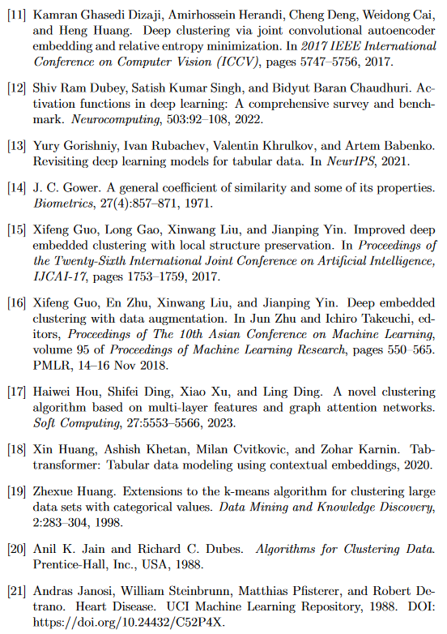
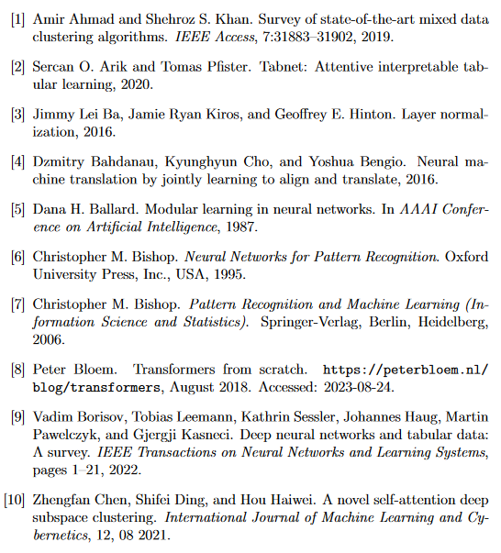
Sources

Slide 27
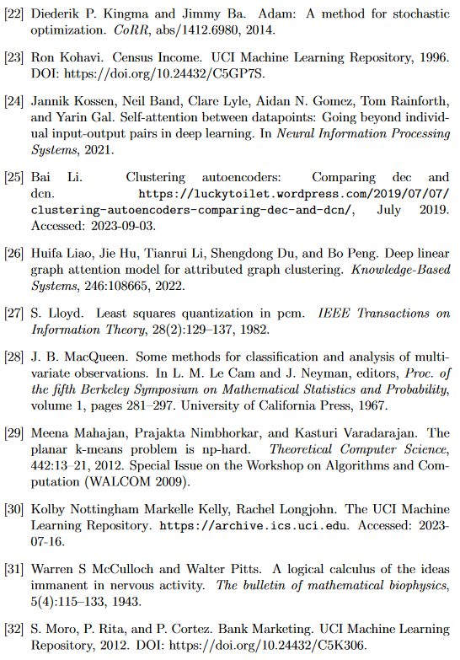
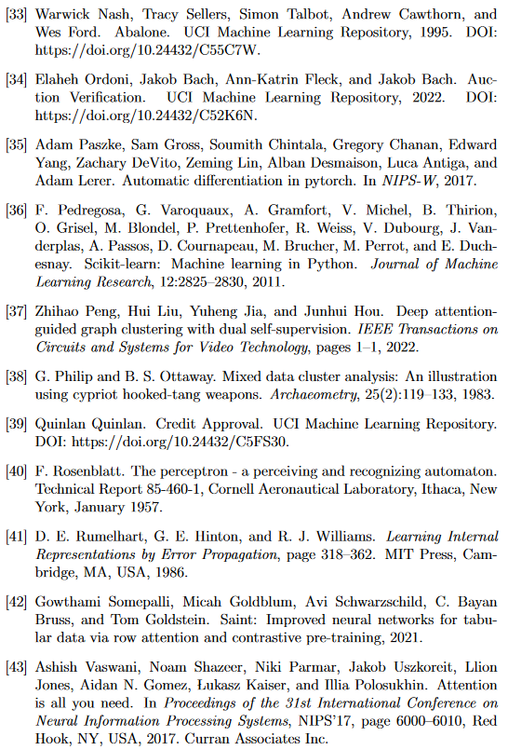

Slide 28
