Slide 1
Attention in mixed-type Clustering
Bachelor Thesis
Jaanis Fehling
22.11.2023
Wissenschaftlicher Betreuer:
Walid Durani
Verantwortlicher Professor:
Prof. Dr. Christian Böhm

Slide 2
k-means
Find optimal centroids that minimize the Euclidean distance to each point
Efficient and powerful, but only for continuous, numerical data

Slide 3
How to handle categorical/mixed-type data?
One-hot encoding
Curse of dimensionality
Poor characteristics of binary features
Clustering algorithms for mixed-type data?

Slide 4

k-modes/k-prototypes
Use the Kronecker-Delta as dissimilarity measure for categorical features:
k-modes for continuous features + k-means for categorical features => k-prototypes
k-modes is slow and does not perform well

Slide 5
Gower distance
Similarity measure for mixed-type data
Creates a distance matrix that can be used for Hierarchical Clustering
Slow
Falsely assigns most instances to one cluster

Slide 6
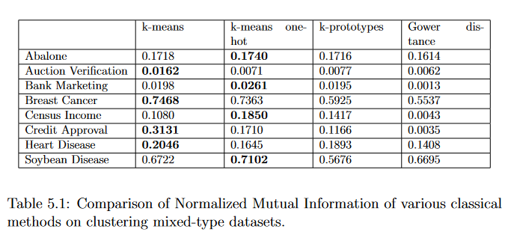
Comparison of classical methods

Slide 7
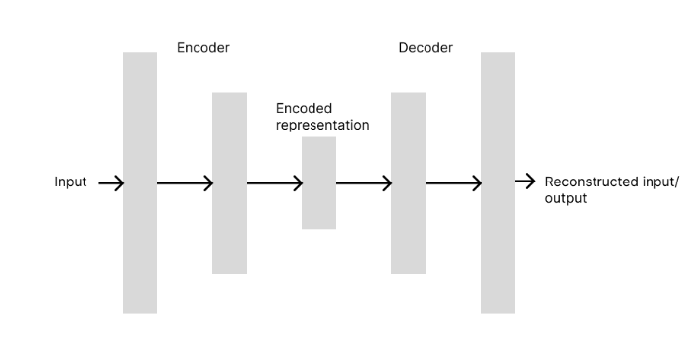
Autoencoder
Idea: Use a neural network to learn a dense representation of continuous and categorical features
Combine the encoded input with classical k-means

Slide 8
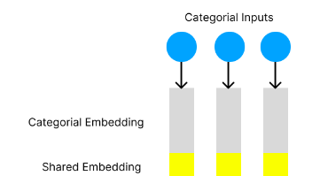
Embeddings
Learnable embedding for each categorical feature
Shared embedding for all features (1/8 of embedding) to differentiate classes of different features (Idea by Huang et al, 2020)

Slide 9
Attention!
Mechanism used in NLP to compute relationships between tokens
We can use attention to compute relationships between features

Slide 10
Attention!
We use Attention before feeding the tensors into the autoencoder
We use 3 different learnable representations for the input
The resulting representations are called Queries (Q), Keys (K) and Values (V)

Slide 11



Attention!
Calculate Attention Weights:
Scale by embedding dimension:
Apply softmax and multiply with input again:

Slide 12
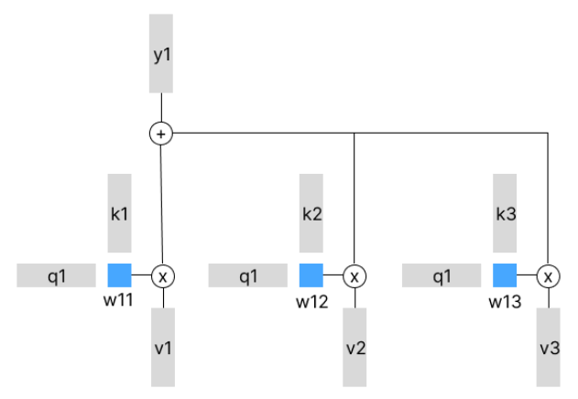
Attention!
Outputs
Keys
Queries
Values

Slide 13
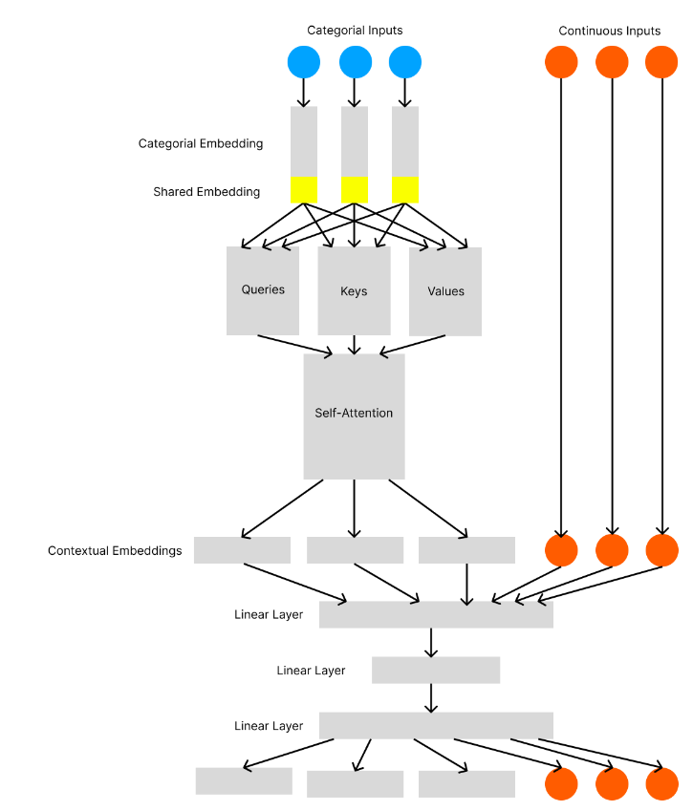

Slide 14
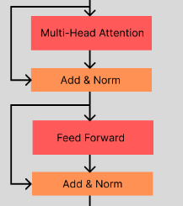
The Transformer
Extension of Attention into a full model
Uses multi-head attention to attend different subspaces of the input
Combines Attention with linear layers and layer normalization
Is used multiple times sequentially

Slide 15
Transformer as a supervised mixed-type data classifier
TabTransformer by Huang et al, 2020
Uses shared embedding
Only categorical features used in transformer
FT-Transformer by Gorishniy et al, 2021
Embeddings for continuous featues
Both types of features used in transformer

Slide 16
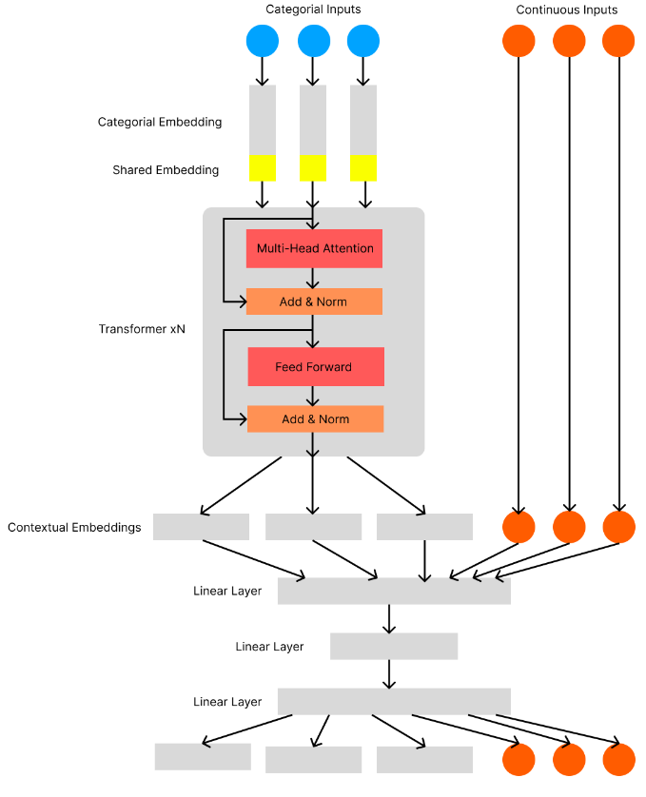

Slide 17
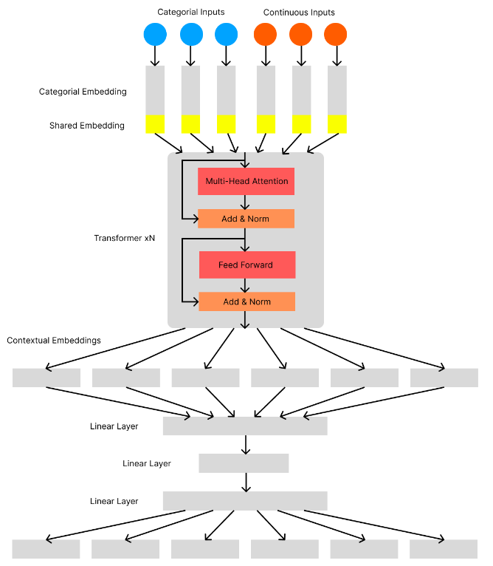

Slide 18
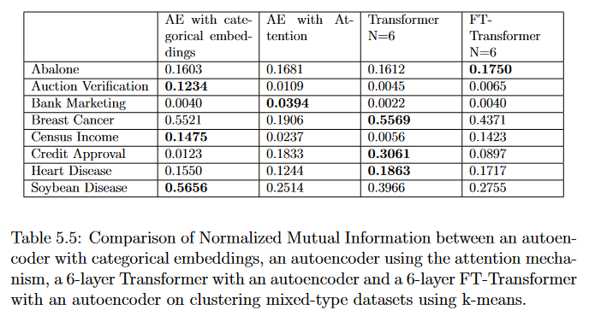
Comparison

Slide 19
Deep Clustering
Combine feature representation learning and clustering instead of a two-step process
Custom loss function
DEC, IDEC and DCN are baseline methods

Slide 20
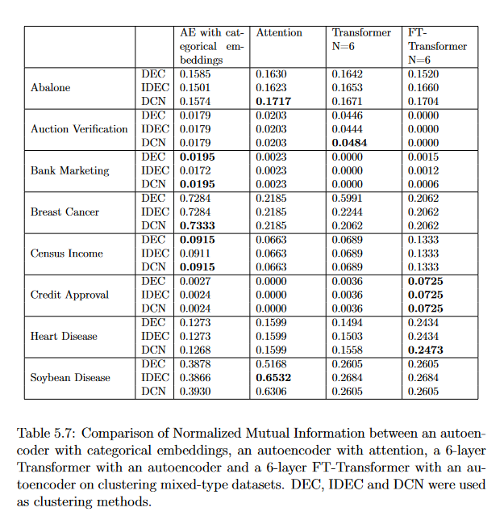

Slide 21
Conclusion
Successful demonstration of Attention- and Transformer-based clustering modules
Attention/Transformer-based networks can improve performance on some datasets
Additional computational resources needed
Clustering mixed-type data remains challenging

Slide 22
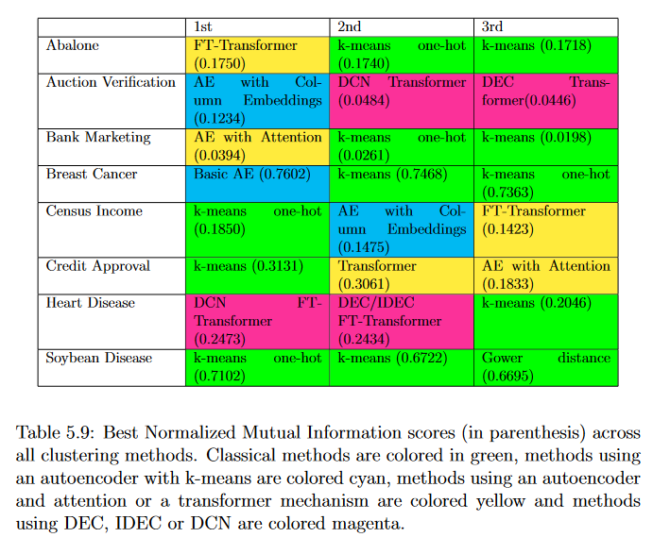

Slide 23
Outlook
Conduct more tests (with more computing power)
Method could be explored that estimate if attention would benefit clustering

