Slide 1
Electronic Plasma Brake (EPB) / Aalto-1 Satellite
Technical note:
Printed Circuit Board specification for the High Voltage board and reel Motor Control boards.
Prepared by Jouni Polkko 29.5.2013 / FMI
Applicable documents:
“Technical Drawing and Pinout for External Connectors for EPB HVM PCB, 22.4.2013”, no doc number
”Experiment Interface Document”, doc number A1-SYS-EID-01-v6
This technical note shall be used together with the documents above.

Slide 2
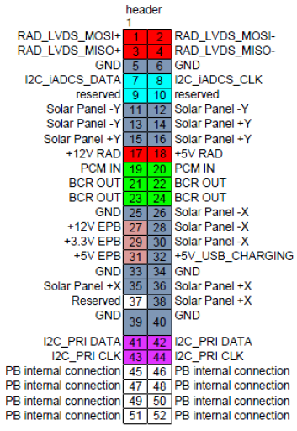
Stack connector pins for the ”short stack”
Connector: GMSM2-35S-CBR-SU1
(EPB is located inside ”short stack”)
EPB = Electronic Plasma Brake (our experiment.
Voltages +12V, +3.3V and +5V available for the EPB.
PB internal connection:
Plasma Brake (EPB) intenal connections. These pins are reserved for High Voltage board and Motor control board interconnections. Pins are low voltage only. The high voltage (+1000V / -500V) will be connected directly by a jumper wire or rod from board to board.

Slide 3
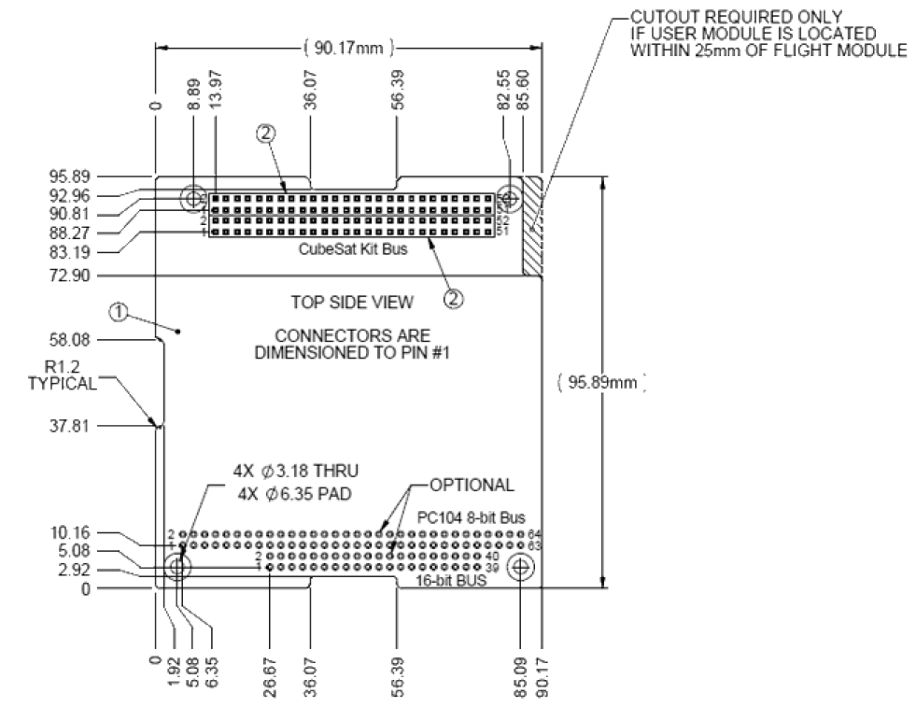
Only this two pin row stack connector (GMSM2-35S-CBR-SU1)
No this cutout
No this cutout
No this cutout
No ”PC104 8/16-bit Bus” pads
No this cutout

Slide 4
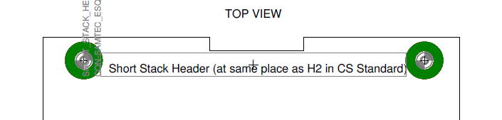
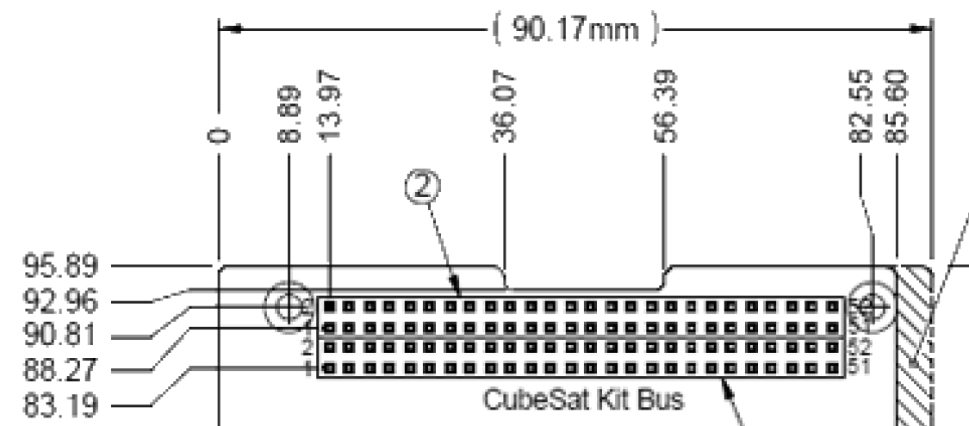
Same as on the previous page but more accurately:

