Slide 1



Actuators and kinematics
IAS0220: Robotics guidance and software

Slide 2
Kinematics
Robotic mechanisms are systems of rigid bodies connected by joints
Kinematics - the motion of bodies in a robotic mechanism without regard to the forces/torques that cause the motion.
Since robotic mechanisms are by their very essence designed for motion, kinematics is the most fundamental aspect of robot design, analysis, control, and simulation.
The position and orientation of a rigid body in space are collectively termed the pose.

Slide 3
Robot kinematics describes the pose, velocity,
acceleration, and all higher-order derivatives of the
pose of the bodies that comprise a mechanism.

Slide 4
Kinematics: terminology
We will make frequent use of coordinate reference frames or simply frames.
A coordinate reference frame i consists of an origin – denoted O_{i} – and a triad of mutually orthogonal basis vectors – denoted (x_{i} y_{i} z_{i}) – that are all fixed within a particular body.
The pose of a body is always expressed relative to some other body, so it can be expressed as the pose of one coordinate frame relative to another.
Similarly, rigid-body displacements can be expressed as displacements between two coordinate frames, one of which may be referred to as moving, while the other may be referred to as fixed

Slide 5
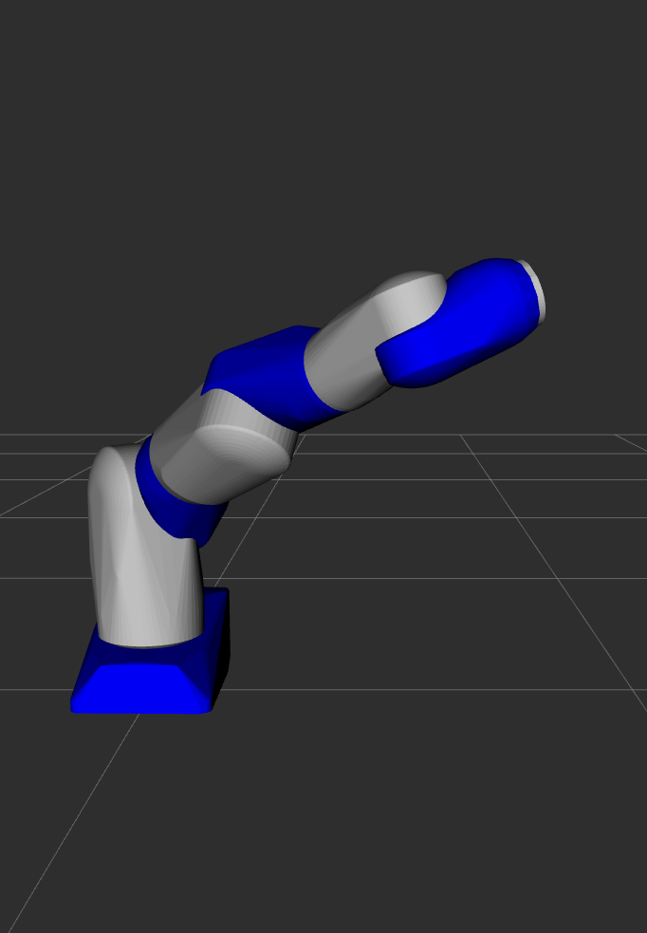
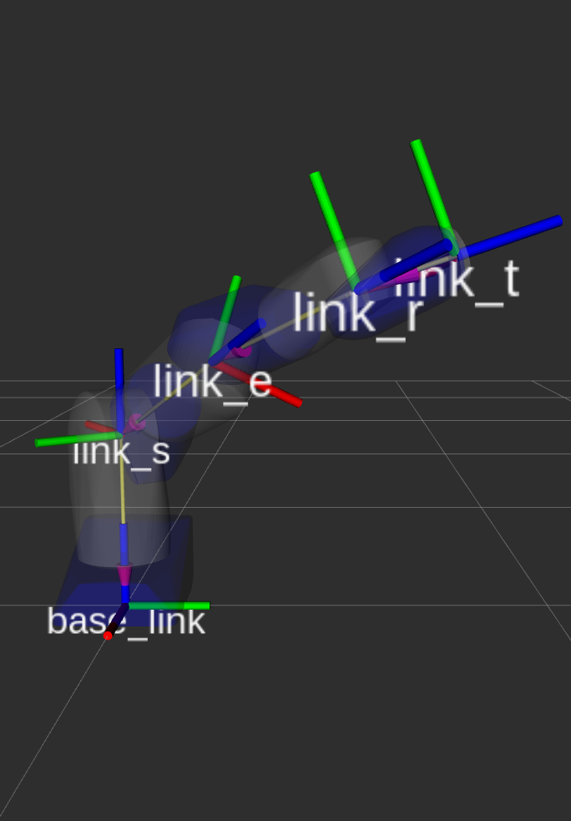
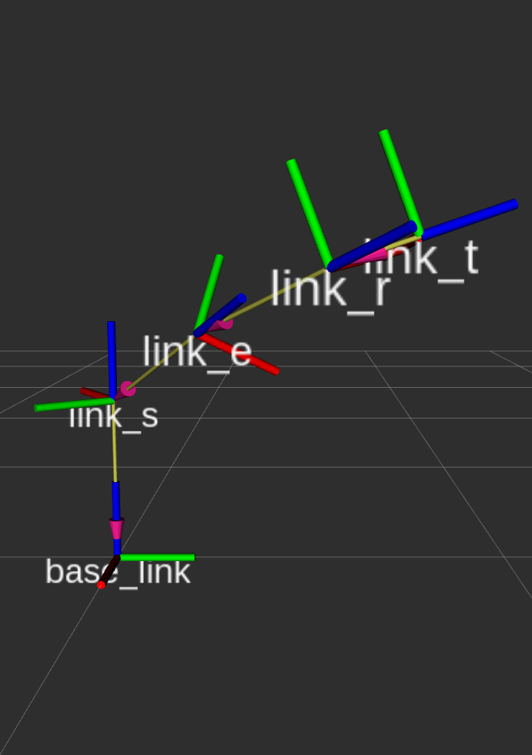
Robot manipulator as a series of frames
Notes:
So in short: a serial manipulaator robot is a chain on frames

Slide 6
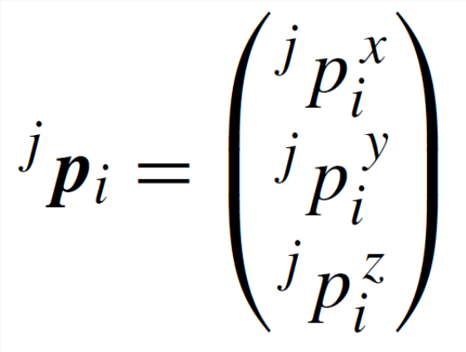
POSITION AND DISPLACEMENT (xyz)
The position of the origin of coordinate frame i relative to coordinate frame j can be denoted by the 3×1 vector
O_{i}
A translation is a displacement in which no point in the rigid body remains in its initial position and all straight lines in the rigid body remain parallel to their initial orientations.
Any representation of position can be used to create a representation of displacement, and vice versa.
O_{j}

Slide 7
ROTATION AND ORIENTATION
A rotation is a displacement in which at least one point of the rigid body remains in its initial position and not all lines in the body remain parallel to their initial orientations.
As in the case of position and translation, any representation of orientation can be used to create a representation of rotation, and vice versa.

Slide 8
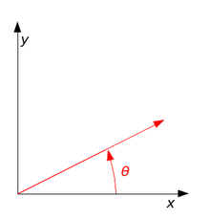


Rotation matrix: REPRESENTING ROTATION AND ORIENTATION (RPY)
Euler angles – rotations relative to moving frame (order matters!)
Fixed angles, e.g., roll-pitch-yaw (RPY) – rotations relative to fixed frame (order matters!)
Angle-axis – single angle θ about one vector w, denoted as θw or (θw_{x} θw_{y} θw_{z})
Quaternions

Slide 9
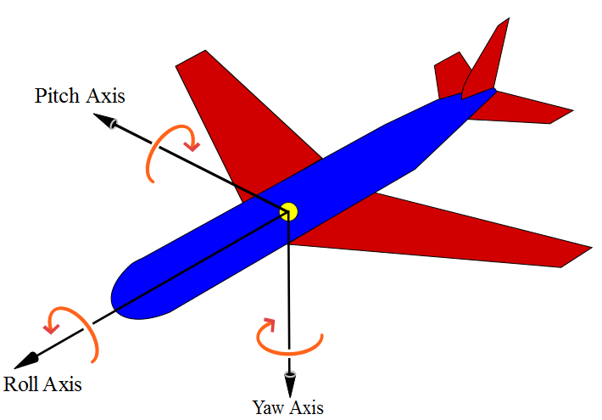
Rotations/orientations in ROS:
RPY (roll-pitch-yaw)
ROS uses quaternions [but RPY is also OK, as long as you know what you are doing☺]
RPY (roll-pitch-yaw)
  Fairly intuitive
  Originates from aerospace
    PITCH – nose up/down
    YAW – nose left/right
    ROLL – rotation about the axis
    from nose to tail
  Axes move with the aircraft,
  relative to Earth

Slide 10
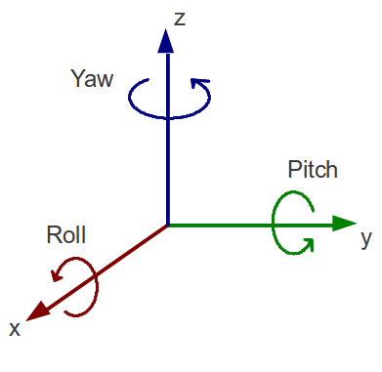
Color coding (RGB – XYZ –RPY)
Red – x – roll
Green – y – pitch
Blue – z - yaw

Slide 11
Rotations/orientations in ROS:
quaternions
Quaternions are widely used in computer graphics (e.g., computer games)
The general form to express quaternions is:
Expression: yields a way of representing orientations and rotations with 4 numbers (x, y, z, w)

Slide 12
Quaternions: points to remember
Quaternions represent orientation in 3D
Quaternions can rotate in 3D
Quaternions can be multiplied
Rotations in sequence can be multiplied in proper order to get one single rotation
Remember to always work with normalized quaternions

Slide 13
Quaternions: hands-on
It is good to understand the general principles of quaternions but there are many C++ libraries that handle common quaternion operations for you
There are many online resources explaining quaternions. E.g., http://www.euclideanspace.com/maths/algebra/realNormedAlgebra/quaternions/index.htm
ROS has a tf library to keep track of coordinate frames:
https://docs.ros.org/en/humble/Tutorials/Intermediate/Tf2/Tf2-Main.html
Quaternion visualisation https://quaternions.online/

Slide 14
geometry_msgs/Pose
The position and orientation of a rigid body in space are collectively termed the pose.
ROS has a geometry_msgs/Pose message type that consists of
  geometry_msgs/Point position
    float64 x
    float64 y
    float64 z
  geometry_msgs/Quaternion orientation
    float64 x
    float64 y
    float64 z
    float64 w

Slide 15
geometry_msgs/PoseStamped
std_msgs/Header header
  uint32 seq
  time stamp
  string frame_id
geometry_msgs/Pose pose
  geometry_msgs/Point position
    …
  geometry_msgs/Quaternion orientation
    …
Notes:
This also a good example how ROS re-uses its own message type and how you can create your own message types based on existing messages.

Slide 16
TF2 ROS2 Lybrary examples (python)
Looking up transforms
Broadcasting transforms
from tf2_ros.transform_listener import TransformListener
from tf2_ros import TransformBroadcaster
Create TransformListener object
self.tf_listener = TransformListener(self.tf_buffer, self)
the listener starts receiving tf2 transformations and buffers them (up to 10 seconds)
Query the listener
t = self.tf_buffer.lookup_transform(
to_frame_rel,
from_frame_rel,
rclpy.time.Time())
query the specific transformation via argument
  Target frame
  Source frame
  Time (at which we want transform, rclpy.time.Time(), gives latest transform)
Create a TransformStamped object and give it the appropriate metadata.
  Timestamp
  Parent frame
  Child node
  Set coordinate information.
  t.transform.translation.x = x
  t.transform.translation.y = y
  t.transform.translation.z = z
  t.transform.rotation.x = q0
  t.transform.rotation.y = q1
  t.transform.rotation.z = q2
t.transform.rotation.w = q3
Send transform
self.tf_broadcaster.sendTransform(t)
More information about tf2: https://docs.ros.org/en/humble/Tutorials/Intermediate/Tf2/Tf2-Main.html

Slide 17
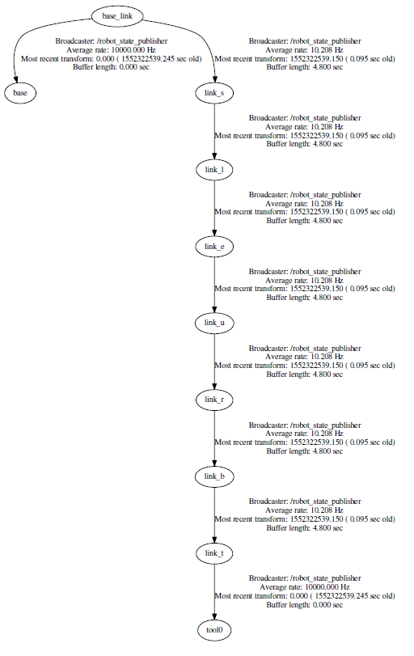
tf tree
Notes:
In ROS, a tf tree is maintained on the background. It knows all the latest transforms between all the frames in your ROS system.

Slide 18
Kinematics of wheeled robots

Slide 19
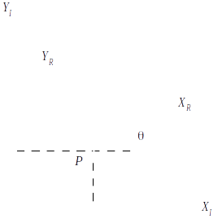
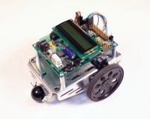
Wheeled robots
Wheeled mobile robots move on the plane.
"Motion planning involves dividing a desired movement task into smaller motions that meet movement constraints and may enhance certain aspects of the motion."
To control the mobile robot motion, positions of the wheels and orientation of the body with respect to the reference frame are needed
Notes:
Motion planning is the process of breaking down a desired movement task into discrete motions that satisfy movement constraints and possibly optimize some aspect of the movement.
Motion planning involves many tasks.
For example
1. Perception (through sensors to understand the obstacles, the terrain, and other relevant information in the environment)
2. Path planning. Needs to plan a path from its current position to desired
3. Trajectory generation. The robot needs to generate a trajectory, which includes not only wheel positions and body orientation but also the velocities and accelerations necessary to follow the planned path accurately.
4. Control robot's control system is responsible for executing the generated trajectory by adjusting the wheel speeds, steering angles, and body orientation to follow the planned path while dealing with uncertainties and disturbances.

Slide 20
Kinematics model of a wheeled robot
Goal: establish the robot speed
as a function of the wheel speeds , steering angles , steering speeds and the geometric parameters of the robot (configuration coordinates).

Slide 21
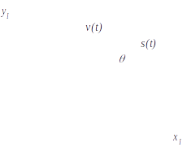
Forward kinematics
Forward kinematics is computation of the position and orientation of the robot as a function of its joint angles or wheel steering angles.

Slide 22
Inverse kinematics
Inverse kinematics is the process of determining the speeds and steering angles in order to achieve a desired pose. Inverse kinematics is a type of motion planning.

Slide 23
Inertial frame
Robot frame
Robot position
Mapping between the frames

Slide 24
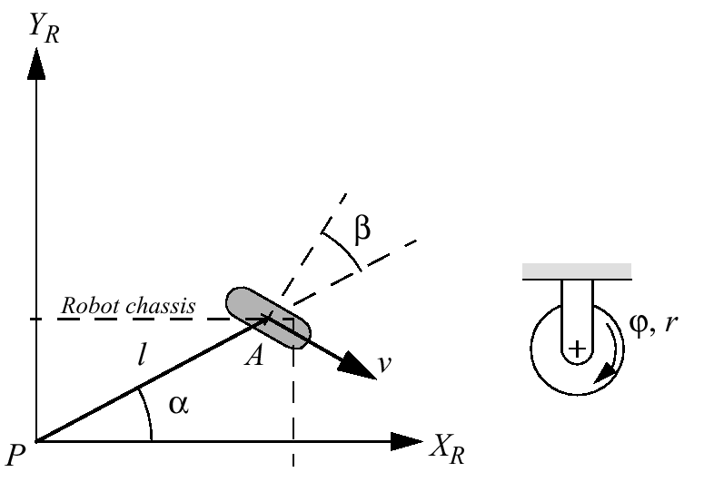
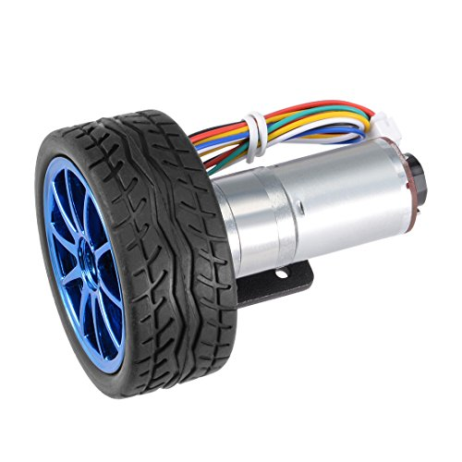
Types of wheels
Standard wheel

Slide 25
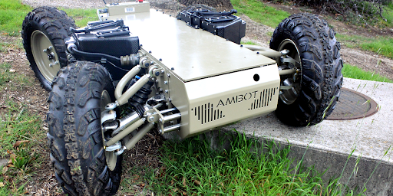
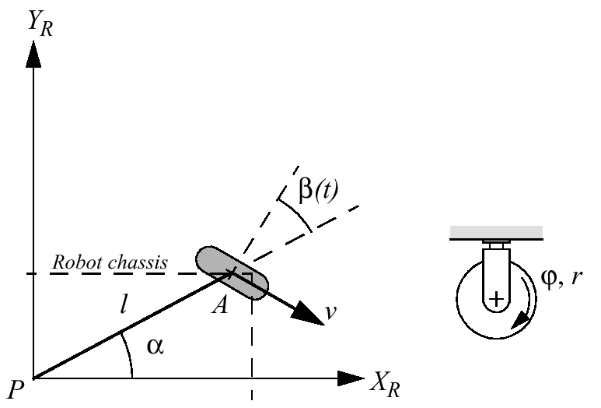
Types of wheels
Steered standard wheel

Slide 26
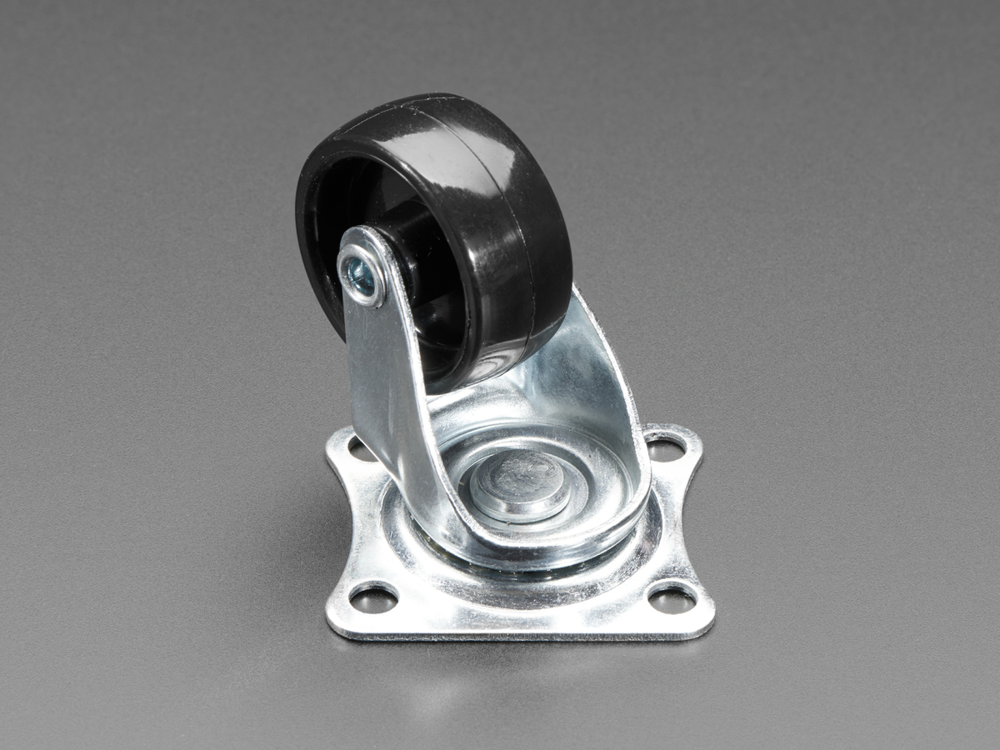
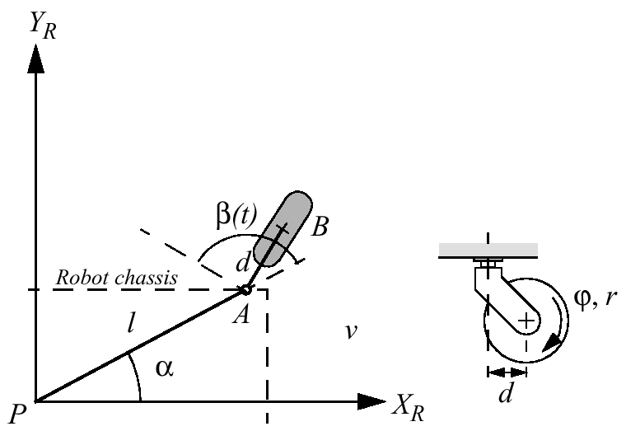
Types of wheels
Castor Wheel

Slide 27
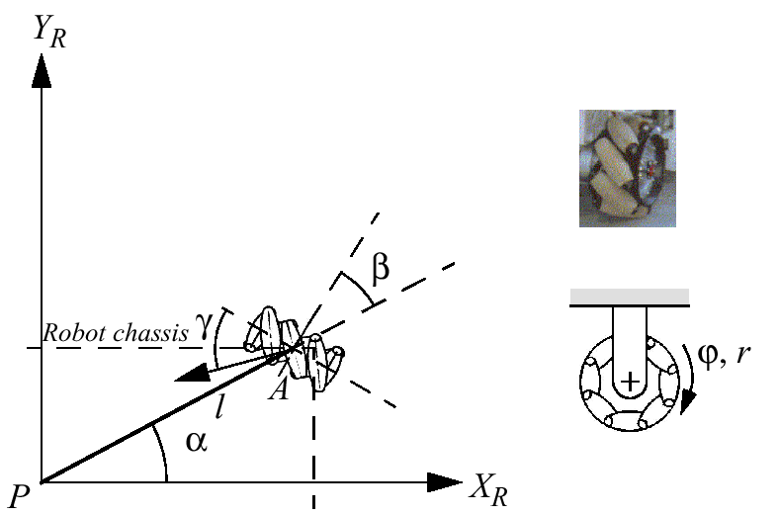
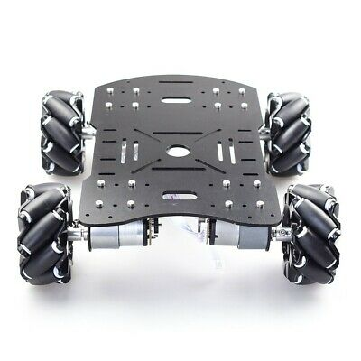
Types of wheels
Swedish wheel

Slide 28
Mobile robot configurations

Slide 29
Simple differential drive robot

Slide 30
Swedish wheel robot configuration

Slide 31
Joint kinematics

Slide 32
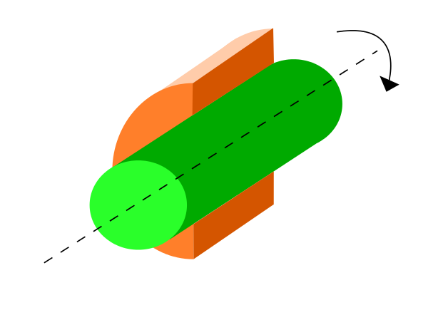
Lower-pair joints
Revolute (R), a.k.a the hinge or pin joint
The position of one body relative to the other may be expressed as the angle between two lines normal to the joint axis, one fixed in each body.
Thus, the joint has one degree of freedom (DOF).

Slide 33
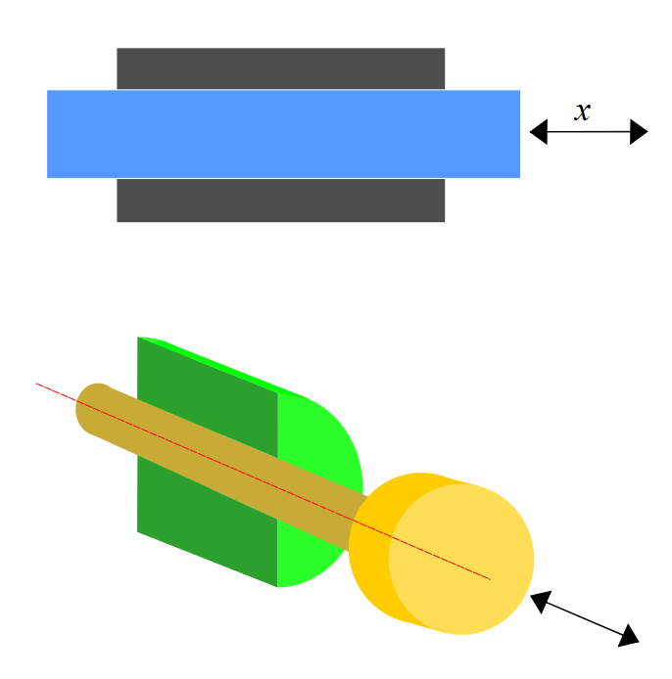
Lower-pair joints
Prismatic (P), a.k.a the sliding joint
The position of one body relative to the other is determined by the distance between two points on a line parallel to the direction of sliding, with one point fixed in each body.
Thus, this joint also has one degree of freedom.

Slide 34
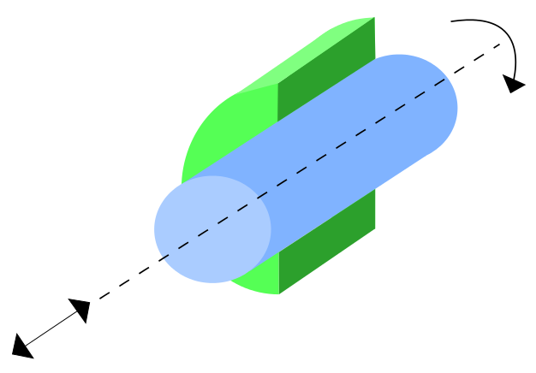
Lower-pair joints
Cylindrical (C)
It permits both rotation about the cylinder axis and sliding parallel to it. Therefore, it is a joint with two degrees of freedom.
The cylindrical joint can be replaced by a revolute in series with a prismatic joint whose direction of sliding is parallel to the revolute joint.

Slide 35
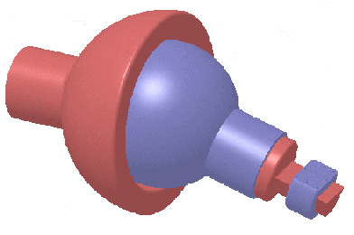
Lower-pair joints
Spherical (S)
A spherical joint permits rotation about any line through the center of the sphere. Thus, it permits independent rotation about axes in up to three different directions and has three degrees of freedom.
A spherical joint is easily replaced by a kinematically equivalent compound joint consisting of three revolutes that have concurrent axes.

Slide 36
Representation of robot
JOINTS
LINKS
a.k.a. rigid bodies
LINKS + JOINTS = KINEMATIC CHAIN
BASE
Notes:
Joints + Links = Kinematic chain

Slide 37
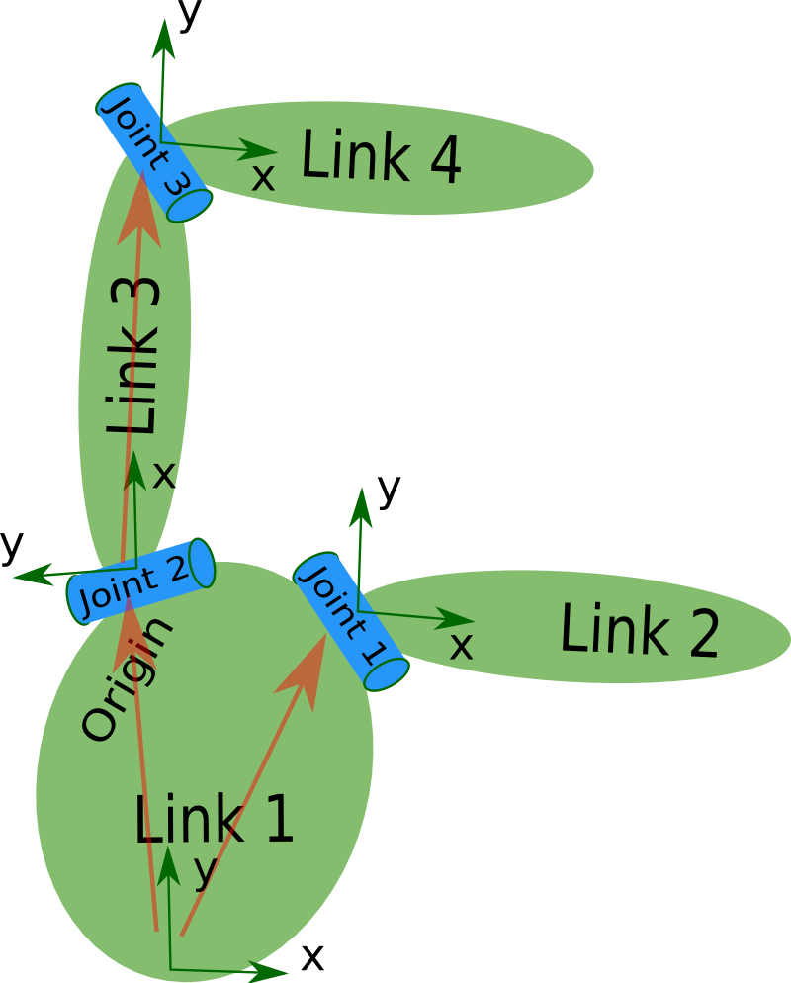
ROS uses URDF
Unified Robot Description Format (URDF) is
an XML specification to describe a robot
The specification covers:
Kinematic and dynamic description of the robot
Visual representation of the robot
Collision model of the robot

Slide 38
URDF basics
The description of a robot consists of a set of link elements, and a set of joint elements connecting the links together.
A typical robot description looks something like this:
<robot name=„my_robot">
<link> ... </link>
<link> ... </link>
<link> ... </link>
<joint> .... </joint>
<joint> .... </joint>
<joint> .... </joint>
</robot>

Slide 39
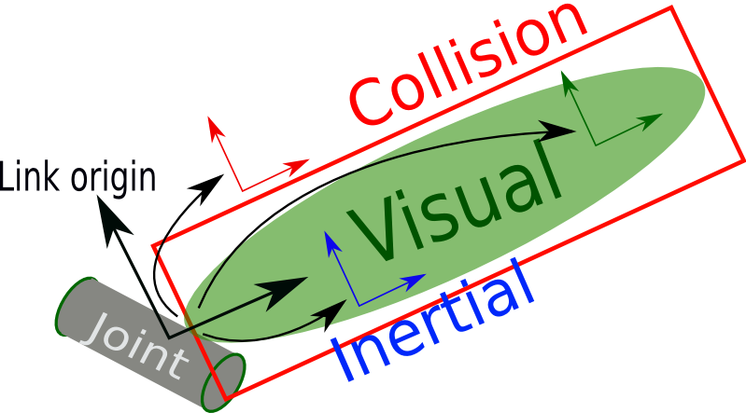
Example of link element
<link name="my_link">
<visual>
<origin xyz="0 0 0" rpy="0 0 0" />
<geometry>
<box size="1 1 1" />
</geometry>
<material name="Cyan">
<color rgba="0 1.0 1.0 1.0"/>
</material>
</visual>
<collision>
<origin xyz="0 0 0" rpy="0 0 0"/>
<geometry>
<cylinder radius="1" length="0.5"/>
</geometry>
</collision>
<inertial>
<origin xyz="0 0 0.5" rpy="0 0 0"/>
<mass value="1"/>
<inertia ixx="100" ixy="0" ixz="0" iyy="100" iyz="0" izz="100" />
</inertial>
</link>

Slide 40
<link> element
The link element describes a rigid body with an inertia, visual features, and collision space

Slide 41
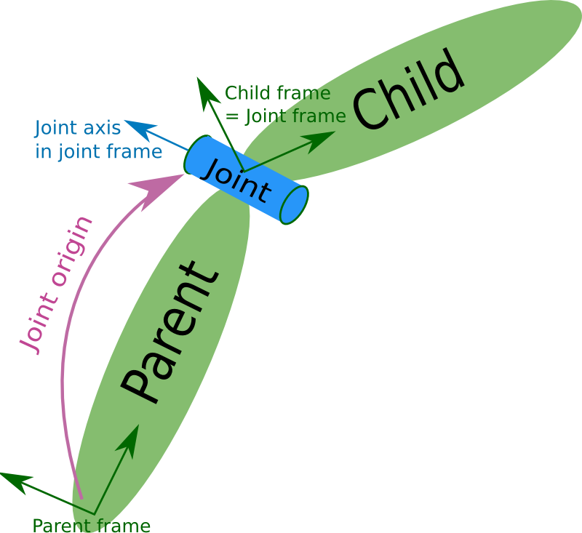
<joint> element
The joint element describes the kinematics and dynamics of the joint and also specifies the safety limits of the joint.

Slide 42
Example of simple joint element
<joint name="my_joint" type="floating">
<origin xyz="0 0 1" rpy="0 0 3.1416"/>
<parent link="link1"/>
<child link="link2"/>
</joint>
A good URDF visualisation tool https://mymodelrobot.appspot.com/5629499534213120

Slide 43
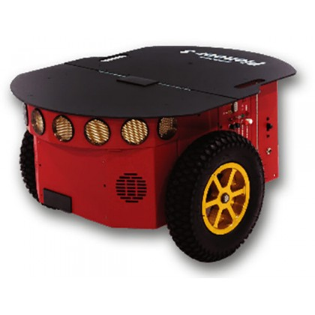
Simple wheeled robot

Slide 44
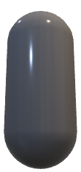
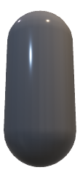
Simple wheeled robot URDF
Baselink
Origin
(Parent)
Joint
Joint
Wheel (child)
Wheel
(child)

Slide 45

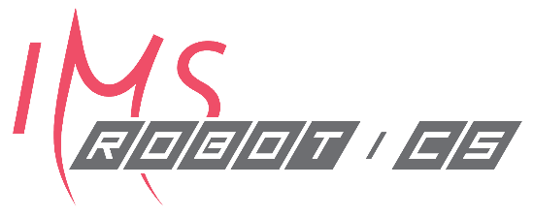
Sellel kursusel on osaliselt kasutatud karl kruusamäe loENgumaterjale

