Slide 1


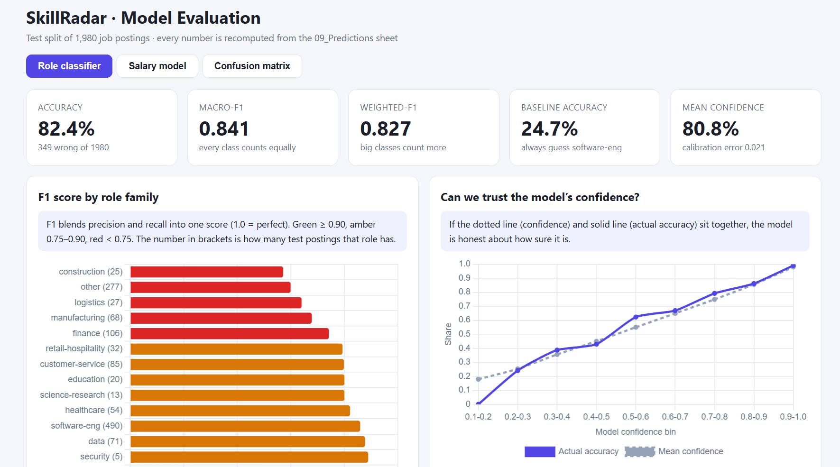
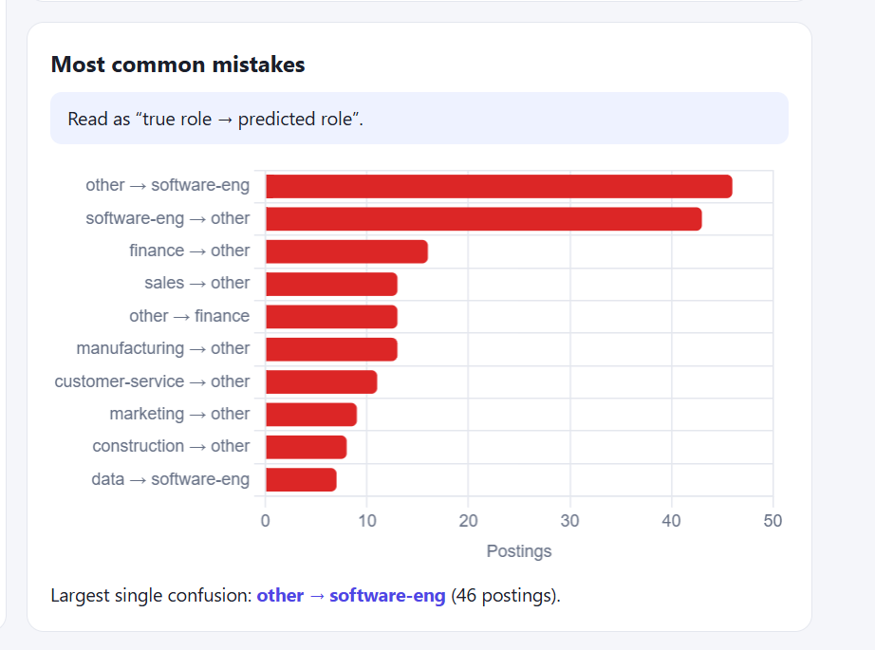
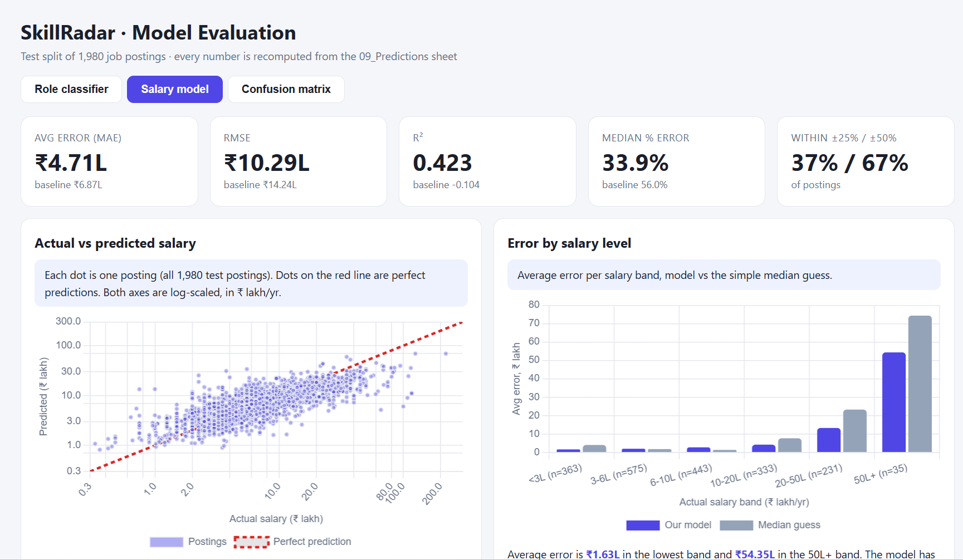
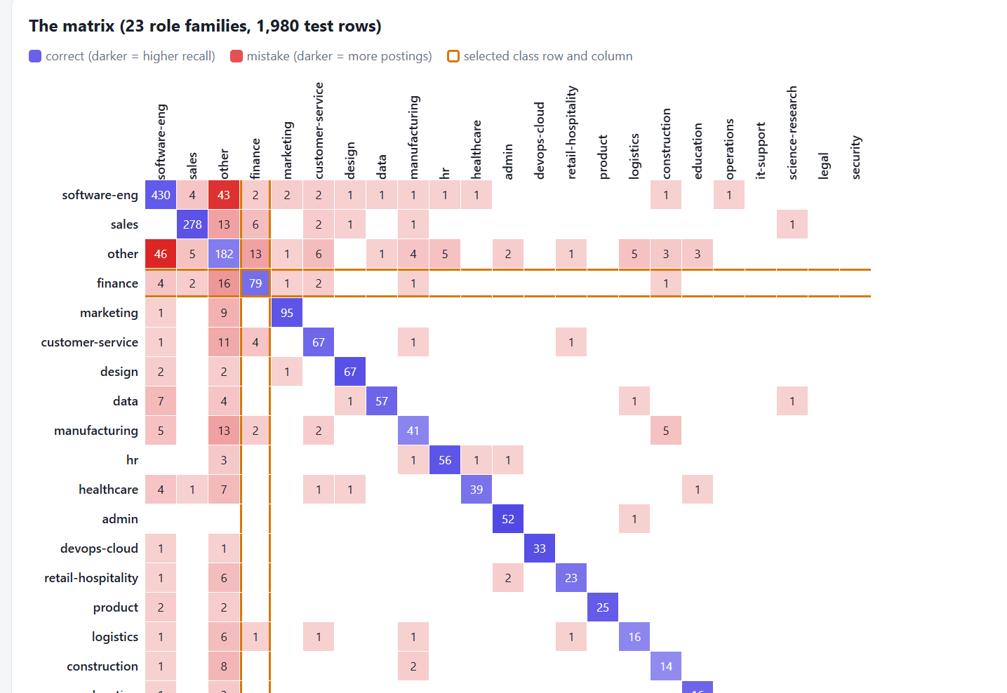
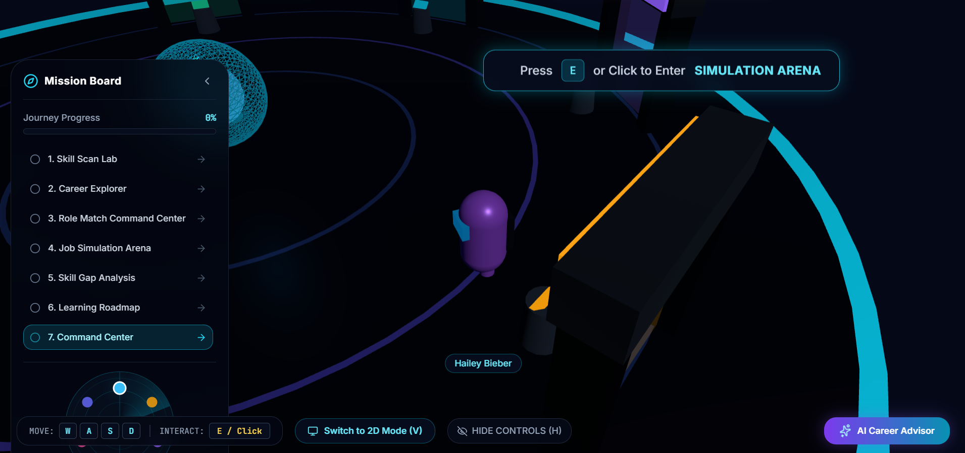
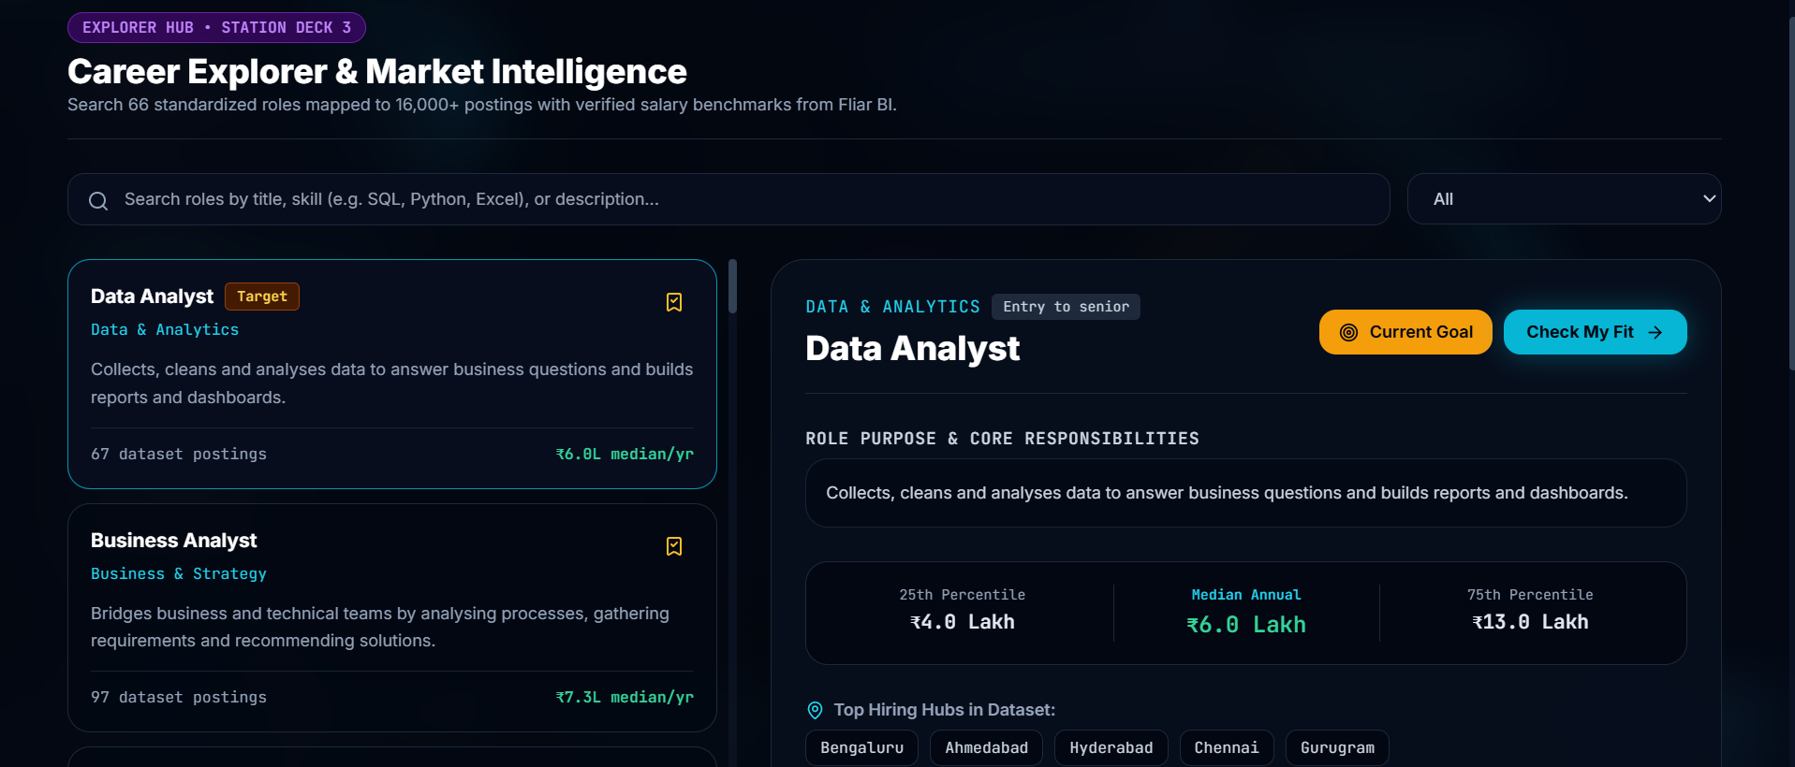
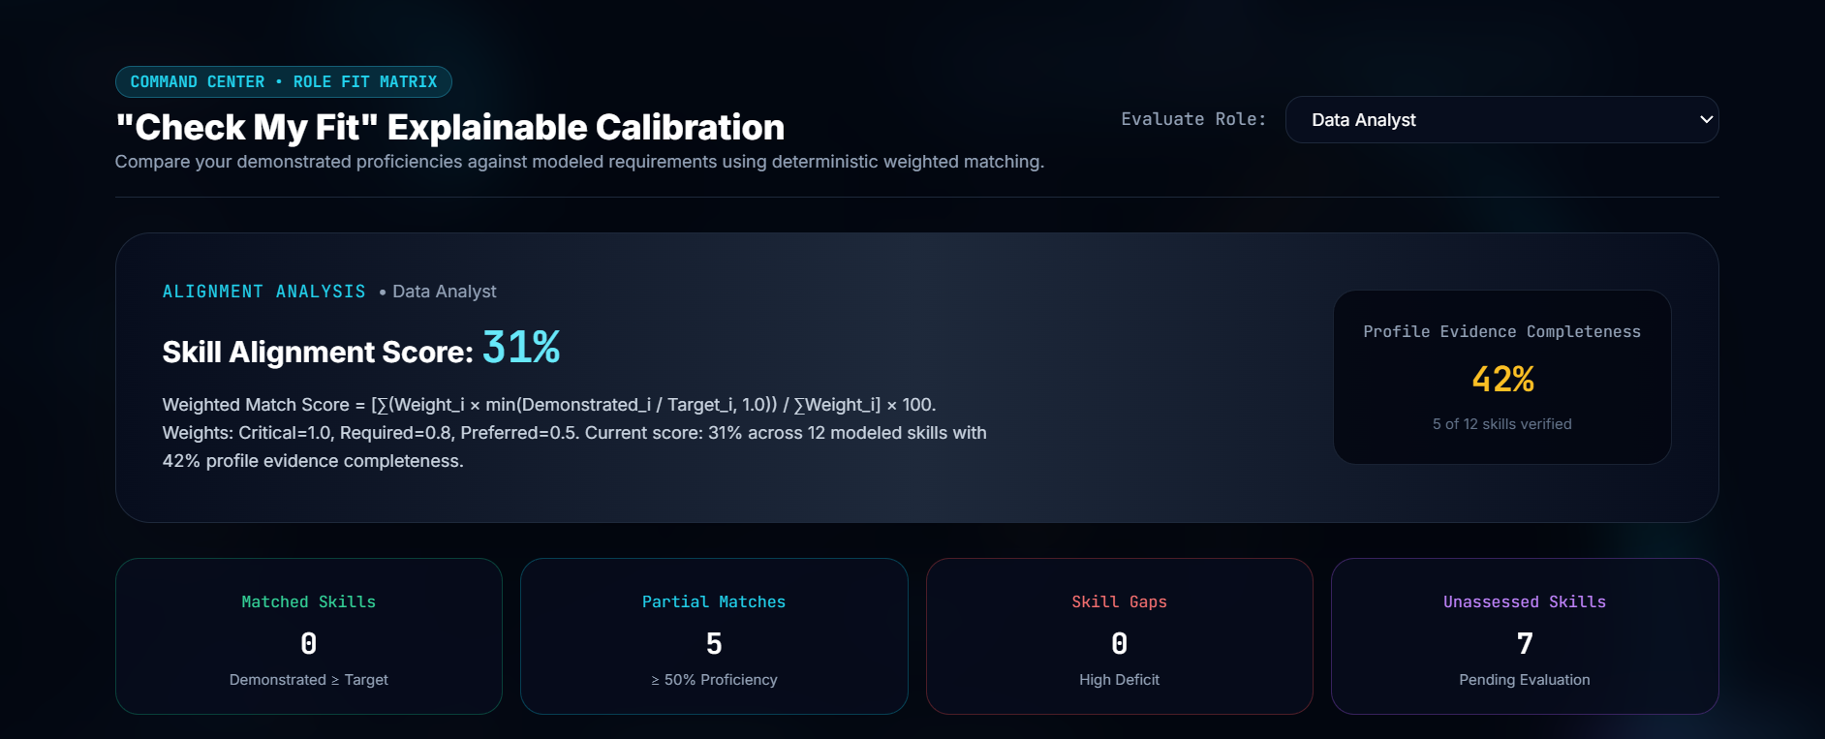
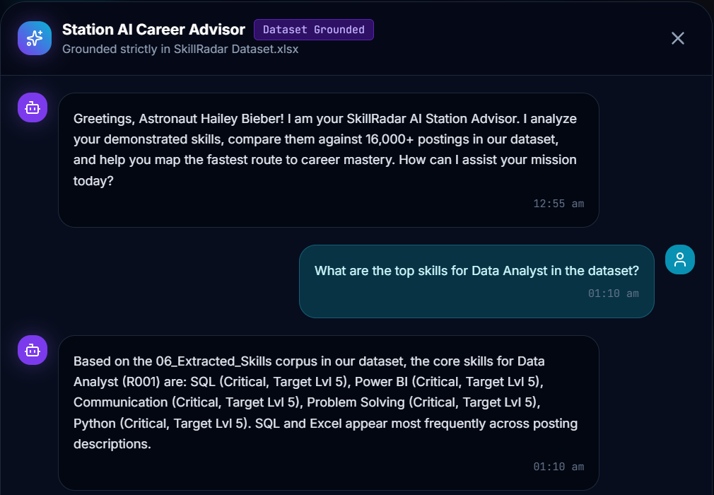
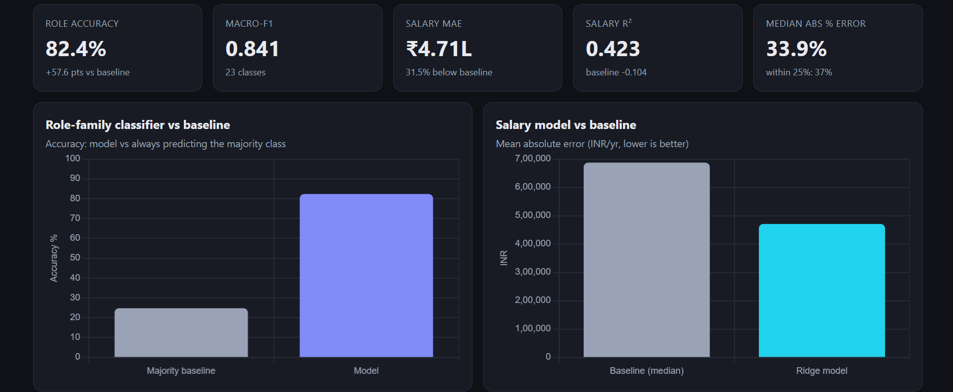
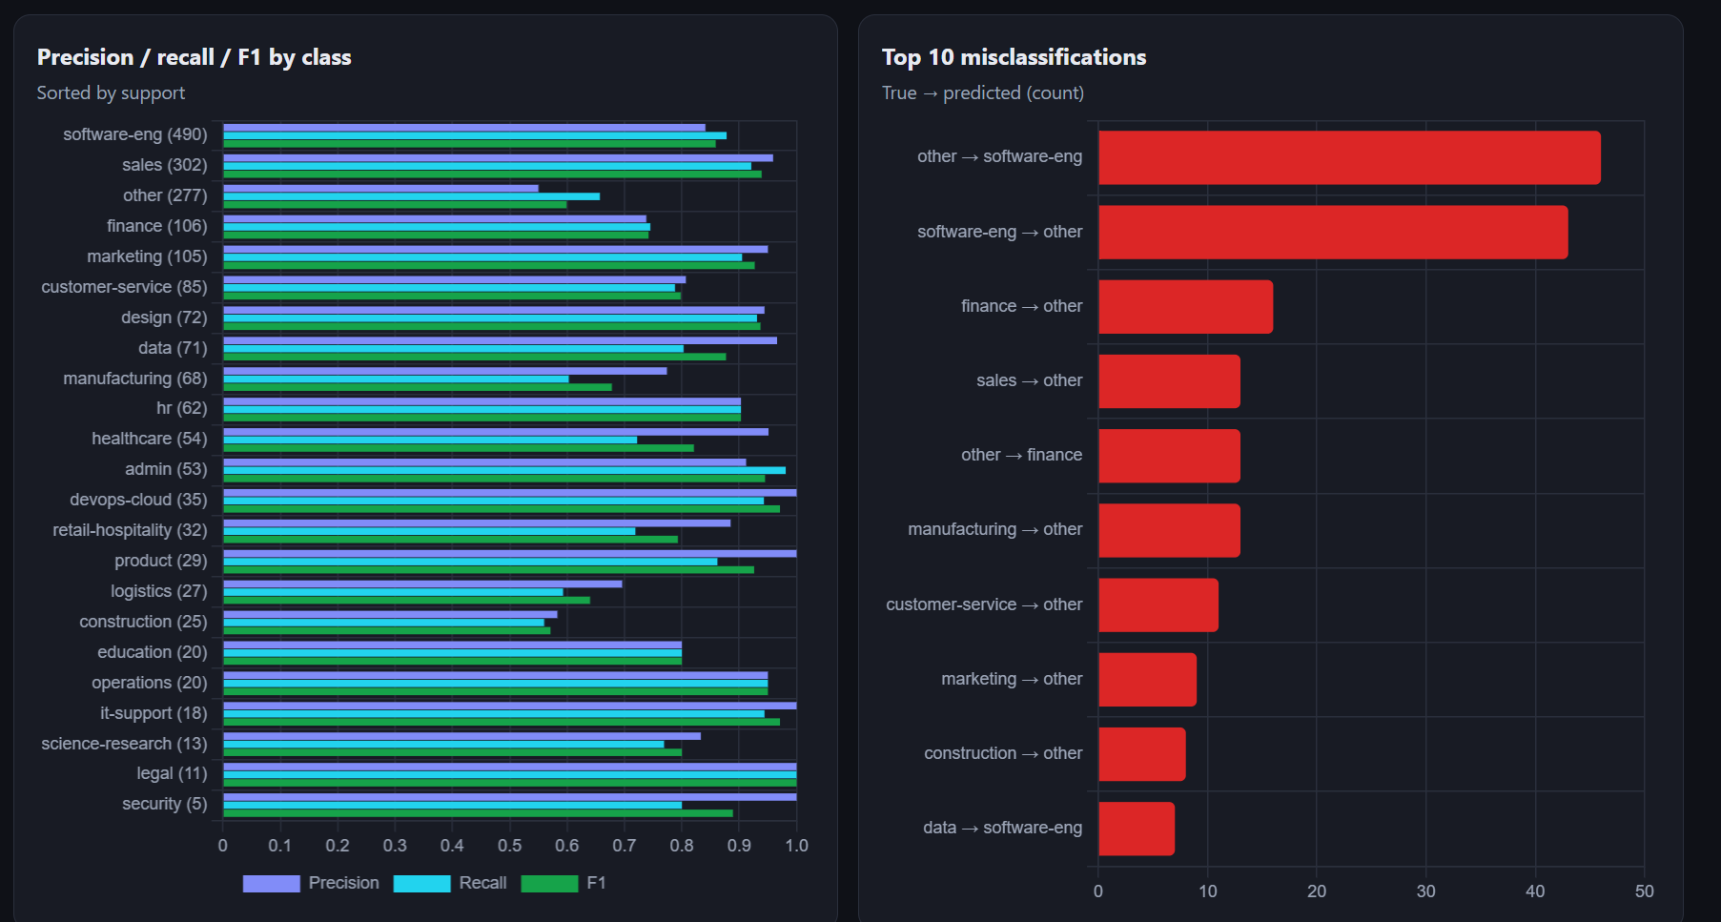
Symbiosis Artificial Intelligence Institute
PROJECT TITLE: SkillRadar: A Gamified 3D Career Exploration and Skill Development Platform for College Students
INTRODUCTION
Most college students choose a career without knowing what employers ask for, how their skills measure up, or what to study next.
Job portals only list vacancies, quizzes only give marks and course sites only offer courses – none shows the distance to a role.
SkillRadar joins market data, skill testing, role matching, job simulations and a weekly roadmap in one gamified web platform: a walkable 3D spaceship hub with a 2D console fallback.
Everything rests on an audited workbook of 16,001 cleaned job postings, 66 roles and 136 skills.
Scores show alignment with dataset requirements; they are not a promise of getting a job.
METHODOLOGY
DATASET
Source: one audited workbook, Dataset.xlsx (15 sheets, 8.8 MB, tabular + job-description text).
Size: 16,459 raw rows → 16,001 clean postings; 66 roles; 136 skills; 12,324 posting–skill links; 992 human-checked gold labels.
Origin: Fliar BI salaries (CC BY-NC 4.0), LinkedIn tech sample, Headcount Labs – hence educational use only.
Limit: only 2,057 postings have descriptions for text analysis.
Project framework
Dataset.xlsx
16,001 clean postings
Cleaning & standardising
roles · skills · INR · cities
Browser web app
static files, no server
Skill Scan Lab
Career Explorer
Role Match Center
Job Simulation Arena
Skill Gap Analysis
Learning Roadmap
Command Center
AI Career Advisor
Role-fit score +
evidence completeness
Weekly learning
roadmap
XP, badges &
progress
RESULTS AND DISCUSSION:
Feature table → role-family classifier (23 classes) + salary model (Ridge)
evaluated on a held-out test split of 1,980 rows against baselines
Algorithms used
Evidence model: every skill is saved at level 1–5 as Quiz-, Simulation- or Self-reported evidence.
Weighted role alignment (deterministic) with a profile-evidence-completeness warning below 40%.
Rule-based rubric grading of job simulations; roadmap built from skill deficits and weekly hours.
ML models: role-family classifier and Ridge salary regression, compared with majority and median baselines.
CODE, DEPLOYMENT & MARKET
Open source: github.com/jaanvi131313-collab/SkillRadar
Live: deployed on Vercel, with a built-in dataset-grounded AI Career Advisor.
Market (illustrative): TAM ₹649.5 cr → SAM ₹128.6 cr → SOM ₹1.29 cr (₹150 per student per year assumed; AISHE 2021-22 data).
Role classifier (23 classes, 1,980 test rows): 82.4% accuracy vs 24.7% baseline, macro-F1 0.841; F1 by family and confidence check
Top 10 misclassifications (true → predicted): largest is other → software-eng (46 postings)
Equation
Score = [ Σ Wᵢ × min(Dᵢ / Tᵢ, 1.0) / Σ Wᵢ ] × 100
W = weight (Critical 1.0, Required 0.8, Preferred 0.5); D = demonstrated level; T = target level.
PROBLEM STATEMENT AND OBJECTIVES:
Problem: students lack one trustworthy place to (a) explore roles backed by market data, (b) measure skills with verified evidence, (c) see how far they are from a target role and (d) get a plan to close the gap.
Objectives
Explore roles, salaries and hiring cities from a real, audited dataset.
Assess skills via scenario quizzes and job simulations, tagging each skill with its evidence type.
Compute a transparent role-fit score with an evidence-completeness percentage.
Generate a weekly roadmap from skill gaps and the hours a student has.
Deliver it as a 3D hub with 2D fallback that deploys easily on open platforms.
Application modules (live web app)
Salary model: MAE ₹4.71L vs ₹6.87L baseline, R² 0.423, median error 33.9% vs 56.0%; actual vs predicted and error by band
23 × 23 confusion matrix: 1,631 of 1,980 postings on the diagonal (82.4%)
What the evaluation graphs show
Classifier: 82.4% accuracy is 3.3× the always-guess baseline (24.7%) and it is well calibrated (mean confidence 80.8%, error 0.021).
By family: best recall for legal (100%), admin (98%) and operations (95%); weakest for construction (56%), logistics (59%) and manufacturing (60%).
Errors: mostly involve the mixed “other” class (other ↔ software-eng: 46 + 43 postings).
Salary model: beats the median guess on every measure but is a rough estimate; it under-predicts very high salaries (₹50L+ band error ₹54.35L).
3D Hub: walkable station deck
Career Explorer: salaries & hiring hubs
“Check My Fit”: explainable score, 31% / 42% completeness
CONCLUSIONS:
SkillRadar turns job-market data, verified skill evidence and an explainable score into a weekly plan. Demo profile: 31% Data Analyst fit at 42% evidence completeness; the role classifier reaches 82.4% accuracy, +57.7 pts over the 24.7% baseline.
Dataset-grounded AI Advisor
GROUP MEMBERS: Jaanvi Rai (PRN: 25030422052) | Aina Jain (PRN: 25030422012) | Sannidhi Mutyala (PRN: 25030422075)
PROJECT MENTOR NAME:
Dr. Bela Joglekar

