Slide 1
Patterns

Slide 2
Working on the project
We have a project description
We have begun to build scenarios, use cases, CRC cards and a bit of UML.
For the most part the user interface is ‘empty’.
For the most part the implementation issues are empty.
The focus should be on the model. This should also be the most familiar part of the project. What are the data needed to satisfy a use case and what are the behaviors?

Slide 3
Patterns and GUI
In chapter five the author intertwines the idea of patterns with the development of a user interface.
The author also provides some insight into the programming designs and patterns as they relate to the Application Programming Interface. (API)
Remember the materials from the previous chapters, especially programming by contract.
Looking at two users: the ‘end’ user and the software developer.

Slide 4
Patterns
Each pattern has
a short name
a brief description of the context
a lengthy description of the problem
a prescription for the solution
See: https://sourcemaking.com/ and also http://www.fluffycat.com/Java-Design-Patterns/ http://hillside.net/patterns http://www.oodesign.com/ http://www.netobjectives.com/files/books/dpe/design-patterns-matrix.pdf

Slide 5
Iterator pattern
Intent
Provide a way to access the elements of an aggregate object (collection of some sort) sequentially without exposing its underlying representation.
You need not know if the underlying representation is an array, a linked list, a hashset, or something else.
Provide an abstraction that makes it possible to decouple collection classes and algorithms.
Promote to “full object status” the traversal of a collection.
Allow polymorphic traversal
Problem
Need to “abstract” the traversal of many different data structures so that algorithms can be defined that are capable of interfacing with each transparently.

Slide 6
Iterator
Context
An aggregate object contains element objects.
Clients need access to the element objects.
The aggregate object should not expose its internal structure.
Multiple clients may want independent access.
Problem
Provide a way to access the elements of an aggregate object sequentially without exposing its underlying representation.
Allows the developer to modify the collection implementation without making any changes outside of the collection.
Solution
Define an iterator that fetches one element at a time.
Each iterator object keeps track of the position of the next element.
If there are several aggregate/iterator variations, it is best if the aggregate and iterator classes realize common interface types.

Slide 7
Example
“Traditional”
List<String> names = new LinkedList<String>();
// ... add some names to the collection
for (String name : names)
System.out.println(name);
Java 8
List<String> names = new LinkedList<>();
// ... add some names to the collection
names.forEach(name -> System.out.println(name));

Slide 8
MVC
Intent
The intent of this design pattern is to help keep the user interface separate from the rest of the program.
This is an essential pattern for building user interfaces.
Some programs have multiple editable views.
There is a model that can be viewed in different ways and may be altered by different controllers.

Slide 9
MVC – Key Issues
Model: data structure, no visual representation (The model of the domain.)
Views: visual representations (These can be various and allow for different visual presentations as well as partial visual presentations)
Controllers: user interaction (There may be more than one that has the same result.)
Views/controllers update model
Model tells views that data has changed (See observer.)
Views redraw themselves

Slide 10
MVC – Microsoft spec
Context
The purpose of many computer systems is to retrieve data from a data store and display it for the user. After the user changes the data, the system stores the updates in the data store. Because the key flow of information is between the data store and the user interface, you might be inclined to tie these two pieces together to reduce the amount of coding and to improve application performance. However, this seemingly natural approach has some significant problems. One problem is that the user interface tends to change much more frequently than the data storage system. Another problem with coupling the data and user interface pieces is that business applications tend to incorporate business logic that goes far beyond data transmission.
Problem
How do you modularize the user interface functionality of a Web application so that you can easily modify the individual parts?

Slide 11
MVC – Microsoft spec
The Model-View-Controller (MVC) pattern separates the modeling of the domain, the presentation, and the actions based on user input into three separate classes
Model. The model manages the behavior and data of the application domain, responds to requests for information about its state (usually from the view), and responds to instructions to change state (usually from the controller).
View. The view manages the display of information.
Controller. The controller interprets the mouse and keyboard inputs from the user, informing the model and/or the view to change as appropriate.
See: http://msdn.microsoft.com/en-us/library/ff649643.aspx
Or new wave http://www.asp.net/mvc

Slide 12
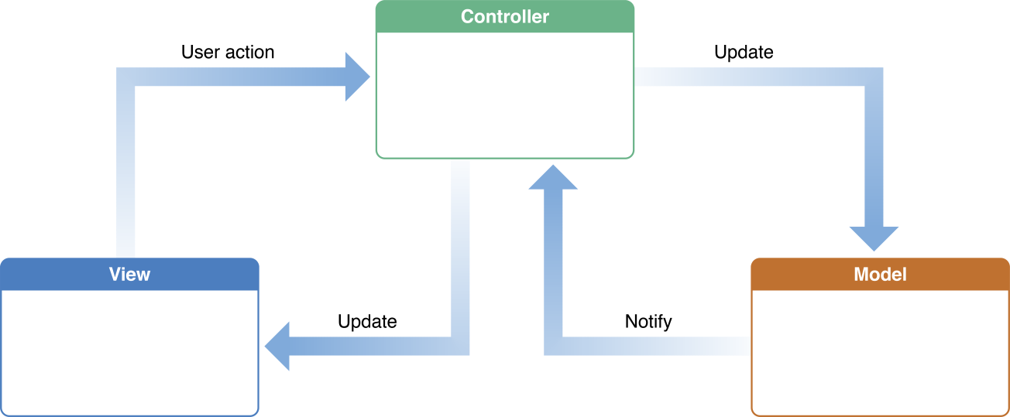
Apple
The Model-View-Controller (MVC) design pattern assigns objects in an application one of three roles: model, view, or controller. The pattern defines not only the roles objects play in the application, it defines the way objects communicate with each other. Each of the three types of objects is separated from the others by abstract boundaries and communicates with objects of the other types across those boundaries. The collection of objects of a certain MVC type in an application is sometimes referred to as a layer—for example, model layer.

Slide 13
Observer pattern
Intent
Define a one-to-many dependency between objects so that when one object changes state, all its dependents are notified and updated automatically.
Encapsulate the core (or common ) components in a subject abstraction, and the variable (or optional or user interface) components in an observer hierarchy.
Often the “View” part of Model-View-Controller.
Problem
A large monolithic design does not scale well as new graphing or monitoring requirements are levied.

Slide 14
Observer – Microsoft spec
Context
In object-oriented programming, objects contain both data and behavior that, together, represent a specific aspect of the business domain. One advantage of using objects to build applications is that all manipulation of the data can be encapsulated inside the object. This makes the object self-contained and increases the potential for reuse of the object in other applications. However, objects cannot simply work in isolation. In all but the most trivial applications, objects must collaborate to accomplish more complex tasks. When objects collaborate, the objects may have to notify each other when an object changes state. For example, the Model-View-Controller pattern prescribes the separation of business data (the model) and the presentation logic (the view). When the model changes, the system must notify the view so that it can refresh the visual presentation and accurately reflect the model's state. In other words, the view is dependent on the model to inform it of changes to the model's internal state.
Problem
How can an object notify other objects of state changes without being dependent on their classes?

Slide 15
Observer – Microsoft spec
Solution
Use the Observer pattern to maintain a list of interested dependents (observers) in a separate object (the subject). Have all individual observers implement a common Observer interface to eliminate direct dependencies between the subject and the dependent objects.
When a state change occurs in the client that is relevant to the dependent objects, a concrete subject invokes a notify method. The subject superclass maintains a list of all interested observers so that the notify method can loop through the list of all observers and invoke an update method on each registered observer. The observers register and unregister for updates by calling the subscribe and unsubscribe methods on the subject .
See: http://msdn.microsoft.com/en-us/library/ff649896.aspx

Slide 16
Example
public interface Subject {
//methods to register and unregister
observers
public void attach(Observer obj);
public void detach(Observer obj);
//method to notify observers of change
public void notify();
}
Concrete subject would typically add subjectState, getState(), and setState().

Slide 17
Example
public interface Observer {
//method to update the observer, used by subject
public void update();
}
Concrete observer would also have an observerState.

Slide 18
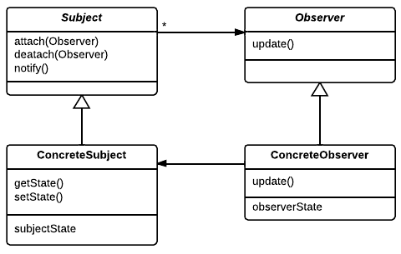
Example
Make concrete subject an observer
Register observer interest in subject
Done!

Slide 19
Strategy Pattern
Intent
Define a family of algorithms, encapsulate each one, and make them interchangeable. Strategy lets the algorithm vary independently from the clients that use it.
Capture the abstraction in an interface, bury implementation details in derived classes.
Problem
One of the dominant strategies of object-oriented design is the “open-closed principle”.

Slide 20
Strategy Pattern
Context
Enables you to use different business rules or algorithms depending on the context in which they occur.
Problem
The selection of an algorithm that needs to be applied depends on the client making the request or the data being acted on. If you just have a rule in place that does not change, you do not need a strategy pattern.
Solution
Separates the selection of algorithm from the implementation of the algorithm. Allows for the selection to be made based upon context.

Slide 21
Strategy Pattern
A class can benefit from different variants for an algorithm
Clients sometimes want to replace standard algorithms with custom versions
So…
Define an interface type that is an abstraction for the algorithm
Actual strategy classes realize this interface type.
Clients can supply strategy objects
Whenever the algorithm needs to be executed, the context class calls the appropriate methods of the strategy object

Slide 22
Example
//Strategy Interface
public interface Strategy {
public void thingToDo(ArrayList<MyType> mt);
}
public class StrategyA implements Strategy {
public void thingToDo(ArrayList<MyType> mt){
// The A approach to thingToDo for MyType
}
}
public class StrategyB implements Strategy {
public void thingToDo(ArrayList<MyType> mt){
// The B approach to thingToDo for MyType}
}

Slide 23
Example
public class TheContext {
private Strategy strategy;
//this can be set at runtime by the application preferences
public void setSpecificStrategy(Strategy strategy) {
this.strategy = strategy;
}
//use the strategy
public void createSomething(ArrayList<MyType> mt) {
strategy.thingToDo(mt);
}
}

Slide 24
Example
public class Client {
public static void main(String[] args) {
TheContext ctx = new TheContext();
//we could assume context is already set by preferences
ctx.setSpecificStrategy(new StrategyA());
//get the list of things of MyType
ctx.createSomething(mt);
}
}

Slide 25
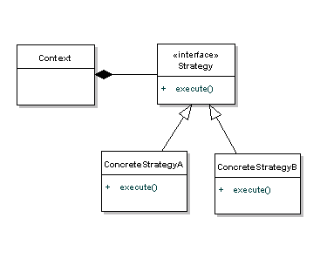
Example
In the diagram Context is composed of a Strategy. The context could be anything that would require changing behaviors - a class that provides a specific functionality. The Strategy is simply implemented as an interface, so that we can swap ConcreteStrategys in and out without effecting the Context.

Slide 26
Composite Pattern
Intent
Compose objects into tree structures to represent whole-part hierarchies. Composite lets clients treat individual objects and compositions of objects uniformly.
Recursive composition
“Directories contain entries, each of which could be a directory.”
1-to-many “has a” up the “is a” hierarchy
Problem
Application needs to manipulate a hierarchical collection of “primitive” and “composite” objects. Processing of a primitive object is handled one way, and processing of a composite object is handled differently. Having to query the “type” of each object before attempting to process it is not desirable.

Slide 27
Composite Pattern
Context
Primitive objects can be combined into composite objects
Composite objects can be treated just as if they were primitive objects.
Problem
Consider a treasure chest in a RPG game. The chest can contain a selection of items for the player to pick up. But what if one of those items were to be another treasure chest, that also contained items of its own. The treasure chest would then both have to be a container and a containable item. The composite patterns teaches how to create such objects.
Solution
Create an interface class that is an abstraction of the primitive.
Both the primitive and composite objects must implement the interface.
The composite object contains a list of primitive objects.
When the one of the methods of the composite object is called it combines the result from all the containing primitives.

Slide 28
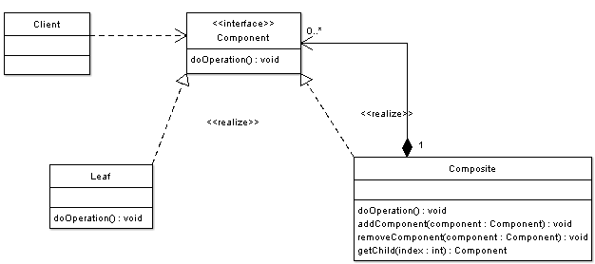
Example
Component - Component is the abstraction for leafs and composites. It defines the interface that must be implemented by the objects in the composition.
Leaf - Leafs are objects that have no children. They implement services described by the Component interface
Composite - A Composite stores child components in addition to implementing methods defined by the component interface. Composites implement methods defined in the Component interface by delegating to child components. In addition composites provide additional methods for adding, removing, as well as getting components.
Client - The client manipulates objects in the hierarchy using the component interface.

Slide 29
Decorator Pattern
Intent
Attach additional responsibilities to an object dynamically. Decorators provide a flexible alternative to subclassing for extending functionality.
Client-specified embellishment of a core object by recursively wrapping it.
Wrapping a gift, putting it in a box, and wrapping the box.
Problem
You want to add behavior or state to individual objects at run-time. Inheritance is not feasible because it is static and applies to an entire class.

Slide 30
Decorator Pattern – Cocoa Apple spec
The Decorator design pattern attaches additional responsibilities to an object dynamically. Decorators provide a flexible alternative to subclassing for extending functionality. As does subclassing, adaptation of the Decorator pattern allows you to incorporate new behavior without modifying existing code. Decorators wrap an object of the class whose behavior they extend. They implement the same interface as the object they wrap and add their own behavior either before or after delegating a task to the wrapped object. The Decorator pattern expresses the design principle that classes should be open to extension but closed to modification

Slide 31
Decorator Pattern – Text version
Context
Component objects can be decorated (visually or behaviorally enhanced)
The decorated object can be used in the same way as the undecorated object
The component class does not want to take on the responsibility of the decoration
There may be an open-ended set of possible decorations
Solution
Define an interface type that is an abstraction for the component
Concrete component classes realize this interface type.
Decorator classes also realize this interface type.
A decorator object manages the component object that it decorates
When implementing a method from the component interface type, the decorator class applies the method to the decorated component and combines the result with the effect of the decoration

Slide 32
Example
public interface Pizza {
public String bakePizza();
public float getCost();
}
public class BasePizza implements Pizza{
public String bakePizza() {
return "Basic Pizza";
}
public float getCost(){
return 100;
}
}

Slide 33
Example
public class PizzaDecorator implements Pizza {
Pizza pizza;
public PizzaDecorator(Pizza newPizza) {
this.pizza = newPizza;
}
public String bakePizza() {
return pizza.bakePizza();
}
@Override
public float getCost() {
return pizza.getCost();
}
}

Slide 34
Example
public class Cheese extends PizzaDecorator {
public Cheese(Pizza newPizza) {
super(newPizza);}
@Override
public String bakePizza() {
return super.bakePizza() + " with Cheese Topping";}
@Override
public float getCost() {
return super.getCost()+80;}
}
public class Pepperoni extends PizzaDecorator {
public Pepperoni(Pizza newPizza) {
super(newPizza);}
@Override
public String bakePizza() {
return super.bakePizza() + " with Pepperoni Topping";}
@Override
public float getCost() {
return super.getCost()+110;}
}

Slide 35
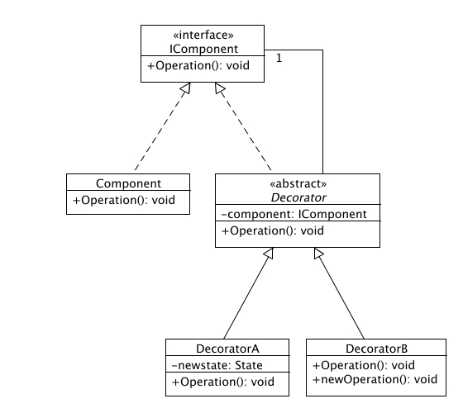
Example
The decorator pattern can be used when there is a need to dynamically add, as well as remove, responsibilities to a class, and inheritance would be undesirable due to the large number of subclasses that could result.
Typical use
Pizza pizza = new Cheese(new Pepperoni(new BasePizza()));

