Slide 1



Quest for performance
civicrm.org/blog/jaapjansma
@JaapJansma

Slide 2
In this session
Performance and concurrency
Performing several tests
The quest for performance at the SP

Slide 3
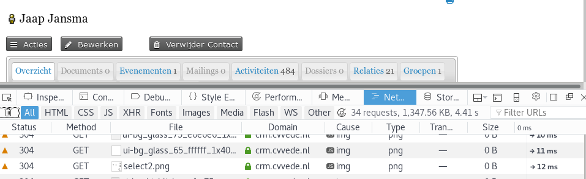
Testing concurrency
Why?
~ 34 concurrent requests p. page view
10 simultaneous users = ~340 concurrent requests!

Slide 4
Is our server ready?
Can our webserver handle 340 concurrent requests in reasonable amount of time?
Can PHP handle and process 340 concurrent requests?
Can MySQL handle and process 340 concurrent requests?

Slide 5
How to test?
ab -n 1000 -c 300 http://hostname/test.php
ab -n 1000 -c 300 http://hostname/test.php
ab -n 1000 -c 300 http://hostname/test.php
1000 requests in total (-n)
300 concurrent requests (-c)
http://hostname/test.php
We want find when the server starts cracking under its load so we need a graph and tune with the concurrent request parameter

Slide 6
Test parameters
test1.txt Plain text without any php/mysql
test2.php A simple php script without mysql
test3.php A simple php with a simple query
We will do both over http and https to see whether SSL makes any difference or not

Slide 7
Server setup
2 cores
4GB RAM
Arch linux
Nginx as webserver
Php version 7
Mariadb 10

Slide 8
test1.txt
File to test

Slide 9
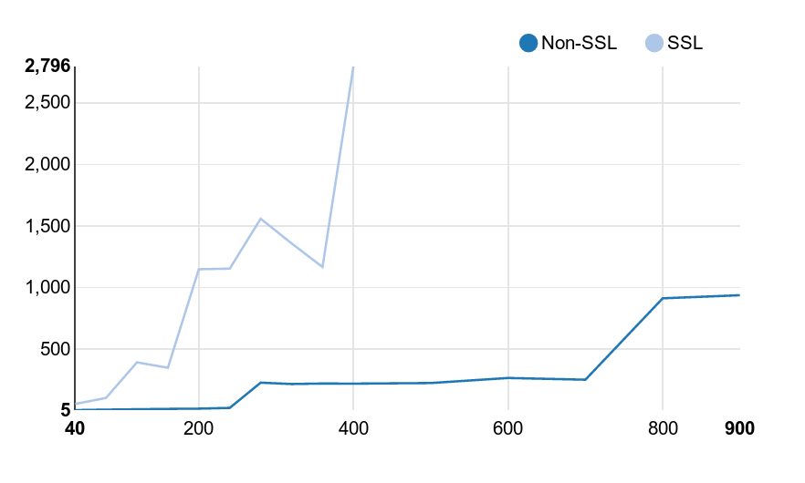
difference between http / https
ab -n 10000 -c ... http://srv/test1.txt
ab -n 10000 -c ... https://srv/test1.txt

Slide 10
Nginx configuration update
keepalive_requests 100000;
tcp_nopush on;
tcp_nodelay on;
client_max_body_size 10m;
client_header_buffer_size 1k;
large_client_header_buffers 4 4k;
output_buffers 1 32k;
postpone_output 1460;
client_header_timeout 3m;
client_body_timeout 3m;
send_timeout 3m;
open_file_cache max=1000 inactive=20s;
open_file_cache_valid 300s;
open_file_cache_min_uses 5;
open_file_cache_errors off;

Slide 11
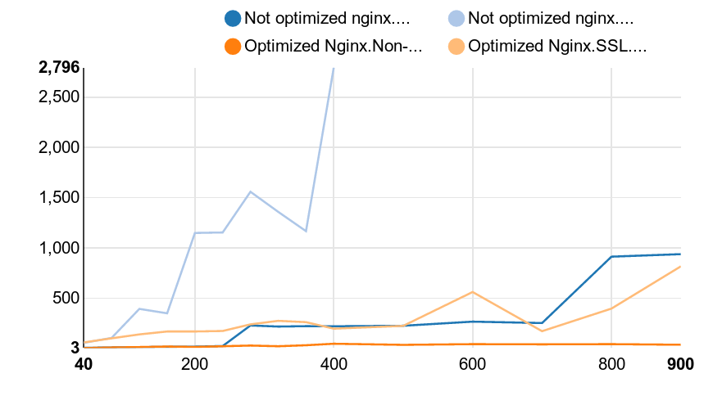
ab -n 10000 -c ... http://srv/test1.txt
ab -n 10000 -c ... https://srv/test1.txt

Slide 12
Test2.php
<?php phpinfo(); ?>

Slide 13
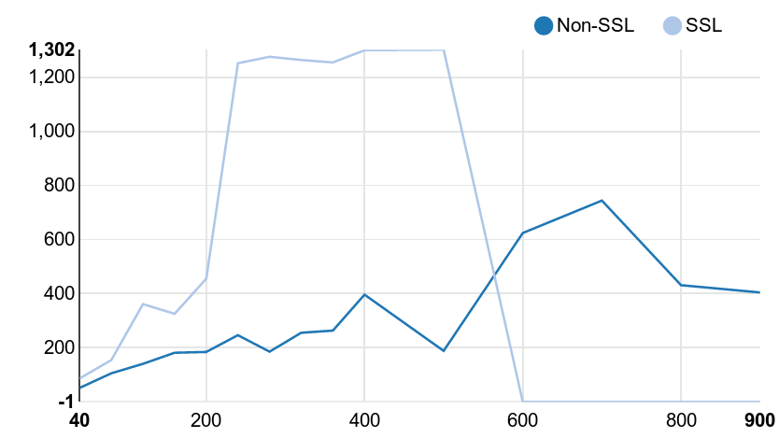
Test2.php

Slide 14
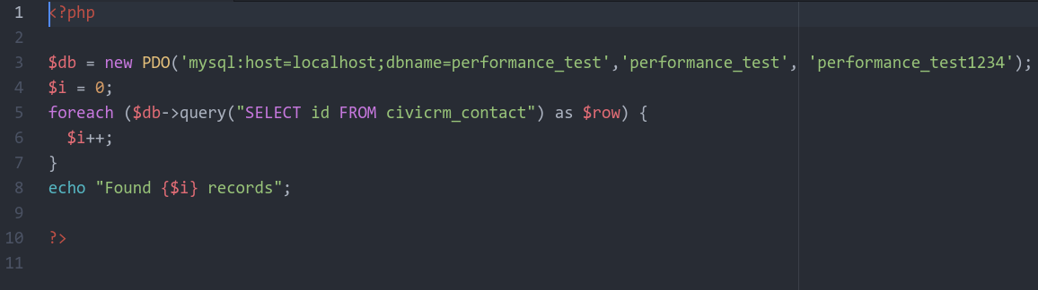
Test3.php

Slide 15
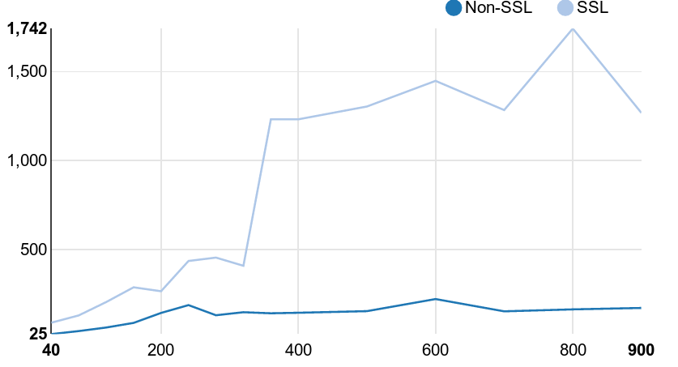
Test3.php

Slide 16
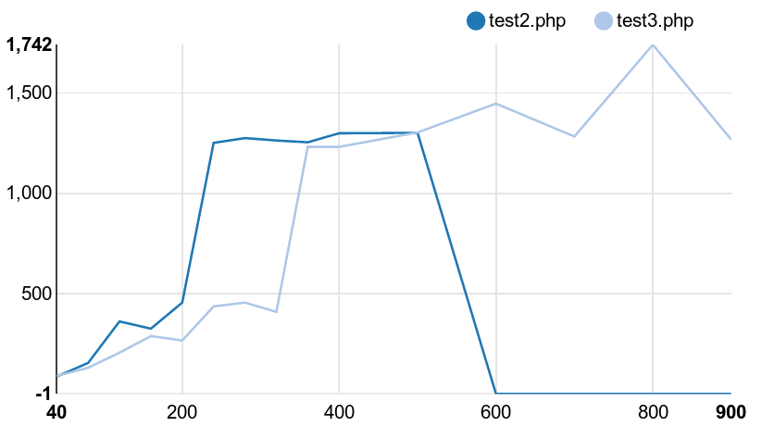
Test2.php vs test3.php

Slide 17
Upgrade server
6 cores
24GB ram
Configuration stays the same

Slide 18
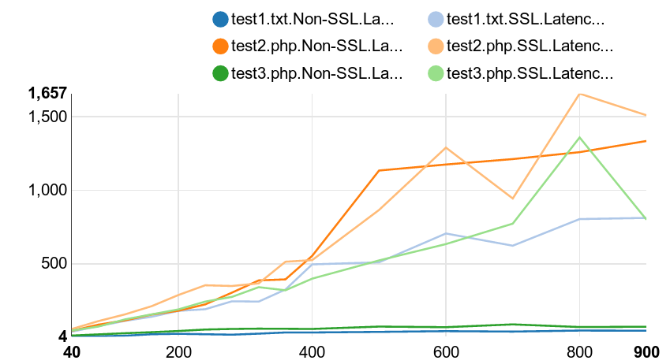
Upgraded server

Slide 19
So far the concurrency test
What did we not test might want to?
MySQL insert / update
HTTP POST request (sending data to the server)
MySQL tuning and PHP tuning
Drupal and civicrm pages

Slide 20
Other performance measurements
Newrelic (= Application Performance Monitoring)
Realtime measures:
CPU Usages / Memory / HDD
End user performance (how long does it take to load a page in the browser)
Which page views did take long and what exactly took time (which php function / query etc)

Slide 21
Quest for performance at the SP
+/- 350 000 contacts in the system
+/- 300 users who can access civicrm
+/- 2700 groups
An campaign running leading to additional +/- 7500 new contacts in the system per week
+/- 40 extensions installed
VPS with 4 cores and 8GB memory
CiviCRM 4.6.x

Slide 22
What did we find?
Used new relic to monitor the performance:
Amount of groups slows the system down (not possible to hard delete the groups)
  Hard deleted groups from the system
  Extension to hard delete groups

Slide 23
What did we find?
CRM_Contact_BAO_Query class adds a left join on the civicrm_group_contact_cache
  Extension to rewrite the generated query into a where with a civicrm_contact.id IN (select ...)

Slide 24
What did we find?
CRM_Contact_BAO_Group::getGroupsHierarchy took around 900ms to execute
  This was due to inefficient use of foreach loops
  Rewrote this function to use a for loop
  Execution time went down to: 20ms

Slide 25
What did we find?
acl_contact_cache is not performing well in combination with the accesscontrol extension for the SP.
  On almost every page request a complicated query is running to lookup every active member in the region of the user
  Rewrote the core acl_contact_cache functionality (not merged into core yet as it is too complicated)

Slide 26
What did we find?
Smart groups… Smart groups… Smart groups
They are rebuilding and rebuilding and locking the database
Not solved yet

Slide 27
Some tips and tricks
In PHP a for performance significant better than foreach
Before diving into fixing pause and think
Then measure your webserver capabilities / find the turning point for a simple request
Then add php scripting and then add mysql and find which one you need to tune
Use new relic for performance monitoring

Slide 28
Thank you!
Resources:
https://medium.freecodecamp.com/how-we-fine-tuned-haproxy-to-achieve-2-000-000-concurrent-ssl-connections-d017e61a4d27
https://github.com/jaapjansma/quest_for_performance_presentation

