Slide 1
XML Healthcare: from ASTM XML DTDs to the Semantic Web
Jonathan Borden, M.D.
Assistant Professor of Neurosurgery, Tufts University, Boston
Director, The Open Healthcare Group
www.openhealth.org

Slide 2
Goals
Leverage HIPAA EDI
XML Healthcare Record
Improve efficiency of healthcare delivery
Improve information management
Enable next generation medical research

Slide 3
The current situation
A disaster: 1.1 Trillion $/year in the USA
30-40 % overhead
mostly paper based
highly proprietary commercial systems
tens of thousands of Americans die each year due to poor information/errors

Slide 4
Fixing the problem
Piggyback on HIPAA EDI
XML schemata, query model
Semantic Web
Data analysis based on actual population rather than small potentially biased samples
Google for healthcare information

Slide 5
Openhealth.org
Open source
physicians, medical students, computer professionals on team
‘100%’ XML medical record
Life of data is longer than life of application
Data driven, Platform independent

Slide 6
Reinventing healthcare informatics
Get the data format right and the rest will follow
Structured information has been the holy grail of medical informatics for the last 30+ years
XML is the culmination of 30+ years of work in structured information
Time to do something

Slide 7
XML in Healthcare
Using XML to represent healthcare information
Integrate legacy and binary information using Groves
XChart: an open source implementation
Security: using metadata
Semantic analysis and medical research

Slide 8
ASTM E31.25
XML DTDs for Healthcare
Emphasize Human Readability
Flexibility
Openhealth reference implementation www.openhealth.org/ASTM
Compatible with HL7 CDA

Slide 9
ASTM Healthcare DTDs
clinical.header
  compatible with HL7 CDA
clinical.body
  specific to document type
  operative.report
  radiology.report
  discharge.summary etc.

Slide 10
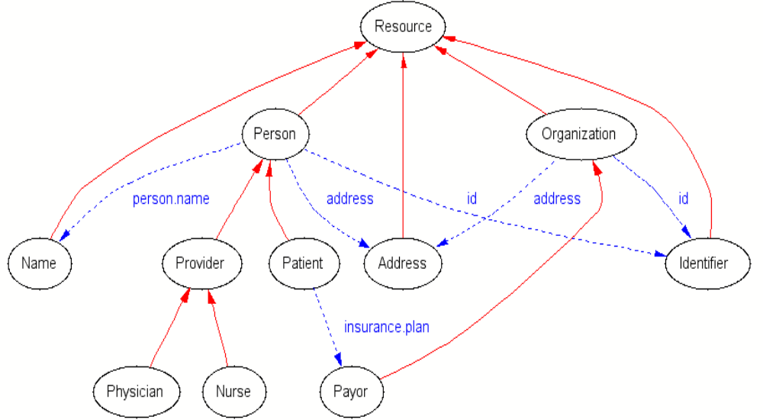
Healthcare Schema

Slide 11
Healthcare datatypes
<person>
  <person.name>
    <family>Jones</family>
    <given>Susan</given>
    <given>Samantha</given>
    <suffix>Jr.</suffix>
    <prefix>Ms.</prefix>
  </person.name>
  <id type=“SSN”>000-11-2233</id>

Slide 12
Healthcare datatypes
<patient>
  <person.name> … </person.name>
  <id authority=“New England Medical Center”>000112233</id>
</patient>
<provider>
  <person.name><family>Smith</family><given>Amanda</given><prefix>Dr.</prefix></person.name>
</provider>

Slide 13
Actors
<service.actor>
  <person.name>…</person.name>
  <id>xxx</id>
  <type.code>Attending</type.code>
  <function>Surgeon</function>
</service.actor>

Slide 14
Encounter
<encounter>
  <patient>…</patient>
  <provider>…</provider>
  <date.time>…</date.time>
  <location> … </location>
  <encounter.id>…</encounter.id>
</encounter>

Slide 15
Integrating binary data using groves
MIME <-> XMTP
HL7 V2
X12 EDI
DICOM

Slide 16
Internet Telemedicine
The OceanMed project, 1998
Merchant vessel, e-mail access via satellite gateway
Digital camera
Web based physician access

Slide 17
XMTP
Gateway
Ship
SMTP
XMTP
MIME -> XML ->
XSLT ->
HTML
HTML

Slide 18
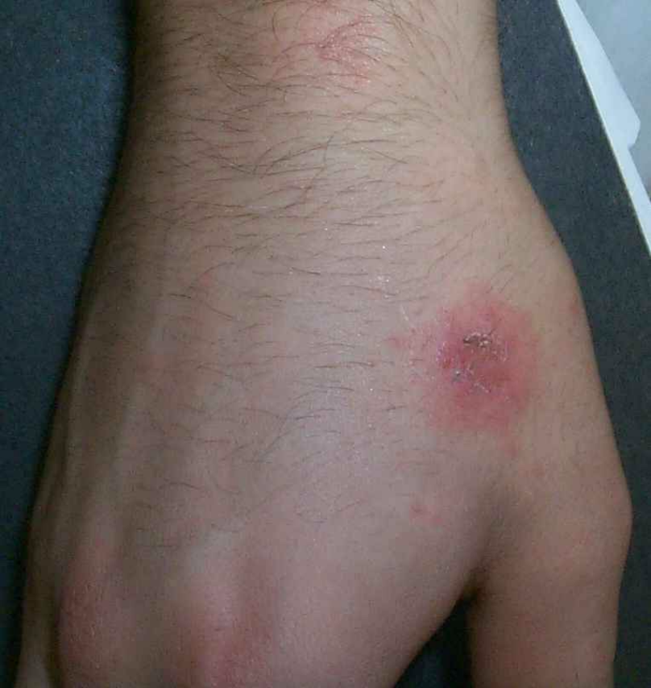
XMTP Consult
36 year old male has itchy rash for 6 days
Hydrocortisone cream 1% to affected area t.i.d.|
reply

Slide 19
How it works
Messages arrive in MIME format
MIME SAX parser ‘converts’ to XML by SAX events
XMTP employs XML object model *not necessarily* serialization format ->
grove processing

Slide 20
XMTP
From: joe.patient@home.com
To: sue.doctor@openhealth.org
Content-type: multipart/related; charset=iso-8859-1
---------
startDocument()
  startElement(“MIME”)
    startElement(“From”)
      characters(“joe.patient@home.com”)
    endElement(“From”)
    startElement(“Content-Type”, attribute(“charset”,”iso-8859-1”))
      characters(“multipart/related”)
    endElement(“Content-Type”)

Slide 21
The XMTP/MIME grove
Content-type: text/plain
From: joe@whereever.org
To: sue@example.com
Hi Sue! See you at XML DevCon 2000, Joe
<MIME>
<Content-type>text/plain</Content-Type>
<From>joe@whereever.org</From>
<Body>Hi Sue! See you at XML DevCon 2000, Joe</Body>
</MIME>

Slide 22
Healthcare Groves
<patient>
  <person.name>
    <given>James</given><given>Steven</given>
    <family>Smith</family><suffix>3rd</suffix>
  </person.name>
startElement(“patient”)
  startElement(“person.name”)
    startElement(“given”);characters(“James”);...

Slide 23
The HL7 Grove
MSH|PAT|Jones^James^Stephen^3rd|
startElement(“patient”)
  startElement(“person.name”)
  startElement(“family”)
    characters(“Jones”);
  endElement(“family”)

Slide 24
The X12 EDI Grove
X12 on the wire

Slide 25
Healthcare Groves
A document is parsed into an internal grove

Slide 26
Benefits of Groves
Legacy and non-XML syntaxes are integrated into XML processing chain
XLink/XPath/Xpointer hyperlinks can point into arbitrary places within any XML or **non XML** document
Multimedia medical record
SAX Parsers can be automagically created for non-XML data

Slide 27
A working implementation of the proposed ASTM E31.25 standard
XChart
www.openhealth.org/XChart

Slide 28
Electronic medical records
The holy grail
Physicians are computer averse
Scattered implementations
XML generating significant activity
HL7/ASTM: next generation
Process has been slow, implementation will be slow in current situation

Slide 29
XChart Architecture
Browser
Apache
Servlet engine
HL7
RDF
xml:db
XSLT
X12 EDI

Slide 30
XChart
Form entry
Generated XML
Transformed XML
XML <-> ASC X12 EDI
Patient’s view

Slide 31
Issues
Simplicity - “easier than paper”
Reliability
Security
Overcome Inertia

Slide 32
Forms language
Transform into XHTML, WML etc.
Simple enough that M.D.s can design forms
Layout performed by XSLT
Customize to site by ‘defaults.xml’

Slide 33
Form generation
XML + XSLT => XHTML
Formgen.xsl
Form.xml
Defaults.xml

Slide 34
Workflow
Form created
Transform into ASTM XML format
XHTML editing (opnote-edit.xsl)
Sign finished product
Render as XHTML for viewing, printing
email to Medical Records and Billing

Slide 35
Workflow
generate
Billing/EDI
edit
repository
sign

Slide 36
Non-form input
ASTM E31 XML format supplied by medical transcriptionists
Convert legacy formats to ASTM E31
  Custom software
  Grove processing (e.g. RTF)

Slide 37
Integration with HL7 CDA
Architectural Forms
  rename elements and attributes
  order needs to be the same
XSLT
  general transform
ASTM clinical header format is similar to most recent HL7 CDA header format

Slide 38
Partitioning medical records
Perhaps sensitive records should not be kept in the same building as general records
The RDF/Web Architecture enables a richly hyperlinked healthcare record
Sensitive information is partitioned in distinct documents using RDF

Slide 39
RDF in Healthcare
<rdf:Description about=“…/patient/12345”>
<lab:HIV>positive</lab:HIV>
<lab:CD4>100</lab:CD4>
</rdf:Description>
<path:Biopsy about=“…/patient/12345”>
<path:description>The brain demonstrates areas of PML including viral inclusion bodies</path:description>
</path>

Slide 40
XML on the Web
Distributed hyperlinked global healthcare repository
As reports are created they become part of a semantic network of healthcare information
Enable a new generation of medical research

Slide 41
Semantic analysis
Class
Class
subClass
type
repository
domain
Class
Property
type
instance

Slide 42
Semantic analysis
“Of all the patient’s I operated on for brain tumors between 1999-2006, matching severity of pathology, did Taxol chemotherapy improve the cure rate at five years?”

Slide 43
RDF/DAML
DARPA Agent Markup Language
Ontologies
Integrate with UMLS
Structured queries
Coding systems
  UMLS
  LOINC
  CPT
  ...

Slide 44
The Semantic Web
Step 1: define vocabularies (UMLS, LOINC, CPT, ICD9/10 etc.)
Step 2: standardize syntax (ASTM,HL7)
Step 3: Translate to DAML/RDF ontologies
Step 4: enter information

Slide 45
Semantic Groves
Documents are tree like
As documents get entered into XChart, a “semantic grove” is created
Medical hypotheses tested as assertions
x holds true for .9 of y

Slide 46
Leveraging HIPAA: attachments are key!
Collect attachments

Slide 47
Future directions
The technology is here …
Just do it!
jonathan@openhealth.org

Slide 48
URLs
www.openhealth.org
www.openhealth.org/ASTM
www.openhealth.org/opnote (demo)
www.openhealth.org/RDF
jonathan@openhealth.org

