Slide 1
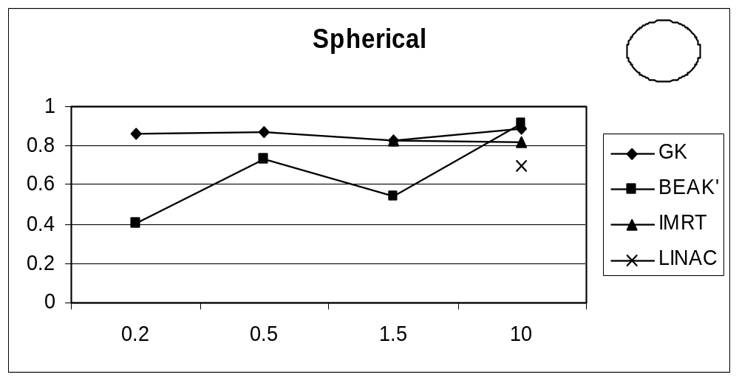
Figure 1 (a) QF 15

Slide 2
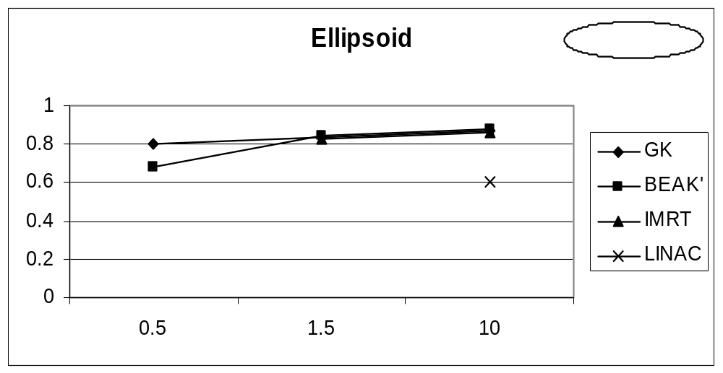
Figure 1 (b) QF 15

Slide 3
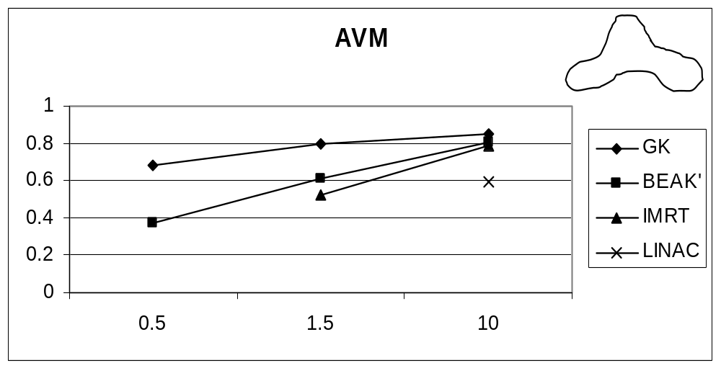
Figure 1 (c) QF 15

Slide 4
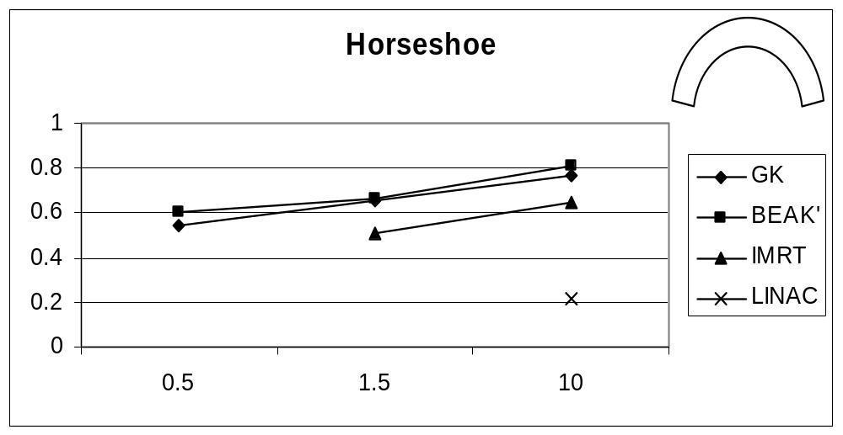
Figure 1 (d) QF 15

Slide 5
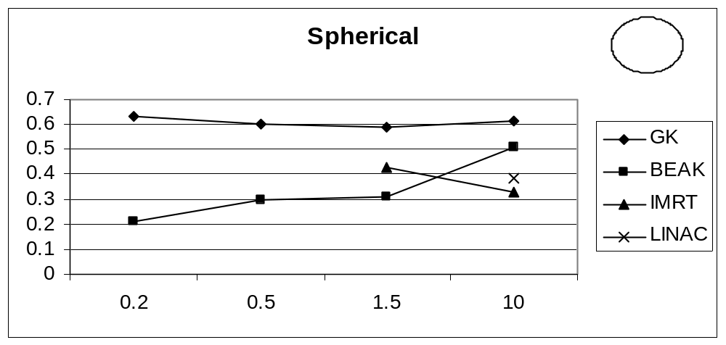
Figure 2 (a) QF 12

Slide 6
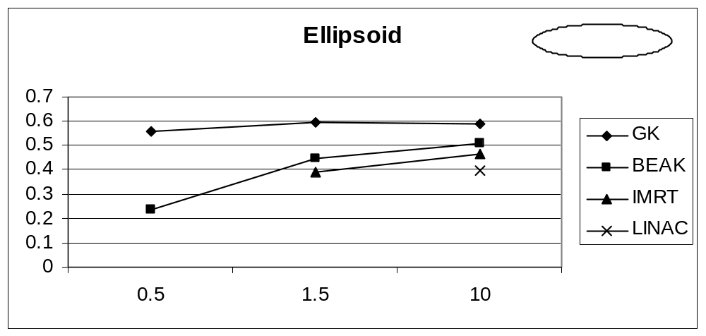
Figure 2 (b) QF 12

Slide 7
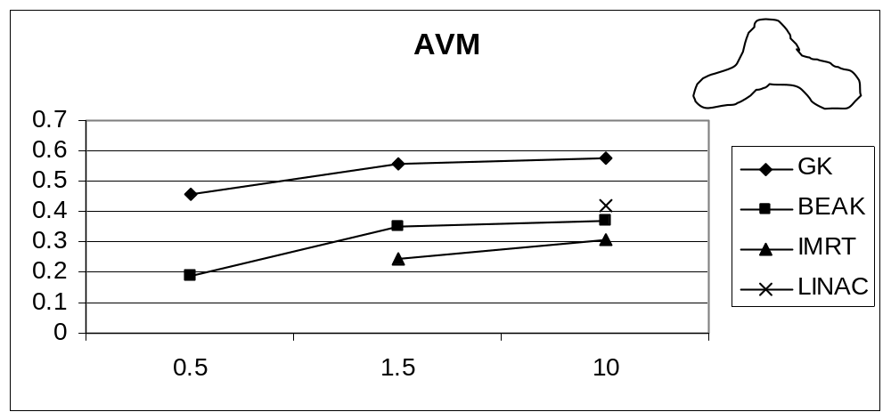
Figure 2 (c) QF 12

Slide 8
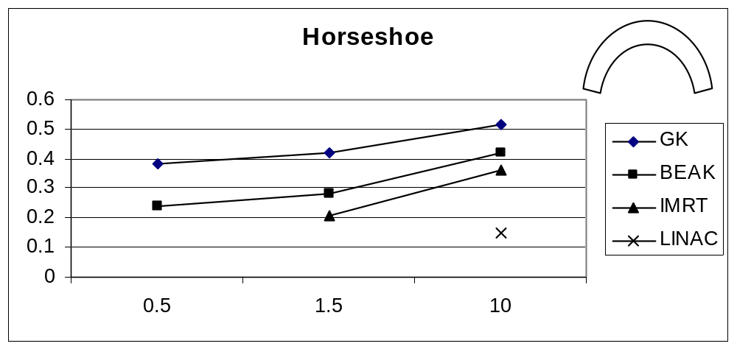
Figure 2 (d) QF 12

Slide 9
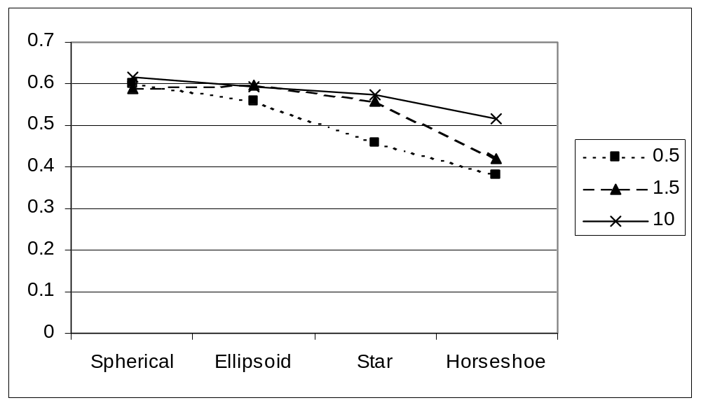
Figure 3 Gamma Knife QF12

Slide 10
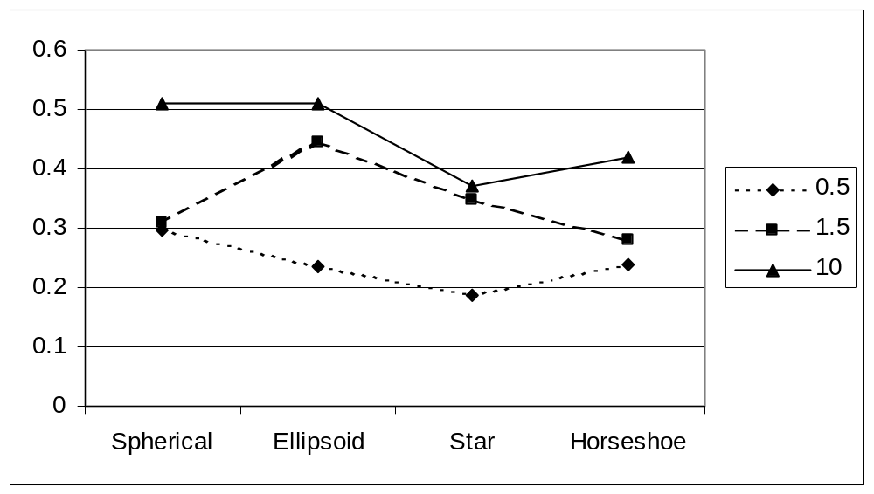
Figure 4 - QF 12 Beak

Slide 11
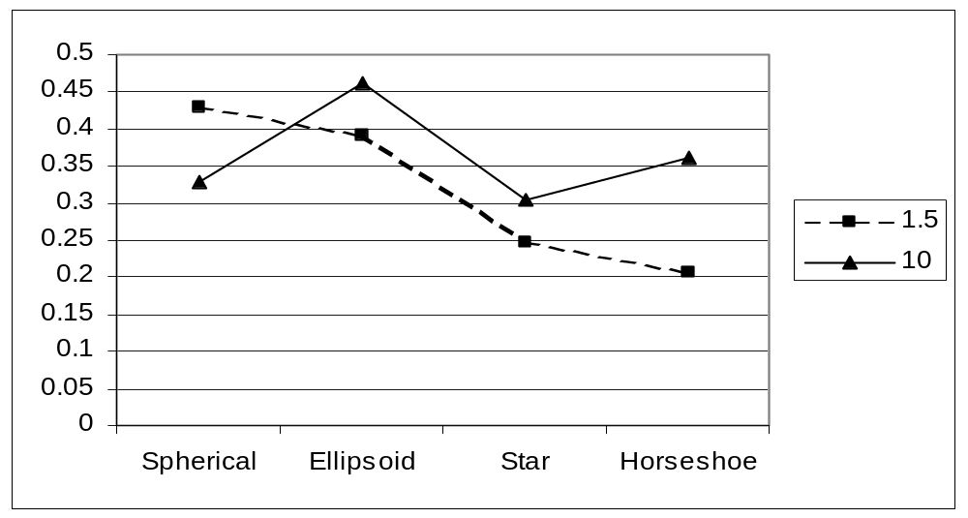
Figure 5 - QF 12 IMRT

Slide 12
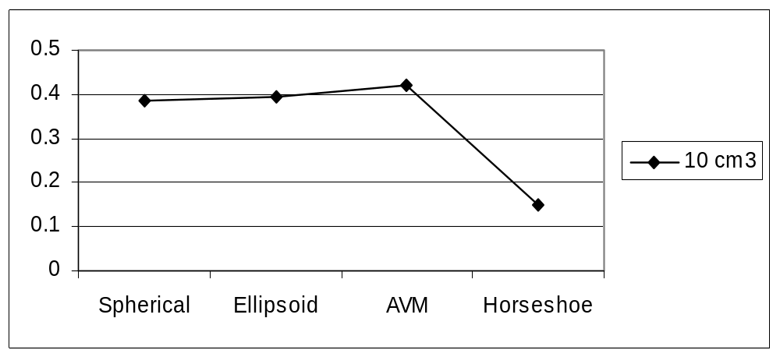
Figure 6 - QF 12 Linac

