Slide 1
Introduction to RDF
the “Resource Description Framework”
Jonathan Borden
The Open Healthcare Group
www.openhealth.org

Slide 2
RDF
predicate
Subject
Object

Slide 3
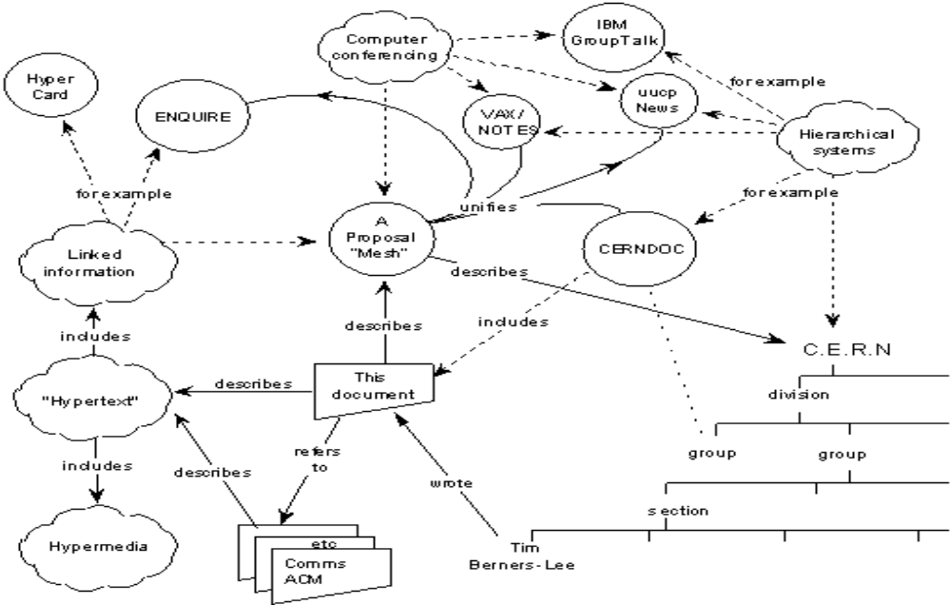
WWW c. 1989

Slide 4
Model
A model is a collection of statements
Statement := (predicate,subject,object)
Predicate is a resource
Subject is a resource
Object is either a resource or a literal

Slide 5
Resource
From RFC 2396:
Resource A resource can be anything that has identity. Familiar examples include an electronic document, an image, a service (e.g., "today's weather report for Los Angeles"), and a collection of other resources. Not all resources are network "retrievable"; e.g., human beings, corporations, and bound books in a library can also be considered resources. The resource is the conceptual mapping to an entity or set of entities, not necessarily the entity which corresponds to that mapping at any particular instance in time. Thus, a resource can remain constant even when its content---the entities to which it currently corresponds---changes over time, provided that the conceptual mapping is not changed in the process.

Slide 6
Resource
A resource is defined by a URI
The resource identified by a URI may be abstract - I.e. not network retrievable
http://www.openhealth.org/RDF/

Slide 7
Edge Labeled Directed Graphs
bar
isa
has
foo
baz
plays
wants
(isa, foo, bar)
(has, bar, baz)
(plays, baz, bop)
(wants, baz, bing)
bing
bop

Slide 8
Node labeled Directed Graph
root
element
1
element
x
foo
attribute
attribute
bar
element
attribute
href
baz
x
attribute
<root>
<foo href=“…” x=“1” />
<bar x=“2” y=“3”>
<baz z=“aaa”/>
</bar>
y
attribute
z
3
aaa

Slide 9
RDF is...
A standard syntax to represent (edge labeled) directed graphs in XML

Slide 10
Semantic Networks
A way to represent natural language circa 1970s
A format for organizing statements in a way that can be queries by computers

Slide 11
Semantic Networks
spine
has
heart
vertebrate
isa
wings
hair
mammal
bird
fly
walk
can
isa
isa
isa
doesn’t fly
canary
yellow
ostrich
freddie
hugo

Slide 12
Semantic Networks
“Can freddy fly?”
“Does hugo have wings?”
“Does freddy have a spine?”
“Of all the canaries, how many live in cages?”

Slide 13
RDF Schemas
Semantic networks on the Web
Nodes are identified by URIs
rdfs:Class
rdfs:Property
rdfs:subClassOf
rdf:type

Slide 14
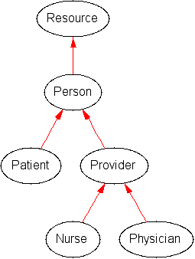
Simplified Healthcare Schema
<rdfs:Class rdf:ID=“Provider”>
<rdfs:subClassOf rdf:resource=“#Person”/>
</rdfs:Class>

Slide 15
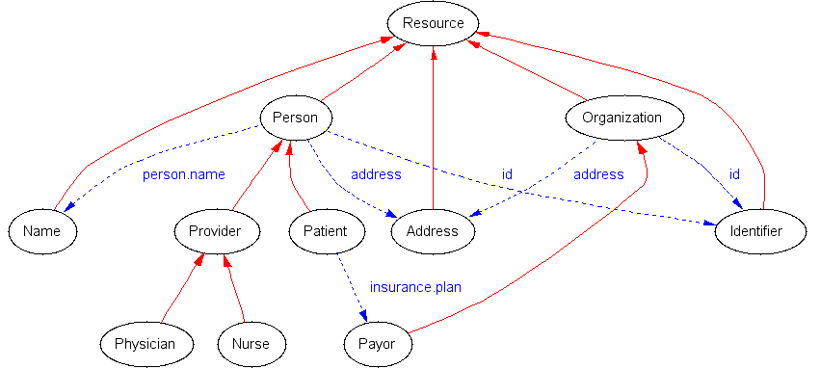
Simplified Healthcare Schema

Slide 16
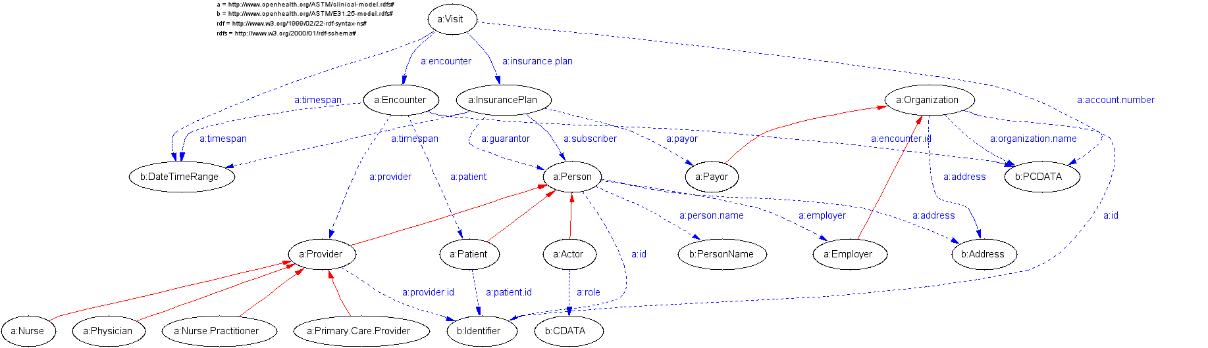
Healthcare Schema

Slide 17
Describing things with RDF
<rdf:Description about=“http://www.openhealth.org/RDF/rdfExtractify.xsl”>
<dc:author>Jonathan Borden</dc:author>
<dc:description>An XSLT based parser which converts an arbitrary XML document into RDF Statements</dc:description>
</rdf:Description>

Slide 18
Describing things with RDF
http://www.openhealth.org/RDF/rdfExtractify.xsl
author
description
Jonathan Borden
An XSLT based ...

Slide 19
RDF Statements
<rdf:Statement>
<rdf:subject resource=“http://www.openhealth.org/RDF/rdfExtractify.xsl”>
<rdf:predicate resource=“http://www.purl.org/dublin-core#author”>
<rdf:object>Jonathan Borden</rdf:object>
</rdf:Statement>

Slide 20
RSS: RDF Typed nodes
<rdf:RDF>
<channel rdf:about="http://www.xml.com/xml/news.rss">
<title>XML.com</title>
<link>http://xml.com/pub</link>
<description> XML.com features a rich mix of information and services for the XML community. </description>
</channel>
</rdf:RDF>

Slide 21
Typed nodes
Class
Property
subClassOf
rss:channel
domain
rss:title
type
type
xml.com
title
http://www.xml.com/xml/news.rss

Slide 22
Rich/RDF Site Summary 1.0
<item rdf:about="http://xml.com/pub/2000/08/09/xslt/xslt.html" position="1">
<inchannel rdf:resource="http://www.xml.com/xml/news.rss"/>
<title>Processing Inclusions with XSLT</title>
<link>http://xml.com/pub/2000/08/09/xslt/xslt.html</link>
<description>
Processing document inclusions with general XML tools can be problematic. This article proposes a way of preserving inclusion information through SAX-based processing.
</description>
</item>

Slide 23
Warning!!
Slightly advanced topics ahead. This is your last chance to exit.

Slide 24
Extracting RDF from Colloquial XML
rdfExtractify.xsl
ID and about name subject nodes
rdf:resource names object nodes
Using XPointer to name anonymous nodes

Slide 25
‘Colloquial XML’
<patient ID=“Patient12345”>
<person.name>
<given>Jonathan</given>
<family>Borden</family>
<person.name>
<primary.care.physician>
<provider ...

Slide 26
RDF Graph: ‘anonymous’ nodes
Person
PersonName
Literal
Person12345
person.name
value
Jonathan
first
last
value
Borden

Slide 27
Using XPointer to name
Person
PersonName
Literal
Person12345
person.name
value
/1/1/1
Jonathan
first
/1/1
last
/1/1/2
value
Borden

Slide 28
RDF
Model, XML Syntax and Schema
A semantic metadata framework
Everything has a URI

