Slide 1
Introduction to RDF
the “Resource Description Framework”
Jonathan Borden
The Open Healthcare Group
www.openhealth.org

Slide 2
RDF
predicate
Subject
Object

Slide 3
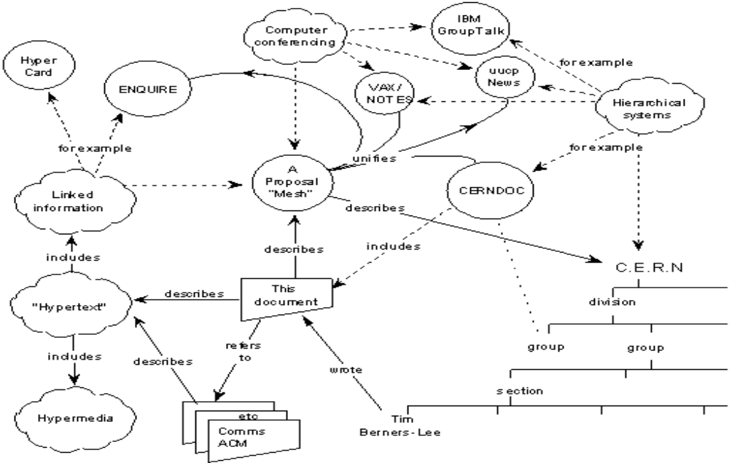
WWW c. 1989

Slide 4
Model
A model is a set of statements
Statement := (predicate,subject,object)
Predicate is a resource
Subject is a resource
Object is either a resource or a literal
Object = Predicate(Subject)

Slide 5
Resource
From RFC 2396:
Resource A resource can be anything that has identity. Familiar examples include an electronic document, an image, a service (e.g., "today's weather report for Los Angeles"), and a collection of other resources. Not all resources are network "retrievable"; e.g., human beings, corporations, and bound books in a library can also be considered resources. The resource is the conceptual mapping to an entity or set of entities, not necessarily the entity which corresponds to that mapping at any particular instance in time. Thus, a resource can remain constant even when its content---the entities to which it currently corresponds---changes over time, provided that the conceptual mapping is not changed in the process.

Slide 6
Resource
A resource is identified by a URI
The resource identified by a URI may be abstract - I.e. not network retrievable
Resource is distinct from entity resolved at any particular time
http://www.openhealth.org/RDF/

Slide 7
URI reference
[absoluteURI | relativeURI] [“#” fragment-id]

Slide 8
Edge Labeled Directed Graphs
bar
isa
has
foo
baz
plays
wants
(isa, foo, bar)
(has, bar, baz)
(plays, baz, bop)
(wants, baz, bing)
bing
bop

Slide 9
Node labeled Directed Graph
root
element
1
element
x
foo
attribute
attribute
bar
element
attribute
href
baz
x
attribute
<root>
<foo href=“…” x=“1” />
<bar x=“2” y=“3”>
<baz z=“aaa”/>
</bar>
y
attribute
z
3
aaa

Slide 10
RDF is...
A standard syntax to represent (edge labeled) directed graphs in XML

Slide 11
RDF Model can be thought of as ..
… a simplified XML Infoset

Slide 12
Semantic Networks
A way to represent natural language circa 1970s
A format for organizing statements in a way that can be queries by computers

Slide 13
Semantic Networks
spine
has
heart
vertebrate
isa
wings
hair
mammal
bird
fly
walk
can
isa
isa
isa
doesn’t fly
canary
yellow
ostrich
freddie
hugo

Slide 14
Semantic Networks
“Can freddy fly?”
“Does hugo have wings?”
“Does freddy have a spine?”
“Of all the canaries, how many live in cages?”

Slide 15
RDF Schemas
Semantic networks on the Web
Nodes are identified by URIs
rdfs:Class
rdfs:Property
rdfs:subClassOf
rdf:type

Slide 16
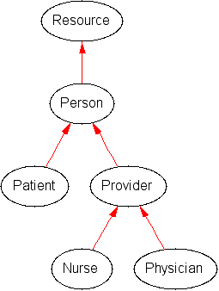
Simplified Healthcare Schema
<rdfs:Class rdf:ID=“Provider”>
<rdfs:subClassOf rdf:resource=“#Person”/>
</rdfs:Class>

Slide 17
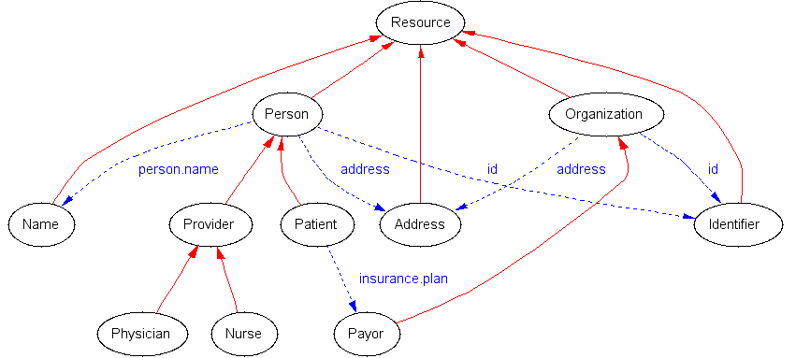
Simplified Healthcare Schema

Slide 18
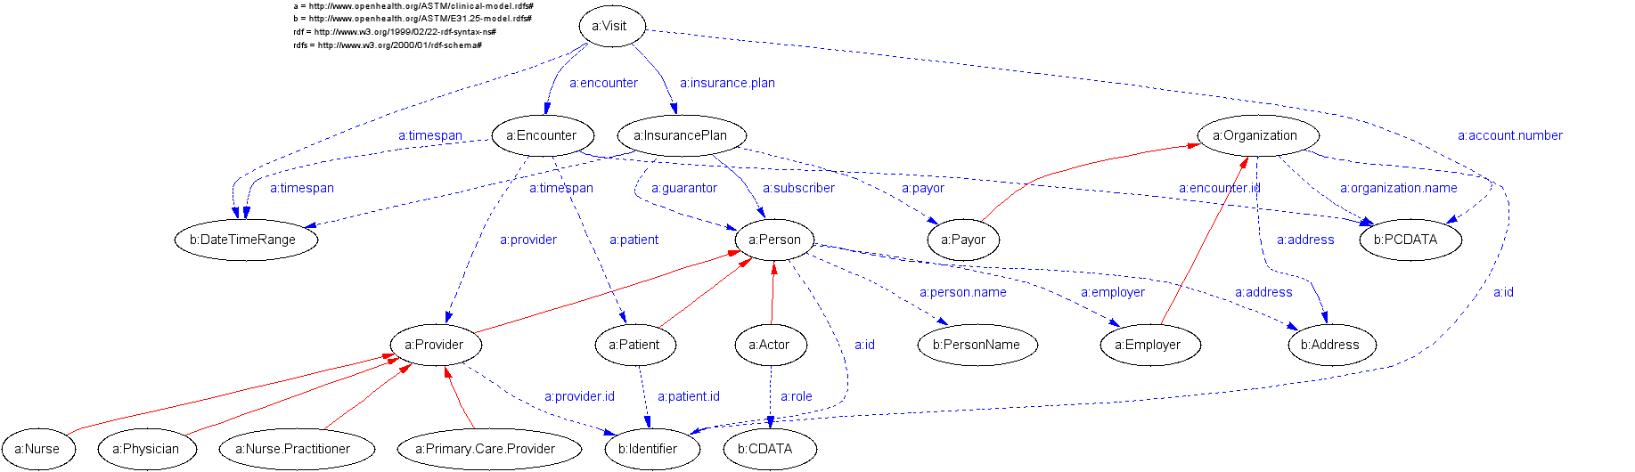
Healthcare Schema

Slide 19
Describing things with RDF
<rdf:Description about=“http://www.openhealth.org/RDF/rdfExtractify.xsl”>
<dc:author>Jonathan Borden</dc:author>
<dc:description>An XSLT based parser which converts an arbitrary XML document into RDF Statements</dc:description>
</rdf:Description>

Slide 20
Describing things with RDF
http://www.openhealth.org/RDF/rdfExtractify.xsl
author
description
Jonathan Borden
An XSLT based ...

Slide 21
RDF Statements
<rdf:Statement>
<rdf:subject resource=“http://www.openhealth.org/RDF/rdfExtractify.xsl”>
<rdf:predicate resource=“http://www.purl.org/dublin-core#author”>
<rdf:object>Jonathan Borden</rdf:object>
</rdf:Statement>

Slide 22
RSS: RDF Typed nodes
<rdf:RDF>
<channel rdf:about="http://www.xml.com/xml/news.rss">
<title>The xml.com site</title>
<link>http://xml.com/pub</link>
<description> XML.com features a rich mix of information and services for the XML community. </description>
</channel>
</rdf:RDF>

Slide 23
Typed nodes
Class
Property
subClassOf
rss:title
rss:channel
domain
The xml.com site
type
title
http://www.xml.com/xml/news.rss

Slide 24
Rich/RDF Site Summary 1.0
<item rdf:about="http://xml.com/pub/2000/08/09/xslt/xslt.html" position="1">
<inchannel rdf:resource="http://www.xml.com/xml/news.rss"/>
<title>Processing Inclusions with XSLT</title>
<link>http://xml.com/pub/2000/08/09/xslt/xslt.html</link>
<description>
Processing document inclusions with general XML tools can be problematic. This article proposes a way of preserving inclusion information through SAX-based processing.
</description>
</item>

Slide 25
RDF Collections
rdf:Bag - an unordered collection that may have repeated members
rdf:Seq - an ordered collection
rdf:Alt - a collection of alternates

Slide 26
rdf:Bag
<rdf:Bag ID=“foo”>
  <rdf:li>The first member</rdf:li>
  <rdf:li rdf:resource=“http://foo.org” />
  <rdf:li>The third member</rdf:li>
</rdf:Bag>

Slide 27
The Bag
The first member
_1
_2
foo
http://foo.org
_3
The third member

Slide 28
Xlink and RDF
Simple Xlink
xlink:arcrole := predicate
xlink:href := object
xlink:role := rdf:type of object

Slide 29
Resource Directory Description Language (RDDL)
<rddl:resource
  id=“example”
  xlink:arcrole=“…#schema-validation”
  xlink:role=“http://www.w3.org/2001/XMLSchema”
  xlink:href=“…myschema.xsd”>
</rddl:resource>

Slide 30
Xlink as RDF
rddl:resource
XMLSchema
rdf:type
#example
#schema
rdf:type
myschema.xsd

Slide 31
XML Namespaces
RDF and RDDL

Slide 32
XML Namespaces
W3C Recommendation
Namespace name is a URI reference
Namespace URI might be dereferencable but what should it reference?

Slide 33
Namespace
Traditionally defined as a set of names
W3C recommendation defines a partition but no set

Slide 34
Resource Directory Description Language (RDDL)
Proposed as a solution to what a namespace name URI ought reference
Both human and machine readable
XHTML Basic + XLink resources
Parsers available two weeks after initial proposal
An XML-DEV project

Slide 35
RDDL
Proposed January 2001
Adopted by namespaces such as XML Schema, Schematron, RSS, Examplotron, XSLT Extension framework, SWAG
http://www.rddl.org/

Slide 36
RDDL resource
<rddl:resource
  id=“myschema”
  xl:role=“http://www.w3.org/2001/XMLSchema”
  xl:arcrole=“http://www.rddl.org/purposes#schema-validation” -- Purpose
  xl:title=“My XML Schema” -- Nature
  >
  <p>This is my XML Schema</p>
</rddl:resource>

Slide 37
RDDL
Displays in popular HTML browsers
Defines a namespace as a formal set of terms (id=“foo”)
Referenced resource described by its intrinsic nature and purpose within the namespace

Slide 38
XSLT resource
<rddl:resource
  xl:role=“http://www.w3.org/1999/XSL/Transform”
  xl:arcrole=“http://purl.org/rss/1.0”
  xl:href=“toRSS.xsl”
  >

Slide 39
Java resources
<rddl:resource
  xl:role=“…application/java-archive”
  xl:arcrole=“…purposes/software#xslt-extension”
  xl:href=“thisNS-xslt-extension.jar”
  ><p>The xslt extensions bound to this namespace are packaged in a JAR</p>
  </rddl:resource>

Slide 40
RDDL
Defines XML namespace as a set of resources
Simple model and syntax
namespace documentation is readable by people and programs
easy conversion to RDF
A simple “Semantic Web” application

Slide 41
Warning!!
Slightly advanced topics ahead. This is your last chance to exit.

Slide 42
Extracting RDF from Colloquial XML
rdfExtractify.xsl
ID and about name subject nodes
rdf:resource names object nodes
Using XPointer to name anonymous nodes

Slide 43
‘Colloquial XML’
<patient ID=“Patient12345”>
<person.name>
<given>Jonathan</given>
<family>Borden</family>
<person.name>
<primary.care.physician>
<provider ...

Slide 44
RDF Graph: ‘anonymous’ nodes
Person
PersonName
Literal
Person12345
person.name
value
Jonathan
given
family
value
Borden

Slide 45
Using XPointer to name
Person
PersonName
Literal
Person12345
person.name
value
/1/1/1
Jonathan
given
/1/1
family
/1/1/2
value
Borden

Slide 46
Using XPointer for collections
#foo/1
#foo/2
#foo/3

Slide 47
RDF
Model, XML Syntax and Schema
A semantic metadata framework
Everything has a URI

Slide 48
uses
good simple way to represent complex data (healthcare)
newsfeeds (RSS)
shared calendars
collaboration (RDFIG, ePinions)
ontologies (wordnet, UMLS)
“Semantic Web” stuff

