Slide 1
A Quality Factor to Evaluate Radiosurgical Dosimetry
Jonathan Borden, M.D., FACS
Co-Director, Boston Gamma Knife Center, Assistant Professor of Neurosurgery, Tufts-New England Medical Center, Boston

Slide 2
Principles of Radiosurgery
Lars Leksell, 1949-1951, invented stereotaxis and coined term ‘radiosurgery’
Stereotactic Coordinate system
Volumetric target definition
Maximize dose inside volume
*Minimize dose outside volume*

Slide 3
Property of single isocenter
50 % isodose

Slide 4
GKRS
Treatment isodose usually 50 %
Maximize % coverage in volume
Minimize dose outside target
No attempt to keep dose homogeneity within target
Clinical results support dosimetry

Slide 5
AVM Cooperative GK Study
Cure % correlates to 50 % isodose
Complication rate correlates to 12 Gy volume

Slide 6
Dose Volume Histogram
99-100 %
3.2 cm3
20 Gy/50 % isodose
4.0 cm3

Slide 7
Conformality Index (CI)
Volume of target getting at least X Gy
/
Total volume getting at least X Gy
1 = perfect plan

Slide 8
Reality = blur, errors
Can be difficult to assess all errors
Clinical results are bottom line!

Slide 9
Quality Factor
% target covered (PTC) x target volume (V_{T})
/
12 Gy volume (V₁₂)
PTC*V_{T}/V₁₂

Slide 10
Quality Factor
Tumor coverage (at minimum theraputic dose) relates to success of treatment: TCP
12 Gy volume relates to risk of complications: NTCP
Simple means to evaluate quality of radiosurgical plans

Slide 11
Dose falloff and Quality

Slide 12
Conformality and Quality
Treatment volume dose homogeneity becomes important
Significant treatment volume falls outside target volume

Slide 13
Registration and Quality

Slide 14
Experimental design
Measure accuracy of treatment (TLD)
Compare MRI vs. CT planning
=>
MRI demonstrates systematic shift ~0.5 - 1mm with respect to CT
Mask positioning error < 2mm
GK treatment delivery is accurate to within measurement error (i.e. < 0.25 mm) on CT

Slide 15
Clinical significance
Acoustic Neuroma/Vestibular Schwannoma
Hearing preservation 12 Gy >>> 16 Gy
0.75 mm shift + 16 Gy gives 12 Gy effective dose
MRI much better at evaluating extent
=> CT + MRI planning critical

Slide 16
Vestibular Schwannoma

Slide 17
Tolerance of cranial nerves
Optic nerves/chiasm < 10 Gy
Cochlea/auditory nerve ~12 Gy?
Trigeminal nerve 80 Gy < 10% numbness
Facial nerve/oculomotor nerves << 1% at 13 Gy
Brain/thalamus 120-160 Gy to produce reliable necrosis
(all this is volume dependent)

Slide 18
Clinical relevance of dose homogeneity?
GK: target treatment isodose 50%
In clinical use since 1968
>150,000 cases worldwide
documented efficacy (e.g. Kondziolka et al. 1998 NEJM long term TCP 98%)
documented low risk of complications

Slide 19
Indications for GKRS
Lesions of optic apparatus
Lesions of functioning cranial nerves (TN,AN)
Benign and malignant tumors of small to medium size - single or multiple
Vascular malformations
Post operative irradiation of metastatic bed
Epilepsy and other functional disorders

Slide 20
Experimental Design
Compare GK, IMRT and Linac Radiosurgery
Create standard targets of known volumes and increasing complexity/surface area
Experts in each area create best clinically practical plan
Measure QF

Slide 21
Team
Jonathan Borden, M.D.: GK planning
Anita Mahajan, M.D.: Nomos Corvus planning
Jen-San Tsai, Ph.D.: Adac/Pinnacle planning, phantoms, TLD, diamond detector on microdrive for GK,IMRT/Beak and Linac

Slide 22
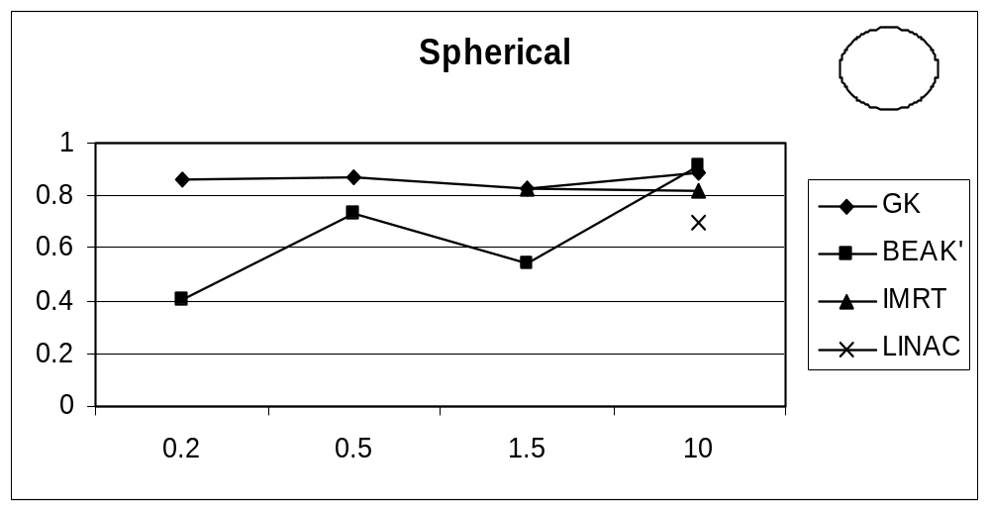
QF15 = Conformality Index

Slide 23
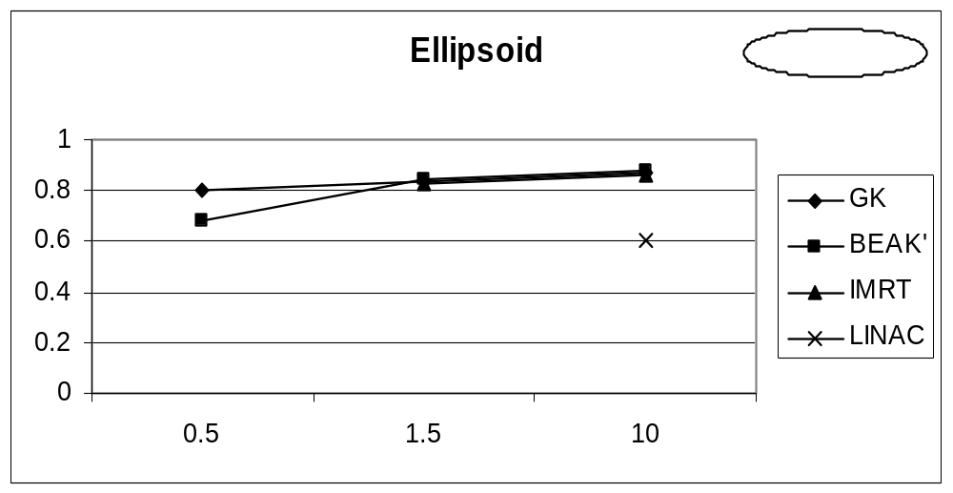
QF15 = Conformality Index

Slide 24
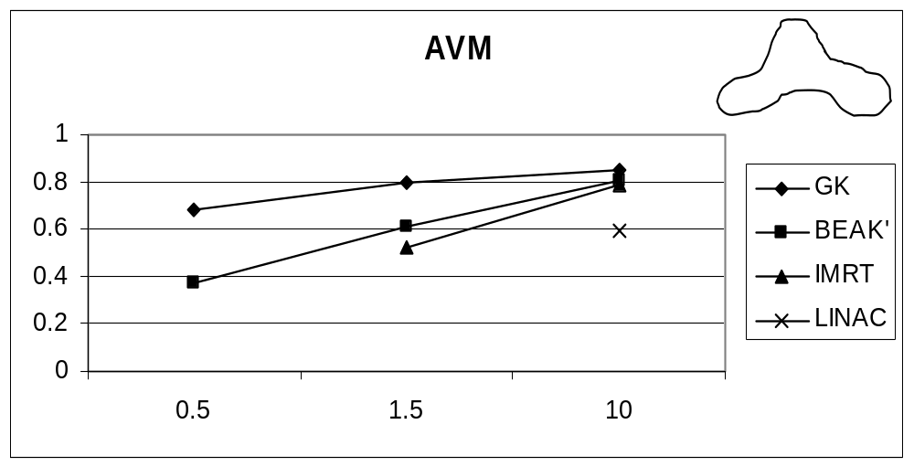
QF15 = Conformality Index

Slide 25
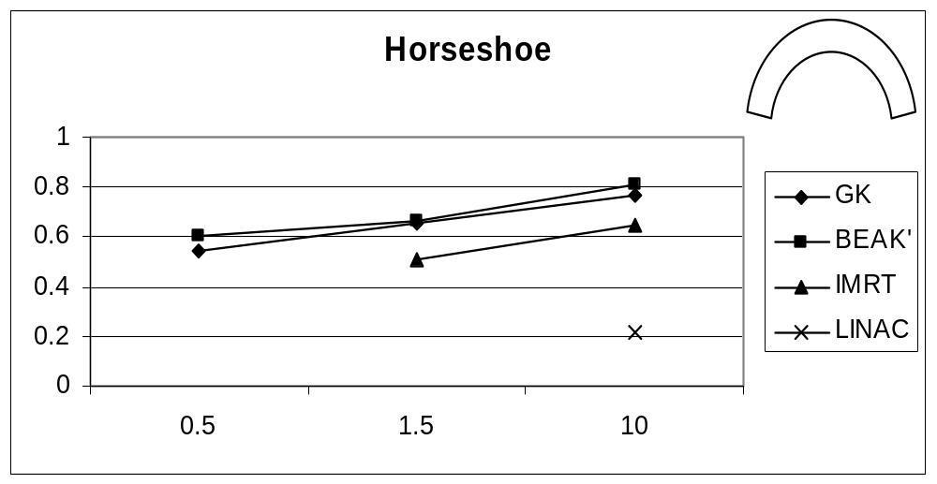
QF15 = Conformality Index

Slide 26
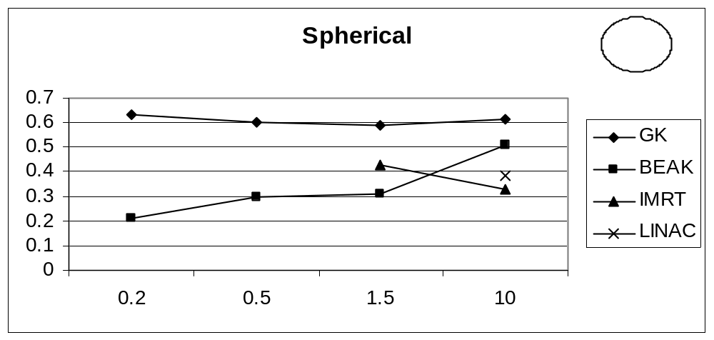
QF 12

Slide 27
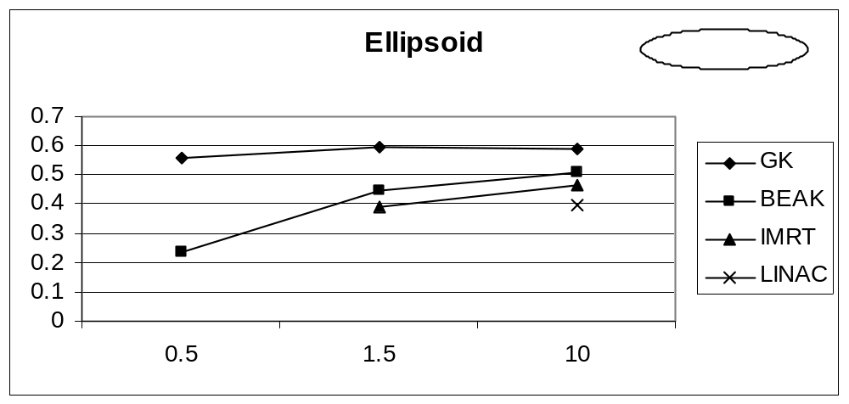
QF 12

Slide 28
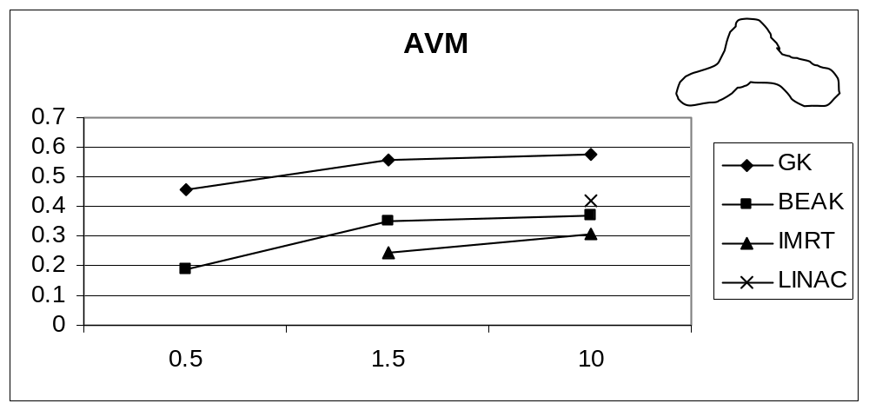
QF 12

Slide 29
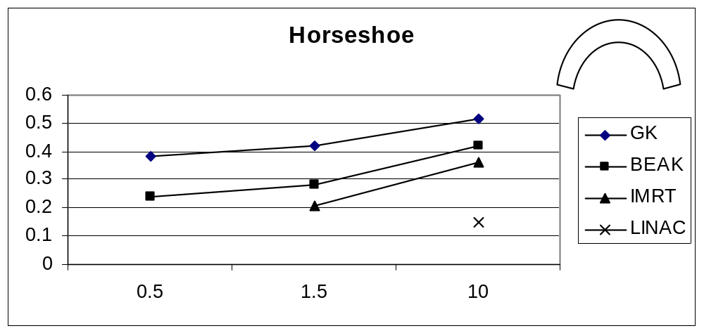
QF 12

Slide 30
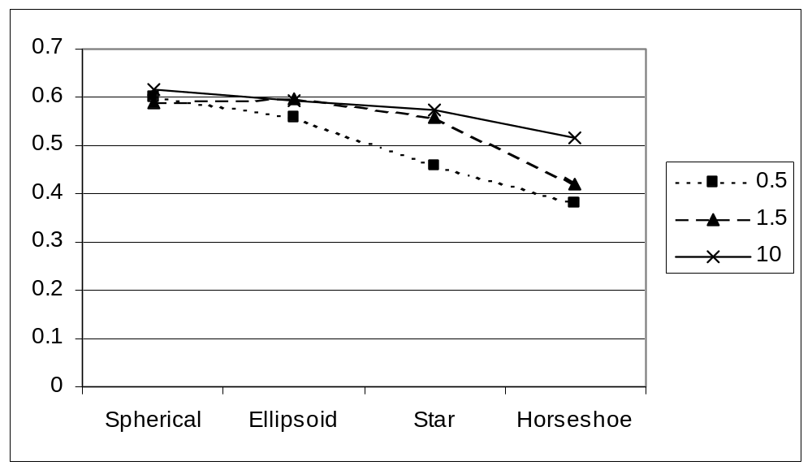
QF vs complexity: GK

Slide 31
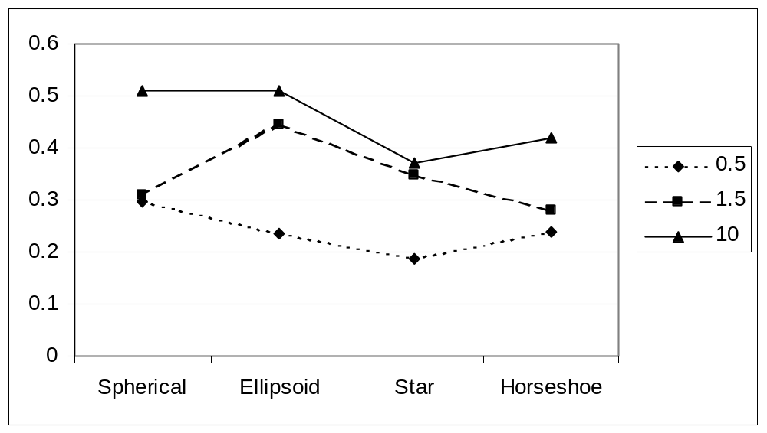
QF vs complexity: Beak

Slide 32
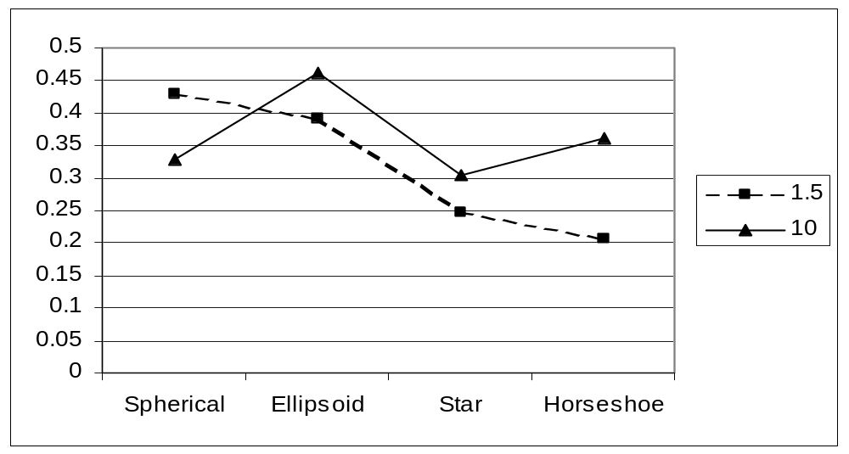
QF vs complexity: IMRT

Slide 33
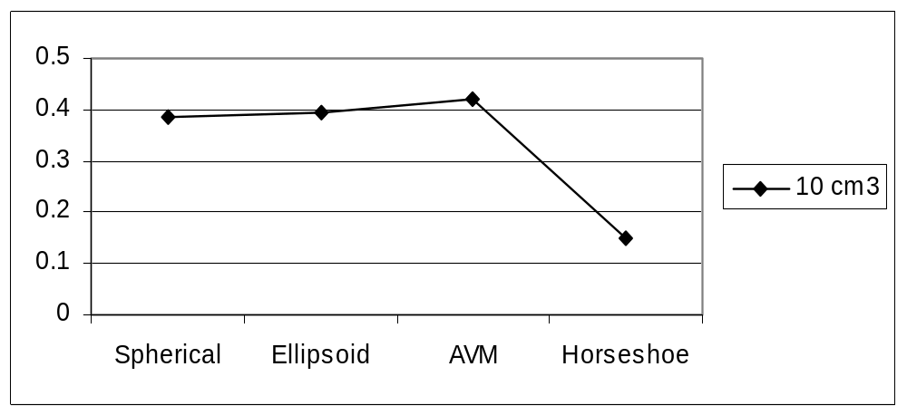
QF vs complexity: Linac

Slide 34
Conclusions
Accuracy of treatment delivery is of critical importance
Stereotactic frame eliminates positioning shifts
High resolution imaging important
Systematic shift in MRI => correction software + combined CT/MRI planning

Slide 35
Conclusions
Conformality of GK/IMRT are similar
QF improved with GK especially on small round targets
Radiosurgical plan quality inversely proportional to target complexity

Slide 36
Our Practice
GK Radiosurgery when not contraindicated ~300 cases since 8/1999
IMRT (fractionated) for large irregular intracranial targets, extracranial targets
Adac/Pinnacle: 3D treatment planning (fractionated)

