Slide 1
XML Healthcare: the OpenHealth Project
Jonathan Borden, M.D.
Assistant Professor of Neurosurgery, Tufts University, Boston
Director, The Open Healthcare Group
www.openhealth.org

Slide 2
Goals
Open Source XML based healthcare record
Works today, grows into tomorrow
Created by and for doctors and patients
Leverage existing standards
Create needed standards

Slide 3
The current situation
A disaster: 1.1 Trillion $/year in the USA
30-40 % overhead
mostly paper based
highly proprietary commercial systems despite active standards bodies
systems don’t work for doctors nor patients

Slide 4
Fixing the problem
Government: HIPAA to be implemented by October 2002
HIPAA alone will save little
We need to overhaul the healthcare information system
How?

Slide 5
Openhealth.org
Open source
physicians, medical students, computer professionals on team
‘100%’ XML medical record
Life of data is longer than life of application
Data driven, Platform independent

Slide 6
Reinventing healthcare informatics
Get the data format right and the rest will follow
Structured information has been the holy grail of medical informatics for the last 30+ years
XML is the culmination of 30+ years of work in structured information

Slide 7
XML in Healthcare
Using XML to represent healthcare information
Integrate legacy and binary information using Groves
XChart: an open source implementation
Security: using metadata
Semantic analysis and medical research

Slide 8
Healthcare EDI
X12 Mandated by (new) HIPAA act
XML not mature at time of specification
XML EDI will be an important bridge

Slide 9
HL7
Health Level 7
Sophisticated object model
Currently text based messaging
Used by most hospitals, implementations vary
HL7 V3 will include XML serialization
Active in XML activities e.g. XML schema datatypes

Slide 10
ASTM E31.25
XML DTDs for Healthcare
Emphasize Human Readability
Flexibility
Openhealth reference implementation www.openhealth.org/ASTM
Compatible with HL7 CDA

Slide 11
ASTM Healthcare DTDs
clinical.header
  compatible with HL7 CDA
clinical.body
  specific to document type
  operative.report
  radiology.report
  discharge.summary etc.

Slide 12
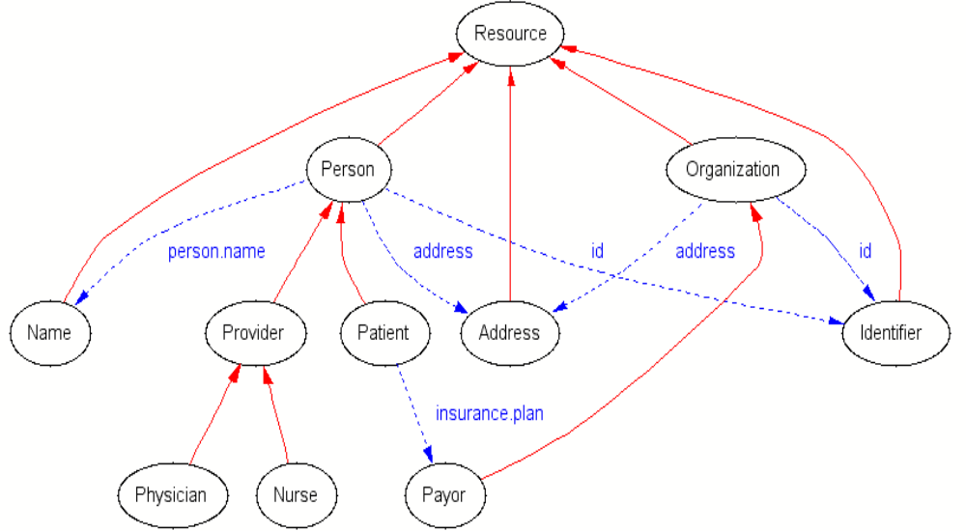
Healthcare Schema

Slide 13
Healthcare datatypes
<person>
  <person.name>
    <family>Jones</family>
    <given>Susan</given>
    <given>Samantha</given>
    <suffix>Jr.</suffix>
    <prefix>Ms.</prefix>
  </person.name>
  <id type=“SSN”>000-11-2233</id>

Slide 14
Healthcare datatypes
<patient>
  <person.name> … </person.name>
  <id authority=“New England Medical Center”>000112233</id>
</patient>
<provider>
  <person.name><family>Smith</family><given>Amanda</given><prefix>Dr.</prefix></person.name>
</provider>

Slide 15
Actors
<service.actor>
  <person.name>…</person.name>
  <id>xxx</id>
  <type.code>Attending</type.code>
  <function>Surgeon</function>
</service.actor>

Slide 16
Encounter
<encounter>
  <patient>…</patient>
  <provider>…</provider>
  <date.time>…</date.time>
  <location> … </location>
  <encounter.id>…</encounter.id>
</encounter>

Slide 17
Integrating binary data using groves
MIME <-> XMTP
HL7 V2
X12 EDI
DICOM

Slide 18
Internet Telemedicine
The OceanMed project, 1998
Merchant vessel, e-mail access via satellite gateway
Digital camera
Web based physician access

Slide 19
XMTP
Gateway
Ship
SMTP
XMTP
MIME -> XML ->
XSLT ->
HTML
HTML

Slide 20
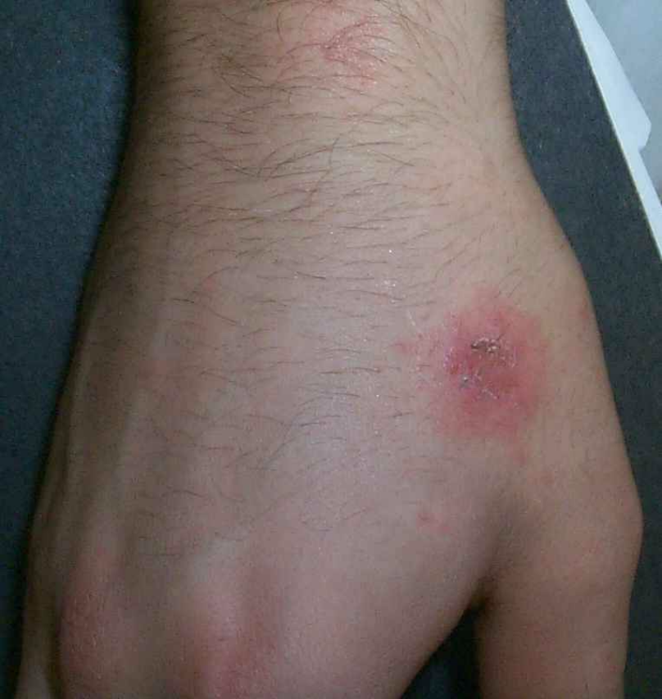
XMTP Consult
36 year old male has itchy rash for 6 days
Hydrocortisone cream 1% to affected area t.i.d.|
reply

Slide 21
How it works
Messages arrive in MIME format
MIME SAX parser ‘converts’ to XML by SAX events
XMTP employs XML object model *not necessarily* serialization format ->
grove processing

Slide 22
XMTP
From: joe.patient@home.com
To: sue.doctor@openhealth.org
Content-type: multipart/related; charset=iso-8859-1
---------
startDocument()
  startElement(“MIME”)
    startElement(“From”)
      characters(“joe.patient@home.com”)
    endElement(“From”)
    startElement(“Content-Type”, attribute(“charset”,”iso-8859-1”))
      characters(“multipart/related”)
    endElement(“Content-Type”)

Slide 23
The XMTP/MIME grove
Content-type: text/plain
From: joe@whereever.org
To: sue@example.com
Hi Sue! See you at XML DevCon 2000, Joe
<MIME>
<Content-type>text/plain</Content-Type>
<From>joe@whereever.org</From>
<Body>Hi Sue! See you at XML DevCon 2000, Joe</Body>
</MIME>

Slide 24
XSet: an XML property set
www.openhealth.org/XSet
ENBF productions in XML 1.0
document := (prolog,element,Misc*)
<document>
  <Seq>
  <prolog/><element/><Misc occurs=“*”/>
  </Seq>
</document>

Slide 25
Healthcare Groves
<patient>
  <person.name>
    <given>James</given><given>Steven</given>
    <family>Smith</family><suffix>3rd</suffix>
  </person.name>
startElement(“patient”)
  startElement(“person.name”)
    startElement(“given”);characters(“James”);...

Slide 26
The HL7 Grove
MSH|PAT|Jones^James^Stephen^3rd|
startElement(“patient”)
  startElement(“person.name”)
  startElement(“family”)
    characters(“Jones”);
  endElement(“family”)

Slide 27
The X12 EDI Grove
X12 on the wire

Slide 28
Healthcare Groves
A document is parsed into an internal grove

Slide 29
Benefits of Groves
Legacy and non-XML syntaxes are integrated into XML processing chain
XLink/XPath/Xpointer hyperlinks can point into arbitrary places within any XML or **non XML** document
Multimedia medical record
SAX Parsers can be automagically created for non-XML data

Slide 30
The Open Healthcare Group
XChart
www.openhealth.org/XChart

Slide 31
Electronic medical records
The holy grail
Physicians are computer averse
Scattered implementations
XML generating significant activity
HL7/ASTM: next generation
Process has been slow, implementation will be slow in current situation

Slide 32
XChart Architecture
Browser
Apache
Servlet engine
HL7
RDF
xml:db
XSLT
X12 EDI

Slide 33
XChart
Form entry
Generated XML
Transformed XML
XML <-> ASC X12 EDI
Patient’s view

Slide 34
Issues
Simplicity - “easier than paper”
Reliability
Security
Overcome Inertia

Slide 35
Forms language
Transform into XHTML, WML etc.
Simple enough that M.D.s can design forms
Layout performed by XSLT
Customize to site by ‘defaults.xml’

Slide 36
Form generation
XML + XSLT => XHTML
Formgen.xsl
Form.xml
Defaults.xml

Slide 37
Workflow
Form created
Transform into ASTM XML format
XHTML editing (opnote-edit.xsl)
Sign finished product
Render as XHTML for viewing, printing
email to Medical Records and Billing

Slide 38
Workflow
generate
Billing/EDI
edit
repository
sign

Slide 39
Non-form input
ASTM E31 XML format supplied by medical transcriptionists
Convert legacy formats to ASTM E31
  Custom software
  Grove processing (e.g. RTF)

Slide 40
Integration with HL7 CDA
Architectural Forms
  rename elements and attributes
  order needs to be the same
XSLT
  general transform
ASTM clinical header format is similar to most recent HL7 CDA header format

Slide 41
Security
Authentication
Access Control
Encryption

Slide 42
Authentication
Function of transport layer
Certificate based e.g. PKI
Key management is limiting factor
XChart leverages existing solutions

Slide 43
Access Control
XML Access Control standard via XML:DB
<ACL:access-control realm=“patient-db”>
  <ACL:grant entity=“Dr.Jones” read=“1”/>
  <ACL:audit entity=“everyone” write=“1” failure=“1” />
  <ACL:deny entity=“administration” access=“all”/>
</ACL:access-control>

Slide 44
Access Control
Implemented at XML repository level
Need for standardized interface to XML databases/repositories
www.xmldb.org

Slide 45
Partitioning medical records
Perhaps sensitive records should not be kept in the same building as general records
The RDF/Web Architecture enables a richly hyperlinked healthcare record
Sensitive information is partitioned in distinct documents using RDF

Slide 46
RDF in Healthcare
<rdf:Description about=“…/patient/12345”>
<lab:HIV>positive</lab:HIV>
<lab:CD4>100</lab:CD4>
</rdf:Description>
<path:Biopsy about=“…/patient/12345”>
<path:description>The brain demonstrates areas of PML including viral inclusion bodies</path:description>
</path>

Slide 47
xchart.net
Distributed hyperlinked global healthcare repository
As reports are created they become part of a semantic network of healthcare information
Enable a new generation of medical research

Slide 48
Semantic analysis
Class
Class
subClass
type
repository
domain
Class
Property
type
instance

Slide 49
Semantic analysis
“Of all the patient’s I operated on for brain tumors between 1999-2006, matching severity of pathology, did Taxol chemotherapy improve the cure rate at five years?”

Slide 50
RDF
Semantic repository
Structured queries
Coding systems
  UMLS
  LOINC
  CPT
  ...

Slide 51
The Semantic Web
Step 1: define vocabularies (UMLS, LOINC, CPT, ICD9/10 etc.)
Step 2: standardize syntax (ASTM,HL7)
Step 3: Create RDF Schemas
Step 4: enter information

Slide 52
Semantic Groves
As documents get entered into XChart, a “semantic grove” is created
Medical hypotheses can be tested as assertions
Fuzzy logic/Bayesian logic is mandatory
Derive probability as function of rdf:Statement
x holds true for .9 of y

Slide 53
Future directions
Continued development of ontologies
Continued standardization of XML data formats
Openhealth.org
XChart.net as National/International repository
jonathan@openhealth.org

Slide 54
URLs
www.openhealth.org
www.openhealth.org/ASTM
www.openhealth.org/XSet
www.openhealth.org/opnote (demo)
www.openhealth.org/RDF
www.openhealth.org/XChart
jonathan@openhealth.org

